Slide 1




Worship:Chinese Incense Culture
中国香文化
Notes:
[-婷婷]旗舰店https://[-婷婷]

Slide 2
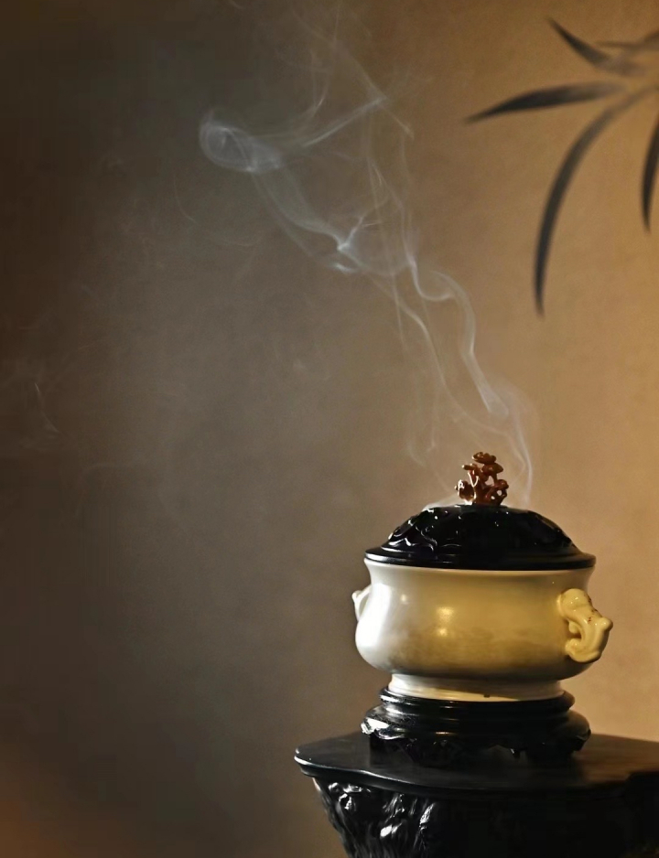
A Timeless Tradition
An essential part of Chinese life for thousands of years
Used in rituals, medicine, and daily relaxation
Symbol of tradition, well-being, and artistic inspiration

Slide 3

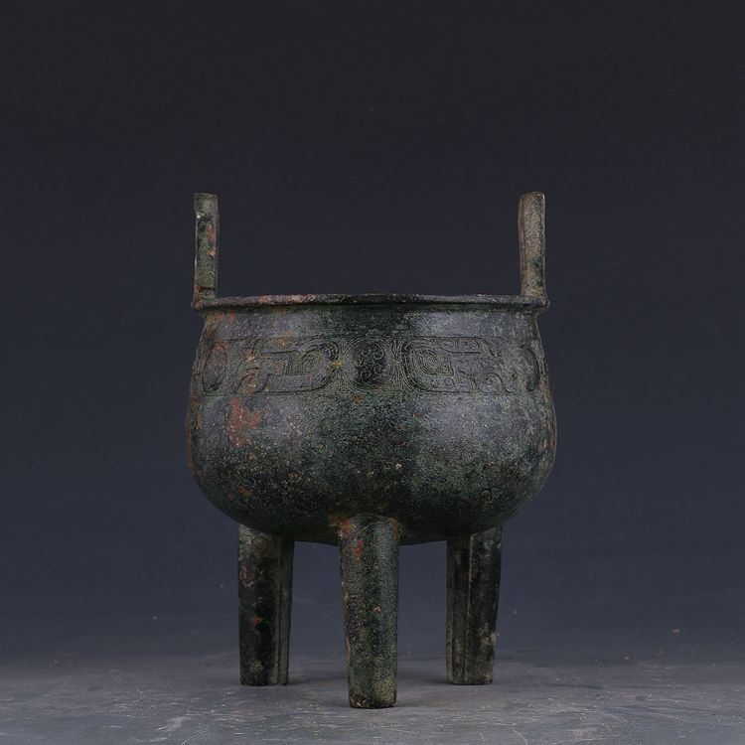
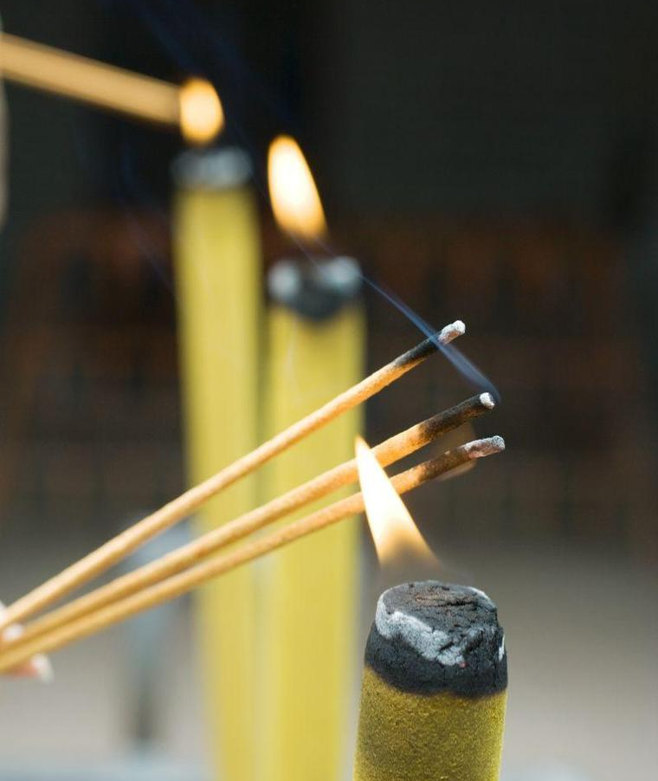
History of Chinese Incense
Shang & Zhou Dynasties
• Used in sacrificial rituals for communication with gods and ancestors.
• Early incense burners appeared.
Han Dynasty (206 BC–220 AD)
•Buddhism introduced incense to temples for worship.
•Incense became part of daily life (e.g., scenting clothes, homes).
•Early medical use recorded in ancient texts.

Slide 4
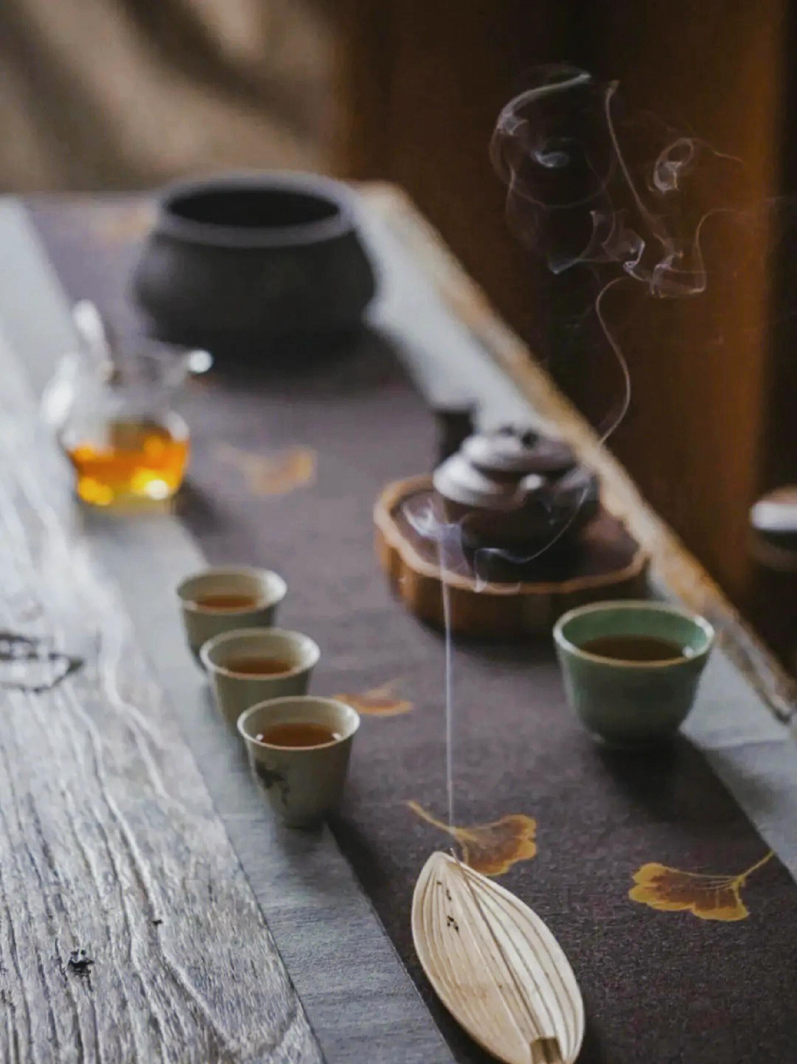
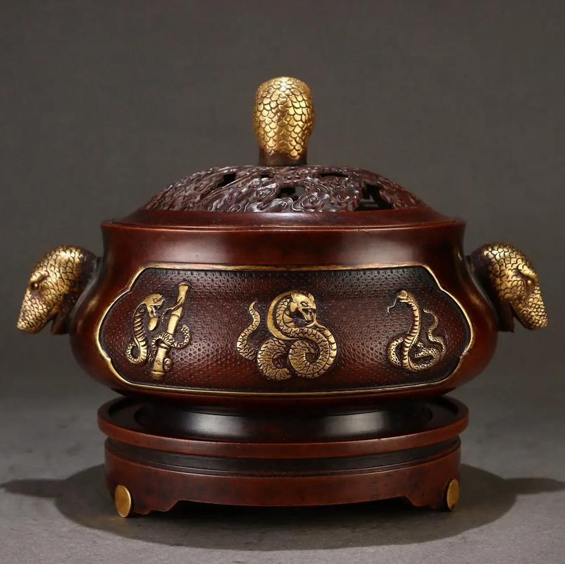
Tang & Song Dynasties (618–1279 AD)
Golden age of incense culture.
Incense appreciation became a refined hobby for scholars.
Development of various incense types (powder, coils, pastes).
Trade expanded, exotic spices like sandalwood & aloeswood were imported.
Ming & Qing Dynasties (1368–1912 AD)
•Incense culture fully integrated into religious and social life.
•More elaborate incense burners and ritual practices emerged.
•Used in Traditional Chinese Medicine (TCM) for healing.
Modern Times
•Incense remains important in Buddhism, Daoism, Confucianism.
•Revival of incense appreciation culture (tea ceremonies, wellness).
•Used in aromatherapy & home decoration.

Slide 5
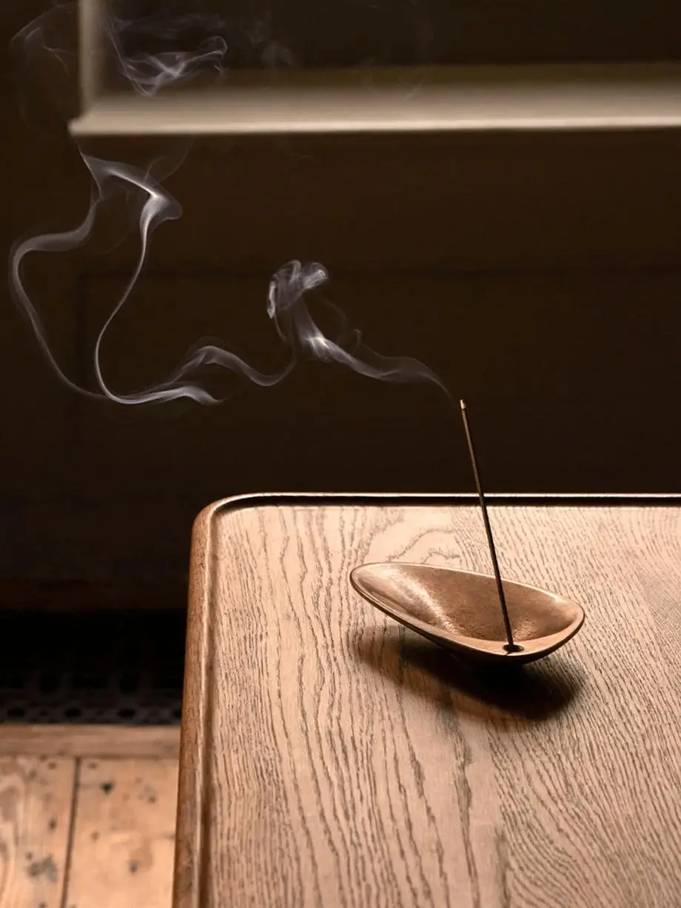
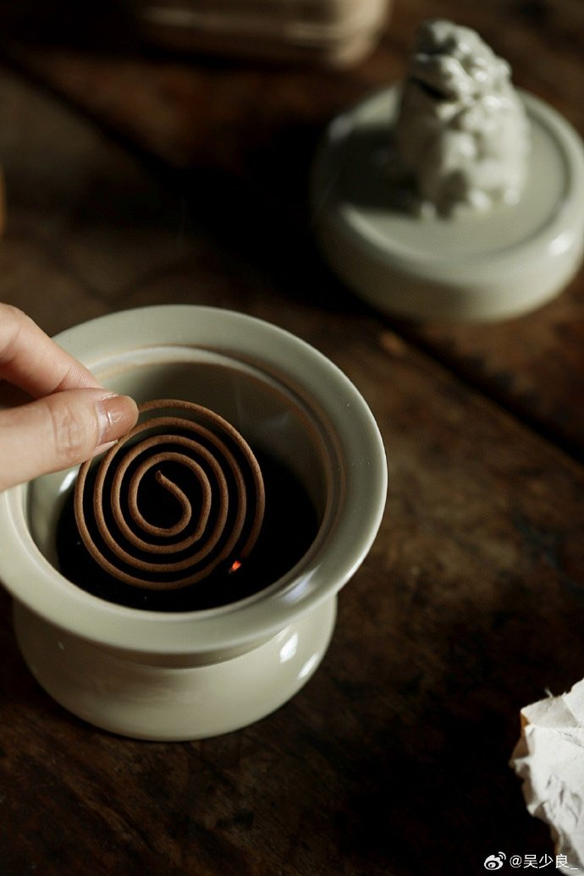
Stick Incense
Coil Incense

Slide 6
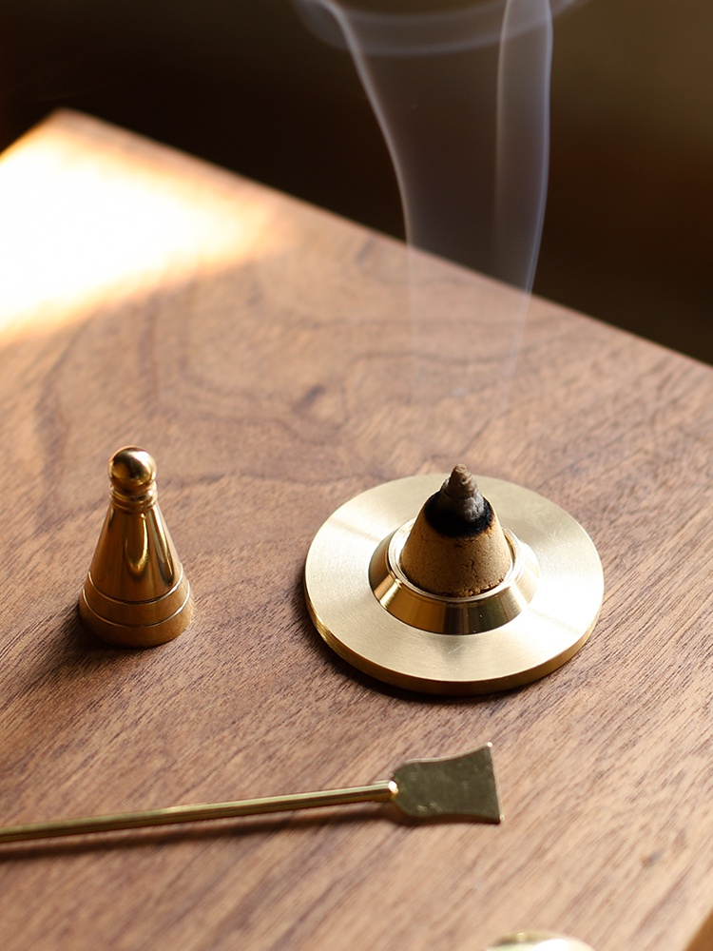
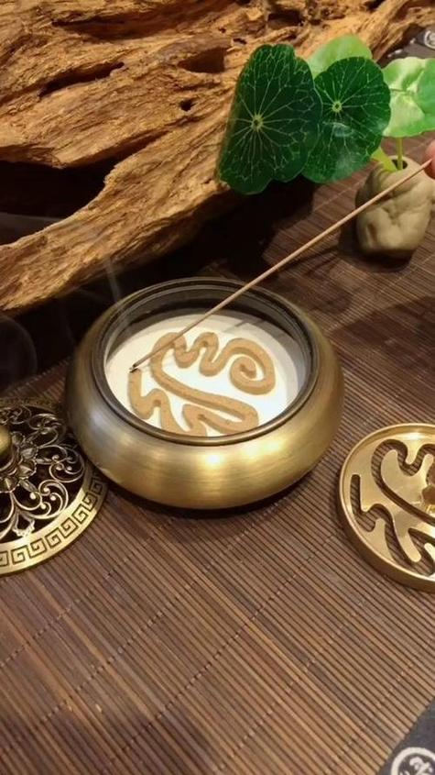
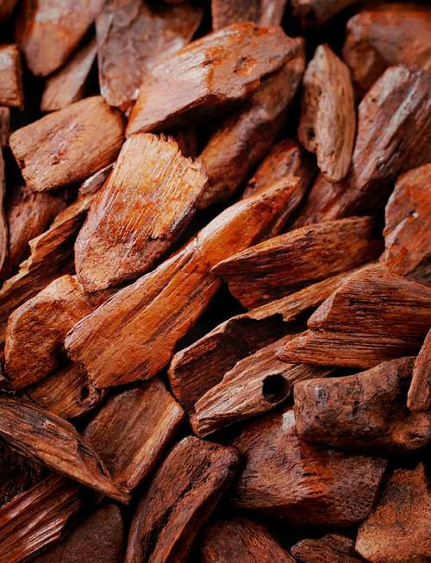
Cone Incense
Powder Incense
Aromatic Wood

Slide 7
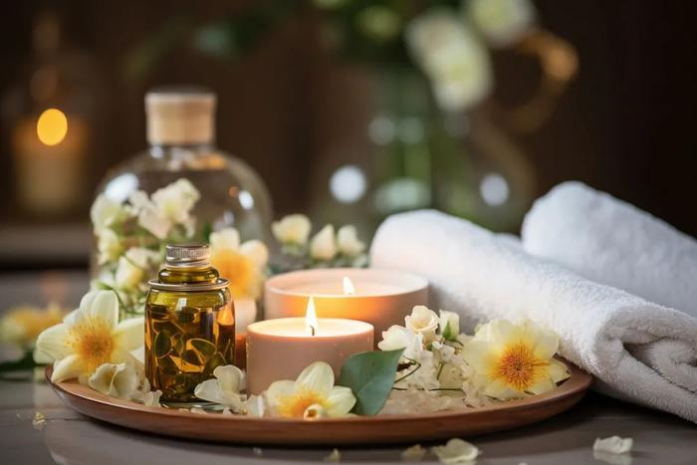
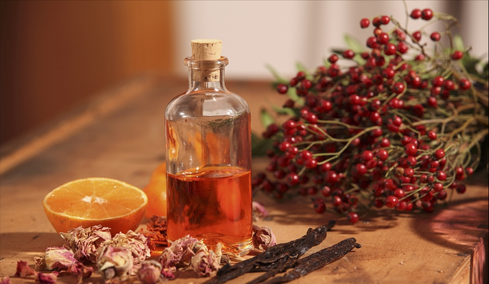
Modern Adaptations of Incense
Incense is increasingly popular in modern life, with its use expanding beyond traditional rituals. In aromatherapy, incense helps relieve stress, improve sleep quality, and boost concentration. Fragrances like sandalwood and lavender are known for their calming and relaxing effects, often used in meditation or mindfulness practices.
In home decoration, incense has found a place as a decorative element that adds atmosphere. Stylish incense burners and holders are used to create peaceful, elegant spaces. This evolution shows how incense has transitioned from a spiritual ritual to a modern lifestyle accessory, blending tradition with contemporary design.

Slide 8
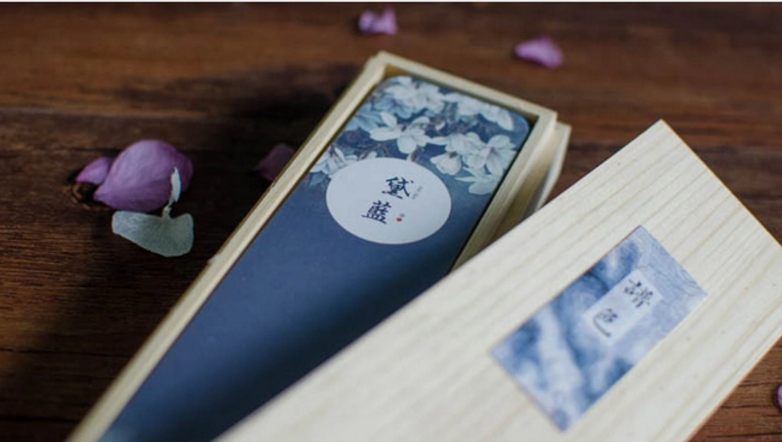
The Lasting Legacy of Chinese Incense
Incense has evolved from ancient rituals to a daily companion.
A blend of tradition and modern aesthetics keeps it relevant.
The act of lighting incense continues to bring peace and reflection.
A simple ritual with deep cultural significance.

Slide 9
Thank you for listening

