Slide 1
Four Satirical Novels in ancient China
四大谴责小说
黄琼 Huang Qiong

Slide 2
Who？

Slide 3
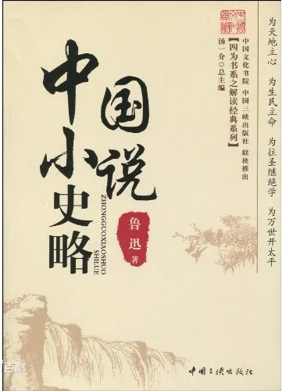
Origin
Lu Xun‘s “A Brief History of Chinese Fiction” put forward the concept of “The Four Late Qing Dynasty Condemnation Novels”, namely The Records of Officialdom Exposure, The Strange Situation of Seeing in twenty years, The Travels of an Old Man, and Nie Hai Hua.
李伯元的《官场现形记》The Records of Officialdom Exposure
吴趼(jiǎn)人的《二十年目睹之怪现状》The Strange Situation of Seeing in twenty years
刘鹗的《老残游记》The Travels of an Old Man
曾朴的《孽海花》 Nie Hai Hua

Slide 4
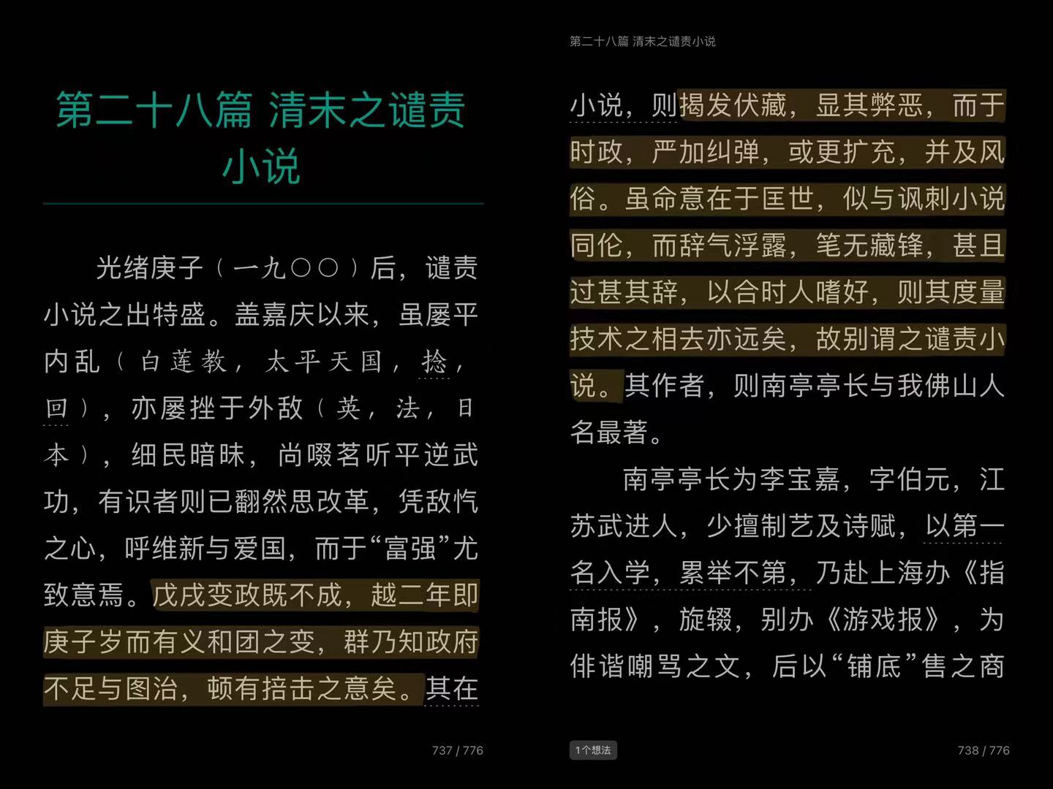
晚清四大谴责小说
social psychology the emergence of novel
these books the Scholars.
However, now the academic circle gives high evaluation to these four novels. Such works are full of the author's strong concern for the country and contain a deep sense of cultural reflection.

Slide 5
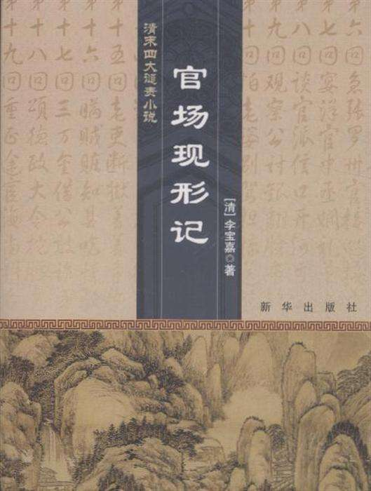
The Records of Officialdom Exposure 官场现形记
The Records of Officialdom Exposure by Li Boyuan(Li Baojia) (1867-1906). This book contains 60 chapters, which are made up of many independent stories. This is the first long chapter novel in China's modern era that was published serially in newspapers and magazines and achieved a social sensation. In this novel, the author presented many ridiculous but thought-provoking scenes and characters with his masterful satirical art. The novel's writing method is modeled on "The Scholars", making full use of exaggeration, comic style, and satirical techniques.
破旧官服
Notes:
the author was good at painting and calligraphy seal cutting and so on.

Slide 6
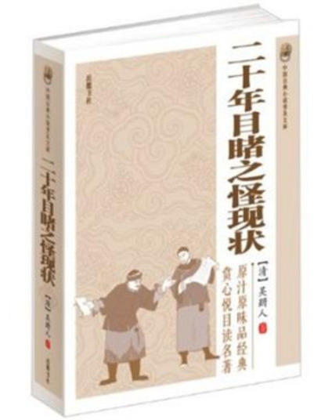
The Strange Situation of Seeing in twenty years
The Strange Situation of Seeing in Twenty Years was written by Wu Jianren(1866-1910). This is a long novel with autobiographical flavor. The protagonist hears and witnesses from the death of his father to his failure in business.
Different from The Records of Officialdom Exposure, this book's criticism of the decadent society is not limited to officialdom, but all aspects of society. It exposes the political situation, social customs, and human conditions of the increasingly colonized Chinese feudal society, helping readers to see the irreparable historical destiny and feudal system.
The novel adopts the first-person narrative way. The novel combines the traditional narrative method with the innovative scenery description technique.

Slide 7

The Travels of an Old Man
The Travels of an Old Man was written by Liu E (1857-1909) and a total of 20 chapters. Although this novel is a travel note, most of the plot of the novel is centered on "officialdom".
The novel narrates the main character’s experiences and activities during his travels in northern China, exposing the darkness of the Qing government, the brutality of the officials, and the poverty of the people, attacking the abusive behavior of those "Qing officials" and expressing the author's strong views on the perilous reality.

Slide 8
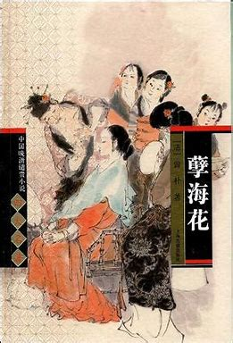
Nie Hai Hua
Nie Hai Hua was written by Zen Pu (1872-1935). The novel criticized the Qing Dynasty government and promoted the values of democracy. The author uses the motif of a beautiful lady and a scholar to create a reflection of the intelligentsia in the late Qing Dynasty.
This book mainly describes the new officials. They have lost the pride of traditional Chinese scholars and are ignorant of the new world. They are outstanding in the imperial examination system, but they have not contributed to national construction. The novel boldly pointed at the Cixi who had the supreme power. The novel reveals her stubbornness and greed.

Slide 9


Slide 10
References
武全全. 晚清四大谴责小说研究[D].哈尔滨师范大学,2016.
王萌. 新时期以来官场小说研究[D].山东大学,2013.
杨蓓蕾. 《儒林外史》与晚清谴责小说[D].济南大学,2013.
王传军. 刘鹗与《老残游记》研究[D].苏州大学,2002.
鲁迅. 《中国小说史略》[M]. 北京：人民文学出版社，1973.
Thank you

