Slide 1
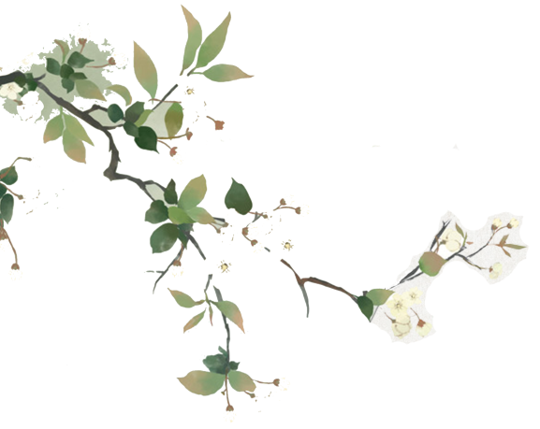
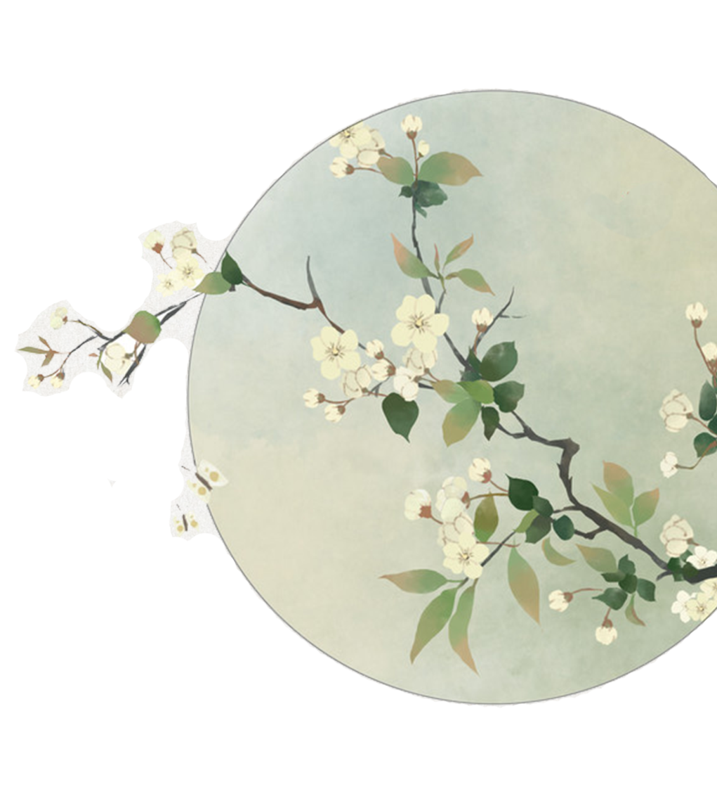
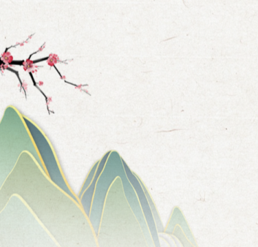
Global Impact of
Chinese Culture
By Xia Jing, Tong Yumeng,
Cao Mengran, Hu Mengqi

Slide 2
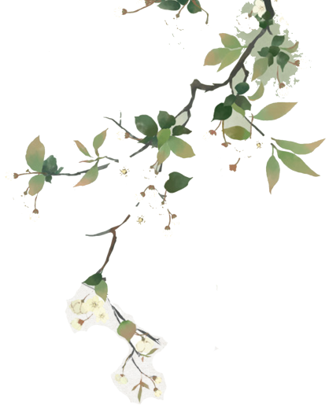
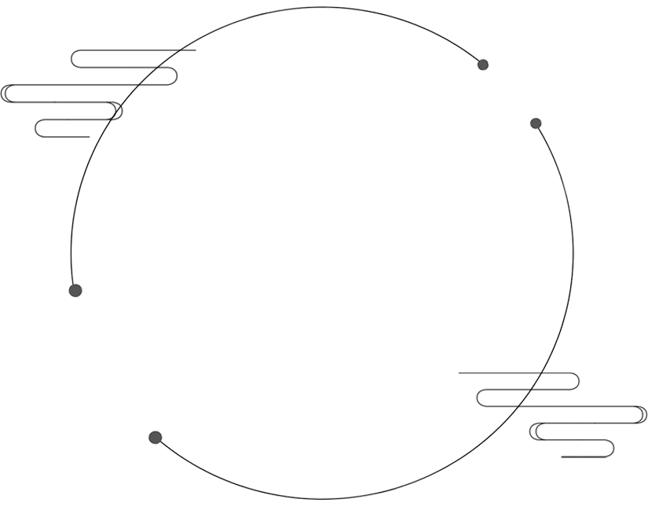
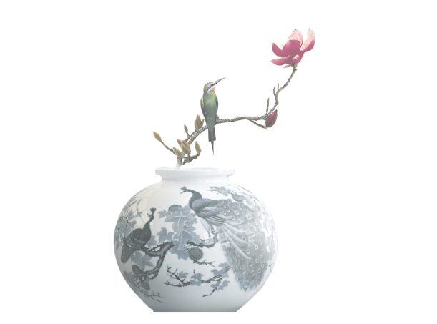
Contents
1
Chinese Literature
2
Chinese Philosophy
3
Chinese Food Culture
4
Chinese Martial Arts

Slide 3


PART.01
Chinese Literature

Slide 4
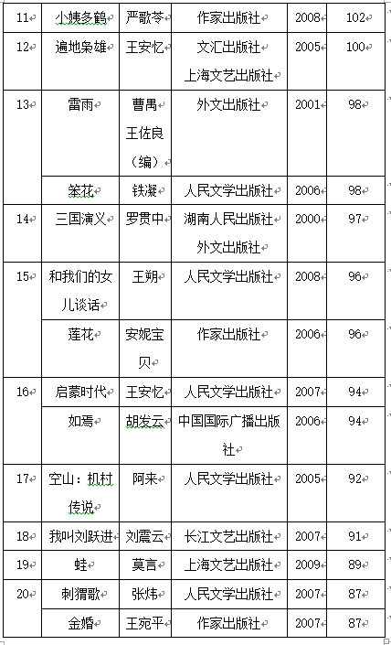
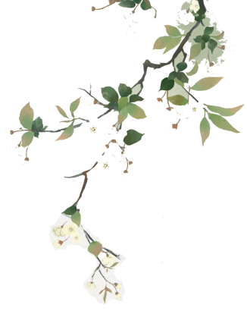
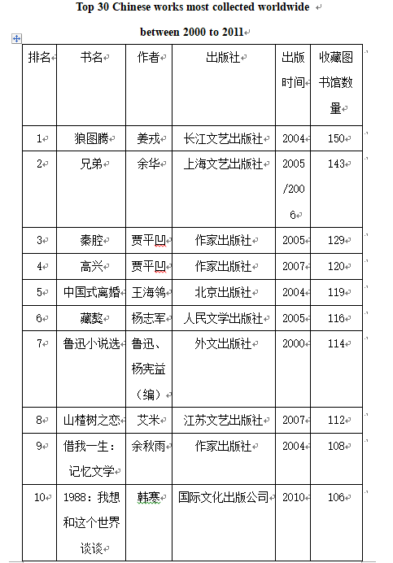
Chinese Literature
Based on the data of OCLC, the following chart summarized the top 30 of Chinese literary works collected by more than thirty libraries around the world.

Slide 5
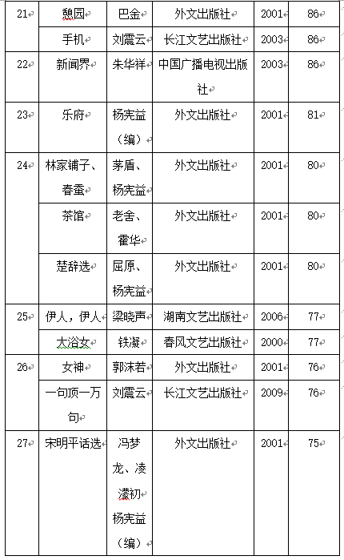
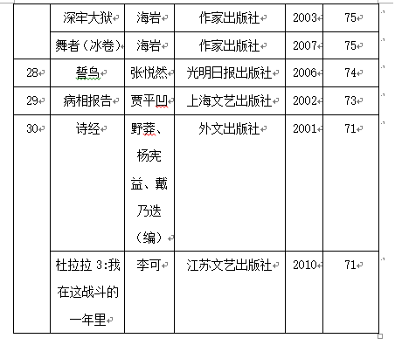
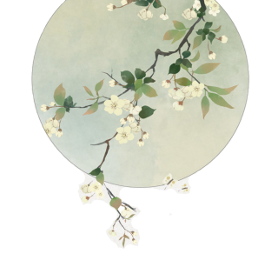
Chinese Literature
The above 42 books are the most widely spread Chinese literary works between 2000 to 2011, which can be seen as the basic appearance of Chinese literature in the world.

Slide 6
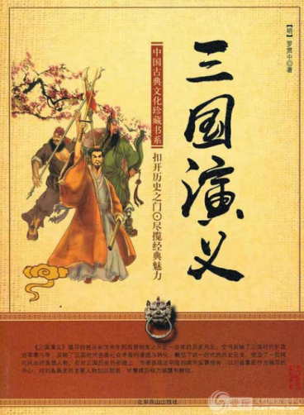
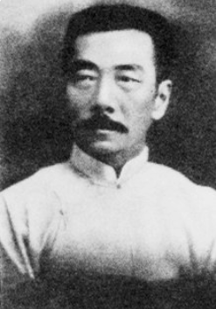
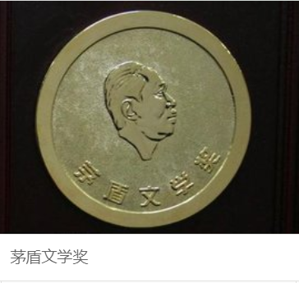
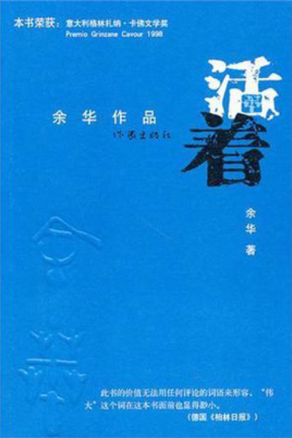
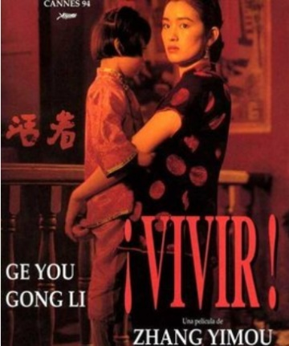
Chinese Literature
The way that Chinese Literature got its global impact can be divided into three points:
First, with going abroad, the Chinese classics have accumulated its popularity.
Third is that the domestic popularity of some writers’ works has spread abroad.
Second, the influence of media.

Slide 7
PART.02
Chinese Philosophy

Slide 8
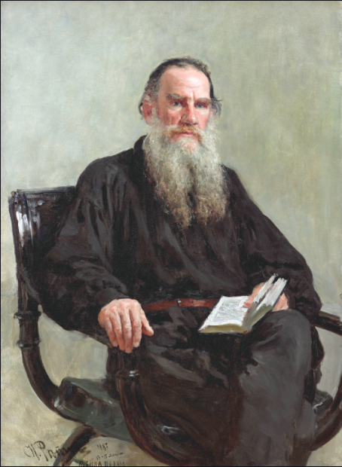
Chinese Philosophy
The combination of Confucianism and the new European thought formed since the Italian Renaissance has become an important ideological source of enlightenment, the leading spirit of the development of modern European history.
Voltaire（伏尔泰）, the leader of the French Enlightenment. He regards Chinese Confucianism as an ideological weapon against European monarchy under theocracy.

Slide 9
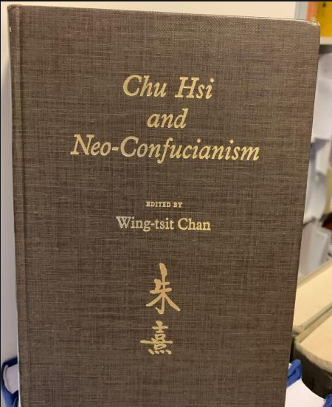
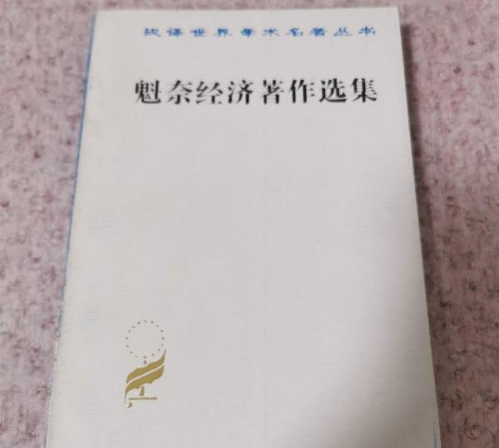
Chinese Philosophy
Neo Confucianism（程朱理学）became the basis for the German philosopher Leibniz to establish classical philosophy and used it to oppose the Revealed Theology of the Holy See
Quesnay（魁奈）, known as “European Confucius”, based on Confucianism, created a new era of modern European political economy and laid a theoretical foundation for the formation and development of classical political economy in England.

Slide 10
PART.03
Chinese Food Culture

Slide 11
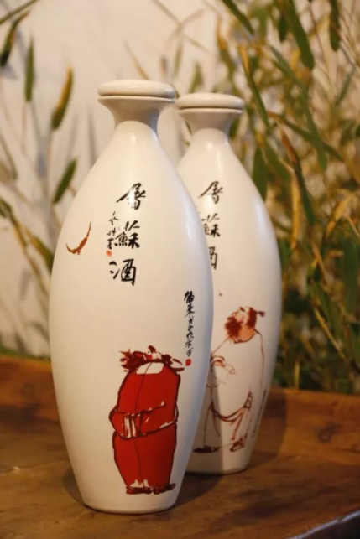
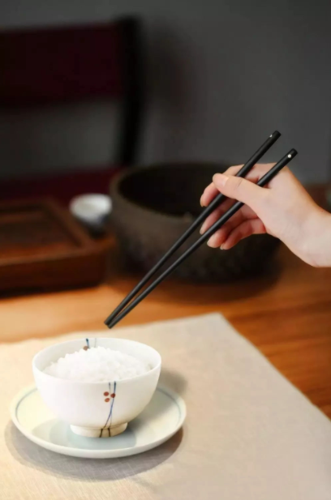
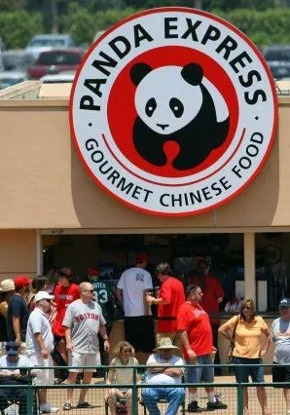

Japan is greatly influenced by Chines food culture. Chinese food customs are very popular in Japan.
With the opening of the Silk Road, China's economic exchanges with Central Asia, West Asia and even Europe have become increasingly close.
By 2015, there have been over 50,000 Chinese restaurants in the United States.

Slide 12
PART.04
Chinese Martial Arts

Slide 13
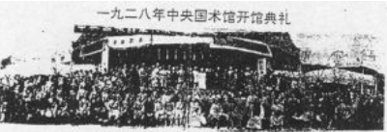
Chinese Martial Arts
Central Guoshu institute 中央国术馆
1928
Chin Woo Athletic Association 精武体育会
1909

Slide 14
International activities
The first international Wushu team of China visited Czechoslovakia（捷克斯洛伐克）and Myanmar（缅甸）under the leadership of Premier Zhou Enlai.
1960
1974
1975
The delegation was invited to Mexico, the United States, and Japan.
The group went to UK, Zimbabwe（津巴布韦）.

Slide 15
Chinese Martial Arts
The golden age of the globalization of Chinese martial arts began in the era of Bruce Lee（李小龙）.

Slide 16
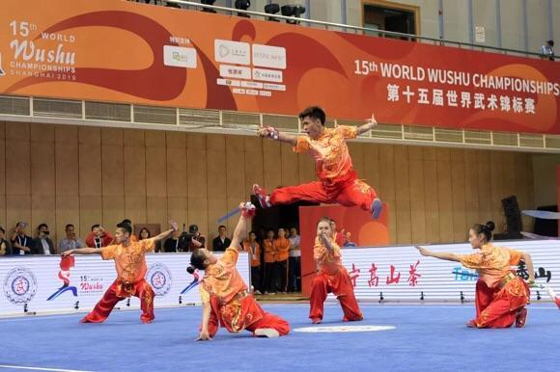
Chinese Martial Arts
At present, martial arts competitions have been set up in seven international multi-sport events. This is an important symbol of the internationalization of martial arts.

Slide 17

Summary
Chinese culture is broad and profound. Its global impact is increasingly enlarging.
The impact is limited, and there is still a long way to go.

Slide 18
Others

Slide 19
Terms and Expressions
the Romance of the Three Kingdoms 《三国演义》
The Songs of Chu 《楚辞》
Thunderstorm 《雷雨》
Teahouse 《茶馆》
The Book of Songs 《诗经》
Brothers 《兄弟》
Neo Confucianism 程朱理学
Voltaire 伏尔泰
Encyclopedia School 百科全书派
Leibniz 莱布尼茨
Quesnay 魁奈
Tusu wine 屠苏酒
chrysanthemum wine 菊花酒
Central Gushu institute 中央国术馆
Chin Woo Athleticiation 精武体育会
The Big Boss 《唐山大兄》
Fist of Fury 《精武门》
Way of the Dragon 《猛龙过江》
Enter the Dragon 《龙争虎斗》
The Shaolin Temple 《少林寺》
A Better Tomorrow 《英雄本色》
Fearless 《霍元甲》
Ip Man 《叶问》
Ip Man 2 《叶问2》
International Wushu Federation 国际武术联盟

Slide 20
References
1.He Mingxing [The global impact of Chinese Literature- Looking back on the ten years of the new century] (01):61-66
2.Zhu Kai（On the inheritance of martial arts culture in the international dissemination of Chinese martial arts.)[G]
3.Zang Guocai.(Research on the International Communication of Chinese Wushu under the Background of Globalization)[G]
4.Yao Weijun.(The dissemination of Chinese food culture and the construction of cultural soft power)[T]

Slide 21
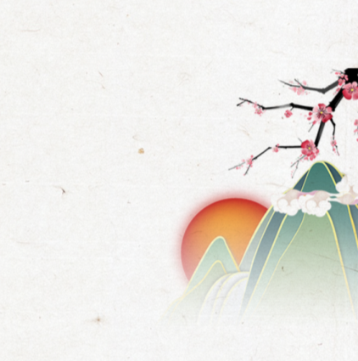
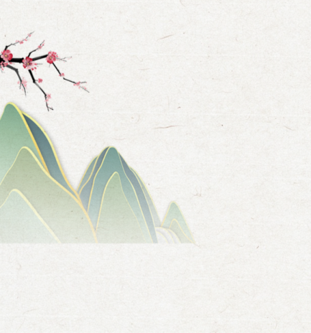
Thank you!

