Slide 1
Hunan Rice Noodles

Slide 2
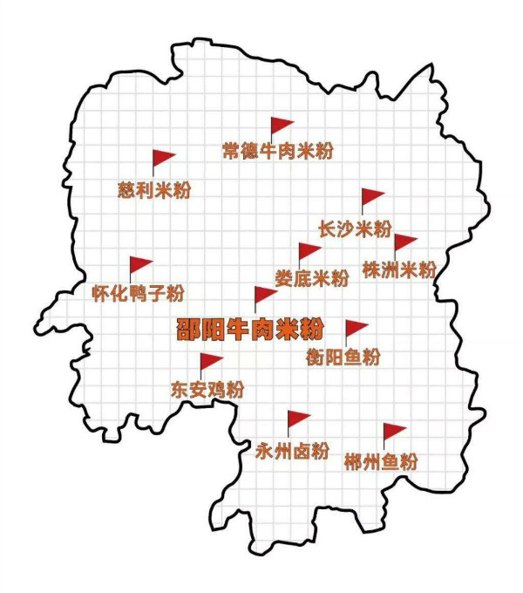

Slide 3
Changsha Rice Noodles
Zhuzhou Rice Noodles
Loudi Rice Noodles
Changde Rice Noodles
Shaoyang Rice Noodles
Dong’an Rice Noodles
Hengyang Rice Noodles
Chenzhou Rice Noodles
Yongzhou Rice Noodles
Cili Rice Noodles
Huaihua Rice Noodles
…

Slide 4
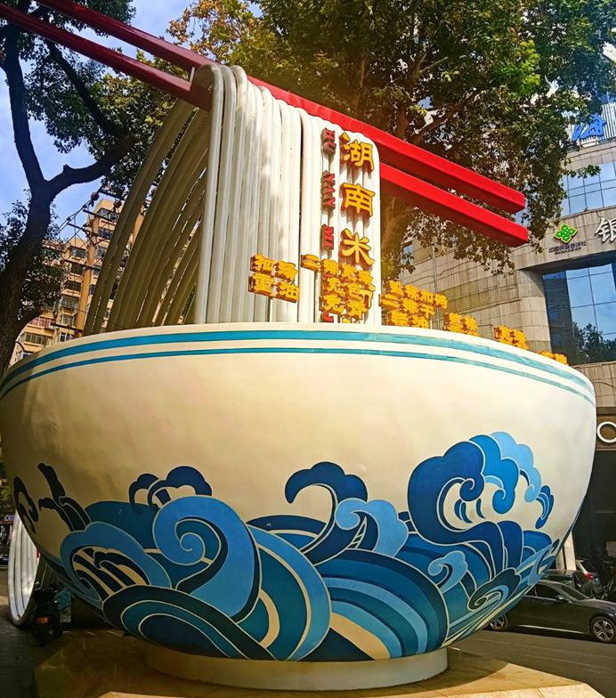
Hunan Rice Noodle Street

Slide 5
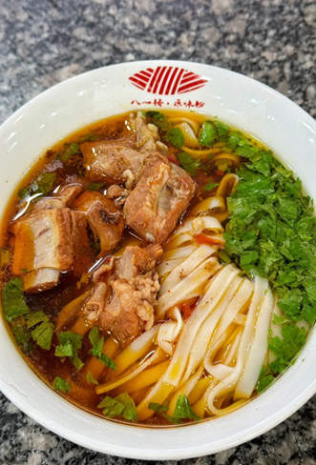
Changsha Rice Noodles

Slide 6
Light soup
Rice noodles
Pork pieces
Some seasonings

Slide 7
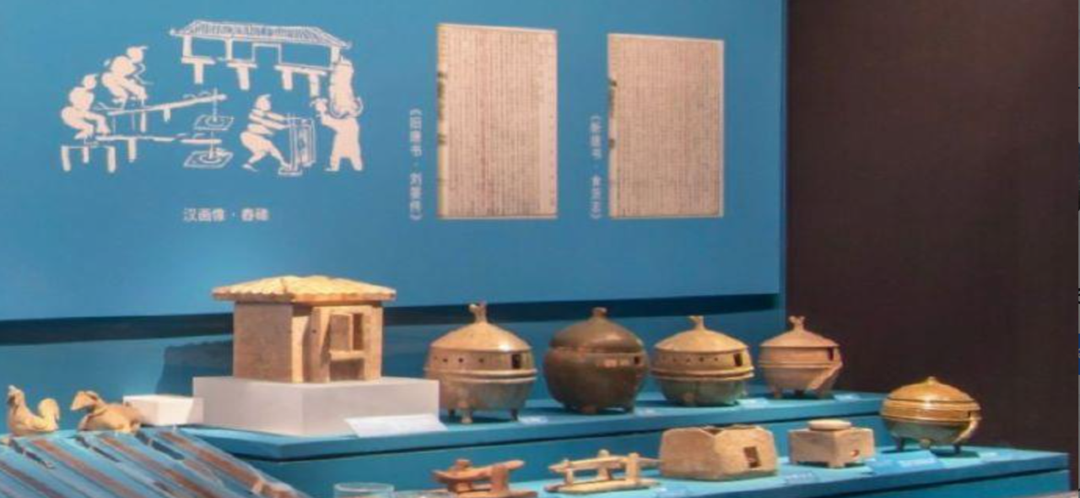
Artifacts unearthed at Emiling

Slide 8
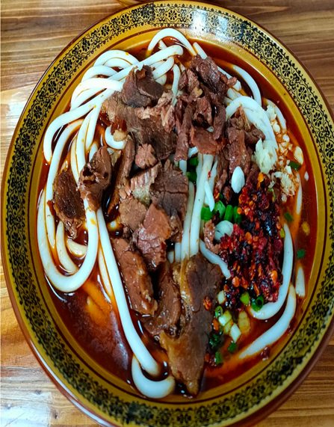
Shaoyang Rice Noodles

Slide 9
Shaoyang Rice Noodles
Beef slices
Thicker rice noodles
Chili sauce
Rich in oil and spice
Some Seasonings

Slide 10
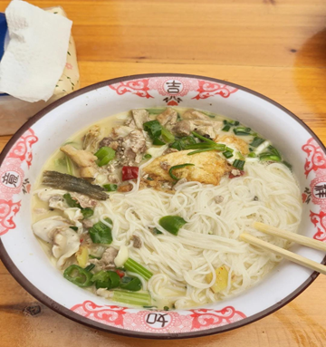
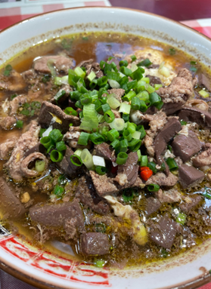
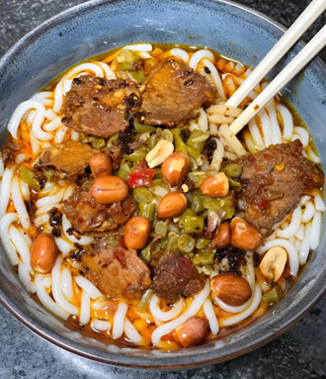
Hengyang Rice Noodles
Fish rice noodles
“Pig-killing rice noodles”
Lu(卤) rice noodles

Slide 11
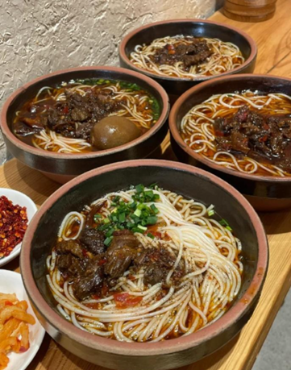
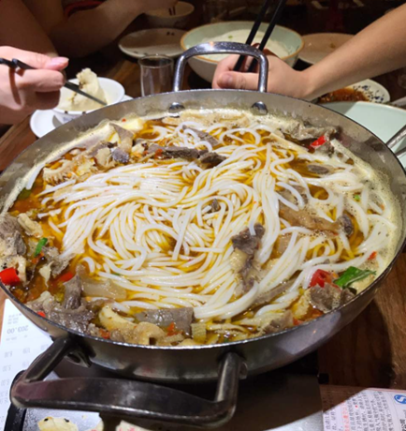
Jinshi Rice Noodles
(Changde Rice Noodles)
Beef Rice Noodles
Stewed Rice Noodles

Slide 12
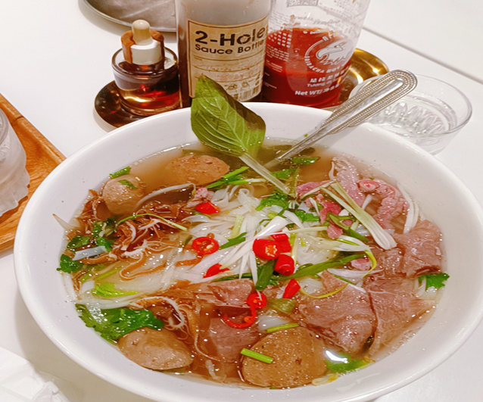
“Pho” from Vietnam

Slide 13
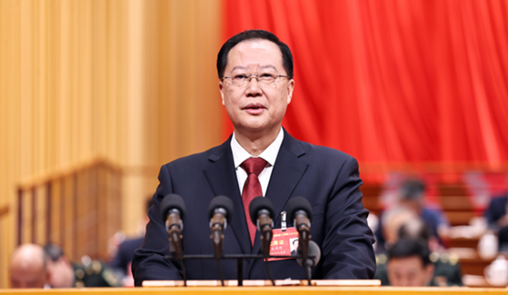
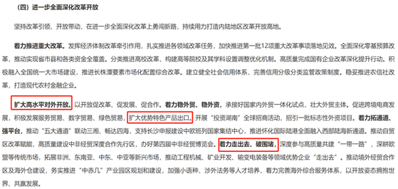
Hunan will expand high-standard opening-up;
Hunan will promote the export of Hunan’s unique and
competitive local products;
…

Slide 14
As translators/interpreters, there’s a lot we can do:
1. Translate the Hunan dishes into English or other languages correctly; set up standard translation names for Hunan dishes.
2. Help build the brands of Hunan dishes.
3. Participate in the activities relating to the promotion of Hunan dishes;
4. Assist in the translation of social media content and the localized operation;
5. Play the role of a bridge in cross-cultural communication.

Slide 15
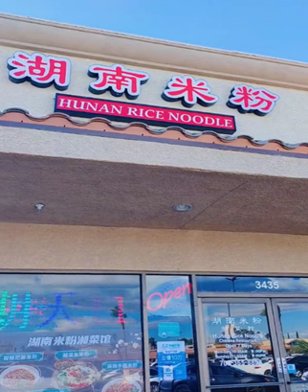
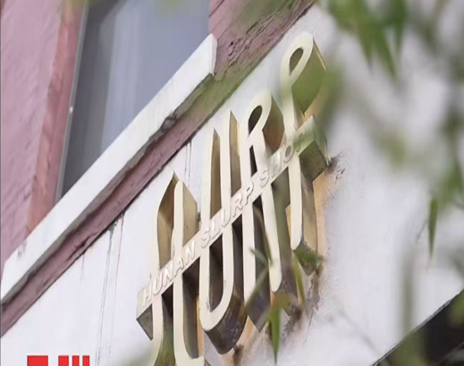
The promotion and dissemination of Hunan rice noodles
Las Vegas, US
New York, US

Slide 16
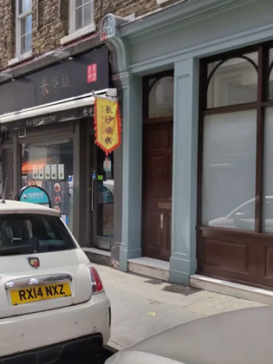
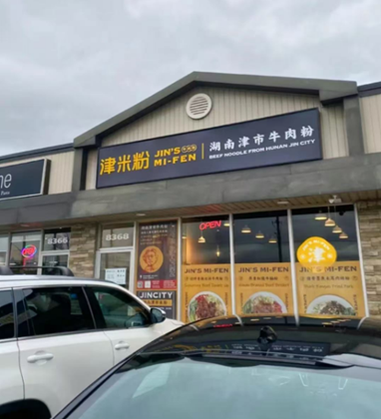

London, UK
Toronto, Canada
Amsterdam, Netherlands

Slide 17

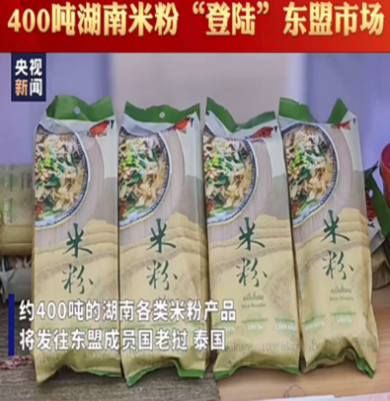
Rice noodles from Youxian County exported to the US
Rice noodles from Huaihua exported to ASEAN

Slide 18

Hunan dishes promotion activity

Slide 19
Thanks!

