Slide 1

Folk Traditional Customs: Fireworks and Firecrackers
Cao Jialong Dec 12, 2024

Slide 2

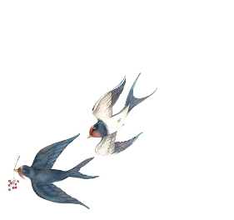

CONTENTS
The Origin and Development of Fireworks and Firecrackers
The Hometown of Fireworks - Liuyang
The valaues of Fireworks and Firecrackers

Slide 3

Chapter 1
The Origin and Development of Fireworks and Firecrackers

Slide 4
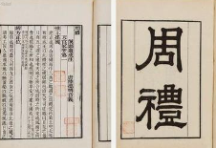
Pre-Qin Period
During this period, there was a kind of religious activity called "Bursting Sacrifice"(爆祭), which included burning firewood to "worship immortals and expel evil spirits. The Ritual of Zhou (《周礼》) recorded the "Nine Sacrifices"(九祭), the third of which is the "Bursting Sacrifice.".

Slide 5
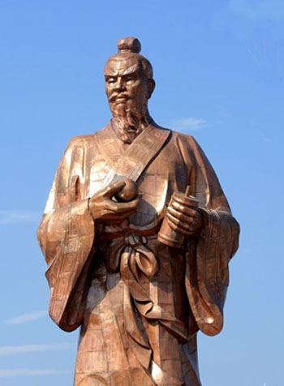
Early Tang Dynasty
Li Tian (李畋), a hunter from Liuyang, Hunan Province, placed gunpowder in bamboo tubes and ignited them to create a loud noise to dispel mountain ghosts and stop the spread of plague, which earned him the title “the originator of firecrackers”. The firecracker made by Li Tian was, in real sense, its earliest version.
Bronze statue of Li Tian

Slide 6
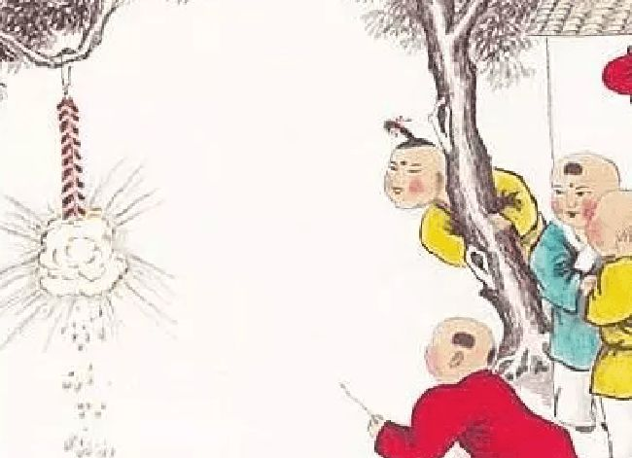
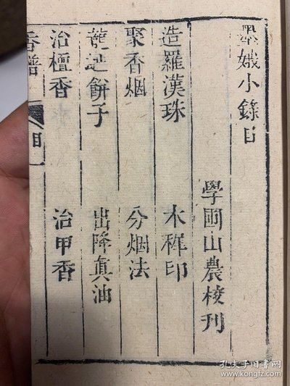
Song Dynasty
Late Yuan and Early Ming Dynasties
People widely replaced the original bamboo tubes with paper rolls to contain gunpowder. They also connected single firecrackers together to create hanging firecrackers.
A book, Mo E Small Record (《墨娥小录》), was the earliest to describe 22 different firework formulas. According to different needs, corresponding metals can be added to produce the desired colors when burned.

Slide 7
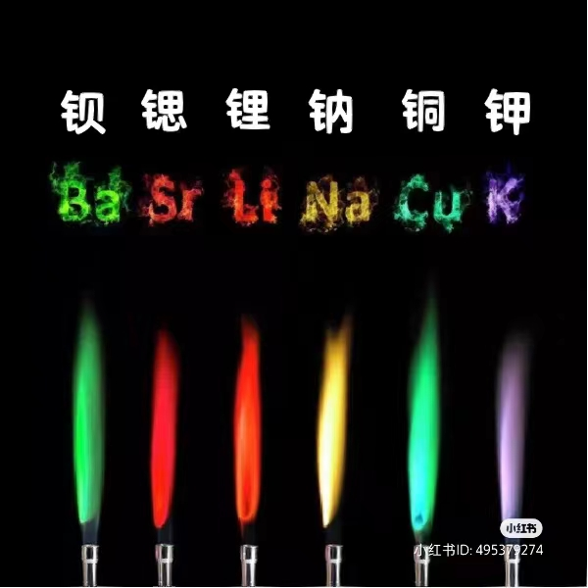
Flame Reaction (焰色反应)

Slide 8

Qing Dynasty
The pinnacle of ancient Chinese fireworks and firecracker culture: Emperors of the Qing Dynasty placed great importance on fireworks performances and hold grand firework shows on important festivals. The fireworks industry in the Qing Dynasty also gradually scaled up, with places like Liuyang becoming famous production center.

Slide 9
Chapter 2
The Hometown of Fireworks - Liuyang

Slide 10
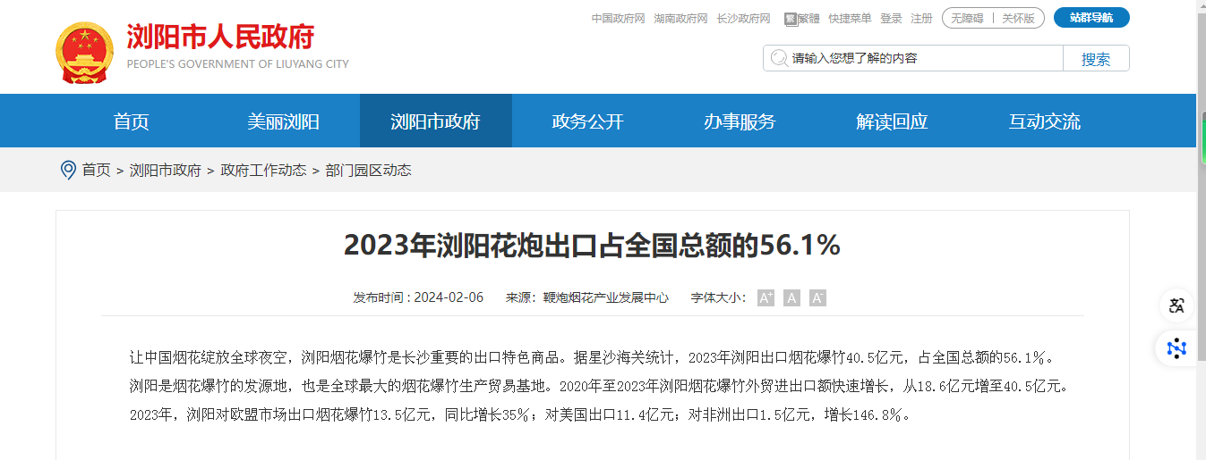
Popularity of Liuyang Fireworks and Firecrackers
In 2023, the exports of Liuyang's fireworks and firecracker broke through 4.05 billion yuan, accounting for 56.1% of China’s total.The fireworks performance at the opening ceremony of the Paris Olympics on July 26th was provided by Hunan Xiaowen Electronic Technology Co., Ltd. from Liuyang Economic Development Zone. It have provided exciting special effects for international events such as the Qatar World Cup and the Hangzhou Asian Games opening ceremony.

Slide 11

Role in Driving Local Economy
The fireworks and firecracker industry is a labor-intensive industry with relatively simple craftsmanship and less labor intensity, which drives the employment of women and older people. This industry has played an important role in providing jobs for local people, especially rural left-behind personnel and promoting poverty alleviation and income increase. Currently, there are nearly 300,000 people employed in the Liuyang fireworks and firecracker industrial chain, with about 180,000 people directly engaged in the production of fireworks and firecrackers.
Technological Innovation
Liuyang enterprises continue to innovate, developing gunpowder-free fireworks, an environmentally friendly product that is widely welcomed around the world.

Slide 12
Chapter 3
The Value of Fireworks

Slide 13
The Value of Fireworks and Firecrackers
Fireworks and firecrackers are important parts of celebration during important festivals, as they symbolize auspiciousness in traditional Chinese culture. The splendor and sound of fireworks and firecrackers imply expelling evil spirits and welcoming good fortune, representing people's blessings and aspirations for a better life.
As a cultural symbol, fireworks and firecrackers enhance people's cultural identity with traditional culture. The inheritance and development of Liuyang fireworks have not only enriched Chinese traditional culture but also strengthened national pride.
In modern times, fireworks and firecrackers remain an indispensable part of various festivals and significant events, especially on New Year's Eve in major cities, where fireworks displays have become one of the highlights to attract tourists and citizens. Fireworks have also been spread globally. Many countries use fireworks and firecrackers in major celebrations and cultural activities, making fireworks performances a part of cross-cultural communication.

Slide 14


Slide 15
Thanks for listening.

