Slide 1

The Ming Dynasty
1368-1644

Slide 2
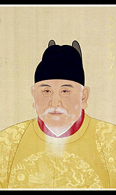
The Hongwu Emperor
I was born Zhu Yuanzhang to a poor peasant family.
I was the eighth child born to my family.
When I was sixteen, the Yellow River broke and flooded the valley where I lived.
A subsequent plague killed my all of my family but one brother.
I later decided to become a monk.
For years I lived as a traveling wanderer.

Slide 3
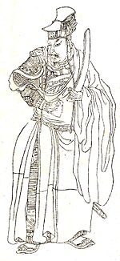
The monastery that I later moved to was destroyed by an army sent to suppress a local rebellion.
I then joined a local insurgent group associated with the Red Turbans.
I rose through the ranks and emerged as a leader within the opposition to the Yuan Dynasty.
My army concurred Nanjing, which we would use as our base of operations.

Slide 4
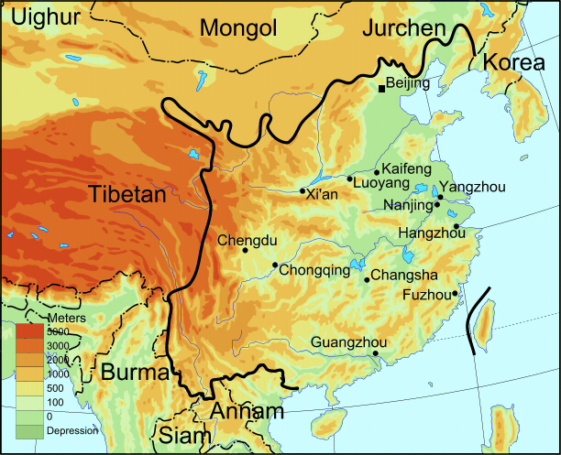
My Nanjing government became known for good governance. It’s population increased 10 times with the influx of citizens fleeing the chaos of other territories.
As the Yuan Dynasty weakened, the Red Turbans began to splinter.
I became the leader of the Ming faction of the Red Turbans.
After seven years of in fighting I gained control of the Red Turban territory.
In 1367 I proclaimed myself emperor and dedicated myself to the removal of the Mongols from the China.
1368 we pushed the Mongols from Khanbaliq (Beijing) and into Mongolia

Slide 5
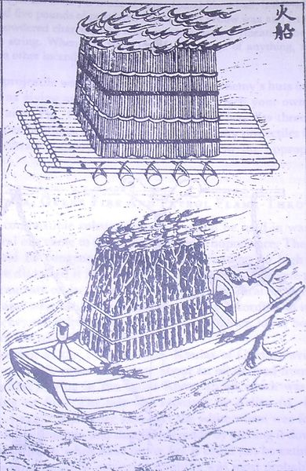
Ming Taizu
At the Battle of Lake Poyang, I defeated the last of my chief rivals.
As Emperor I initiated vast land reform and irrigation projects to help out my peasantry.
I reorganized the army to better defend against the Mongol threat.
I was against military intervention abroad, except in the case of Japanese Pirates

Slide 6
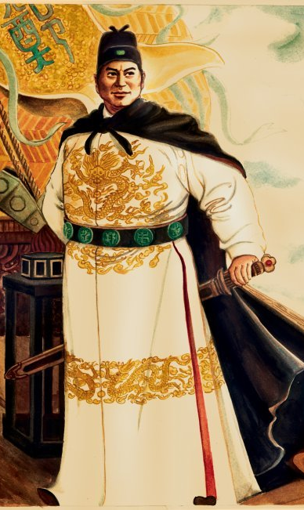
Zheng He
My Grandfather and Great Grandfather served as administrators to the Mongol Dynasty.
At age eleven, I was captured by the Ming armies and castrated.
I was sent to work in the household of Zhu Di, the Prince of Yan (Beijing Area).
There I was educated and gained the trust of Zhu Di.
I helped Zhu Di gain ascend to the Emperor in a civil war with his nephew.

Slide 7
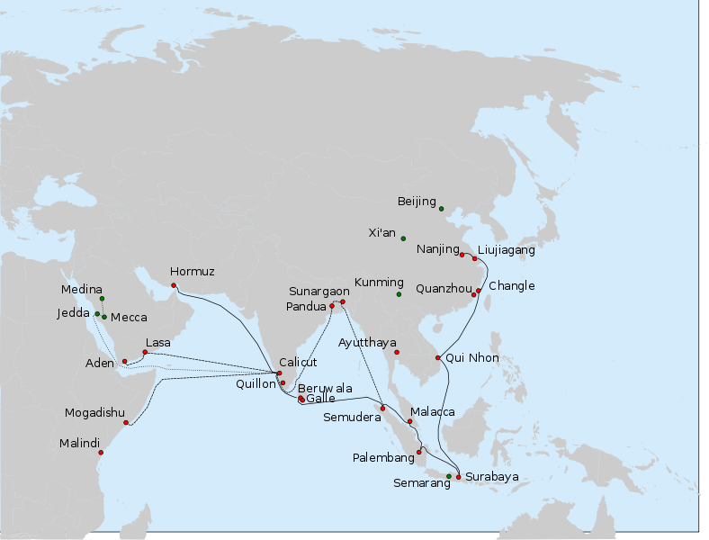
Under the Yongle Emperor I was promoted to Grand Director and Chief Envoy
I was one of the world’s greatest explorers. My first expedition consisted of 317 ships.
We traveled to Thailand, India, Arabia, and the horn of Africa.
Unlike European expedition, our trips were not for exploration and trade, but rather to expand our tributary system.

Slide 8
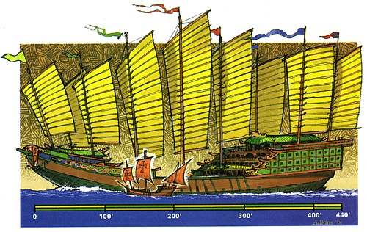

Slide 9
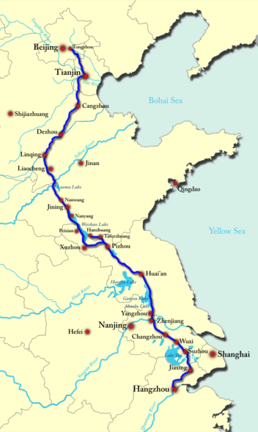
The Yongle Emperor
Repaired and expanded the Great Canal
Repaired the Great Wall to what we know today
Mounted five campaigns in the north. Resulting in the Mongols being brought into the tributary system
Sent armies into Vietnam
Moved the capital to Beijing
Built the Forbidden Palace

Slide 10
Downfall of the Ming Dynasty
Lost the Mandate of Heaven
Foreign invaders
Rebellion
Natural disasters
Famine
Inability to mount effective campaigns against invaders and insurgencies
Costly military campaigns
In ability to control the empires finances
In ability to control eunuchs and bureaucrats
Slowed innovation and entrepreneurship just when Europe was increasing it’s

Slide 11
Sources
Sources of Chinese Tradition From the Earliest Times to 1600- Compiled by WM. Theodore de Bary & Irene Bloom
Chinese Civilization, a Sourcebook- Edited by Patricia Buckley Ebrey
Illustrated History China- Patricia Buckley Ebrey
Encyclopedia Britannica
The Overall Survey of the Ocean’s Shores, Ma Huan

