Slide 1
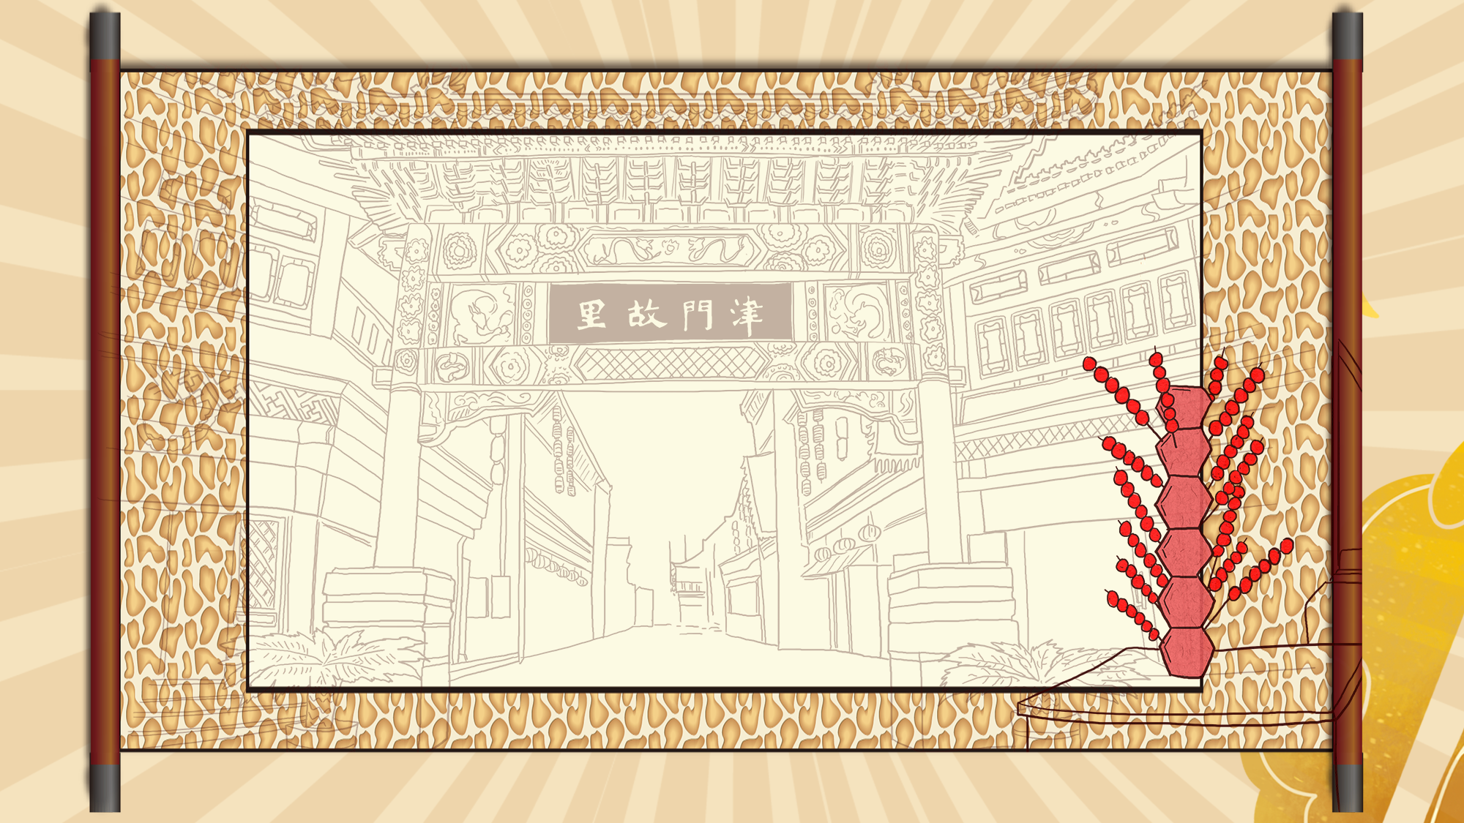

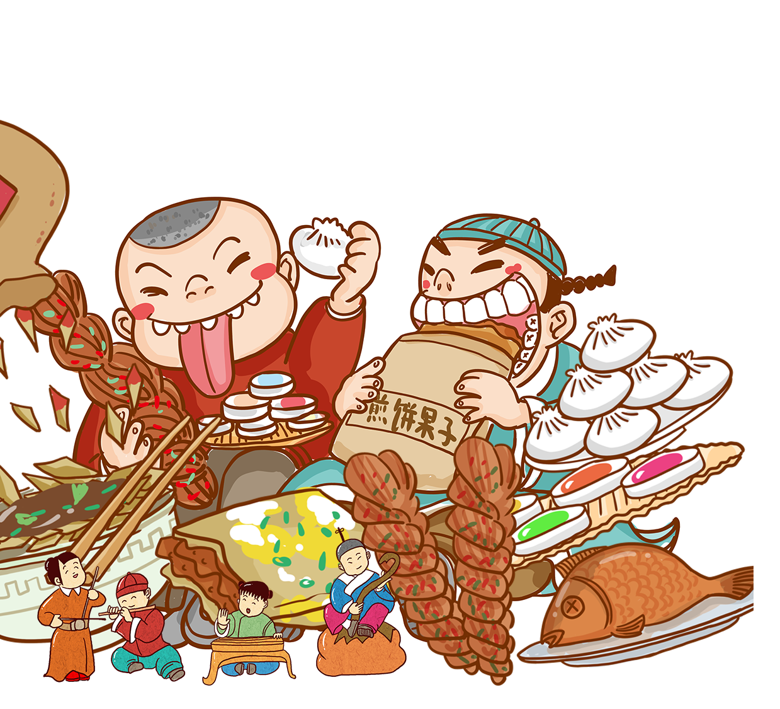
là
辣
条
tiáo
Presented by Jiang Yaping

Slide 2

Content
01
02
The making process
of Latiao
Introduction
Latiao
from Hunan
03
04
Interaction

Slide 3
01
Introduction

Slide 4
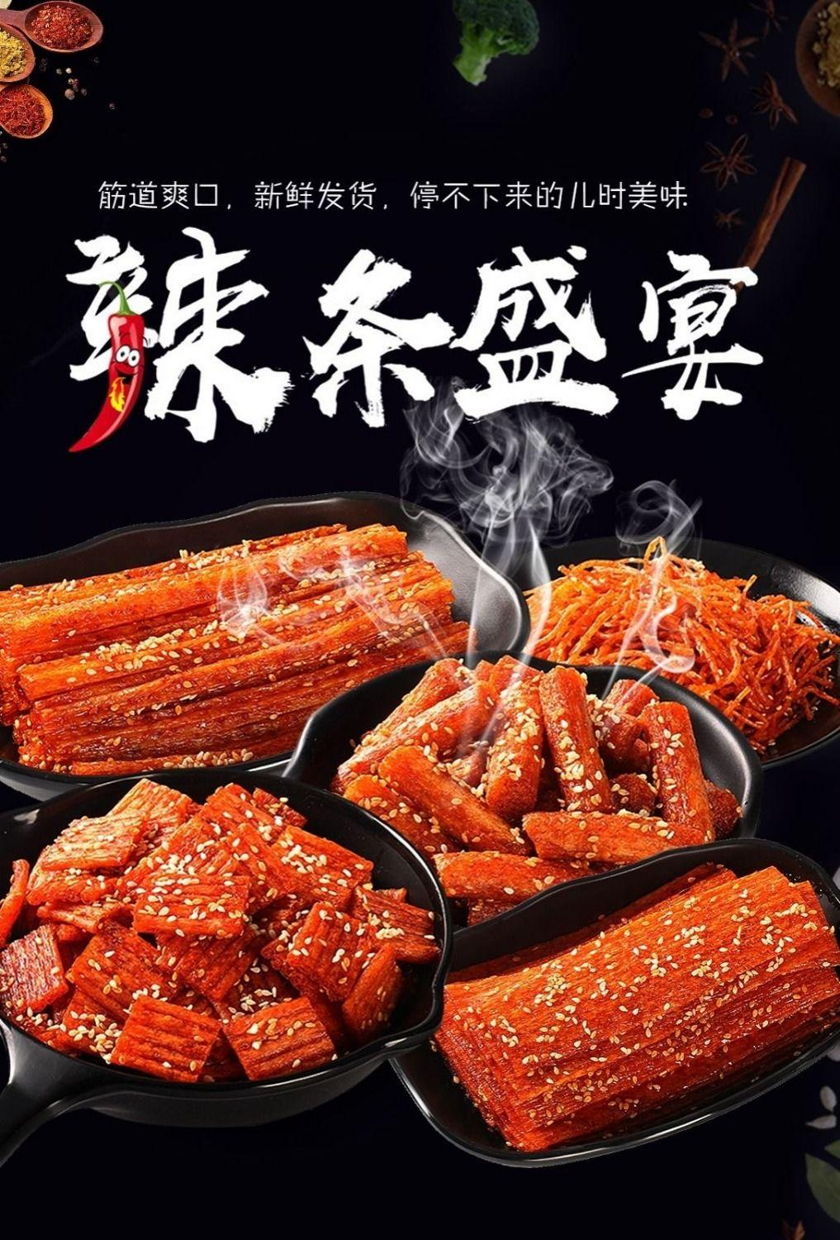
Introduction
Latiao, also called spicy gluten, spicy bar and spicy strip, is one of the most popular snacks for young people in China. It is an unforgettable memory for these people with its spicy taste and cheap price. After continuous development and innovation, Latiao has now enjoyed a reputation at home and abroad, loved by people around the world.

Slide 5
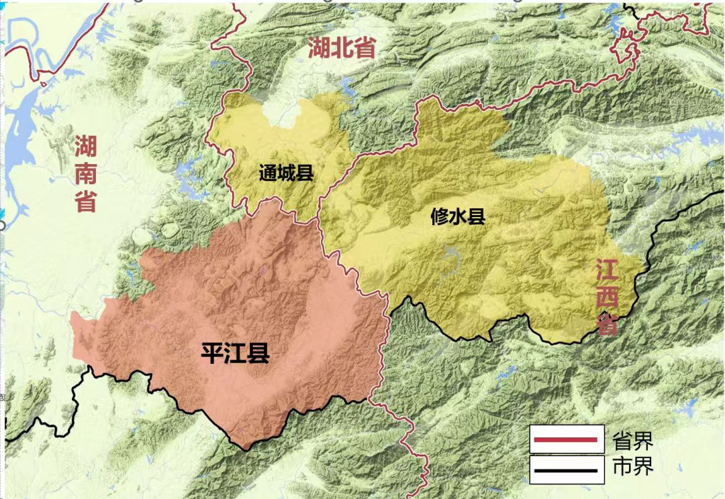
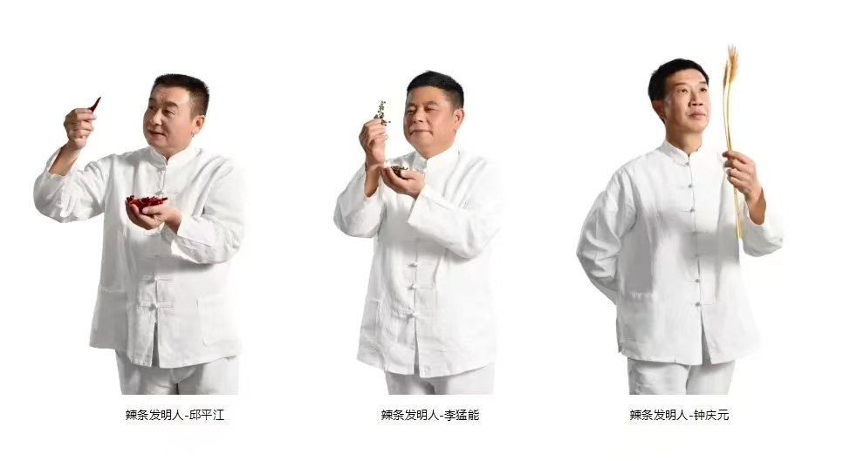
Introduction
Latiao originated in Pingjiang of Hunan Province. It can be traced back to a traditional Chinese food: dried sauces. Three Pingjiang people—Qiu Pingjiang, Li Mengneng and Zhong Qingyuan replaced the soybean flour with wheat flour. They improved the production process, adding chili, pepper, cumin, sugar, salt, vegetable oil and other condiments in the basis of dried sauces. As a result, they invented and innovated the spicy gluten.
Pingjiang of Hunan Province
The creators of Latiao

Slide 6
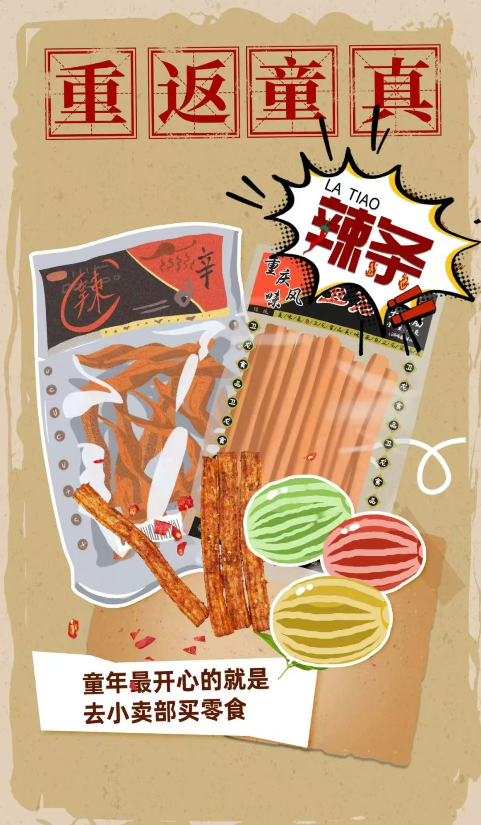
The making process
of Latiao
02

Slide 7
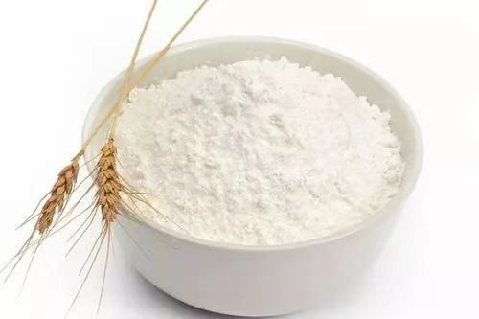

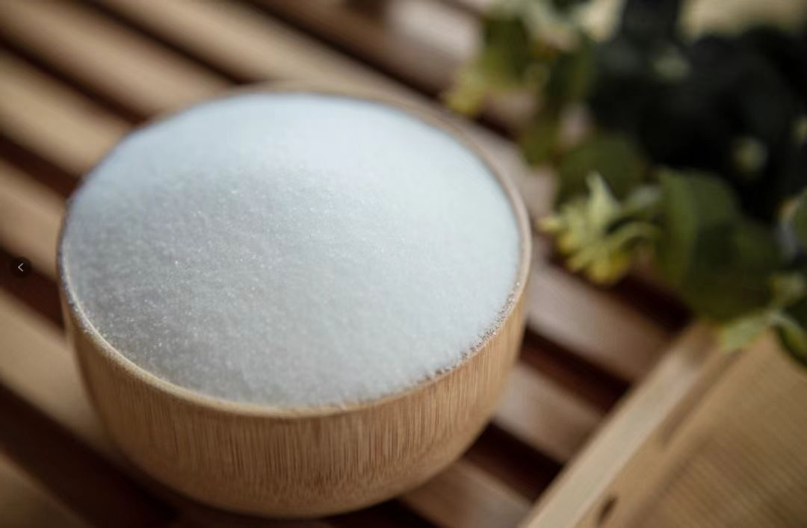
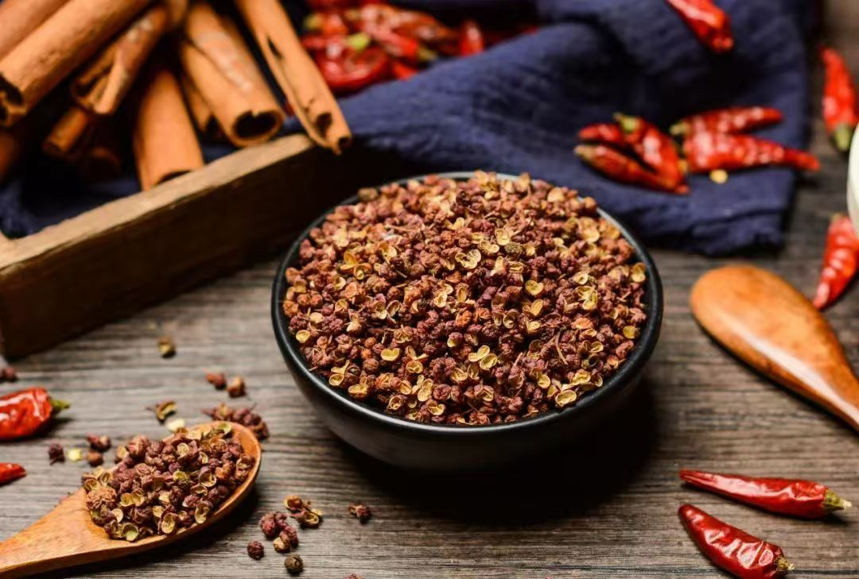
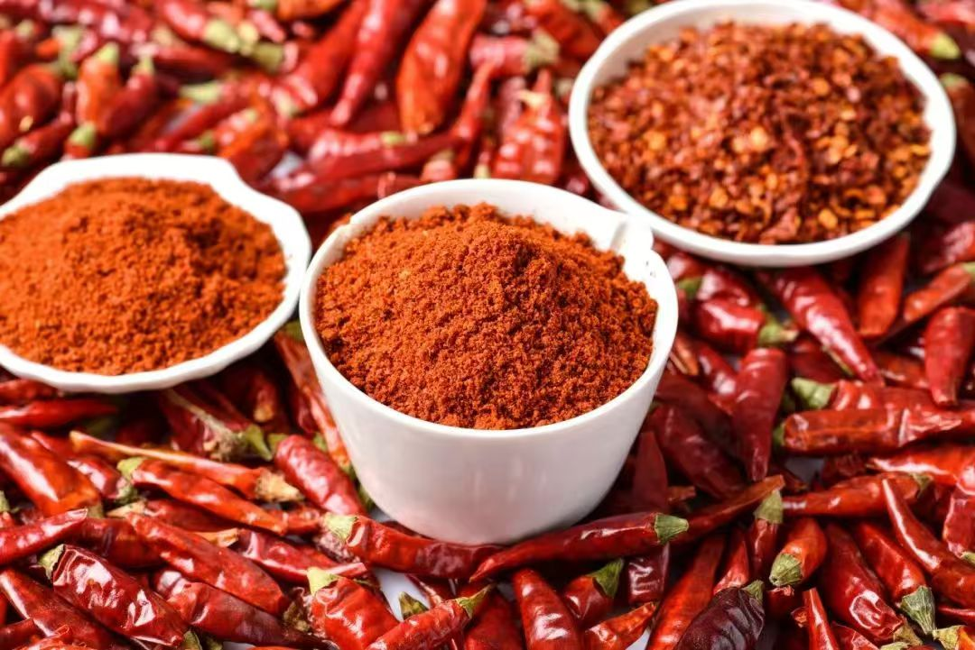
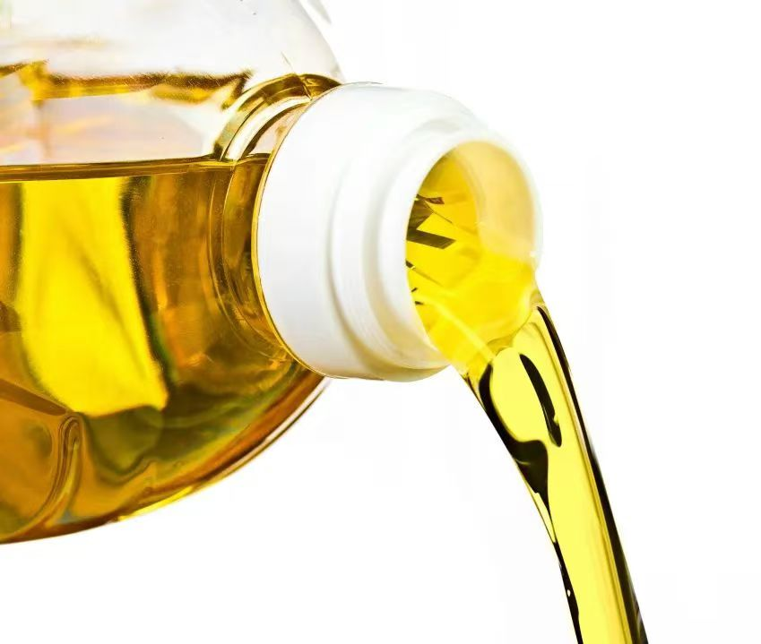
Key Ingredients
Wheat flour
Water
Salt
Peppercorns
Chili powder
Oil

Slide 8
A video on how to making Latiao

Slide 9
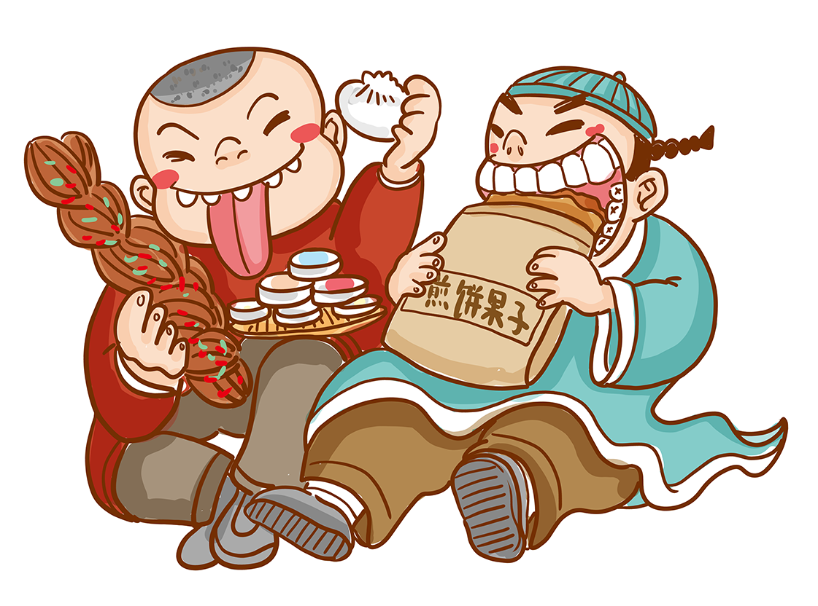
03
Latiao from Hunan

Slide 10
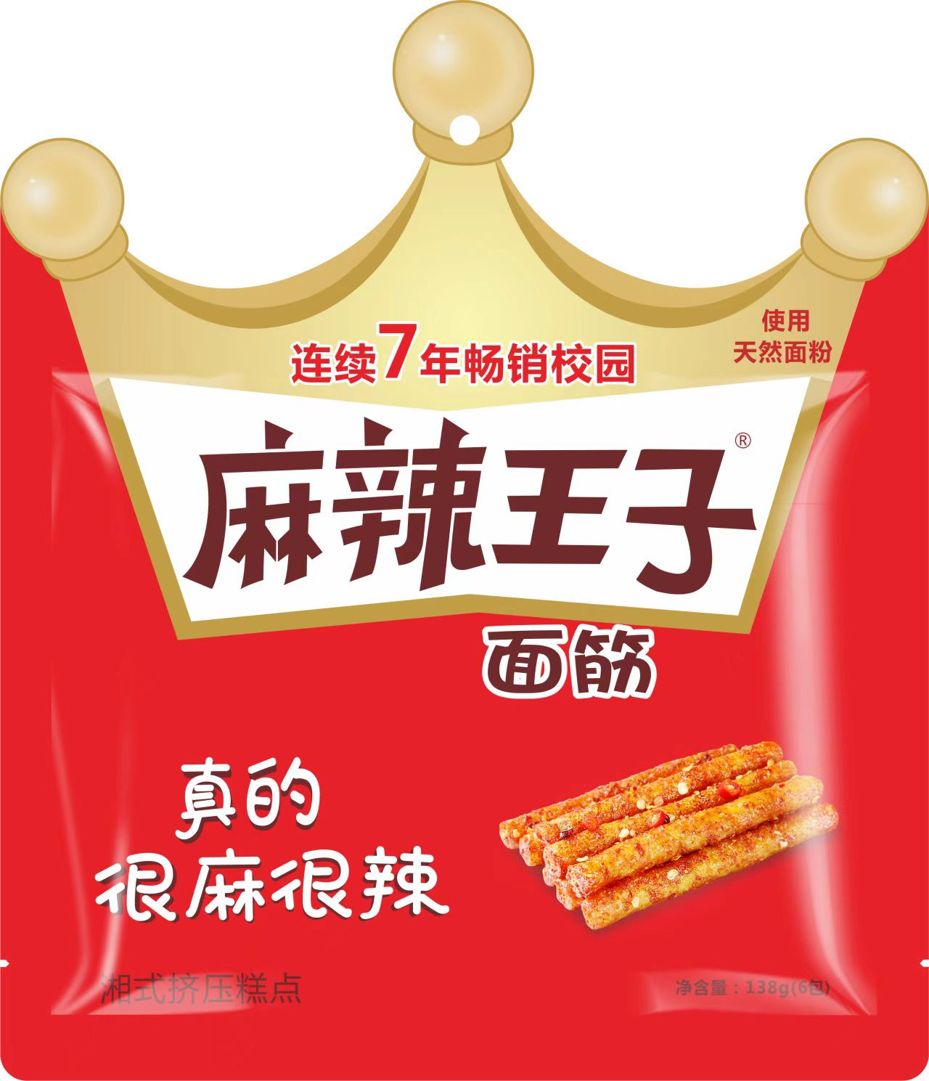
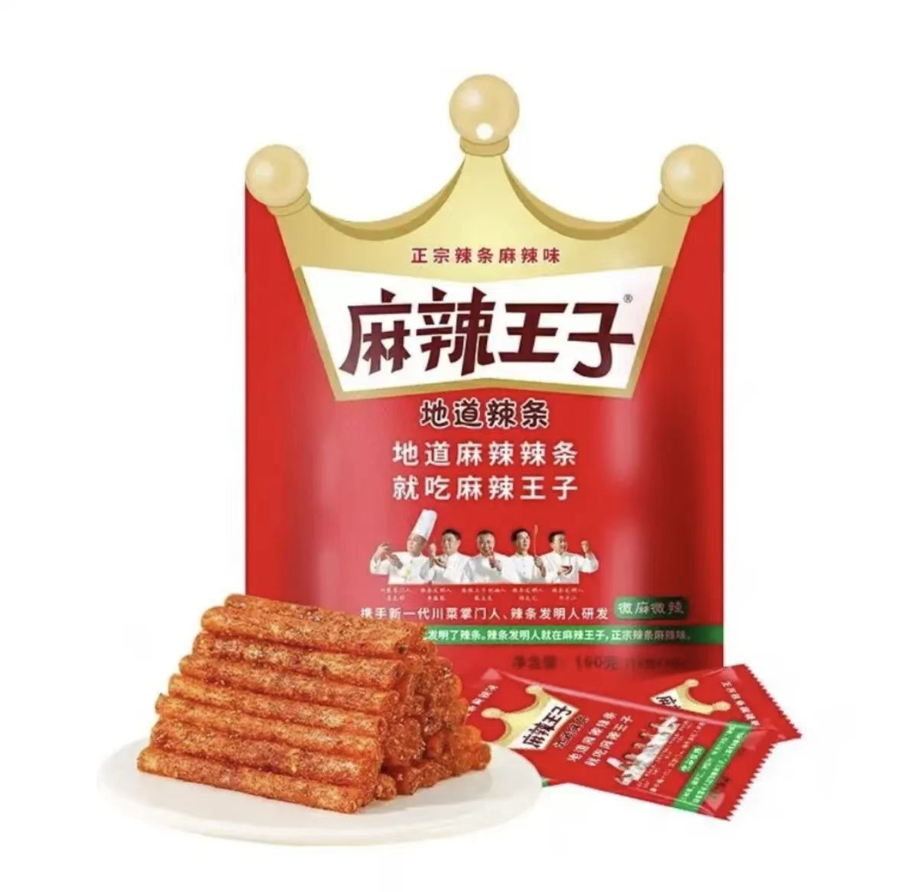
Spicy Prince
Main ingredients: wheat flour; chili; edible salt
Key steps: dough mixing, pressing, frying, seasoning and packaging
Feature: spicy flavor, a soft yet chewy texture
and vibrant color
Pingjiang

Slide 11
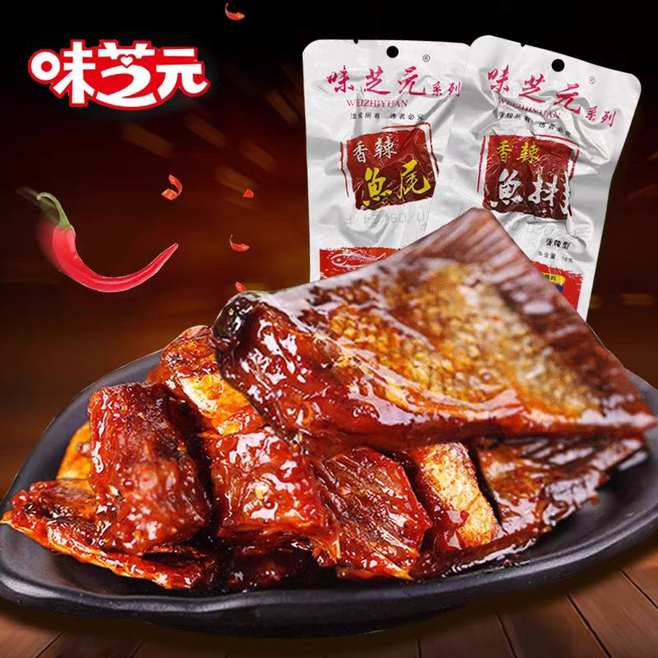
Weizhiyuan Fish Fillet
Ingredient: fresh fish from the Dongting Lake
Purpose: to ensure the quality and freshness of the fish
Key steps: smoke and marinate
Purpose: to remove the fishy taste; to make the fish fillet
tender and a unique flavor
Feature: spiciness and a distinctive smoky flavor
Yiyang

Slide 12
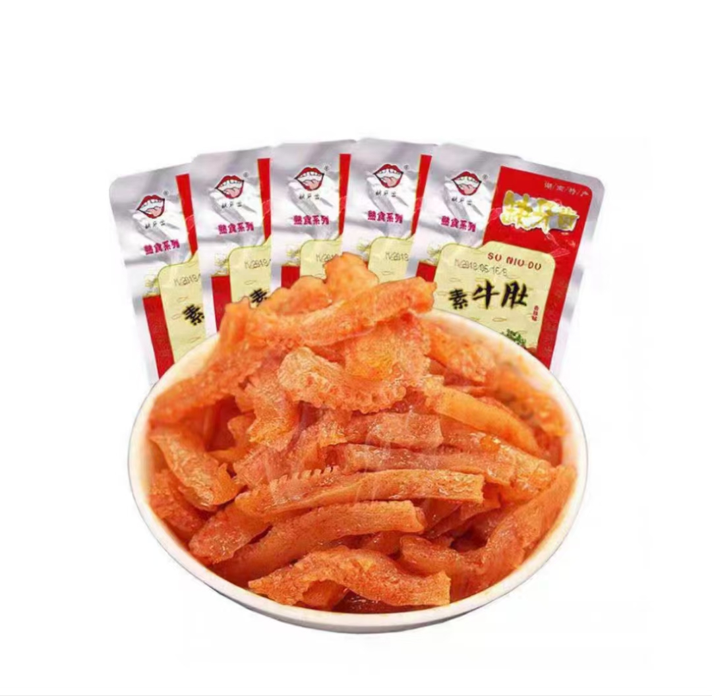
Queyachi
A konjac-based product
Main ingredients: konjac flour, soy protein and wheat protein
Feature: the texture and flavor of tripe; low-calorie and low-fat; spiciness
Yiyang

Slide 13
04
Interaction

Slide 14
Rules
Number: 3 students
Requirement: a packet of Latiao (Queyachi); within the shortest time; 不嘶哈
Prize: Spicy Prince（一大包麻辣王子）

Slide 15
Thank you
for your listening!

