Slide 1
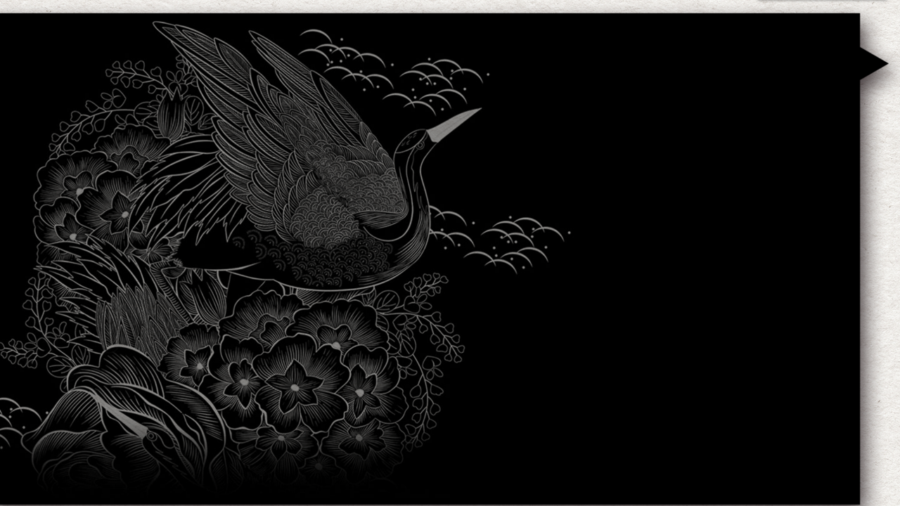
Traditional Crafts: Carving
唐启洲 2019级翻译班 201930096006

Slide 2
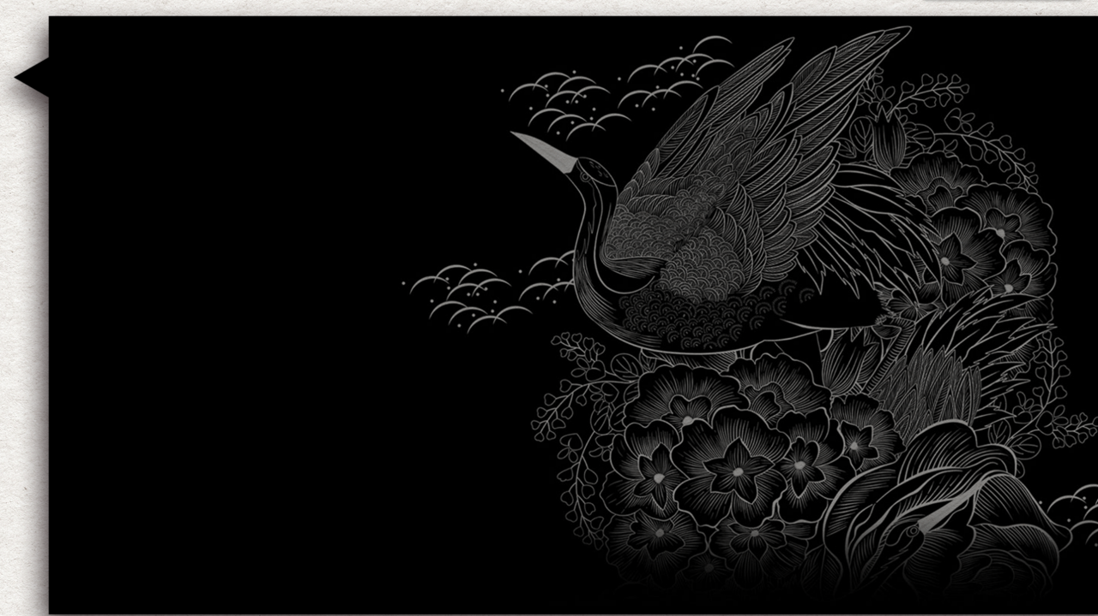

Contents
01
Jade Carving
02
Wood Carving

Slide 3
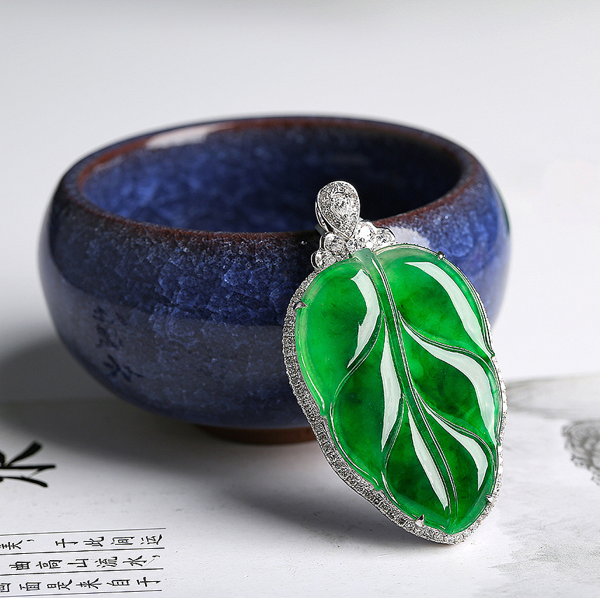
Its hardness suggests firmness and loyalty
Jade has been cherished by the Chinese people as a symbol of many virtues. Thus it is not surprising to see many Chinese wear jade ornaments on their persons.
its luster（光泽） projects purity and beauty
ward off evil forces and protect the wearer against anger and misfortune
have many magical and curative qualities

Slide 4
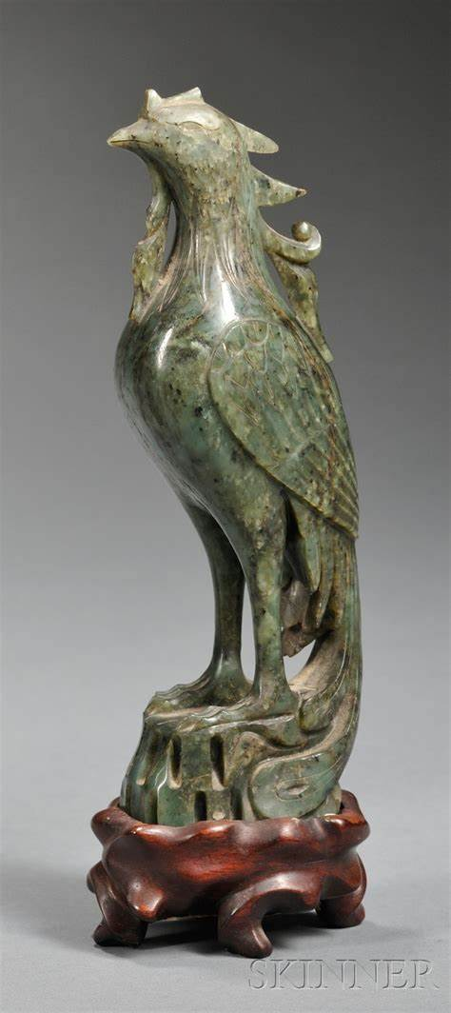
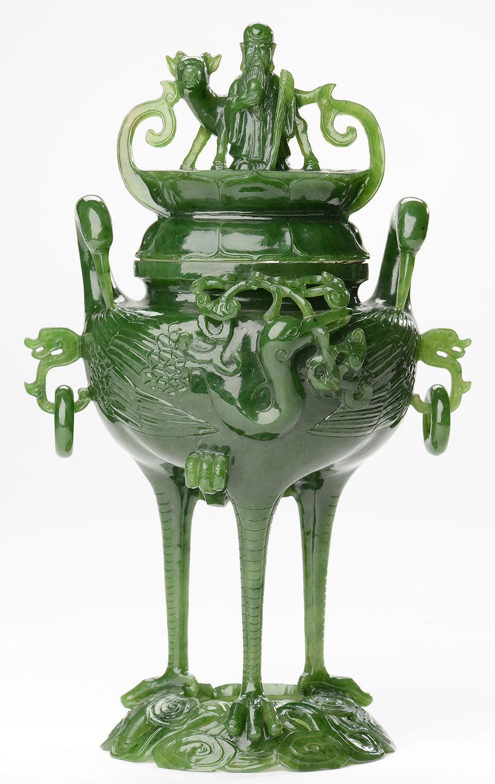
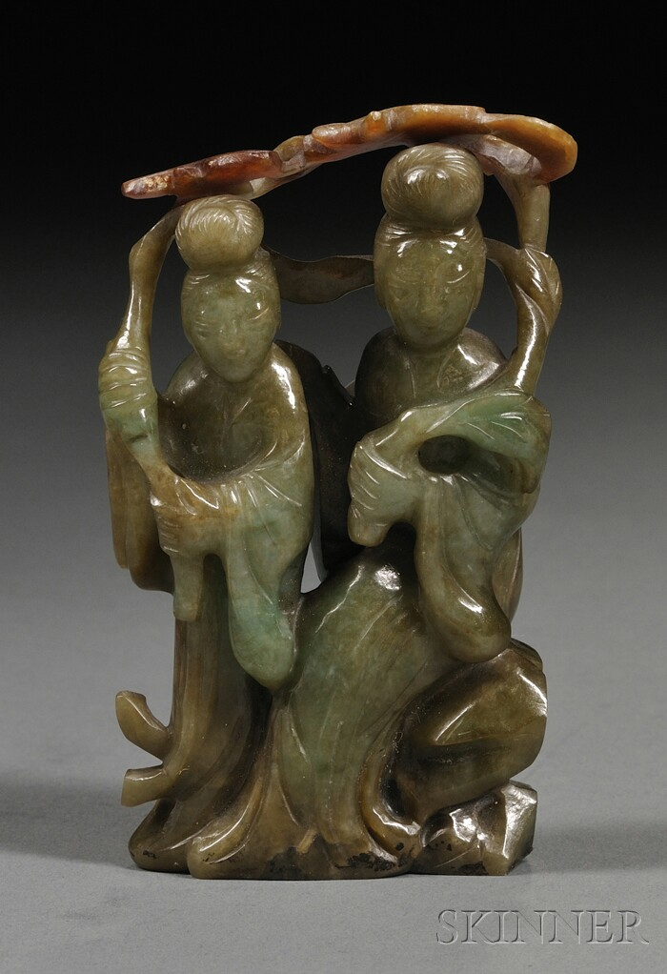
techniques: Jade carvings are made by chiseling（凿）, grinding（磨） and boring（钻）. The skill of the craftsman is shown in his ability to make the best use of the natural color and the shape of the raw material.
Typical subjects: flowers, birds, animals, vases, incense burners and human figures, especially beautiful women from popular fairy tales and legends.

Slide 5

The History of Jade Carving
New China
Four newly carved giant jadeite ornaments show that jade carving reached a new level after the founding of New China in 1949. To a great extent, these sculptures represent the development of jade carving in the 20th century.
Shang and West Zhou dynasties,
IJade articles were used as ritual objects and symbols of personal morality or political authority.
Prehistoric Times
In China, jade carving dates back to the late Paleolithic Age（旧石器时代）, the period of the “Upper Cave Man” about 10,000 years ago.By the late Neolithic Period（新石器时代）, jade ornaments（饰品） such as “bi”(璧) (pierced discs), “zhui” (pendants), ear-rings and beads had appeared.
Qing Dynasty
Jade sculptures of the Qing Dynasty (1644-1911) used to be regarded as the best ones.

Slide 6
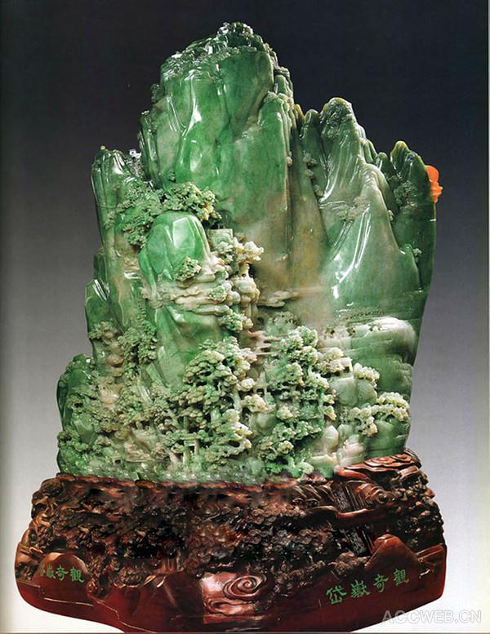
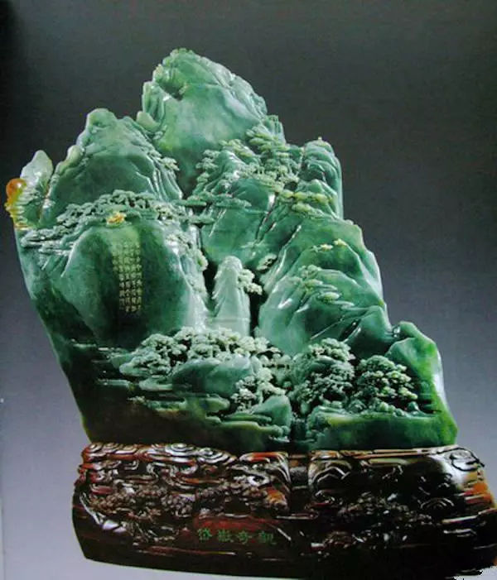
岱岳奇观 a miniature Taishan Mountain

Slide 7
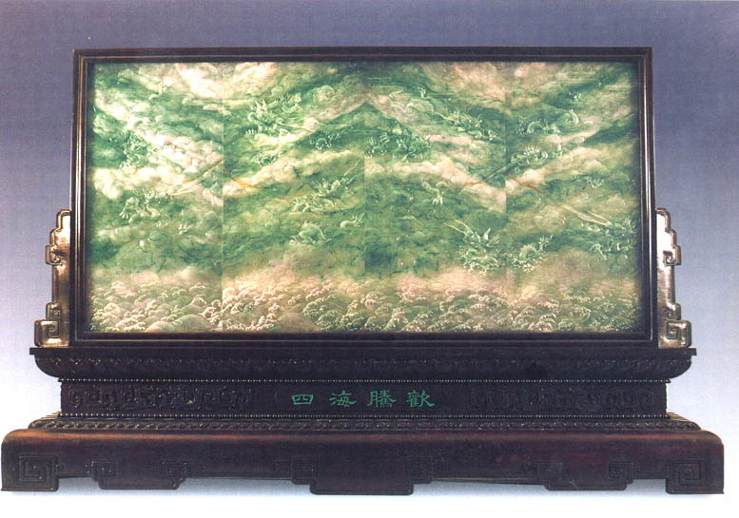
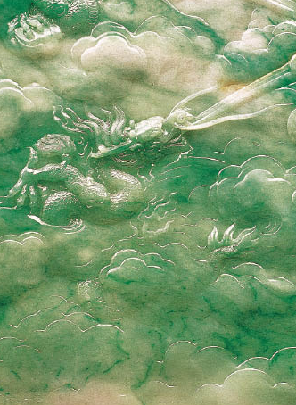
四海腾欢 the screen carved with nine dragons

Slide 8
Wood Carving
Wood carving was mostly limited to religious sculpture and architecture and furniture decoration in the past centuries.
Nowadays, artisans use boxwood, camphor- wood and tree roots to create ornaments and items for daily use, such as trunks, screens and cupboards.

Slide 9
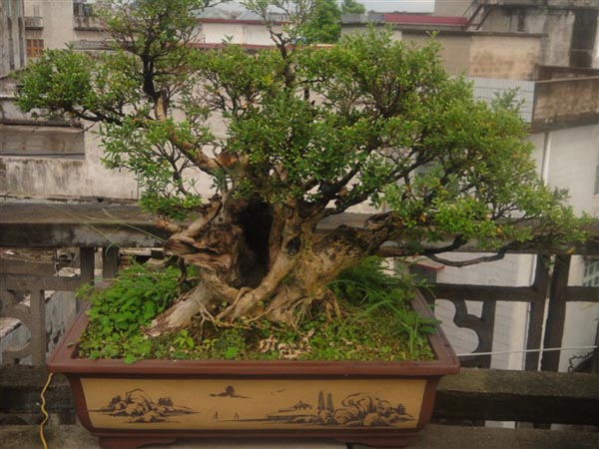
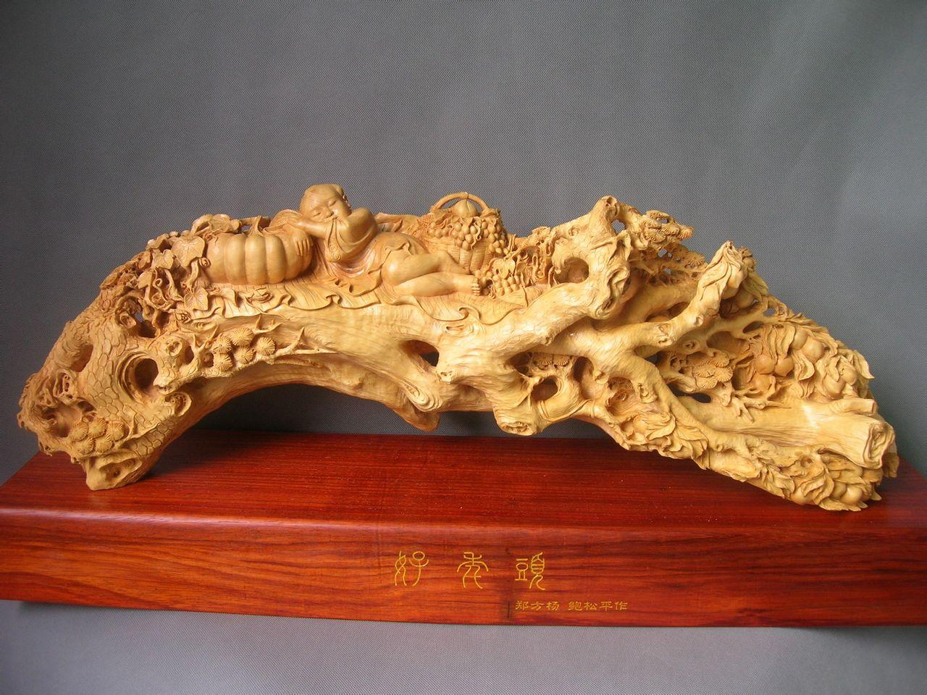
Boxwood 黄杨木
Boxwood grows slowly. With its hard and fine texture and yellow tone, it is similar to ivory and is an ideal material for carving human figures.

Slide 10
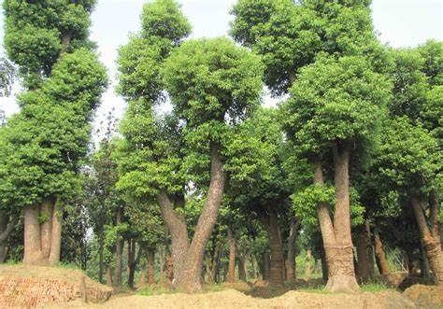
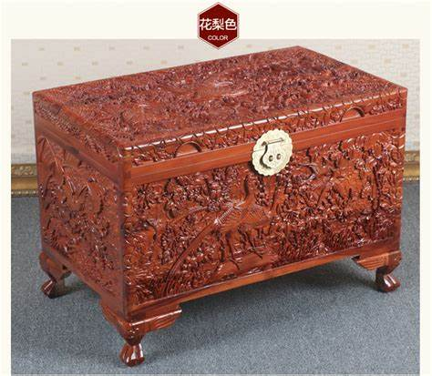
Camphorwood 樟木
Camphorwood, which is grown in the southern part of China, is valued as an excellent material for making trunk and furniture because its strong camphor scent can keep moths off clothes.
Camphorwood furniture such as tea tables, cupboards, book- shelves, screens and trunks is much sought after by buyers abroad.
The traditional high-relief technique is an innovative way to bring out motifs（装饰图案） that show good perspectives and gradations（渐变）.

Slide 11
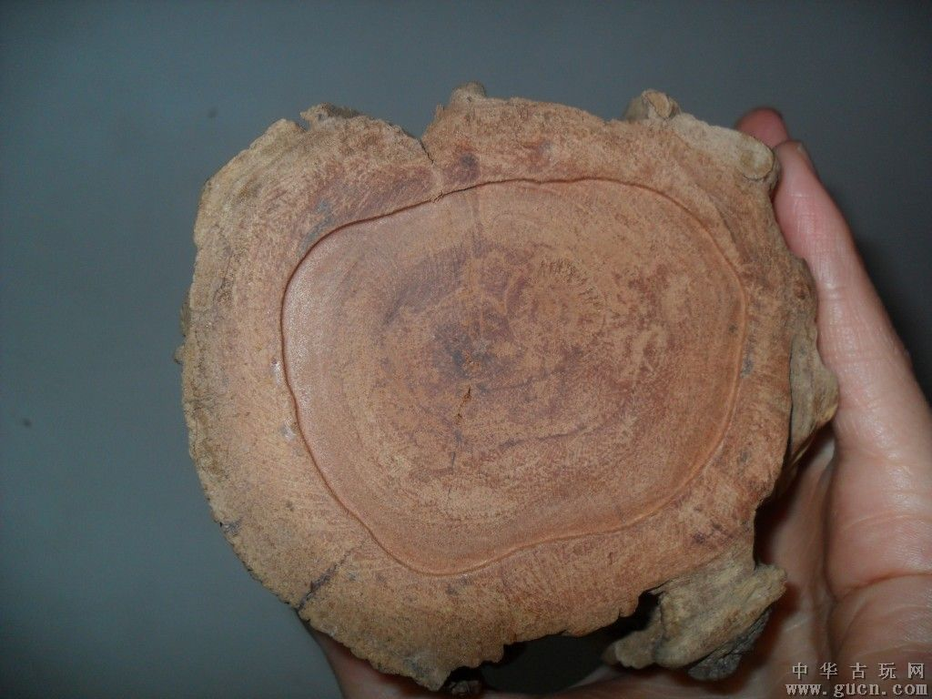
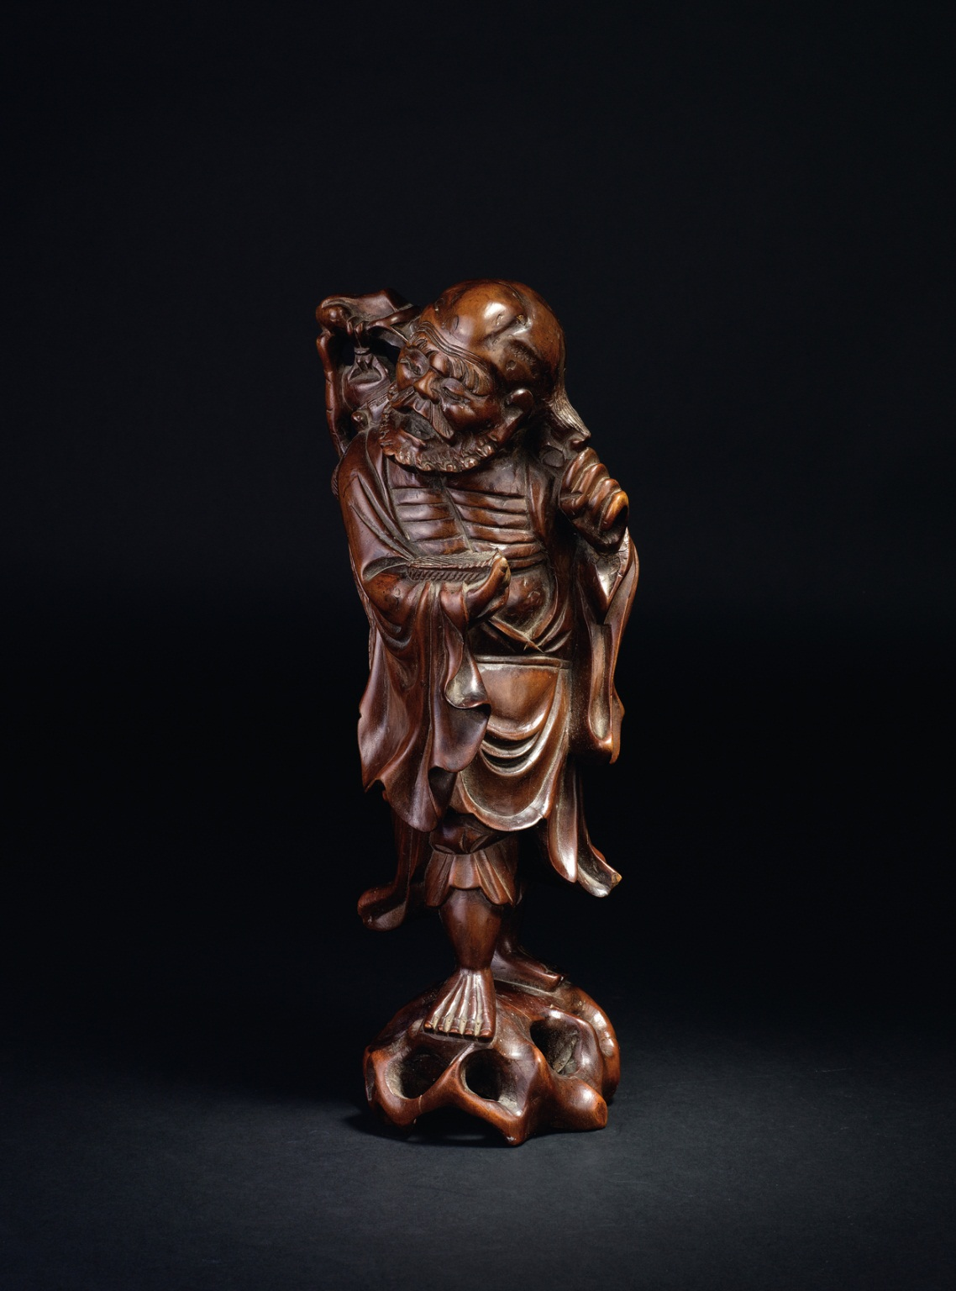
Longanwood 龙眼木
The longanwood carving of Fujian Province in South China, with its heavy hues and glossy tone, has an elegant classic touch（风格）, while the wood carving of Guangdong Province is more decorative with its gold paint coating.

Slide 12
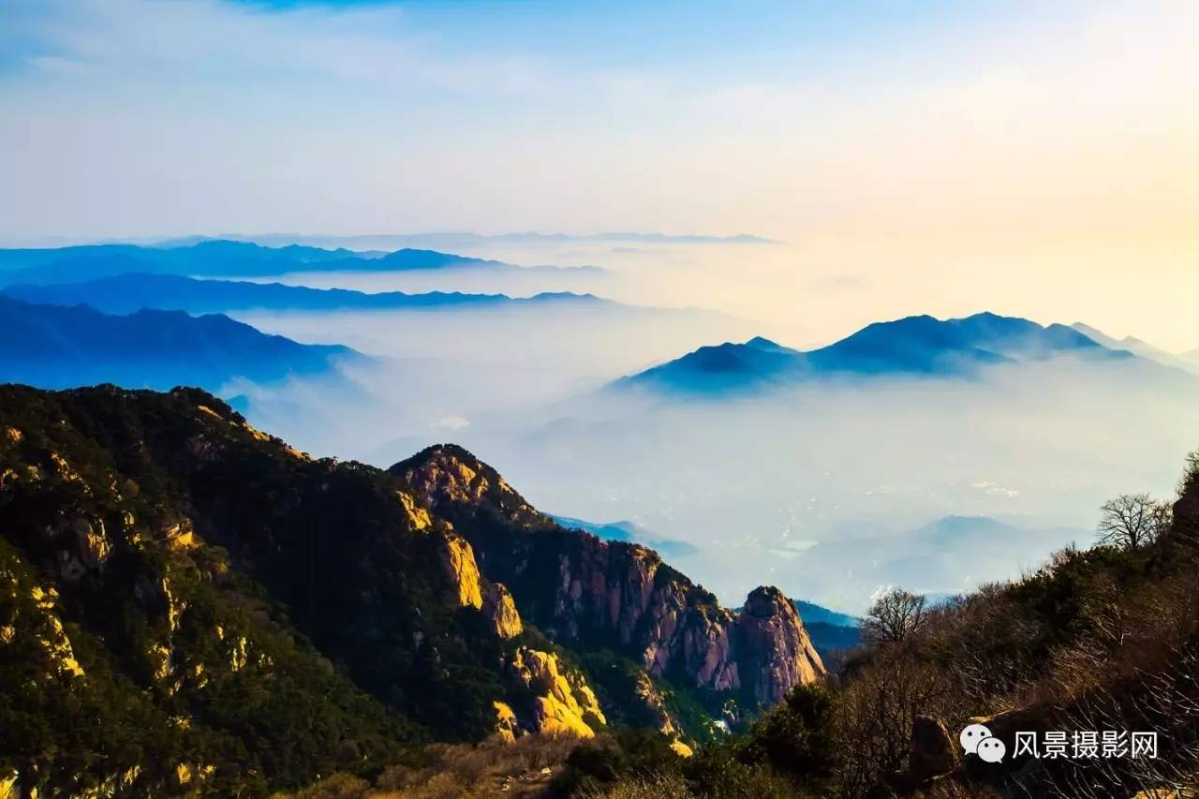
Translation of “岱岳奇观”
岱岳：the ancient name for Mount Tai
Wonders of Mount Tai

Slide 13
Thanks!

