Slide 1
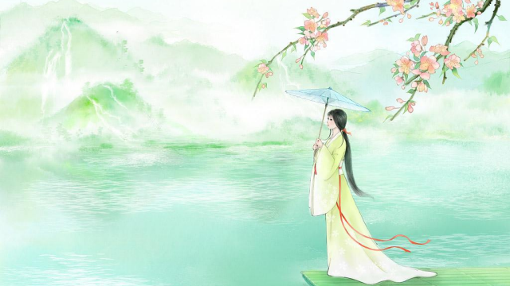

Chinese Term of Endearment
Reporter:Zhu Huiting
2025.04.24

Slide 2
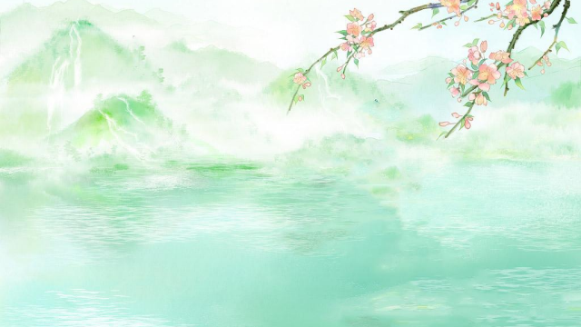


01
02
03
What Chi n ese T e r ms of
E n dea r me n t A r e
Chi n ese T e r ms of
E n dea r me n t
B etwee n Co u p les
The Evol u tio n of
Chi n ese T e r ms of
E n dea r me n t

Slide 3

PART 01
What Chi n ese T e r ms
of
E n dea r me n t A r e

Slide 4
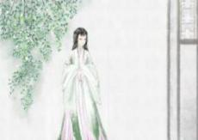
Defin ition
✲
✲ ✲
Informal & Affectionate
forms
Show love,care,or a close
bond with another per son
Be used in var ious
contexts

Slide 5

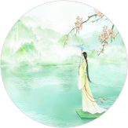
Types
✲
✲
✲
Between Couples
Within Families
Among Friends

Slide 6
PART 02
Chi n ese T e r ms of
E n dea r me n t B etwee n
Co u p les

Slide 7
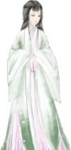
Terms for a Beloved
Question
Terms Used by Men for a Beloved Woman
Connotation
R e fe r r i ng t o a p e rs o n w h o is id e a liz e d o r c h e r is h e d
R e fl e c ti ng th e sp e a k e r ' s a d m i r a ti o n o r a ffe c ti o n
Example
“ I n th e w a t e r , th e o n e I
l o ng fo r s t a n ds a fa r . ” From The Book of Songs (Shijing)
❁
Yi (伊）
Emotional Expression
Ad m i r a ti o n a n d r e v e r e n c e

Slide 8
Terms for a Beloved
Terms Used by Women for a Beloved Man
Connotation
O r igi n a t e fr o m P a n Yu e
F o r a h a nds o m e a n d c h a r m i ng m a n
Tan Lan g（ 檀郎 ） Example
" 绣 床 斜 凭 娇 无 那 ， 烂 嚼 红 茸 ， 笑 向 檀 郎 吐 。 "
From Li Yu's "Yi Hu Zhu" (南唐·李煜 《一斛珠》)
❁
Emotional Expression
Ad m i r a ti o n fo r his app e a r a n c e
a n d c h a r m

Slide 9
Formal Spouse Terms
Terms Used by Men for Their Wives
Connotation
Sh o w i ng g r a tit u d e a n d r esp e c t
h u m ility a n d r esp e c t
Zao Kan g（ 糟糠 ） Example
" A w ife w h o h a s s h a r e d h a rds hips s h o u ld n o t b e
❁
a b a n d o n e d . "
" 糟 糠 之 妻 不 下 堂 "
From Records of the Grand Historian (Shiji):
Emotional Expression
Th e i mp o rt a n c e o f v a l u i ng a w ife

Slide 10
Modern Endear ing Terms
Connotation
Eq u a lity a n d I n ti m a cy
D e ep Affe c ti o n
Emotional Expression
I n t e rd ep e n d e n c e a n d Tr u s t I n ti m a cy a n d W a r m th
❁
Ai R en（ 爱人）

Slide 11
Modern Endear ing Terms
Connotation
R esp e c t a n d F o r m a lity
Tr a diti o n a n d St a bility
Emotional Expression
R esp e c t a n d R e c og n iti o n
❁^{Xian} ^{Shen} ^{g（} ^{先生）}

Slide 12
PART 03
The Evol u tio n of
Chi n ese T e r ms of
E n dea r me n t

Slide 13

Histor ical Evolution
Cla n syste m
Hiera rchica l c oncepts
Anc ie nt Tim e s
Mod e r n Tim e s
Emphas izing
eq ua lity a n d respect
Dive rse a n d pers ona lized
T e mpo r a r y Tim e s
Reta in ing t raditiona l elements while inc orp orating mode rn
c u lt ura l va l u es

Slide 14


Important Impacts
Question
Divers i Sp read Co ncep | fi catio n o f Te r ms o f the t o f Eq ua lity
Cultu r a l Ex ch a ng e
B e t w e e n
China a nd th e W e s t
Cu lt ura l I ntegratio n
Impa ct of Int e r n e t Cultu r e
I nnovatio n in Te r ms

Slide 15
Thank
Reporter:Zhu Huiting
You !
2025.04.24

