Slide 1


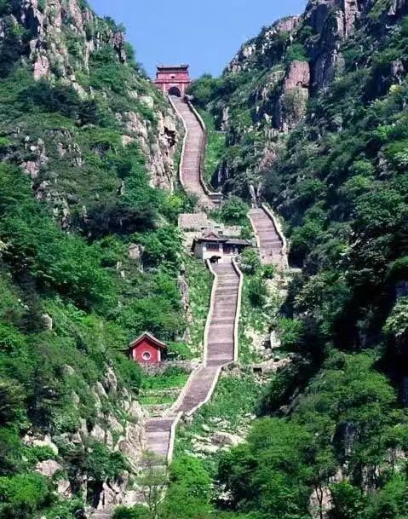
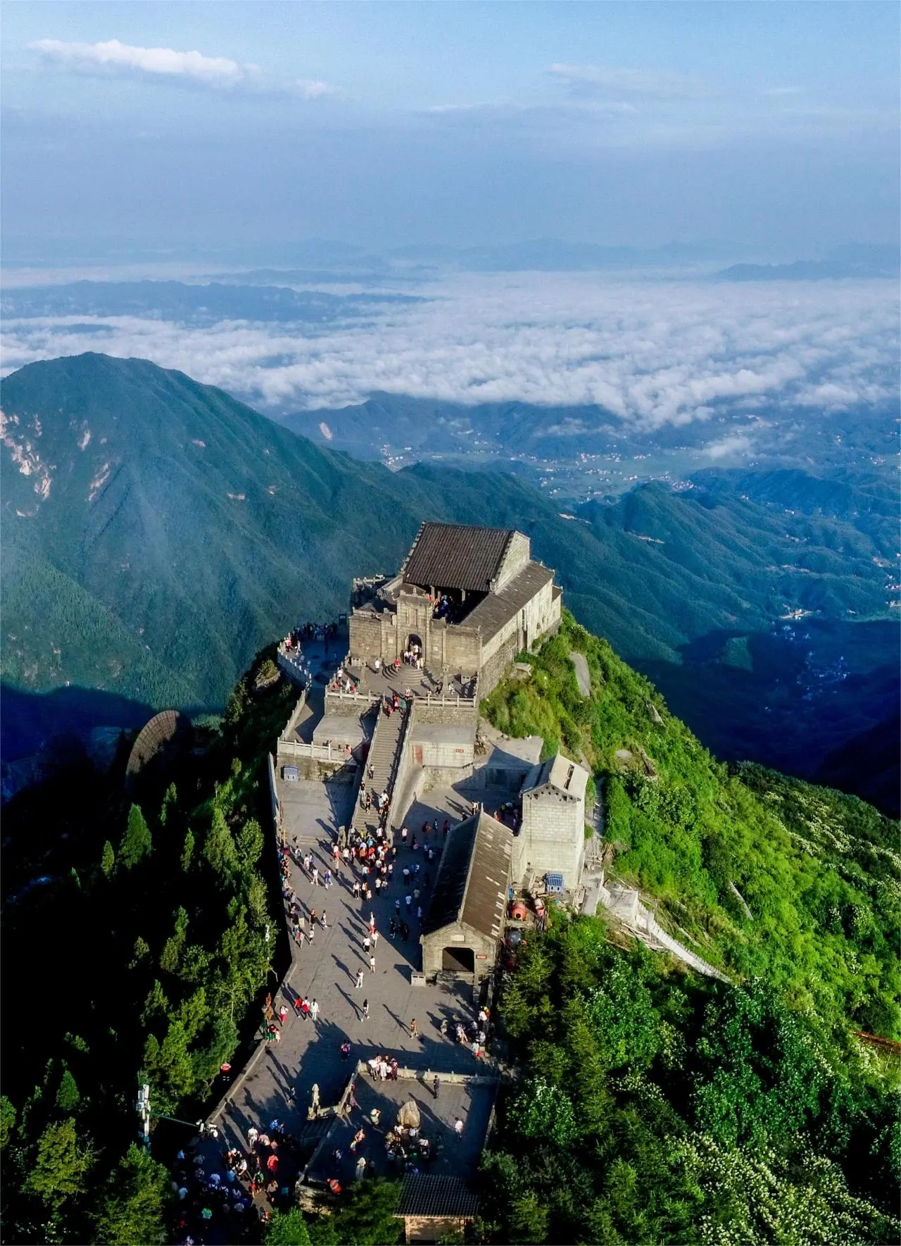
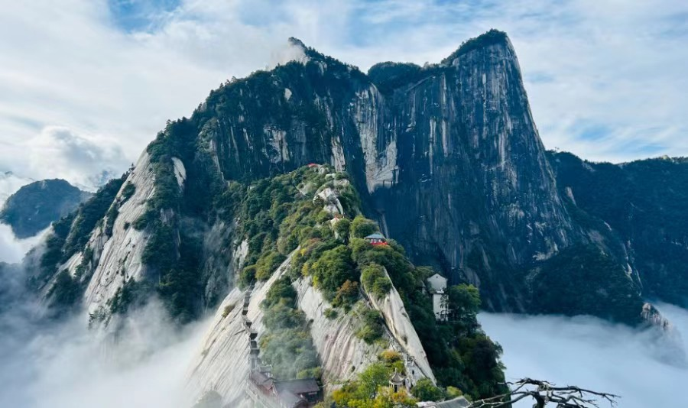
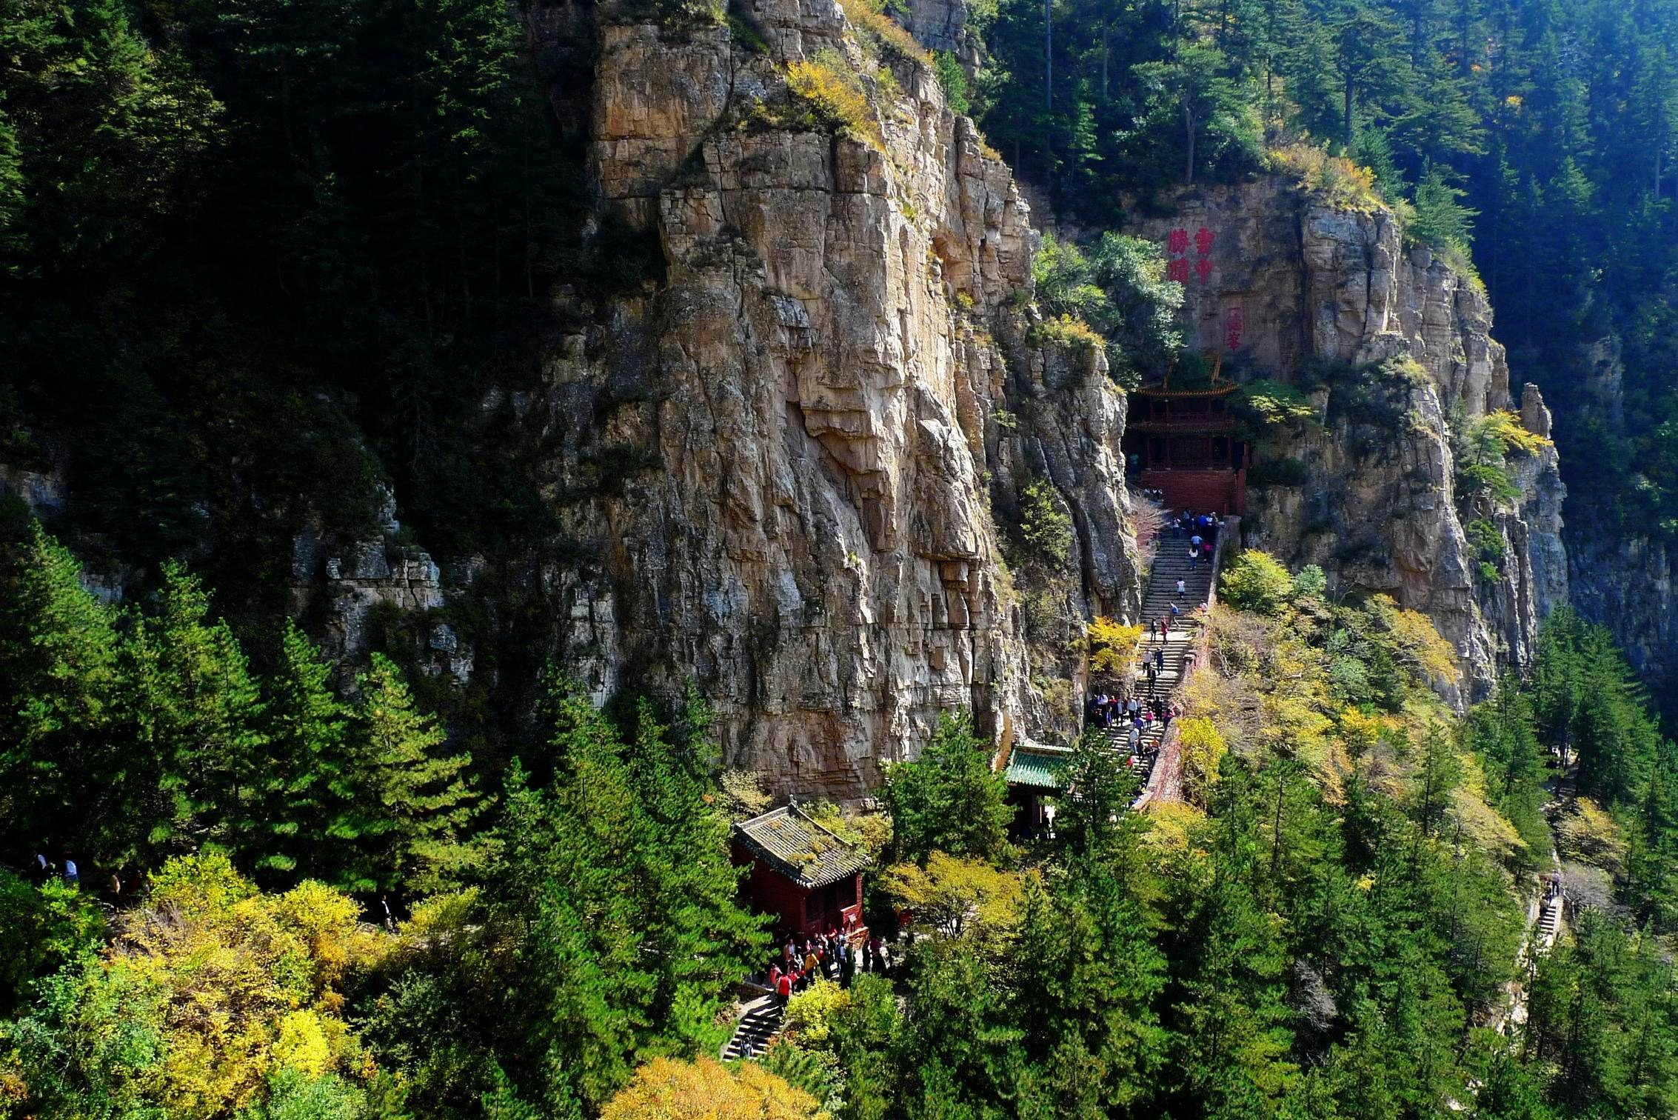
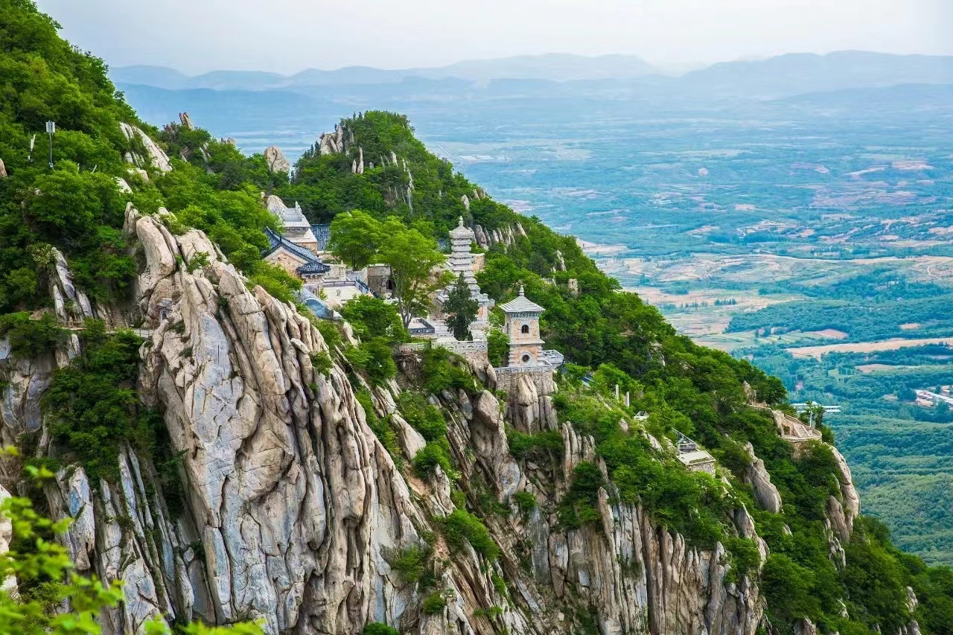
Five Famous Mountains

Slide 2
Wuyue (五岳) is the general name of the Five Famous Mountains in Chinese Han culture and is the product of the combination of ancient folk reverence towards mountain god, the concept of the Five Elements, imperial excursions and meditation in ancient times.

Slide 3
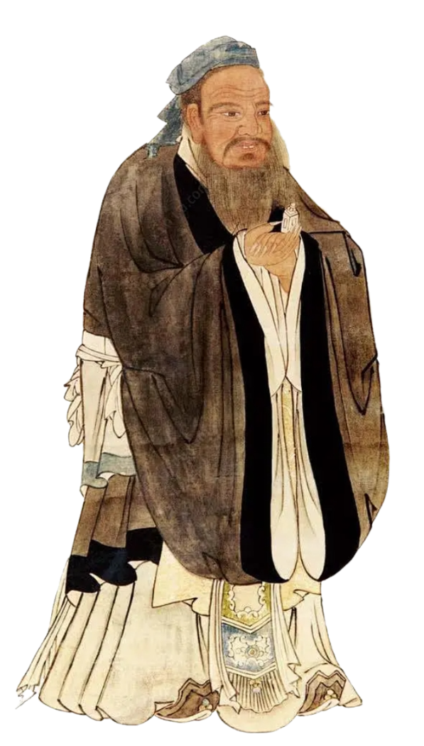
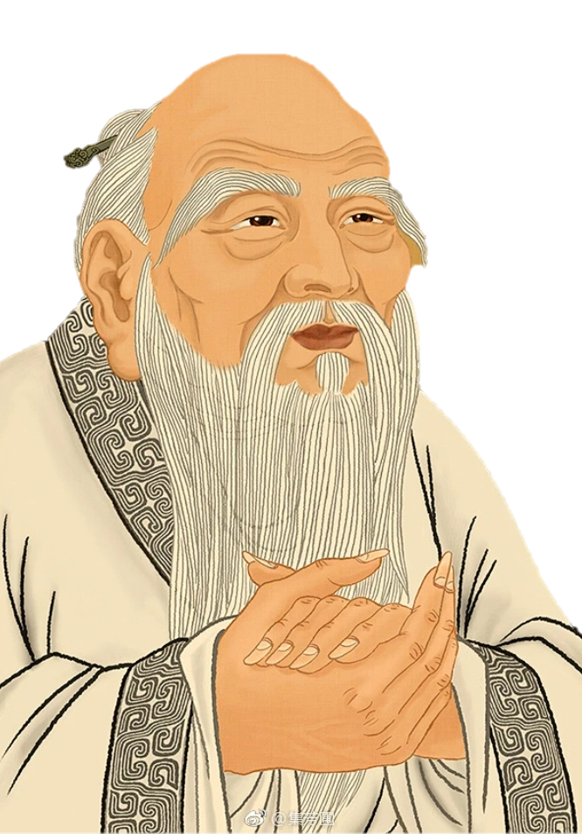
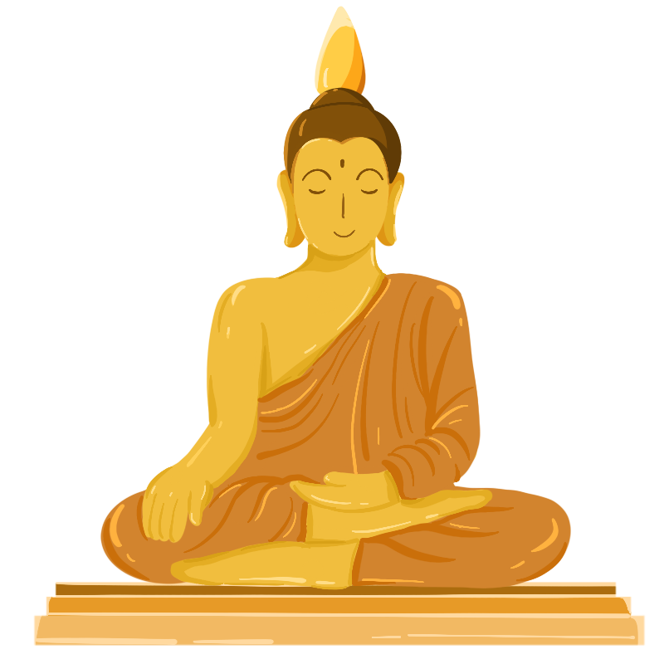
During the Wei, Jin and Southern and Northern Dynasties, Buddhism and Taoism began to build temples and carry out religious activities on the Five Sacred Mountains. Emperors of ancient China would perform excursions to the mountain peaks and offer non-human sacrifices on a regular basis. This tradition became a ritual of the state according to Confucianism and was one of the must-do activities upon becoming emperor. This tradition continued right up until the fall of the last dynasty in 1911.

Slide 4
The Five Great Mountains remain places of pilgrimage to this day with many young people having the goal of climbing all five and retracing the footsteps of the ancient emperors during Imperial China.

Slide 5
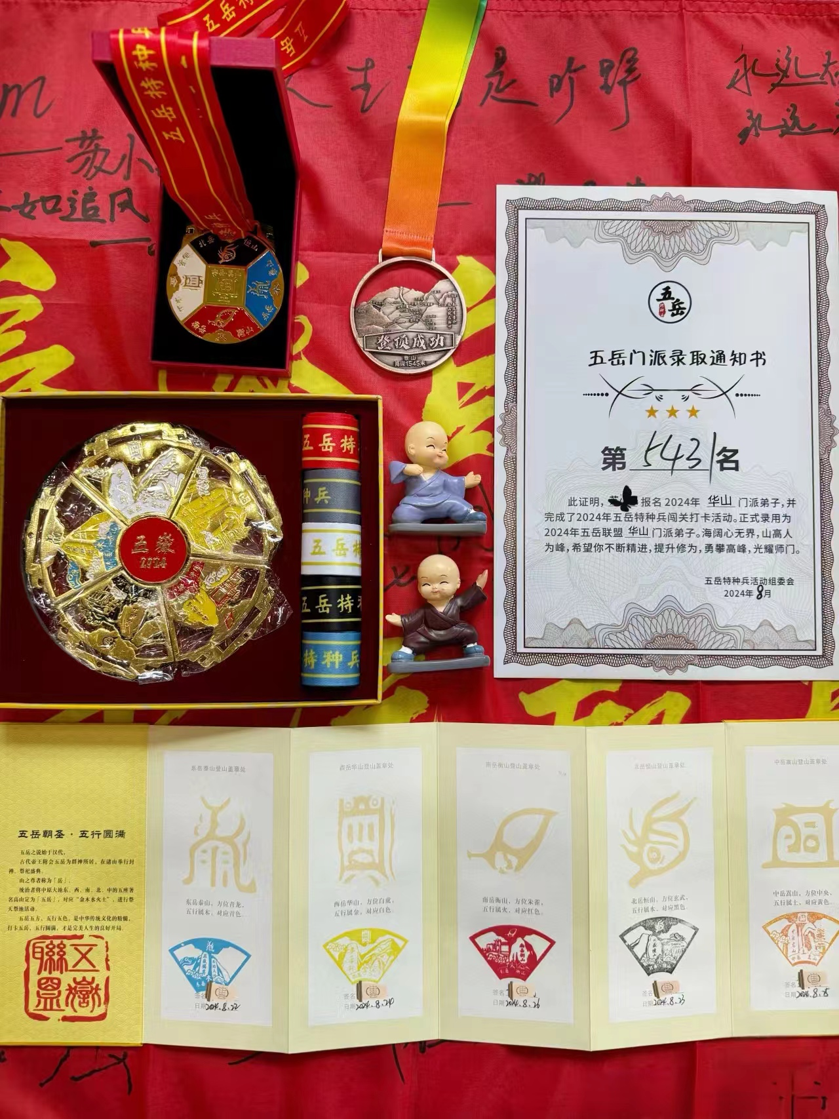
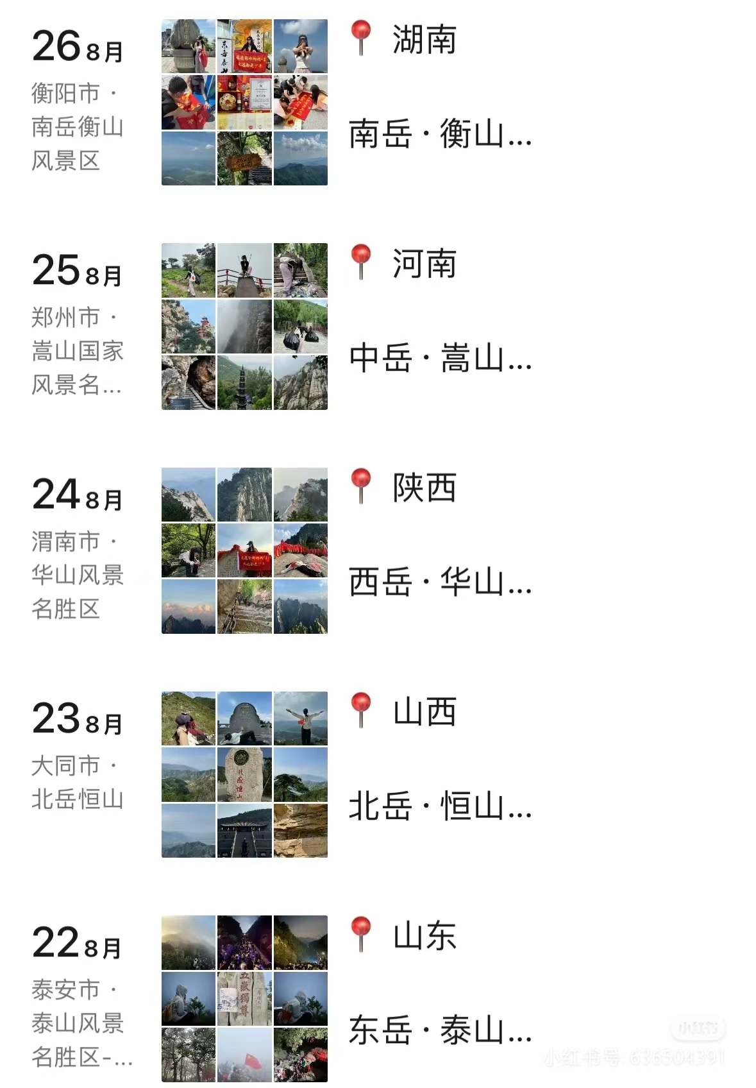
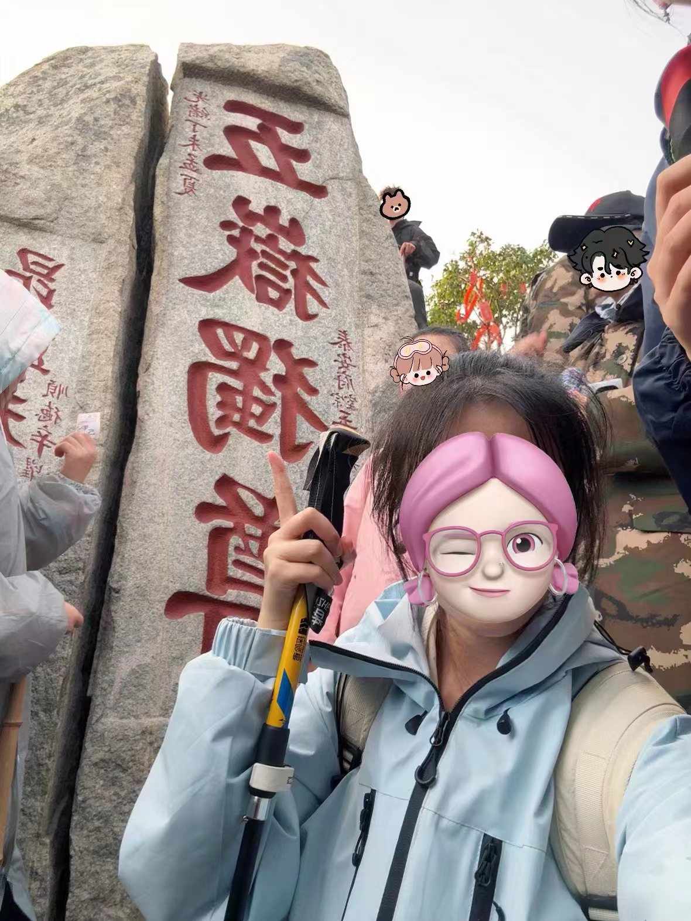
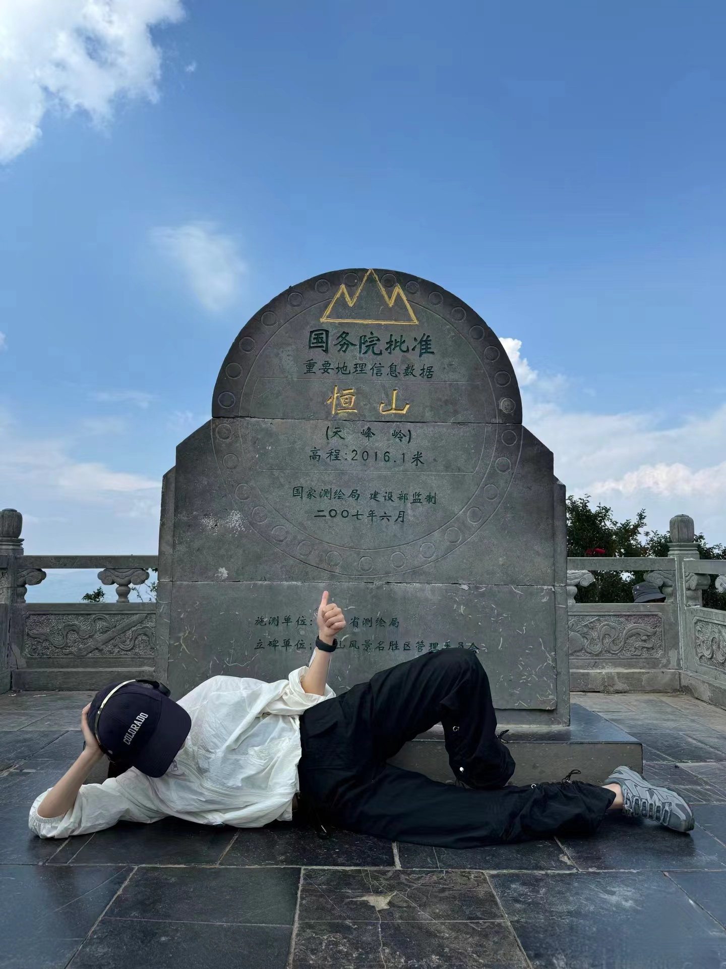
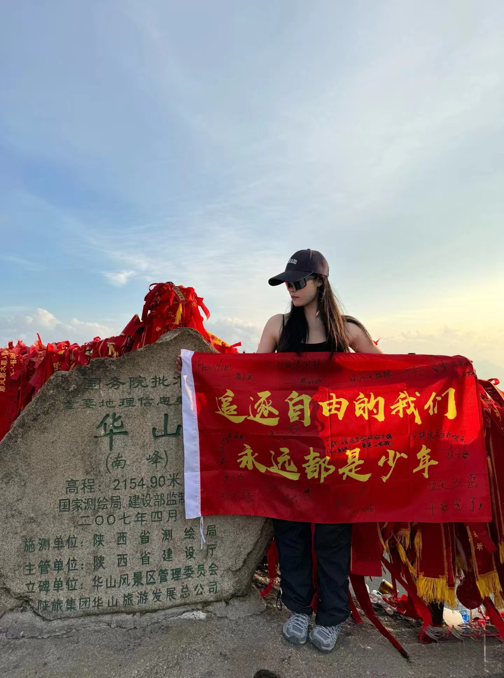
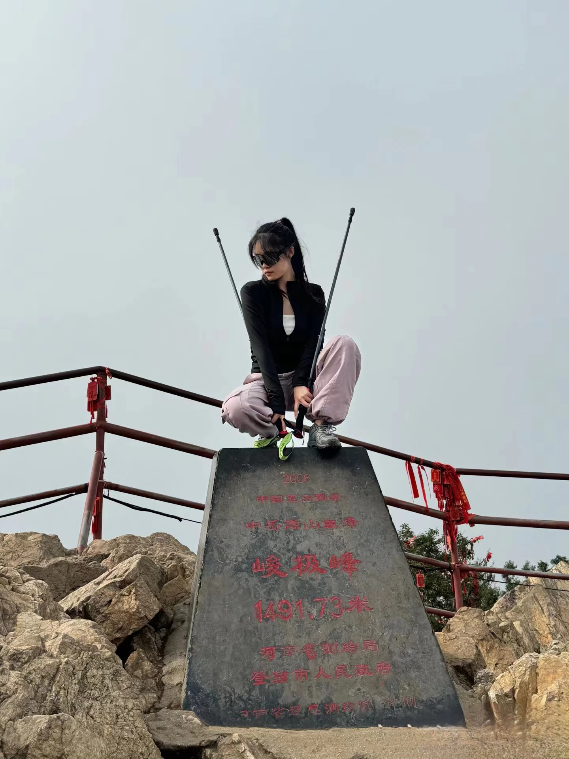
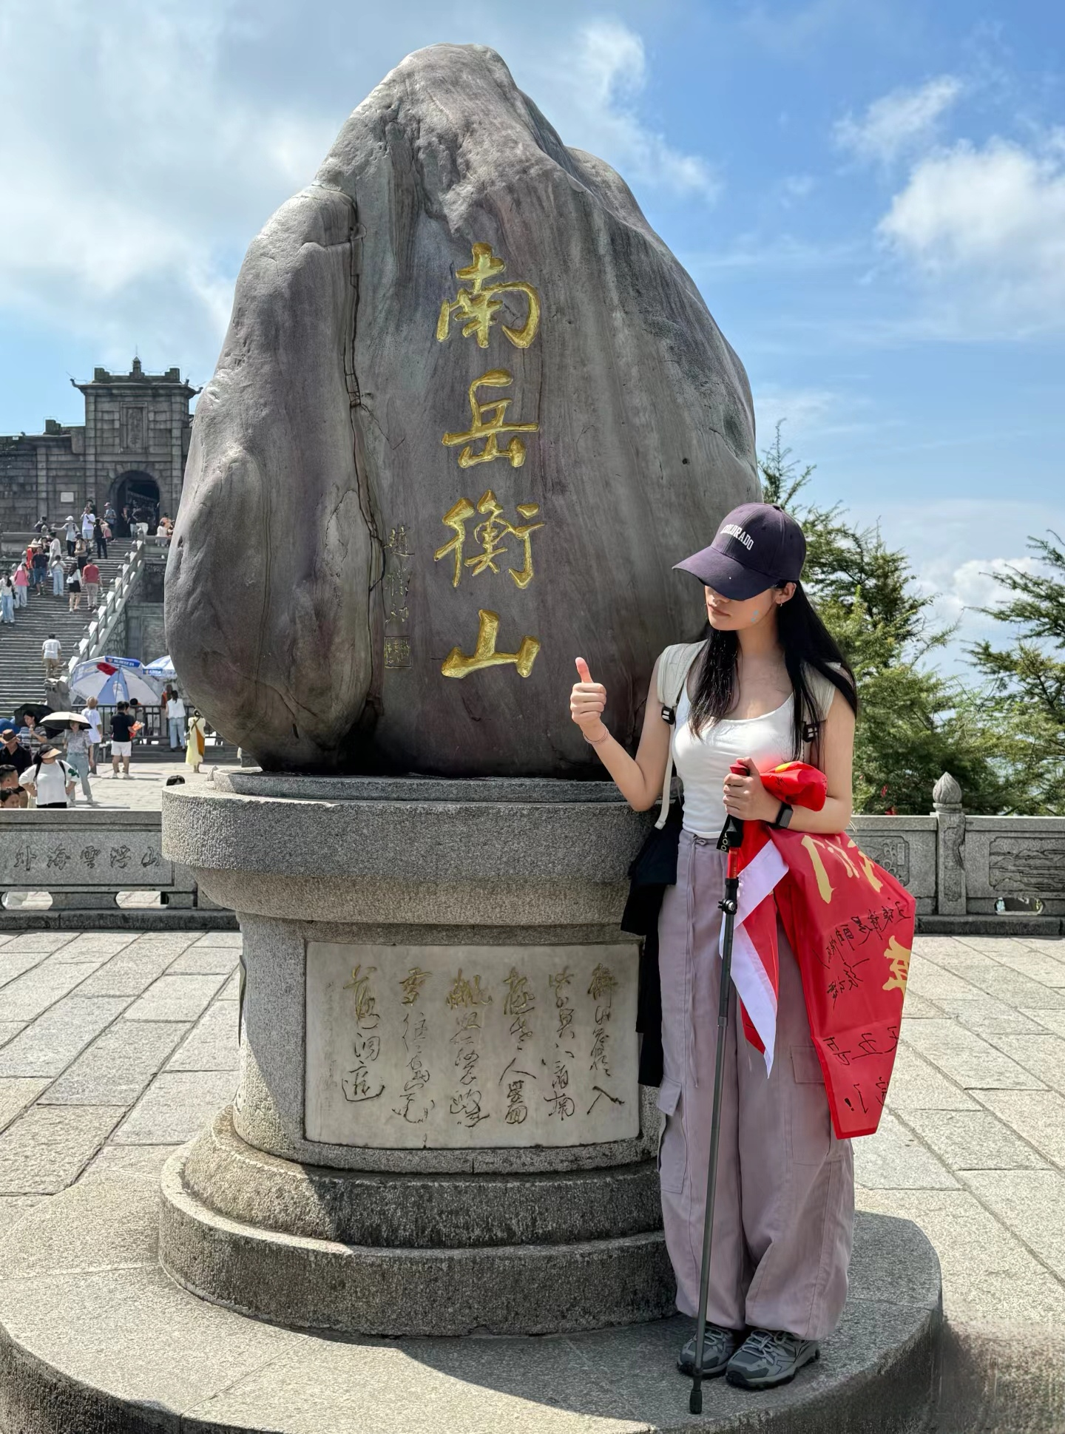

Slide 6


泰
Mount Tai
泰山
山

Slide 7
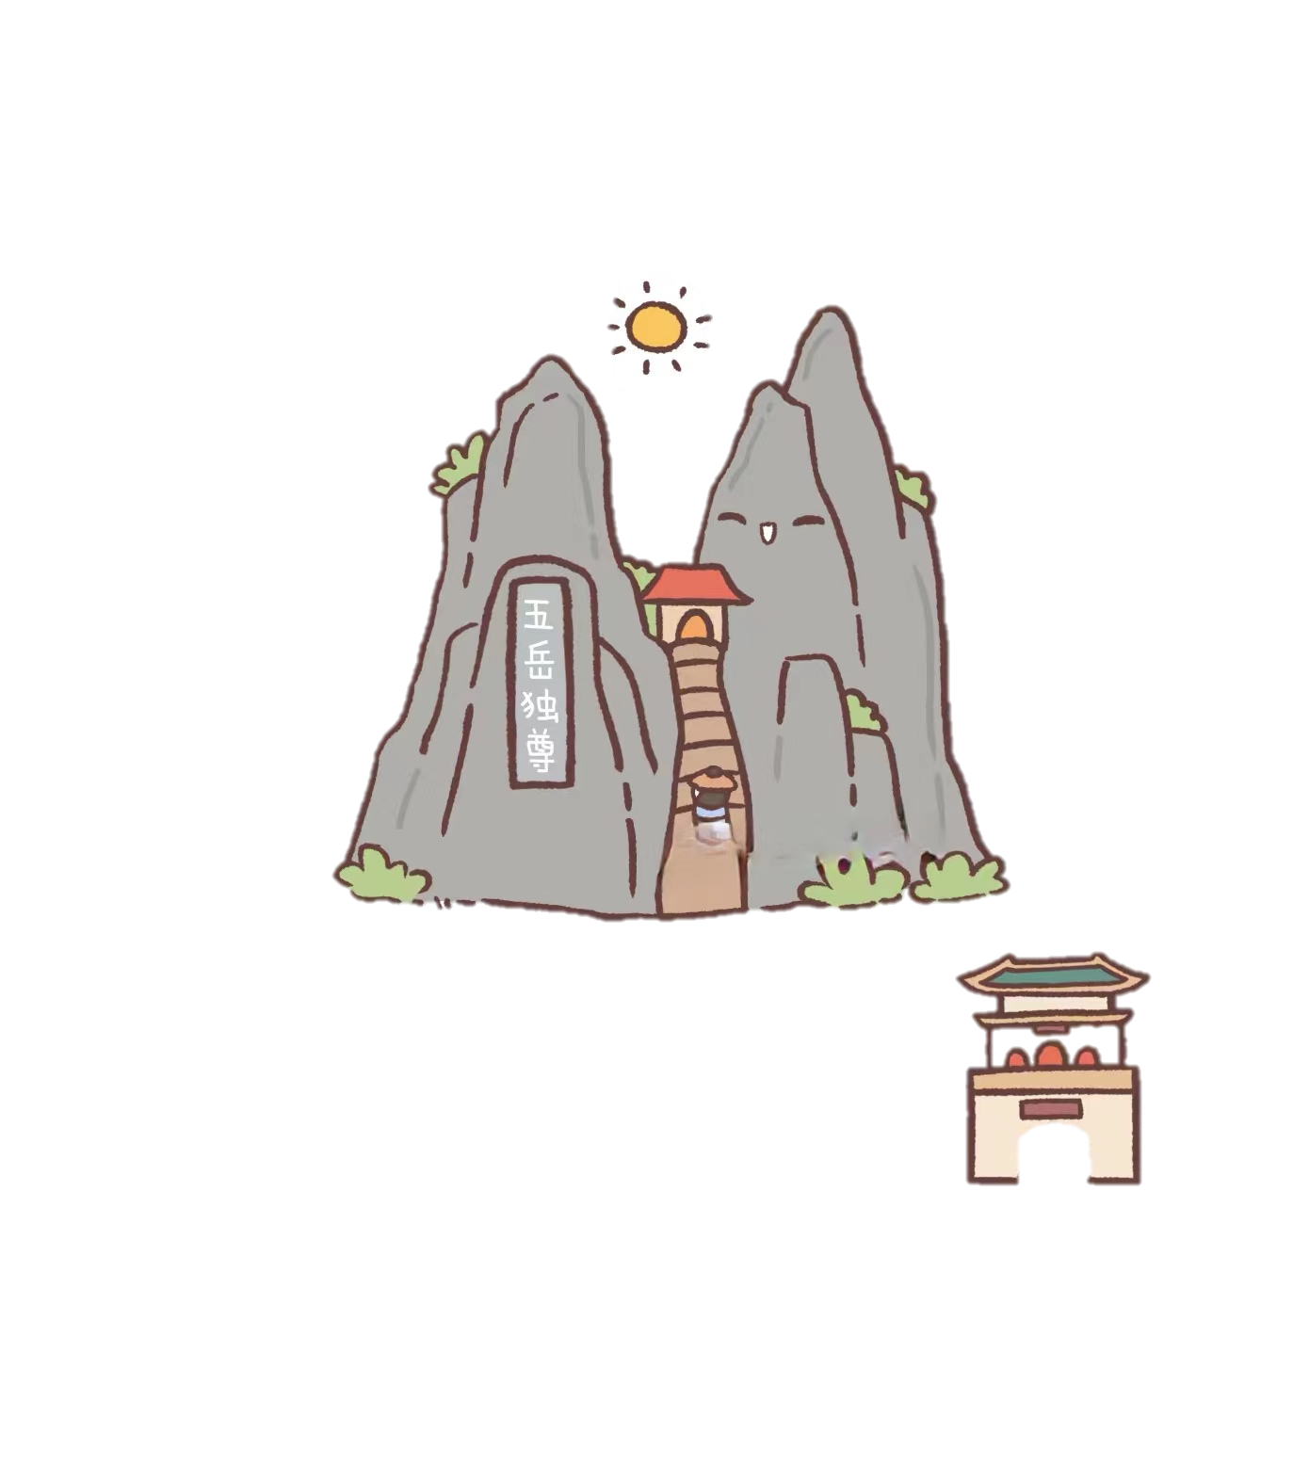
Taian, Shandong province
泰山
Mount Tai
1, 545 meters (5069 ft)
worship

Slide 8
衡
Mount Heng
衡山
山

Slide 9
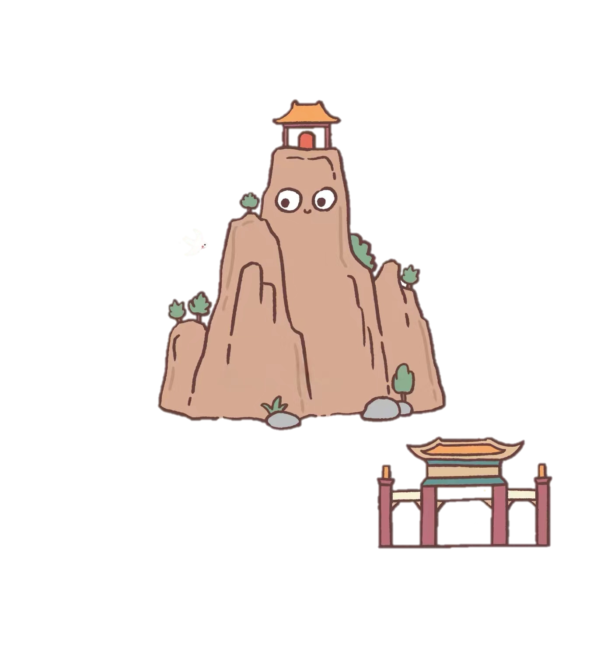
Hengyang, Hunan province
衡山
Mount Heng
1, 300 meters (4, 300 ft)
the Grand Temple of Mount Heng (Nanyue Damiao)

Slide 10
华
Mount Hua
华山
山

Slide 11
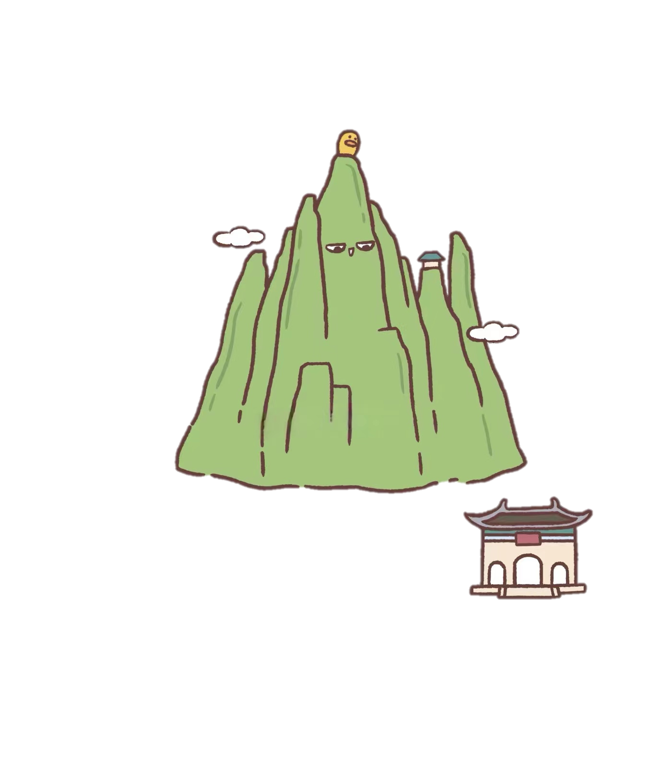
Weinan, Shaanxi province
Mount Hua
华山泰山
2, 155 meters (7070 ft)
“奇险天下第一山”

Slide 12
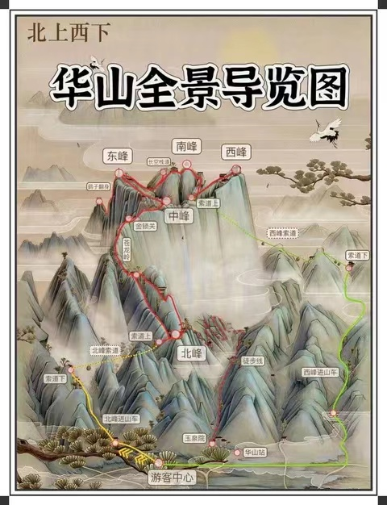
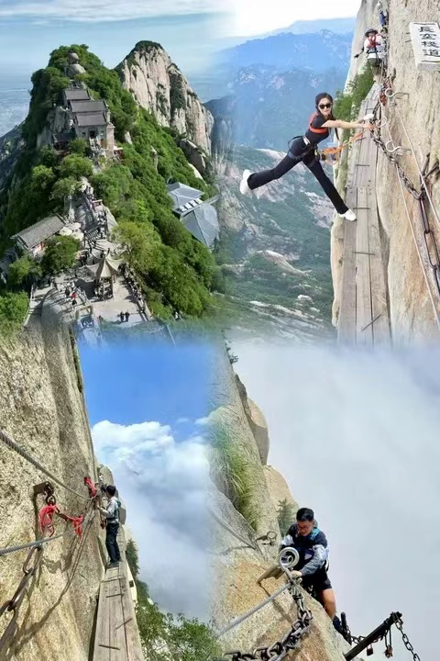

Slide 13
恒
Mount Heng
恒山
山

Slide 14
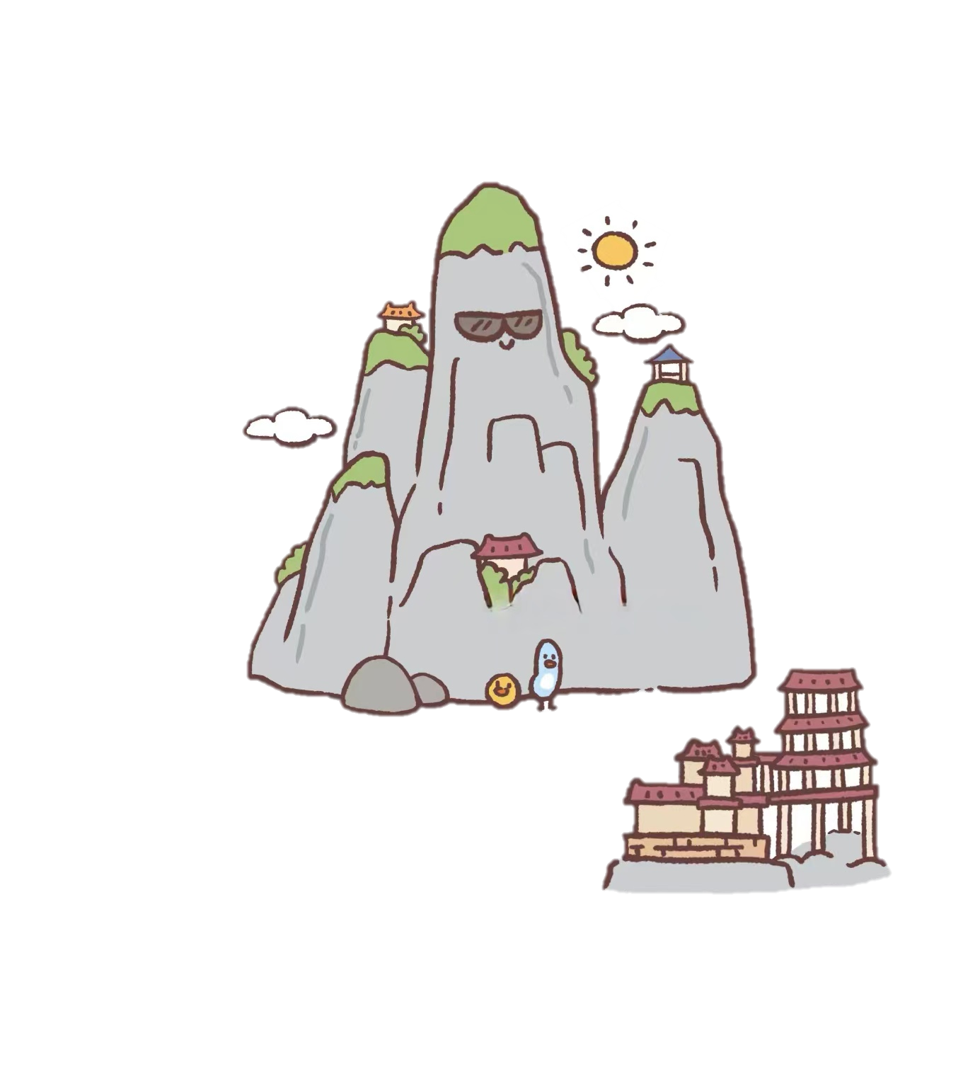
Datong, Shanxi province
恒山
Mount Heng
2, 017 meters (6, 617 ft)
Hanging Monastery (Xuankong Si)

Slide 15
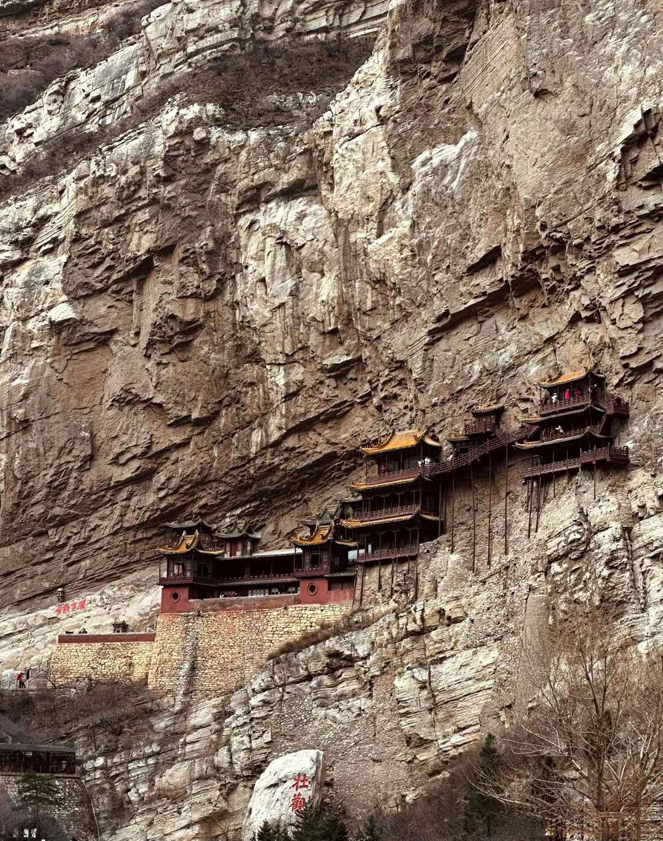
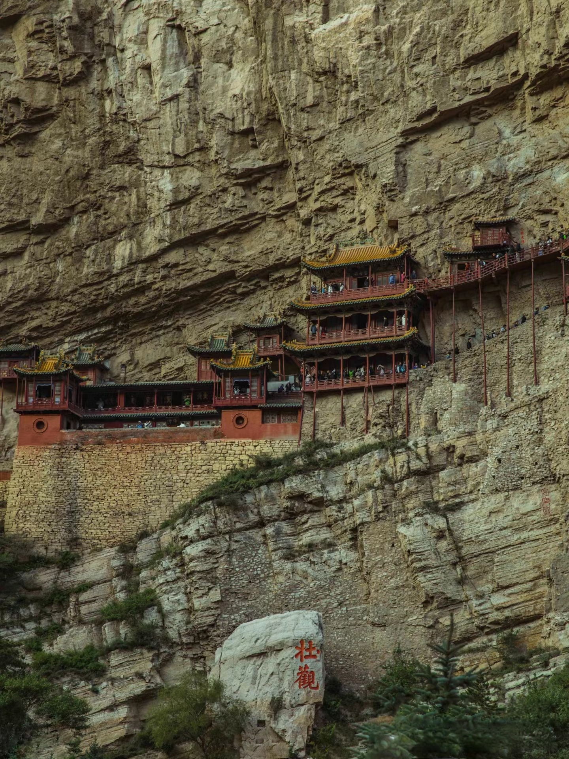
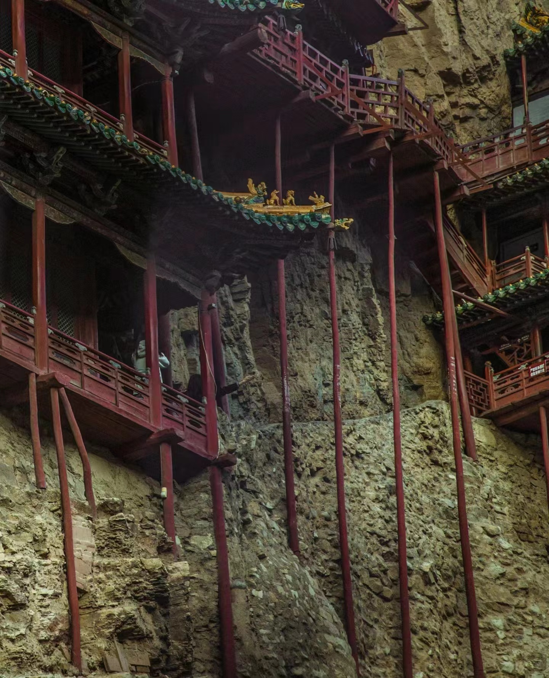

Slide 16

Mount Heng in Shanxi province is AAAA level tourist attraction. It is not as popular as the other four, given its northern location. Although rich in natural beauty and cultural heritage, it has relatively low global or national visibility and influence. It’ s the only one among Wuyue that are not on the list of National AAAAA level scenic spot.

