Slide 1
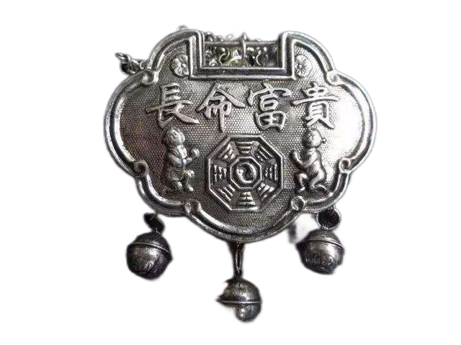
The Long-life Lock
长命锁
By Shirleen (Shu Lin)

Slide 2
CONTENTS
1
The historical origin
2
The materials and the shapes
3
The pattern design
4
The cutural meaning

Slide 3
01 The historical origin of the long-life lock
A popular traditional Chinese mascot to bless the baby’s health and longevity and to drive away disasters and diseases

Slide 4
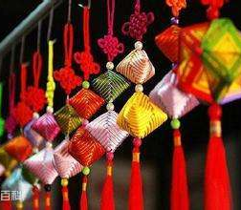

In the Han Dynasty (BC 202-AD 220)
Zhu Suo (朱锁)
It is a colorful rope made of five colors of silk
Which is originally an ornament decorated on doors and windows on the Dragon Boat Festival.
The ancients believed that the five-color rope symbolizes the five divine powers and can drive away evil spirits.

Slide 5
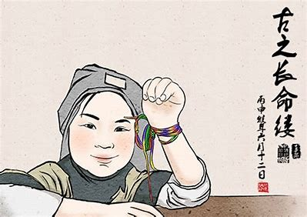

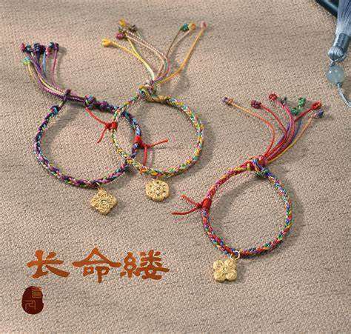

During the Wei-Jin and Southern and Northern Dynasty period (403BC-581AD)
Due to frequent wars, plague and famine, the vast majority of people long for peace.
On every Dragon Boat Festival, people use silk woven ropes of five colors, tied to the arms of women and children
In order to drive away evil, disaster and illness in the hope of prolonging life expectancy

Slide 6
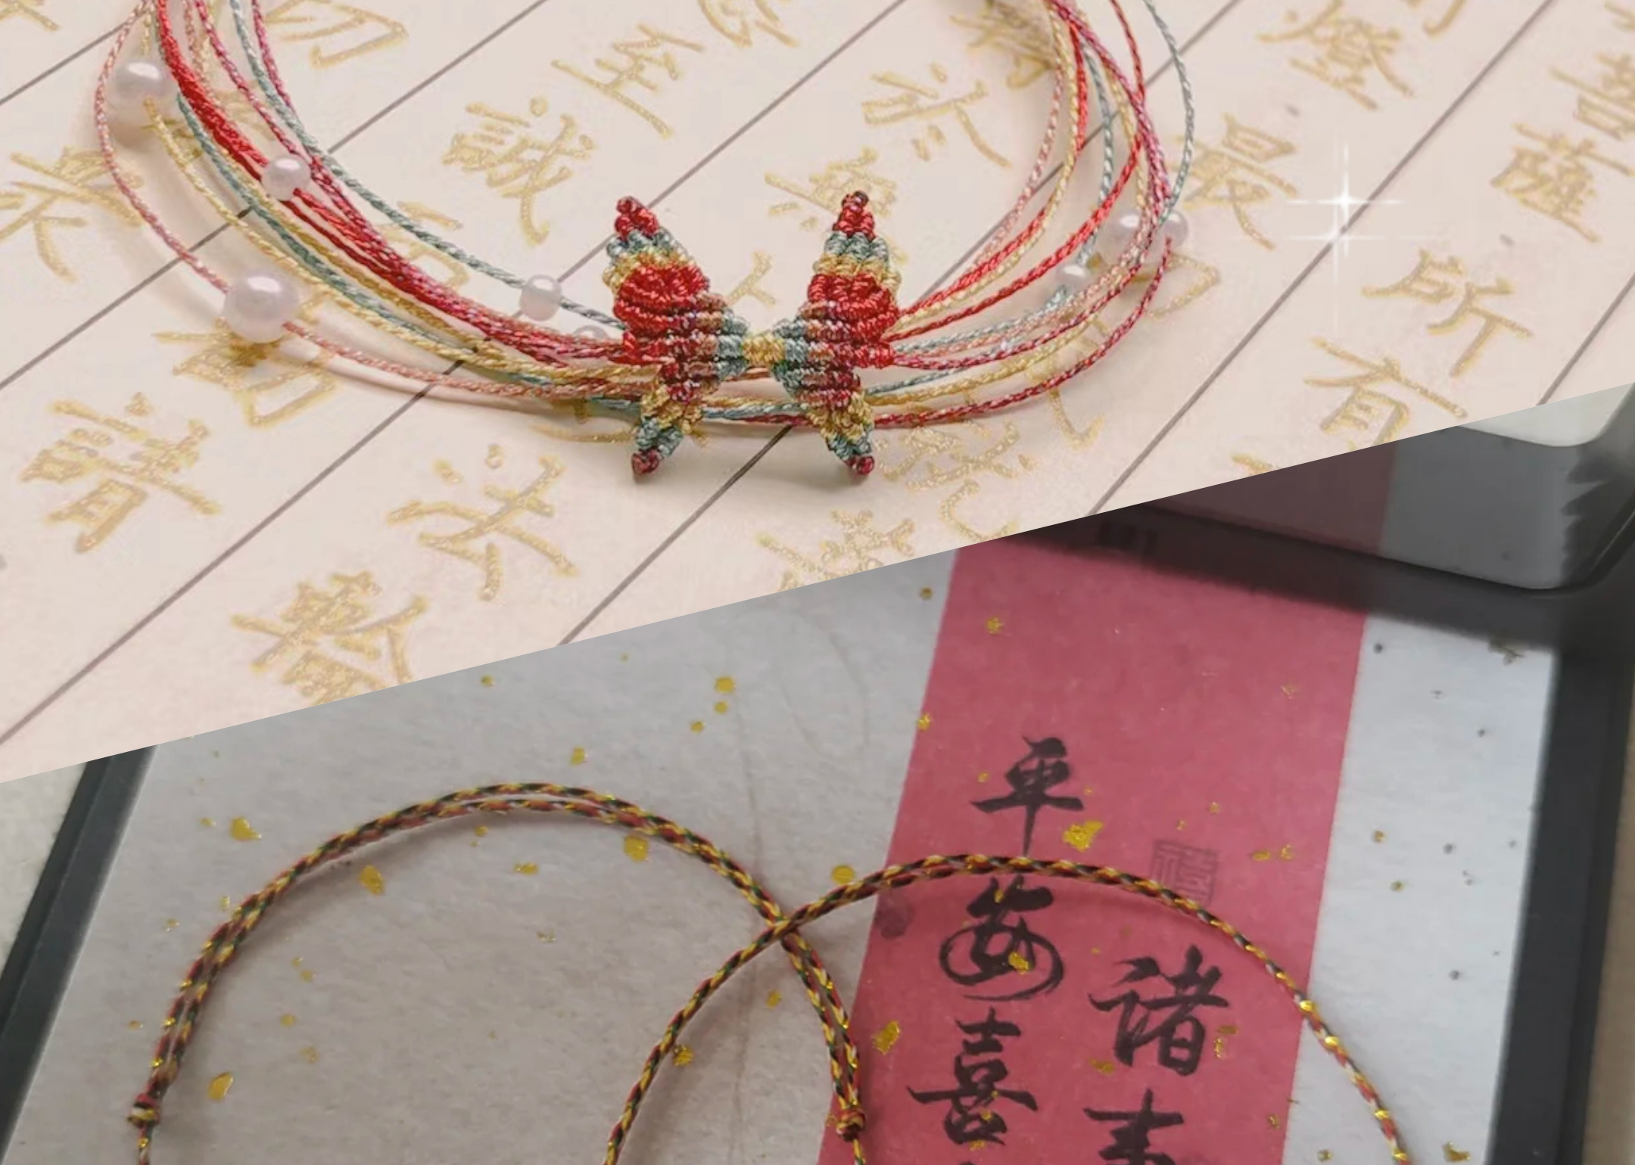
This custom has been spread to the land of Jing-Chu and other places during this period, and become popular throughout the country in the Tang Dynasty.

Slide 7
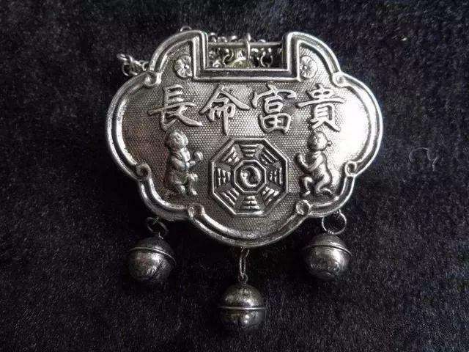
In the Tang Dynasty
Popular throughout the country
A cable-like ornament, also known as a long life rope (长命索)
Due to the same pronunciation of Chinese characters “索(rope)” and “锁(lock)”, the long-life rope naturally evolved into the long-life lock(长命锁).

Slide 8
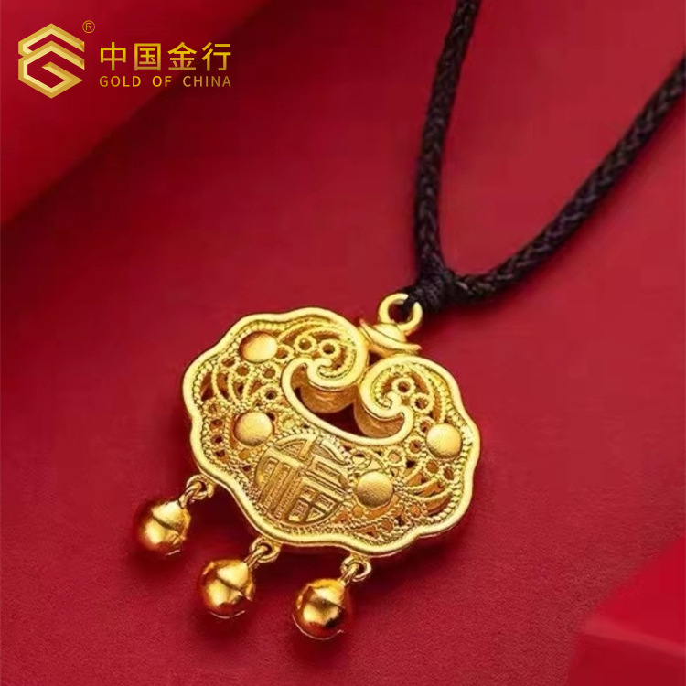
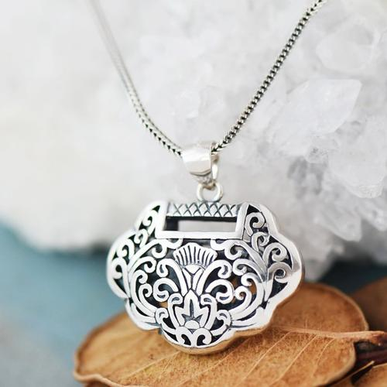
In the Song Dynasty
01
Not only did it prevail among the people, but also was introduced to the court.
02
On the eve of the Dragon Boat Festival, the Emperor would give Five-color ropes to their intimate ministers.
03
According to the historical records in the Book of Song, one hundred ministers were given five-color ropes by the emperor.
04
They were more complex because the maker added a pearl and other things to the accouterment apart from the colorful threads.

Slide 9
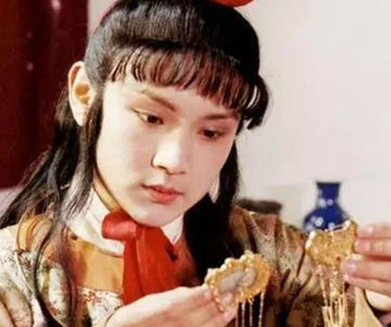
In the Ming and Qing Dynasties (1368-1912)
01
extremely popular throughout the country
Children’s exclusive accessories
Children wear the lock from their first birthday and do not stop wearing it until they are adults.
02
The rocks were depicted in the Ming and Qing novels, paintings, New Year pictures and handicrafts.
03
For example, A Dream of Red Mansions, a classic work of the Qing Dynasty, has a record about the long-life lock in the 8th chapter.
《红楼梦》第八回描写贾宝玉“项上挂着长命锁、记名符,另有一块落草时衔下来的宝玉”

Slide 10
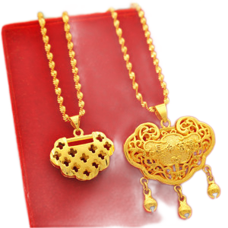
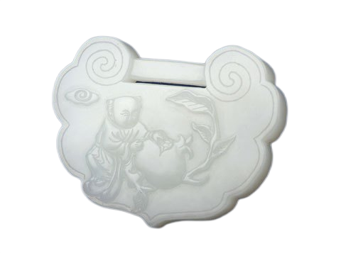
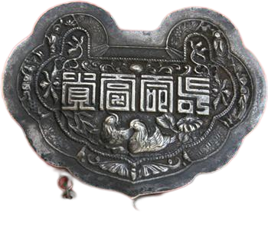
02 The materials and the shapes of the Long-life Lock

Slide 11
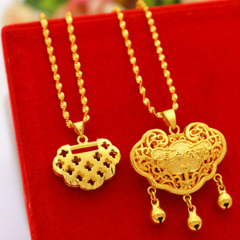
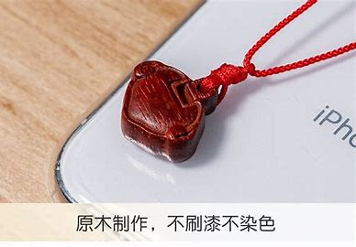
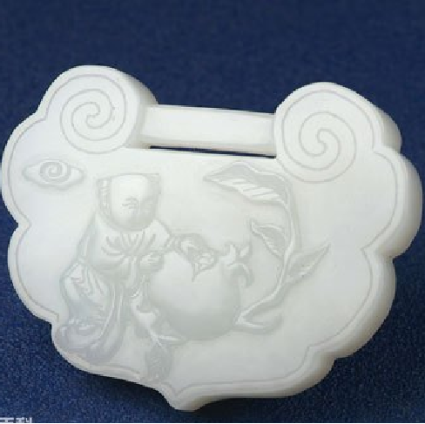

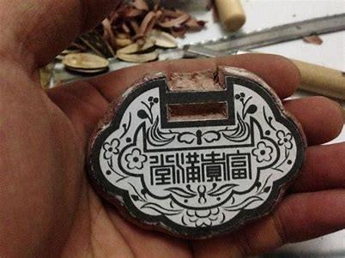
The materials of the Long-life Lock
Be made of different materials such as gold, silver, copper, iron, wood, stone, jade, bone, tooth and horn
In the old days, the gold, jade and tooth were commonly used in rich families, and silver, copper, stone and wood were generally used in poor families.
With the development of Chinese silverware during the Ming and Qing Dynasties and during the Republic of China, the silver long-life locks became extremely popular in China.

Slide 12
The shapes of the Long-life Lock
In different shapes, such as square, round, long, single or double.
Often in conjunction with necklaces or necklace rings, or with silk ropes.
The symbolic meaning of the long-life locks is important, so most of them cannot be opened with a key.

Slide 13
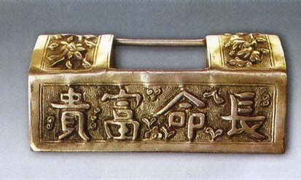
Rectangular long life locks
Rectangular long life locks
simple and elegant
generally can opened with a key
The long-life locks in the shapes of gold ingot are unique, conveying the auspicious meanings and its crafts are relatively complicated and brilliant.

Slide 14
03 The pattern design of the Long-life Lock
mainly traditional auspicious patterns, such as folk auspicious words, flowers, birds, insects, animals and mythical characters

Slide 15
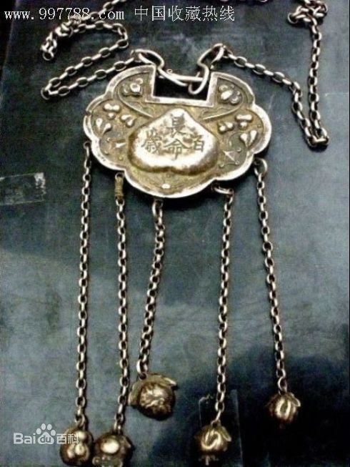
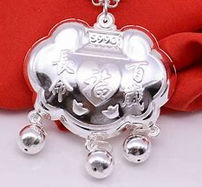
Folk auspicious words
The long-life locks have inscriptions of Chinese characters on the front side, such as “Chang Ming Fu Gui (longevity, fortune and honour)” and “Chang Ming Bai Sui (long life of 100 years)”.
01
长命富贵
02
长命百岁

Slide 16
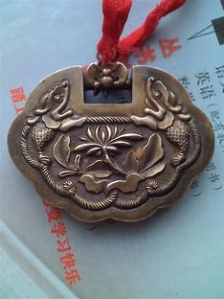
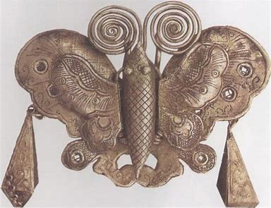
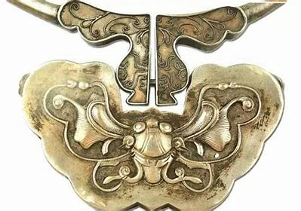
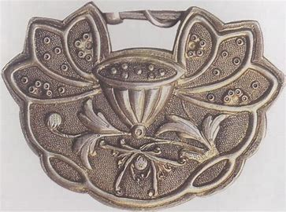
Flowers, birds, insects and animals words
Animals, such as bats, butterflies, fish, deer, magpies, and mythical animals, such as dragons, phoenix, are often carved in the back of the locks.
Flowers and plants, such as peonies, plum blossoms, lotus, pines and cypresses, are also commonly used.
01
bats
02
loutus

Slide 17
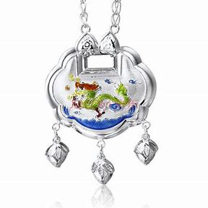
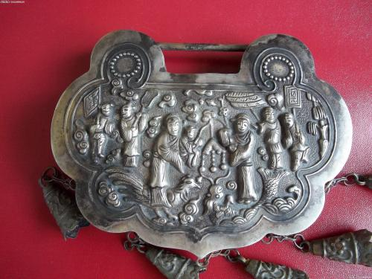
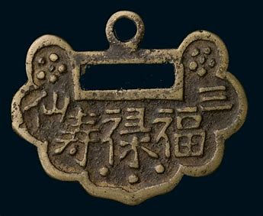
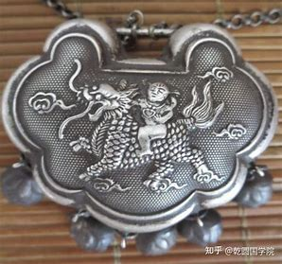
Traditional mythological elements
Traditional mythological elements are always typical themes such as Kylin Sends Sons. The Kylin is a legendary mythical beast as one of “Four Spirits”, symbolizing good fortune.
Pictures of Kylin (Chinese unicorn), or characters of “Long (dragon)”, “Hu (tiger )” and “Shou (longevity)” are sometimes carved on the back.

Slide 18
04 The culture behind the Long-life Lock

Slide 19
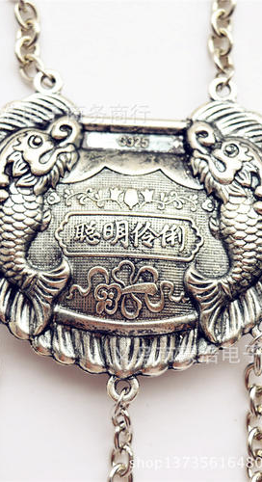
The culture behind the Long-life Lock
In the past, many Chinese babies died of diseases because of limited medical care, and there is a saying in folk that the King of Hell accepts babies.
Therefore, adults were afraid that their babies died in infancy, so adults worn a long-life lock for their children to protect their children so as not to let the evil spirits go into the body, not to be entangled by the evil spirits and not to be taken away their lives by the King of Hell, and to pray for the healthy and smooth growth of their children and pray for their long lives. Children are not allowed to pick their long-life lock until they became adults.

Slide 20
The culture behind the Long-life Lock
The differences in the long-life locks between Chinese and Western culture are obvious.
Western people pursue liberty and do not like to be shackled, so they regard something like the long-life lock is a fetter. As a result, they do not have the long-life locks and this custom.

Slide 21
1. Which dynasty did the long-life lock originate from? 2. What Chinese characters are usually engraved on a long-life lock?

Slide 22

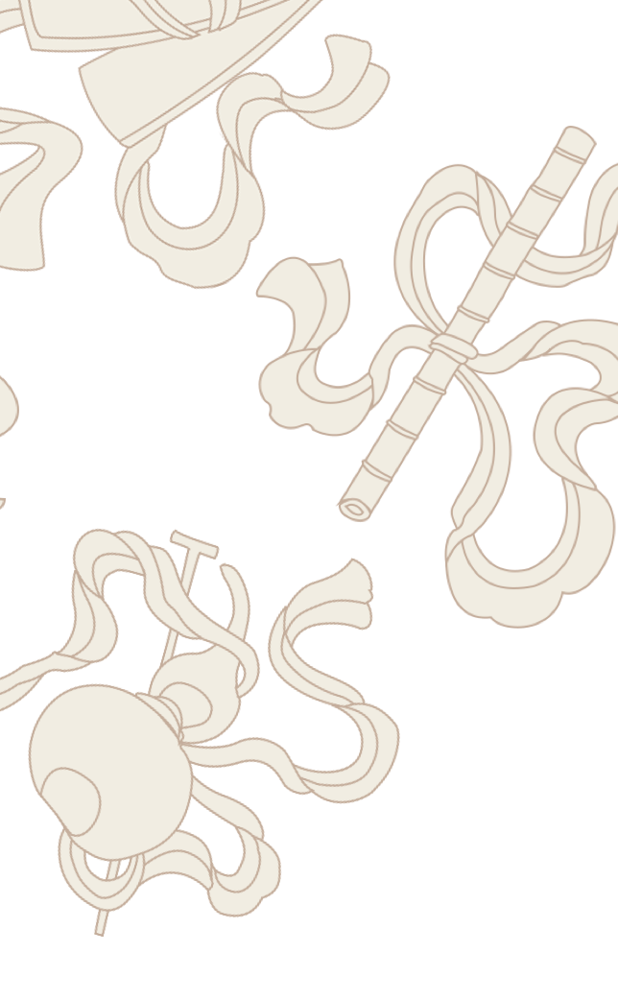

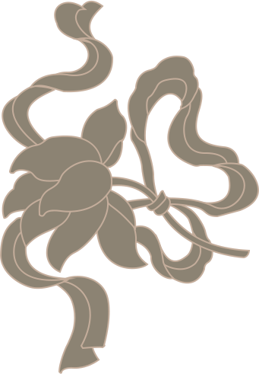
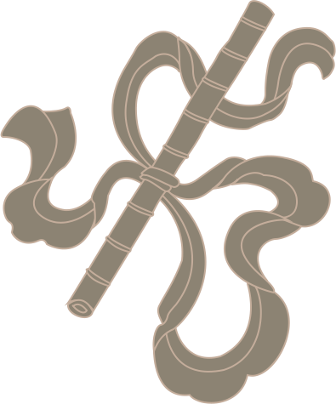
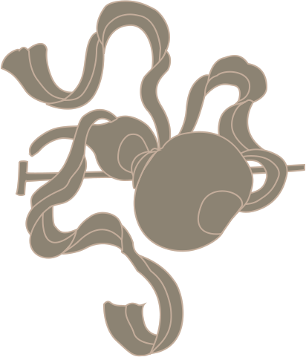
Thanks!

