Slide 1


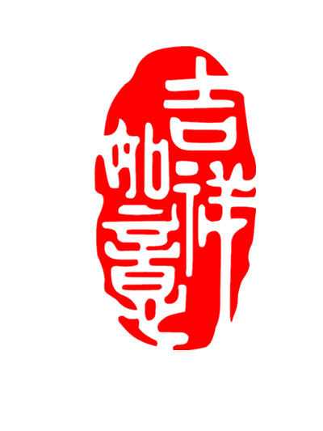


Calendar,
The 24 Solar Terms
Wang Zihan 2021/5/26

Slide 2
01
The Origin and Development of the 24 Solar Terms
CONTENTS
02
The Definition and Classification of the 24 Solar Terms
03
Importance and Values of the 24 Solar Terms

Slide 3
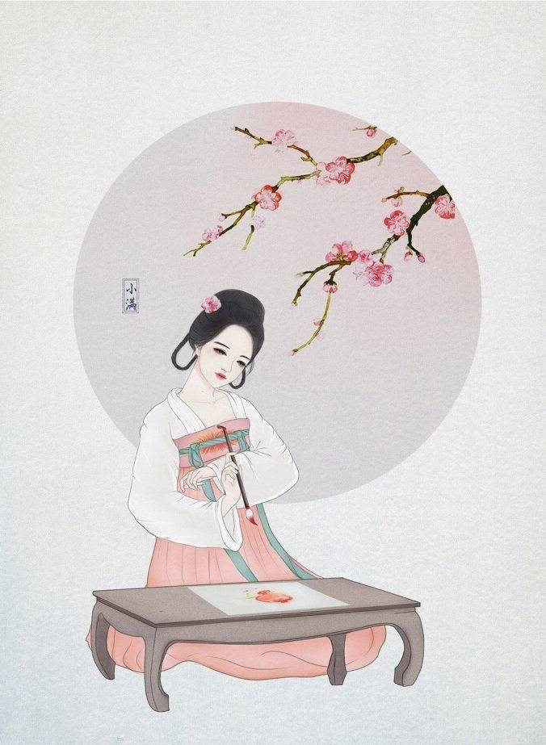
壹
The Origin and Development

Slide 4




The Origin and Development
01
02
03
04
Origin
Western Zhou Dynasty
Warring States period
Qin and Han Dynasty
It originated in the Yellow River valley, and is the result of people's observation, exploration and summary of astronomy, meteorology, and weather
People had already measured the first four solar terms: Winter Solstice, Summer Solstice, Spring Equinox
and Autumn Equinox.
With the improvement of measurement technology and the further strengthening of people’s understanding of the laws of nature, the complete 24 solar terms were basically formed.
A complete system was perfected and formed into today's complete 24 Solar Terms system.

Slide 5
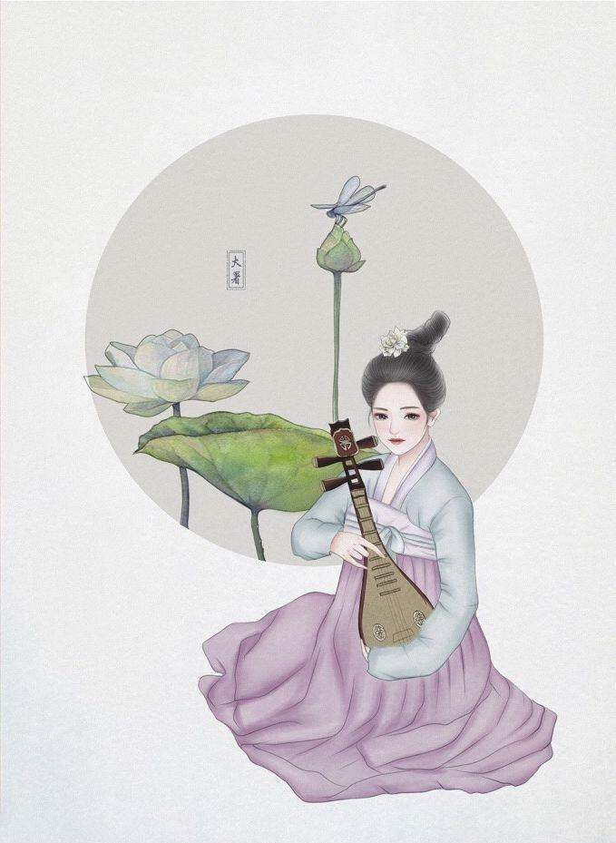
贰
The Definition and Classification

Slide 6
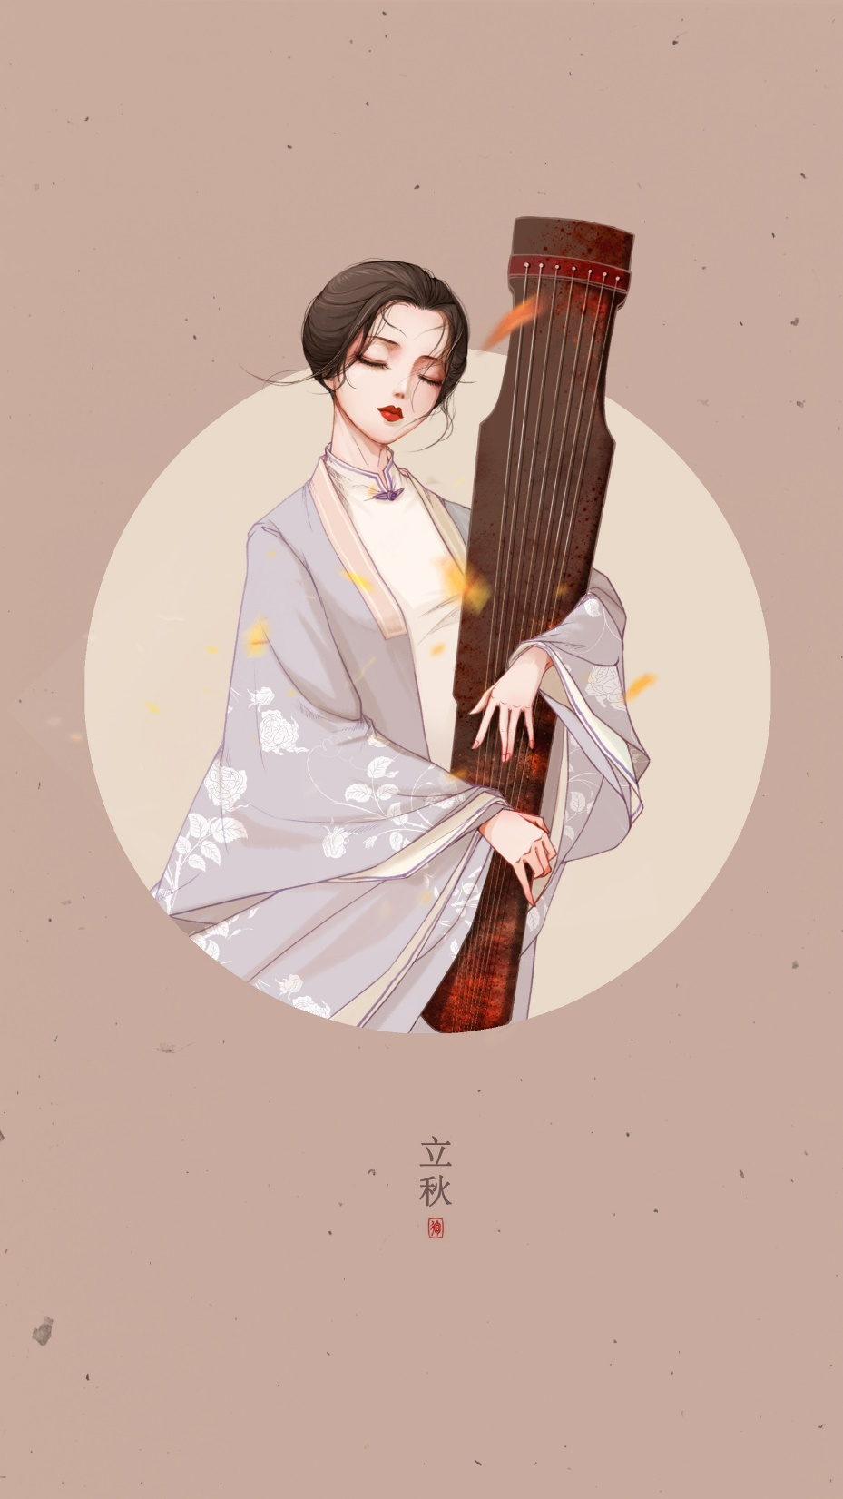
China Meteorology Administration
立春 the Beginning of Spring Feb.3,4, or 5
雨水 Rain Water Feb.18,19 or 20
惊蛰 the Waking of Insects Mar.5,6, or 7
春分 the Spring Equinox Mar.20,21 or 22
清明 Pure Brightness Apr.4,5 or 6
谷雨 Grain Rain Apr.19,20 or 21
立夏 the Beginning of Summer May 5,6 or 7
小满 Lesser Fullness of Grain May 20,21 or 22
芒种 Grain in Beard Jun.5,6 or 7
夏至 the Summer Solstice Jun.21 or 22
小暑 Lesser Heat Jul.6,7 or 8
大暑 Greater Heat Jul.22,23 or 24
立秋 the Beginning of Autumn Aug.7,8 or 9
处暑 the End of Heat Aug.22,23 or 24
白露 White Dew Sep.7,8 or 9
秋分 the Autumn Equinox Sep.22,23 or 24
寒露 Cold Dew Oct.8 or 9
霜降 Frost’s Descent Oct.23 or 24
立冬 the Beginning of Winter Nov.7 or 8
小雪 Lesser Snow Nov.22 or 23
大雪 Greater Snow Dec.6,7 or 8
冬至 the Winter Solstice Dec.21,22 or 23
小寒 Lesser Cold Jan.5,6 or 7
大寒 Greater Cold Jan.20 or 21

Slide 7
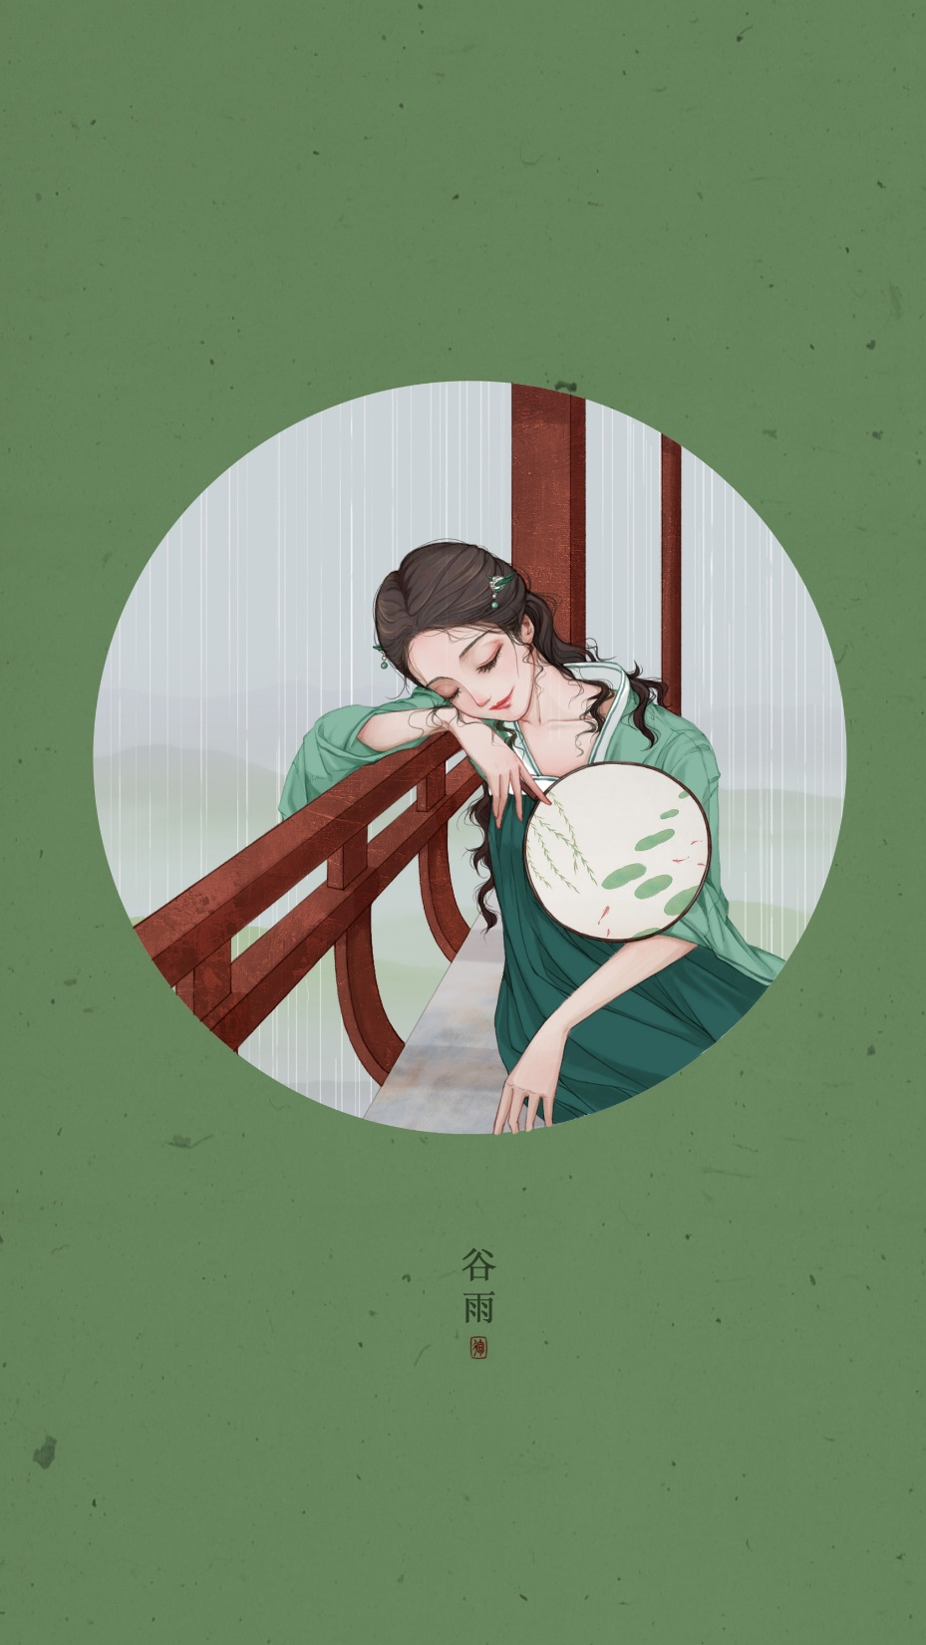

Slide 8
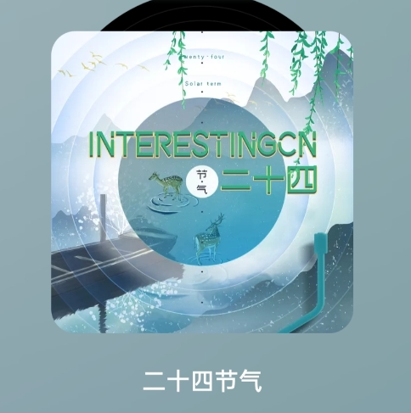
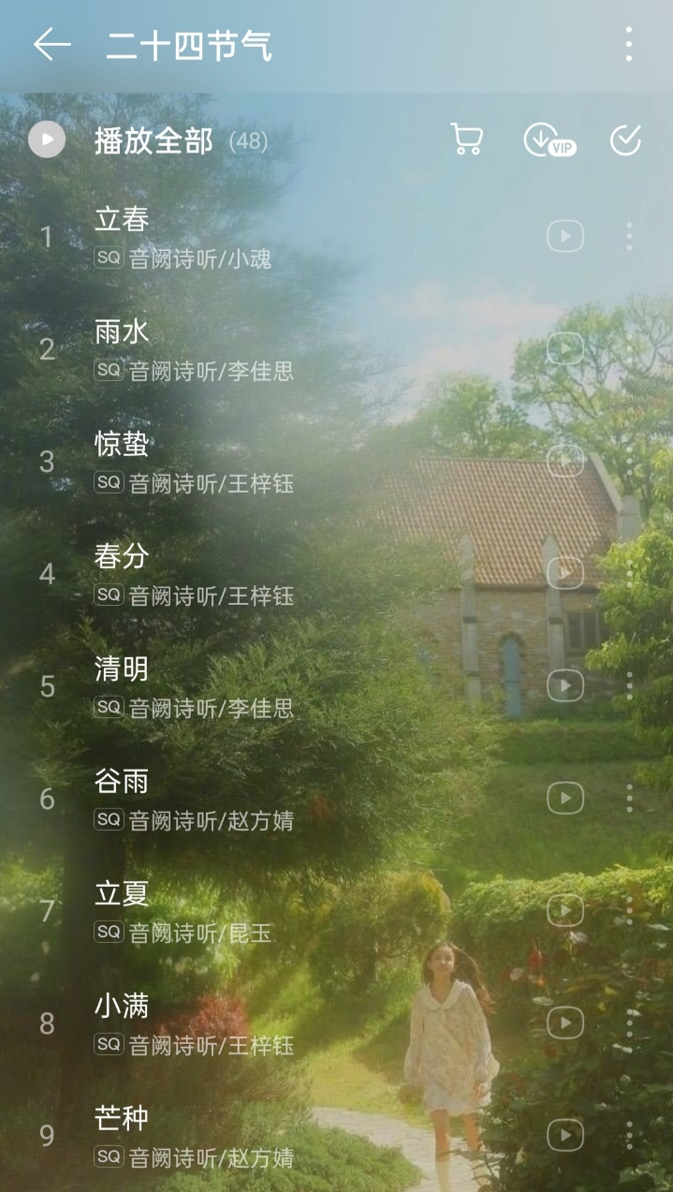
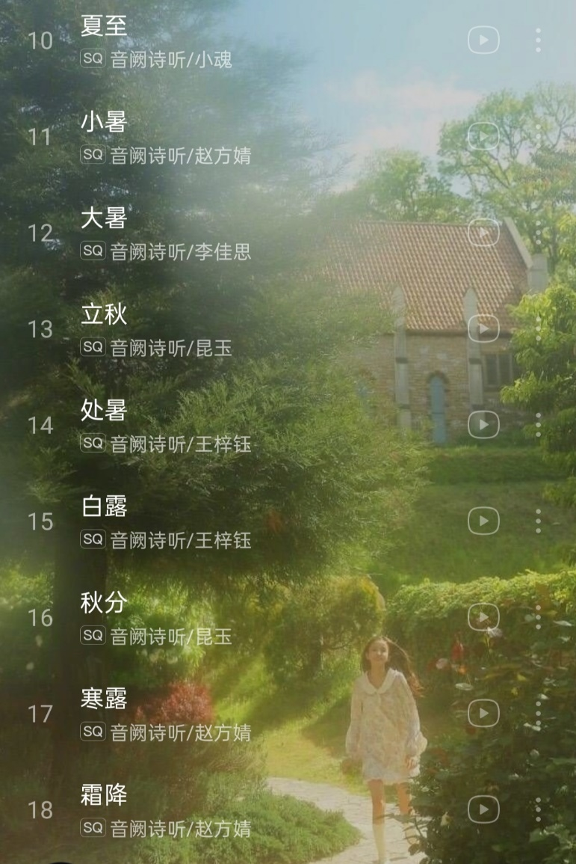
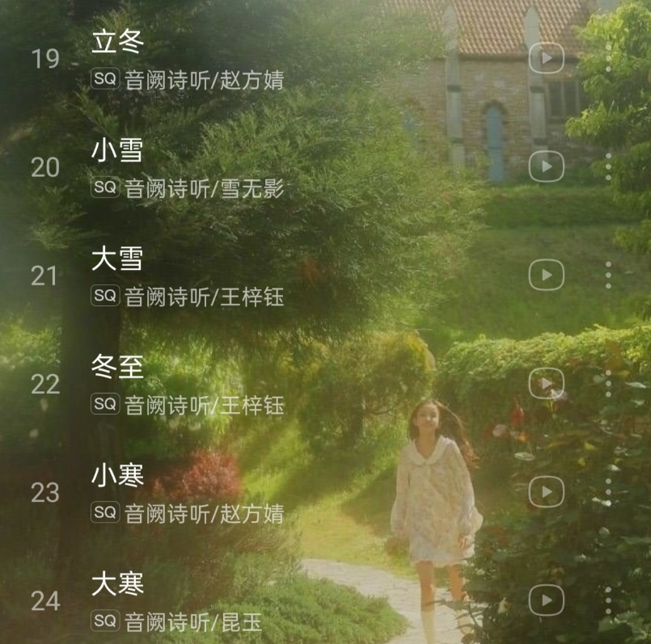
Interesting音阙诗听

Slide 9
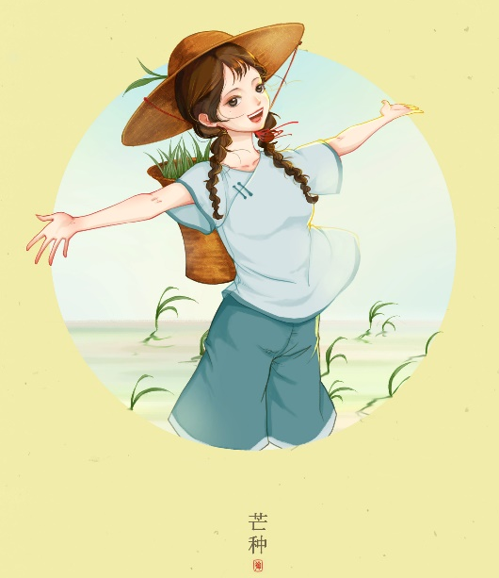
芒 种
Translation: Grain in Ear
Grain in Beard
Meaning: Grain in ear means the grains are mature. During this period, crops like barley and wheat all get mature and are waiting to be harvested.
（“忙种”）

Slide 10
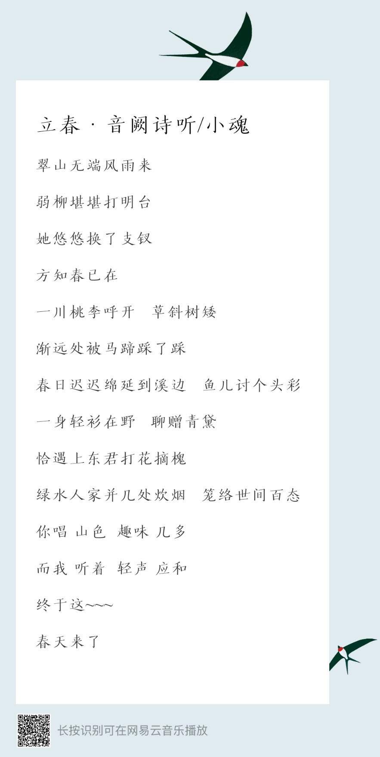
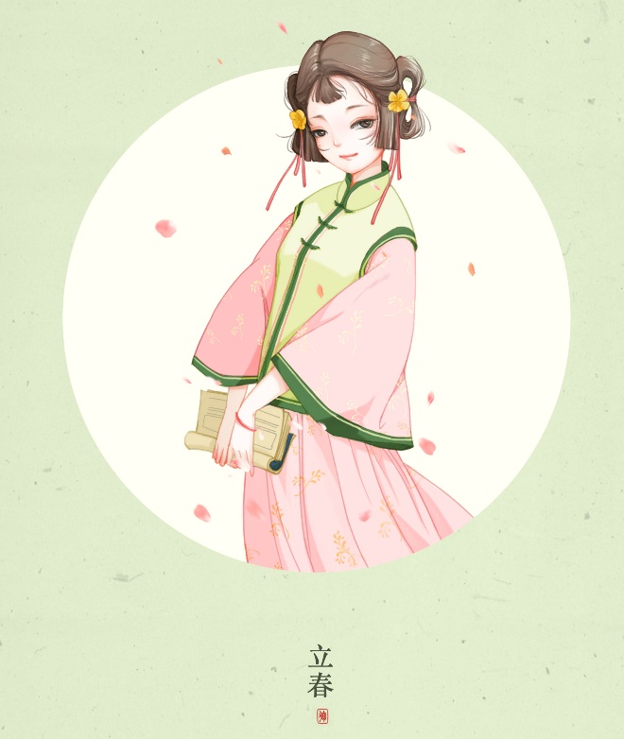

立 春
Translation: the Beginning of Spring
Start of Spring

Slide 11
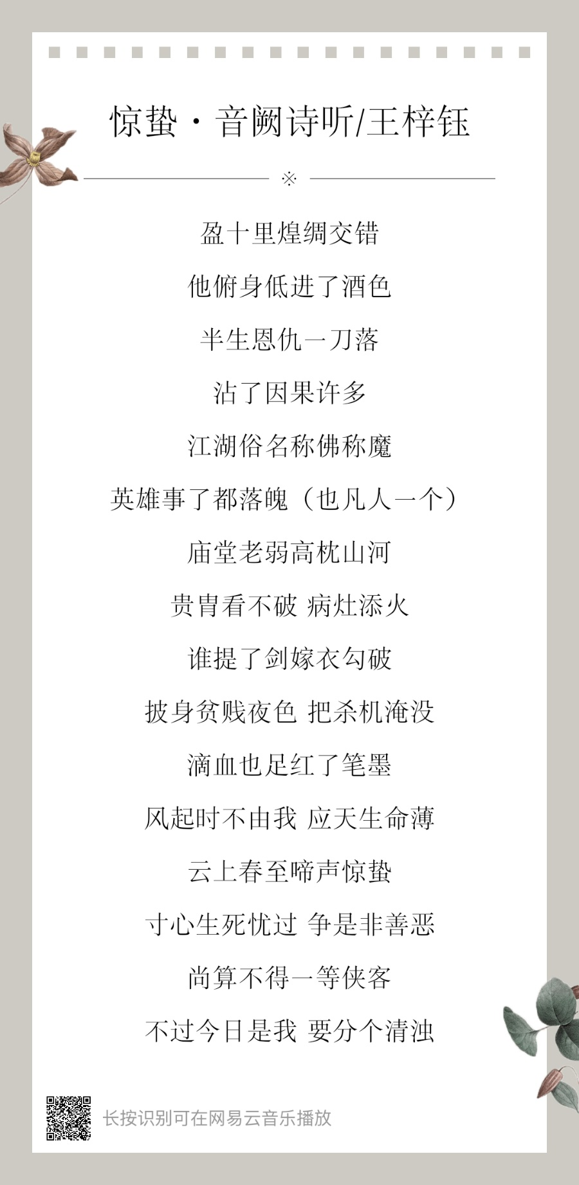

惊 蛰
Translation: the Waking of Insects
Meaning: It means the hibernate insects begin to wake up gradually.

Slide 12
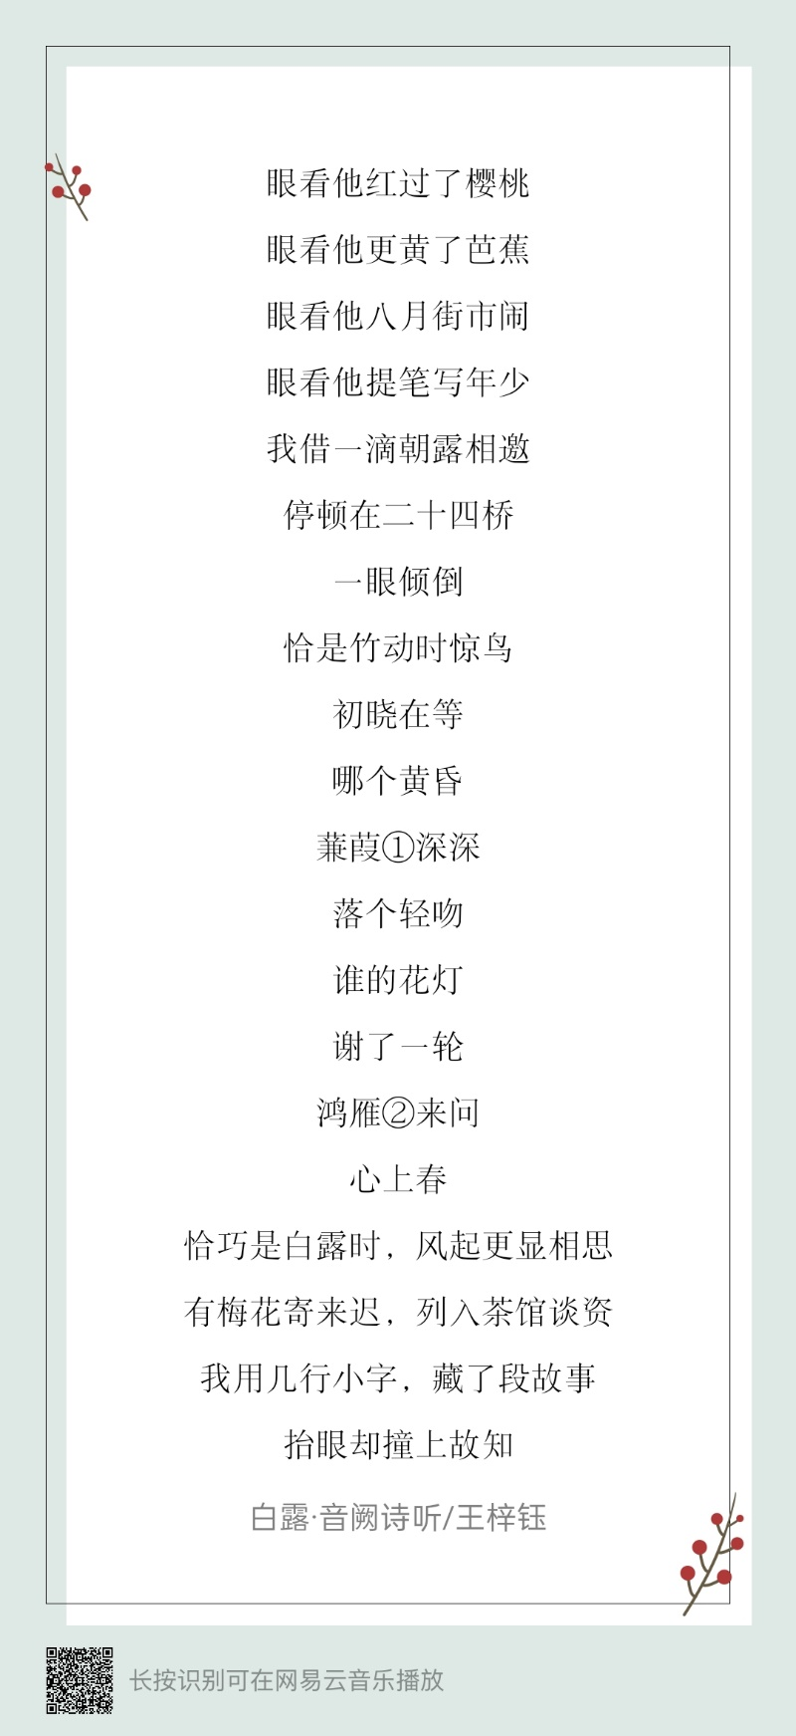
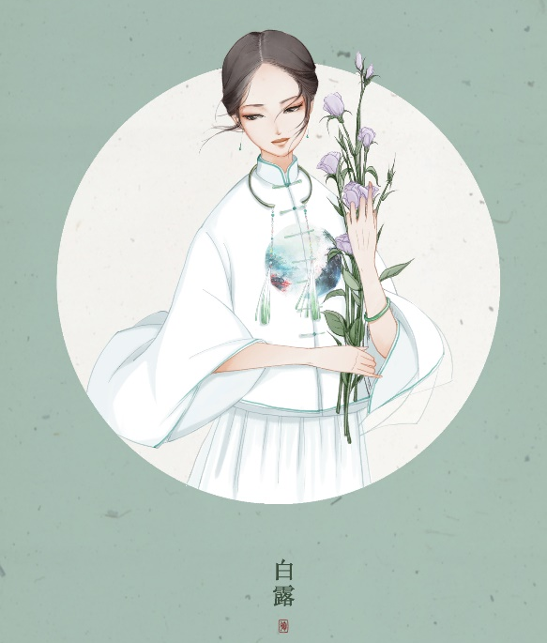
白 露
Translation: White Dews
=white + dews
Whether: There is typically autumn weather during Bailu period, when wild geese begin to migrate to the south and birds start to stock food for the long winter time. Hot summer is gone. However, it could be still warm in south China.
Customs：
Children Playing with Swallow Cars 孩子们玩燕子车
Eating Longan 吃龙眼
White Dew Wine 白露米酒
White Dew Tea 白露茶

Slide 13
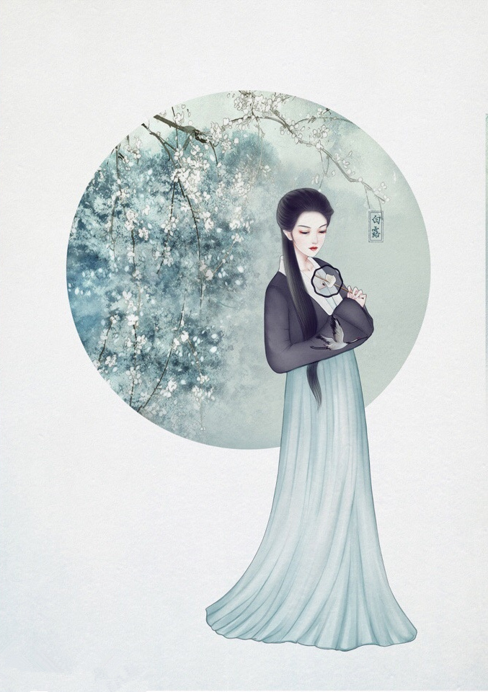
叁
Importance and Values

Slide 14


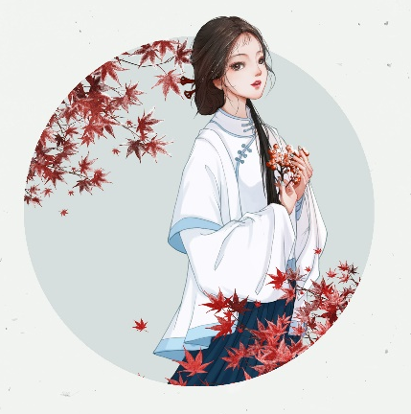

Importance in Ancient Times
Agricultural production activities
Time points
Festivals
Colorful lives

Slide 15
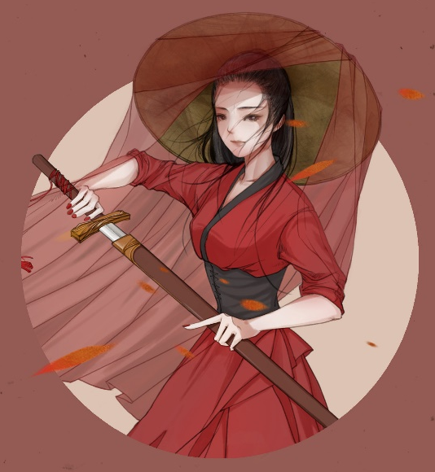
Values in Modern Society
Spiritual and cultural connotations
respecting nature,
adapting to the time of the day,
venerating ancestors,
filial piety,
respect for the elderly,
and being good neighbors and friends
Relationship between man and nature

Slide 16
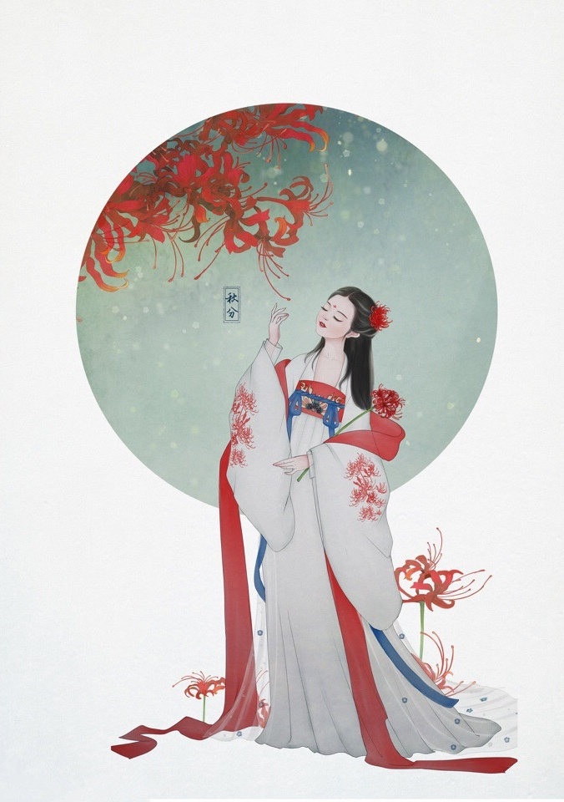
Thanks

