Slide 1

Sinicization-Politics for Cultural Export
The Example of the Chinese classics
文化输出的中国化政治：以中国古典文学为例
Chen Luyao
陈路瑶
21级英语笔译

Slide 2

Content
What Is Sincization？
Taking the TV Drama The Qin Empire as an Example.
The Embodiment of Politics in Classical Literature in World Politics.

Slide 3


Part one
Sinicization refers to the process of assimilating the language or culture of other countries or nations into Chinese language or culture. We can often see the sinicization of Marxism and desinicization.

Slide 4


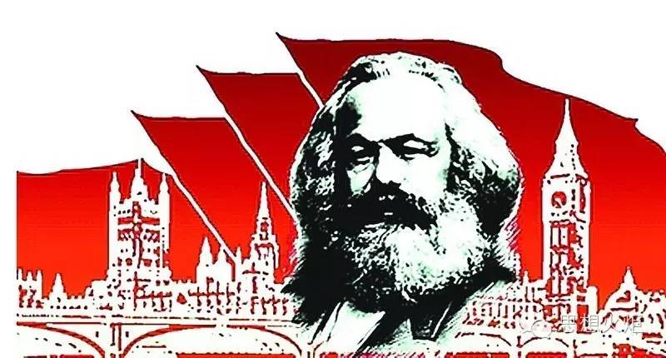
Sinicization of Maxism
Desinicization

Slide 5
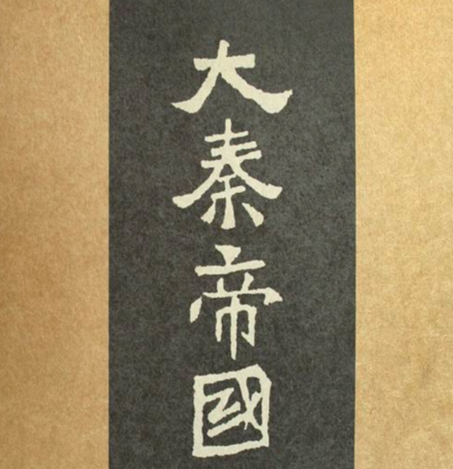
Part Two
Taking the TV Drama The Qin Empire as an Example.

Slide 6
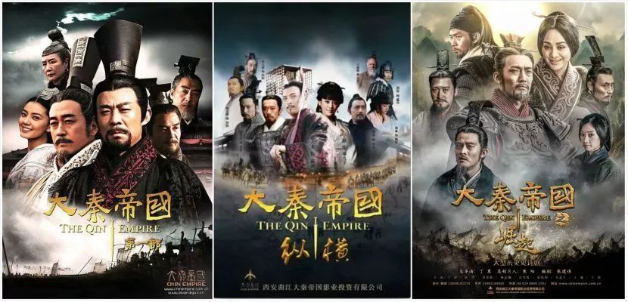
The Qin Empire

Slide 7
The essence of vertical and horizontal cooperation is the diplomatic and military struggle carried out by the great powers in the Warring States period to win over their countries. Joint vertical means that the countries in the north and South column unite to jointly deal with the powerful countries and prevent Qi and Qin from annexing the weak countries; Lianheng means that Qin or Qi drew some countries together to attack other countries. The purpose of collusion is to unite many weak countries against a powerful country in order to prevent the merger of powerful countries. The purpose of Lianheng is to serve a strong country as a backer, so as to attack other weak countries, so as to achieve the purpose of Annexing and expanding land. In addition to Su Qin and Zhang Yi, the most famous strategists at that time also had Gongsun Yan.
合纵连横（纵横）vertical and horizontal cooperation
The essence of vertical and horizontal cooperation is the diplomatic and military struggle carried out by the great powers in the Warring States period to win over their countries. Vertical cooperation means that the countries in the north and south unite to jointly deal with the powerful countries and prevent Qi and Qin from annexing the weak countries;Horizontal cooperation means that Qin or Qi drew some countries together to attack other countries. The purpose of vertical cooperation is to unite many weak countries against a powerful country in order to prevent the merger of powerful countries. The purpose of horizontal cooeration is to serve a strong country as a backer, so as to attack other weak countries and achieve the purpose of annexing and expanding land. In addition to Su Qin and Zhang Yi, the most famous strategists at that time also had Gongsun Yan.

Slide 8

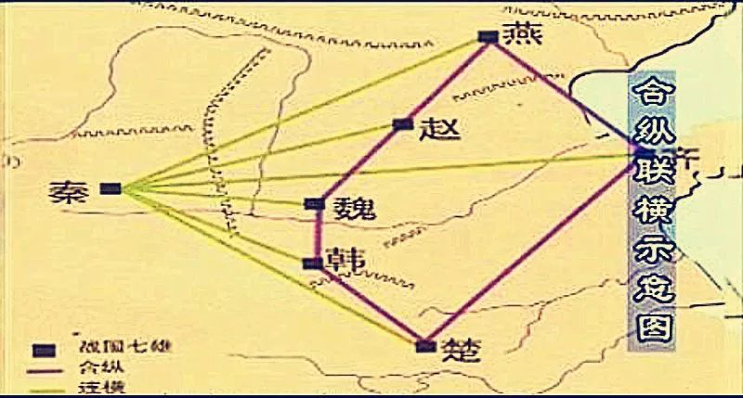
How did Qin unify China？

Slide 9
Part Three
The Embodiment of Politics in Classical Literature in World Politics.

Slide 10
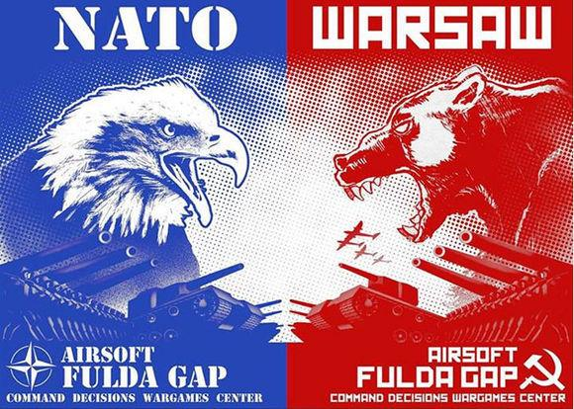
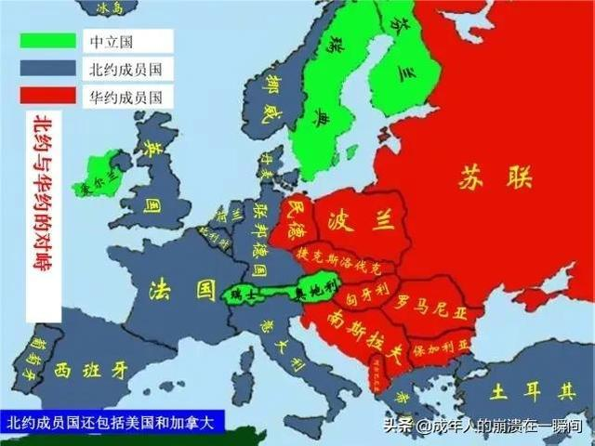
NATO vs WARSAW
Is it a kind of vertical and horizontal cooperation?

Slide 11
[1]彼黍离离. 《大秦帝国之崛起》以恢弘史诗格局,重现战国大争之世[J]. 电视指南, 2017(3):2.
[2]李衍柱. 华夏文明原生态的生动再现——论《大秦帝国》[J]. 东方论坛:青岛大学学报, 2010.
[3]刘燕. 在艺术创作与历史重塑之间--评大型历史剧《大秦帝国之崛起》[J]. 当代电视, 2019(2):3.
[4]王洋. 试论中国在FTA竞争中的策略——合纵连横与大秦帝国的建立[J]. 全国商情, 2016(18):4.
[5]漆海霞. 战国的终结与制衡的失效——对战国时期合纵连横的反思[J]. 当代亚太, 2015(5):45.
[6]赵德宇. 合纵连横:战国时期"联合作战"雏形思想初探[J]. 学理论, 2009(20):2.
[7]刘根良. 从"合纵连横"到"远交近攻"──评战国中期秦国的军事与外交[J]. 江西社会科学, 1995(10):4.
[8]傅海燕. 苏秦、张仪与合纵连横[J]. 前线, 2019(8):3.
[9]潘玉. 张仪连横政策的指导思想及其在秦的成功实行[J]. 开封教育学院学报, 2019, 39(8):2.
[10]苗润莲, 曾华东. 论战国纵横家产生的历史契机[J]. 山西师大学报：社会科学版, 2005, 32(3):3.
[11]王保国. 战国时期秦国统一策略的演变[J]. 淮阴师范学院学报(哲学社会科学版), 2006, 28(4):525-529.

Slide 12
THANK YOU!

