Slide 1
Decoding and Recoding
彭小玲 Peng Xiaoling
彭丹 Pengdan
Nov. 23, 2020

Slide 2
Definition
01

Slide 3
Decoding（解码）
1
The process of converting something from a coded form into a normal form.
Recoding（重新编码）
2
The process of converting from one code to another.

Slide 4
Theoretical Foundation
02

Slide 5
(1)Intralingual translation（语内翻译）
An interpretation of verbal signs by means of other signs in the same language.
Types of Translation
by Roman Jakobson
(1896-1982):
(2) Interlingual translation（语际翻译）
An interpretation of verbal signs by means of some other language.
(3)Intersemiotic translation（符际翻译）
An interpretation of verbal signs by means of signs of nonverbal sign systems.

Slide 6
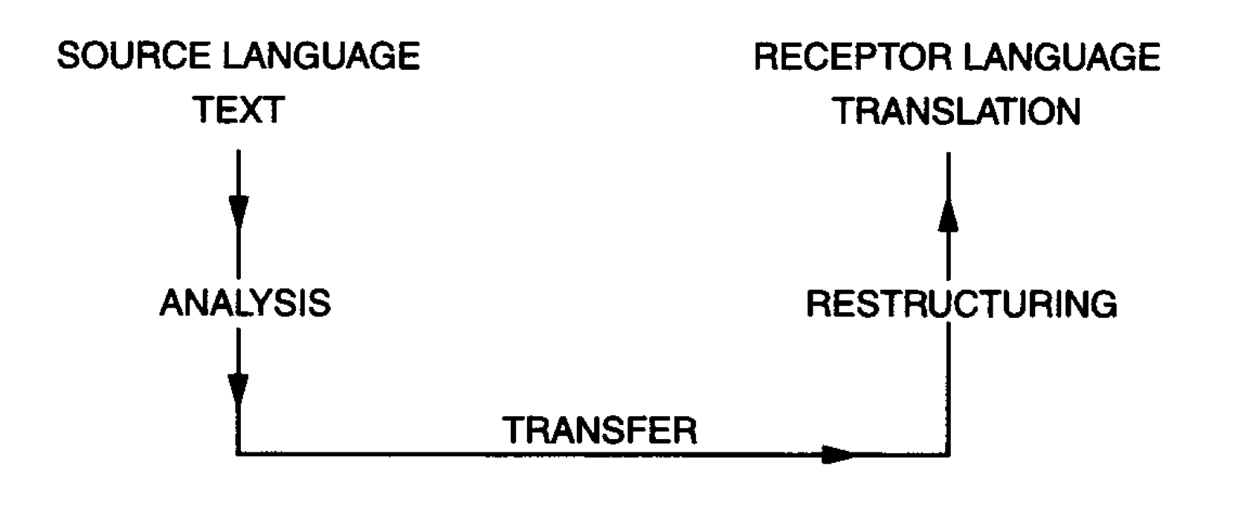
Having established these three types, of which (2) interlingual translation describes the process of transfer from SL to TL, Jakobson points to the central problem in all types: that translation is only an adequate interpretation of an alien code unit and complete equivalence is impossible.
The translator, therefore, operates criteria that transcend the purely linguistic, and a process of decoding and recoding takes place. Eugene Nida’s model of the translation process illustrates the stages involved:

Slide 7
Applications
03

Slide 8

Example 1: Translating Yes into French, German and Italian
Firstly, oui is the generally used term; si is used specifically in cases of contradiction, contention and dissent.
Secondly, yes cannot always be translated into the single words oui, ja or si, for French, German and Italian all frequently double or ‘string’ affirmatives in a way that is outside standard English procedures (e.g. si, si, si; ja, ja, etc). Hence the Italian or German translation of yes by a single word can, at times, appear excessively brusque.
French: oui,si
yes
German: ja
Italia: si

Slide 9
Example 2: Translating Hello into French, German and Italian
Firstly, English does not distinguish between the word used when greeting someone face to face and that used when answering the telephone, French, German and Italian all do make that distinction. The Italian pronto can only be used as a telephonic greeting, like the German hallo.
Secondly, French and German use as forms of greeting brief rhetorical questions.
Thirdly, the Italian ciao is used equally on arrival and departure.
French:ça va?;
hallo
hello
German: wie geht's; hallo
Italia: olà; pronto; ciao

Slide 10
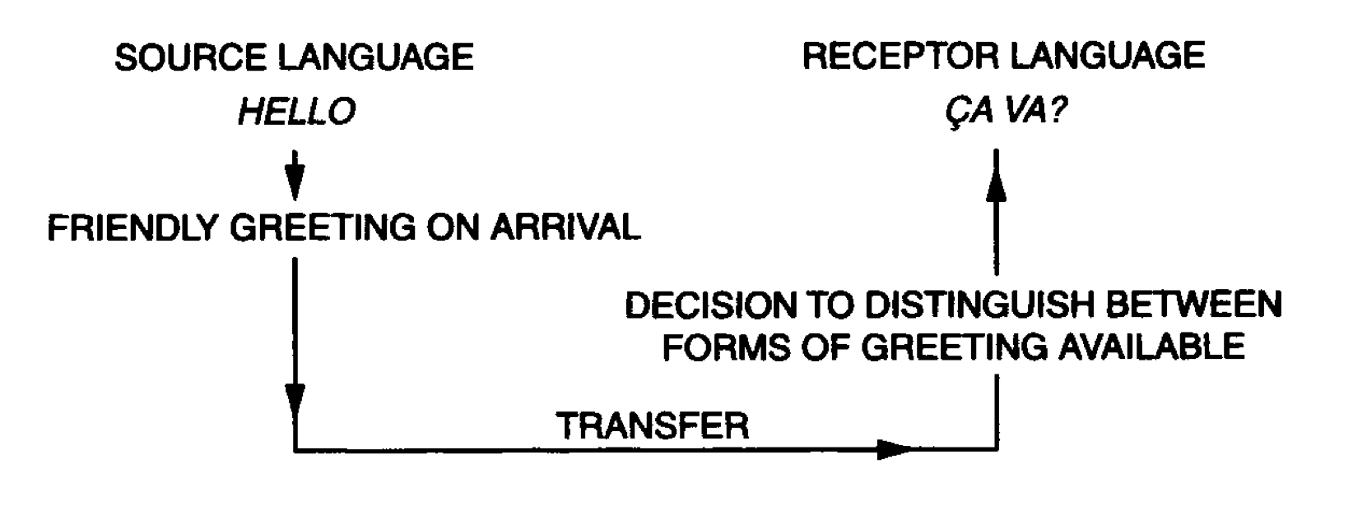
Example 2: Translating Hello into French, German and Italian
The translator faced with the task of translating hello into French must first extract from the term a core of meaning and the stages of the process, following Nida’s diagram, might look like this:

Slide 11
Conclusion
04

Slide 12
Conclusion
In the case of yes the invariant information is affirmation, while in the case of hello the invariant is the notion of greeting. But at the same time the translator has had to consider other criteria, e.g. the existence of the oui /si rule in French, the stylistic function of stringing affirmatives, the social context of greeting—whether telephonic or face to face, the class position and status of the speakers.

Slide 13
Conclusion
The translator should:
(1) Accept the untranslatability of the SL phrase in the TL on the linguistic level;
(2) Accept the lack of a similar cultural convention in the TL;
(3) Extract the invariant information of the SL phrases;
(4) Consider the stylistic function, social context, class and status and so on.

Slide 14
Thanks.

