Slide 1
Traditional Cuisines:
Four Distinct Regional Cuisines
He Ying 何颖

Slide 2
Four Distinct Regional Cuisines:
Sichuan Cuisines
Shandong Cuisines
Guangdong (Cantonese) Cuisines
Jiangsu-Zhejiang Cuisines

Slide 3
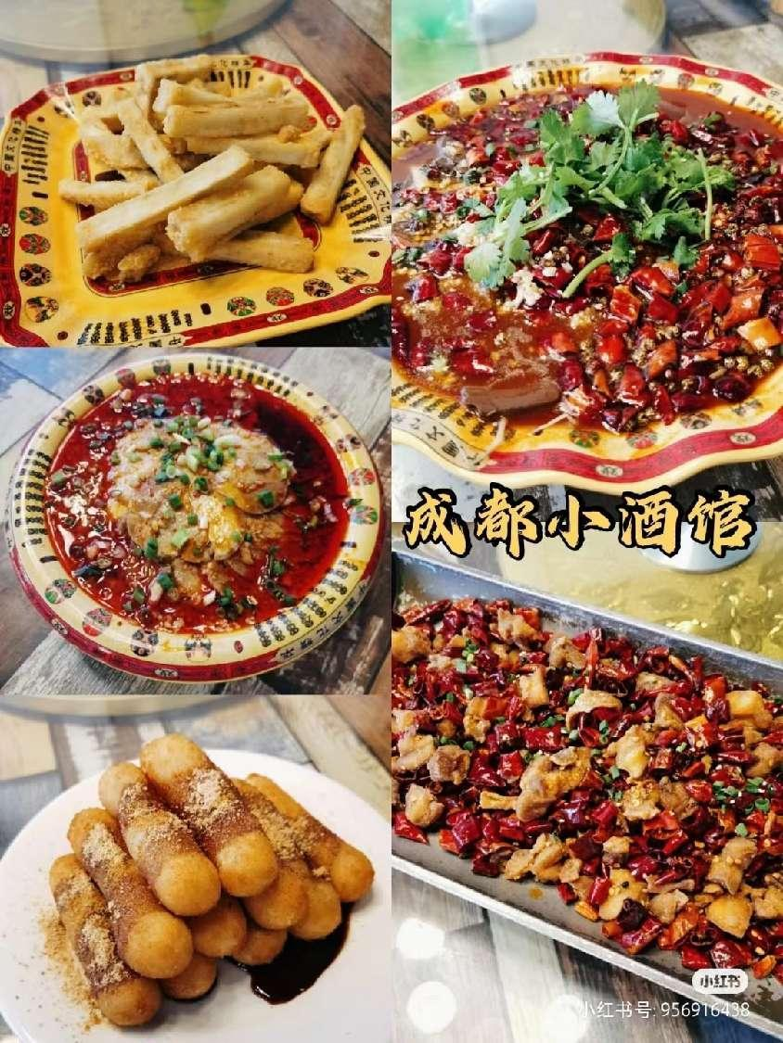
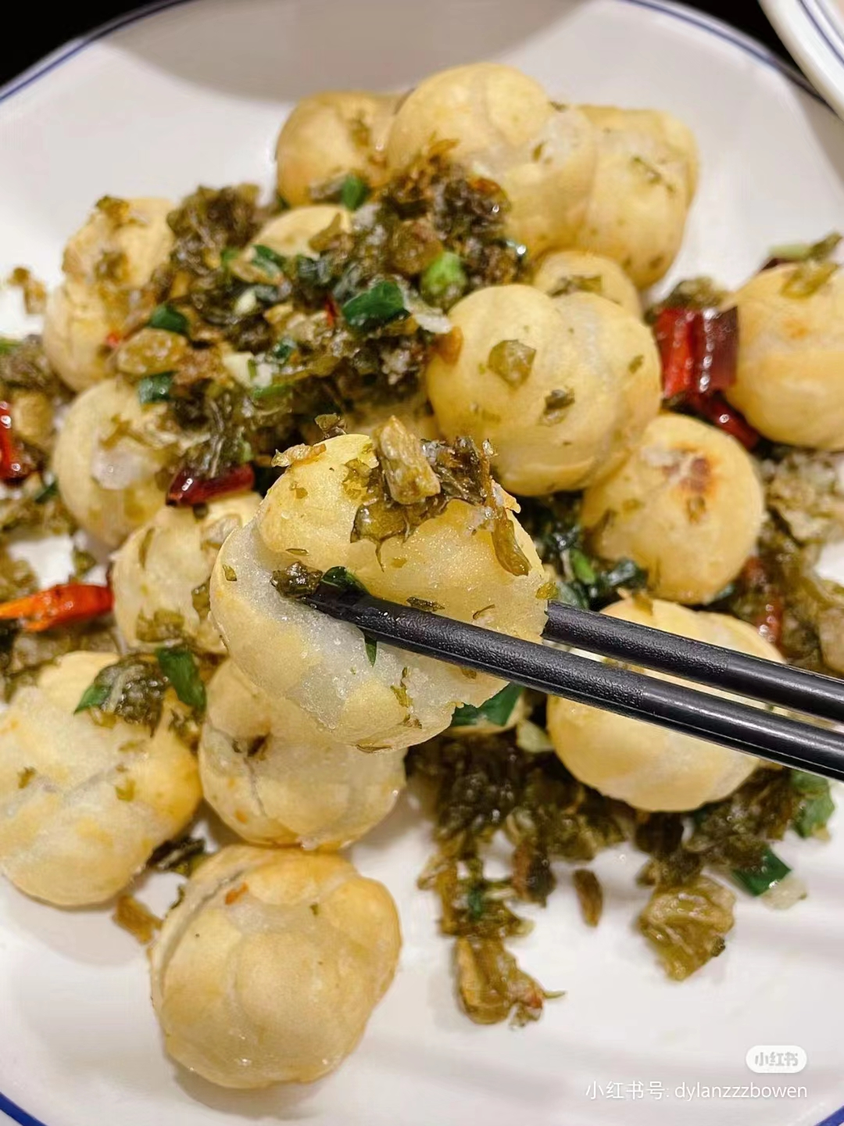
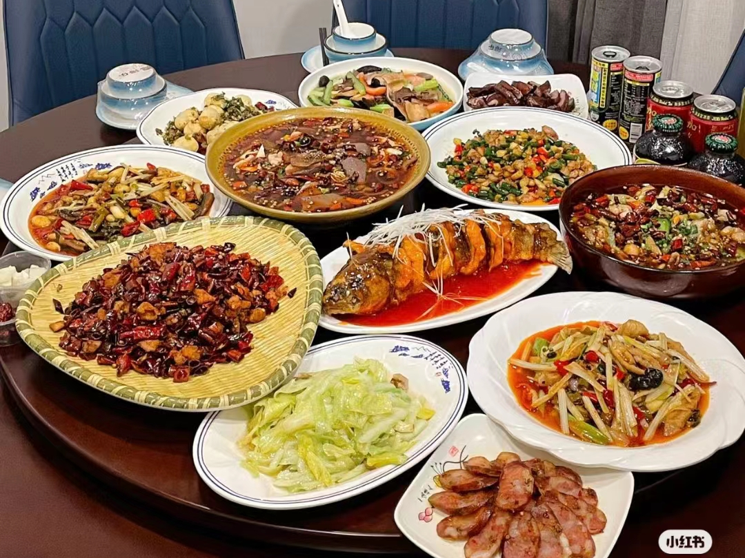
1.Sichuan cuisine--川菜
Sichun cuisine is perhaps the most
popular one. It is well-known for its hot and
pungent flavoring. Sichuan cuisine boasts
a variety of flavors and different methods of
cooking. A Sichuan dish may be hot, sweet,
sour, salty or tongue-numbing.

Slide 4
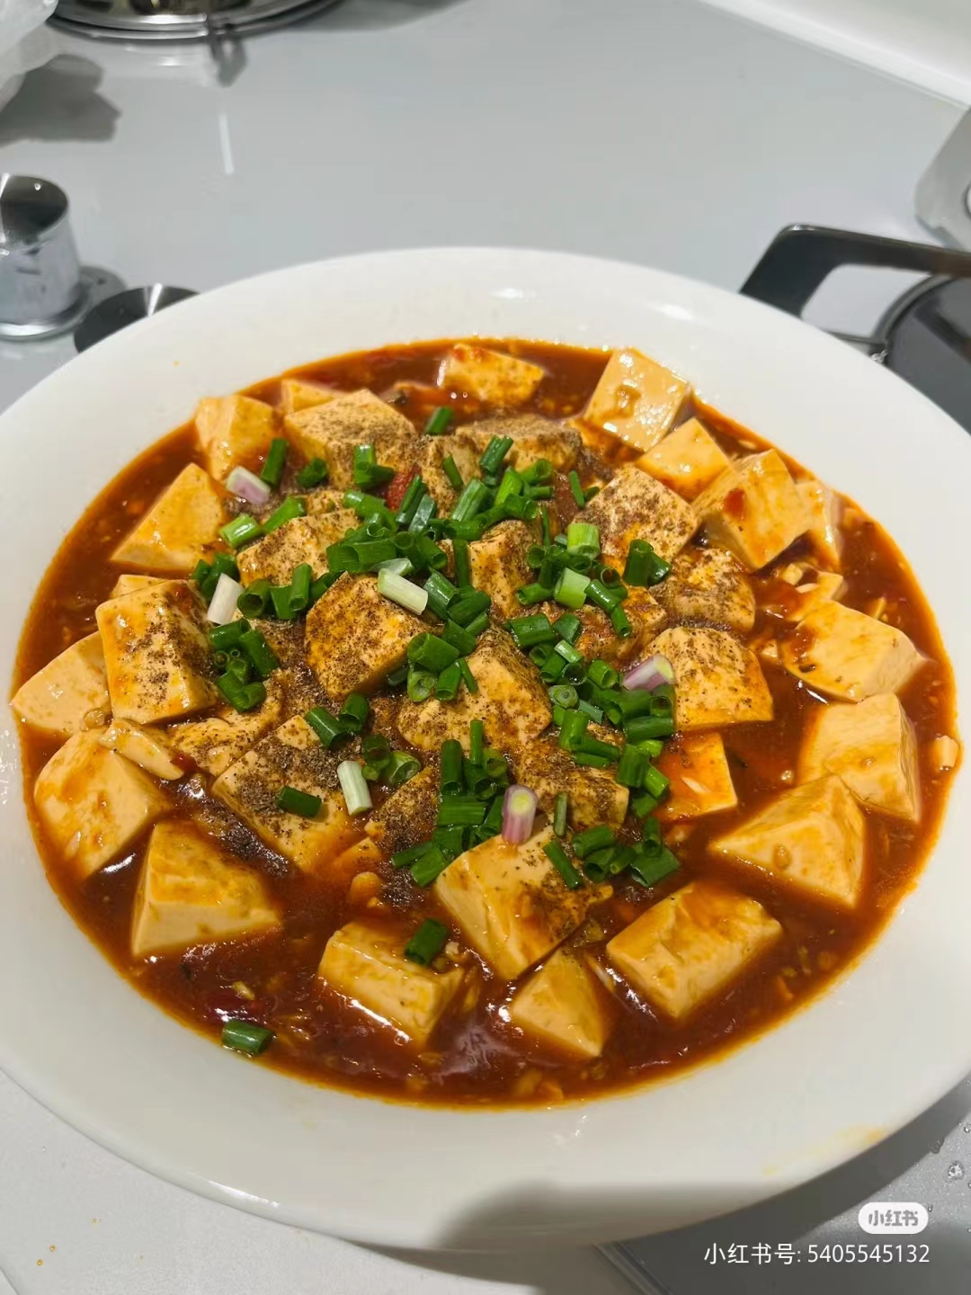
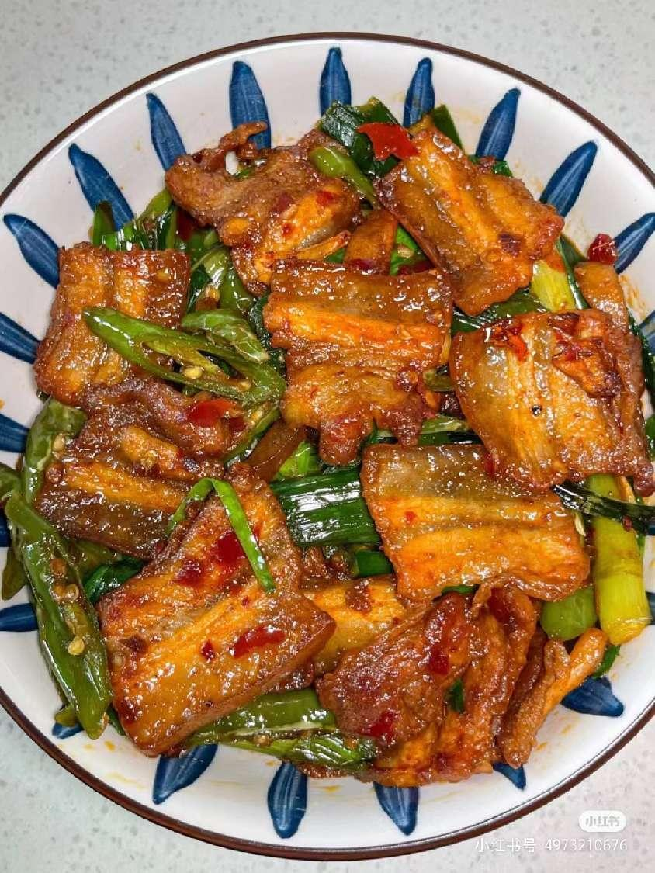
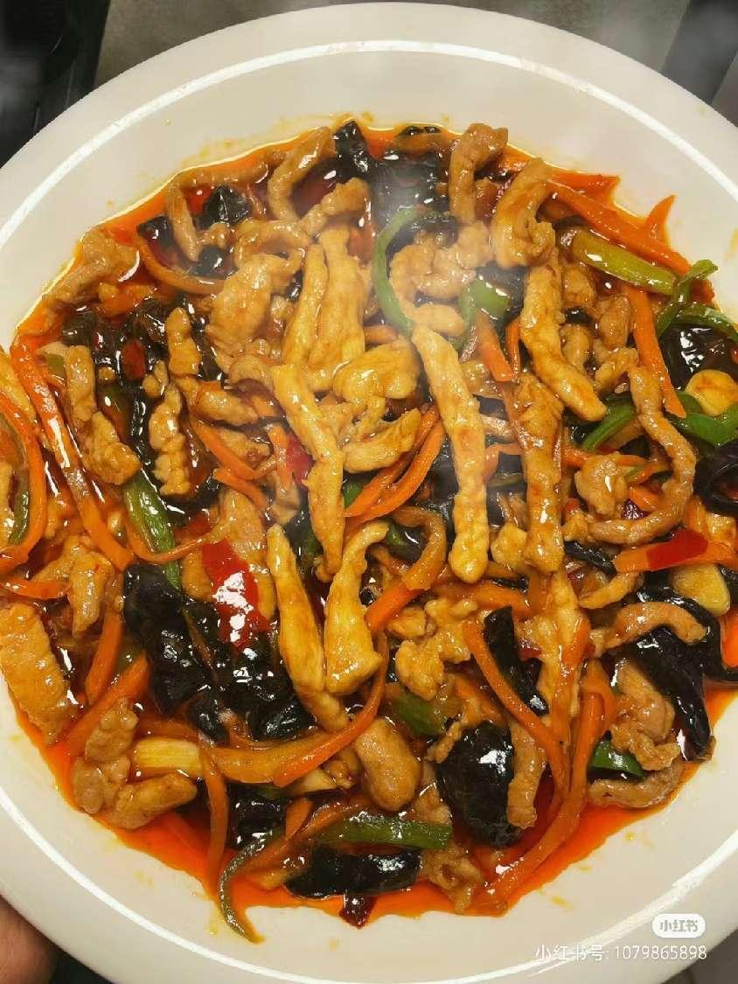
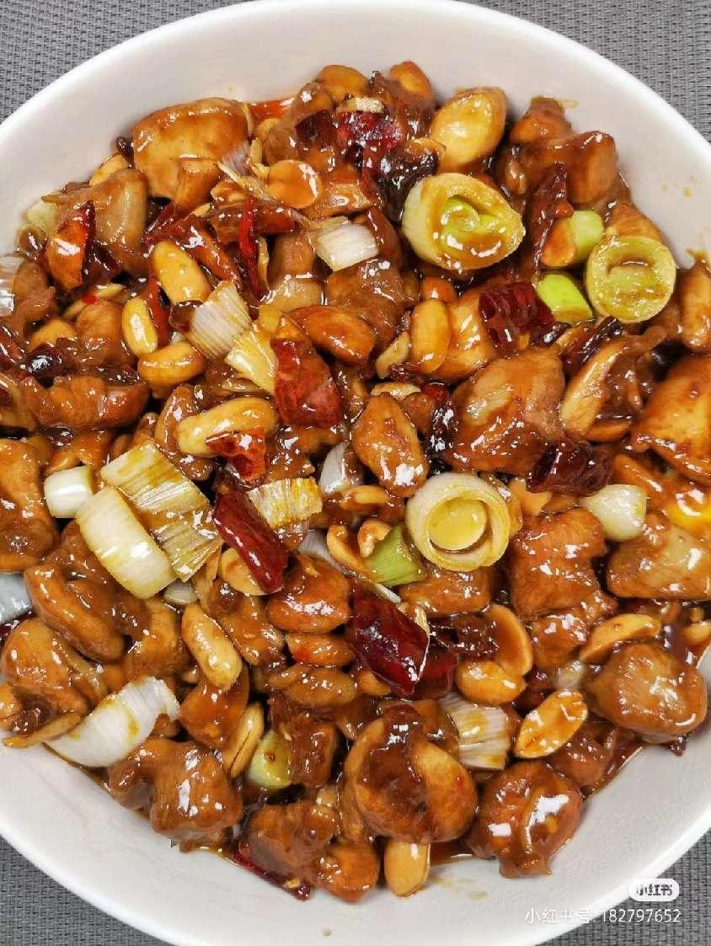
1.Sichuan cuisine--川菜
Pockmarked Woman’s Bean Curd
麻婆豆腐
Spicy Diced Chicken with Peanuts
宫保鸡丁
Twice Cooked Pork Slice
回锅肉
Fish-flavored Pork Shred
鱼香肉丝

Slide 5
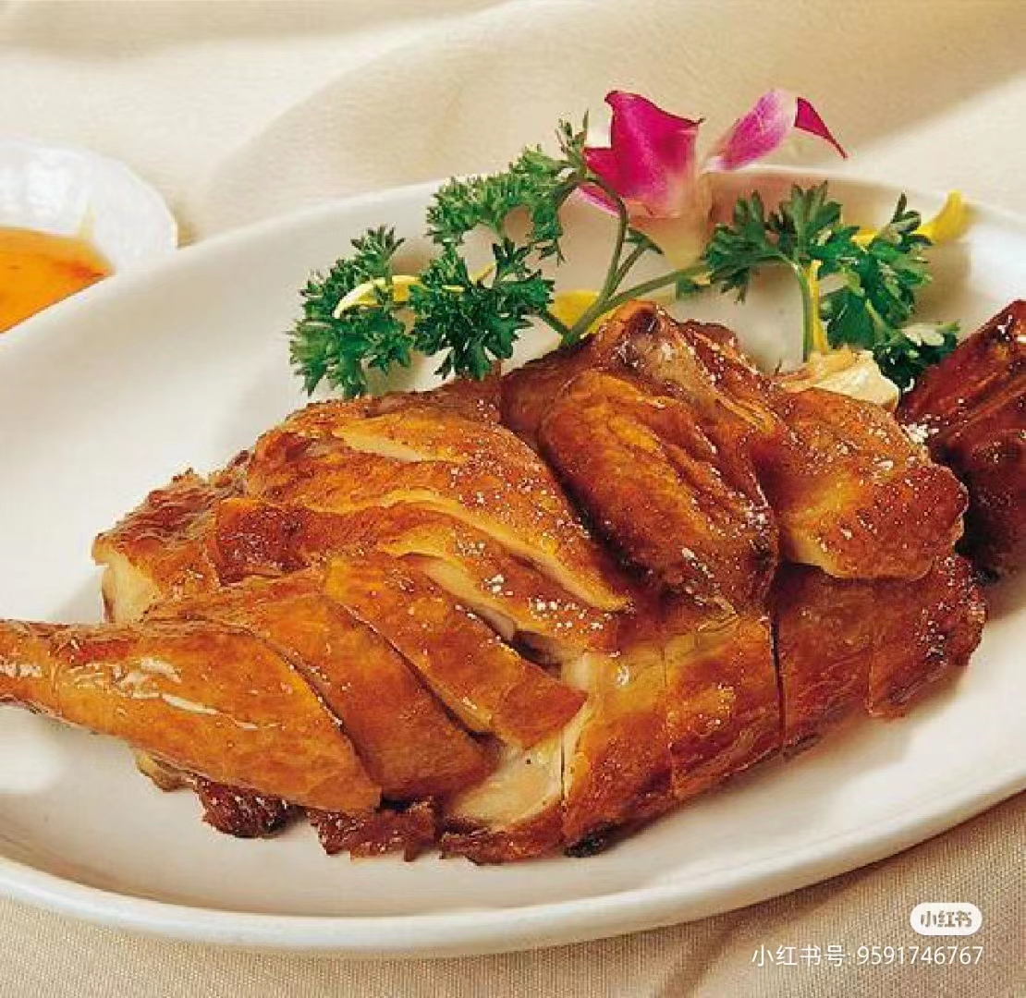
2.Shandong cuisine--鲁菜
The most representative of Shandong cuisine is, perhaps, Peking Roast Duck.
Shandong dishes are usually fresh, tasty but not greasy.
Dezhou Braised Chicken（德州扒鸡） is known throughout the country. The chicken is so well cooked that the meat easily separates from the bone although the shape of the chicken is preserved.

Slide 6
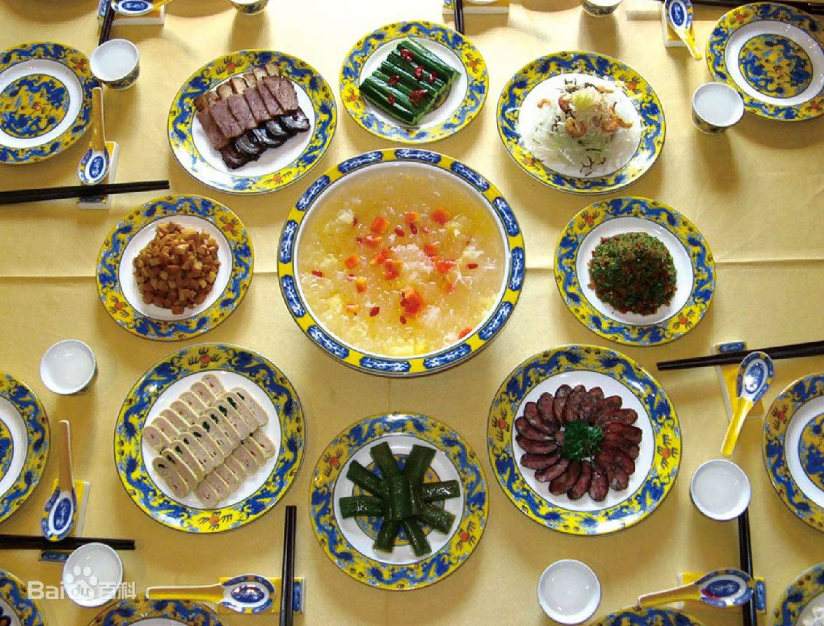
2.Shandong cuisine--鲁菜
As an important part of Chinese food culture, the Confucius Family Dishes is a special high-level banquet for the reception of distinguished guests, the appointment of a Lord, anniversary, birthday, wedding and funeral. After hundreds of years of continuous development and enrichment, it becomes a unique family feast.
the Confucius Family Dishes
孔府家宴

Slide 7
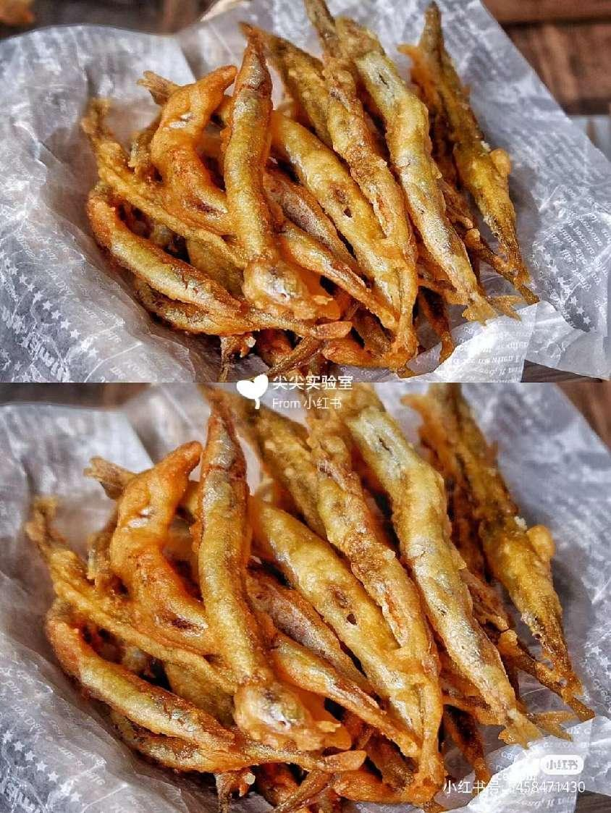
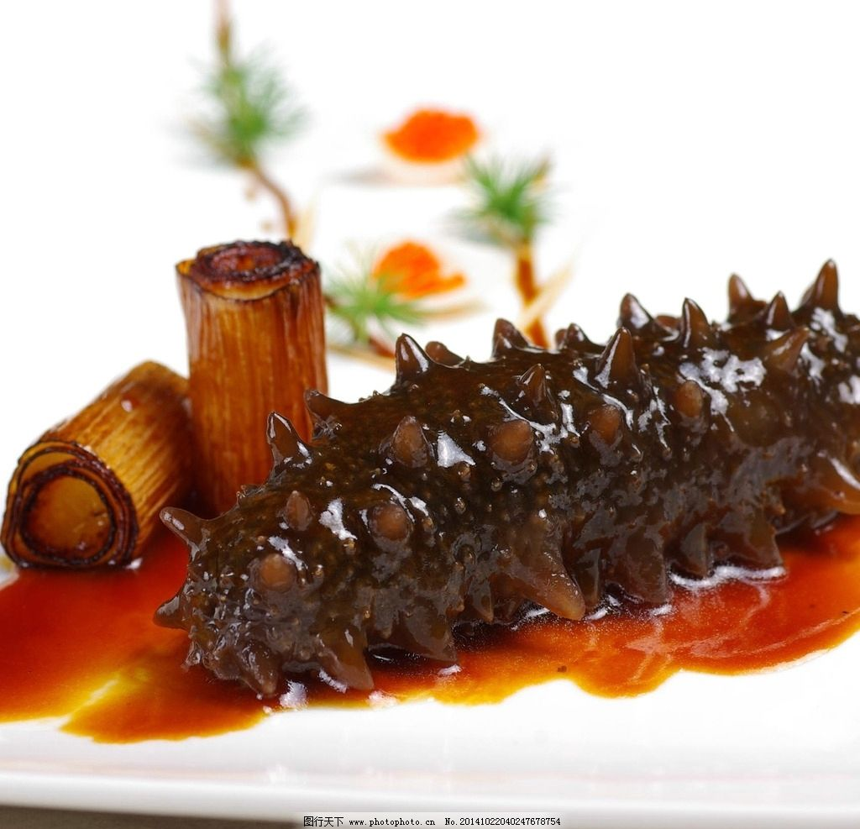
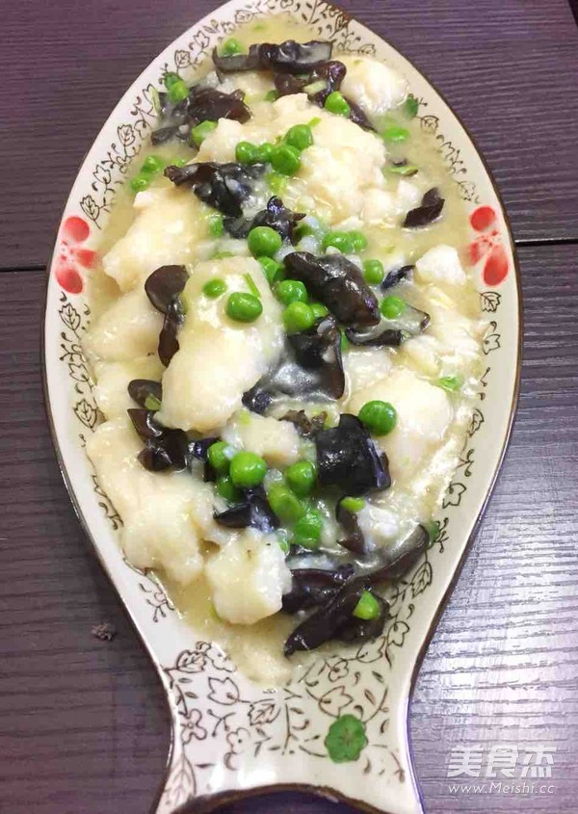
2.Shandong cuisine--鲁菜
Stewed Sea Cucumber
红烧海参
Sautéed Pickled Fish Slice
糟溜鱼片
Deep-Fried Red-Scale Fish
干炸赤鳞鱼

