Slide 1





Mahjong：An Ancient Chinese Card Play
麻将Mahjong
2023英语笔译 曾文静
2024.9.19

Slide 2



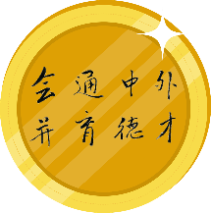

Content
?
?
?
?
?
?
Name

Slide 3
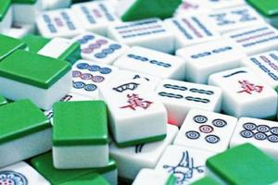


Content
Why is Mahjong called“麻将”?
Do you know any other names of the game？

Slide 4


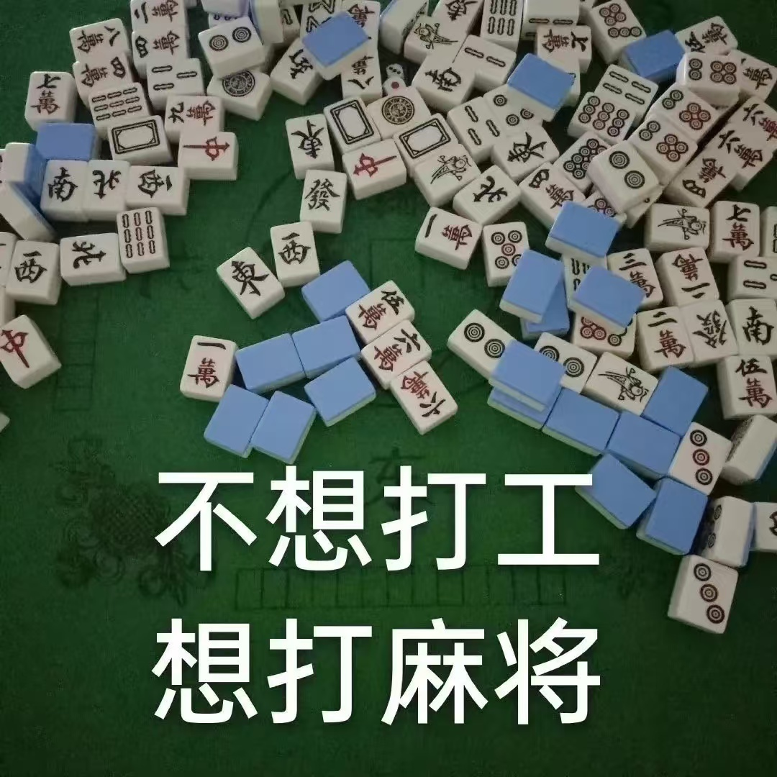
Content
Mahjong was originally called "麻雀" (sparrow) in China, due to the chattering sound of the tiles during shuffling.
The name is also linked to horse tags(马吊牌), as the earliest written record of mahjong tiles was "马将牌" (Ma Jiang tiles).

Slide 5

Content
?
?
?
?
?
Name
Origin

Slide 6
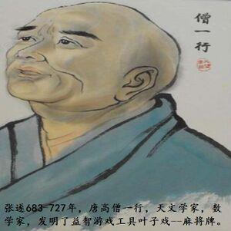

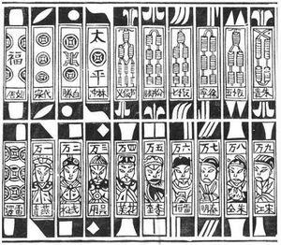
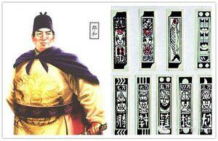
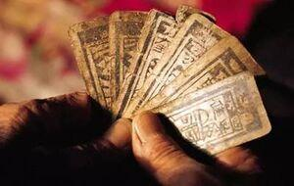
Content
A. Zhang Sui Theory
B. Water Margin Theory
C. Zheng He's Voyage Theory
D. Food-Protection Cards Theory

Slide 7

Content
Food-Protection Cards Theory
The "Food-Protection Cards" from Taicang, Jiangsu, also known as "sparrow cards," were used to record bird catches to protect grain. These bamboo cards, with symbols and numbers, served as game pieces and prize proofs. The "Tong" represented the powder gun's barrel, "Suo/Shu" showed a bird strung up, "Wan" was the reward unit, and "South", "East", "North", "West" were wind directions. "Middle" was red for shooting, "white" was a blank tile, and "Green" indicated rewards and prosperity.

Slide 8

Content
Food-Protection Cards Theory
Mahjong terms are also related to sparrow catching and grain protection. For example, "Peng" is the sound of a gunshot, and "Hu" (winning the game) is a homophone for "鹘(Hu)," a type of hawk used for catching sparrows.

Slide 9
Content
?
?
?
?
Name
Origin
Components

Slide 10
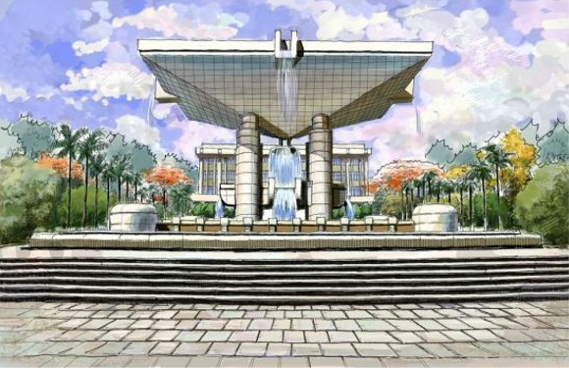
Content
Tiles（麻将牌）: A full set of Mahjong tiles consists of 144 pieces, divided into different suits: (9+9+9+7)x4+8=144
Numerical Tiles（序数牌）: These include the Circles/Dots/Wheels（饼/筒）, Bamboo（条/索）, and Characters（万）, each numbered from 1 to 9.
Honor Tiles（字牌）: These are the Wind tiles（风） (East, South, West, North) and Dragon tiles (Red/红中, Green/发财, White/白板).
Bonus Tiles（花牌）: These are the Flower tiles（Spring、Summer、Autumn\Winter；Plum、Orchid、chrysanthemum、bamboo）, which are extra and can score points.
Dice（骰子）: Used to determine the starting player and where to draw tiles from.
Chips（筹码）: Used for scoring.

Slide 11
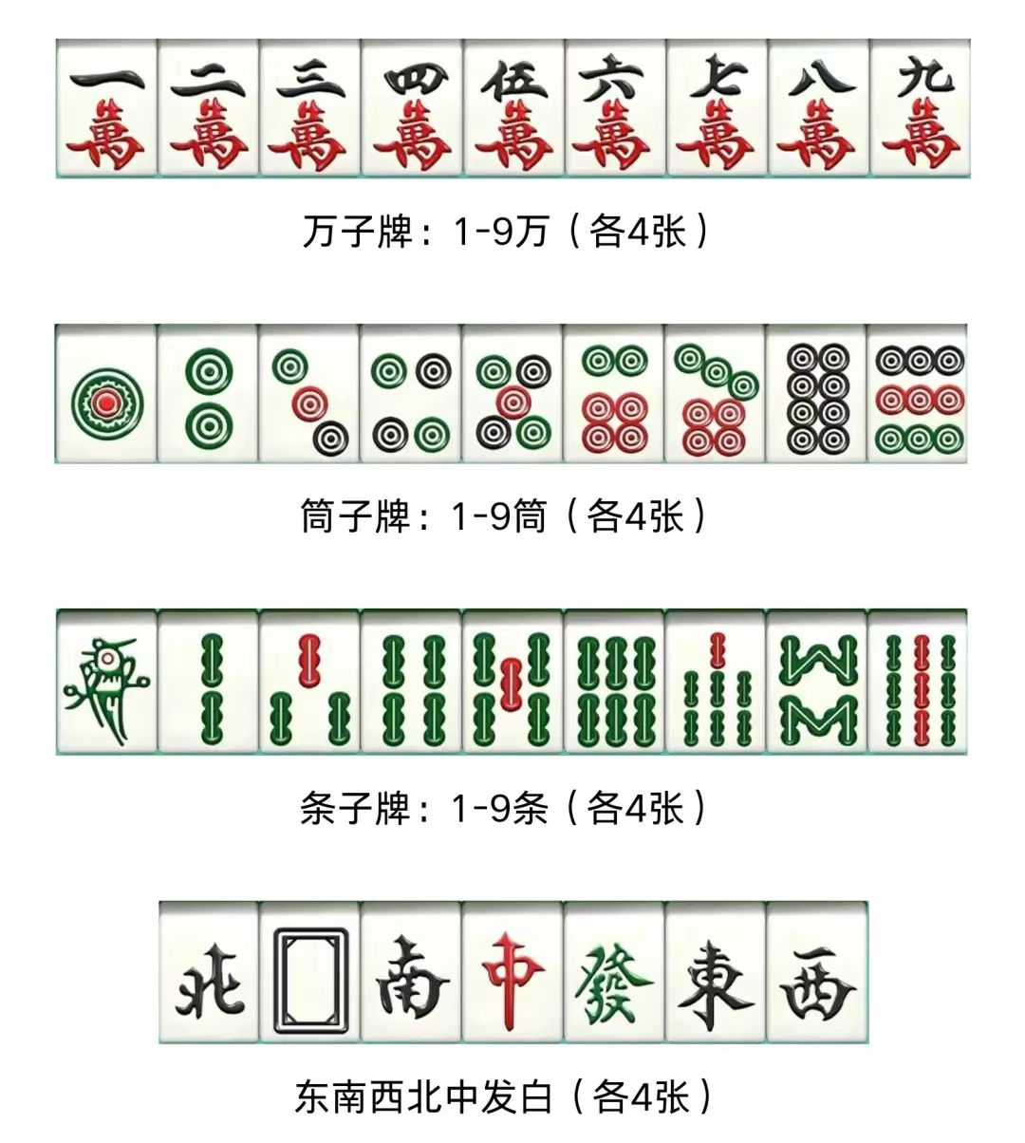
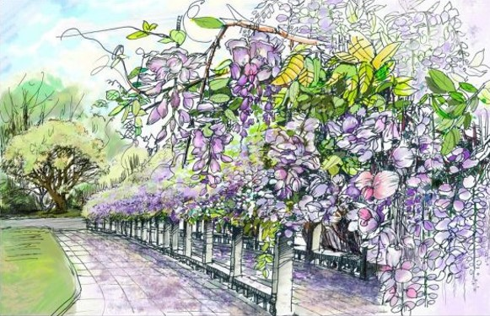
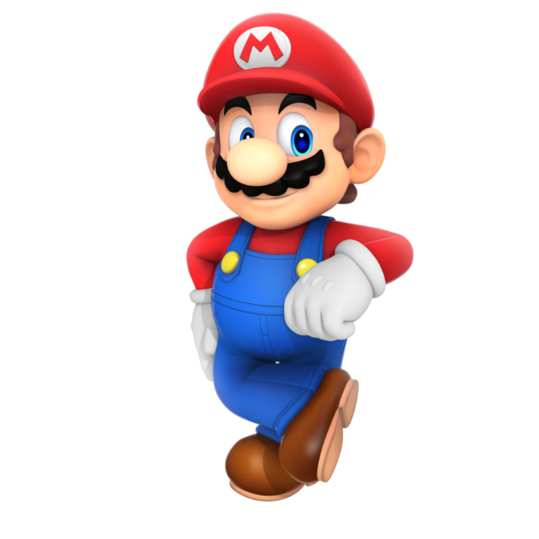
Content

Slide 12
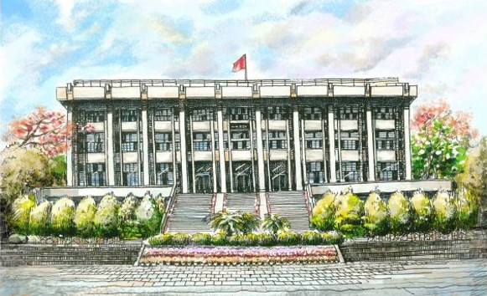




Content
Shuffling and Building Walls（洗牌和砌墙）

Slide 13
Content
Shuffling and Building Walls（洗牌和砌墙）
Rolling the Dice（掷骰子）

Slide 14
Content
Shuffling and Building Walls（洗牌和砌墙）
Rolling the Dice（掷骰子）
Drawing and Discarding（摸牌和打牌）

Slide 15
Content
Shuffling and Building Walls（洗牌和砌墙）
Rolling the Dice（掷骰子）
Drawing and Discarding（摸牌和打牌）
Claiming Tiles (吃、碰、杠)

Slide 16
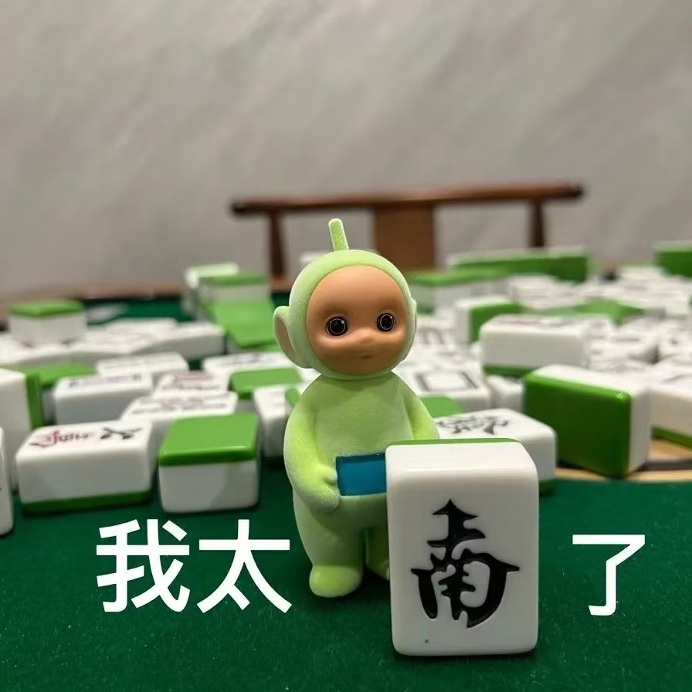

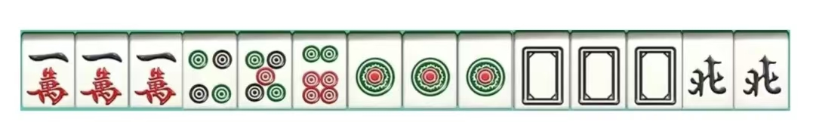
Content
Claiming Tiles:
Chow（吃）: If a player's tile matches two tiles in your hand to form a sequence, you can claim it.(only opponent on the left)
Pung（碰）: If another player discards a tile that matches two in your hand, you can claim it to form a set of three.
Kong（杠）: If you have three identical tiles, you can claim an additional tile from the wall to form a set of four.
HOW to WIN:
You win by being the first to have four sets of tiles and a pair.

Slide 17
Content
?
?
?
Compo
nents
Game
Time
Name
Origin

Slide 18
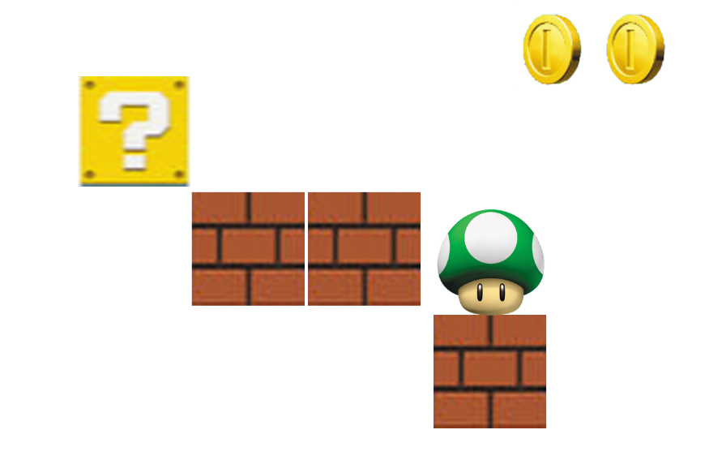
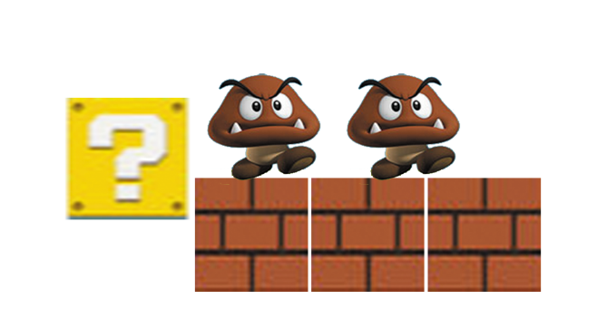


Content

Slide 19
Content
?
?
Wisdom
Compo
nents
Game
Time
Name
Origin

Slide 20
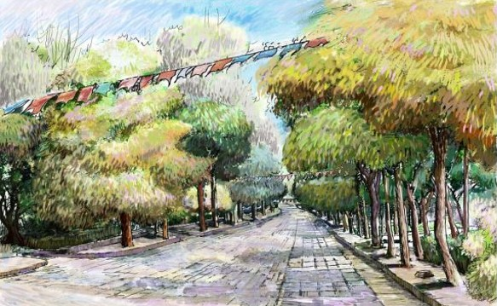
Content
A. Confucianism
In mahjong games, the Confucian principle of "doing at will without breaking rules(从心所欲不逾矩)" is well expressed. Players act independently, adhering to the game's rules, with consequences for violations. Mahjong promotes equality, contrasting with traditional Chinese hierarchy, as players compete regardless of social status. The game's harmony reflects Confucian values, with success achieved through strategic combination of tiles.

Slide 21
Content
B. Philosophy
Mahjong’s tiles are rooted in the Five Elements Theory, with “white” representing earth and “green” the sky. The “red” tile symbolizes the center, connecting the elements and creating a cosmic circle. The complete set of 144 tiles aligns with ancient cosmological concepts, and the suits of “wan,” “cake,” and “strip” reflect the form and quantity of substances. Mahjong’s 13-tile hand mirrors the 52 weeks of the year, illustrating its intricate design and cultural significance.

Slide 22
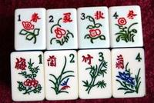
Content
C. Aesthetics
The pattern design of each mahjong card implies a certain appeal of traditional Chinese culture. Take the "flower" as an example, people usually use plum, orchid, bamboo and chrysanthemum ("Four Gentlemen") as the pattern. "Plum" stands for nobility, "orchid" for elegance, "bamboo" for modesty and "chrysanthemum" for purity, showing people's understanding of the order of time and the meaning of life and the chase of a kind of aesthetic personality realm. And "middle", "hair", and "white" 3 cards are on the moral meaning of "fair", "development" and "purity".

Slide 23
Content
Influ
ence
Wisdom
Compo
nents
Name
Origin
Wisdom

Slide 24
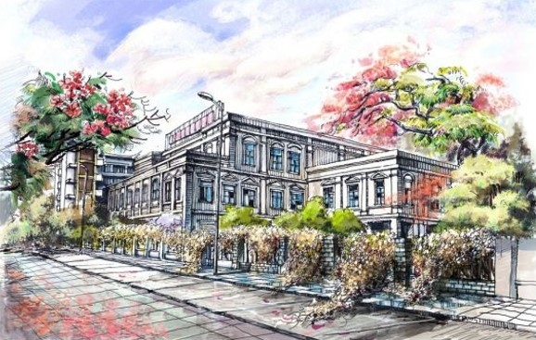
Content
A. Mahjong in America
Mahjong was introduced to Europe and the U.S. in the early 1900s. In the 1920s, John Babcock compiled an English mahjong book, introducing the game to Westerners. The book was successful in the U.S., Canada, and Mexico, and by 1923, mahjong was popular with nearly 15 million Americans. In 1937, the National Mahjong Federation was established in New York.

Slide 25
Content
B. Mahjong in Japan
In 1909, a Japanese man brought Chinese mahjong tiles back to Japan and called them "sparrow". The game quickly gained popularity, leading to the formation of clubs and the creation of Mahjong Pass for learning. In 1998, the Japan Mahjong Tournament Organizing Committee was established, and in 1999, Japan opened the world’s first mahjong museum.

Slide 26
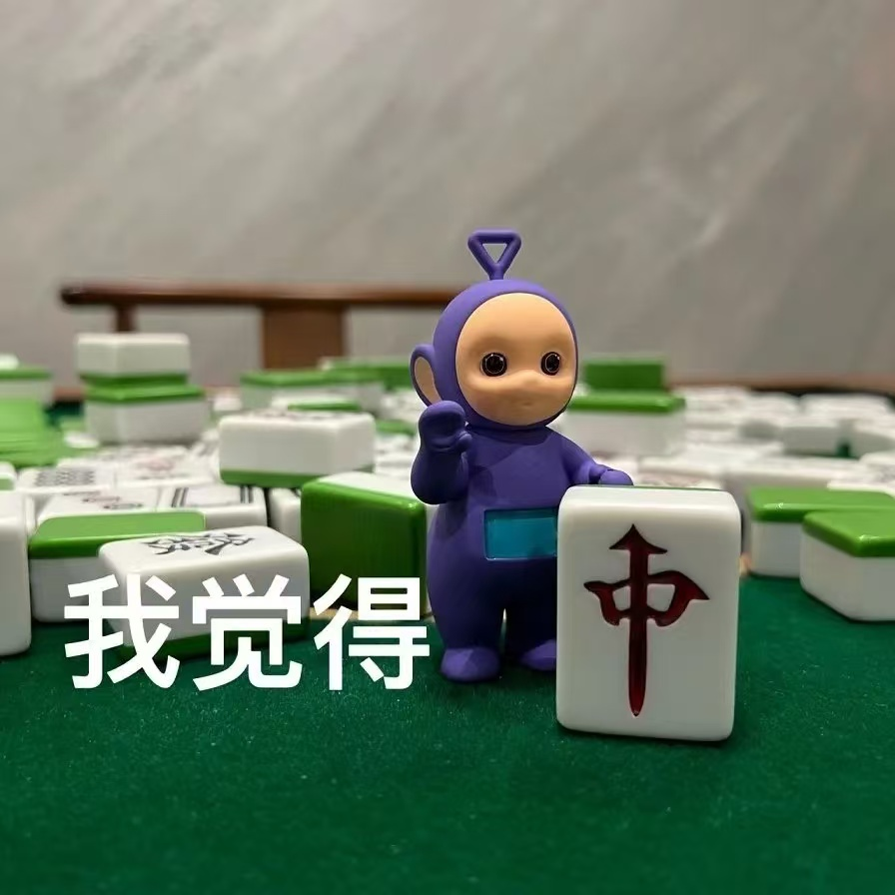

Content
C. Mahjong in Modern China
In 1998, mahjong was officially recognized as a sport in China, marking a significant milestone. In 2005, the World Mahjong Organization was established in Beijing, uniting mahjong groups globally. The World Mahjong Games, held annually, is the highest professional competition, likened to the Olympics for mahjong. The first games were in 2015 in China, with players from over 40 countries. China is considering applying to the IOC to include mahjong in the Olympics. Mahjong is the sixth 'mind sport' recognized by the International Mind Sports Association.

Slide 27
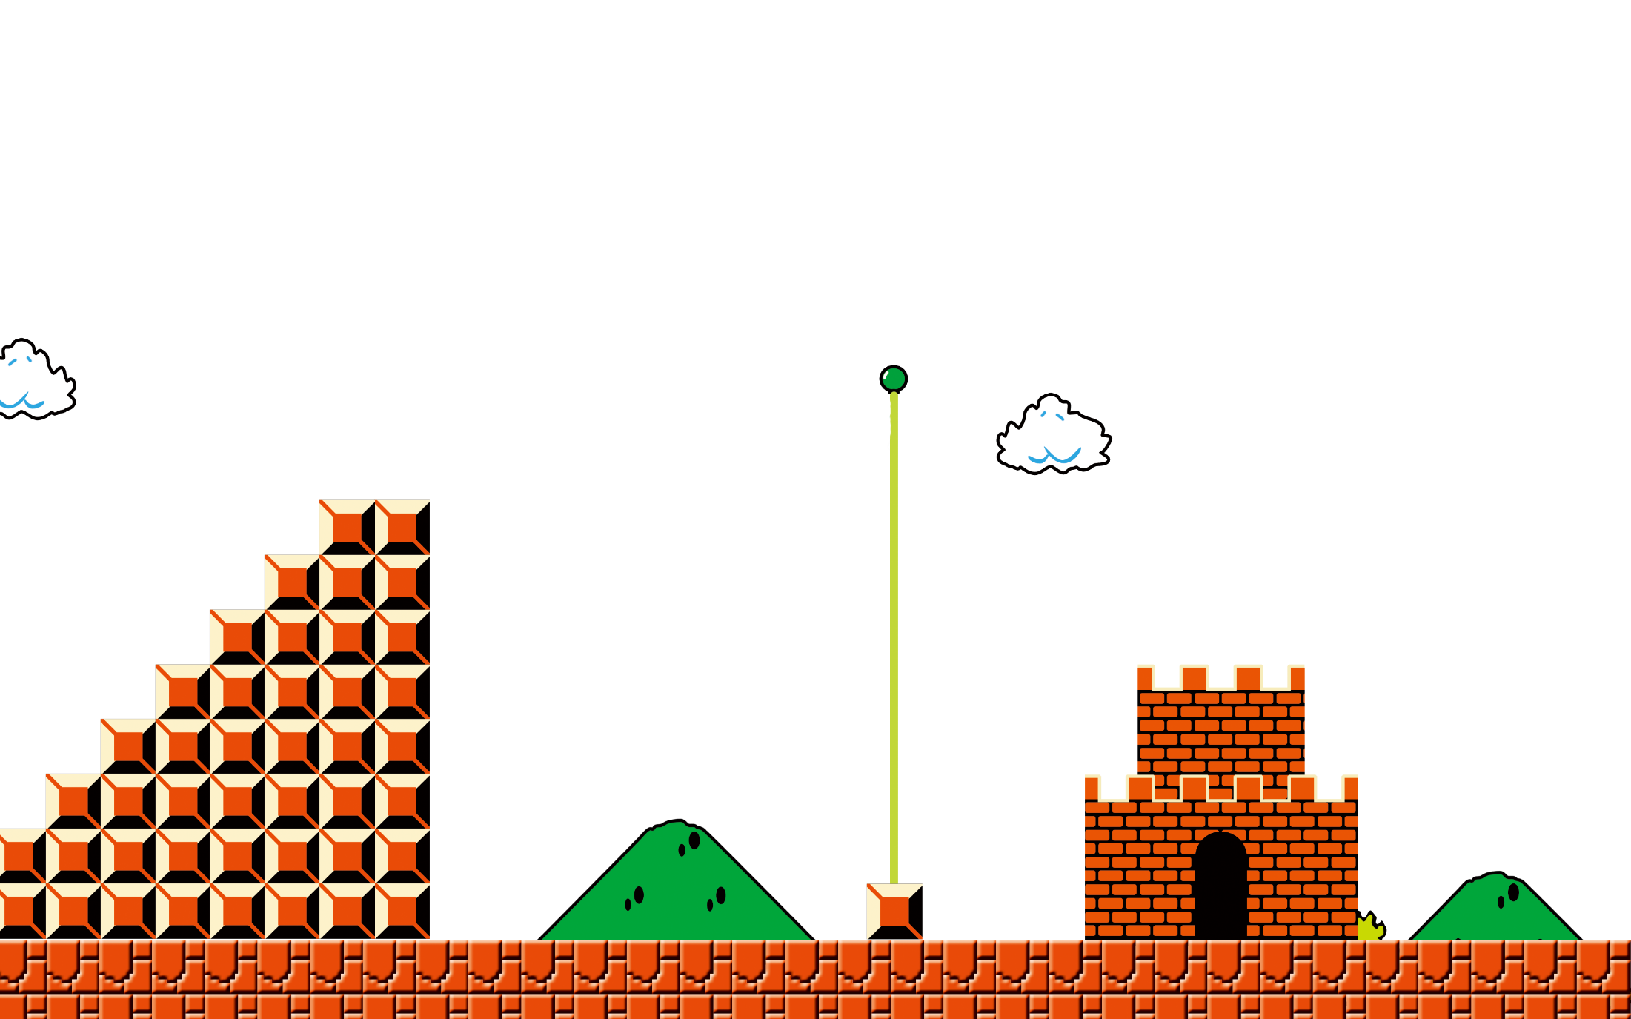
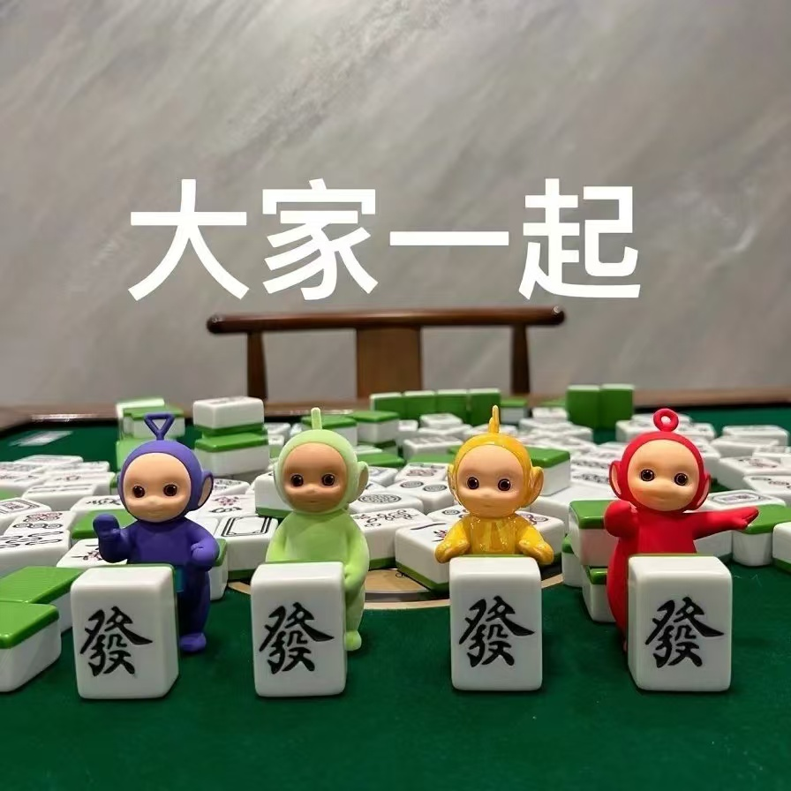

Thank you!

