Slide 1
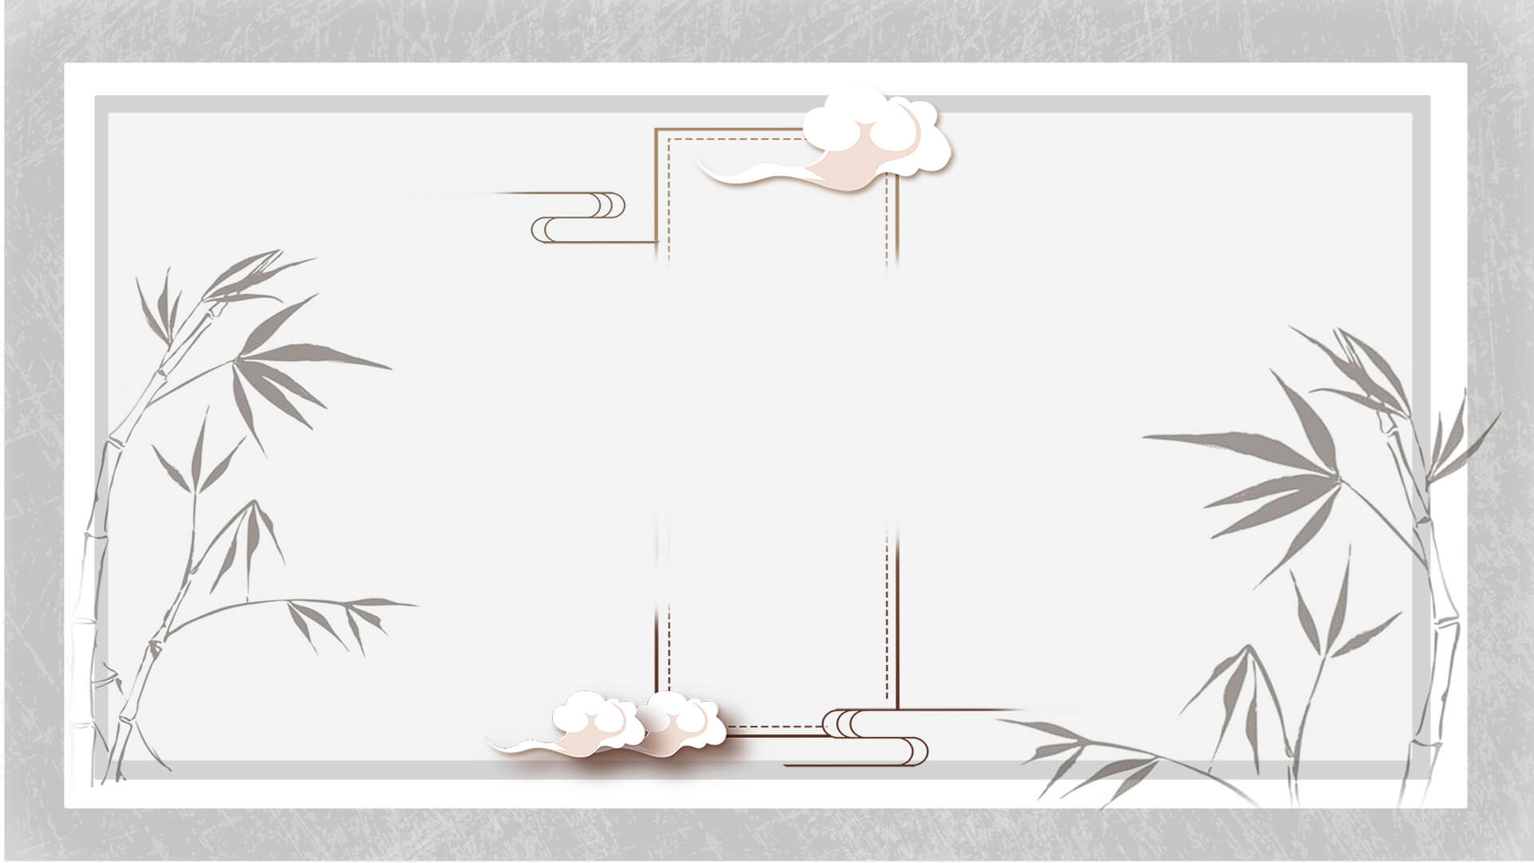
Spring Festival Couplets
Cao Wen

Slide 2
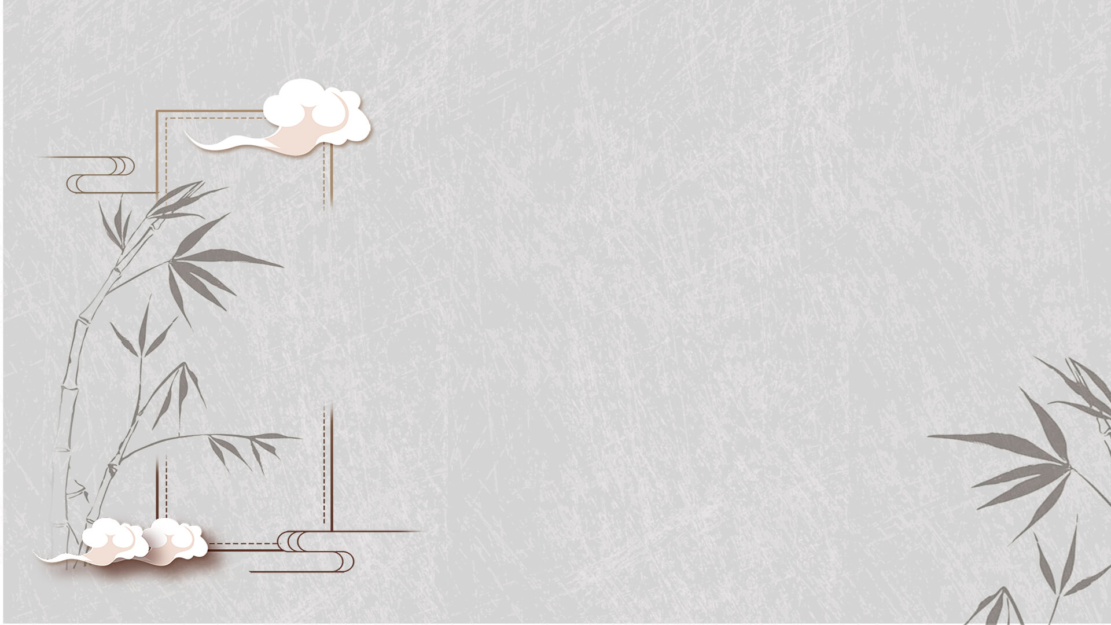
Features & History
Reading & Pasting
Contents
Traditional & Modern
Examples of Spring Festival Couplets

Slide 3
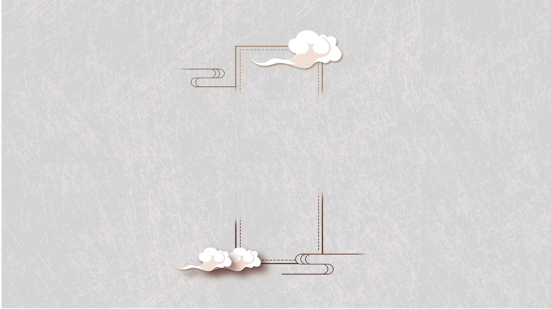
Features & History

Slide 4
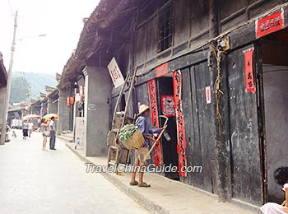
What are Spring Festival Couplets?
black or golden characters
red paper
a pair of poetry lines
a four-character

Slide 5
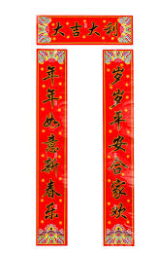
Features
the first line (upper scroll)
parallel structures
antithetical meanings
one-to-one correspondence
the second line (lower scroll)

Slide 6
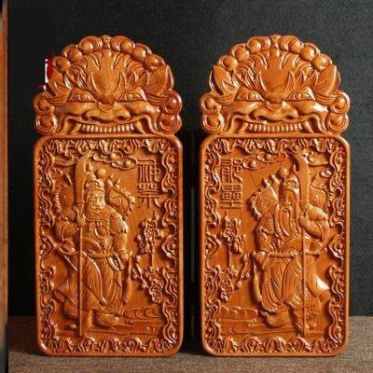
Legend
originated from Taofu
an inscription on boards made from peach trees

Slide 7
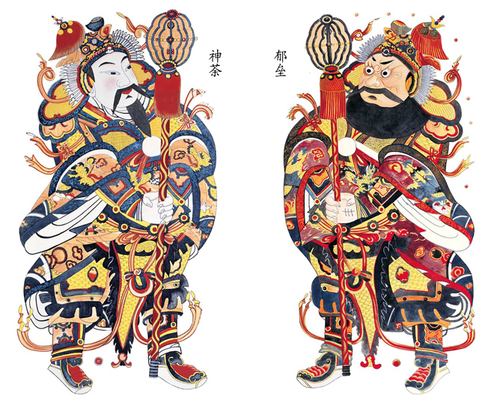
Legend
In the ghost world, a rooster perching in a big peach tree will crow at dawn to call all the traveling ghosts back. In front of the entrance of the dark world, there are two guards named Shentu and Yulei.
If the ghosts harm any people at night, the guards will kill them as the tiger’s breakfast. People believed that peach trees can scare and subdue evil things, so they hung peach boards in front of the doors with the guards’ names written or inscribed on them.

Slide 8
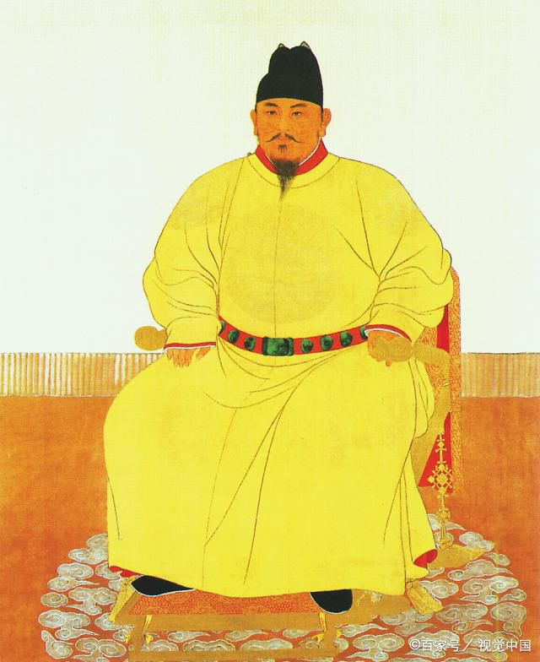
History
During the Song Dynasty (960 - 1279 AD), the wood board was replaced by paper.
The custom became popular in Ming Dynasty (1368 - 1644 AD).
Zhu Yuanzhang ordered all household to paste the scrolls during the Chinese New Year.

Slide 9
Reading & Pasting

Slide 10
How to read？
If the four characters are written from left to right, the upper scroll will be on the left and the lower scroll on the right.
If the characters of the horizontal scroll are reversed, the two side scrolls should be read from right to left.
First, look at the horizontal scroll.

Slide 11
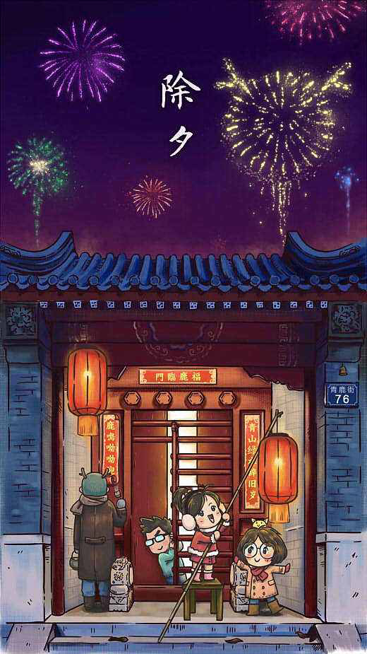
How to paste？
Usually, they should be pasted before New Year’s Eve, and the best time is between 13:00 and 15:00 on the 29th of lunar December.
The correct pasting order is: upper scroll → lower scroll → horizontal scroll.

Slide 12
Taditional & Mordern

Slide 13
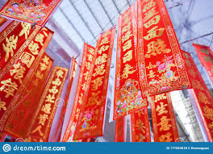
Traditional
In remote or rural areas, people will not remove the old scrolls until the next New Year. Although they are damaged by wind and rain, they will still keep them up until replaced the following year.

Slide 14
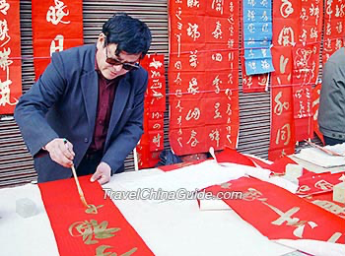
Traditional
Traditional couplets are done with ink and brush, and require excellent calligraphy skills that not everyone has.
The essence of the couplets is demonstrated by the implicit good meaning and stylish calligraphy work.

Slide 15
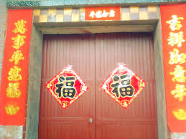
Modern
In modern cities, if the couplets are ruined or damaged, people usually tear them off after the Lantern Festival. Some will just throw them away, while others will burn them.
According to legend, Spring Couplets are gods. After burning, the god can go back to heaven, which will bring good luck to the family.

Slide 16
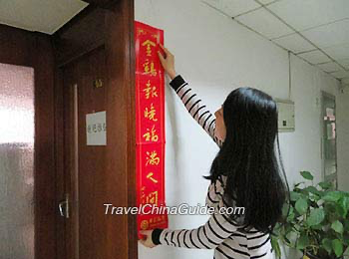
Modern
Nowadays, the most commonly seen couplets in China are printed ones. People usually purchase the printed ones 5 – 10 days before New Year's Eve.
Banks and supermarkets will also present printed ones to their customers. Printed ones are cheap and convenient, but are still delicate and colorful in design and decoration.

Slide 17
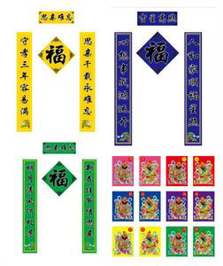
In some rural area, the couplets in yellow, green or purple can also be seen, which suggests that a household has family members passed away in three years, and it is a special custom to mourn for them.

Slide 18
Examples of Spring Festival Couplets

Slide 19
上联：事事如意大吉祥
Upper Scroll:May you have good luck in everything
下联：家家顺心永安康
Lower Scroll: May you feel content and your family healty
横批：四季兴隆
Horizontal Scroll: Flourishing in Four Seasons

Slide 20
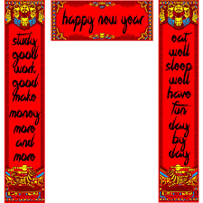

Slide 21
Thanks！

