Slide 1
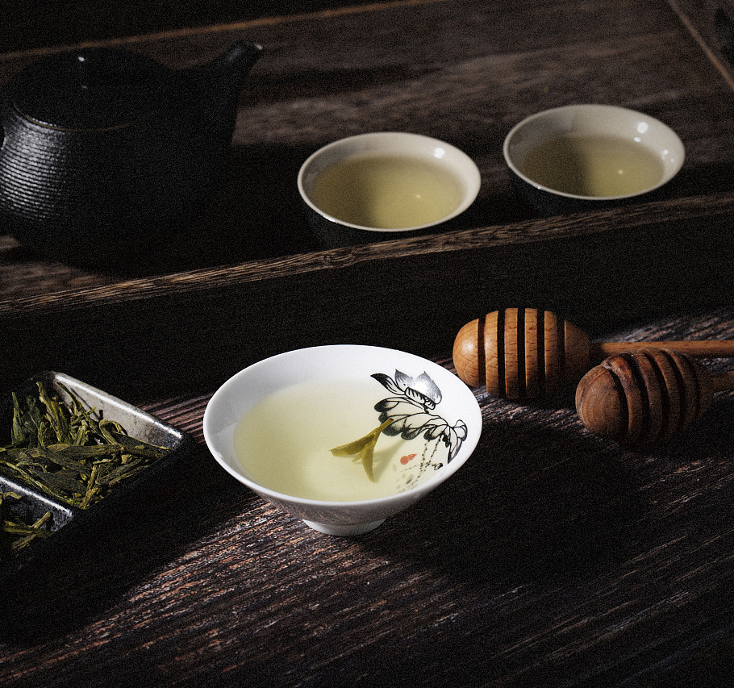
Tea
Li Siwen

Slide 2
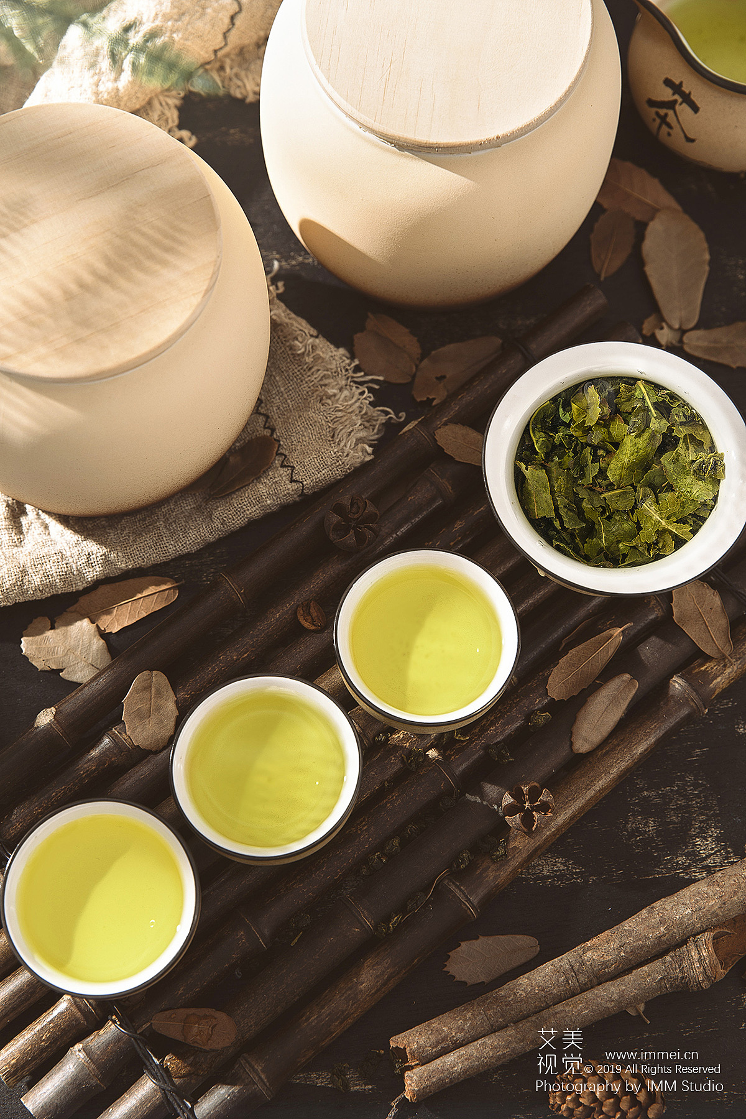
contents
the types of tea
philosophy of Chinese tea culture

Slide 3
the types of tea
green tea
black tea
Oolong tea
white tea
Fermented tea
yellow tea
Standard: different craftsmanship and oxidation degree of polyphenols in tea

Slide 4
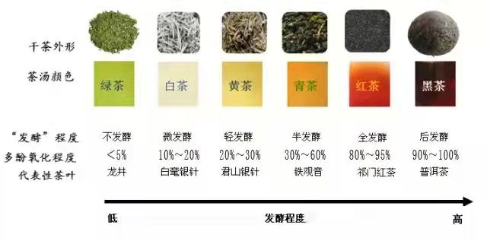

Slide 5
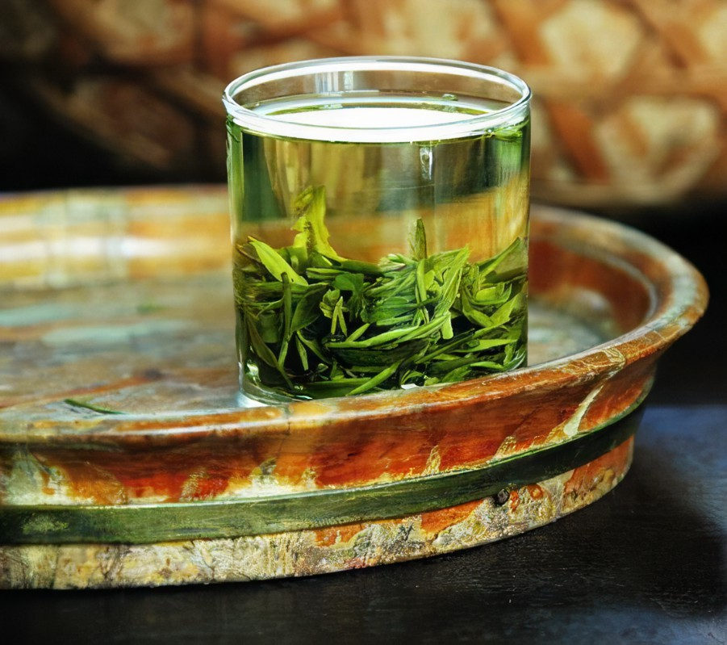
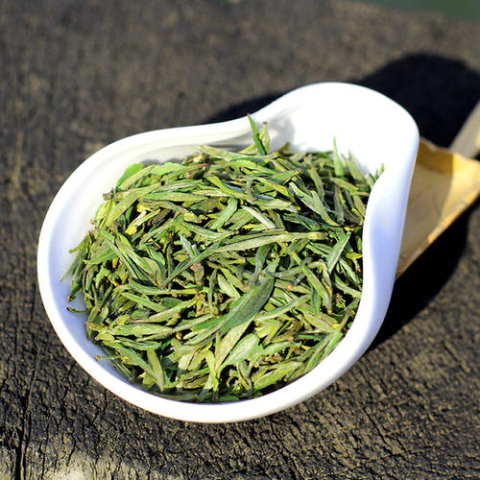
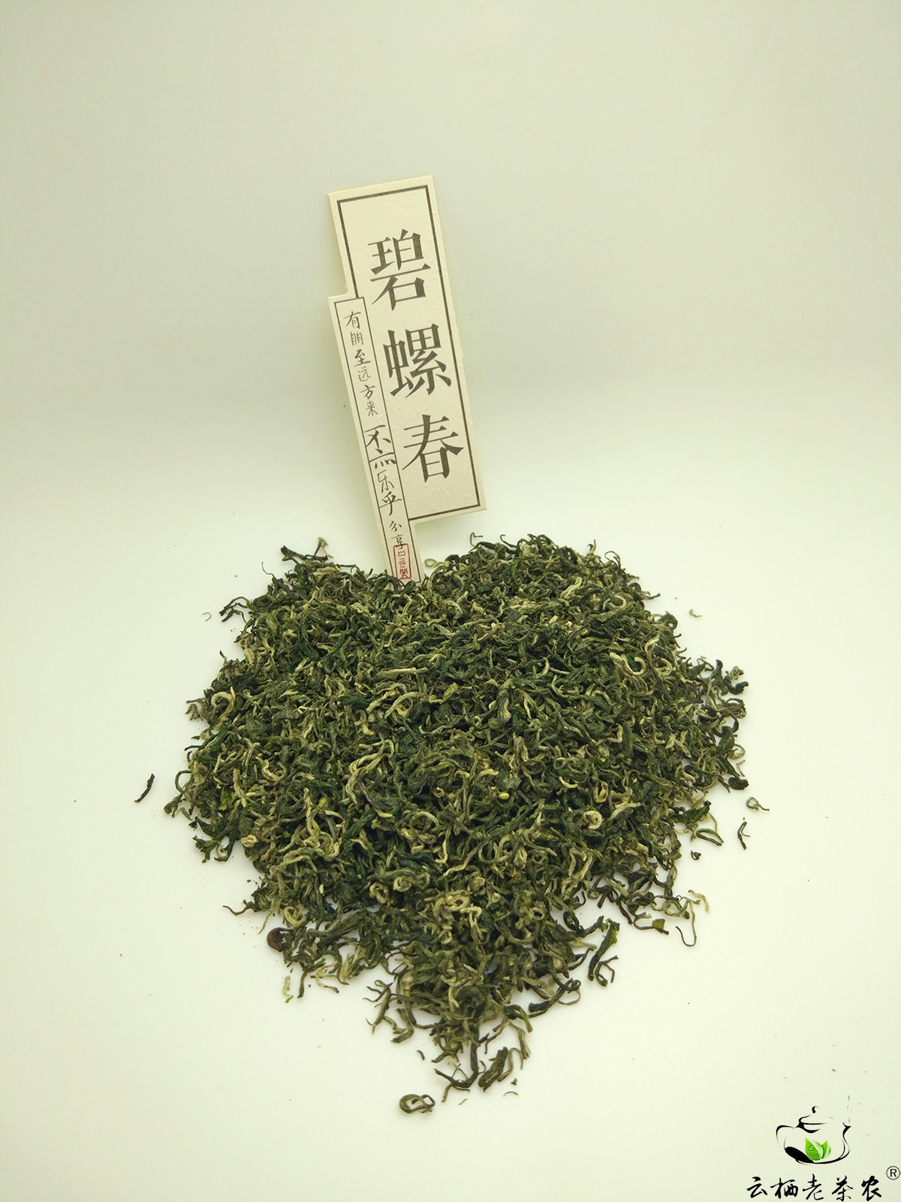
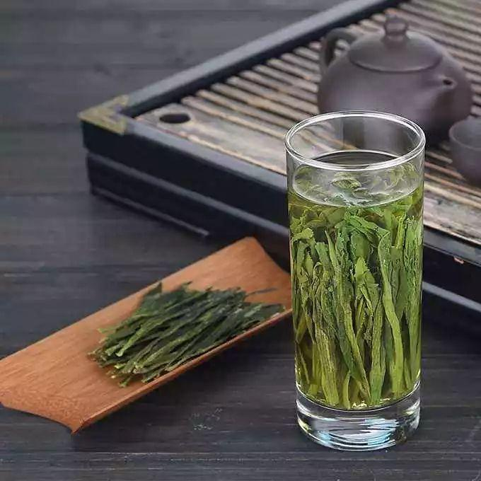
Green tea
Green tea has the longest history and still ranks first in output and variety today, produced all over the country.
It has the “ three green” characteristics of dry tea green, tea soup green and green leaf bottom. Green tea is rich in chlorophyll, vitamin C. It is cold, high in theophylline and easier to stimulate nerves.
West Lake Dragon Well
Maofeng Tea from Mount Huangshan
Biluochun
Taiping Houkui

Slide 6
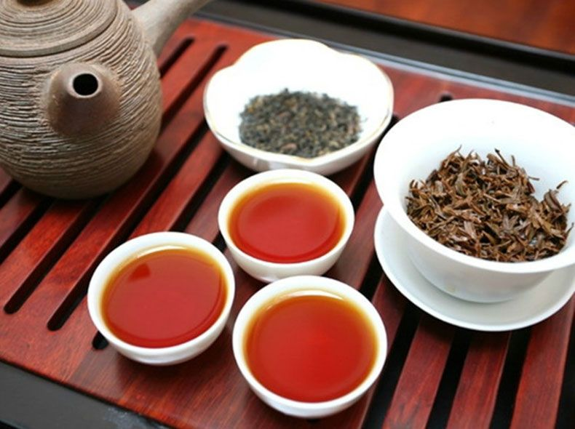
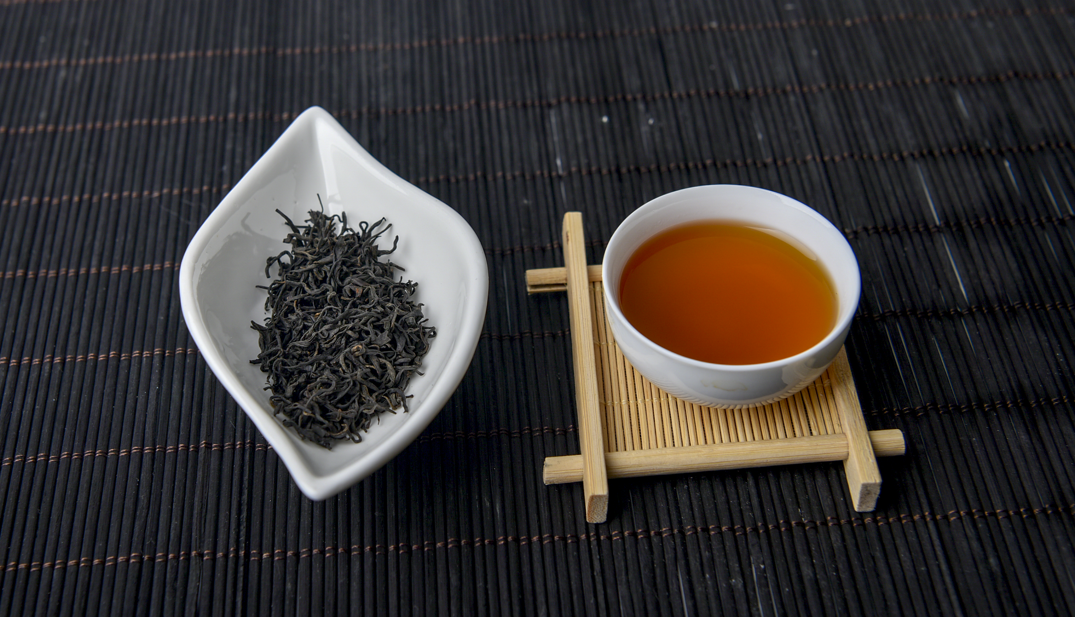
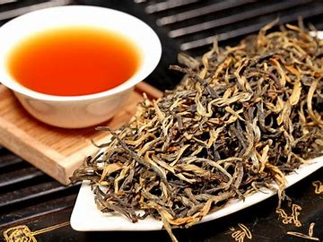
Black tea
Black tea is also popular both at home and aboard. Different from green tea, it is thoroughly fermented. In the fermentation, the tea turns from green to black and rare and healthful fungi grow so that it is more fragrant and nutritious.
Keemun black tea
Keemun black tea
Ninghong tea
Dianhong tea

Slide 7
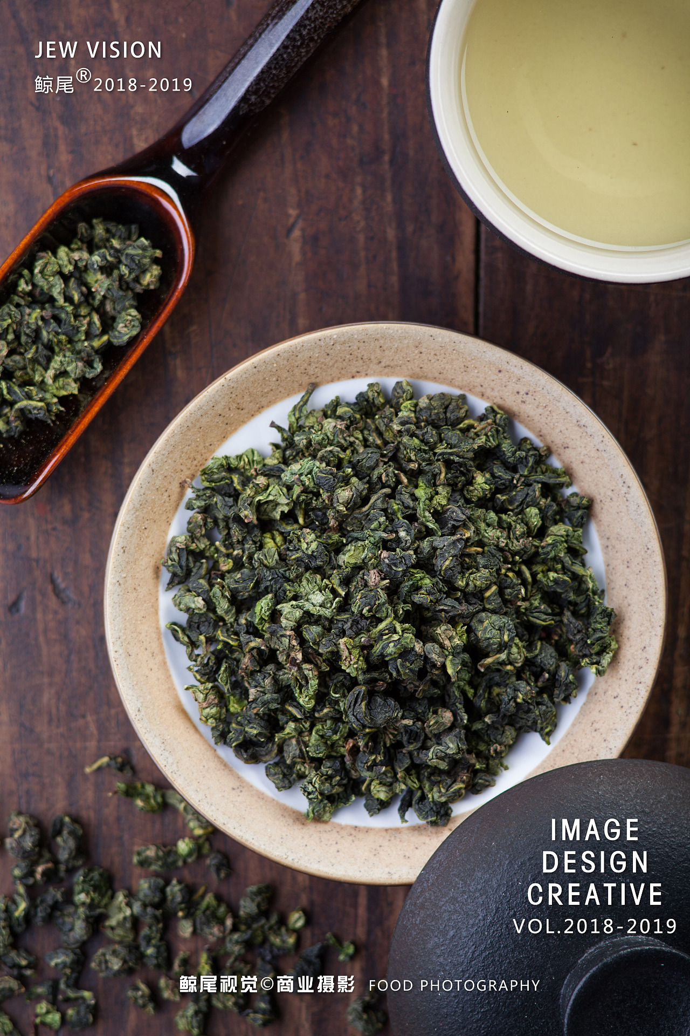
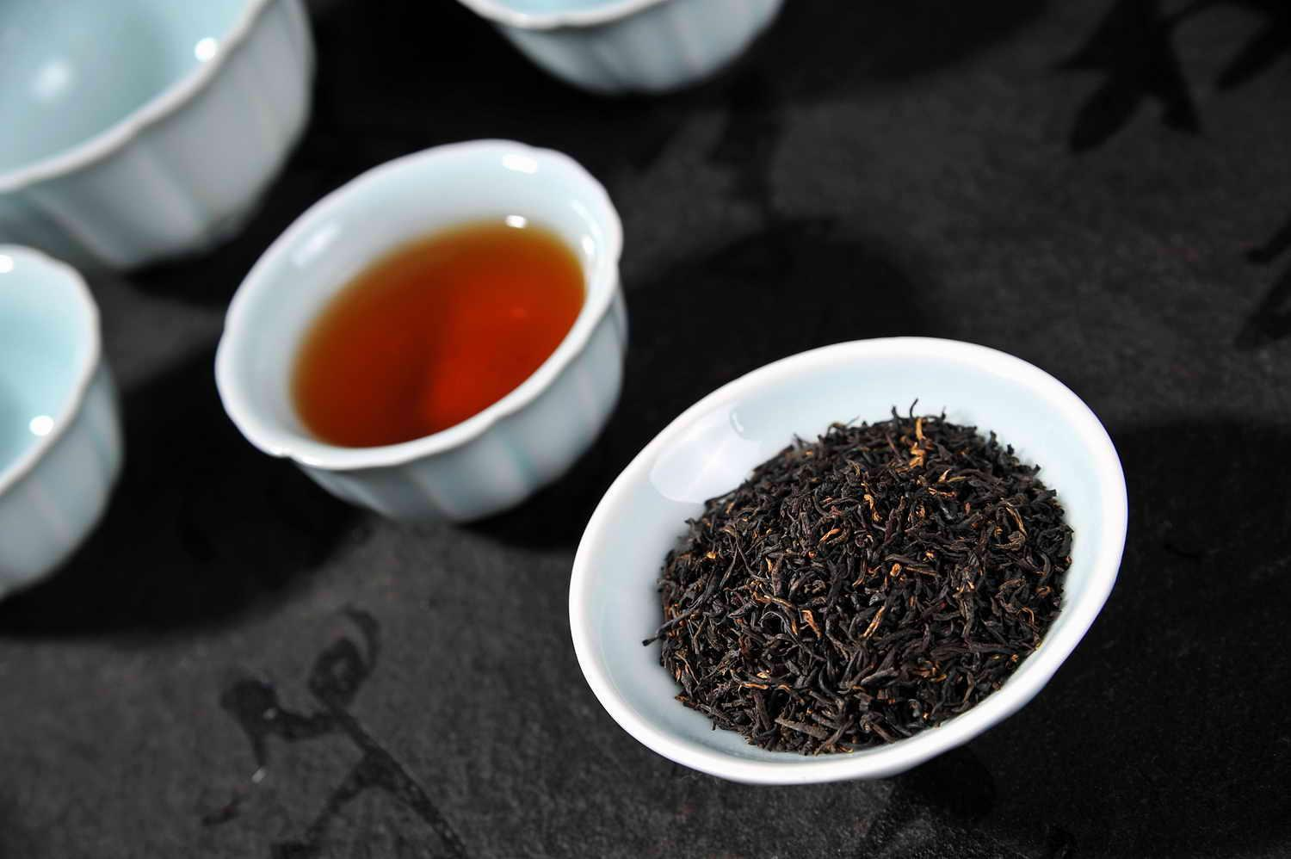
Oolong tea
Oolong is a traditional semi-oxidized Chinese tea produced through a process including withering the plant under strong sun and oxidation before curling and twisting and possessing the freshness of green tea and the fragrance of black tea. Oolong is especially popular in south China and among Chinese expatriates in Southeast Asia as is the Fujian preparation process known as the Gongfu tea ceremony.
Wuyi Rock Tea
Anxi-tieguanyin

Slide 8
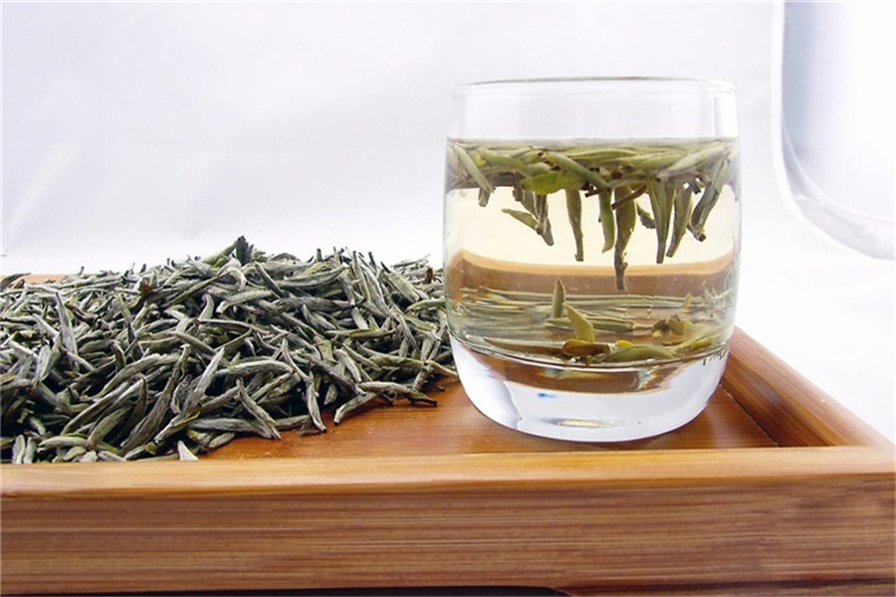
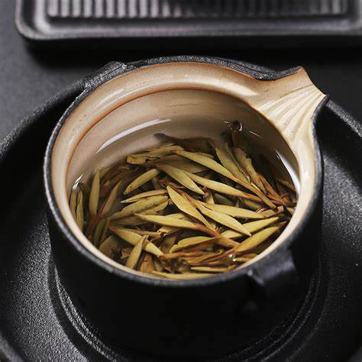
withe tea
With tea is generally feature young or minimally processed leaves of the Camellia sinensis plant. White tea is as white as silver and its water is almost clear. It is mainly produced in Fujian province.
Baekho Silver Needle
White Peony scented tea

Slide 9
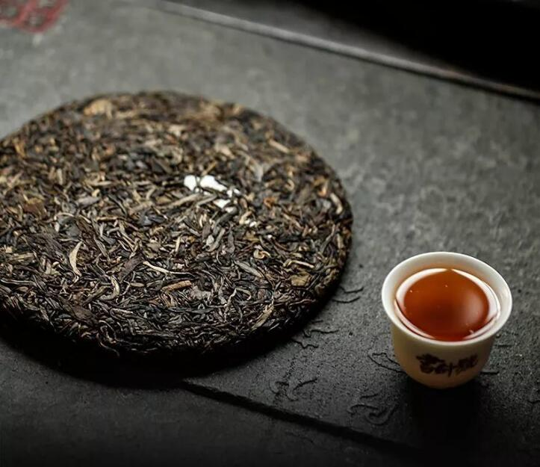
Fermented tea
Fermented tea is a class of tea that has undergone microvial fermentation, from several months to many years. The most famous fermented tea is Pu-erh produced in Yunnan province.
Pu-erh

Slide 10
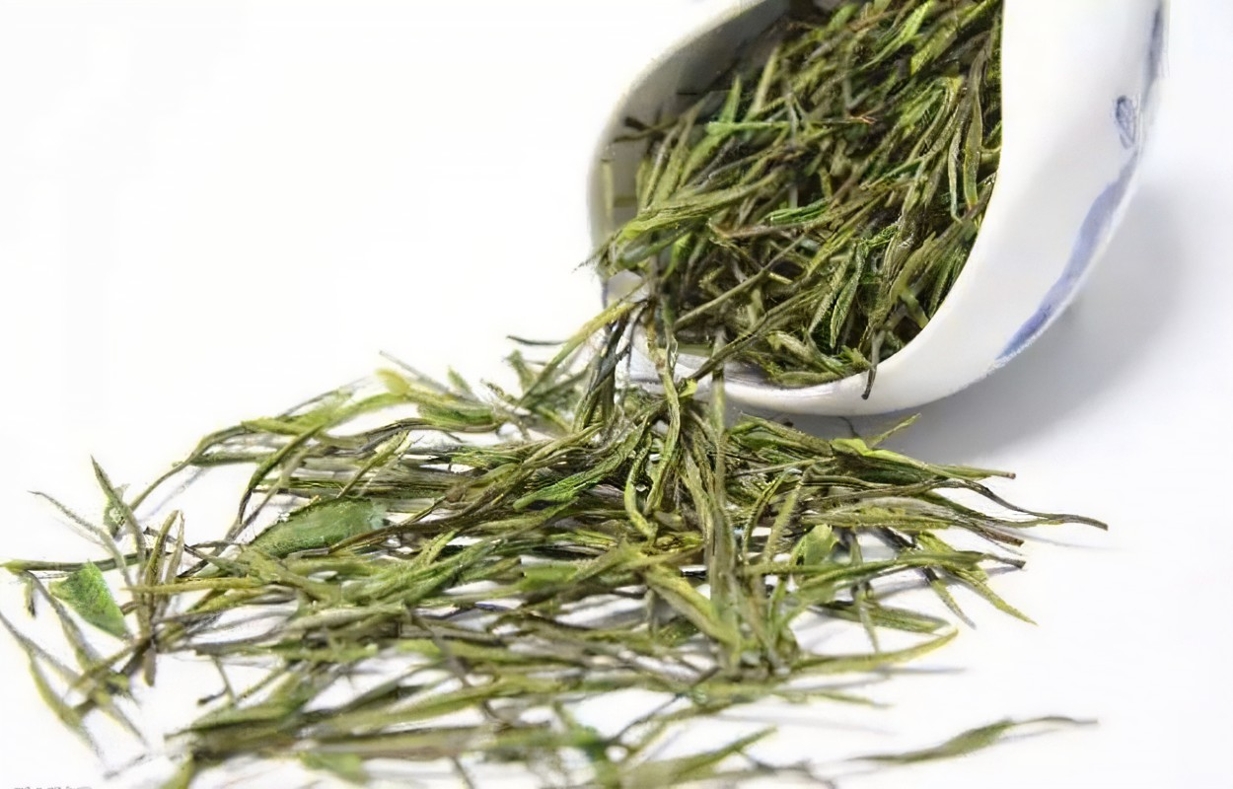
Yellow tea
Yellow tea is an increasingly rare and expensive variety of tea. The process for making yellow tea is similar to that of green but with an added step of encasing and steaming the tea.
Junshan Silver Needle

Slide 11
philosophy of Chinese tea culture
The spirit ritual: there is a saying of serving tea,which was used to promote harmonious relations. For example, subjects presented tea as tribute to the monarch and the monarch gave tea to his ministers to show respect.
Confucianism
Taoism
Chinese tea culture
Quiet and inaction: the ancient Taoist priests and poets did not pay attention to tea techniques and utensils but use a natural and casual way to enjouy tea, in order to pursue the spiritual realm of the heart.
Buddhism
Zen and karma

Slide 12
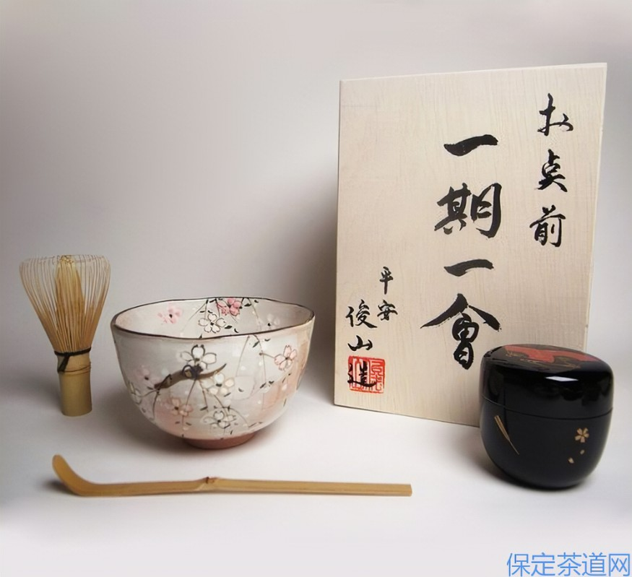
A lifetime for a moment
This means that every time we sit and drink tea with friends, we should cherish it deeply, because it may only be once in a lifetime. Once it is over, it will never happen again. In other words, the tea, the time, the weather, the place, the communication and moods couldn’t be the seem with the last one and the next one. Each of our tea experiences is unique, so when we drink tea, we will sink into a kind of deep treasure, so as not to miss the most karma.

Slide 13
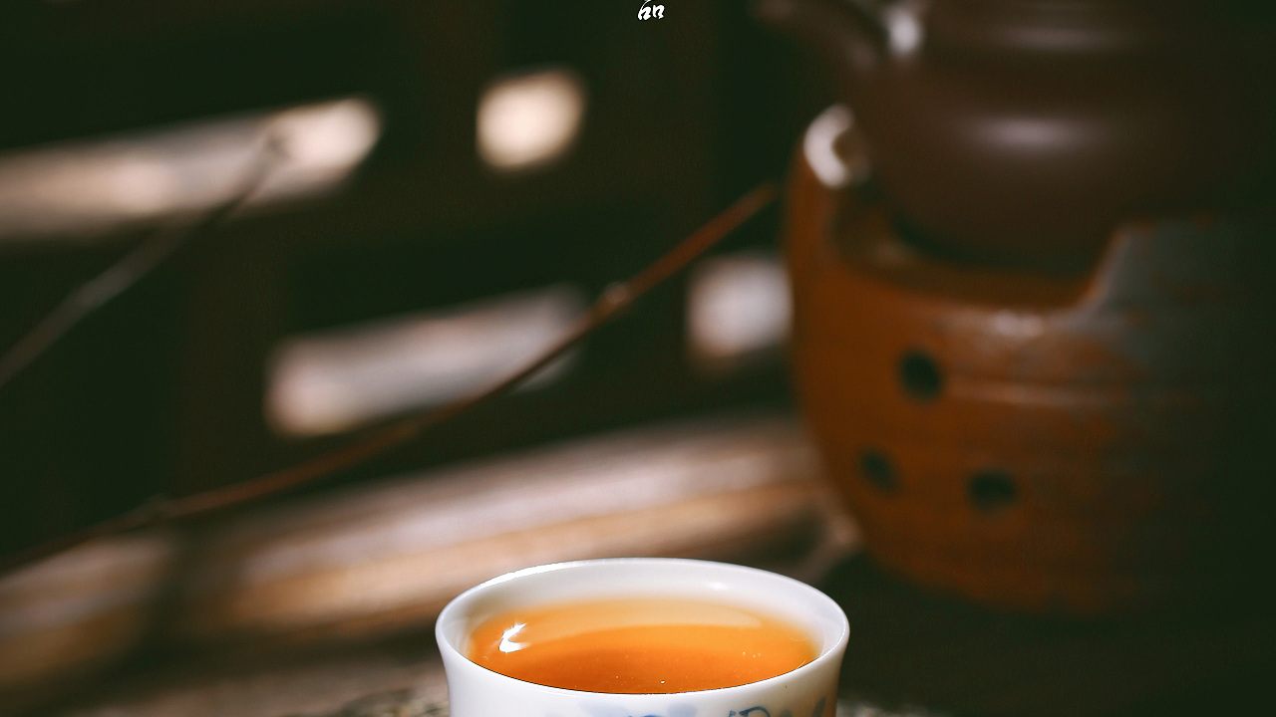
Thank you !

