Slide 1
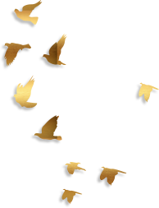
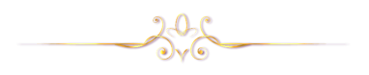
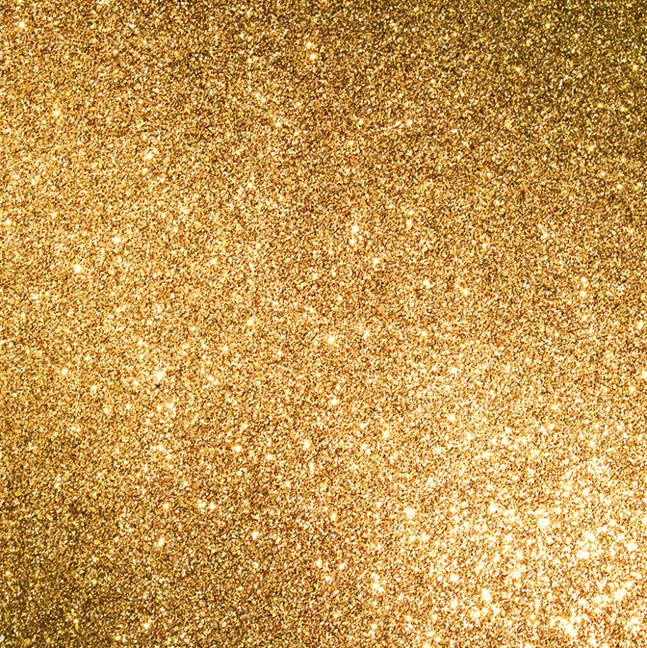
步
摇
——A Traditional Chinese Headdress: Buyao
By Yang Jing

Slide 2
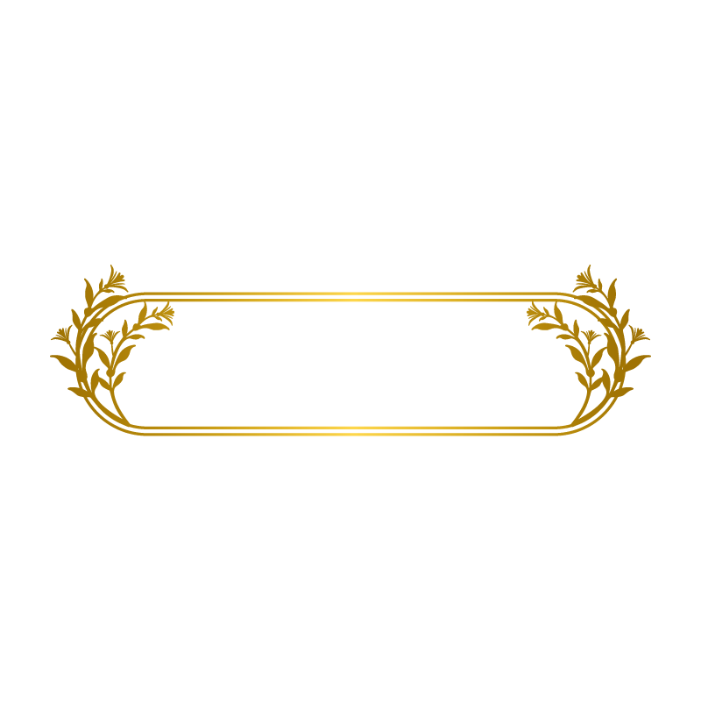
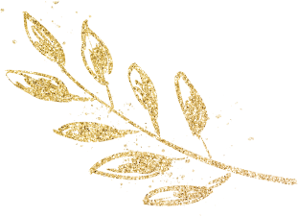
Origin
Contents
Development
Definition
(Composition)
Function

Slide 3
1
Definition
&
Composition
of Buyao

Slide 4

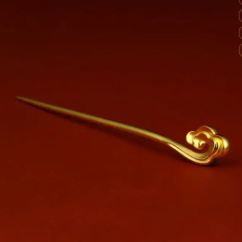
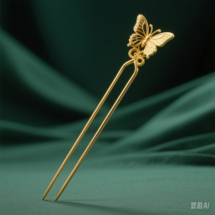
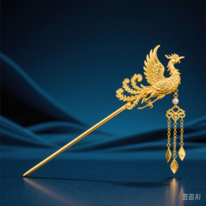
Which one is Buyao?
A
B
C
√
Zan簪
Chai钗
Buyao步摇
hair stick
(single-pronged hairpin)
hair fork
(U-shaped hairpin)

Slide 5
The composition of Buyao:
Zan簪
or
+
Dangling pendants
=
Chai钗
Buyao步摇
pendant-adorned hairpin

Slide 6
Contents
Definition
(Composition)
Function

Slide 7
2
Function
of Buyao

Slide 8
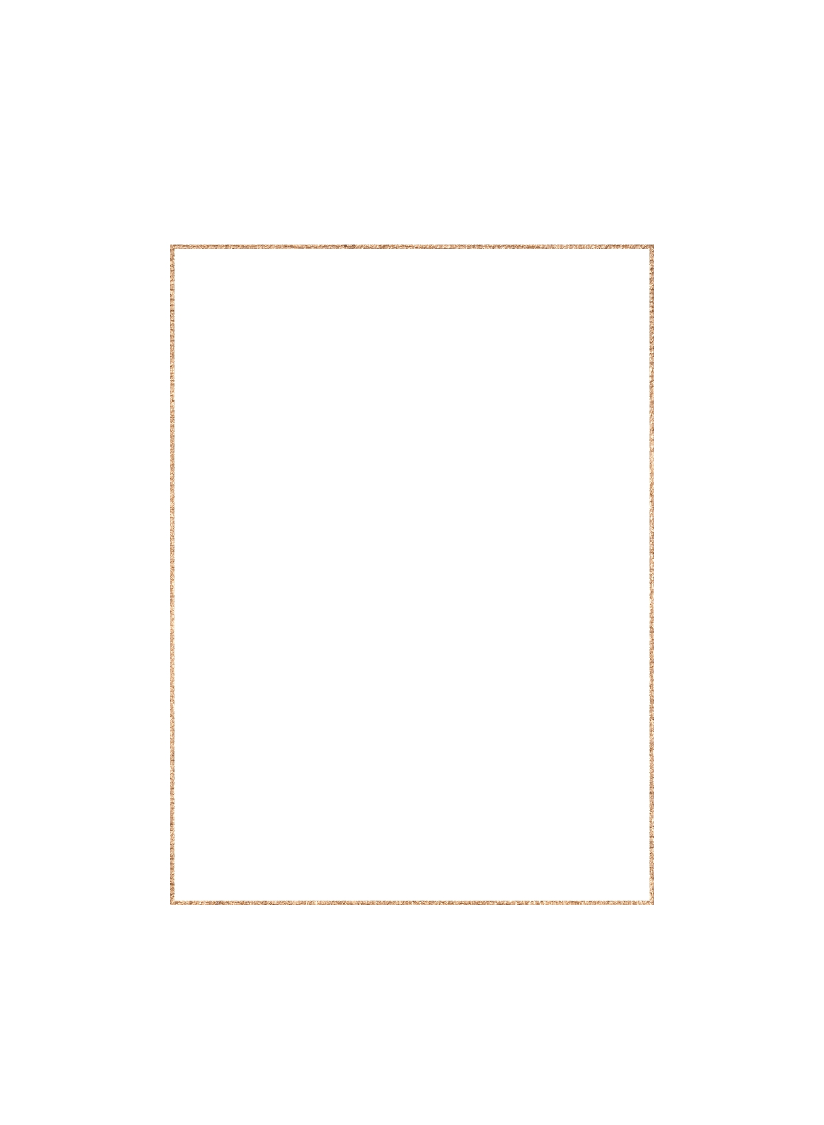
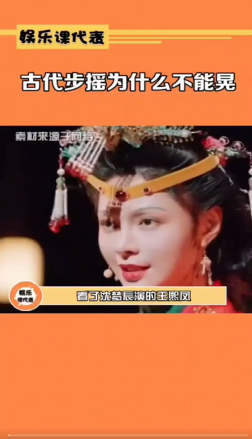
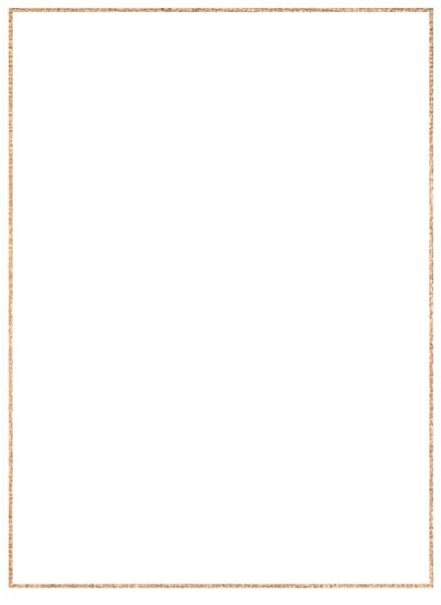

Function of Buyao
restricting the demeanor of the wearer?
步摇=不摇？
the wearer can not make it sway?

Slide 9
步摇 = 不摇？
No book clearly states that the buyao was used to restrict wearers' demeanor.
《释名·释首饰》：“步摇，上有垂珠，步则动摇也。”
王先谦集解引陈祥道曰：“汉之步摇，以金为凤，下有邸，
前有笄，缀五采玉以垂下，行则动摇。”
It is precisely the swaying and graceful movement of the buyao while walking that can show its unique charm.
to restrict the behavior of the wearer
√
Function of Buyao：
×
Decorative function

Slide 10
Conclusion
Many traditional customs in ancient China were initially positive and beneficial. However, during the process of inheritance in later generations, there were misinterpretations, causing the original "essence" to turn into "dross".
Therefore, we should maintain rationality, think dialectically, and inherit traditional culture with a critical mindset.

Slide 11

Thank you
By Yang Jing

