Slide 1

抖音(Douyin)
Record your life
记录你的美好生活
Presenter: 王慧安

Slide 2
Contents
01
02
03
Platform introduction
Effects
Comparison of the different versions
Record your life

Slide 3
Platform introduction
Douyin
Record your life

Slide 4
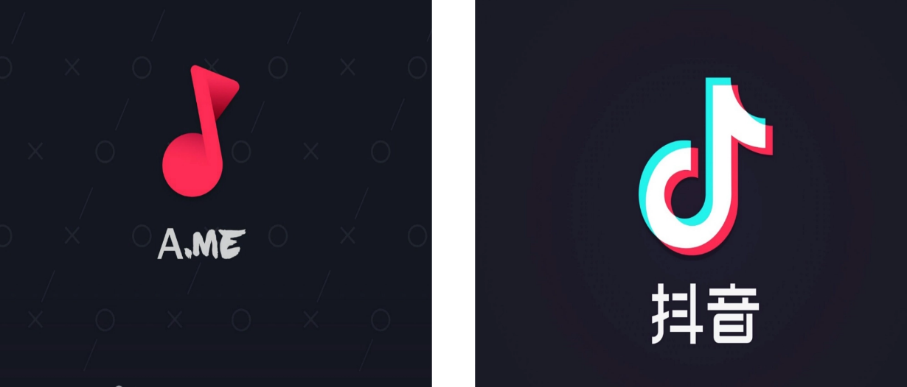


Platform introduction
Douyin, (抖音, literally “shaking sound” in Chinese)
Founder: Zhang Yiming（张一鸣）
Slogan:Record your life
2016.9, A.me 2016.12,抖音
2022.5

Slide 5
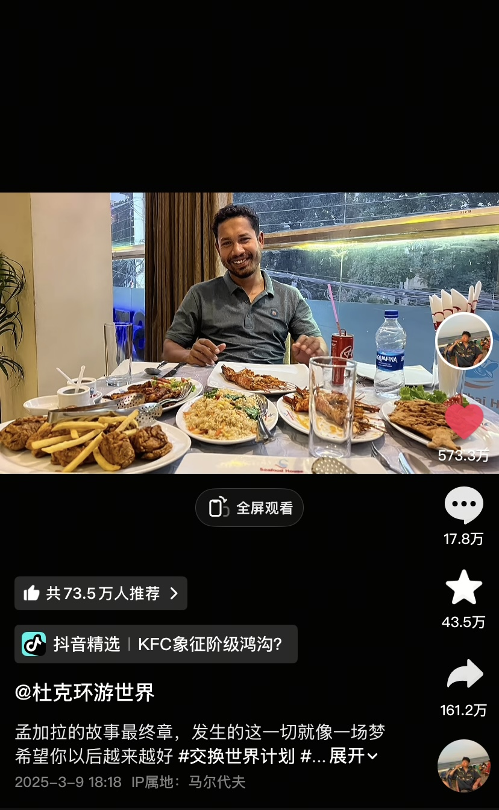
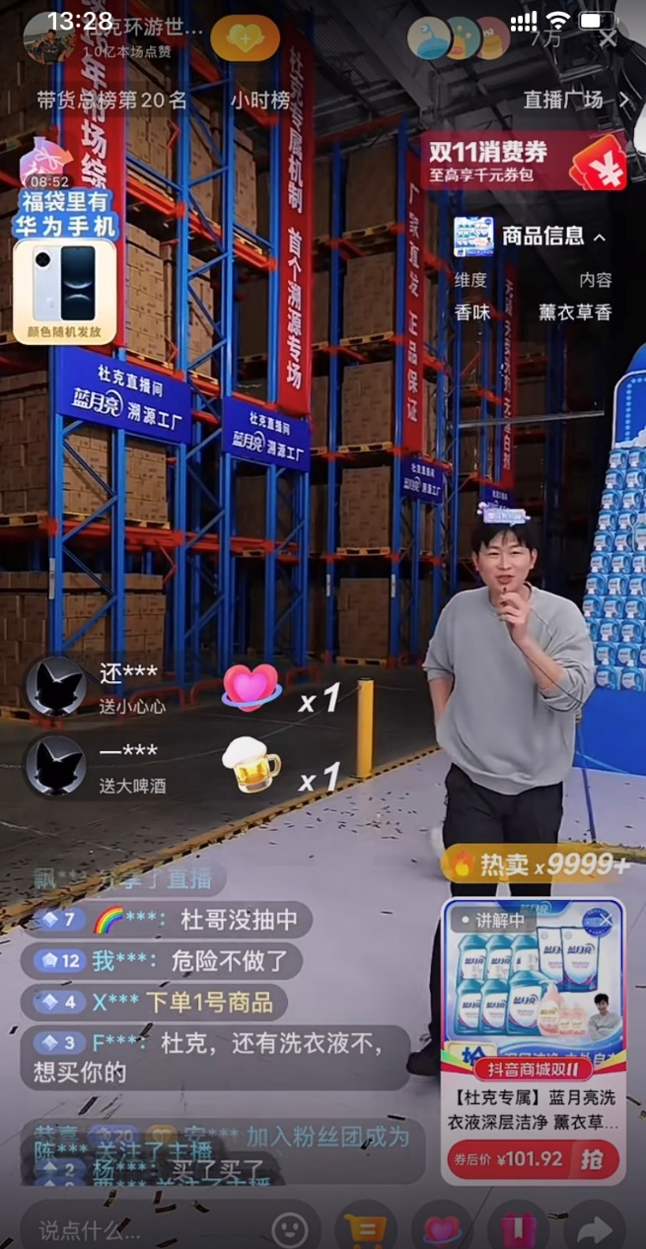
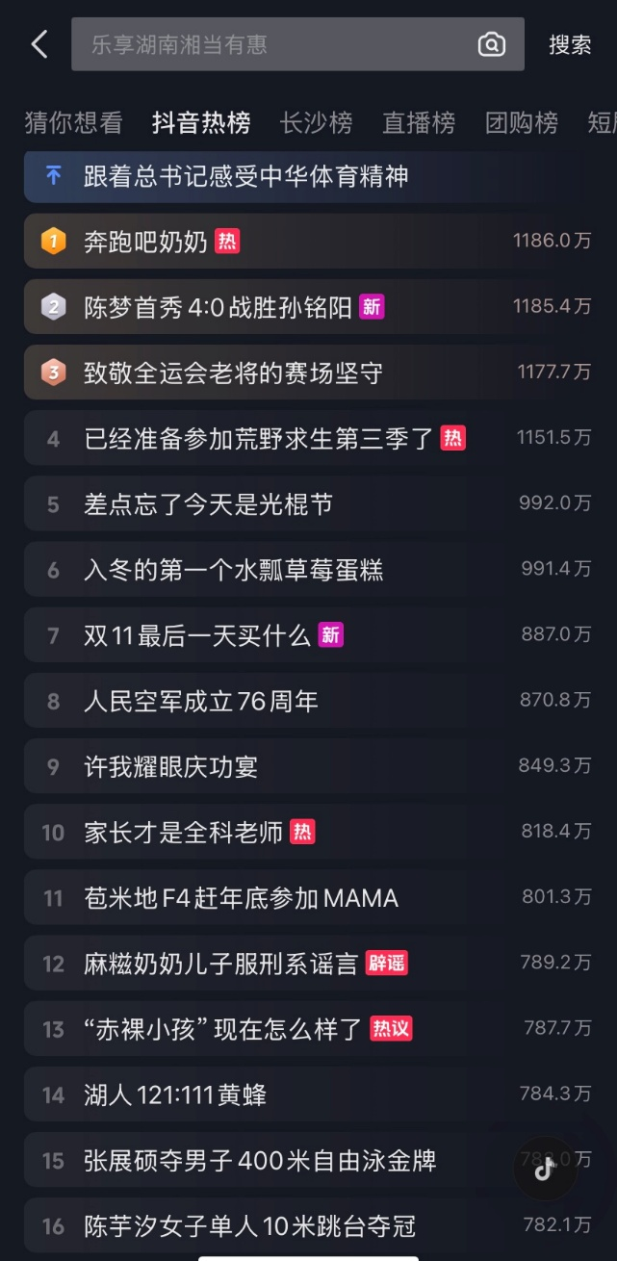
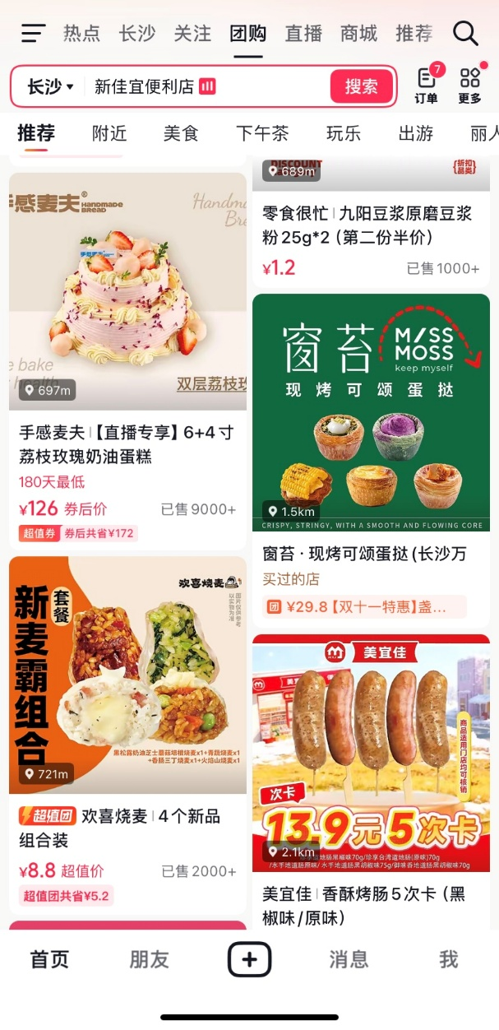
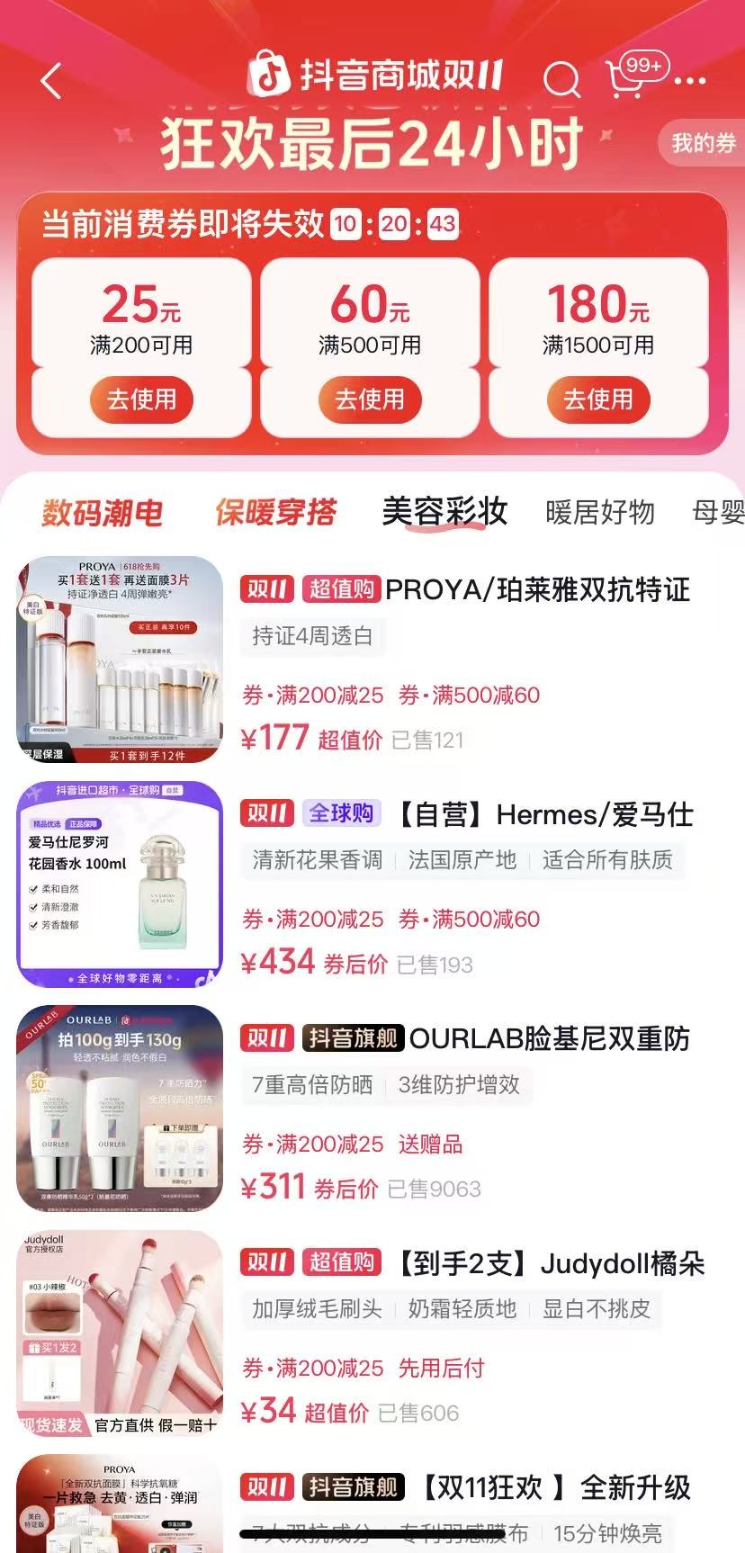
Main functions
1.Live streaming function
2.Social interaction
3.Search function
4.E-commerce function

Slide 6

Main functions
5.Short video shooting and editing
Selfie or ask someone else to
take pictures for you
Music
Flashlight
Countdown
Picture editing
Filter
Photos or videos
Special effects

Slide 7
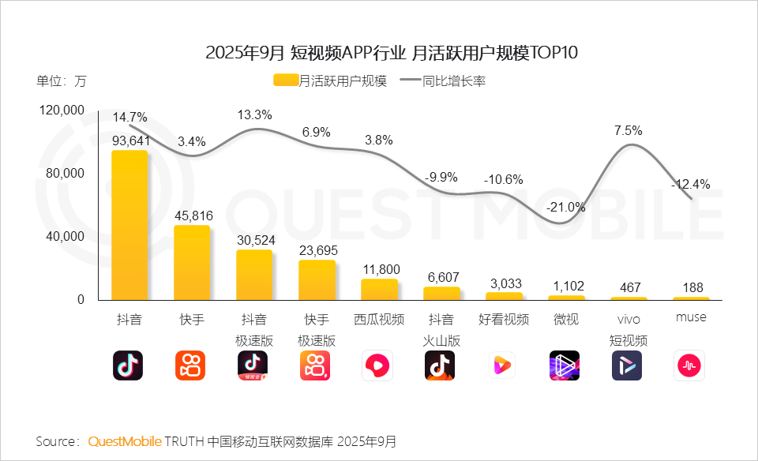
Data analysis
1.3 billion

Slide 8
Comparison of the different versions
Douyin
Record your life

Slide 9




抖音极速版
抖音火山版
抖音精选
AI抖音
A smaller installation package than the official version.
Life hacks,humorous skits,and local stories.
Knowledge popularization, skill tutorials, and documentaries
Understand video content and extract key points for users.
Earn money by watching videos.
Earn money,karaoke.
Tool-based monetization
Retaining only video
browsing and simple
Sharing.
Users in third and fourth-tier cities make up 72% of its user base.

Slide 10
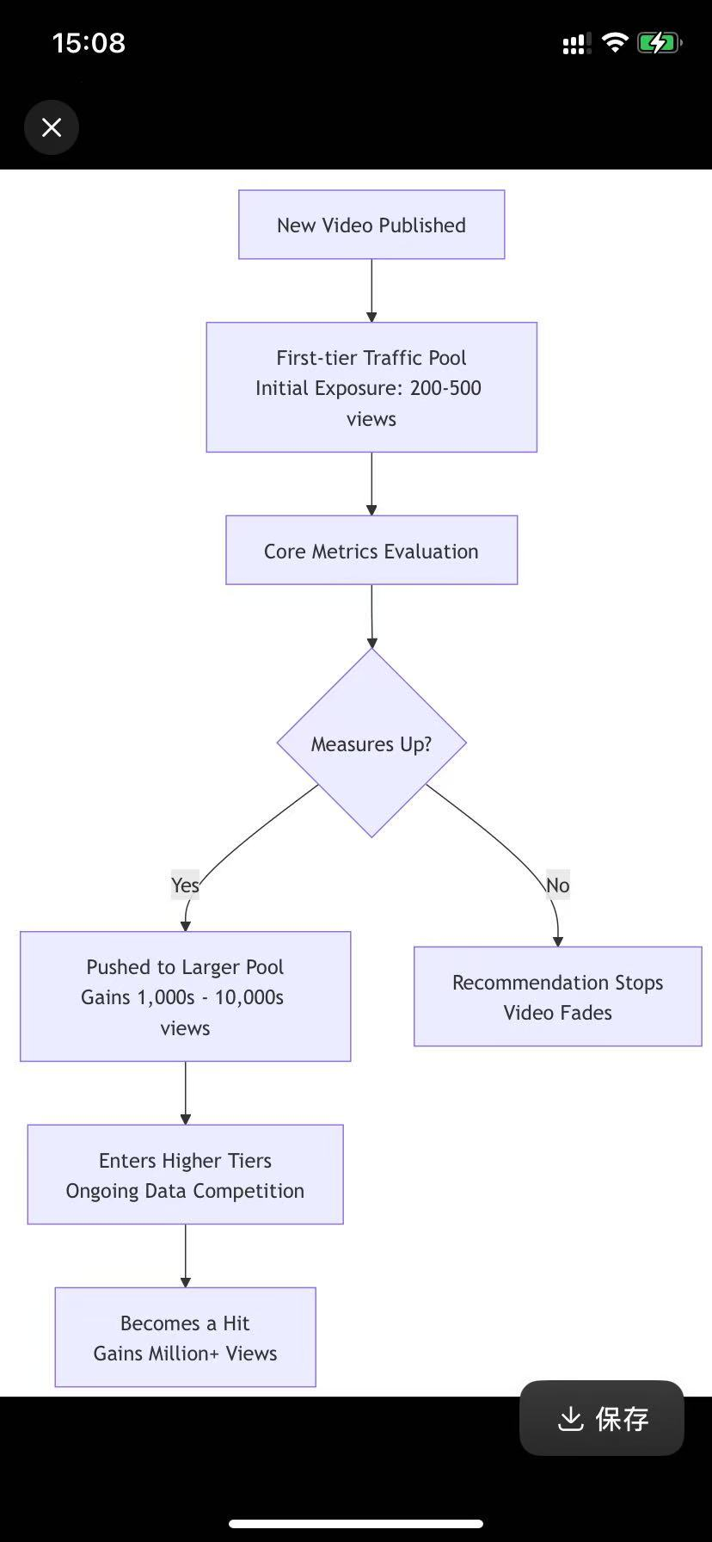


Targeting the Chinese mainland market; Domestic MAU:>936 million(all>1.3 billion). | Traffic Pool Mechanism. | Live stream commerce is mature,accounts for ~50% of platform traffic,and operates within a complete ecosystem.
Targeting the global market; Global MAU:>1.58 billion | Global Competition Mechanism | Shoppable short videos are the key growth driver. · Q3 2025 Global GMV: ~$19B (comparable to eBay). · United States: ~50% of GMV from short videos; live commerce share is minimal at just 2%. · Southeast Asia: Live stream commerce is booming, aided by consumer habits similar to China's.
Users and the marketplace
Recommendation algorithm
E-commerce

Slide 11
Targeting the Chinese mainland market; Domestic MAU:>936 million(all>1.3 billion). | Traffic Pool Mechanism. | Live stream commerce is mature,accounts for ~50% of platform traffic,and operates within a complete ecosystem.
Targeting the global market; Global MAU:>1.58 billion | Global Competition Mechanism | Shoppable short videos are the key growth driver. · Q3 2025 Global GMV: ~$19B (comparable to eBay). · United States: ~50% of GMV from short videos; live commerce share is minimal at just 2%. · Southeast Asia: Live stream commerce is booming, aided by consumer habits similar to China's.
Users and the marketplace
Recommendation algorithm
E-commerce

Slide 12
Effects
Douyin
Record your life

Slide 13

Positive effects
· Entertainment & Relaxation: Offers a vast collection of short, creative videos for quick entertainment and stress relief.
· Knowledge & Learning: Serves as an informal learning tool for life hacks, professional knowledge, and skills in an engaging way.
· Trend Discovery: Keeps users updated on the latest trends in music, fashion, travel, and pop culture.
· Community & Belonging: Connects like-minded users through algorithm-driven recommendations and interest-based communities.
· Creative Inspiration: Sparks inspiration in daily life and work through diverse content from global creators.

Slide 14

Negative effects
1.Addiction & Time Loss
Endless scrolling and personalized algorithms can lead to excessive use and wasted time.
2. Mental Health Concerns
May cause anxiety, low self-esteem, and shortened attention spans due to social comparison and fast-paced content.
3. Misinformation & Bias
Spread of unverified claims and "filter bubbles" that limit exposure to diverse viewpoints.
4. Privacy Risks
Extensive data collection and potential privacy exposure for users.
5. Negative Youth Impact
Promotion of unrealistic values and potential exposure to cyberbullying.

Slide 15

Thank you

