Slide 1
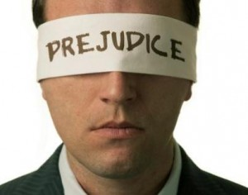
Culture and Prejudice: Harmful or Helpful?
Presentation by:
Benjamin Wellsand 202111080018
Xu Siyu 202270081700
Image: https://psychology.iresearchnet.com/social-psychology/prejudice/

Slide 2


Slide 3

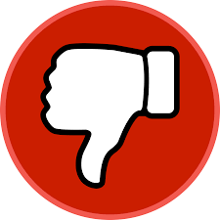


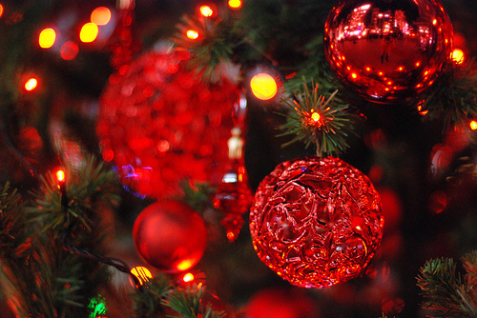
What do the American People Think of the Color Red?
Bad
Anger
Blood
The Republican Party
Christmas

Slide 4
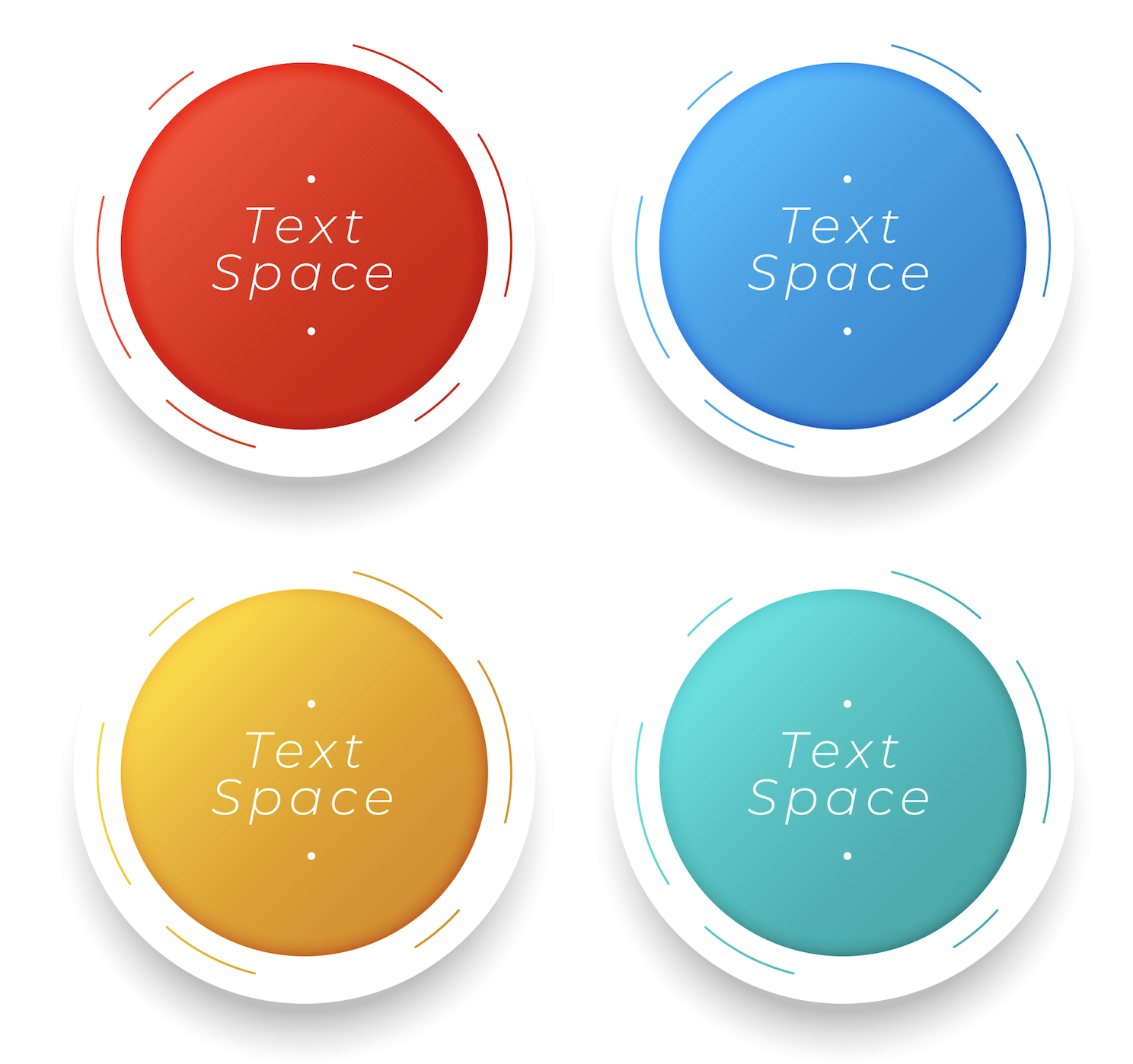
Hofstede’s Four Cultural Dimensions Model
Power
Distance
Uncertainty Avoidance
Individualism
Collectivism
Masculinity
Femininity

Slide 5
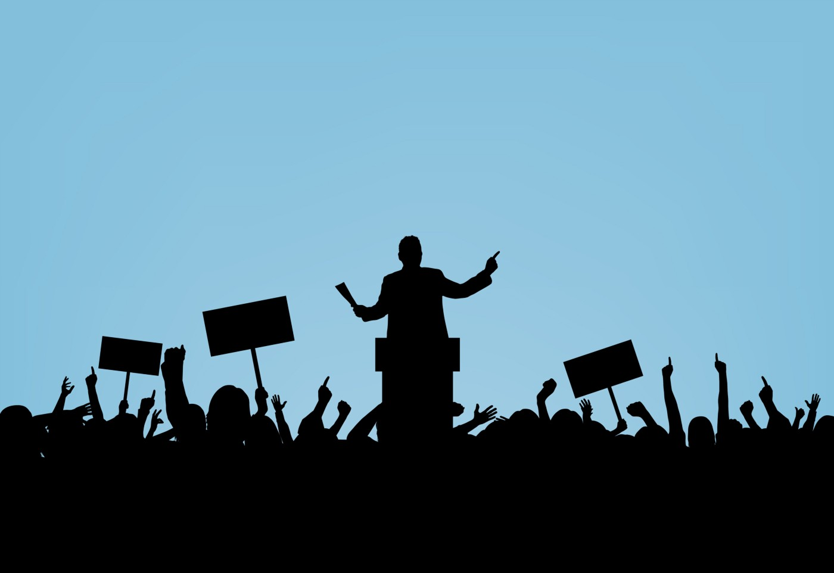
What is Power?
Power is the ability to control people and events.

Slide 6
Low and High Power Distance
Power distance is defined as the extent to which the less powerful members of institutions and organisations within a country expect and accept that power is distributed unequally. It has to do with the fact that a society’s inequality is endorsed by the followers as much as by the leaders.
Hofstede Insights Definition
Low Power Distance
See inequality as sometimes necessary (think professor to student), but the more that relationships can be equalized, the better for everyone
High Power Distance
Inequality is seen as the basis of societal order

Slide 7
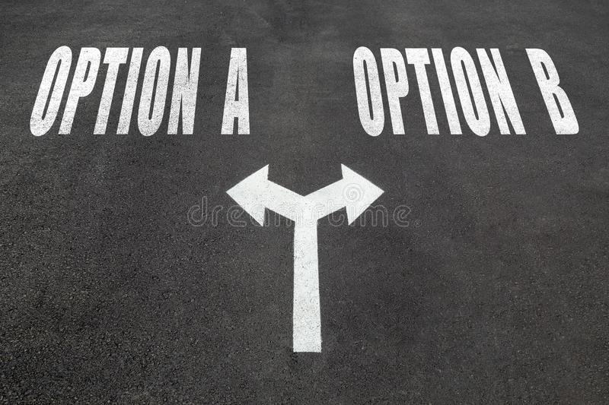
Cultural Biases
Negative terms like dependence or intolerance to describe non-Western cultures
Employment of Western-styled cognitive and intellectual frameworks
Binary Cultural Dimensions
https://www.shutterstock.com/image-photo/start-vs-finish-choice-concept-two-736974055

Slide 8

Low Power Distance
e.g. The Swiss
Low Power Distance
Sweden has a very low power distance score which results in Swedish style:
Being independent
Equal rights
Superiors are accessible
Challenges to authority
Management supports and empowers.
Controlling behavior is disliked and often avoided
Attitude towards managers are informal and on first name basis
Communication is direct and participative.
Everyone is encouraged to have a say
Some challenges can arise from the lack of a final say...
https://prezi.com/9jaxvlaiqhqh/cultural-dimensions-of-sweden/?frame=d4693fda681b2b92c46ce8356f8b9ee1d7c7edb6

Slide 9
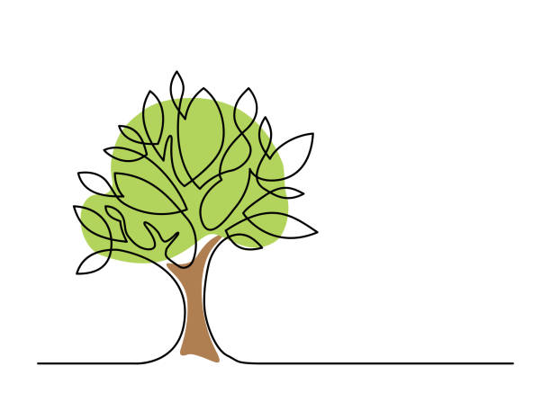
High Power Distance
e.g. The Chinese
Yet another culturally biased view from a particular Asian cultural perspective.
e.g. The Polynesian “Big Man”
“The place of the leader in the district group is well summed up by his title, which might be translated as “center-man” … He was like a banyan, the natives explain, which, though the biggest and tallest in the forest, is still a tree like the rest. But, just because it exceeds all others, the banyan gives support to more lianas and creepers, provides more food for the birds, and gives better protection against sun and rain.” -Ian H. Hogbin

Slide 10
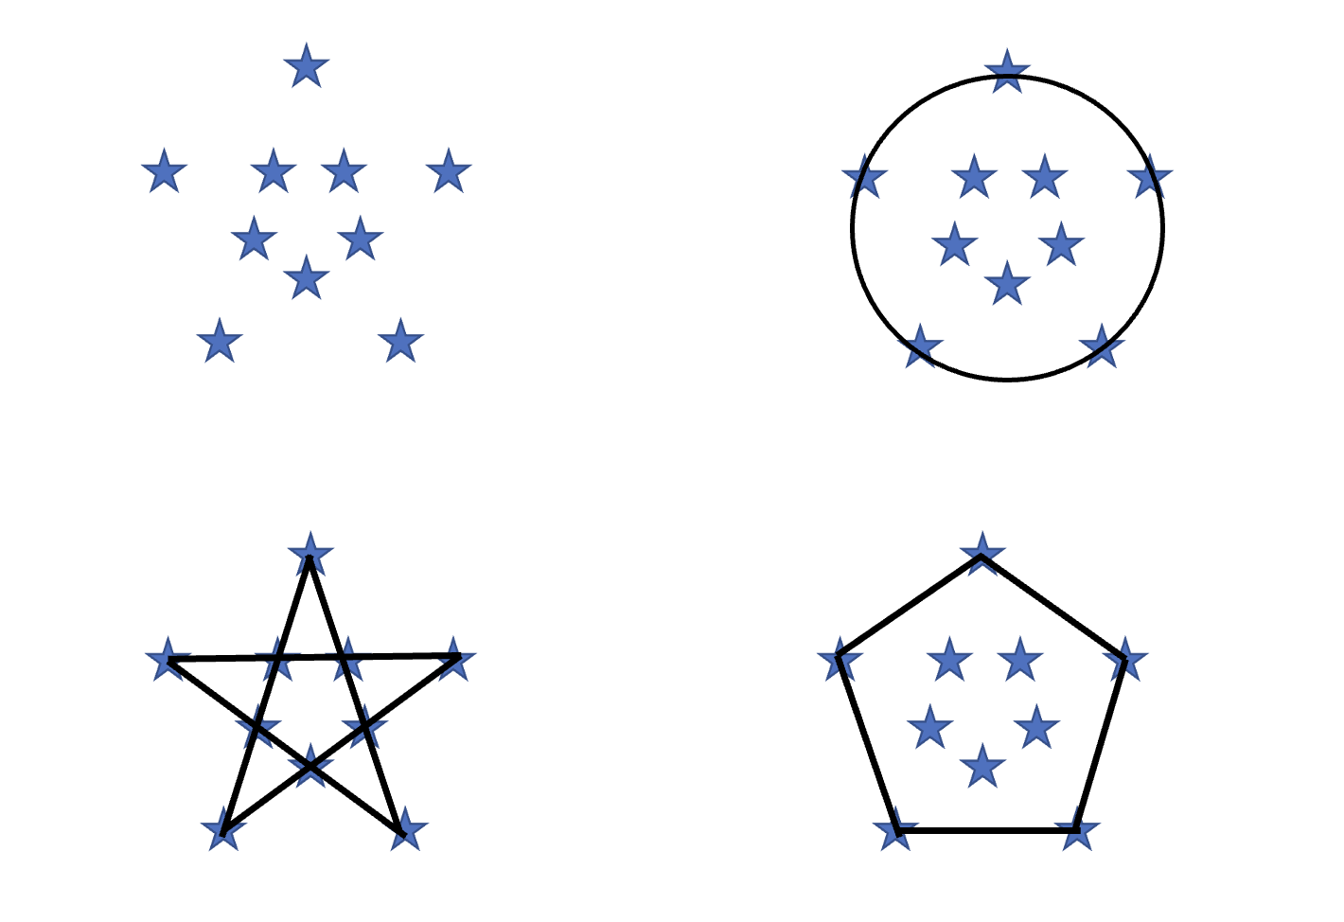
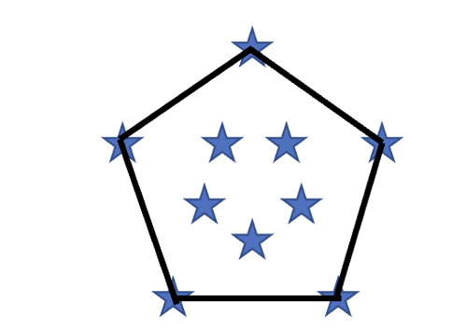
Star Cluster Perspectives
Adapted from Paul G. Hiebert’s Transforming Cultures

Slide 11
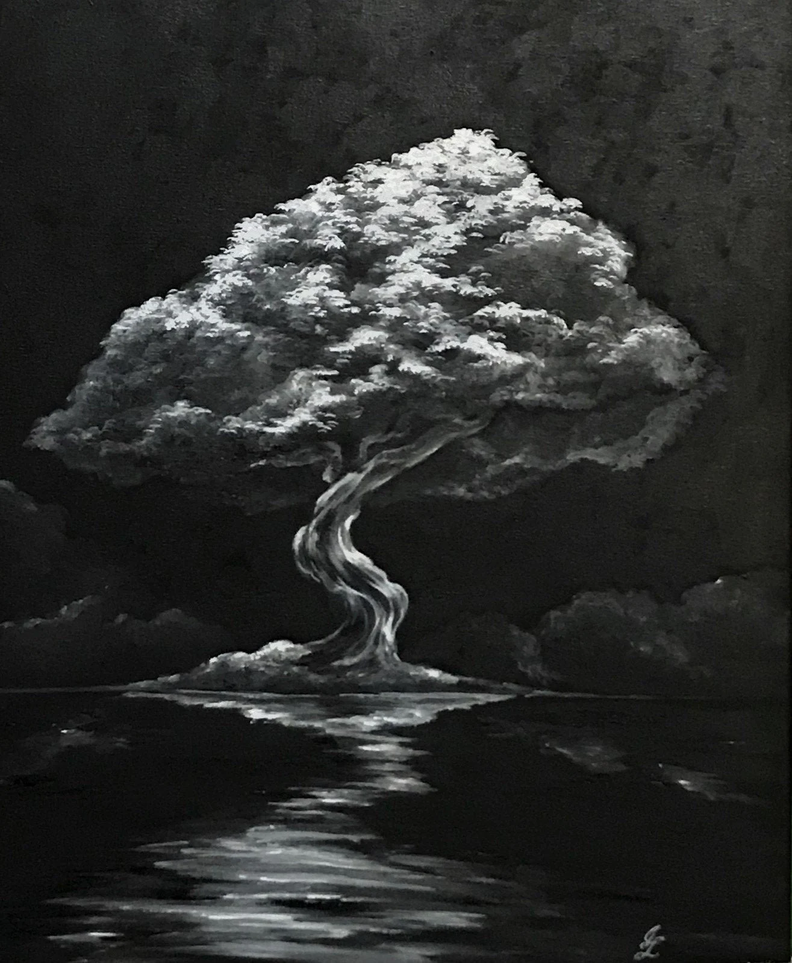
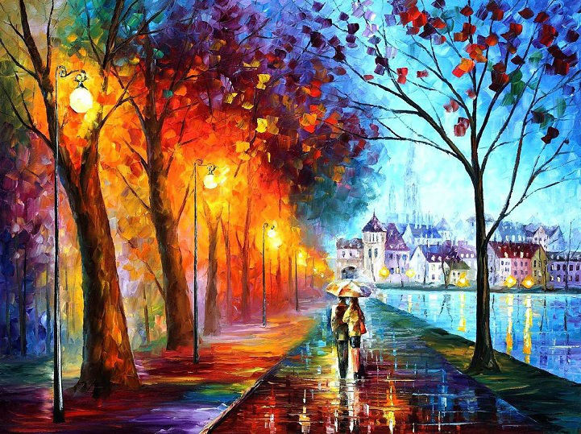
https://www.etsy.com/listing/723255003/beautiful-black-and-white-painting-of
https://www.sortra.com/colorful-oil-painted-landscapes/

Slide 12
References
Hiebert, Paul G. 2008. Transforming Worldviews: An Anthropological Understanding of How People Change. Grand Rapids: Baker Academic.
Hogbin Ian H. 1943-1944. “Native Councils and Courts in the Solomon Islands.” Oceania, 14: 258-283.
Hofstede, Geert. 1991. Culture’s Consequences: International Differences in Work-Related Values. London: Sage Publications.
___________, 1991. Cultures and Organizations: Software of the Mind: Intercultural Cooperation and Its Importance for Survival, 3rd ed. New York: McGraw-Hill Companies.
___________, 1999. “The Universal and the Specific in 21st Century Global Management.” Organizational Dynamics, 28 (1): 34-43.
Lewis, Richard D. 1996. When Cultures Collide: Leading Across Cultures, 3rd ed. Boston: Nicholas Brealey International.
Salihns, Marshall D. 1963. “Poor Man, Rich Man, Big-man, Chief: Political Types in Melanesia and Polynesia.” Comparative Studies in Society and History, 4 (3): 285-303.
Woesler, Martin, ed. 2022. “Culture and Prejudice.” In Chinese Language and Culture. Bochum: European University Press.

Slide 13
Thank you!

