Slide 1


道
教
Taoism
桂一枝 阳慧

Slide 2
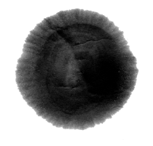

CONTENTS
Origin and development
Translation tips
Deity and doctrines
Regional texts

Slide 3


Origin and development
Taoist philosophy（道家）
Taoist religion（道教）
It is a philosophical tradition of Chinese origin which emphasizes living in harmony with the Tao ('the Way'). The Tao is a fundamental idea in Taoism.
It is an indigenous Chinese religion with its own practices, morals, worldviews, texts, ethics, or organizations.
Two definition

Slide 4
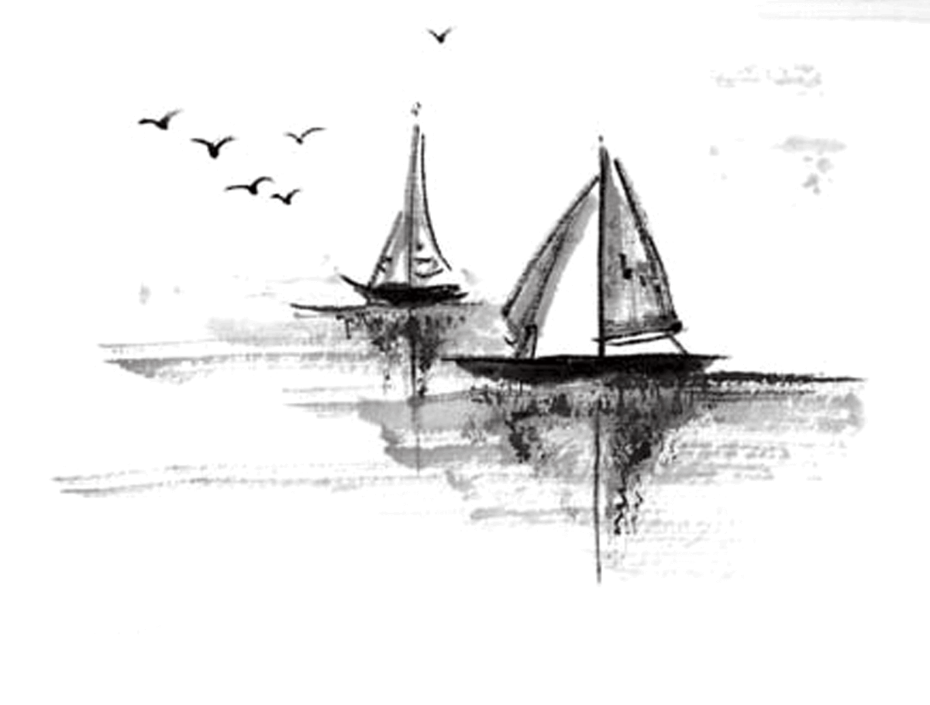
Origin and development
Taoism
Formed: Taoism developed during the Eastern Han dynasty. Taoism did not exist as an organized religion until the Way of the Celestial Masters sect was founded in 142 C.E. by Zhang Daoling, who based the sect on spiritual communications from Laozi.
Main schools:
Zhengyi Taoism 正一道
张道陵
Quanzhen Taoism 全真道
王重阳

Slide 5
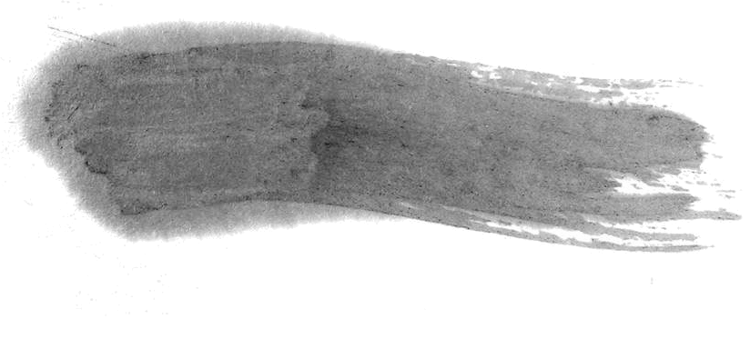
Deity
Taoism is a pantheistic religion.
Taoist orders usually present the Three Pure Ones（三清）at the top of all the deities.
Laozi, is considered the incarnation of one of the Three Purities and worshipped as the ancestor of the philosophical doctrine.
Doctrines
Tao – highest faith and fundamental core of Taoism
Tao Te Ching – sacred text
Attain Tao to be Xian or immortal
The basic aim of the adherents of Taoism is the achievement of long life, for which a whole series of practices are used. A characteristic method aiming for longevity is Taoist alchemy

Slide 6

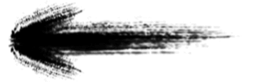
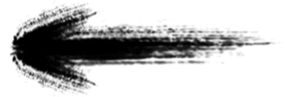
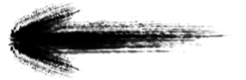
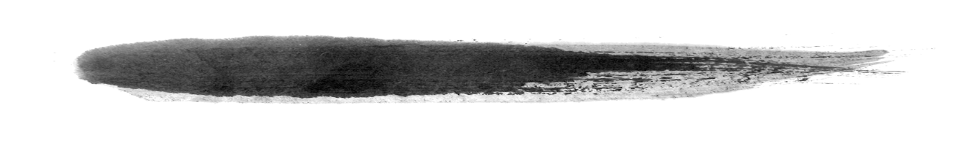
Regional texts
Zhuangzi
《庄子》/《南华经》
Tao Te Ching
《道德经》/《老子》
Daozang
《道藏》
Taoist text

Slide 7
Terms of Taoism
无为 (action without intention) non-action
自然 naturalness
《道德经》云：“我有三宝，持而宝之，一曰慈，二曰俭，三曰不敢为天下先”
三宝 Three Treasures / Three Jewels
不敢为天下先 “not daring to act as first under the heavens”
慈 "compassion”俭 "frugality" 让 "humility"
精 氣 神
精 is usually translated as essence
气 as life force
神 as spirit

Slide 8
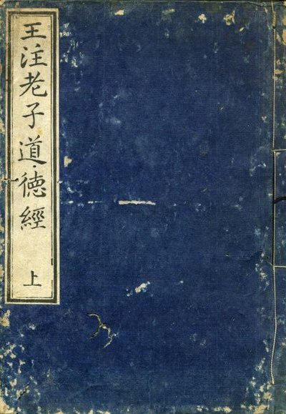

The famous opening lines of the Tao Te Ching
道可道非常道
"The Tao that can be told is not the eternal Tao" 名可名非常名
"The name that can be named is not the eternal name."

Slide 9


Thank you

