Slide 1


Al Communication
In China
By Qing Ziye & Wumin
from English Translation

Slide 2
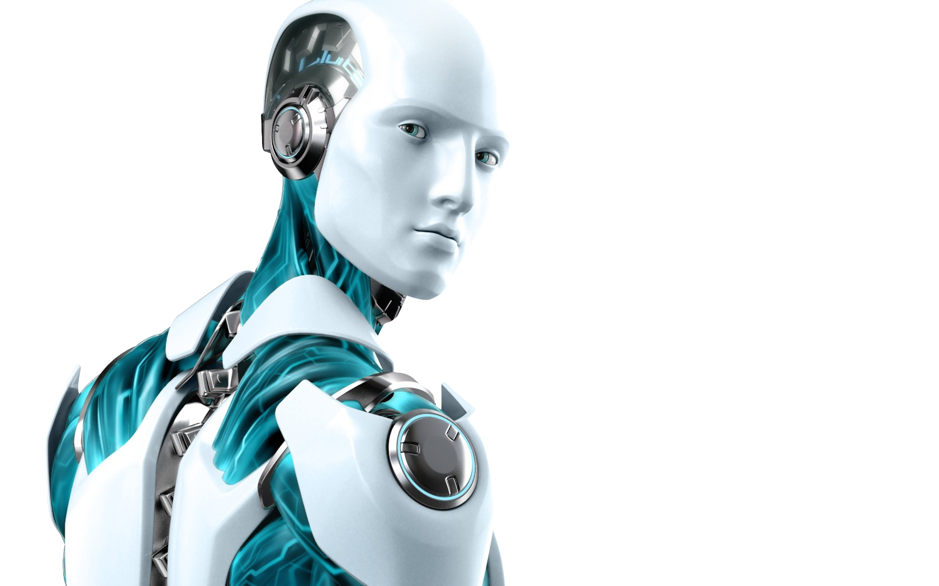
AI Has Entered Our Communication.

Slide 3

Politic
Violence
Horror
Pornography
Military
Anti-social

Slide 4
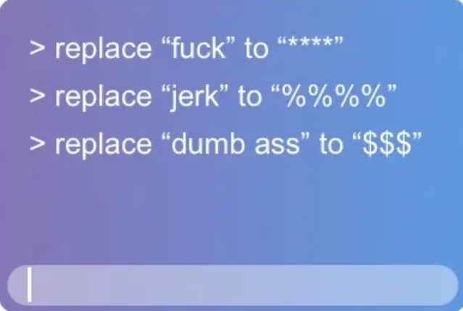

Slide 5

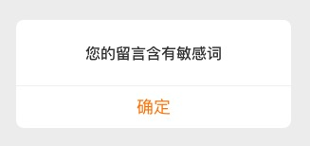

Slide 6
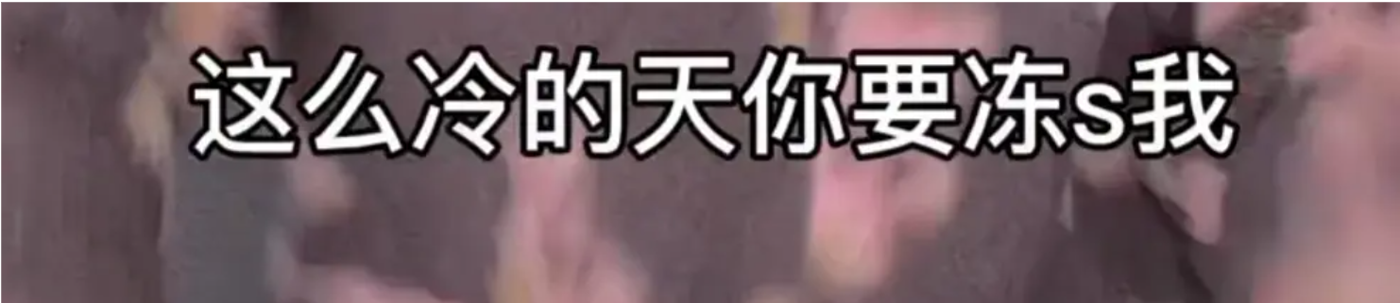
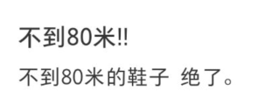
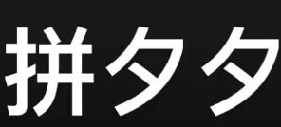
What did we do to avoid it?

Slide 7
AI Is Analyzing Us.

Slide 8



Slide 9
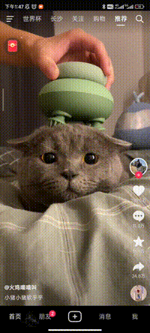
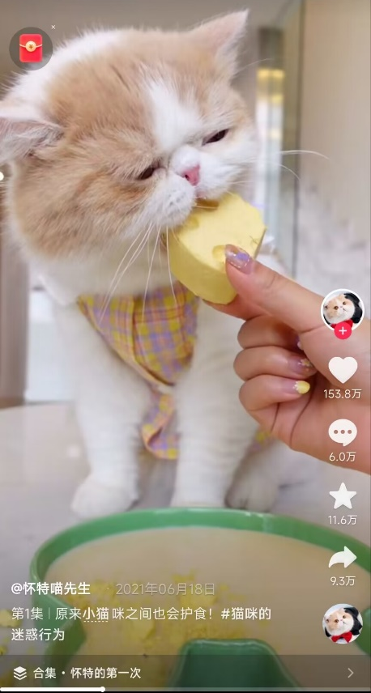
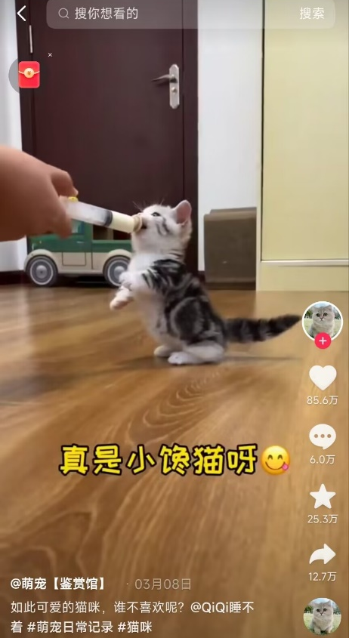
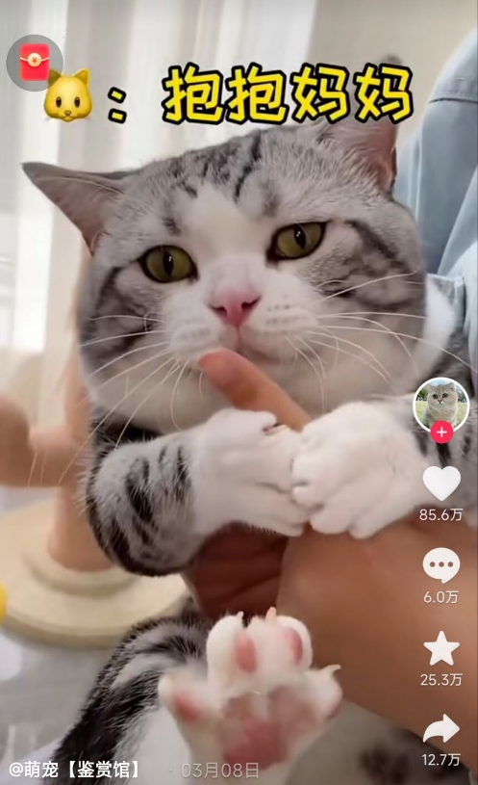

Slide 10

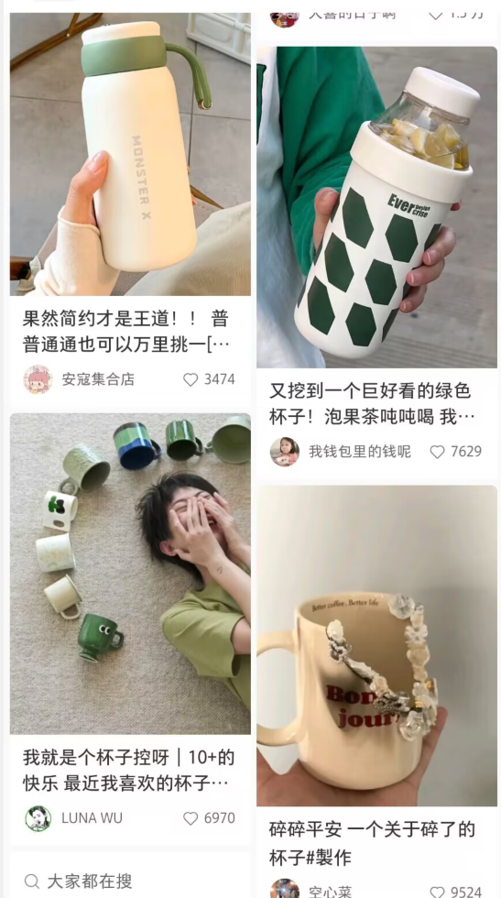
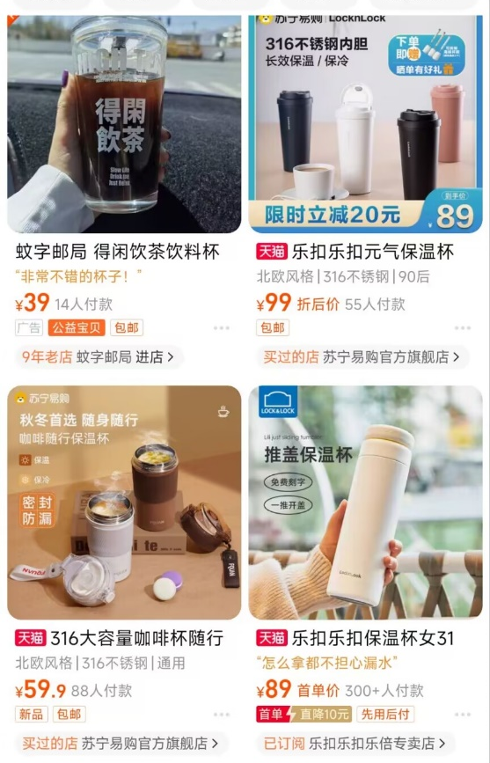
Buy a cup?
Yup.

Slide 11
AI Is Influcing Us.

Slide 12
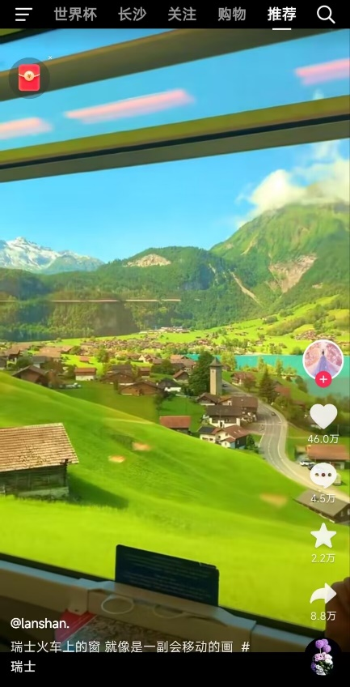
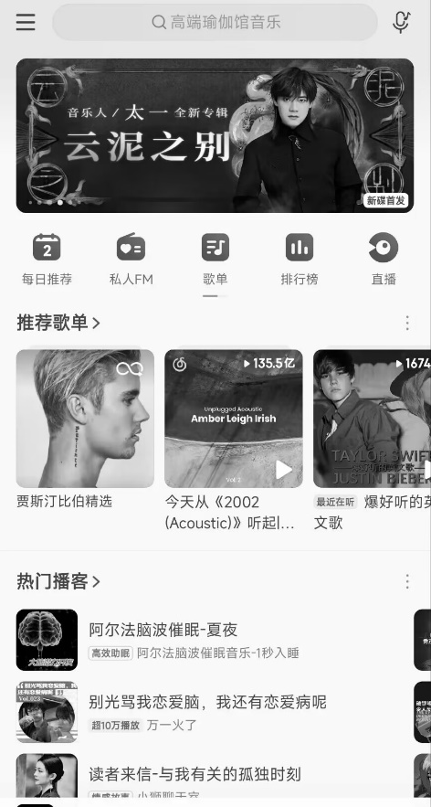
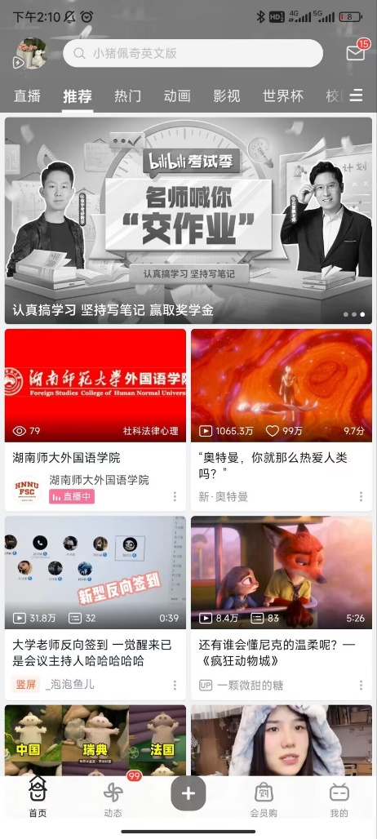
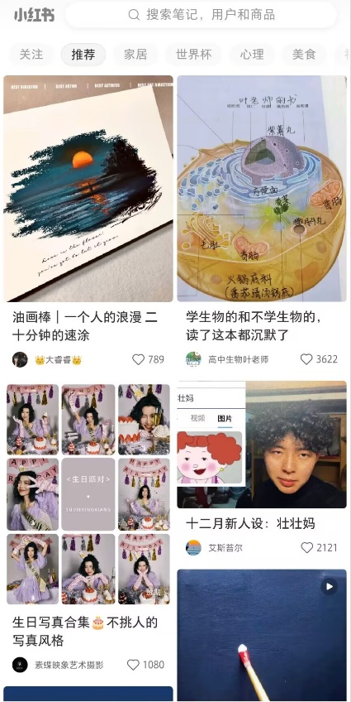
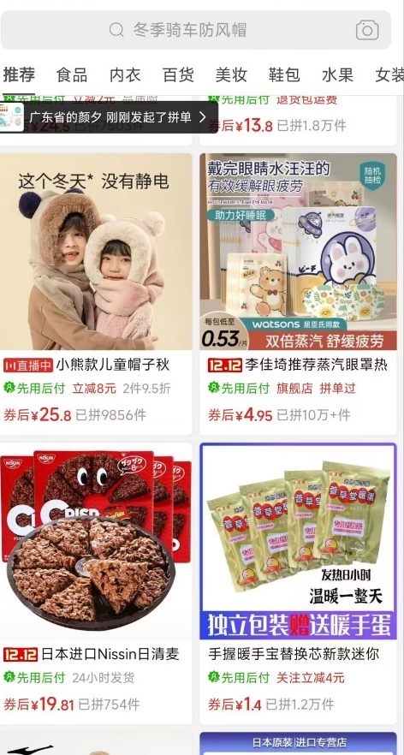

Slide 13
1. Can you think of any applications of AI in your life

Slide 14
2. Whether AI is good or bad for society？

Slide 15
Thank You!
By Qing Ziye & Wumin
from English Translation

