Slide 1

Chinese Baijiu Culture
Chen Siyang、Xie Zijia
English translation

Slide 2
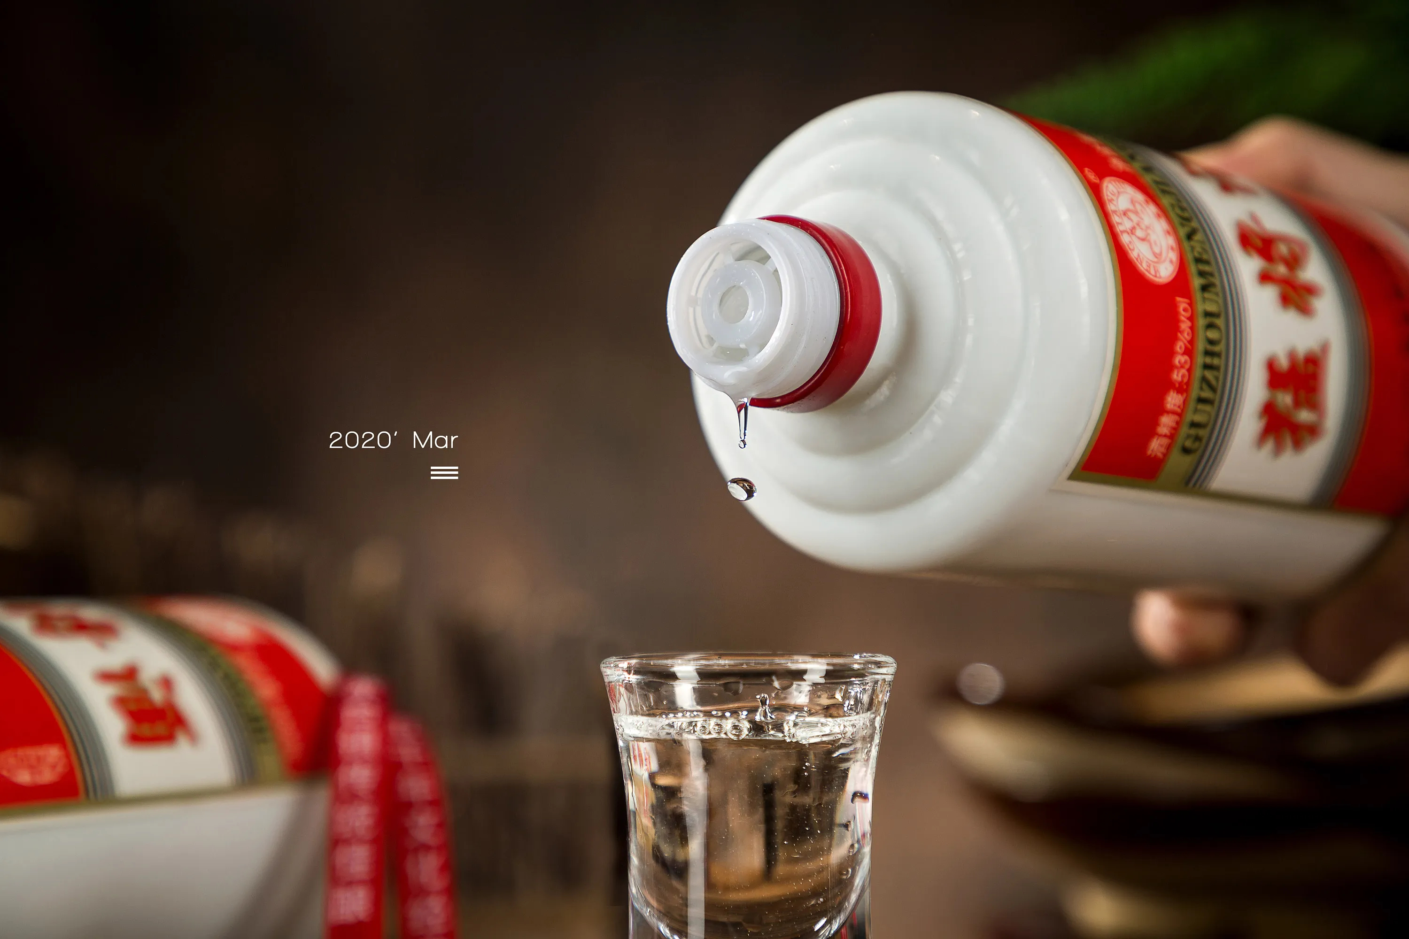
spicy?
bitter?
sweet?

Slide 3
Questions:
List the famous Baijiu you know in China?
Mao Tai; Wu Liangye; Fen Jiu; Luzhou Laojiao etc.
What are the main raw materials used to make Baijiu?
Sorghum; Wheat; Rice
List the ancient Chinese poets you know who loved to drink liquor?
Li Bai; Bai Juyi; Su Shi; Tao Yuanming; Li Qingzhao etc.

Slide 4
CONTENTS
The origin and development of Chinese Baijiu culture
Classification of Five Flavor Types of Chinese Baijiu
Chinese Baijiu etiquette
Chinese medicinal liquor

Slide 5
The origin of Chinese Baijiu
1
2
3
Dukang Baijiu making
Yidi brewing
Naturally fermented
It is said that Yidi invented brewing in the Xia Yu period, which is recorded in the Warring States policy.
Dukang Baijiu making is widely popular among the people.
Baijiu is the product of natural fermentation of grains, fruit Baijiu and milk Baijiu are the first generation of beverage Baijiu.

Slide 6
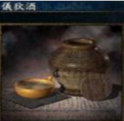
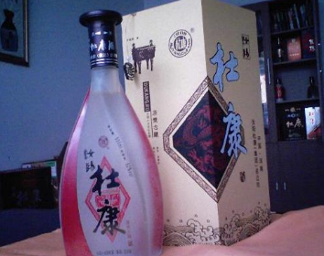
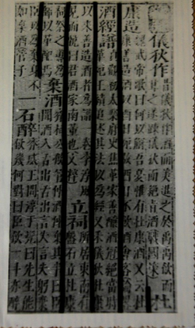
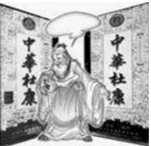

Slide 7
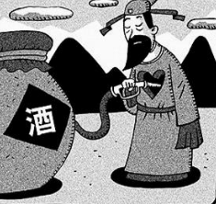
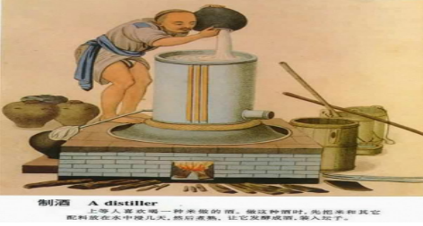

The development of Chinese Baijiu
Han Dynasty
koji making technology酒曲
Tang and Song Dynasties
fruit baijiu and medicinal baijiu
pre Qin period
active microorganisms or their enzymes活性微生物或酶
Yuan Dynasty
distillation
Shang Dynasty
saccharification and re-alcoholization糖化和再醇化
Ming and Qing Dynasties
further development of liquor making

Slide 8
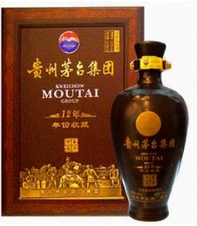
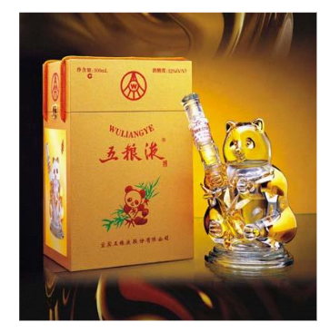
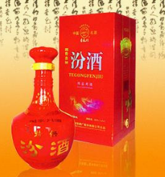
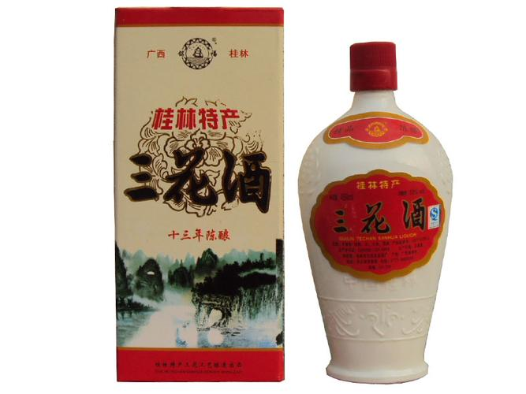
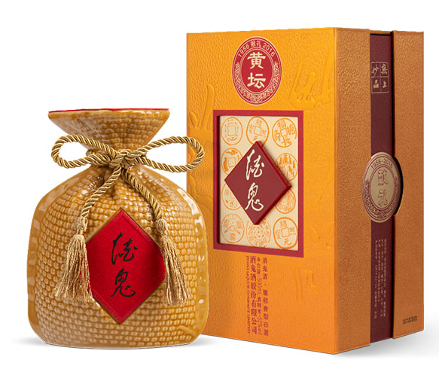
Classification of Five Flavor Types of Baijiu
Maotai-flavor liquors(酱香型）
Luzhou-flavor liquors(浓香型）
Fen-flavor liquors(清香型）
rice-flavour liquors(米香型）
other flavour liquors(其他香型)

Slide 9



Chinese Baijiu etiquette
Baijiu etiquette is the etiquette of Baijiu behavior, which is used to reflect the dignity, status of Baijiu behavior and even the etiquette norms of various occasions.
1. How to pour Baijiu?
2. When do you propose a toast?
3. What should you pay attention to when toasting?
4. What you can say during the toast?

Slide 10
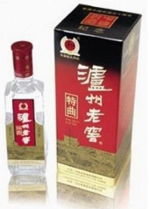

Chinese Baijiu etiquette
1. How to pour Baijiu?
If you are drinking Baijiu, fill the Baijiu glass and drink it all at once when you raise your glass.
2. When do you propose a toast?
Generally, it is the guest of honor, the leader and the person with the highest seniority first, and then it is OK to toast next to each other in turn. After the host or the guest has finished toasting everyone, it's time for others to toast.

Slide 11
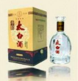
Chinese Baijiu etiquette
3. What should you pay attention to when toasting?
when toasting leaders, elders or unfamiliar people, your glass must be lower than their glass, and you should hold the glass with both hands. If others stand up, you should also stand up.In addition, never say to the leaders or elders: I will finish all of it, you are free.
4. What you can say during the toast?
As the host or the guest, We can say thank you for taking time out of your busy schedule etc. If you are going to toast the host or the guest, you can say thank you for your hospitality. When others toast each other, they can say something auspicious, such as wishing each other good health and getting better.

Slide 12
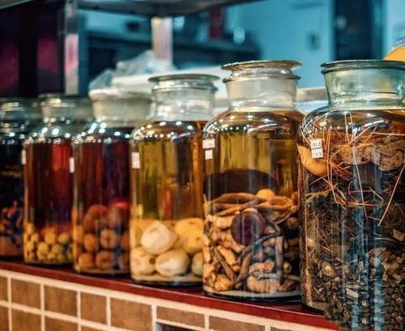

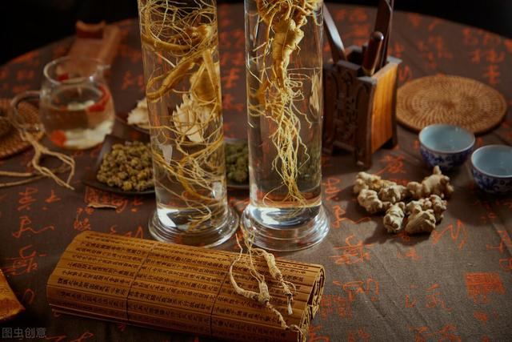
Chinese medicinal liquor
Medicinal liquor, which is used to prevent and treat diseases, has played an important role in the history of medicine in China.
activate blood circulation
eliminate accumula-tion
relax tendons
dredge collaterals
expel coldness
strength-en the spleen
has certain curative and health care effects
calm nerves

Slide 13
References
[1]鲁达.发扬中国酒文化的优秀传统[J].中国酒,2022(01):3.
[2]杨运, 杨蔚.从目的论看中国酒文化中“白酒”的英译 [J].现代英 语,2021(11):74-76.
[3]赵毅飞. 中国酒文化的发展与传播及中外酒 文化对比[D].厦门大学,2019.
[4]刘文婷.中国川酒文化“走出去”的翻 译探究[J].西南科技大学学报(哲学社会科学版),2021,38(04):52-57.
[5] 赵建军. 生 命 活 性 ： 中 国 酒 文 化 的 逻 辑 本 质 [J]. 东 方 论 坛,2021(04):115-129+2.
[6]王宇.论多角度下的中国传统酒文化传承 与发展[J].汉字文化,2021(14):162-163.
[7]薛富兴.酒文化：内涵、特 征及反思[J].贵州大学学报(社会科学版),2021,39(04):24-30+121.
[8] 杨运,杨蔚.从目的论看中国酒文化中“白酒”的英译 [J].现代英 语,2021(11):74-76.

Slide 14

Thank you！

