Slide 1




Romanization of Chinese Characters
Speaker: Li Dan（李丹）

Slide 2
目 录
PART ONE
C O N T E N T
1
Definition
定义
2
PART THREE
Process
过程
3
PART FOUR
Personal opinion
个人看法

Slide 3

1
PART ONE
Definition
定义

Slide 4

Definition
Romanization
(Latinization)
Romanization of
Chinese Characters
the representation of the pronunciation of languages using the Latin alphabet
1
2
replacing the written form of Chinese characters and finally abolishing them

Slide 5
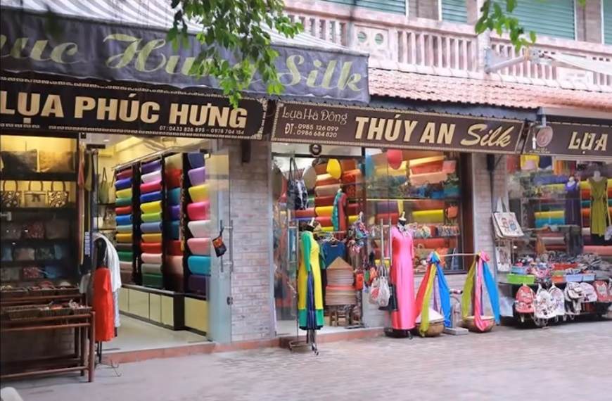
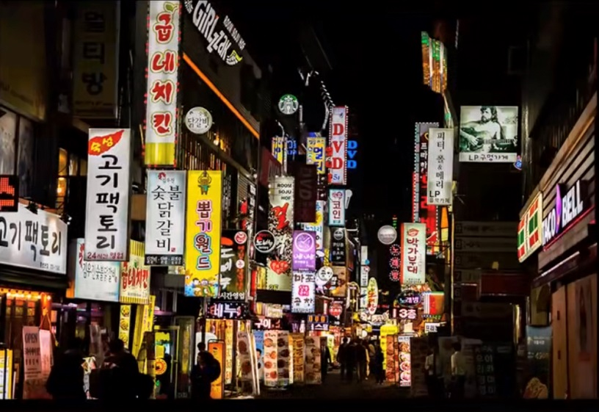
Definition
Using Latin alphabets(its sound) to replace the written form of Chinese characters
Vietnam
South Korea

Slide 6
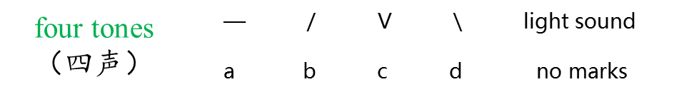
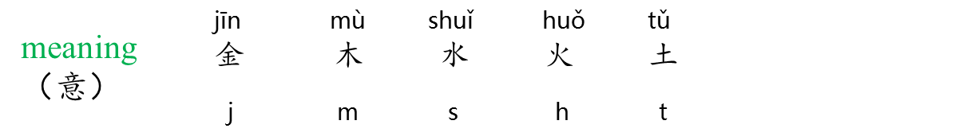

Definition
Using Latin alphabets to represent sound, tone and meaning
mái
埋
maibt

Slide 7
3
PART THREE
Process
过程

Slide 8
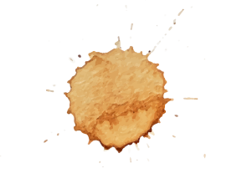
Process
Modern Times
(1895-1949)
After the founding
of the PRC
(1949- )
Late Ming and
Qing Dynasty
(1600-1895)
PPT模板 http://www.1ppt.com/moban/

Slide 9
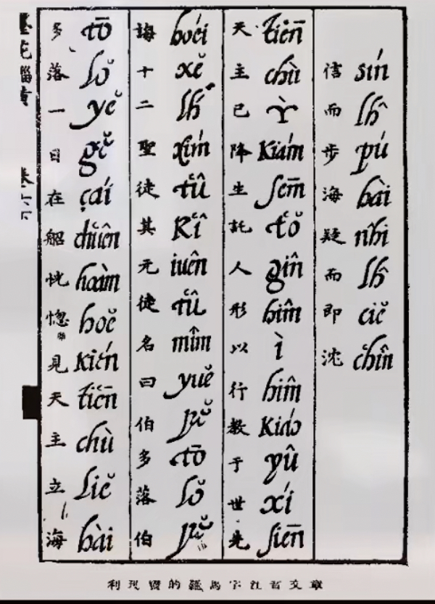
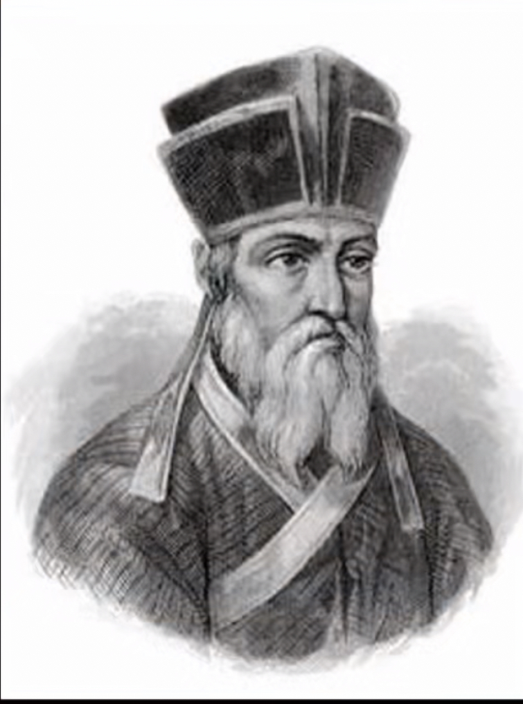
Process
Matteo Ricci（利玛窦）
Taixi Alphabet（泰西字母）

Slide 10
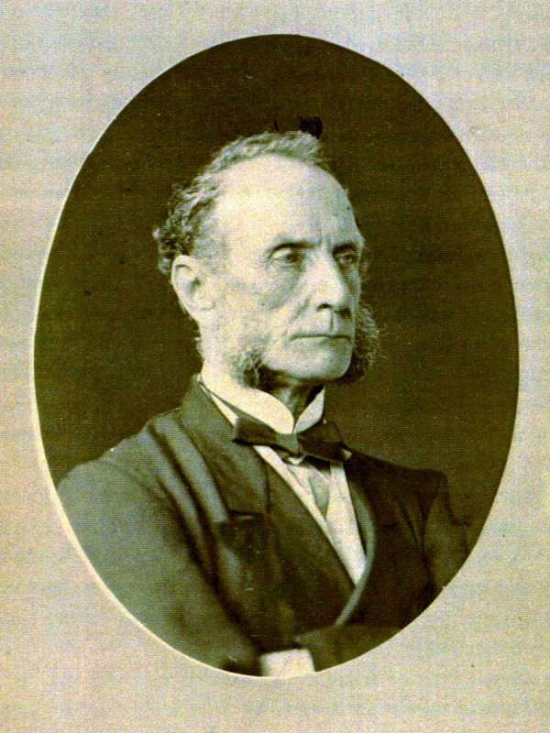
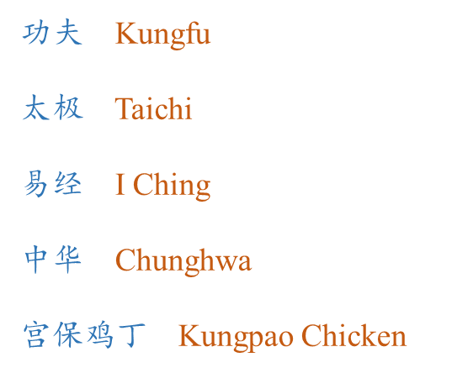
Process
Thomas F. Wade
（威妥玛）
Wade-Giles Romanization
（威妥玛式拼音法）

Slide 11
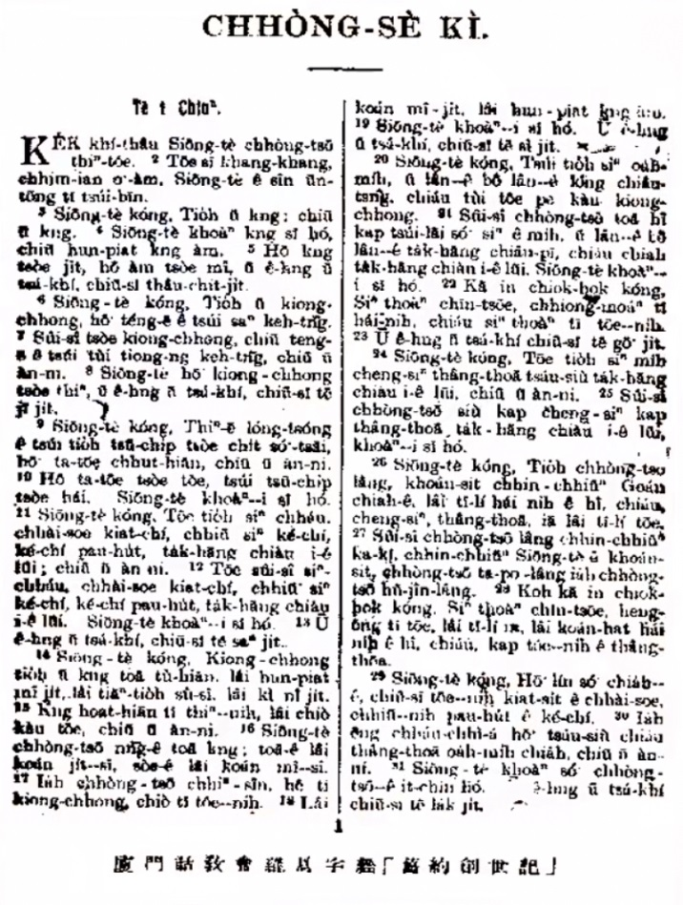
Process
missionary work:
  illiterate of poor people at the countryside of China
  the great difficulty of learning Chinese characters
assistance rather than replacement
The Old Testament Genesis in Amoy’s dialect

Slide 12
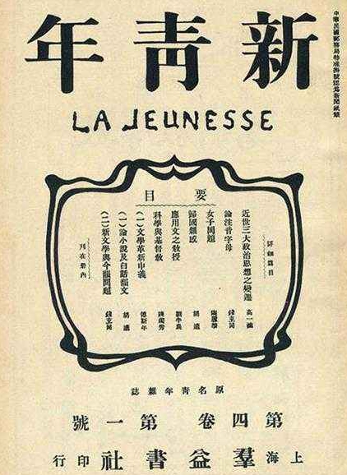
Process
Language:
abolishing classical Chinese and embracing vernacular（“废除文言文，使用白话文”）
Character:
abolishing Chinese characters and embracing the Latin alphabet（“废灭汉字，使用拉丁文字”）
The Vernacular Language Movement
（白话文运动）

Slide 13
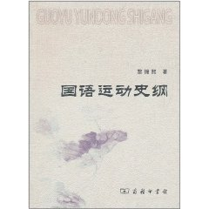
Process
adopting a standard set of
language and character
One set of pronunciation
The Mandarin Movement（国语运动 ）

Slide 14
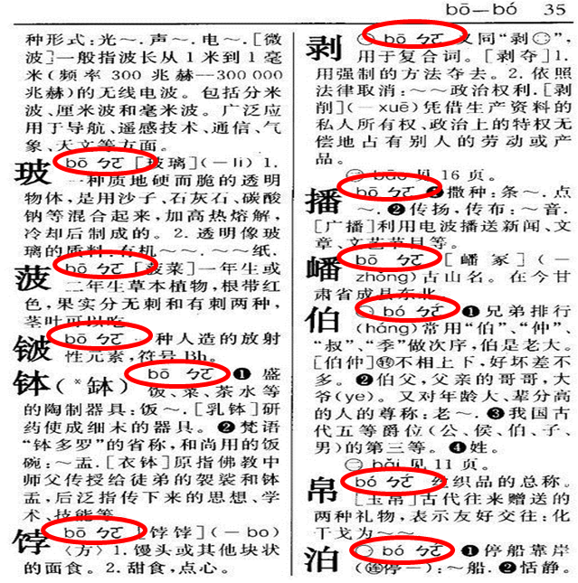
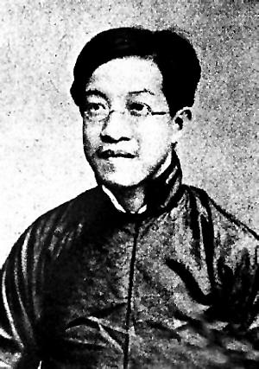
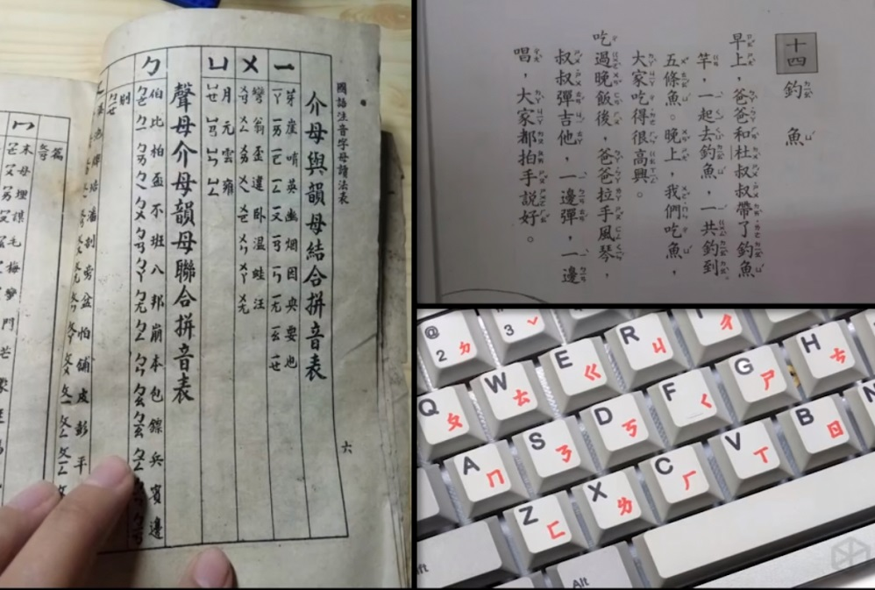
Process
Zhang Taiyan
（章太炎）
Phonetic Script
（注音字母）

Slide 15
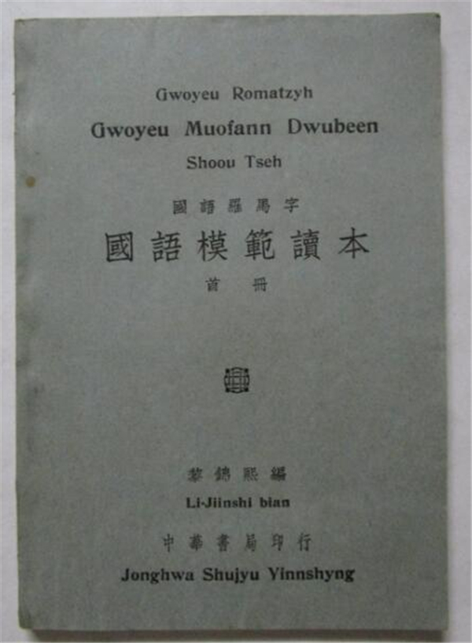
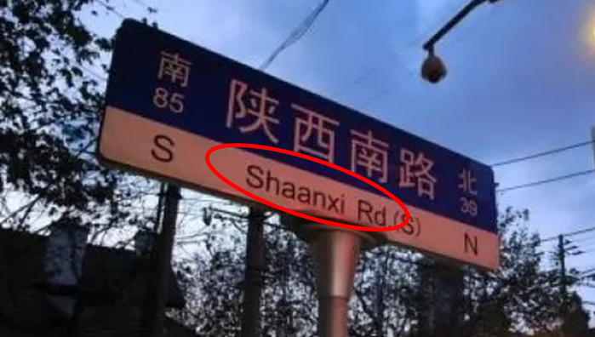
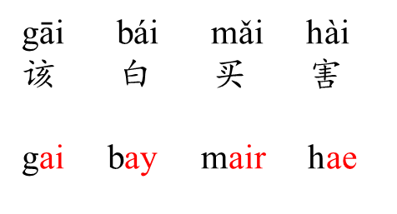
Process
Similar to Wade-Giles
Tone varies according to different combination of alphabets
National Language Romanization
（国语罗马字）

Slide 16
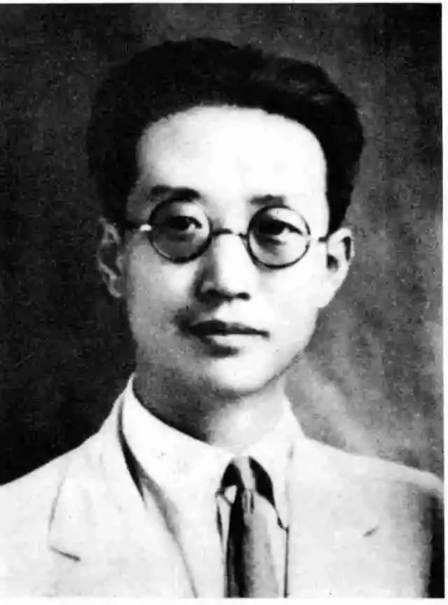
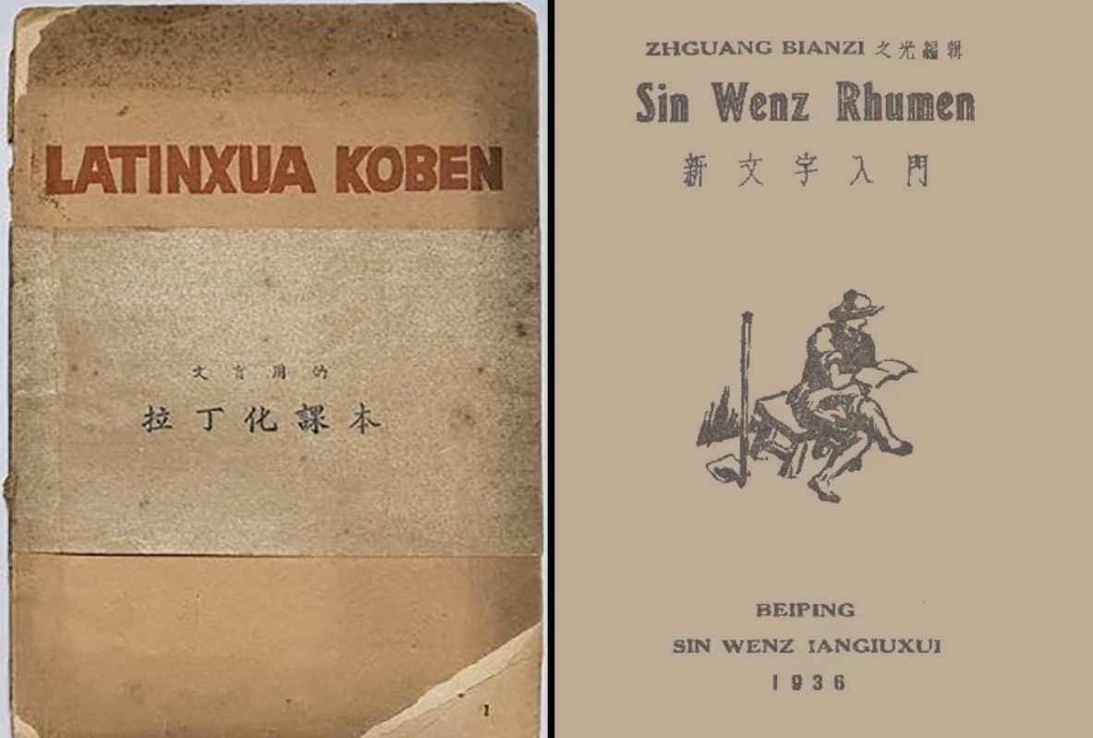
Process
The proper tones could be understood from context
Qv Qiubai
（瞿秋白）
Sin Wenz
（拉丁化新文字）

Slide 17
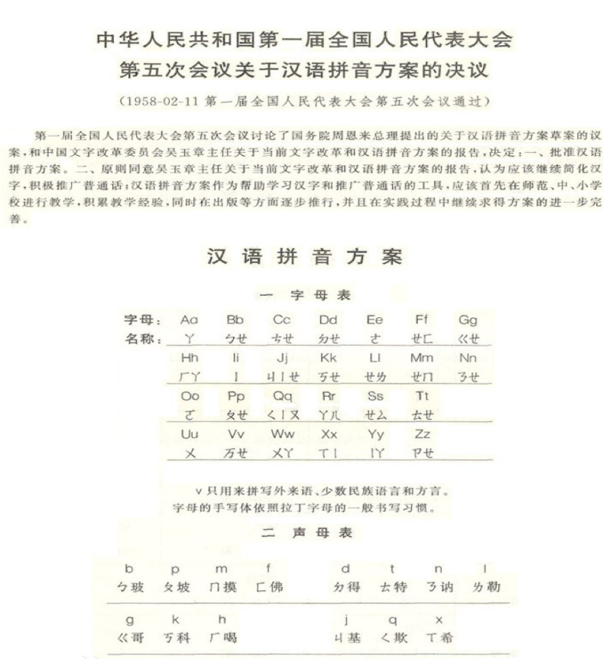
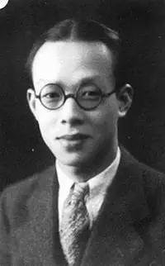
Process
used to teach native speakers
a standardized form of a language
Zhou Youguang
（周有光）
Pinyin

Slide 18
4
PART FOUR
Personal Opinion
个人看法

Slide 19
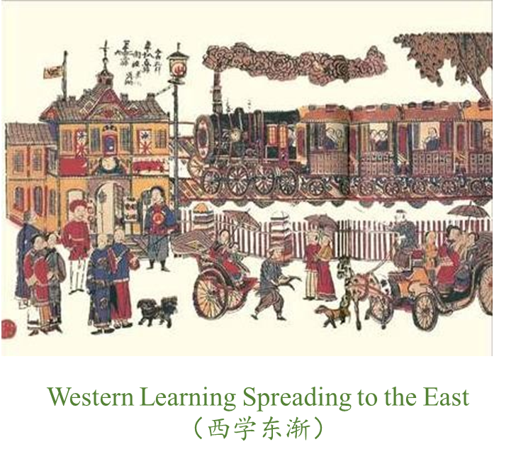
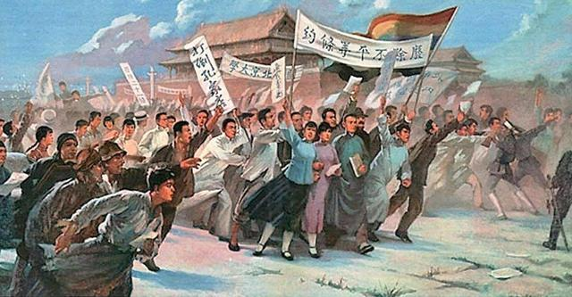
Personal opinion
Understanding
Historical background
Educational needs
Fight for the Survival and Salvation of the Nation
（“救亡图存”）

Slide 20
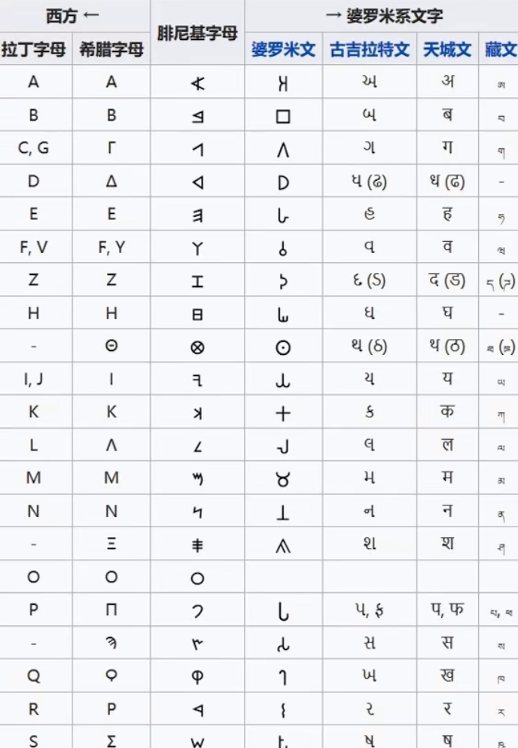
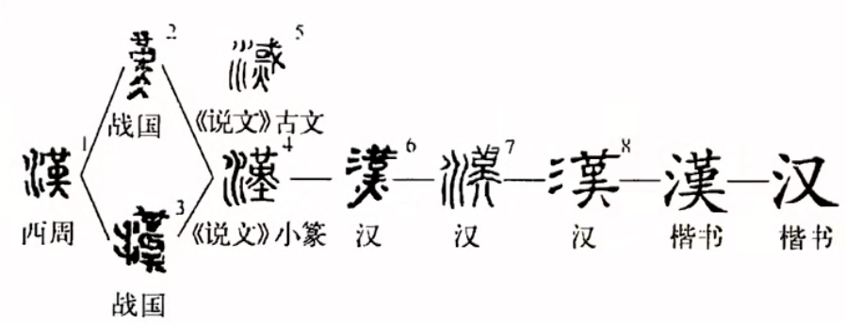
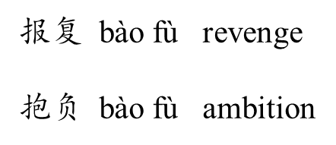
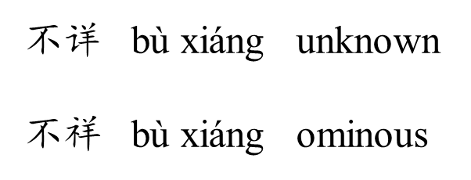
Personal opinion
Features of Language
Simplicity
Uniqueness

Slide 21
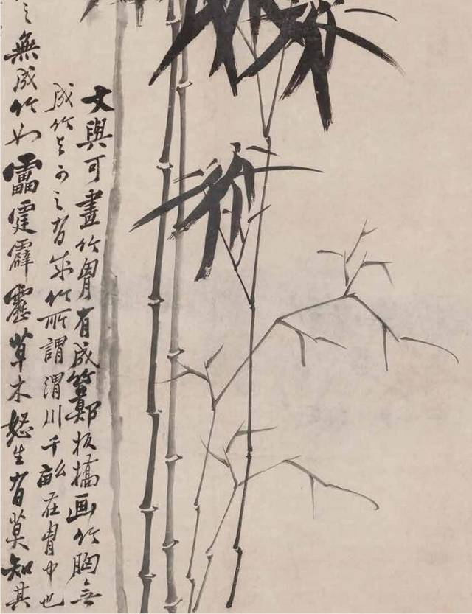
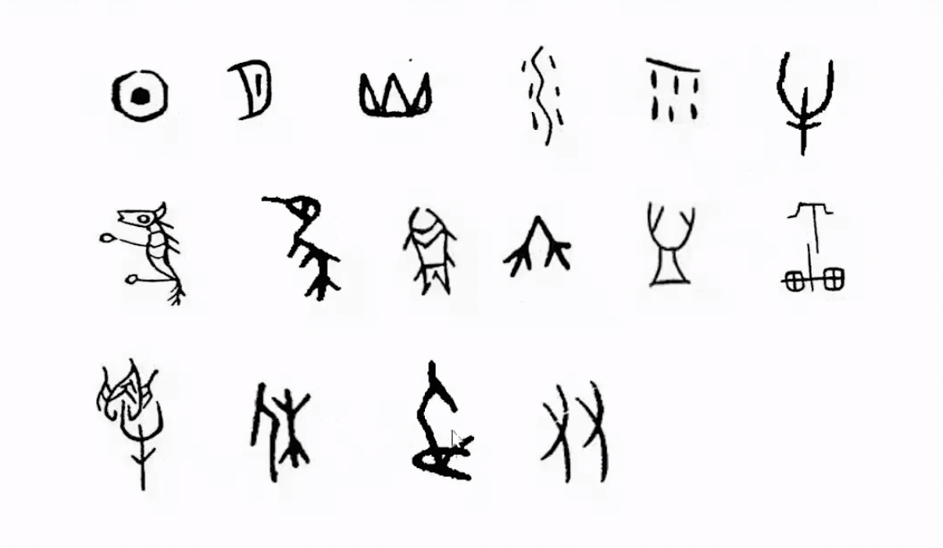
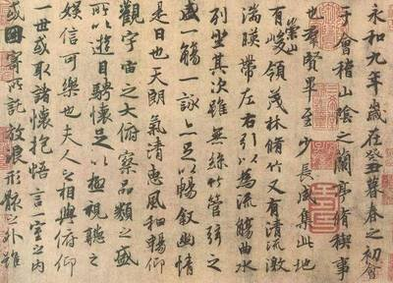
Personal opinion
Cultural Heritage
Across-time
Aesthetics interest

Slide 22
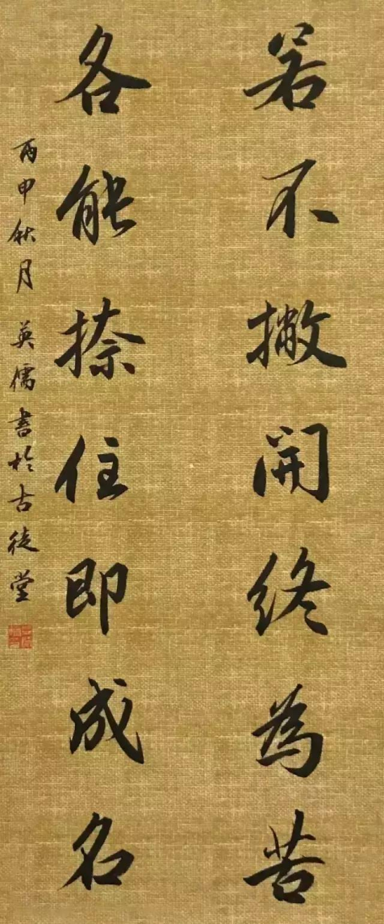

Personal opinion
若不撇开终为苦，
各能捺住即成名。
If one cannot put things aside, he/she may end up in bitterness;
If one can hold everything right, he/she may set on the road to fame.
苦
各
名

Slide 23
Thank You

