Slide 1
Life of the Gotama Buddha
Phyo Su Kyi

Slide 2
Content
Five Buddhas
Born
Marriage at the age of 16
Renouncing at the age of 29
Practise the Great Struggle for 6 years
At the age of 35 attained the Supreme Enlightment of a Buddha
Preached Dhamma 45 years
Parinibbanna(Death) at the age of 80

Slide 3
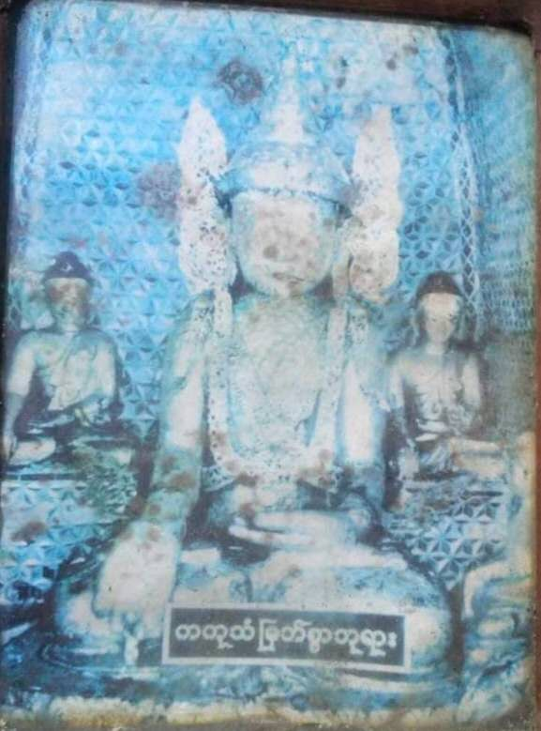
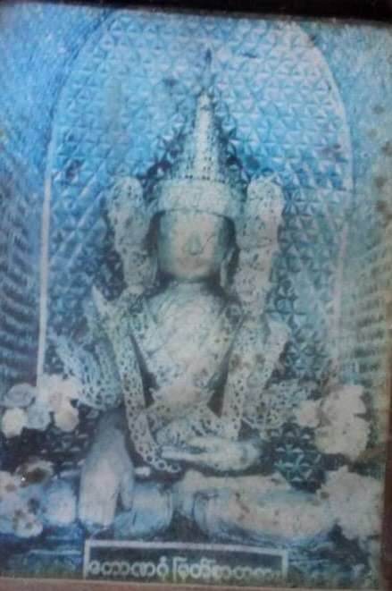
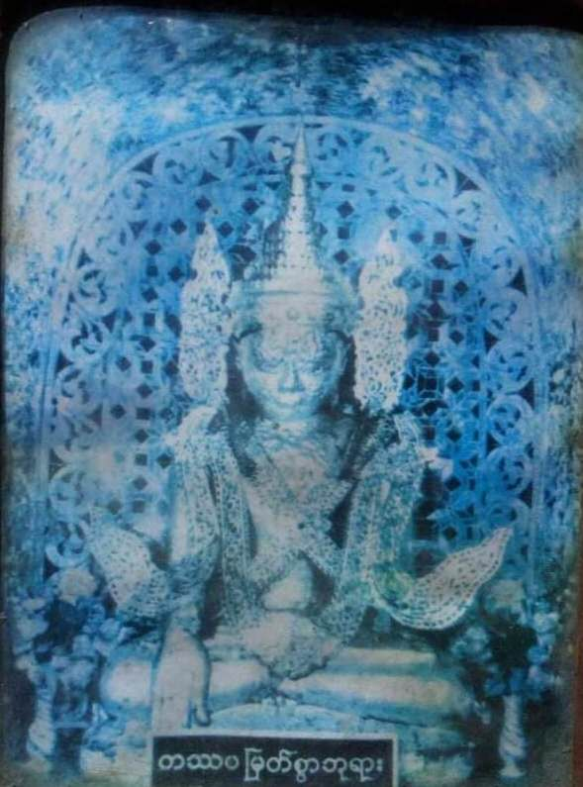
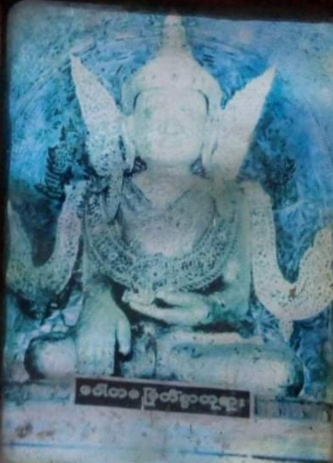
Five Buddhas
Badda Kaba: five Buddhas
Kakusa Buddha, Koṇagaṃ Buddha, Kassapa Buddha,Gotama Buddha appeared formerly
Arimettaya Buddha that will appear in the future world
Gotama( Gotama, the man): our worshipful, sacred, devoted Buddha
Tow periods in Sāsanā of Gotama Buddha: within Sāsanā(we can see and worship to the Buddha, listen to Buddha’s Doctrine directly) and far beyond Sāsanā( we couldn’t see and worship to the Buddha, had no chance to listen to Buddha’s Doctrine in front of the Budhha,but we worship to the Buddha Image and practise the Doctrine)
Kakusaṃ Buddha
Koṇagaṃ Buddha
Kassapa Buddha
Gotama Buddha

Slide 4
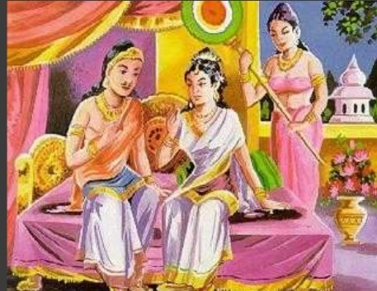
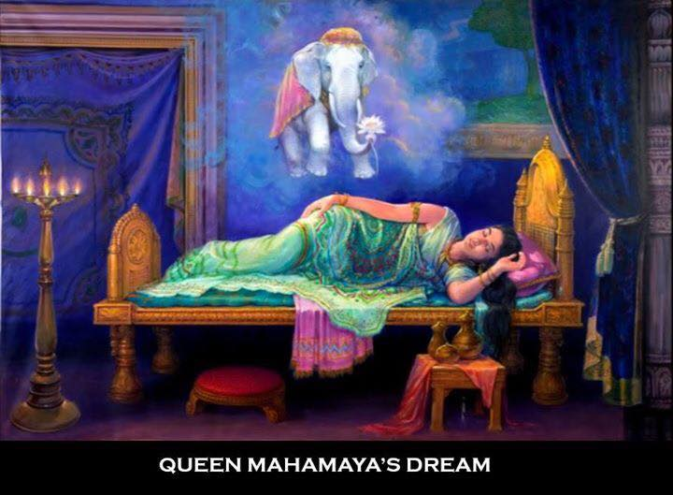
King Suddhodana and Queen Mayā
The God(Nat), the future Buddha-Leaving Tusita Heaven was asked to be reborn as a man by the higher and lower gods of all ten thousand worlds .
King Suddhodana and Queen Mayā lived in Kappavali country.
Queen Mayā dreamed of the future Buddha to enter her womb. The conception took place.

Slide 5
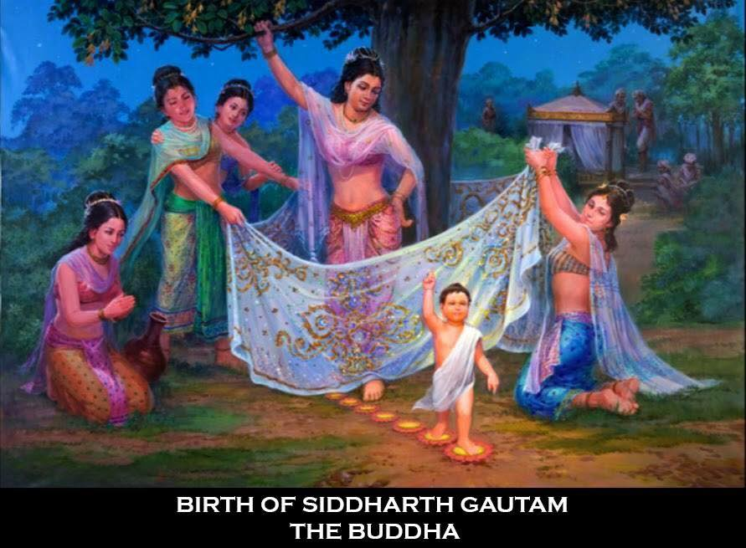
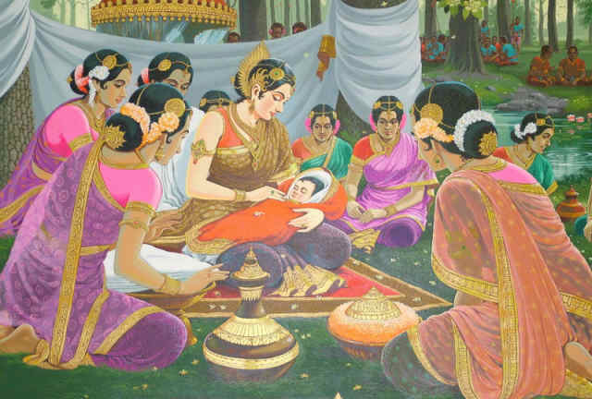
The Future Buddha Was Born
Queen Mayā gave birth to her son, the future
Buddha, standing up and holding one of the branches
of the sal tree in Lumbini Grove of sal trees.
Lotuses raised from the ground and the flowers of sal
trees were presenting a very pretty scent at that time.

Slide 6
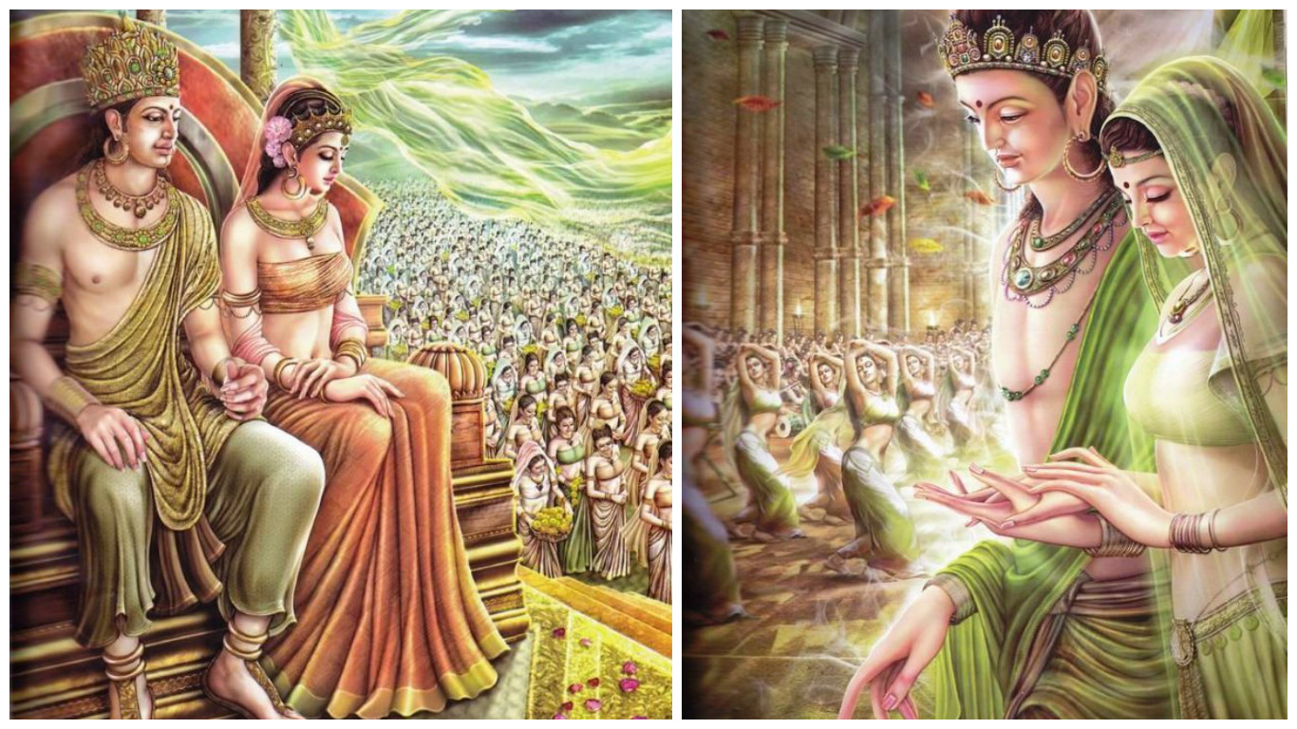
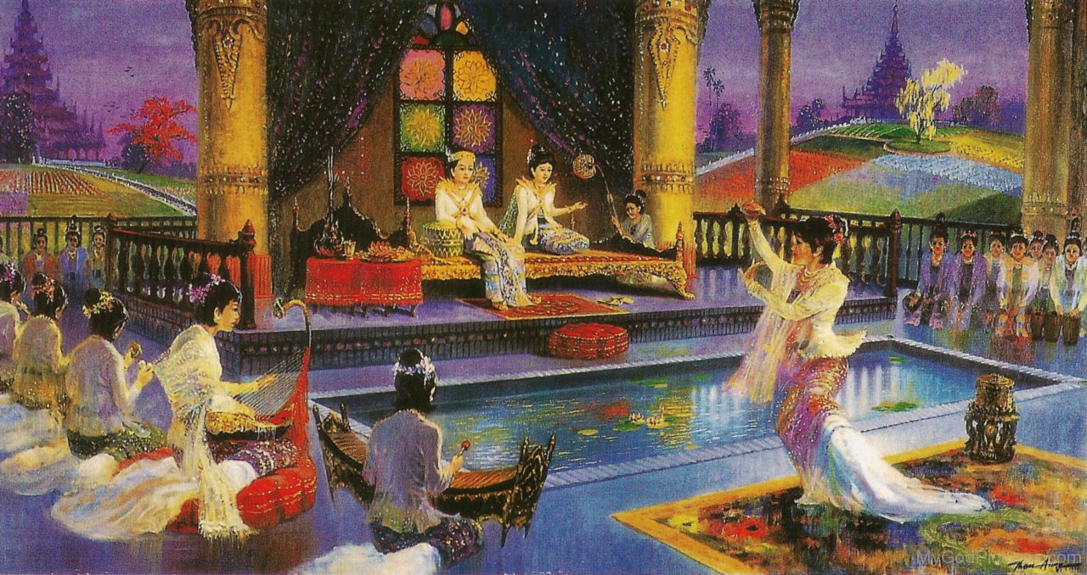
Prince Siddhatta with Princess Yasodhara in the palace
Prince Siddhatta chose princess Yasodhara.
He married her by celebrating a great wedding
when he was at the age of 16.

Slide 7
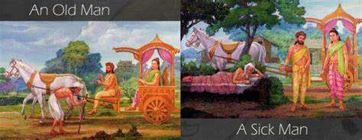
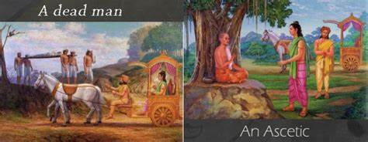
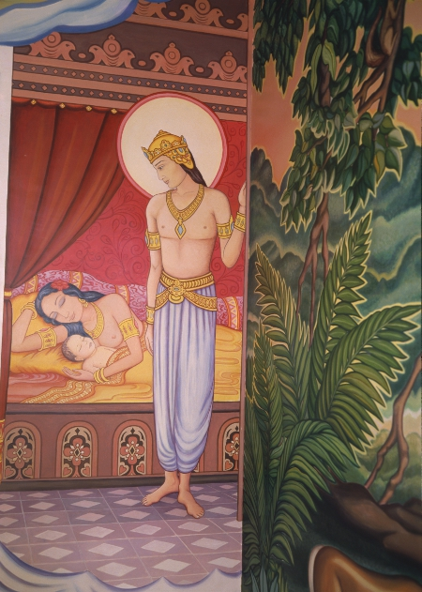
Siddhattha Renounced the World after seeing the four Signs
The prince went to the Royal Park at the age 29 and saw the Four Signs.
They are--- an old man, a sick man, a dead man, a monk.
At that very moment he got a message
that a son had been to him

Slide 8
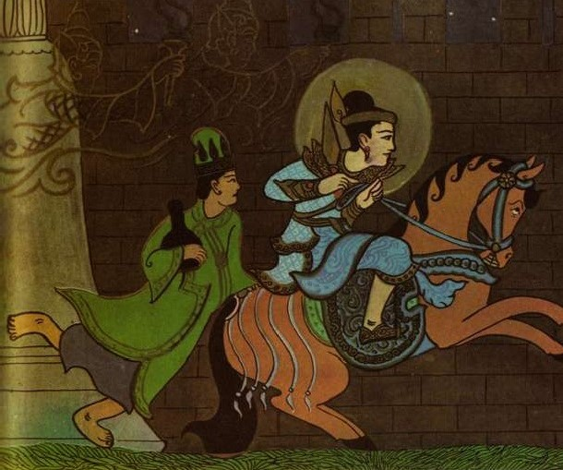
Renounced
Although King Suddhodana wanted his son to
succed him the throne and become a Universal Monarch,
Siddhattha renounced after he had noticed the four sings.
Siddhattha gave up the throne, Queen Yaso, sonYāhura and
all the sensual pleasure in the world.
Siddhattha renounced riding on the mighty Kanthaka
horse at midnight. Slave Channa was also holding on
by the tail. And the divinity that guarded the city-gate had opened it for them.

Slide 9
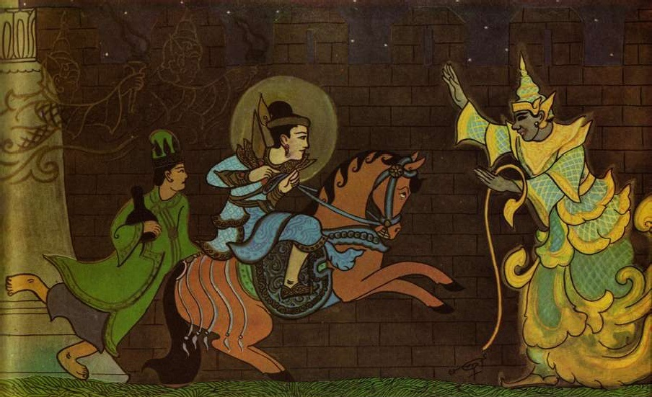
The Future Buddha and Mara, the evil one
At this moment Mara came and persuaded
Siddhattha to turn back. He told that on the
seventh day from then the jewel-wheel of
empire would appear to him.
He replied that he knew that the wheel of
empire was on the point of appearing, but
he didn’t wish to be a king. His sole desire
was to become a Buddha and save the world
of Devas and men.

Slide 10
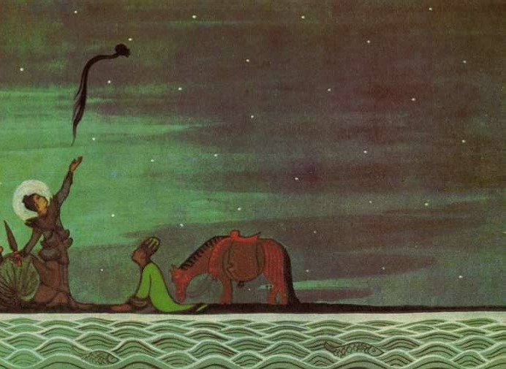
The Future Buddha Cut his hair to become a monk
After Siddhattha had got to the Anoma River at day-break,
he handed his ornaments and the horse, Kanthaka
to Channa and asked him go back palace with them.
He cut his hair with the sword on the sandy beach
Anoma river.
He seized hold of his top-knot and threw
it in the air, saying- “If I am to become
a buddha, let it stay in the sky; but if not
let if fall to the ground”.

Slide 11
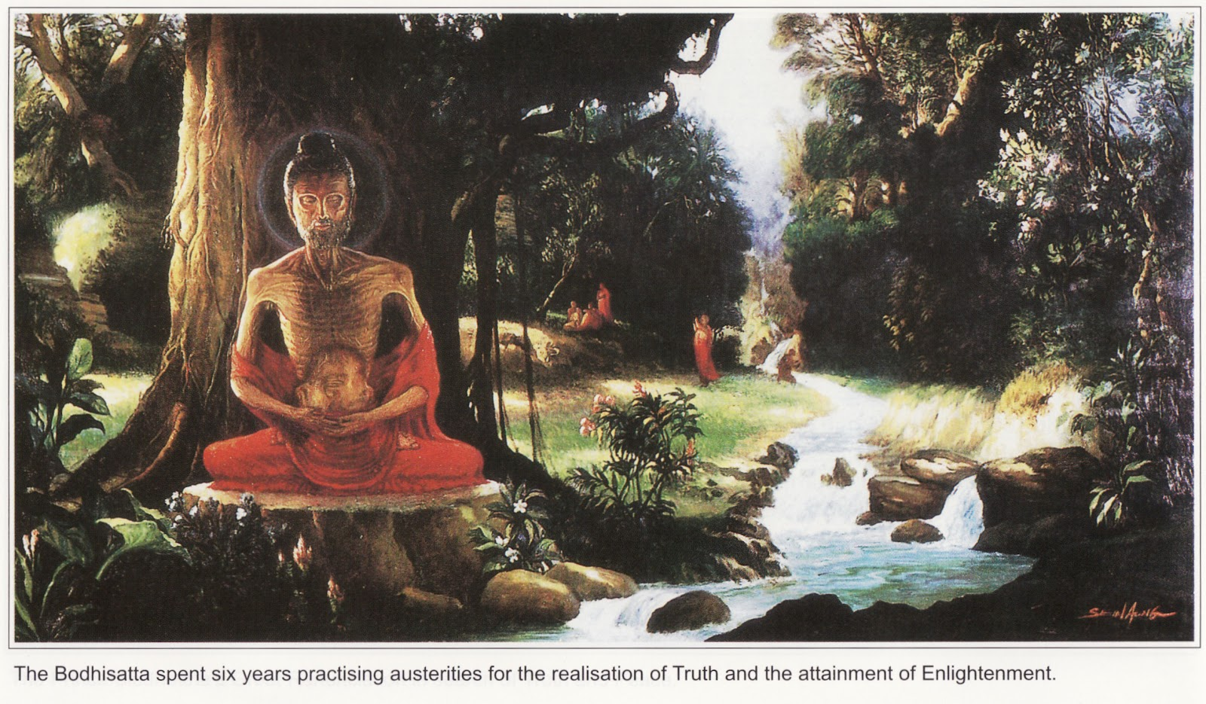
The Future Buddha Made the Great Struggle
The future Buddha seeked for not only the teachers
but Dhamma such as virtue, ethics, good habits, chastity,
morality, purity, the methods of meditation and practised
and followed them.
Then he found two renowned Brahmins but it was wrong way.
And he left the teachers and went to Uruvela Grove and
searched for the ways to Nibbanna.
The future Buddha changed to practise the Great Struggle for 6 years
He didn’t eat anything except fruit which dropped from trees, near at hand. Just one fruit a day.
His body was reduced to skin and bones and lost its golden colour and became dry and black.

Slide 12
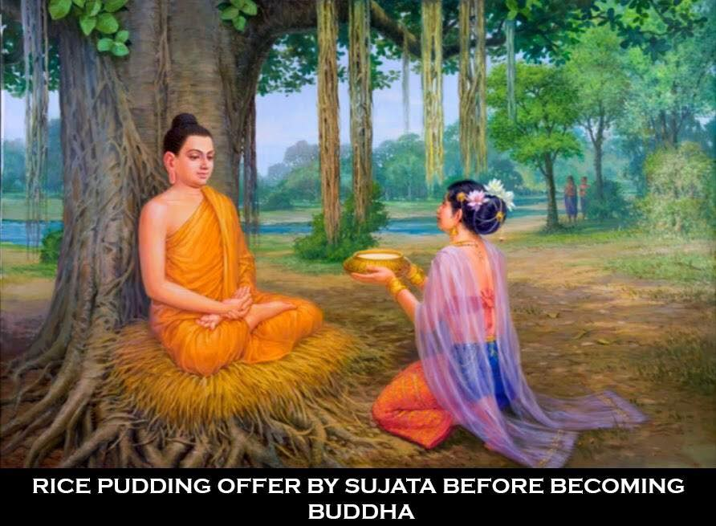
Sujata, the rich lady offered the milk porridge
But the future Buddha knew the way of Great Struggle
was not the way to Enlightenment. Then he followed
the Middle way of the noble practice better to meditate.
The rich lady Sujata offered the future Buddha under the Bo
or Banyan tree the milk porridge, the most delicious food.

Slide 13
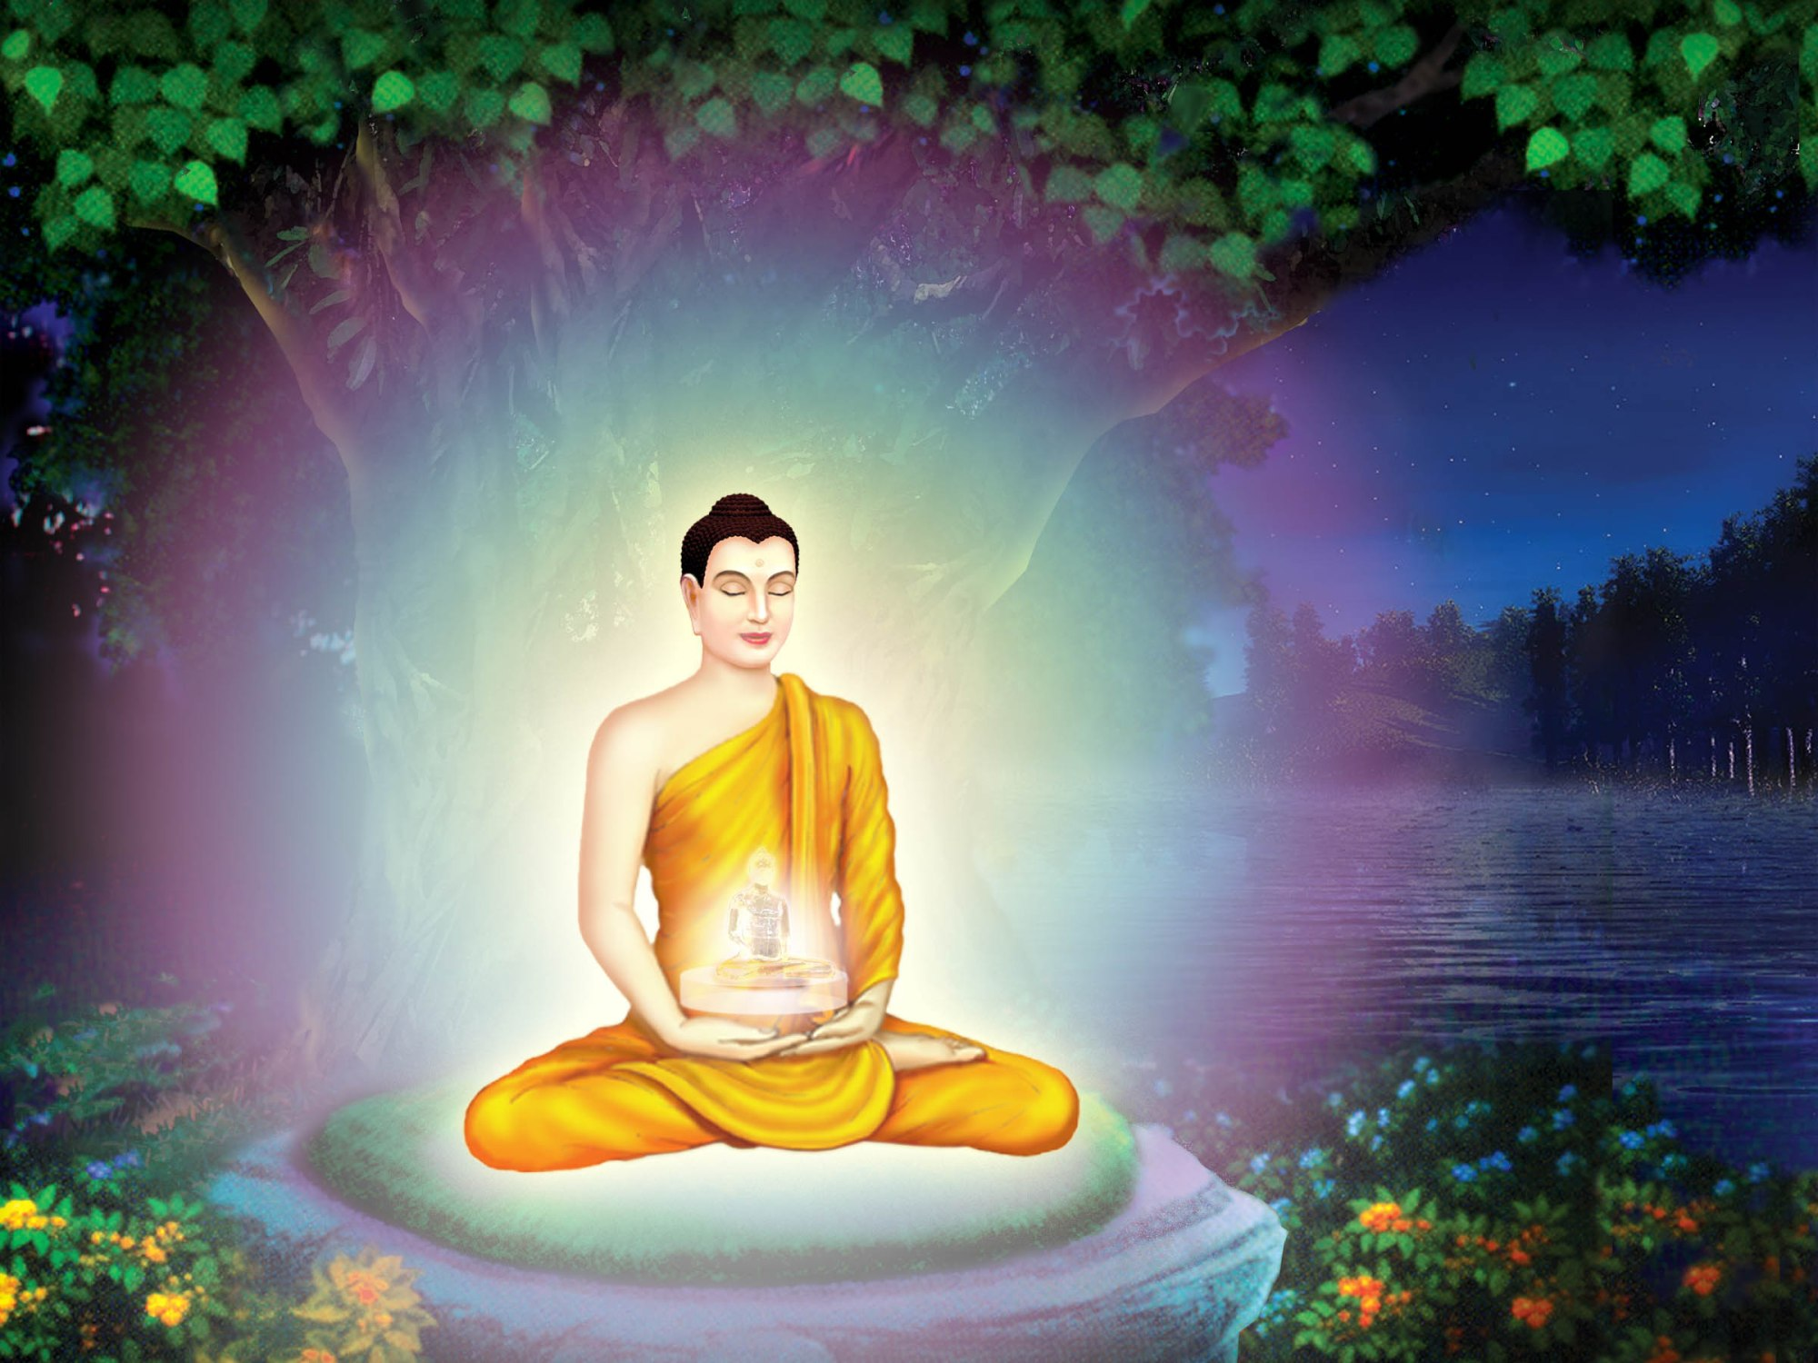
The Future Buddha got his enlightenment
The future Buddha sat cross-legged at the foot
of the Bo tree and made firm resolution to attain
the Supreme wisdom, not to move from this place
and went into deep meditation.
Firstly, he acquired the knowledge of previous existences
at midnight.Secondly, he acquired devine eye, the beings of all
(thirty-one planes of existence) at late midnight. Finally, he
gained the Enlightenment to Nibbanna.
On Wednesday the full moon day of Visakha,
at dawn the Great Being attained the Supreme Enlightment of a Buddha.
At the age of 35 attained the Supreme Enlightment of a Buddha.

Slide 14
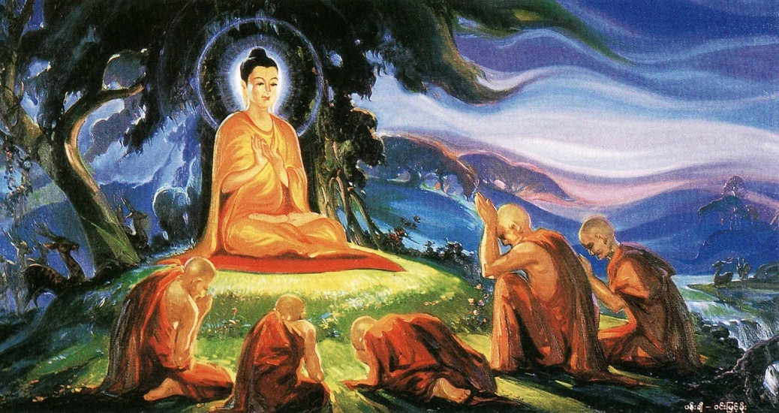
The Buddha preached the first sermon “The Wheel of Dhamma”
The Buddha preached his first Sermon to the five ascetics:
(Koṇḍañña, Assaji,Bhaddiya,Vappa and Māhanāma)
in the Deer Park at Isipatana near Benares.
First Sermon called the Dhammacakkappavattana

Slide 15
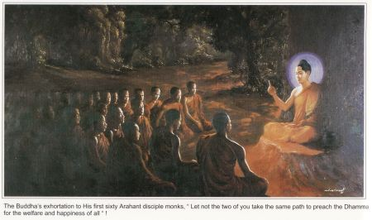
Sending out A mission of Arahants
The Buddha endeavoured to enlighten all
those who could be guided and lead them on to
the right path-natural way.
The Buddha simply preached the Truth or Dhamma
understanding the Truth is the essence of Enlightenment.
He send the disciples to all parts of
places.
He didn’t allow the monks to lead the way in group. He
guided each to one way just to enlarge the places.
Buddha preached his Dhamma 45 years last long.

Slide 16
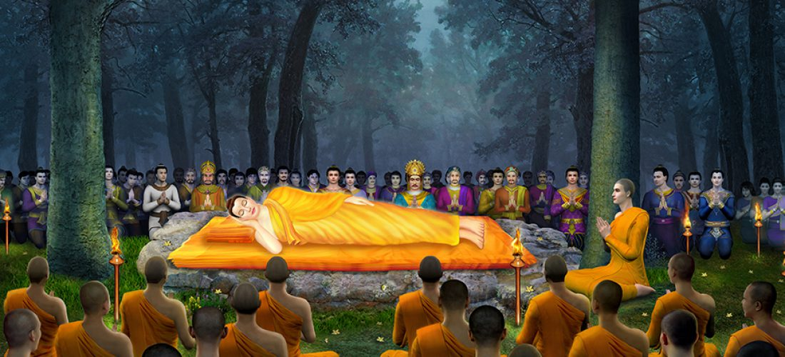
Parinibbanna(Death) of the Buddha
The Blessed one’s last words, all things are subject to decay. Work out your salvation with diligence.
The Buddha death(Parinibbanna) at the age of 80, in Pāvā City near Vesali.

Slide 17
Today Buddhism is found in Ceylon, Burma, Thailand, Cambodia, Laos, Vietnam, Tibet, China, Japan, Mongolia, Korea, Formosa, in some parts of India, Pakistan and Nepal, and also in the Soviet Union. The Buddhist population of the world is over 500 million.

Slide 18
Thank you for your attention

