Slide 1




Mythology: Huli-jing
吴婷 Wu Ting

Slide 2
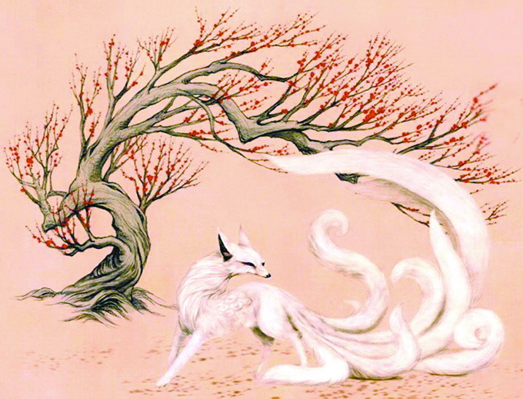
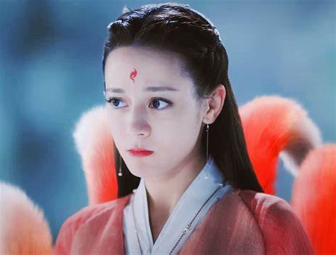
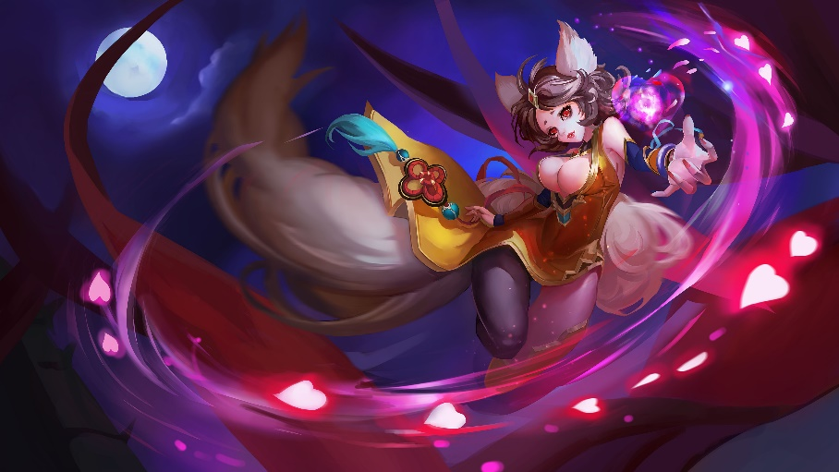
When it comes to Huli-jing, what first appears in your mind?
Huli-jing figure in Chinese mythology and its analogs（类似物） in Japan and Korea

Slide 3

Huli-jing in China
werewolf foxes
young and extremely beautiful women
《吴越春秋》：“禹娶涂山，白狐显现。”
Xia dynasty
Yu（禹）, married a nine-tailed white fox who lived on Mount Tu.
People, especially women, believed that due to the cult of the fox, they would be able to gain unearthly beauty and immortality.

Slide 4

The fox was a very positive and uplifting image.
After the fall of the Han Dynasty, the official authorities tried to resist the representatives of the Huli Jing cult.
东晋郭璞 《玄中记》：“狐五十岁能变化为妇人，百岁为美女，为神巫，或为丈夫，与女人交接。能知千里外事。善蛊魅，使人迷惑失智。”
In the Tang and Song Dynasty, the fox's feminized image was basically solidified.The story of Huli-jing not only spread widely among the folk, but also began to penetrate into prose, poetry and other literary works.In the Song Dynasty, Huli-jing was closely associated with the prostitute（妓女）.
《搜神记》：“千岁之狐，起为美女”“狐者，先古之淫妇也，其名为阿紫，化而为狐。故其怪多自称阿紫。”
In the Ming Dynasty, the fox demon began to transform into the "fox fairy" under the influence of Taoism at that time. The purpose was clear: the fox should become immortal through cultivation.

Slide 5



The image of the Huli Jing as a mythological character by the 21st century was constantly supplemented with small details. We can say that most of the works of literature and cinema, in which the werewolf fox was encountered, for the most part, were very strongly romanticized.
beautiful but scheming women
"Painted Skin” (畫皮)

Slide 6

Kitsune (キツネ) in Japan
In Japanese folklore, these animals have great knowledge, long life, and magical abilities. Chief among them is the ability to take shapeshift themselves; the fox, according to legend, learns to do this after reaching a certain age (usually a hundred years old, although in some legends it is fifty).
take possession of other people's bodies;
breathe out or otherwise create fire;
appear in other people's dreams;
create illusions so complex that they are almost indistinguishable from reality

Slide 7
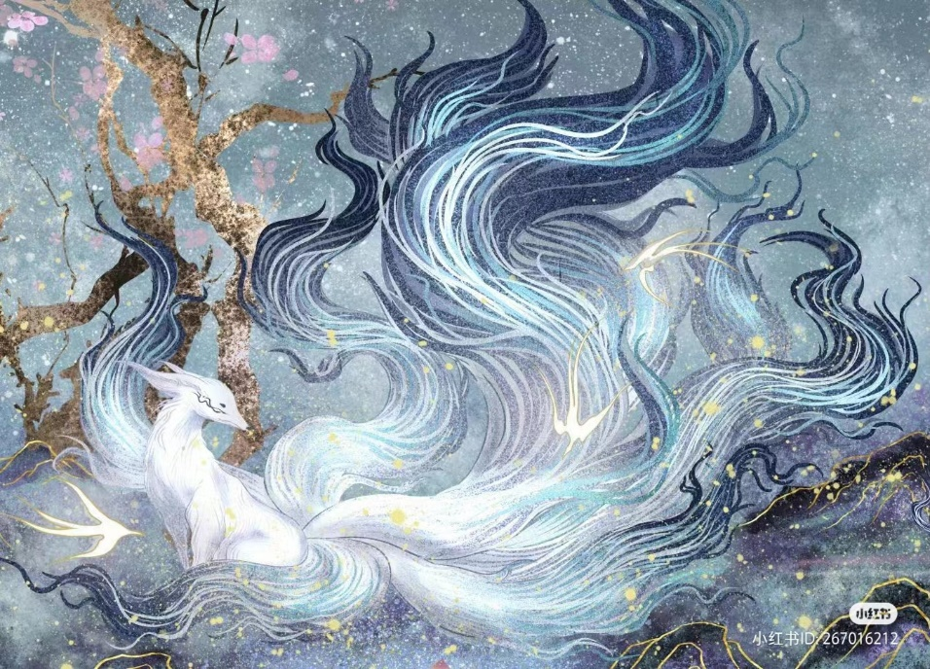
Kumiho (구미호) in Korea
Kumiho - (구 "ku" - nine, 미 "mi" - tail, 호 "ho" - fox - "fox with nine tails") is a folklore animal, the fox of which is first mentioned in the era of Gojoseon.
One of her superpowers is transforming into a beautiful girl. Although in myths there are also references to the becoming of a charming young man. In this form, the mythical animal fell in love with the opposite sex, and then ate their liver (according to some beliefs, and the heart).

Slide 8
Why exactly the liver?
The liver contains human energy, that is, we eat and receive the energy that our liver stores.
The person who recognized her as Kumiho when she is in human form will keep this secret for ten years.
She refrains from eating corpses and killing people for a thousand days.
Transform into a human
Kumiho will eat the liver of thousands of men over a thousand years (if this does not happen, it will disintegrate into many small bubbles).

Slide 9
THANK YOU

