Slide 1

中华典籍外译 Chinese Classics Translation for Master Students of Translation Studies
湖南师范大学 2022年2月25日-2021年6月10日 中国文化基础 周五第九和第十节课14:30-16:10，
上课地点：线上VooV
助教：Li Xin 李欣 – Session no. 7
吴漠汀特聘教授 Distinguished Professor Dr. Martin Woesler
培高德 教授 Professor Dr. Cord Eberspächer
湖南师范大学外国学院 Foreign Studies College, Hunan Normal University

Slide 2
Schedule 学期题目
1 2.25 Organizational things, intro to the concept of a „classic“
2 3.4 Canonization
3 3.11 Early Translation of Chinese Literature
4 3.18 Reception of the Red Chamber Dreams in the West
5 3.25 How to make people read classics again?
6 4.1 Western Classics in Chinese clothes: The example of Utopian Literature
7 4.8 Attractiveness of Chinese Classics as part of softpower
8 4.15 Chinese Classics in the West: The Example of Germany
9 4.22 Sinicization – Politics for Cultural Export: The Example of the Chinese classics
10 4.29 Chinese Classics in World Lit. Anthologies and World Literary History Books
11 5.6 Translation of Modern Classics: Mo Yan, Yu Hua, Liu Cixin etc.
12 5.13 Chinese Classics on Overseas Bookfairs
13 5.20 Cinema Movie Adaptions of Chinese Classics
14 5.27 Lessons to learn from the Classics: Integration or Sharpening the Cultural Profile?
15 6.3 Final Discussion
16 6.10 Final Exam

Slide 3
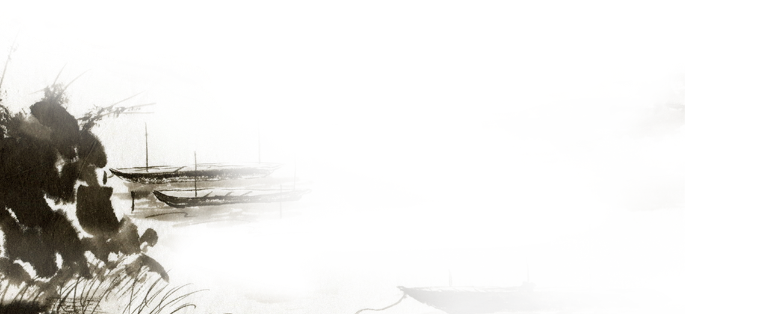



How to make foreigners read Chinese classics? for Master Students of Translation Studies
吴漠汀教授
Prof. Dr. Martin Woesler
Hunan Normal University
Spring 2022

Slide 4
Student Input
Presentation by Li Xin 李欣 Attractivenss-of-Chinese-classics-as-part-of-soft-power
literature review with handout by Li Ying 李颖 handout:An Overview of Chinese Classicss as Soft Power
argumentative debate live in class by Li Simin 李思敏 & Li Yijia 黎溢佳 handout: Whether Chinese classics enhance China’s soft power or not
吴漠汀教授
Prof. Dr. Martin Woesler
Hunan Normal University
Spring 2022

Slide 5
Teacher Input
Discussion
吴漠汀教授
Prof. Dr. Martin Woesler
Hunan Normal University
Spring 2022

Slide 6
Chinese Classics are unsuccessful abroad – Why?
Currently, everybody in the world has heard of Shakespeare and Hemmingway. Almost nobody outside of China has heard of the Book of Songs, Li Bai, the Red Chamber Dreams, Lu Xun and Qian Zhongshu. Everybody loves to read Romeo and Juliet, Chinese literature is a marginal literature which ranges under 1% of the world literature.
Cao Jiao: a country’s ability to influence the preferences and behaviours of various actors in the international arena (states, corporations, communities, publics etc.) through attraction or persuasion rather than coercion. A nation with strong soft power will attract people around the world read its classics to learn more about it.
He Lina: for foreign readers, the fast-paced story is what attracts them. But classical Chinese novels are often flat, slow-moving and rarely psychological, which doesn't appeal to foreign readers.
Kung Yuqi: Chinese literature is full of local flavor, which is unfamiliar to western countries that have entered the post-industrial era. Even in China, let alone the West, for a child growing up in Beijing, reading foreign novels like Norwegian Wood is far more intimate than Life.
Xiao Jiali: Western culture started around Sea as trade culture, China as isolated area
Wrong answers: egocentrism of the West, Cultures are too different, Chinese is hard to understand (translations), Discrimination, Lack of Cultural Confidence, quality of translation

Slide 7
Chinese Classics are unsuccessful abroad – How to change it?
[Answers I doubt: Bian Wangqian: Fault of translators, translators need to be more confident; Cao Jiao: Change communication (not problems)]
Chen Luyao: The characters written by writers should be "people", not just the so-called "Chinese". Wang Siqi: If we give up our individuality and become the Chinese literature that the West knows and imagines, we will be abandoned by the West again.
Deng Yanglin: Chinese is too obscure to read, simplify Chinese as far as it can be done
Hu Liangming: Not intervening, successful example of web literature, only need to create good conditions
Li Yijia: Reading circles, TikTok; Liu Chang: Book Expo
Li Ting: Develop market-oriented mechanism for literary translation
Yang Ziwei, Zhao Yuxiang: vernacularize, Modernize classics with movie/cartoon/TV
Tuo Shumei: interchange and communicate more with the outside world; Liu Lele: Less classics more Youtube, movies; Reform & Opening: “When our country is strong and happy enough, other countries and their people would naturally want to know more about China.”; Liu Zhen, Wang Yajuan: Increase soft power; => make China more attractive
Answers: https://wiki.rub.de/uvu/index.php/On_the_relation_of_reading_classics_of_a_country_and_the_attractiveness_of_that_country

Slide 8
Soft power
Nye (Harvard) 1990: hard, soft, smart power
To promote one‘s culture with money or phsyical force is called „hard power“
Approach to enhance soft power by means of hard power: Movies on Times Square
US‘ soft power unintentional, based on appeal

Slide 9
International students

Slide 10
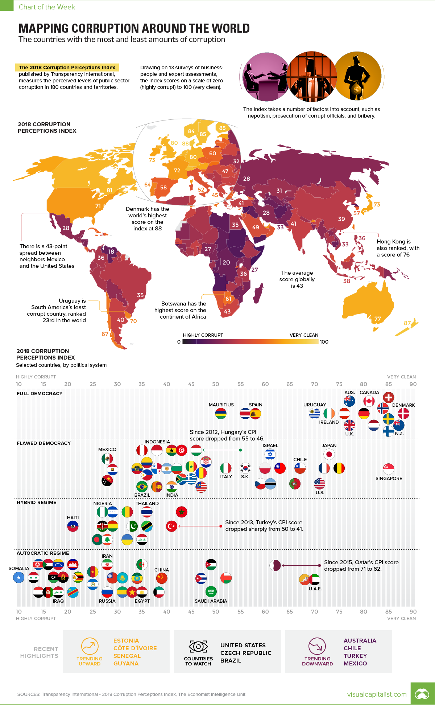
Soft power

Slide 11
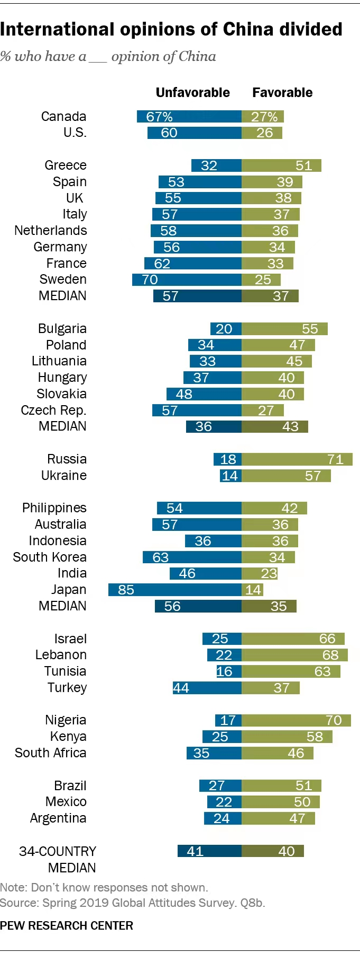

Slide 12
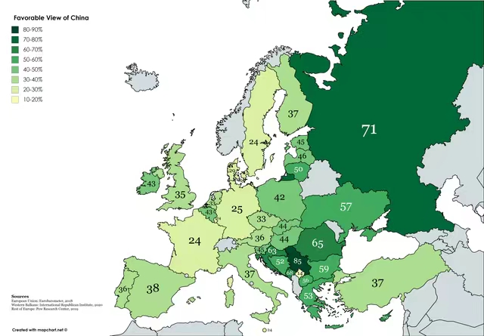
Europe

Slide 13
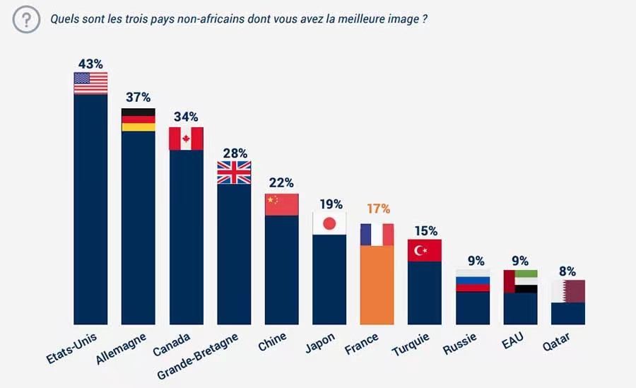
Africa

Slide 14
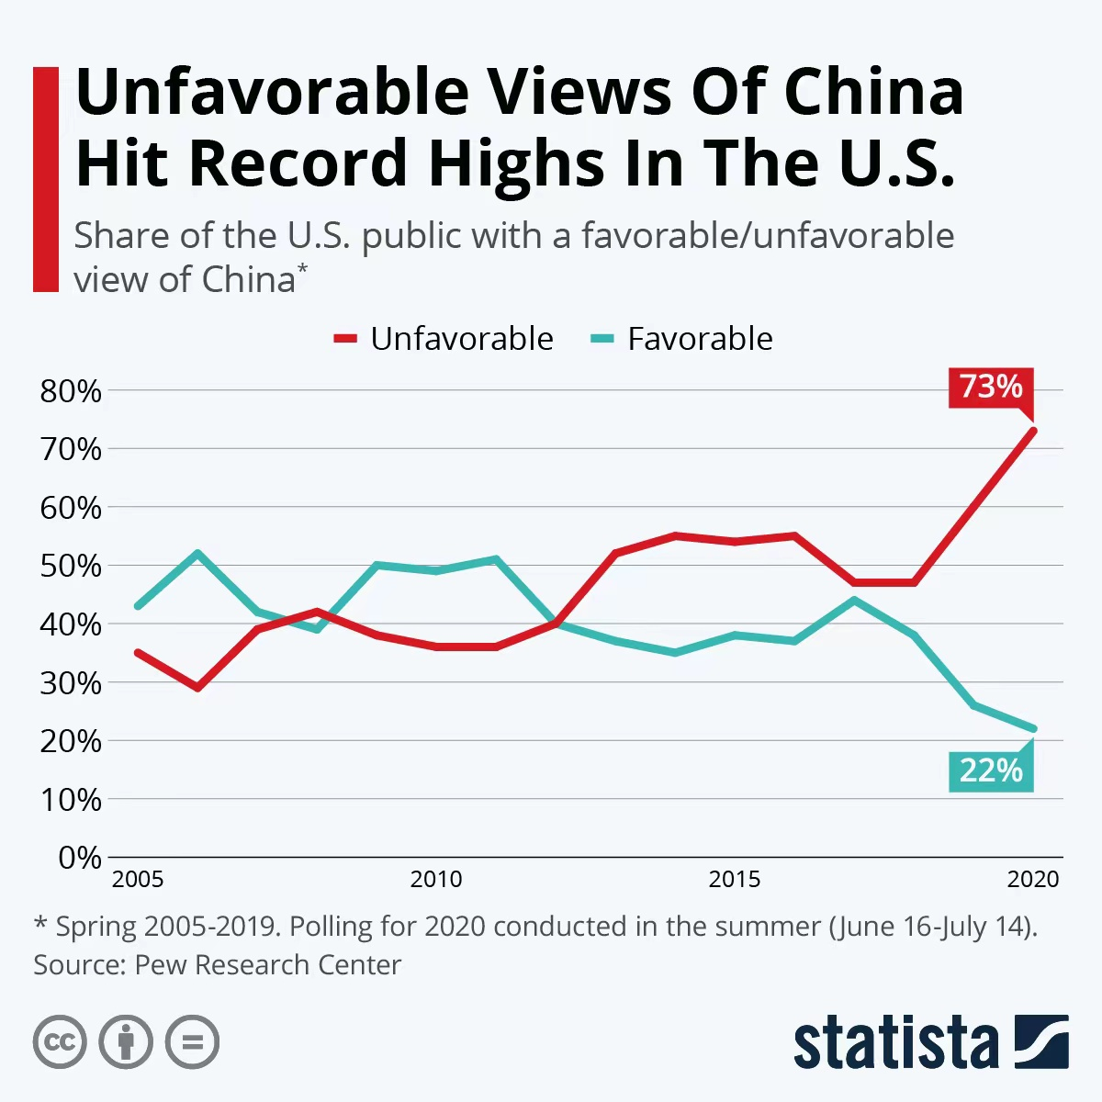
USA

Slide 15
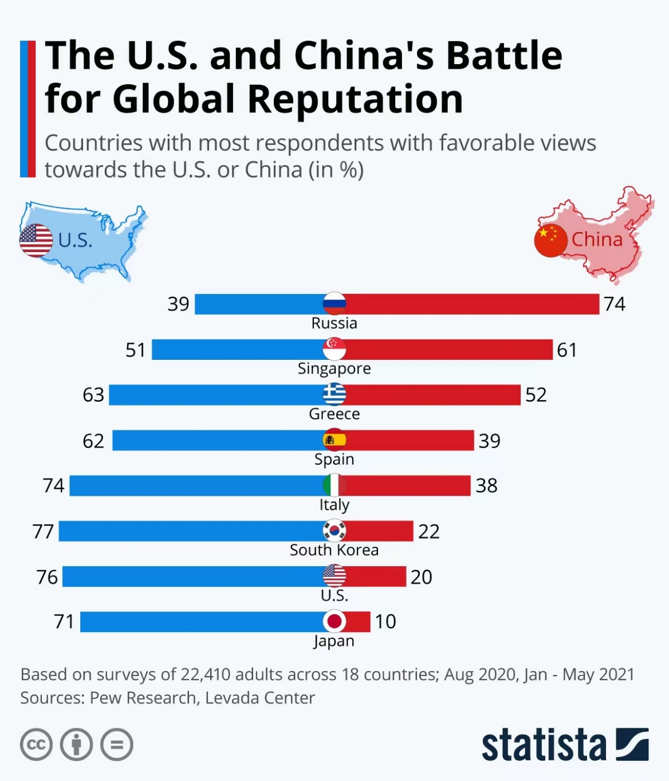
China vs US

Slide 16
China vs US

Slide 17
How to make China more clean, free and to one of the „good guys“? => culture more accepted, classics more read
[Many students deny that the problems, why the international community is rejecting China, actually exist. Yang Xinyi: Reading classics is not related to who is [in] the corner of the chart. Zhang Rui: Foreign media has information deficit]
Liu Lele: Become aware of difference between self-perception and foreign perception
Cao Jiao: Promote exchanges, cooperation; Deng Yanling: deepen reform; Olympic Games, World Expo; He Lina: transparent government; Kuang Yuqi: clean energy, public health; Li Yuan: Go Global strategy; Liao Shiyun: also through popular culture; Liu Ting: practical solutions for international issues like climate change, environmental protection => win the trust of the world; improve education, welfare and employment system; Nie Wei: „vividly show the outside world that Chinese people live in happiness because of our political, cultural, economic and other conditions”; Wang Siqi: win recognition and respect; Zhu Lijuan: stable legal environment, infrastructure,admin service
Ma Yanhuan: Economical attractiveness
Zhong Qing: Win the hearts of the people is not just difficult internationally, but also domestically
Li Simin: China does not want to lead any country; Li Siyuan: China never wanted to be a world leader, to invade or bully other countries <= maybe no choice, because China will be no. 1 economically? => leader of hearts (favourite country, voluntary support, not by force)
=> The world perceives China to seek its leadership through force, self-perception: peace
[Results: https://wiki.rub.de/uvu/index.php/Global_attractiveness_of_Chinese_culture]

Slide 18
What is the definition of hard power, soft power and smart power?
Hard power: Economical, financial, military power, power of political actions
Soft power: Attractiveness of one‘s culture, positive foreign perception of country‘s image
Smart power: Combination of both powers

Slide 19
Water is fluid, soft, and yielding. But water will wear away rock, which is rigid and cannot yield.
As a rule, whatever is fluid, soft, and yielding will overcome whatever is rigid and hard.
This is another paradox: what is soft is strong.

Slide 20
Preparation for next session
1 2.25 Organizational things, intro to the concept of a „classic“
2 3.4 Canonization
3 3.11 Early Translation of Chinese Literature
4 3.18 Reception of the Red Chamber Dreams in the West
5 3.25 How to make people read classics again?
6 4.1 Western Classics in Chinese clothes: The example of Utopian Literature
7 4.8 Attractiveness of Chinese Classics as part of softpower
8 4.15 Chinese Classics in the West (students) – Teacher input: The Example of Germany
9 4.22 Sinicization – Politics for Cultural Export: The Example of the Chinese classics
10 4.29 Chinese Classics in World Lit. Anthologies and World Literary History Books
11 5.6 Translation of Modern Classics: Mo Yan, Yu Hua, Liu Cixin etc.
12 5.13 Chinese Classics on Overseas Bookfairs
13 5.20 Cinema Movie Adaptions of Chinese Classics
14 5.27 Lessons to learn from the Classics: Integration or Sharpening the Cultural Profile?
15 6.3 Final Discussion
16 6.10 Final Exam

Slide 21
Preparation for next session
Gather information on Chinese Classics in the West
Take the quiz
Translation
Correction of translation
Please choose your final exam paper and start writing (grade)

Slide 22
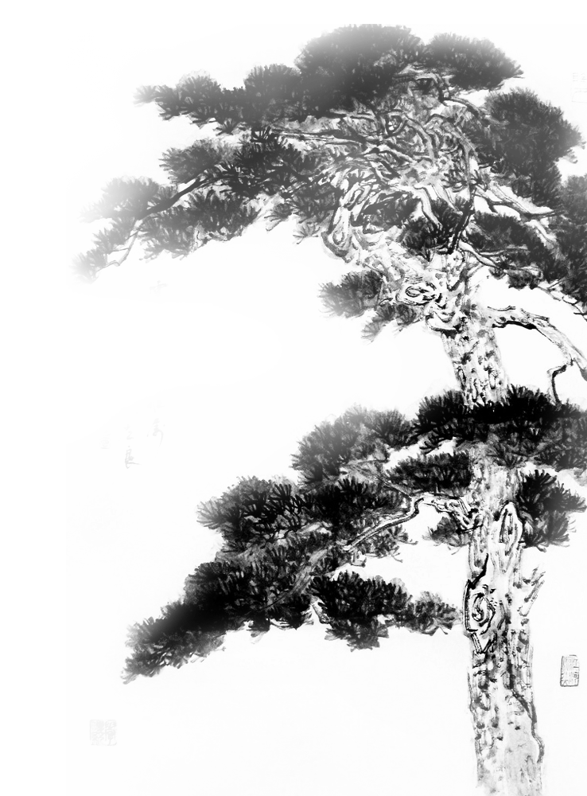
謝謝觀賞

