Slide 1


PART 02
公主王子们
这是第二部分
Part2 Taobao Technological Innovations

Slide 2

01
AI Fitting Room:
Taobao has introduced an AI fitting room feature that combines artificial intelligence with fashion styling. It uses AIGC technology to analyze billions of users' size data and a vast array of clothing images to recommend suitable outfits. Users can search for "ifashion" on the Taobao app, upload their photos, and experience AI-powered virtual fitting.

Slide 3
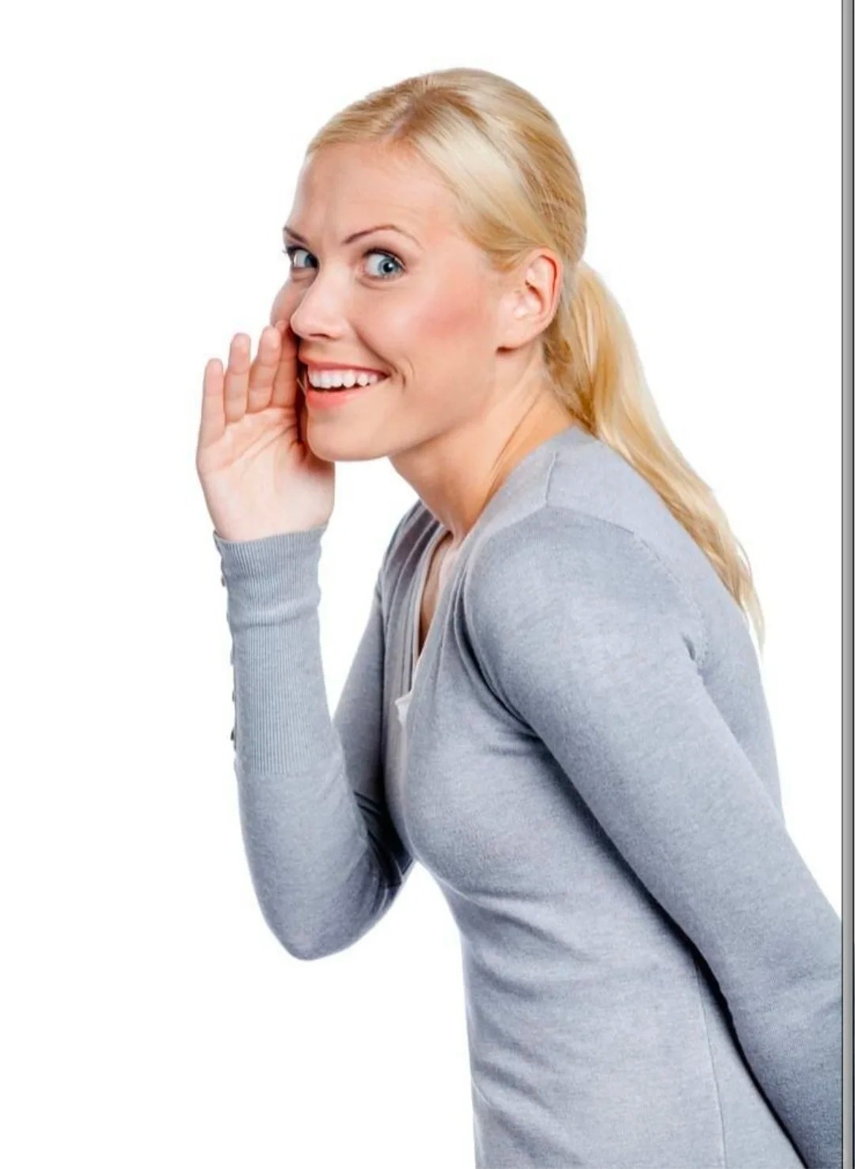
02
WeChat Pay Integration:
Taobao announced that starting from September 27, 2024, it fully integrated WeChat Pay, allowing consumers to use WeChat Pay for purchases on Taobao. This move signifies a more open internet landscape in China and a significant step forward in the online shopping experience. Over 90% of Taobao and Tmall merchants now support WeChat Pay, and users can utilize this feature after updating to the latest version of the Taobao app.

Slide 4

03
AI Dressing:
The Outfit Anyone project, an open-source one-click clothing change virtual try-on initiative by Alibaba, allows users to experience it online through ModelScope or the Hugging Face community. Users can select an AI model, upload or choose tops and bottoms, and then click to run, presenting the synthesized dressing effect. This technology offers consumers a new shopping experience and also provides convenience for fashion designers, models, and e-commerce professionals.

Slide 5
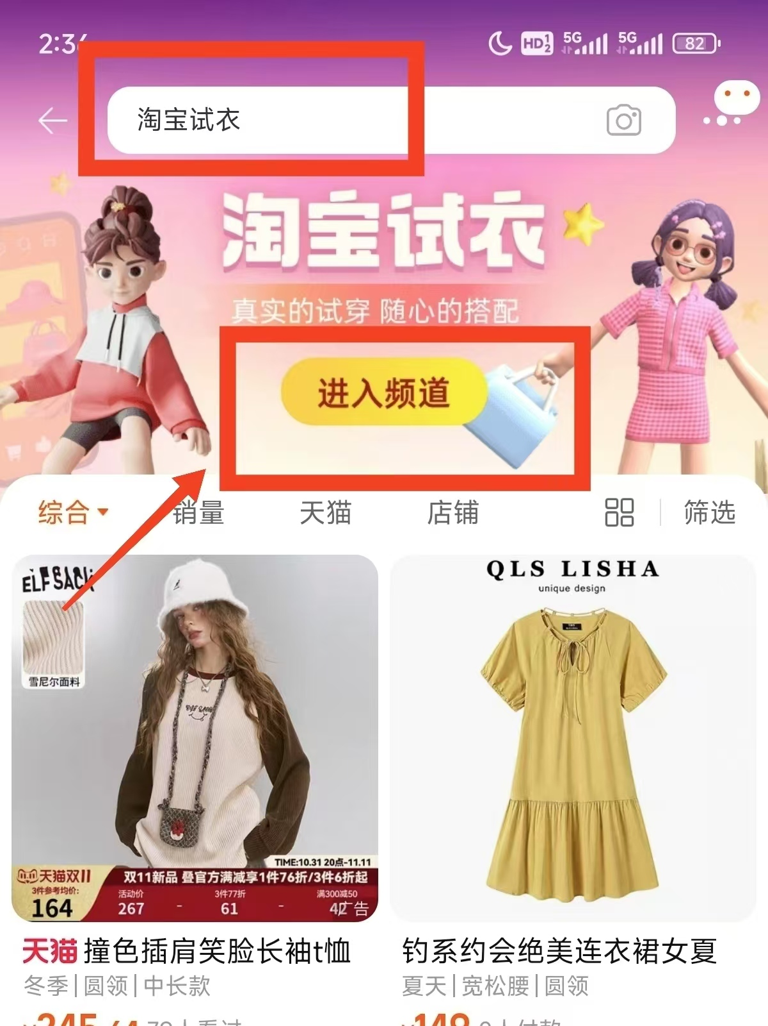
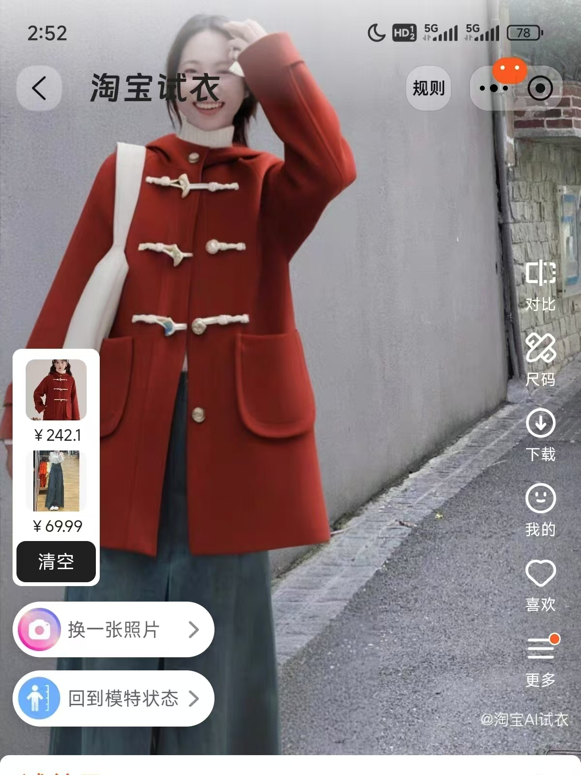
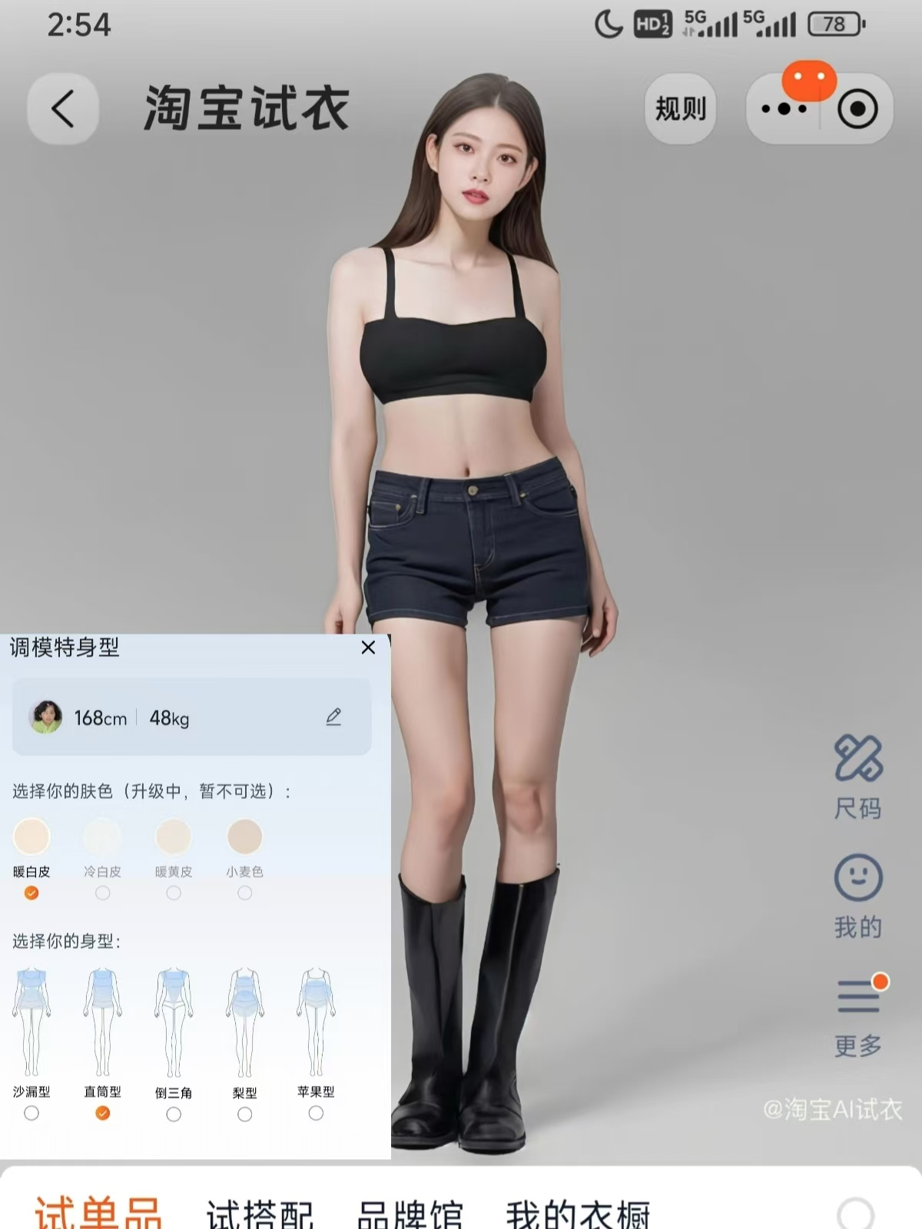
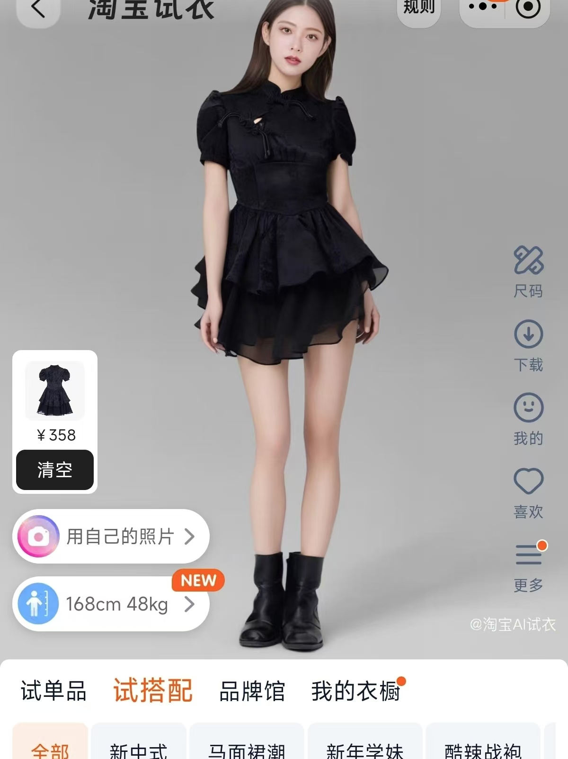
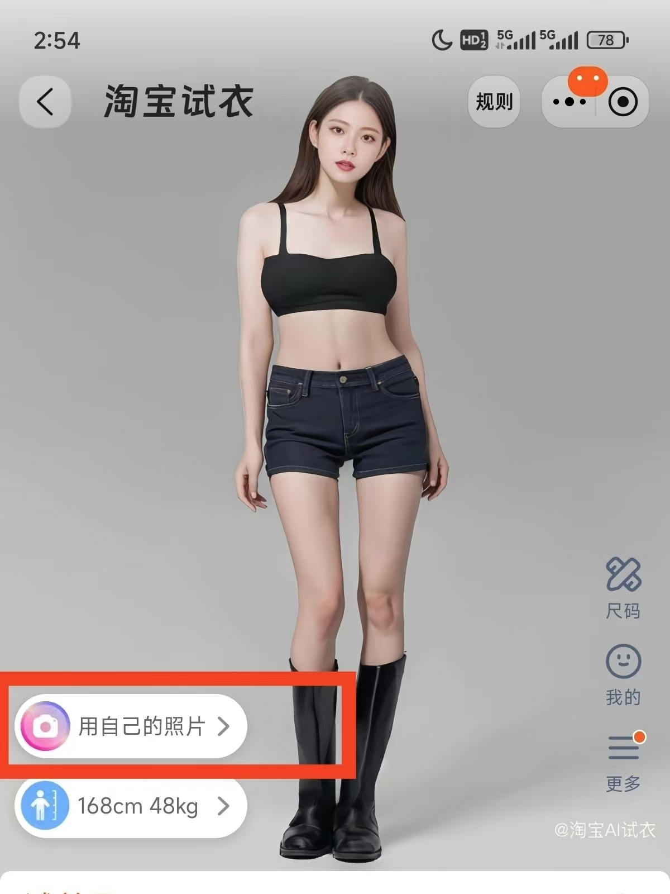
AI Dressing

Slide 6
AI Dressing

Slide 7
AI Dressing

Slide 8
AI Dressing

Slide 9
AI Dressing

Slide 10
AI Dressing

Slide 11
AI Dressing

Slide 12
AI Dressing

Slide 13
AI Dressing

Slide 14
AI Dressing

