Slide 1

Voices of Chinese Female Writers
主讲人：
Zhou Tianyi
时间：
2025.5

Slide 2
CONTENTS
1.
Introduction
目录
2.
Individual Author Sections
3.
Comparative Analysis
4.
Conclusion

Slide 3
01
Introduction

Slide 4
Significance of Female Writers in Chinese Culture
Historical Evolution of Female Writers
Impact on Cultural Discourse
Role in Modern Literature

Slide 5
02
Individual Author Sections

Slide 6
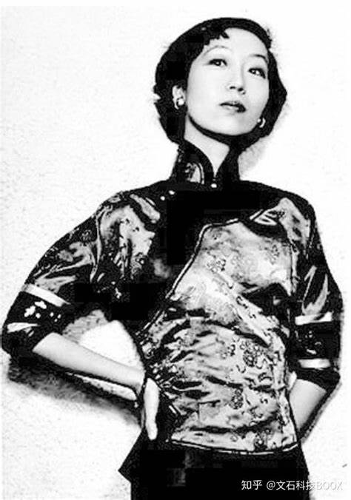
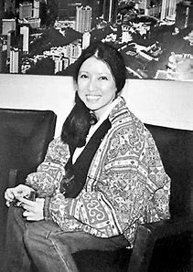

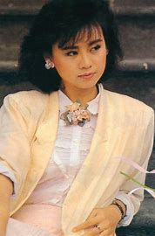
Zhang Ailing (Eileen Chang)
Chen Ping (Sanmao)
Li Bihua (Lillian Lee)
Lin Yihan

Slide 7
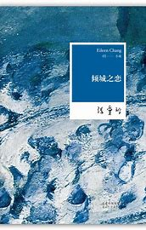
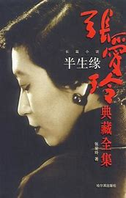
Zhang Ailing (Eileen Chang)
Born in Shanghai, Zhang Ailing grew up during the Republican era and later lived in Hong Kong and the US. Her experiences during wartime and personal relationships deeply influenced her writing, capturing the complexities of urban life.
Notable works include Love in a Fallen City and Half a Lifelong Romance.
Her writing is characterized by urban modernity, disillusionment, and psychological depth, often exploring the intricacies of love and human nature.
Zhang Ailing’s legacy in Sinophone literature is profound, with many of her works adapted into films and TV series. She is celebrated for her ability to depict the nuances of human relationships and the urban experience.
Biography and Historical Context
Major Works and Style
Cultural Impact

Slide 8
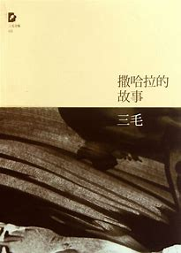
Chen Ping (Sanmao)
Biography and Context
Major Works and Style
Cultural Impact
Chen Ping, known by her pen name Sanmao, led an adventurous life in Spain, the Sahara Desert, and Taiwan. She became a cultural icon for her spirit of wanderlust and individualism, inspiring many to seek freedom and self- discovery.
Her major works include Stories of the Sahara, which are autobiographical essays detailing her life in the desert. Sanmao’s writing explores themes of freedom, cross-cultural identity, and existential reflection, resonating with readers seeking a deeper understanding of life.
Sanmao’s influence on travel writing and youth culture in China during the 1980s and 1990s was significant. Her works encouraged a generation to embrace adventure and individualism, challenging traditional norms.

Slide 9
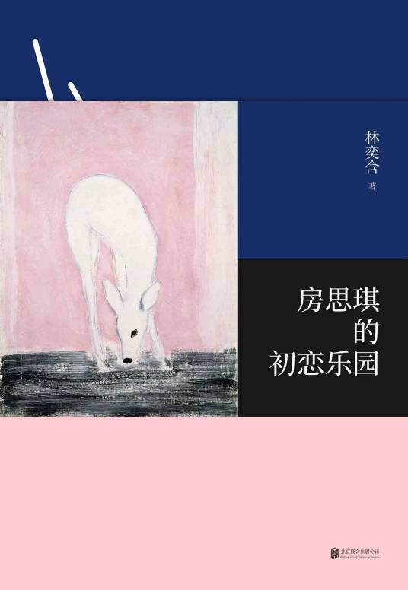
Lin Yihan
Major Works and Style
Biography and Context
Cultural Impact
Her notable work includes Rakuen. Lin Yihan’s writing is characterized by its poetic yet harrowing blend of lyrical prose and visceral emotional intensity. Her central themes revolve around sexual violence, power imbalances, and the collapse of cultural and personal faith. Her work grapples with the existential fallout of betrayal, both personal and cultural.
Lin Yihan is a contemporary Taiwanese writer with an academic background. Her connection to modern youth and digital-age readership has made her a popular figure in contemporary literature.
Lin Yihan’s legacy lies in her unflinching exposure of systemic sexual violence and its psychological toll, sparking critical dialogues across East Asia. Her death and novel catalyzed movements to destigmatize mental illness and confront the prevalence of child sexual abuse, particularly in educational settings.

Slide 10
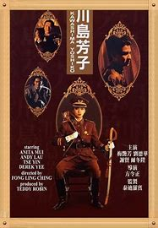
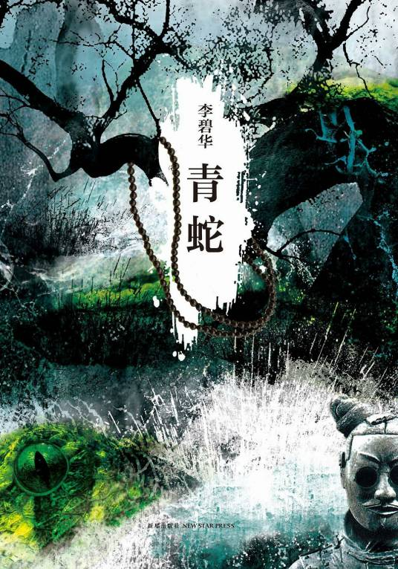
Li Bihua (Lillian Lee)
Biography and Context
Li Bihua is a renowned Hong Kong-based novelist and screenwriter. Her works often blend history with myth, creating a unique narrative style that explores complex human emotions.
Major Works and Style
Key works include The Last Princess of Manchuria and Green Snake. Li Bihua’s writing is characterized by tragic love, historical trauma, and queer subtexts, offering a nuanced view of human relationships.
Cultural Impact
Li Bihua’s works have been widely adapted into films, gaining international recognition and acclaim. Collaborations with directors like Chen Kaige have further elevated her status in global cinema.

Slide 11
04
Comparative Analysis

Slide 12
Common Themes
All four writers explore gender roles and cultural identity, reflecting the experiences of women in different historical contexts. Their works provide insights into the struggles and aspirations of women, challenging traditional gender norms.
Gender and Identity
Symbolism in Writing
Each writer employs symbolism to convey deeper meanings, such as cities representing modernity or deserts symbolizing freedom. These symbols enrich the narrative and offer multiple layers of interpretation.

Slide 13
Cultural and Temporal Contexts
Geographical Contexts
The writers live in different places, each shaped by their respective cultural contexts. Zhang Ailing’s works reflect the social dynamics of Republican-era Shanghai, while Li Bihua’s narratives are influenced by Hong Kong’s historical and cultural landscape.
Reflection on Cultural Norms
These writers challenge and redefine cultural norms, providing new ways of understanding gender, identity, and society. Their influence extends beyond literature, inspiring future generations of writers and readers.
Impact of Era on Themes
The era in which each writer lived significantly influenced their themes and reception. For example, Sanmao’s works resonated with the spirit of the 1980s and 1990s, while Lin Yihan’s stories speak to the concerns of modern youth.

Slide 14
05
Conclusion

Slide 15
Synthesizing Contributions
The works of Zhang Ailing, Sanmao, Lin Yihan, and Li Bihua collectively illuminate the diverse voices of women navigating Chinese cultural landscapes. Though their styles and settings differ—from Zhang’s wartime Shanghai to Sanmao’s Sahara Desert—they share a profound exploration of identity, agency, and societal constraints. Zhang Ailing dissected the tensions between tradition and modernity in urban life, while Li Bihua reimagined history and myth to critique patriarchal norms. Sanmao’s nomadic narratives celebrated individualism and cross-cultural belonging, resonating with a generation yearning for freedom, while Lin Yihan’s contemporary romances bridge tradition with digital-age youth culture in Taiwan. Together, they challenge monolithic portrayals of “Chinese femininity,” offering nuanced perspectives on love, loss, and resilience. Their legacies endure not only in literature but also through film adaptations and pop culture, proving their relevance across generations. By amplifying marginalized voices and redefining women’s roles, these writers remain vital to understanding the evolving interplay of gender, culture, and power in Chinese society.

Slide 16
Relevance and Reflection
These authors’ works transcend their eras, speaking to universal struggles: Zhang Ailing’s themes of urban alienation mirror modern loneliness, while Li Bihua’s tragic heroines echo debates about historical trauma and queer identity. Sanmao’s quest for self-discovery inspires today’s globalized youth, and Lin Yihan’s romantic idealism reflects shifting attitudes toward love in East Asia. Their stories ask: How do women negotiate autonomy in societies shaped by Confucian values and rapid change? By blending personal and political, they redefine literature as a space for cultural critique and reinvention. To conclude, consider Zhang Ailing’s poignant observation: “Love is about timing. It’s no use meeting the right person too early or too late.” This metaphor extends beyond romance—it encapsulates the struggle of women navigating societal expectations across time. Their works remind us that literature is not just a mirror of culture but a catalyst for reimagining it. What new narratives might today’s writers create, standing on their shoulders?

Slide 17
That’s All
Thank You

