Slide 1
Buddhism
Presentation: 康浩宇 Handout: 刘欧

Slide 2
Content
1.
General Introduction
2.
Founder of Buddhism
3.
Introduction to China
4.
Sinicization of Buddhism
5.
Buddhism and Translation

Slide 3
1
General Introduction

Slide 4
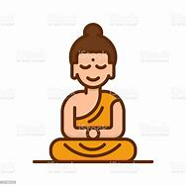
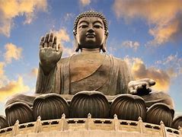

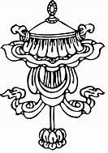




Buddhism
Religion
6 century BC
One of three world major religions

Slide 5
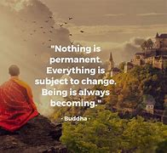
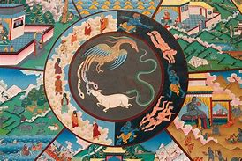
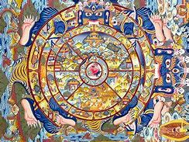
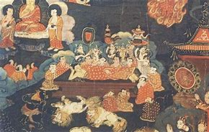
Buddhist
Beliefs
Suffering
Karma
Reincarnation
Samsara
Nirvana

Slide 6
2
Founder of Buddhism

Slide 7
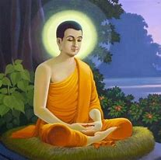
Siddhartha Gautama
philosopher, mendicant, meditator, spiritual teacher, and religious leader
Birthplace: Kapilvastu District, Nepal
Death place: Kushinagar, India
Parents: Śuddhodana (Father) · Maya (Mother) · Mahapajapati Gotami (Foster Mother)

Slide 8
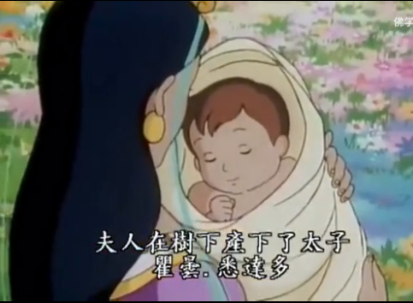
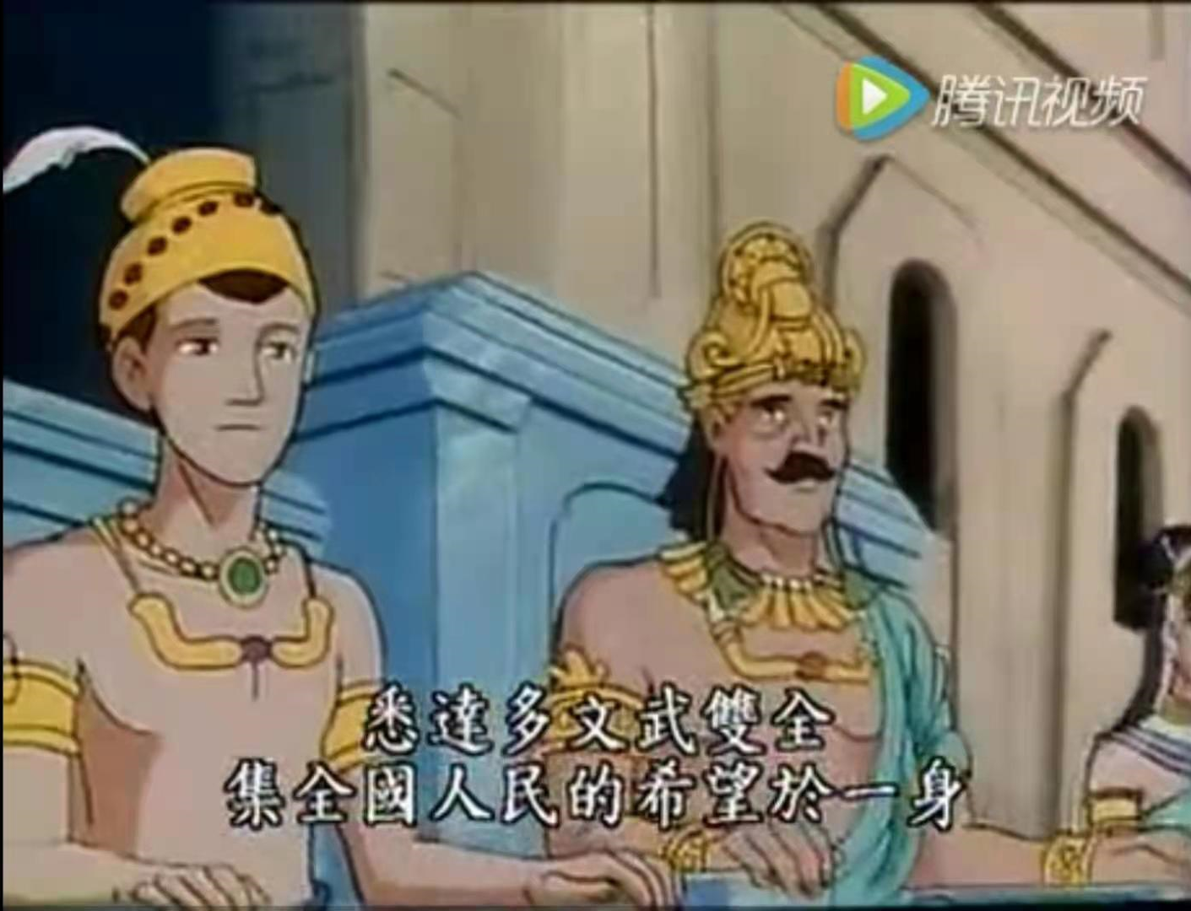
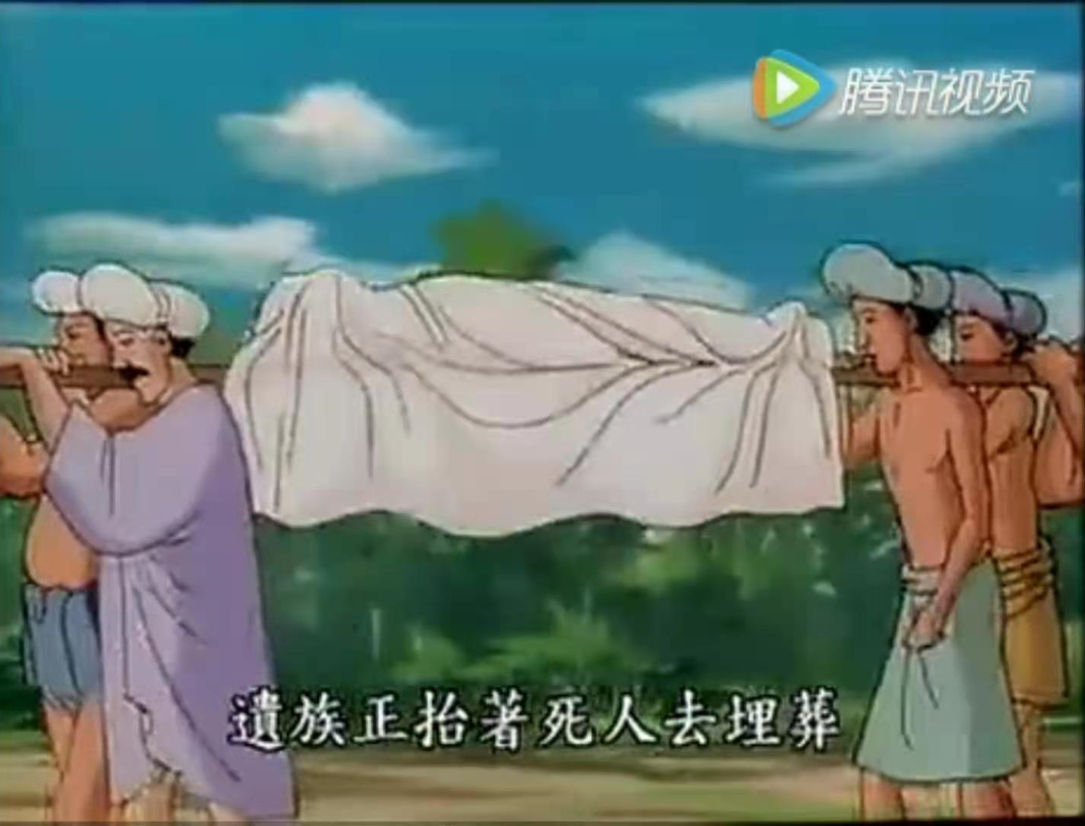
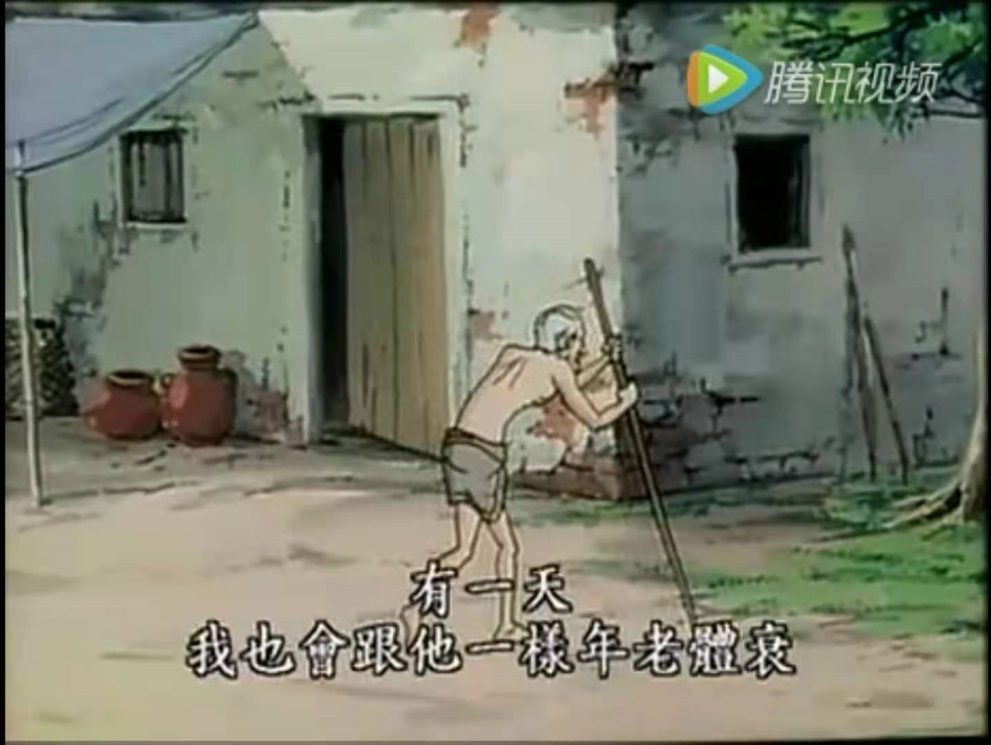
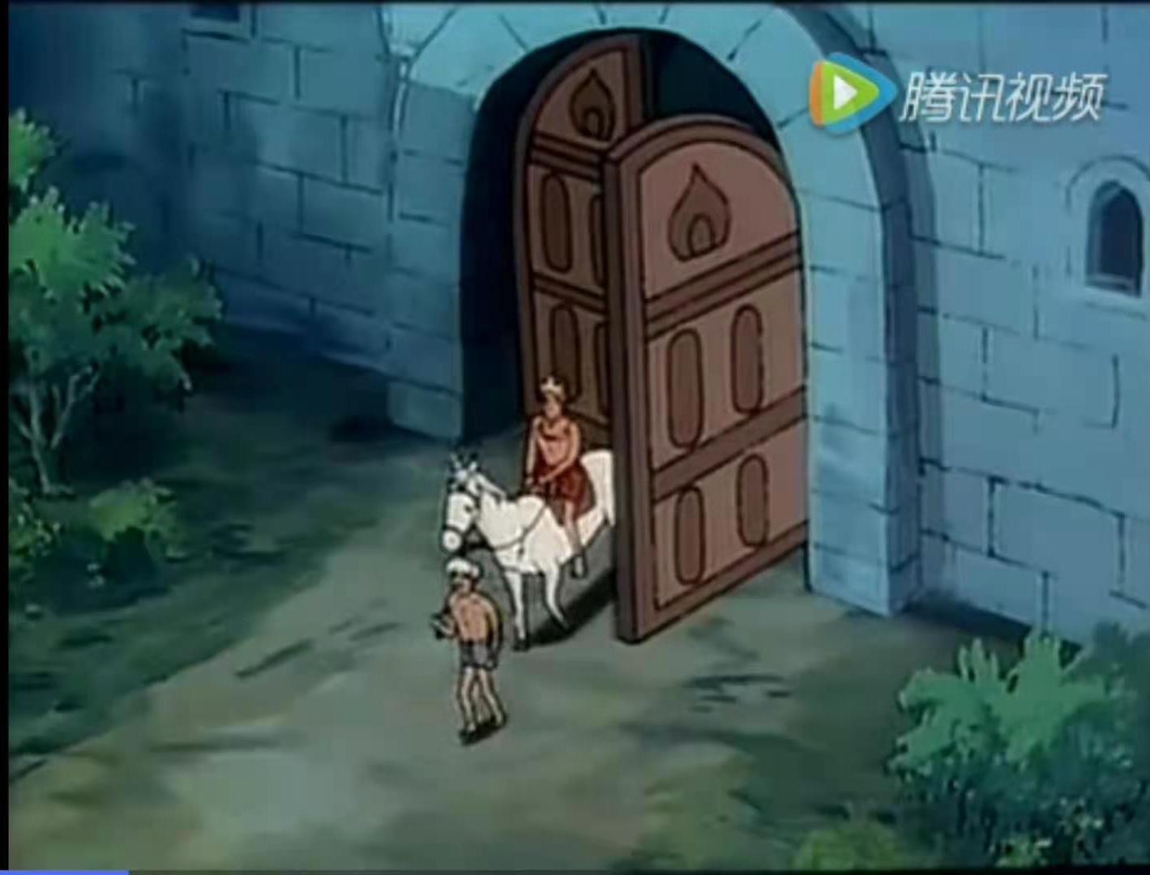
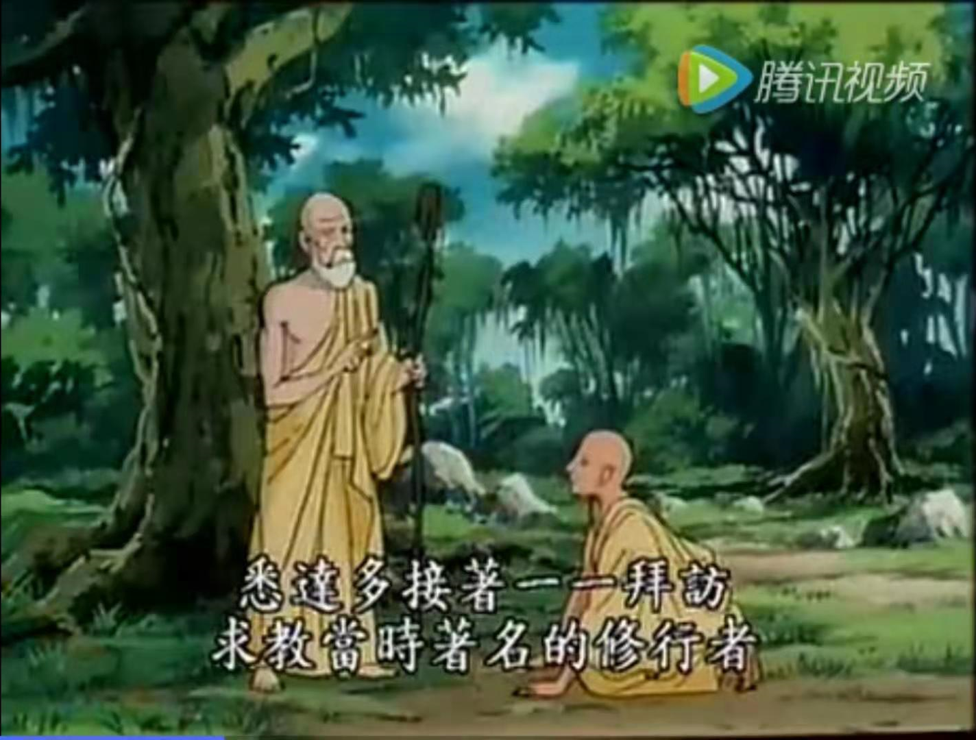
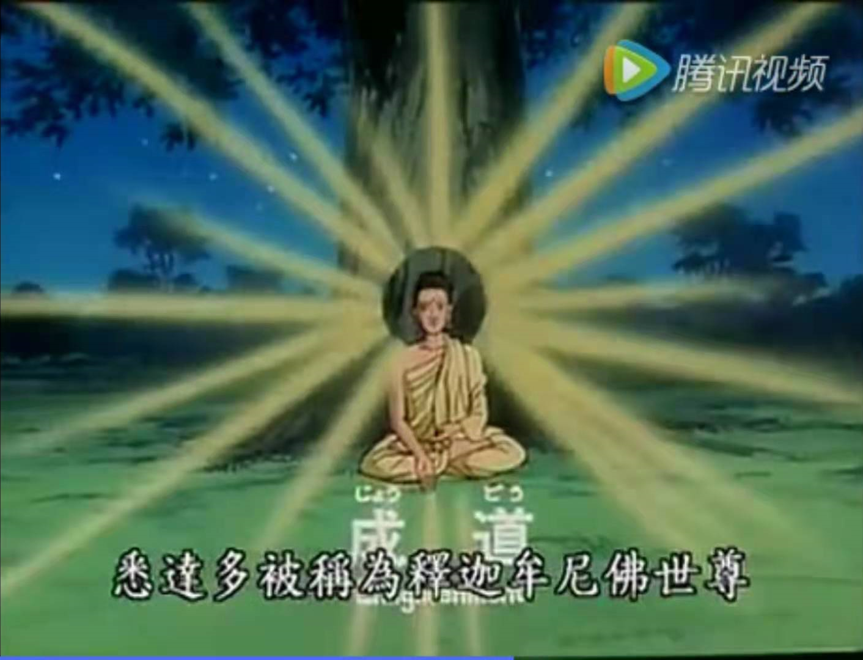
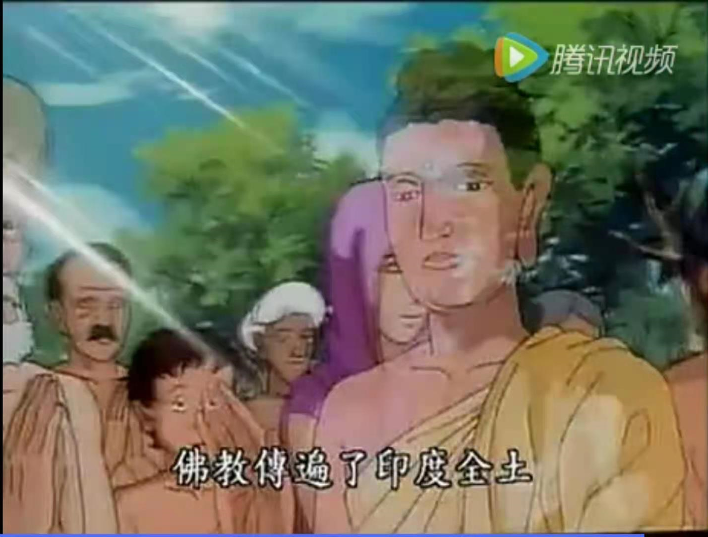
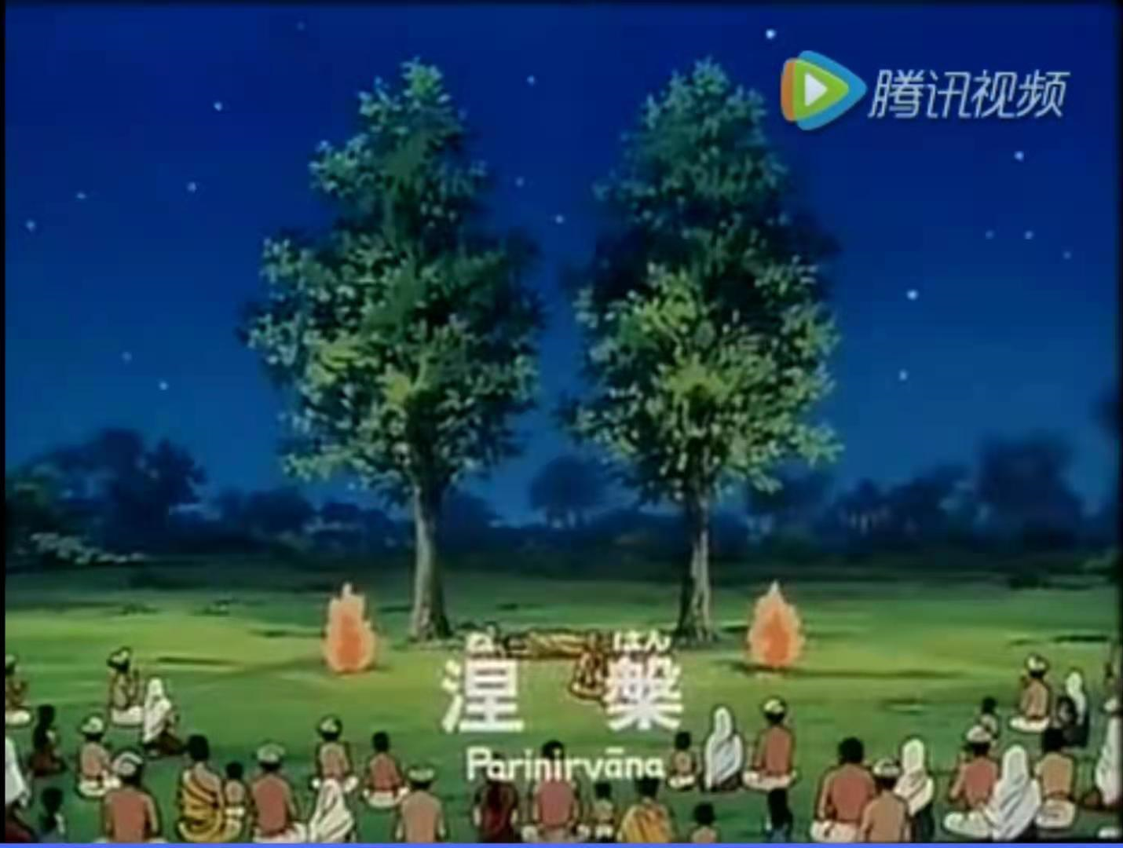

Slide 9
3
Introduction to China

Slide 10
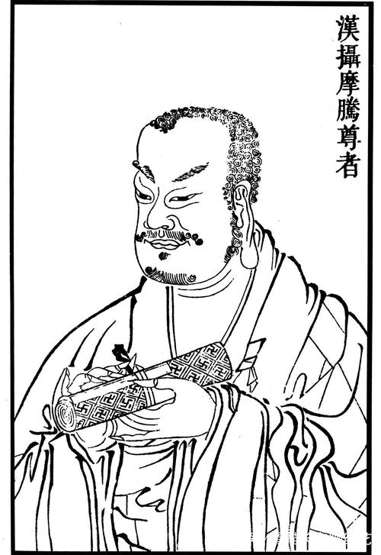
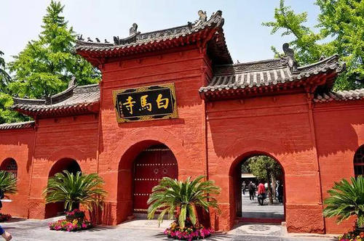
Han Dynasty
Buddhism was firstly introduced into China in Han Dynasty.
The Sutra of Forty-two Sections
Kasyapa Matanga

Slide 11
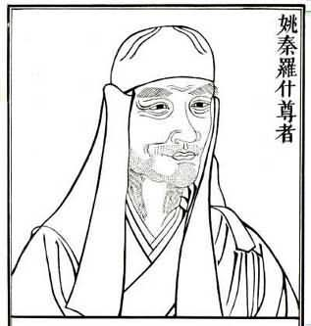
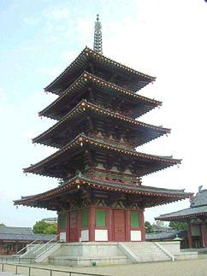
Wei and Jing Dynasty
Buddhism in China became blooming
North to South
Prajna
Kumārajīva

Slide 12
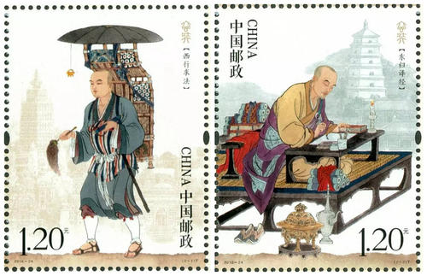
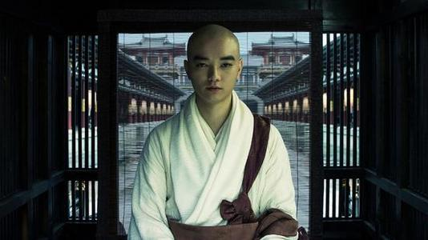
Tang and Song Dynasty
Booming
Protected by rulers
Learned by Japan and Korea

Slide 13
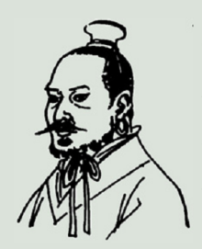
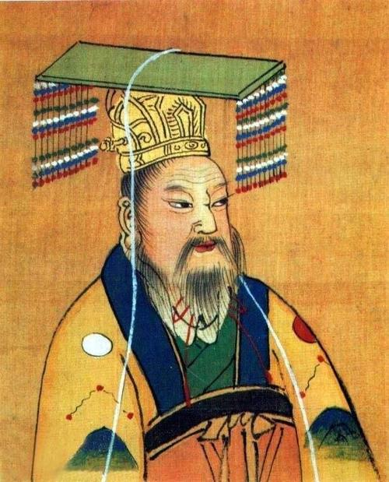
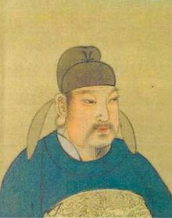
三武灭佛
posthumous title
北魏太武帝
Emperor Taiwu of North Wei Dynasty
北周武帝
Emperor Zhouwu of North Zhou Dynasty
唐武宗
Emperor Wuzong of Tang Dynasty

Slide 14
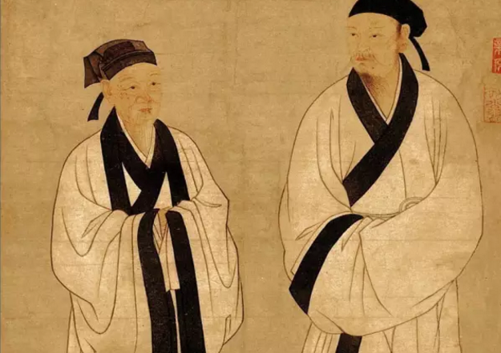
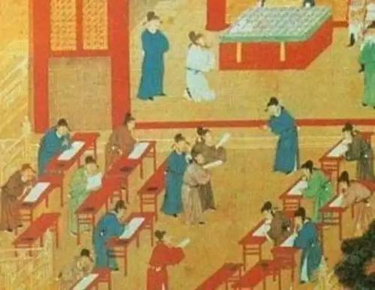
Ming and Qing Dynasty
Changing from prosperity to decadence.

Slide 15
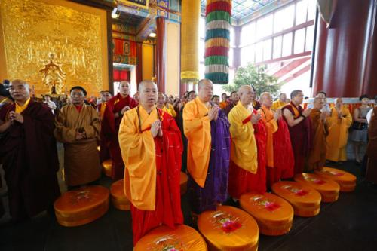
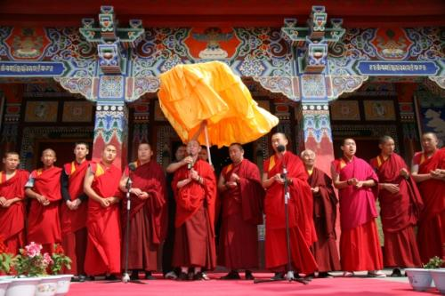
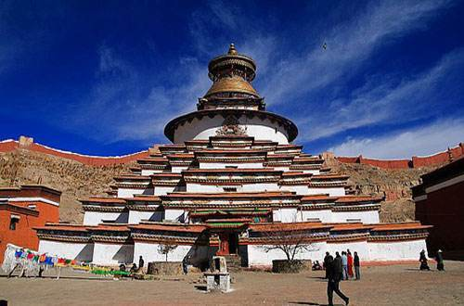
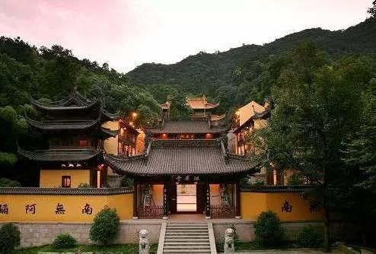
Han Buddhism
Tibetan Buddhism

Slide 16
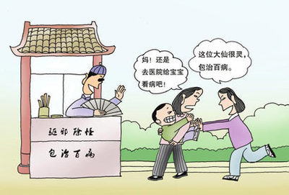



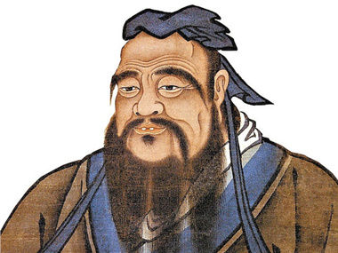
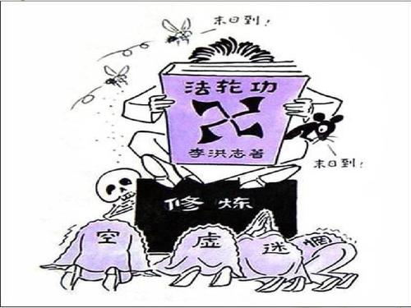
Superstition and heresy
Religion and Philosophy

Slide 17
4
Sinicization of Buddhism

Slide 18
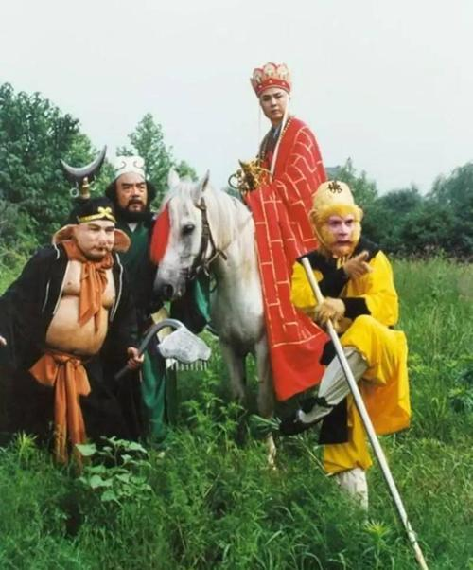
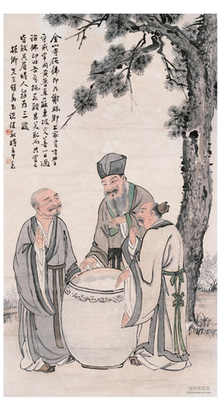
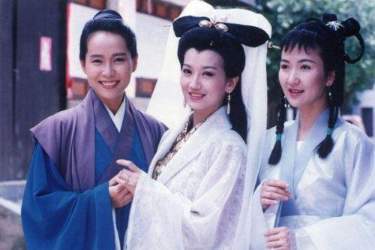
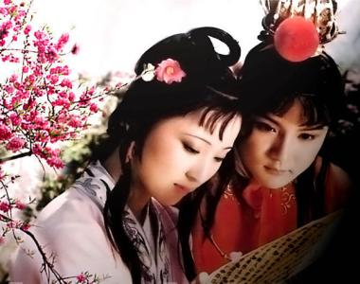
Combination of Buddhism, Taoism and Confucianism
三教合一

Slide 19

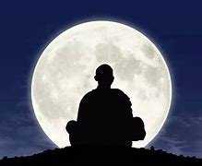
Zen
Zazen
Meditation
Enlightment

Slide 20
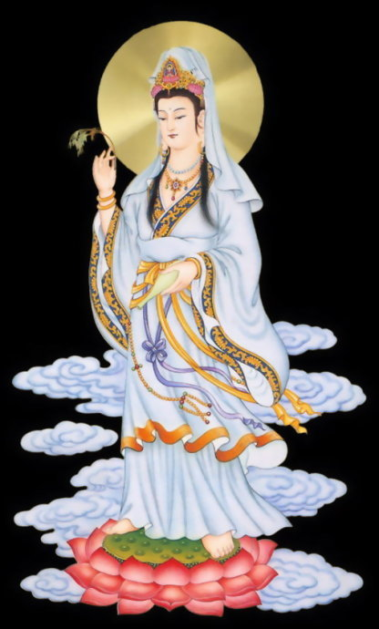
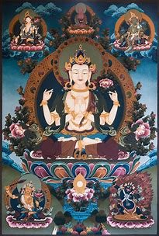
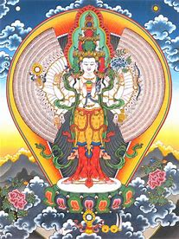
Avalokiteśvara(观音菩萨)

Slide 21
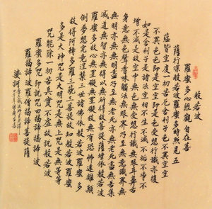
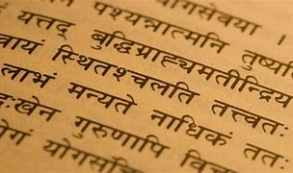
1
Translation and Buddhism

Slide 22
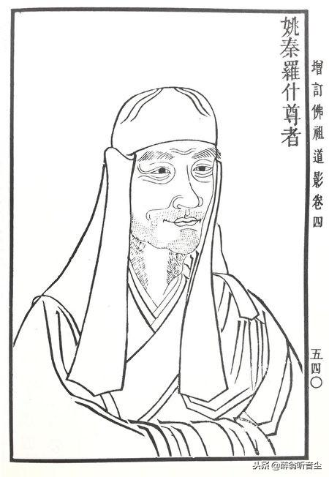
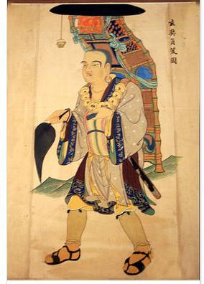
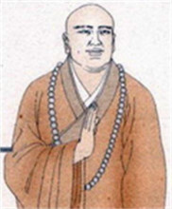
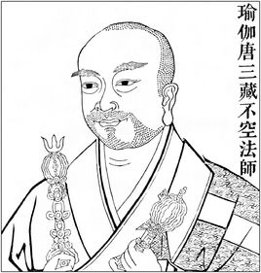
Four Buddhism Translators
Kumārajīva
Paramārtha
Xuan Zang
Amoghavajra

Slide 23
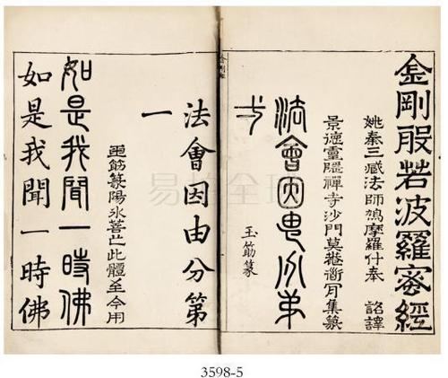
Translation Thoughts
道安 五失本，三不易
Five instances of losing the source and three instances of difficulties
彦琮 八备
Eight Prerequisites
玄奘 五不翻
Five guidelines for not-translating a term

Slide 24


Five Guidelines for Not-translating a Term
秘密故不翻
多义故不翻
bhagavat
自在、炽盛、端严、名称、吉祥、尊贵
薄伽梵
此无故不翻
Jambu
阎浮树

Slide 25


顺古故不翻
生善故不翻
anuttarasamyaksambodhi
阿耨多罗三藐三菩提
能够知觉佛教的一切真理
并如实了解一切事物
从而获得无所不知的智慧
Prajna
般若

Slide 26

Example
菩提本无树，
明镜亦非台，
本来无一物，
何处惹尘埃。

Slide 27
Machine Translation
Literal Translation
Free Translation
There is no tree in Bodhi,
and the mirror is not a platform.
There is nothing in it,
so where to make dust.
Bodhi is fundamentally without any tree;
The bright mirror is also not a stand.
Fundamentally there is not a single thing
Where could any dust be attracted?
There is no Bodhi,
and mirror has no stand.
Nothing it must be,
Whereon can dust land?

Slide 28
Thank U

