Slide 1


Slide 2
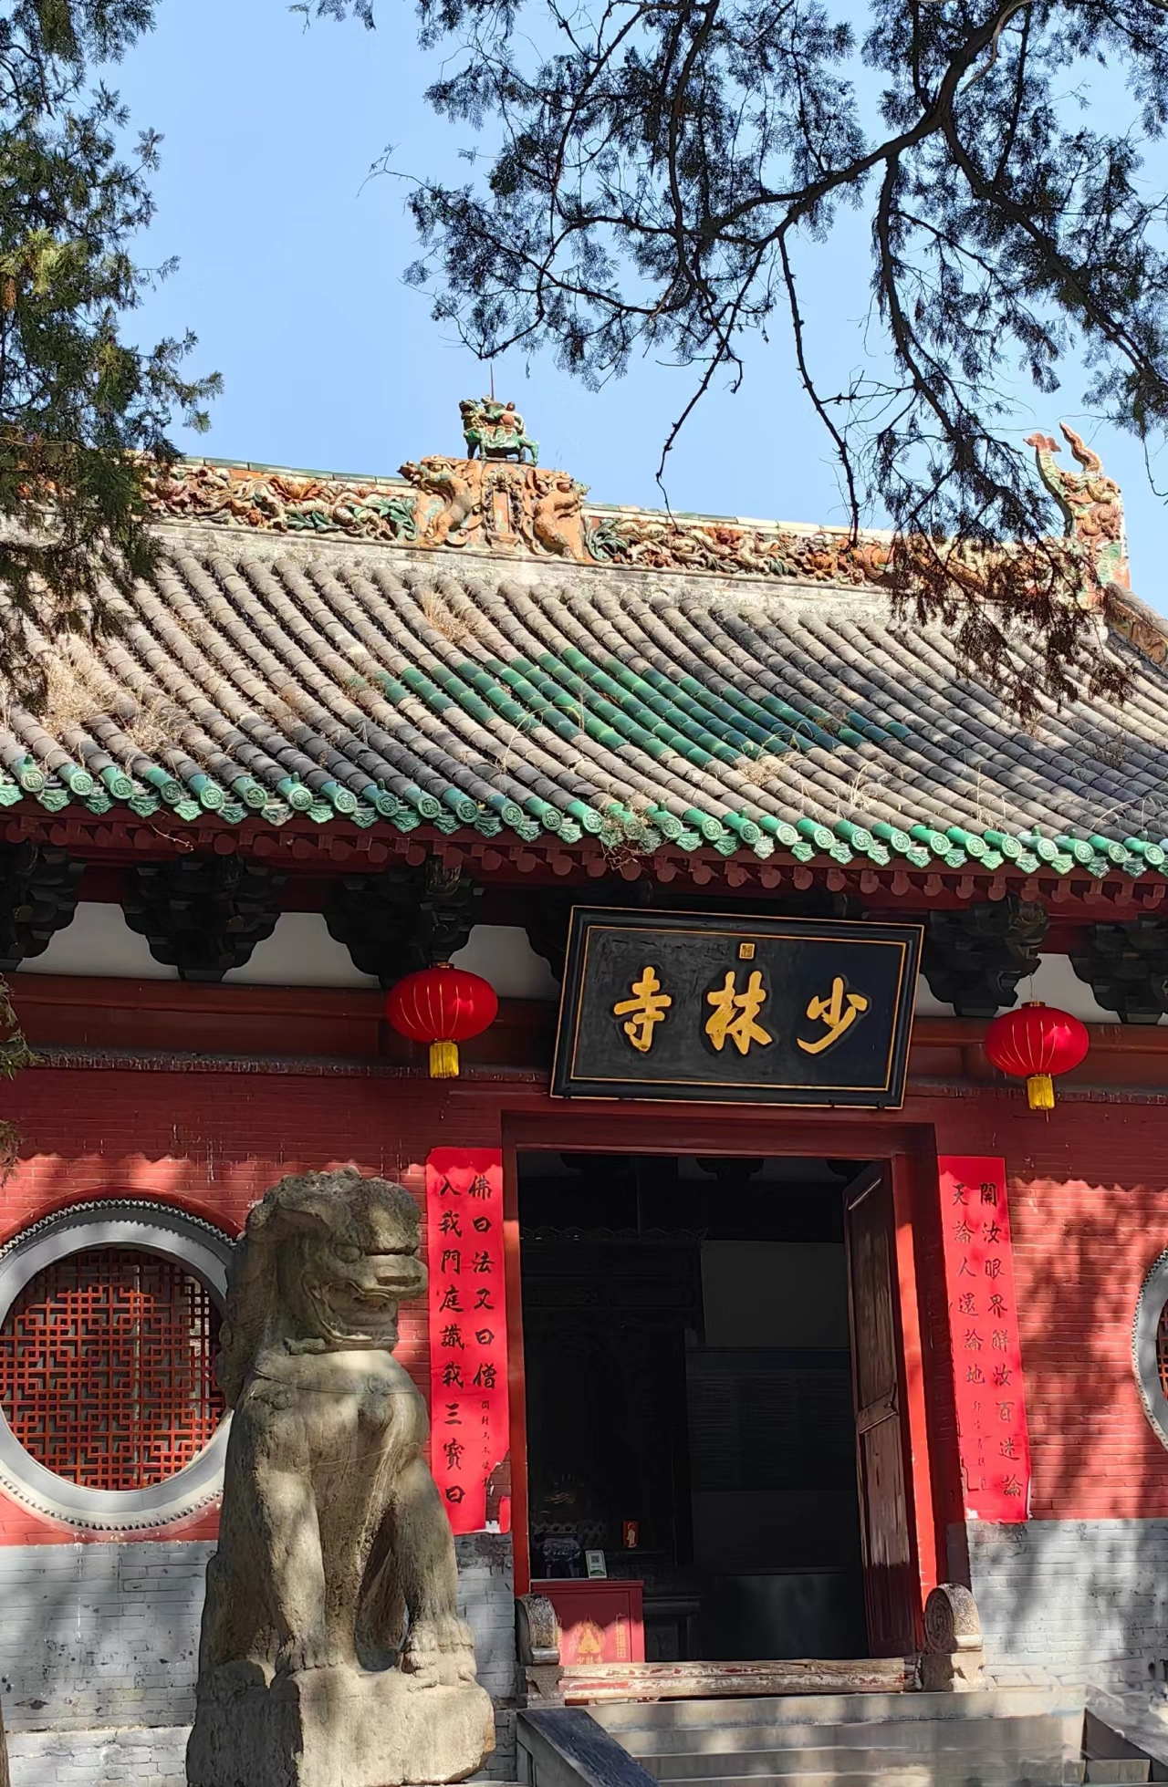
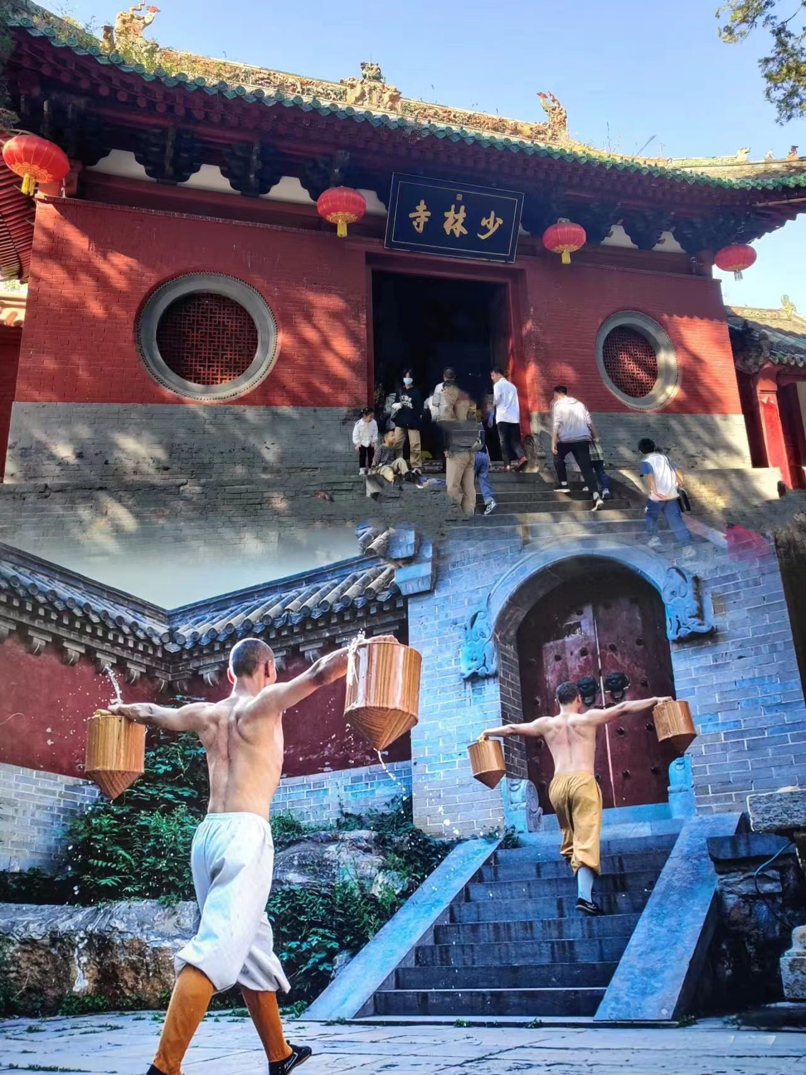
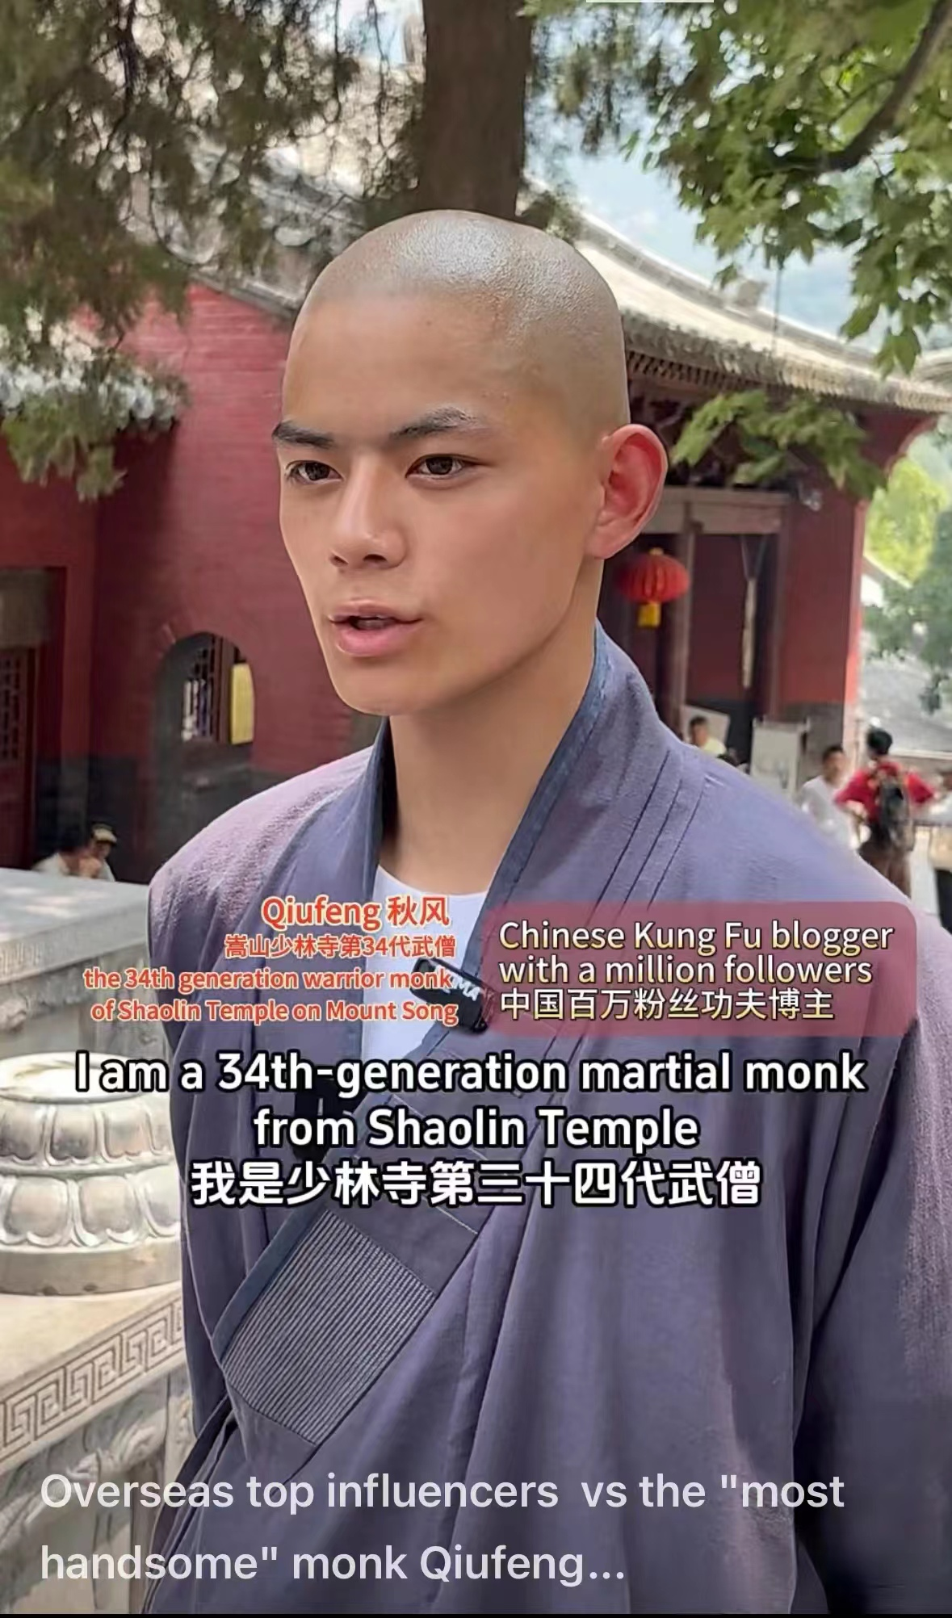
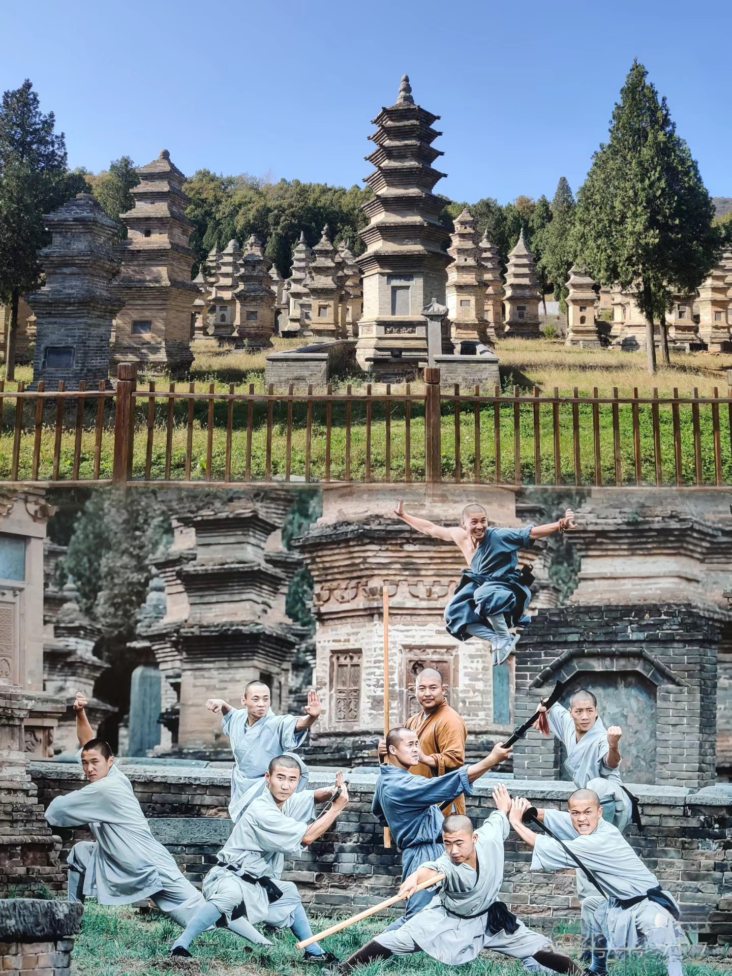
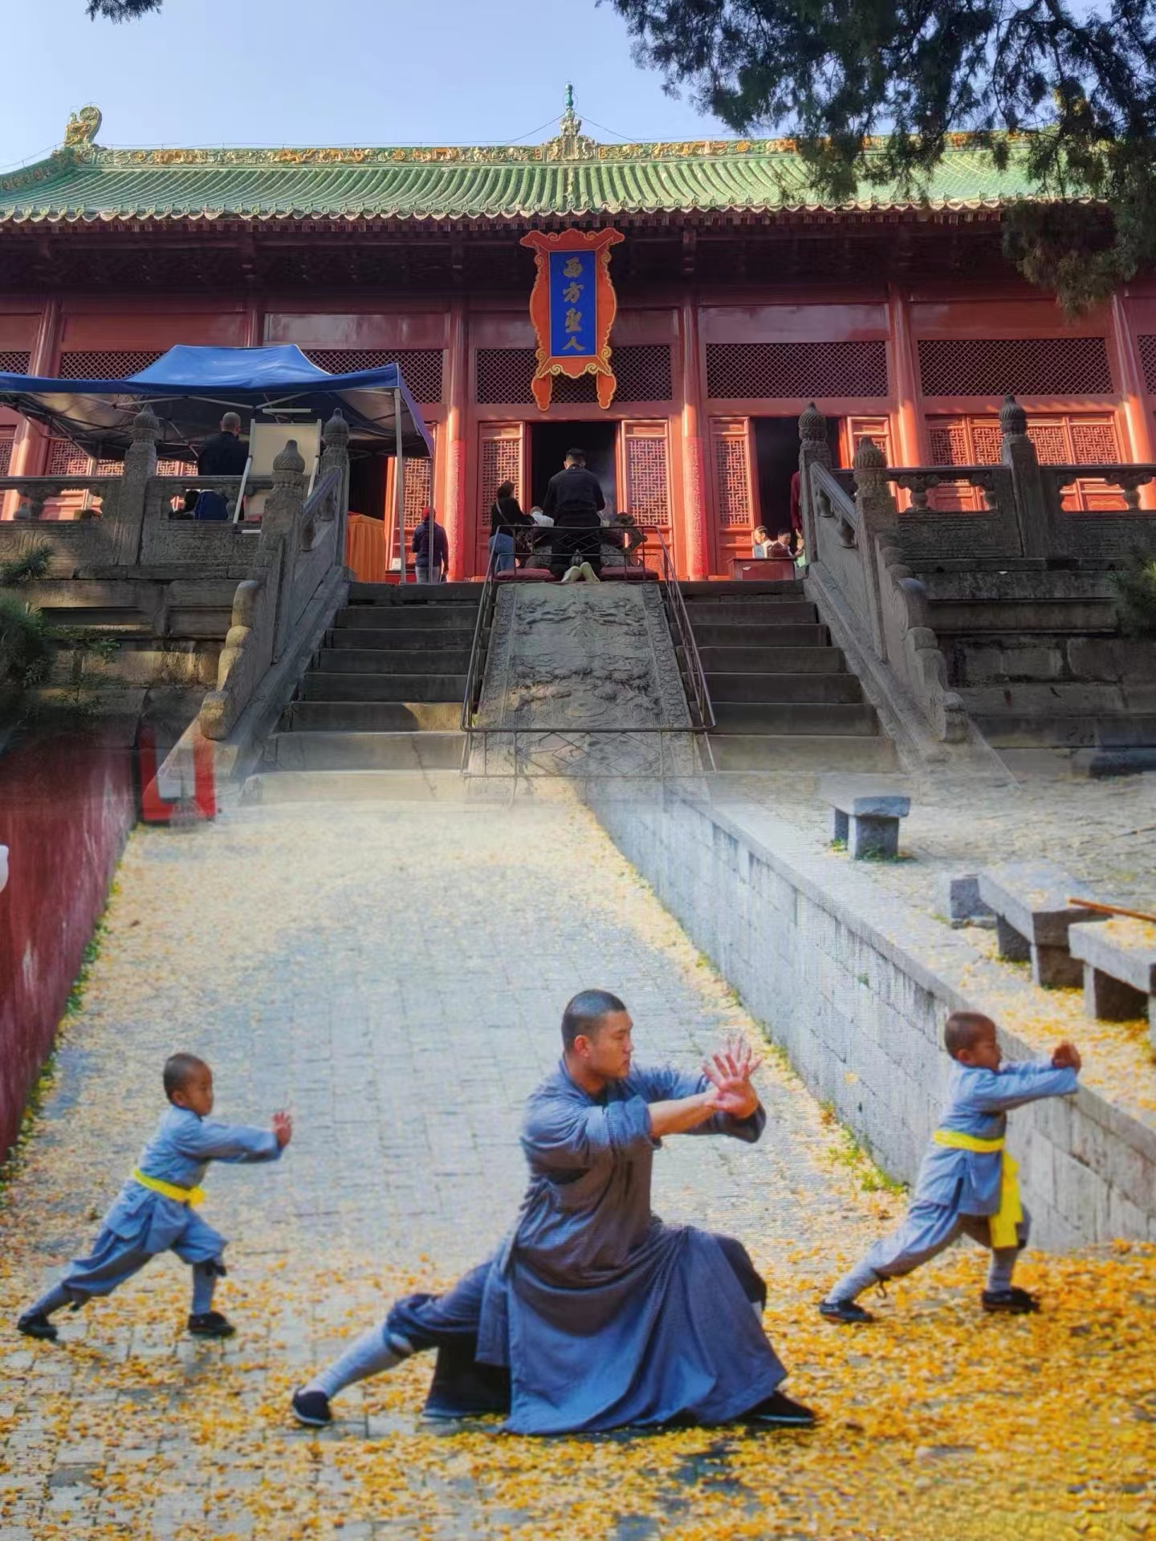

Slide 3

1. What does “Wuyue（五岳）” mean ?
2. What is the largest temple in southern China?
3. What is the famous site in Mount Song?
4. Do you know any famous Chinese lyrics related to Mount Tai?
1. Wuyue means five great mountains in China.
They are... (东南西北中)
2. the Grand Temple of Mount Heng (Nanyue Damiao)
3. Shaolin Temple

Slide 4

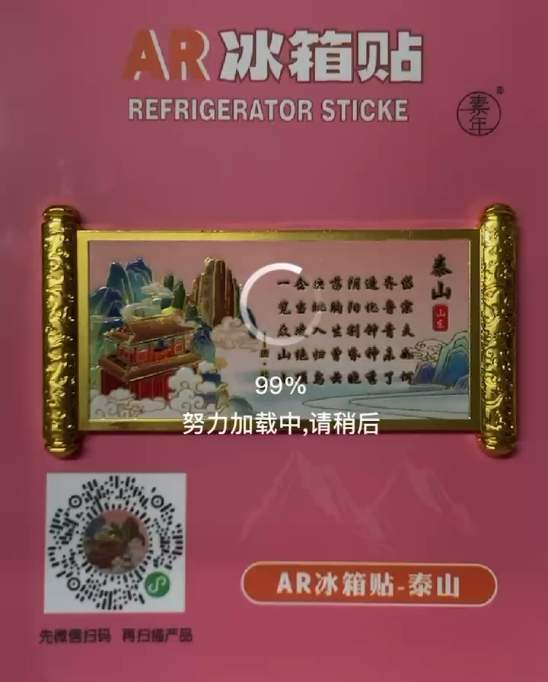
2. 例：《望岳》杜甫
岱宗夫如何？齐鲁青未了。
造化钟神秀，阴阳割昏晓。
荡胸生层云，决眦入归鸟。
会当凌绝顶，一览众山小。
Gazing at Mount Tai Du Fu (translated by Xu Yuanchong)
O peak of peaks, how high it stands!
One boundless green o'erspreads two States.
A marvel done by Nature's hands,
O'er light and shade it dominates.
Clouds rise therefrom and lave my breast;
My eyes are strained to see birds fleet.
Try to ascend the mountain's crest:
It dwarfs all peaks under our feet.

Slide 5
Terms and Expressions
Taoism 道教
cultural revolution 文化大革命
plank 厚木板
Hanging Monastery 悬空寺
Zen 禅宗
Shaolin Temple 少林寺
Wei, Jin and Southern and Northern Dynasties 魏晋南北朝
practitioners of martial arts 习武之人
monastery 寺庙

Slide 6


中国传统文化
Thank you for listening!

