Slide 1


Mordern Literature
张玲Zhang ling
杨海容Yang Hairong
Nov. 16th 2020

Slide 2
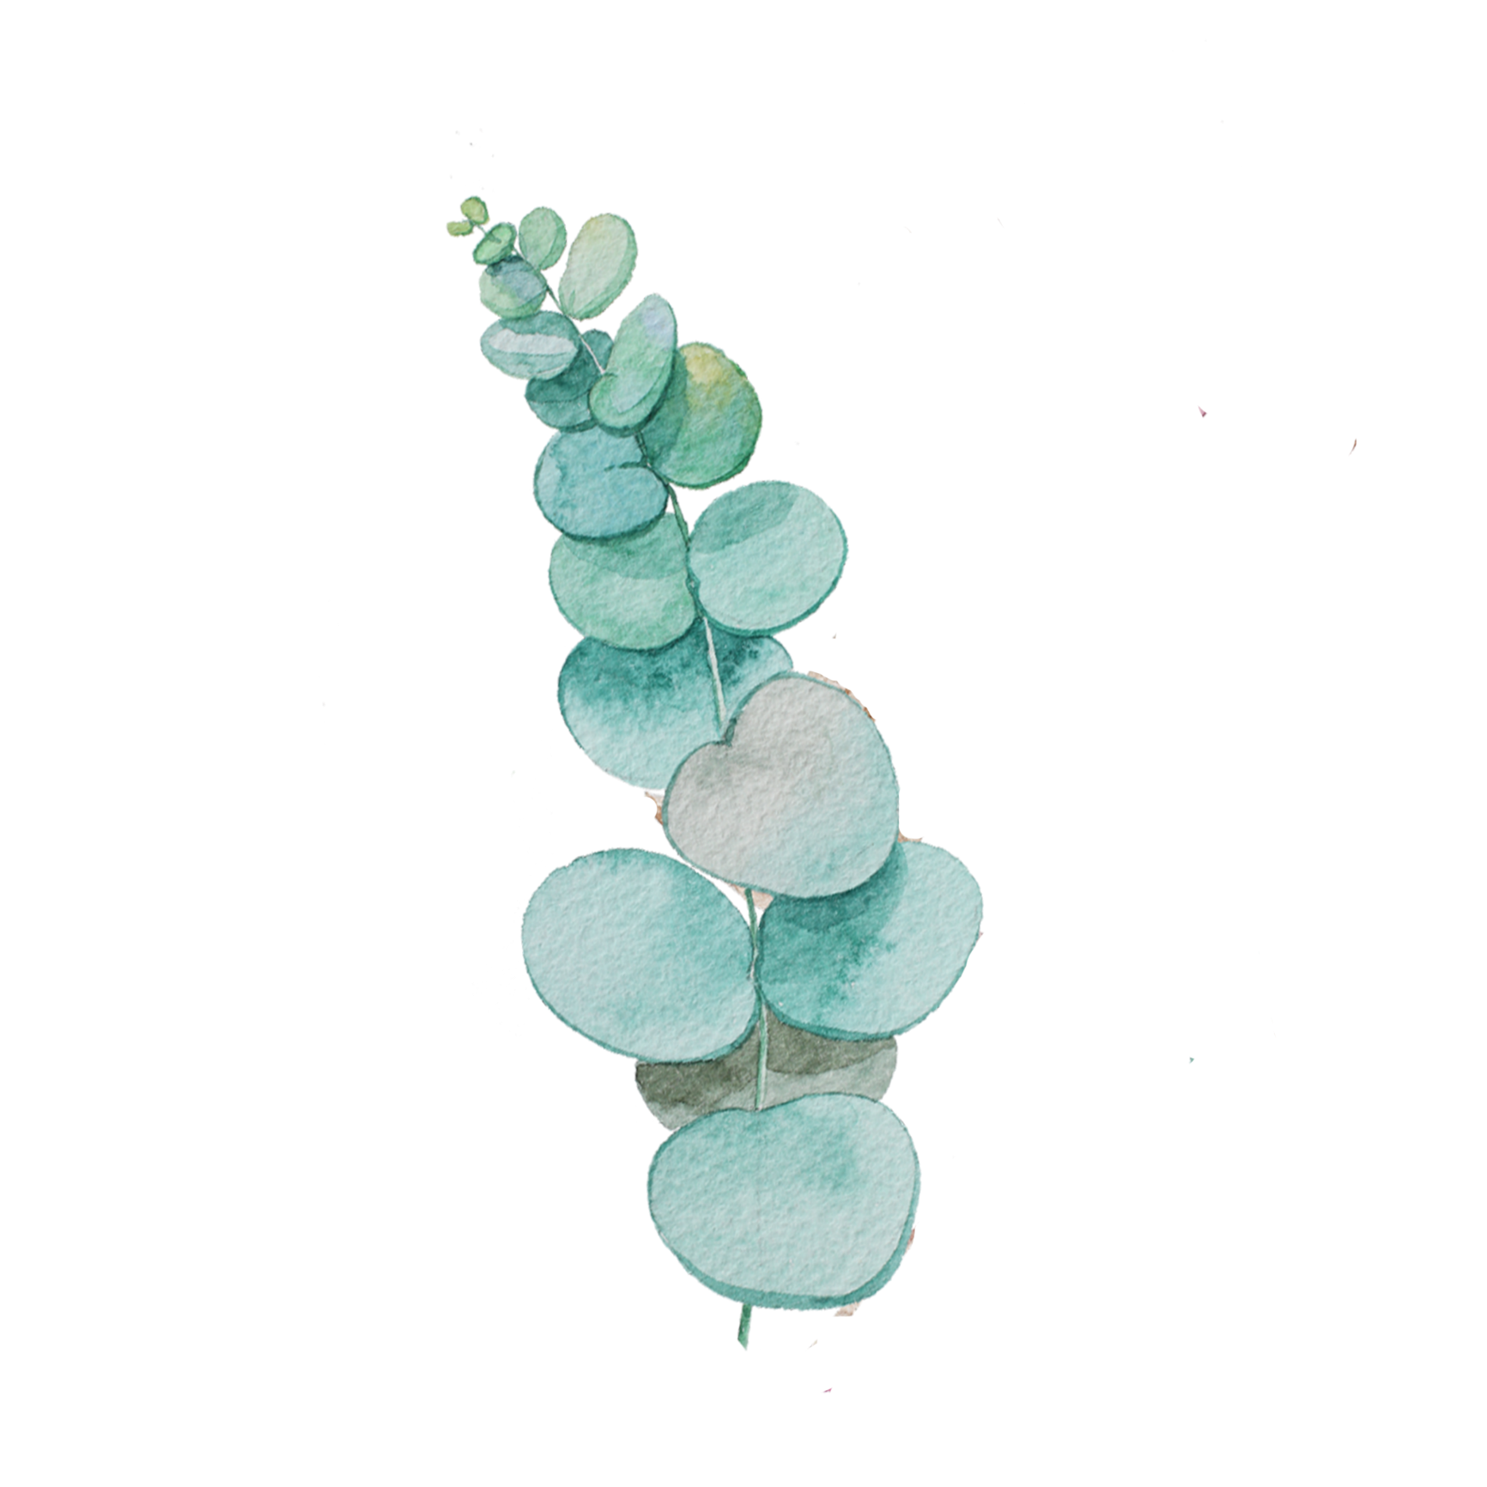
01
Late Qing Period (1840-1919)
02
Republic Era (1919-1949)
Contents.
03
Translation Methods

Slide 3


PART Ⅰ
Late Qing Period
(1840-1919)

Slide 4
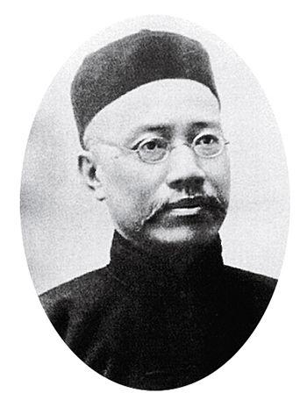

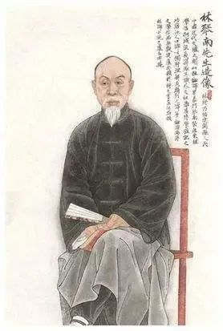
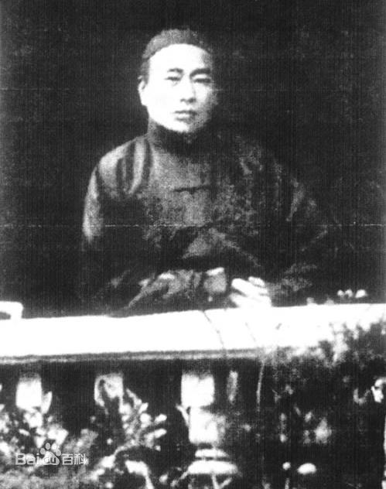
Chinese Translators>
(
Yan Fu
Lin Shu
Wang Shouchang

Slide 5
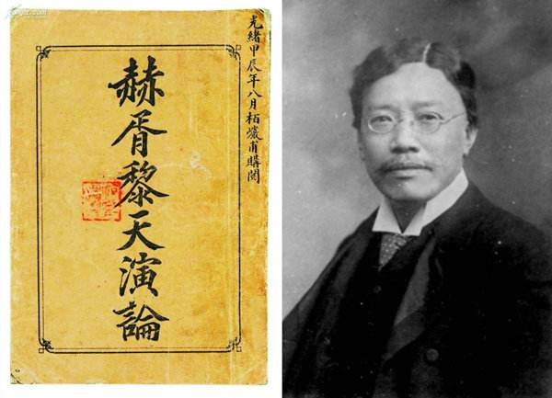
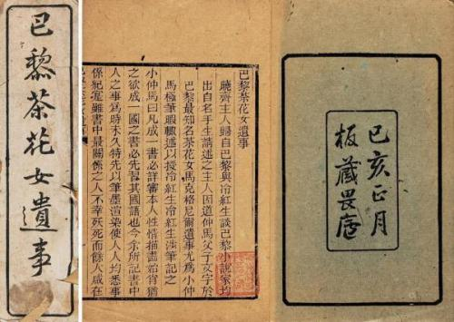
“Faithfulness, Expressiveness and Elegance”
Translation of
La Dame Aux Camélias

Slide 6
PART Ⅱ
Republic Era
(1919-1949)

Slide 7
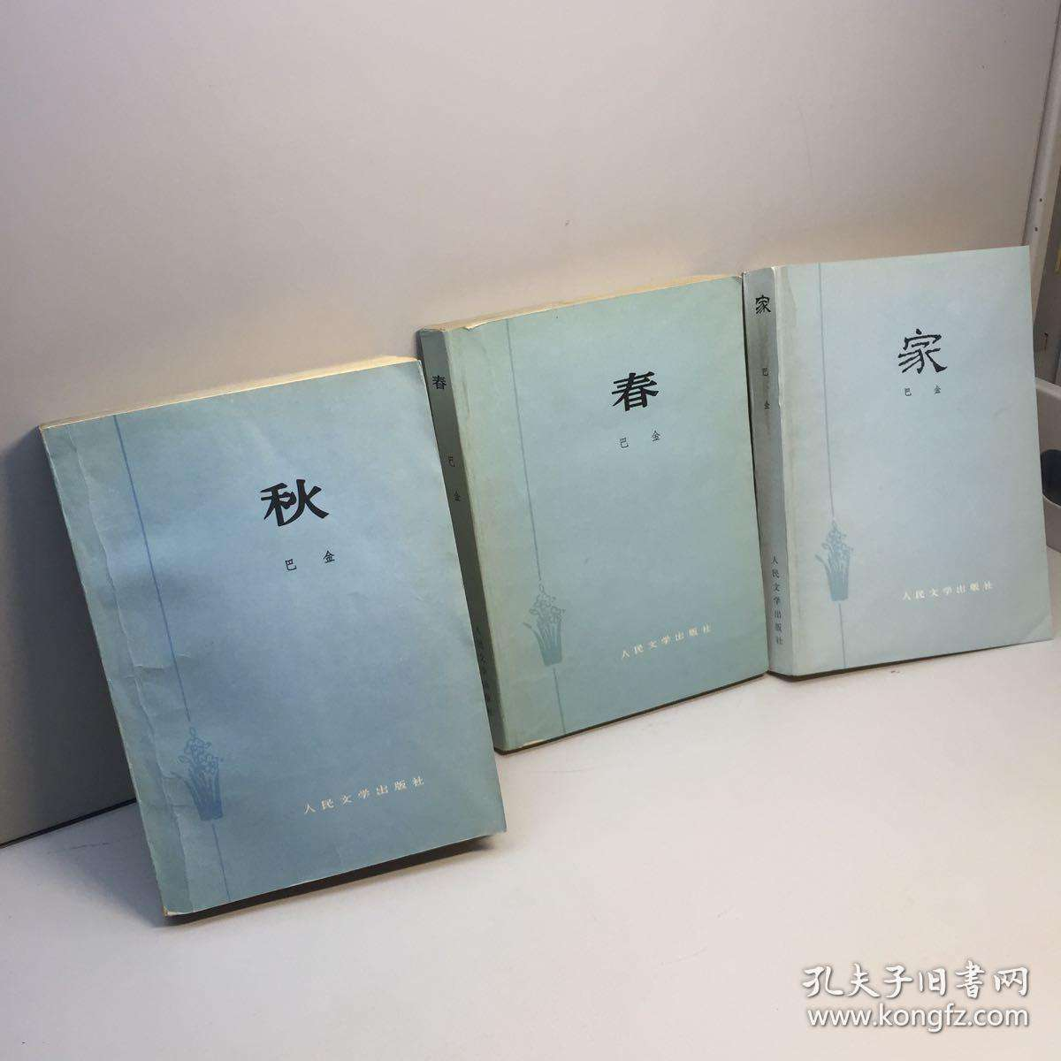
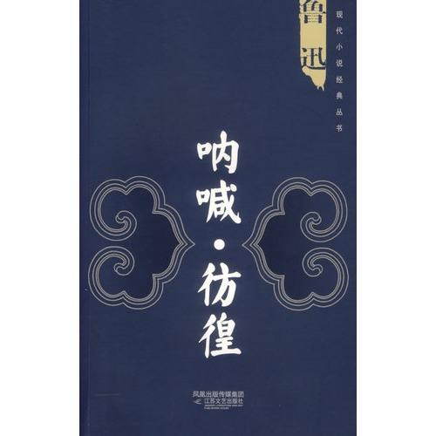
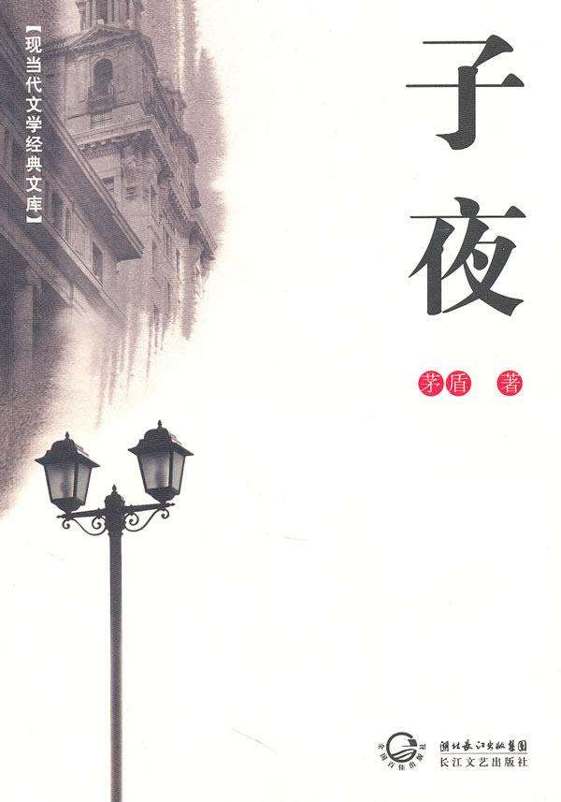
Well-known Works in Republic Era

Slide 8
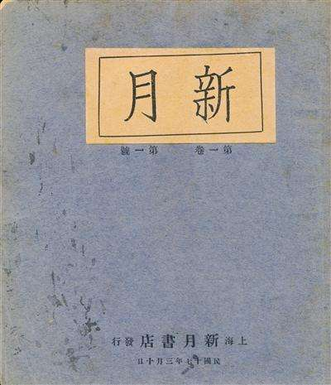
the Crescent School
1
2
3
poem excerpts>
Brief Introduction>
Representative poets>

Slide 9
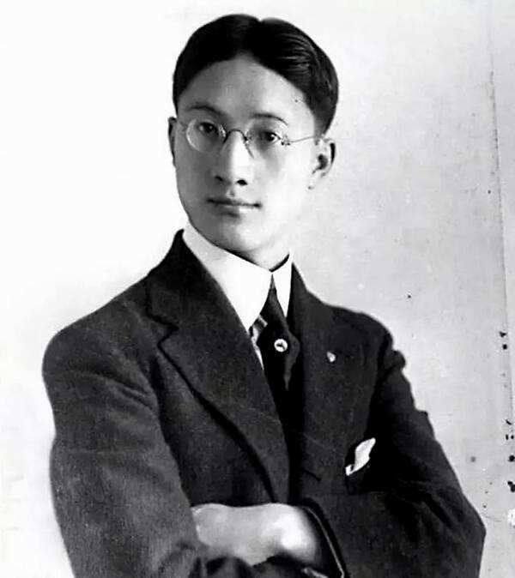
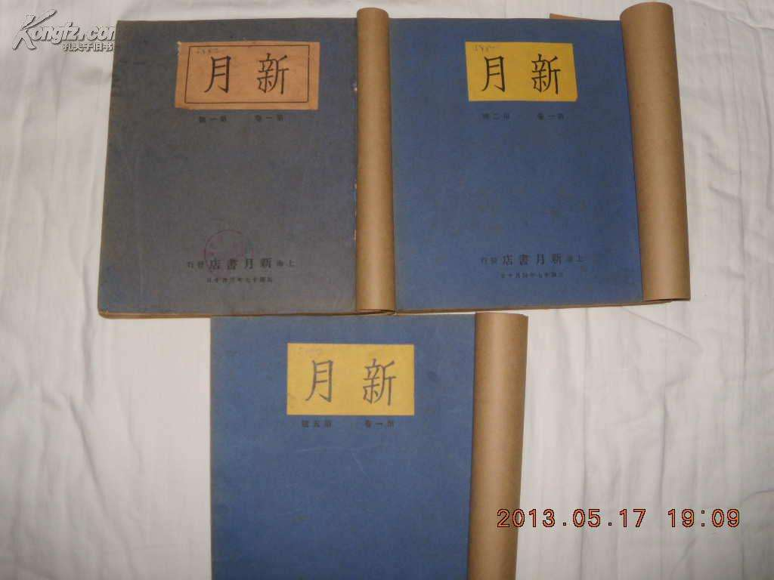
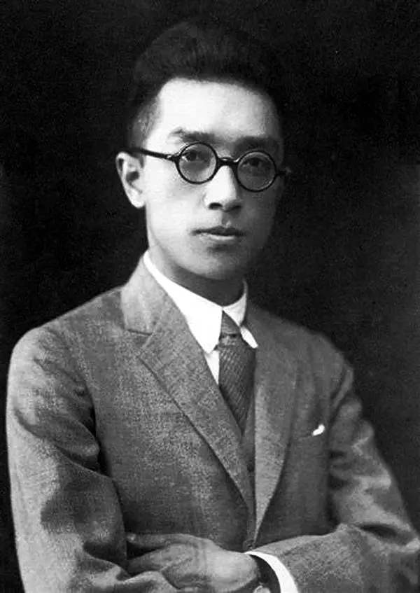
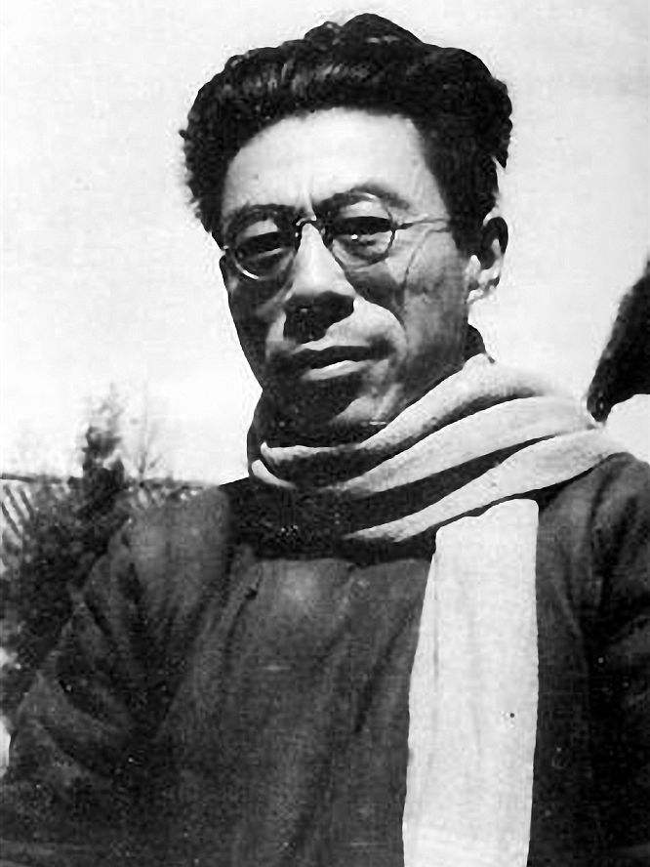
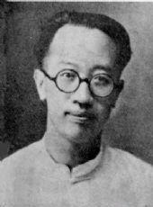
Representative Poets
Xu Zhimo
Hu Shi
Wen Yiduo
Liang Shiqiu
--The Crescent School

Slide 10

Saying Good-bye to Cambridge Again(excerpts)
By Xu Zhimo
Very quietly I take my leave
As quietly as I came here;
Quietly I wave good-bye
To the rosy clouds in the western sky.
The golden willows by the riverside
Are young brides in the setting sun;
Their reflections on the shimmering waves
Always linger in the depth of my heart.

Slide 11
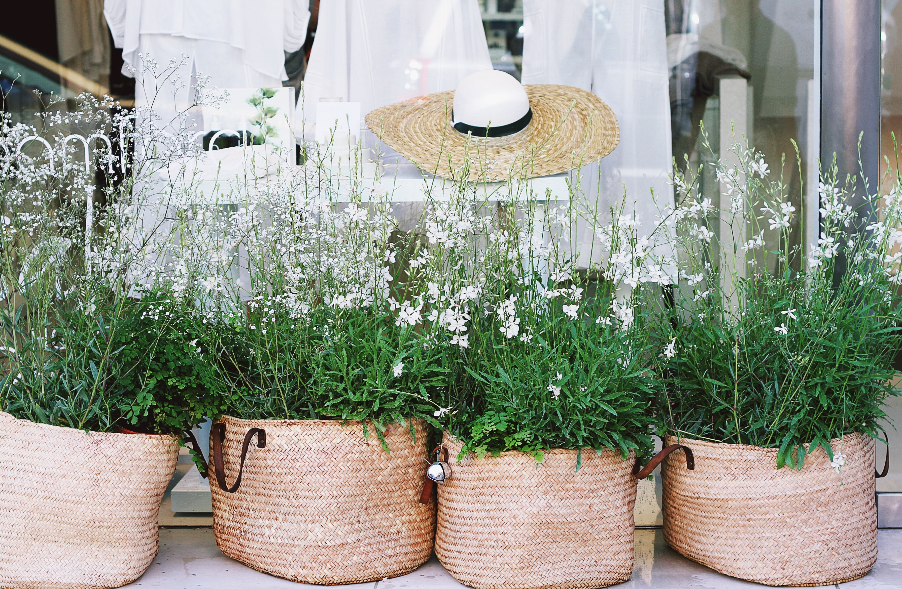
Part of Article
By Bian Zhilin
As you are enjoying the scenery on a bridge
Upstairs on a tower people are watching you
The bright moon adorns your window
But you adorn others' dream

Slide 12
PART Ⅲ
Translation
Methods

Slide 13

When translating the title of literary works...
(1)Be faithful to the original title and adopt free translation when it is necessary
(2)Strive for concise
(3)Try to be of literariness and eye-catching

Slide 14
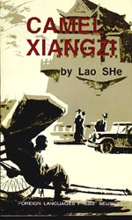
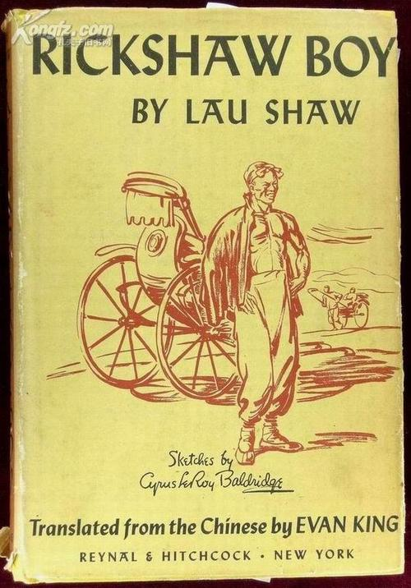
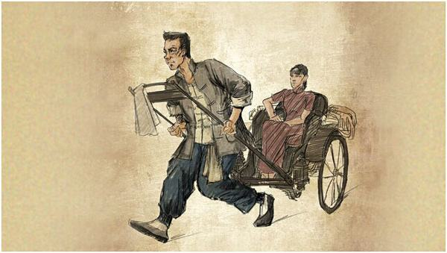
Two Versions of The Translation of 《骆驼祥子》
1. Camel Xiangzi
literal translation
2. Rickshaw Boy
free translation

Slide 15
THANK YOU

