Slide 1

Early Translation
of Chinese Literature
汇报人：第二小组李思源

Slide 2

目
录
1、Three Major Translators
2、Their Translation Theories
3、 Positive Influence to Chinese Literature

Slide 3

01
Three Major Translators

Slide 4
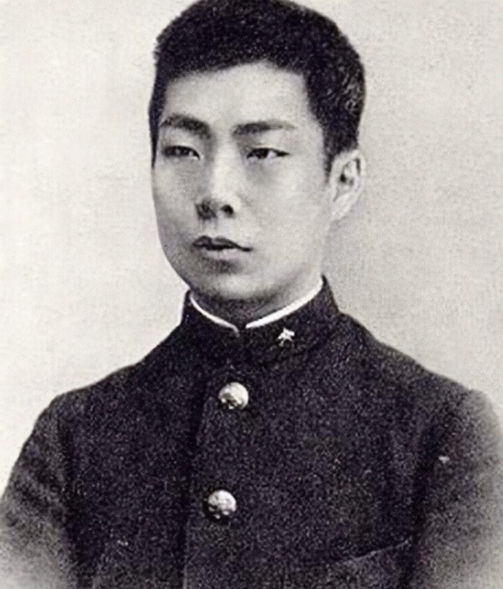

Lu Xun
Lu Xun (September 25, 1881 ~ October 19, 1936), originally named Zhou Zhangshou, later renamed Zhou Shuren, was born in Shaoxing, Zhejiang Province. He was a famous writer, ideologist, revolutionist and educator. Works of translation: 《小约翰》《出了象牙之塔》...

Slide 5
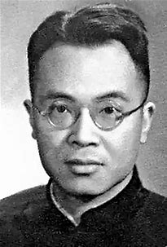
Qian Zhongshu
Qian Zhongshu (November 21, 1910 -- December 19, 1998), a native of Wuxi, Jiangsu Province, was a modern Chinese writer and literary researcher. Works of translation: 《毛泽东选集》《围城》英译本

Slide 6
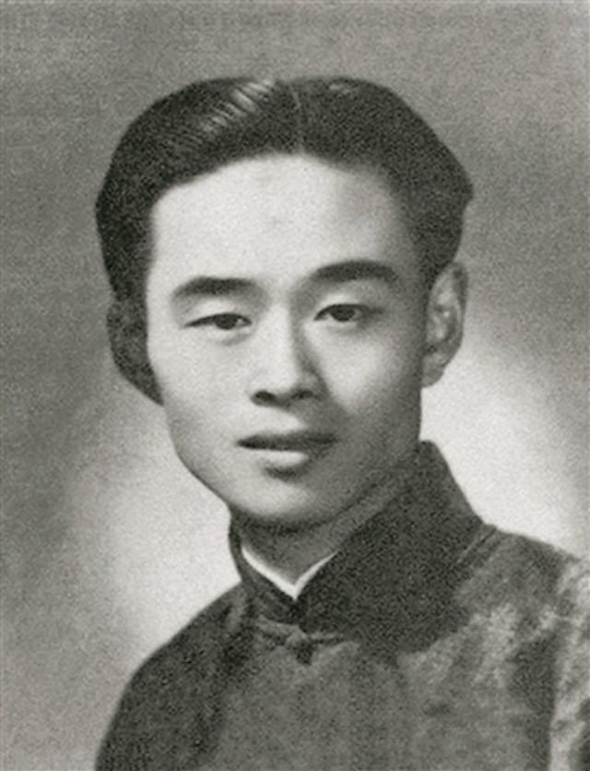
Zhu Shenghao
Zhu Shenghao (February 2, 1912 -- December 26, 1944) was a celebrated Chinese translator. He is one of the earliest translators of Shakespeare in China, and his translations are recognized by Shakespeare researchers at home and abroad. Works of translation: 《仲夏夜之梦》《威尼斯商人》《第十二夜》...

Slide 7
02
Their Translation Theories

Slide 8

Lu Xun
Lu Xun's translation thoughts can be summarized as "literal translation, hard translation" and so on. He insisted on literal translation and regarded "faithfulness" as the most important. In fact, he put forward such translation theories based on certain social purposes under the social environment at that time, thus promoted the development of the New Culture Movement.

Slide 9
Qian Zhongshu
In his opinion, the highest state of literary translation is "sublimation", which means that when a literary work is transferred from one language to another, it can not only avoid far-fetched traces due to differences in language habits, but also completely preserve its original flavor.

Slide 10
Zhu Shenghao
Zhu shenghao treated translation seriously. His tenet was "to the maximum possible scope, to maintain the charm of the original" .

Slide 11
03
Positive Influence to Chinese Literature

Slide 12
Those early translation works
have made remarkable contributions to the establishment and development of China's new literary language.
Chinese readers have been able to appreciate many excellent foreign works, enriching people's spiritual world.

Slide 13
谢谢
观看
汇报人：第二组李思源

