Slide 1

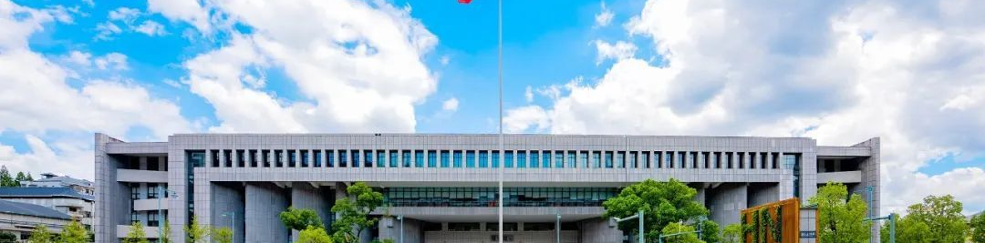
76. Take Su Shi as an example.
Relegation Literature in Ancient
China
仁爱精勤
Duan Binyao

Slide 2
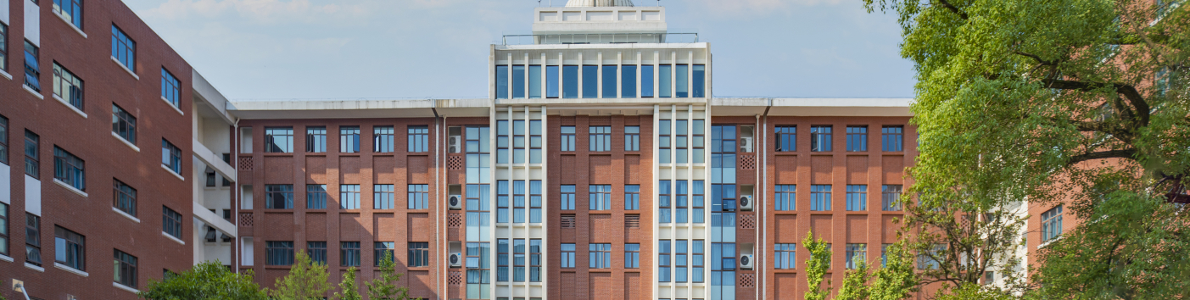
01
What is Relegation Literature?
贬谪文学
仁爱精勤

Slide 3
What is Relegation Literature?
"Relegation Literature" refers to literary works created by relegated scholars during their period of exile, reflecting on their experiences of banishment.
Indignation? Resentment? Loneliness?
Unfulfilled ambitions? Optimism…
仁爱精勤
Notes:
These works usually reflect their Indignation，Resentment，loneliness, optimism and so on.

Slide 4
What is Relegation Literature?
Examples
Qu Yuan’s The Lament (Encountering Sorrow)
or (Sorrow After Departure) 《离骚》
Bai Juyi’s Song of a Pipa Player 《琵琶行》
Fan Zhongyan’s The YueYang Tower 《岳阳楼记》
Su Shi’s First Visit to the Red Cliff 《赤壁赋》
仁爱精勤
Notes:
Among these Su Shi (苏轼), or Su Dongpo, stands out as a symbol.

Slide 5
02
Su Shi – A Life of Exile and Genius
仁爱精勤

Slide 6
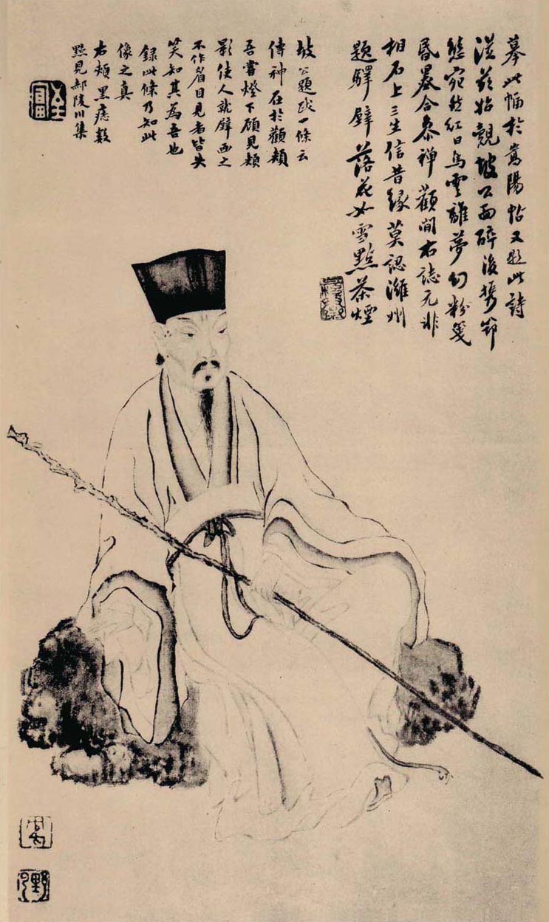
Su Shi
Su Shi (8 January 1037 – 24 August 1101), courtesy name Zizhan, art name Dongpo, born in Sichuan, was a Chinese poet, writer, politician, calligrapher and painter of the Song Dynasty.
Su Shi is widely regarded as one of the most accomplished figures in classical Chinese literature.
仁爱精勤

Slide 7
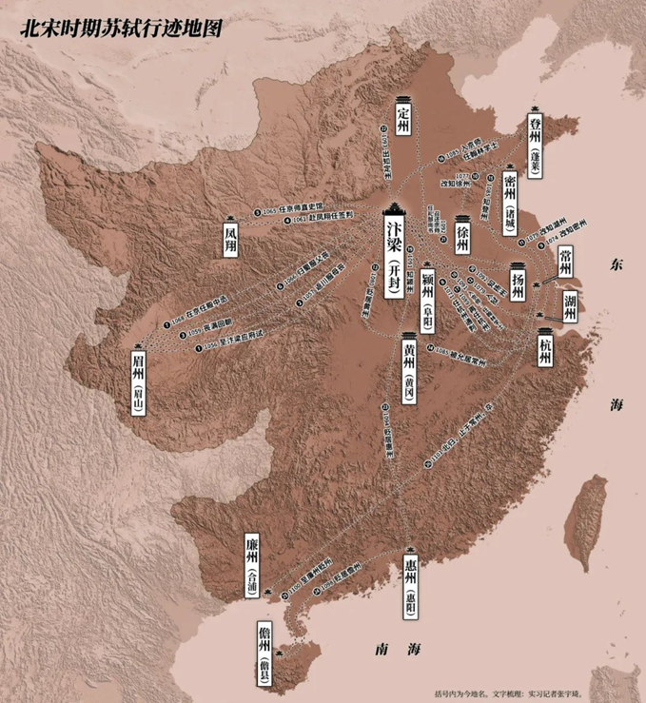
请输入你的标题
Su Shi
But his whole life was almost intertwined with misfortunes.
Yet, he endured several ups and downs and each exile became a stage for his literary brilliance.
He stands out as a symbol of transcendent optimism. His life and works redefine what it means to turn suffering into art.
仁爱精勤
JUNE 12th
Notes:
and his delegation took him to Huangzhou (黄州), Huizhou (惠州), and finally Danzhou (儋州), the remotest corners of the empire.

Slide 8
03
Masterpieces Across Three Exiles
仁爱精勤

Slide 9
Masterpieces Across Three Exiles
1. Huangzhou Period (1080–1084)
Here, Su Shi composed some of his most iconic works:
•《卜算子·黄州定慧院寓居作》Song of Divination
“惊起却回头，有恨无人省。
拣尽寒枝不肯栖，寂寞沙洲冷。”
Startled, I turn my head,
With grief none can share.
Choosing no branch to rest,
Cold sandbar, desolate and bare. （许渊冲译）
仁爱精勤
Notes:
It shows Su Shi’s unyielding integrity amid isolation.

Slide 10
Masterpieces Across Three Exiles
1. Huangzhou Period (1080–1084)
Here, Su Shi composed some of his most iconic works:
•《定风波·莫听穿林打叶声》Calming Wind and Waves
“回首向来萧瑟处，归去，也无风雨也无晴。”
“Looking back on the place so bleak where I used to stay,
I find neither rain nor shine will matter anyway.”
（许译）
仁爱精勤
Notes:
This poem embodies his Daoist-inspired calmness, accepting life’s unpredictability.

Slide 11
Masterpieces Across Three Exiles
1. Huangzhou Period (1080–1084)
Here, Su Shi composed some of his most iconic works:
•《念奴娇·赤壁怀古》Charm of a Maiden Singer
“人生如梦，一尊还酹江月。”
“Life is but a dream. Let me drink to the moon which once saw him on the stream.”
（许译）
仁爱精勤

Slide 12
Masterpieces Across Three Exiles
2. Huizhou Period (1094–1097)
Despite poverty, Su Shi found joy in simplicity:
•《食荔枝二首》Eating Litchis
“日啖荔枝三百颗，不辞长作岭南人。”
“If I could eat three hundred litchis every day, I'd gladly be a southerner for good and all.”
（许译）
仁爱精勤
Notes:
This poet shows his humor, turning exile into a celebration of local culture.

Slide 13
Masterpieces Across Three Exiles
3. Danzhou Period (1097–1100)
In Hainan, his writings reached philosophical heights:
•《自题金山画像》
Inscription on My Portrait at Jinshan Temple
“心似已灰之木，身如不系之舟。
问汝平生功业，黄州惠州儋州。”
My heart seems like a withered tree;
My body, a boat adrift.
If you ask what I have achieved in my life,
My banishment to Huangzhou, Huizhou and Danzhou would be the answer.
（许译）
仁爱精勤

Slide 14
04
Why Su Shi Stands Apart
仁爱精勤

Slide 15
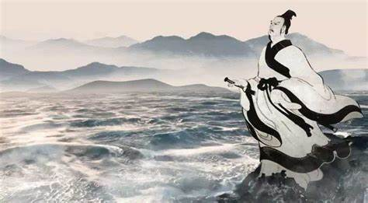
Why Su Shi Stands Apart
Unlike earlier exiled poets like Qu Yuan, who dwelled on resentment,
Su Shi, as a traditional Confucian scholar, blended Confucian resilience, Daoist harmony, and Buddhist detachment and used them to soothe his inner turmoil.
Qu Yuan
仁爱精勤

Slide 16
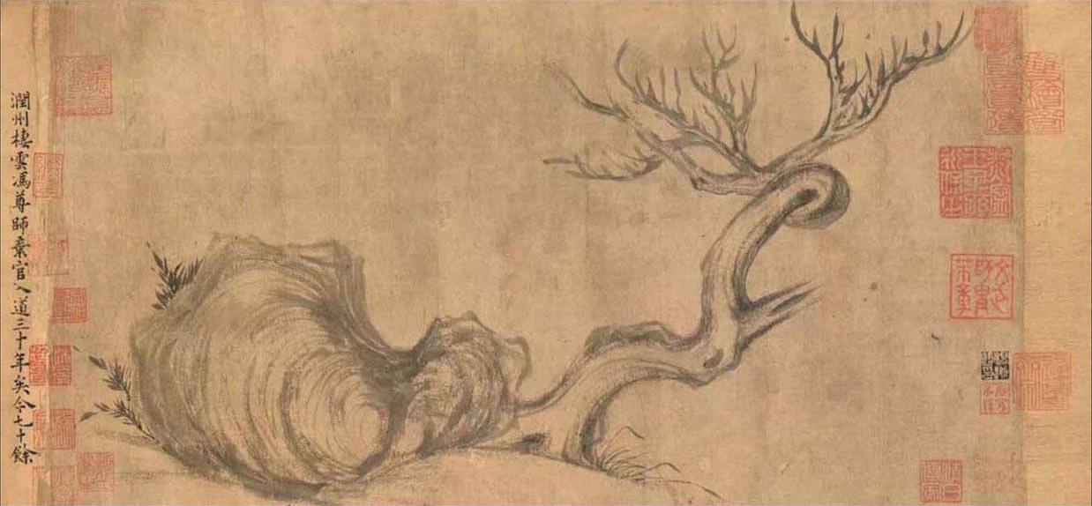
Why Su Shi Stands Apart
Within him, Confucian ideals of social engagement(入世) coexisted harmoniously with Daoist detachment(出世).
Thus, he became a beacon of courage and optimism.
the Painting of Withered Tree and Strange Rock
drawn by Su Shi
仁爱精勤
JUNE 12th
Notes:
So why we still love Su Dongpo after hundreds of years? It’s not only his literary works but also his inner spirit of optimism that is still inspiring us today.

