Slide 1
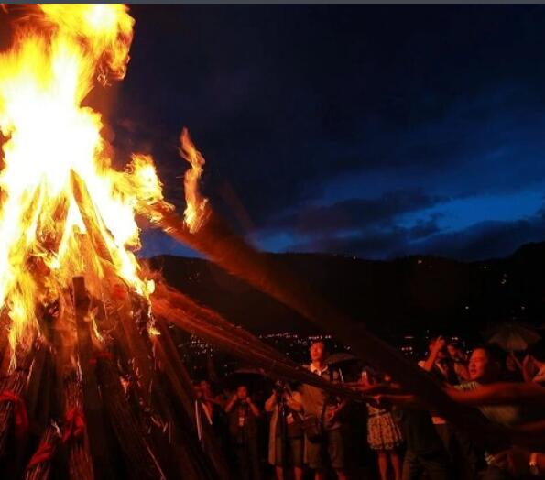
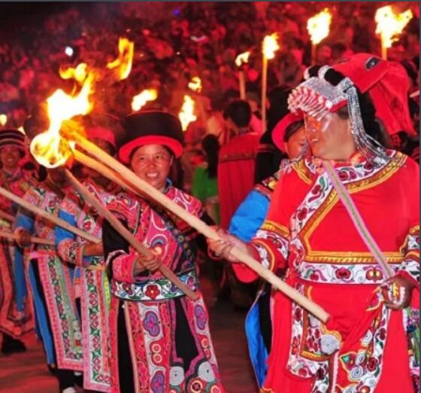
The Torch Festival
The Torch Festival, colloquially referred to as "huobajie" in Chinese, stands as a vibrant and pivotal cultural phenomenon.
Xiao Feiyan

Slide 2
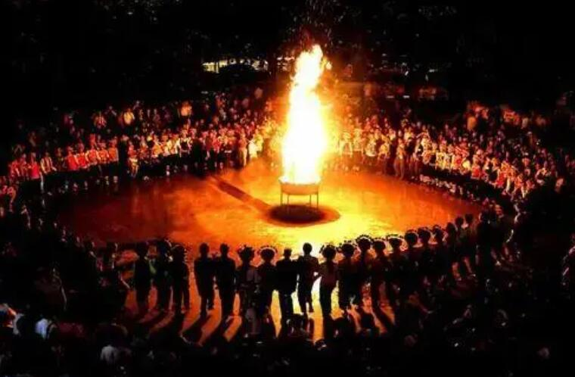
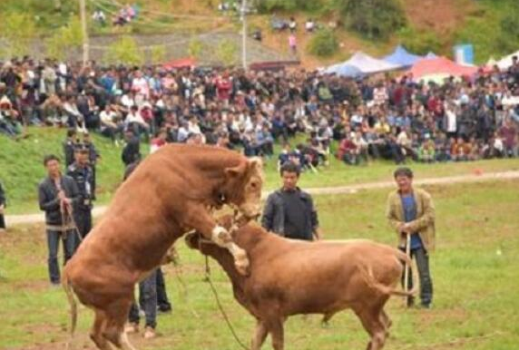
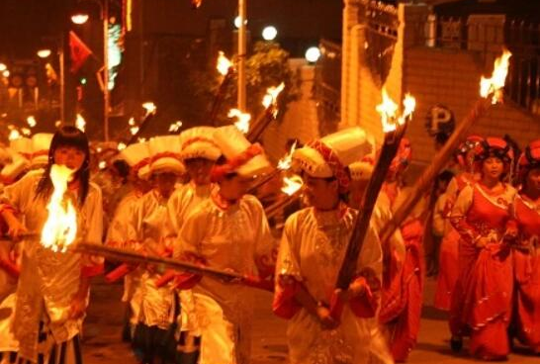
Festival
Part Ⅰ：Introduction
Part Ⅱ: Activities
Part Ⅲ: Summary

Slide 3
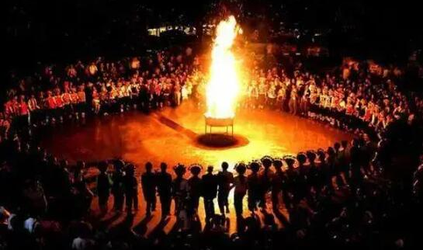
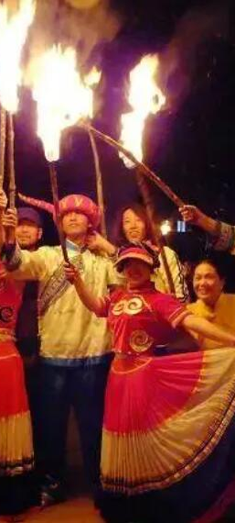
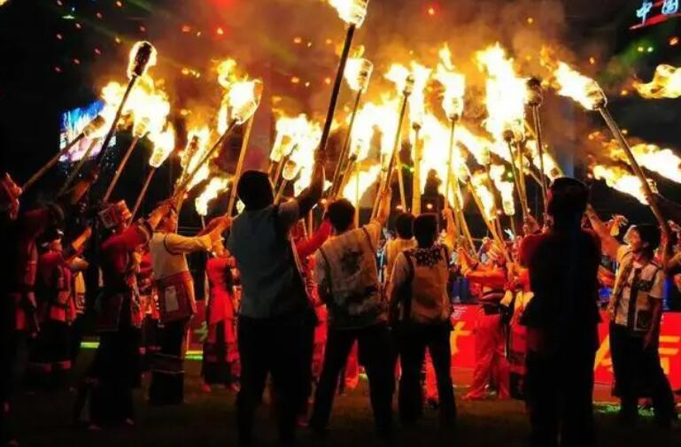
Part Ⅰ：Introduction
Legends of Yunnan's various ethnic groups about the Torch Festival each have their own distinctive content.

Slide 4
“
“
Oriental Carnival
The Torch Festival, celebrated on the 24th day of the 6th lunar month, is a traditional festival of Yi, Bai, Naxi, Jinuo, Lahu and other ethnic groups, with deep folk cultural connotations, known as the ‘Oriental Carnival’.

Slide 5
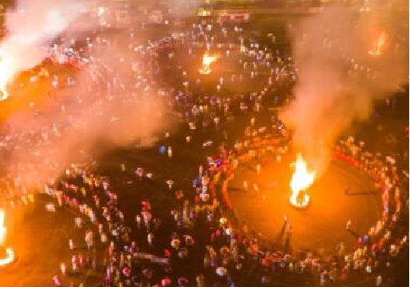
“
“
National Intangible Cultural Heritage
The Torch Festival, a traditional festival popular in Yunnan, Guizhou, Sichuan and other areas, one of the national intangible cultural heritage.

Slide 6
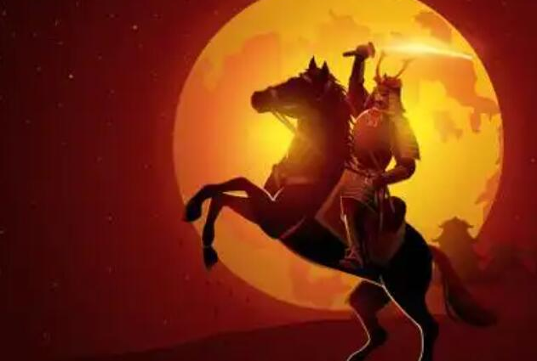
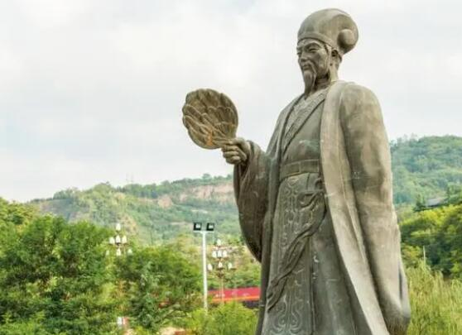
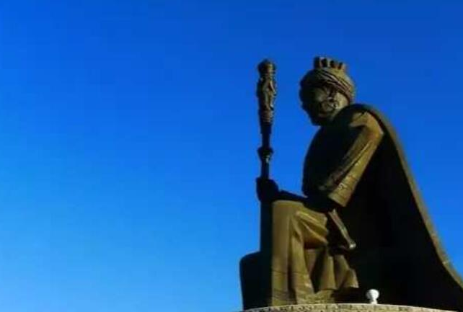
Stories of different ethnic groups
Naxi（纳西族）——天将
Lisu （傈僳族）——Zhuge Liang
Yi （彝族）——撒梅王

Slide 7
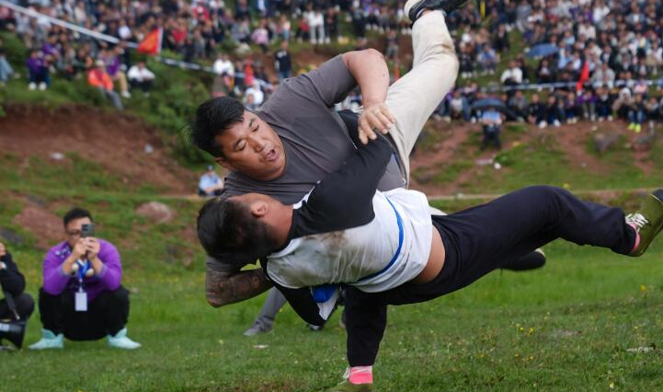
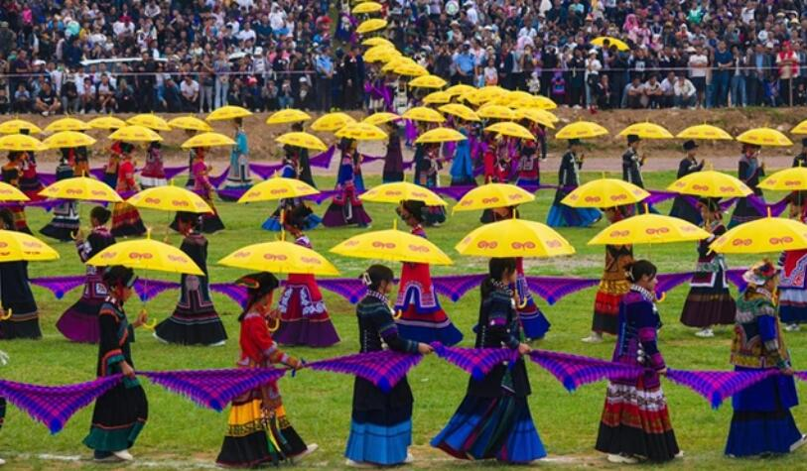
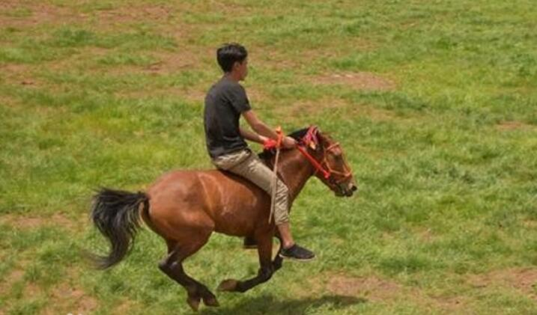
Part Ⅱ: Activities
These activities not only display the cultural characteristics of various ethnic groups, but also reflect the people's worship of fire and their expectation of a good harvest.

Slide 8
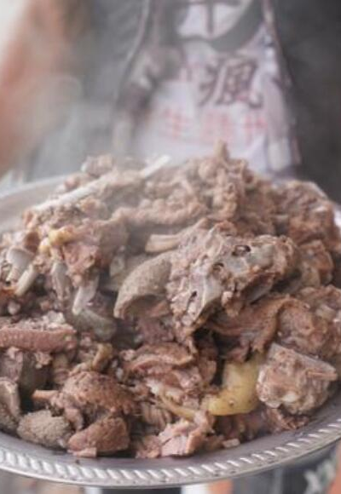
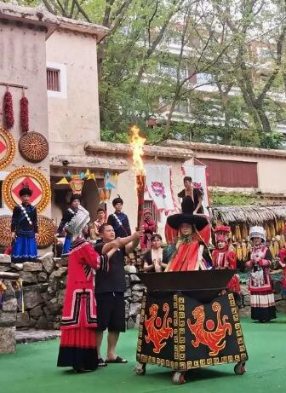
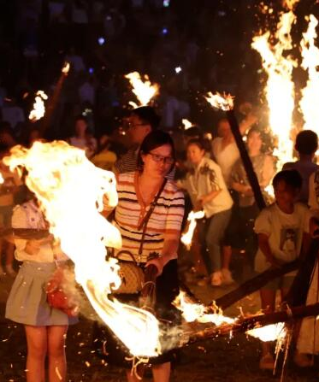
The First Day
Sacrifice
Chant scriptures
Wandering around with torches

Slide 9
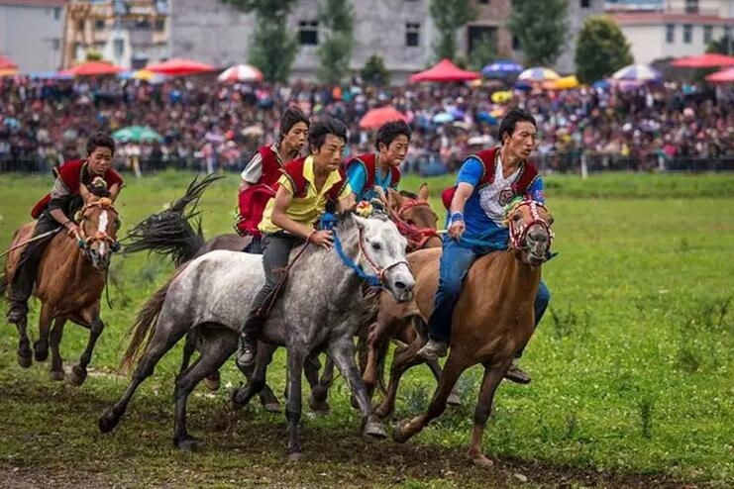
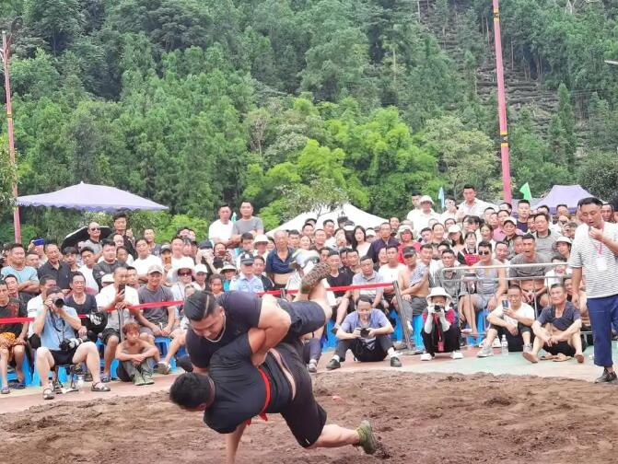
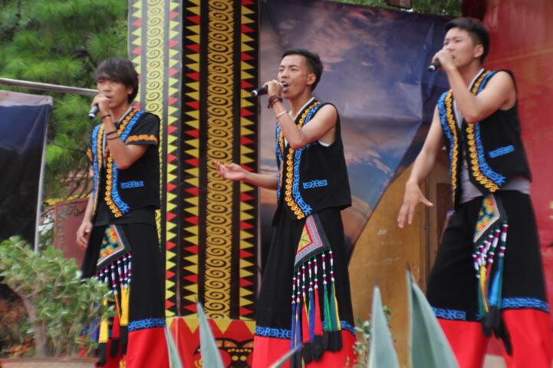
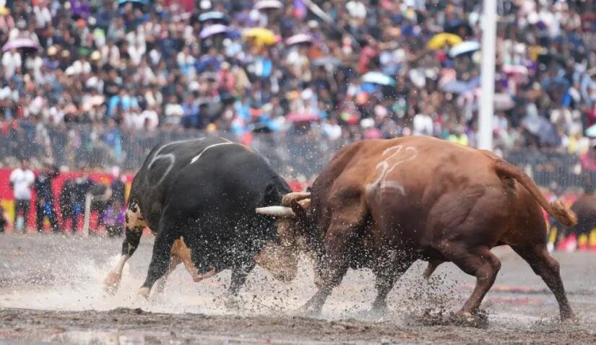
The Second Day

Slide 10
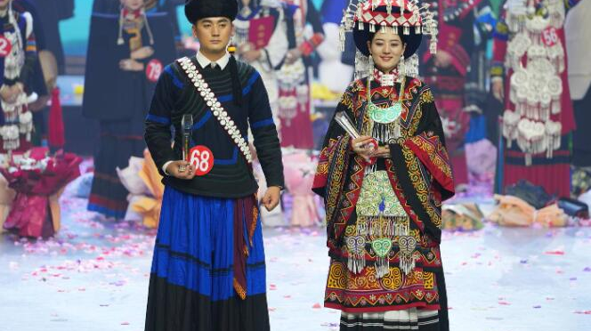
朵洛荷
Beauty Pageant
Golden Soma（金索玛）
Golden Eagle（金鹰）

Slide 11
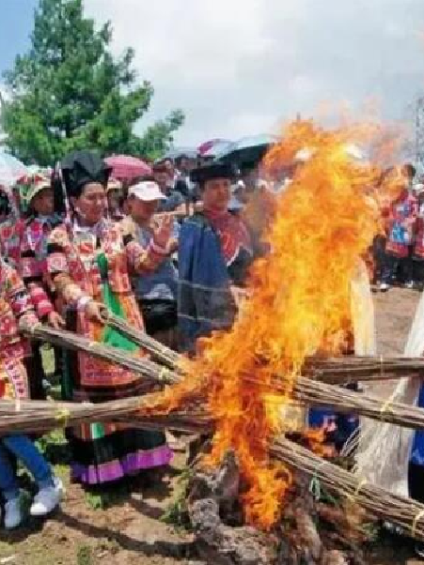
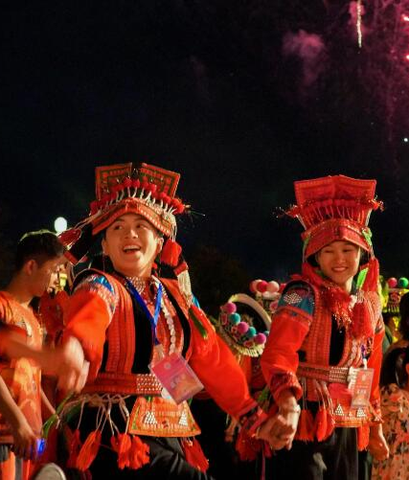
The Third Day
This is the climax of the entire Torch Festival. When the night falls on this day, everyone will hold a torch and wander around. At last, people will gather the torches together to form a pile of huge bonfires, and people will gather around the bonfires to sing and dance.

Slide 12
Watch the Video
https://www.bilibili.com/video/BV1894y1S7JH/?vd_source=f2acd211c9c15ba0c5ba4e78a0cf525a

Slide 13
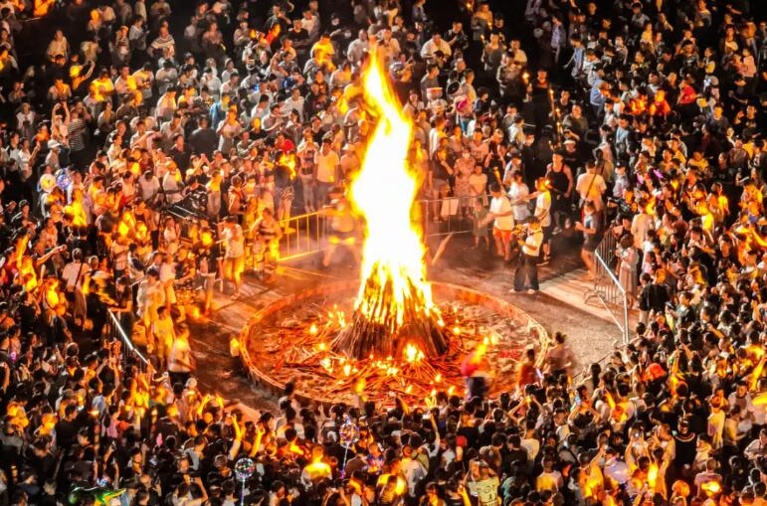
Part Ⅲ: Summary
The Torch Festival is a folk festival with a long history, a simple and ancient form, and the most intense and distinctive national characteristics, with fire as the core and torch as the theme.

Slide 14
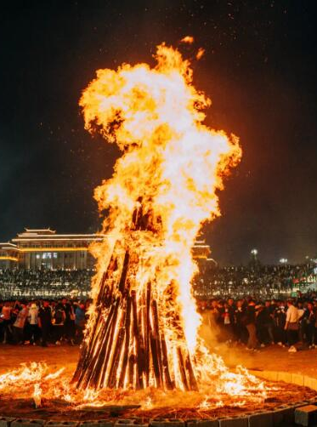
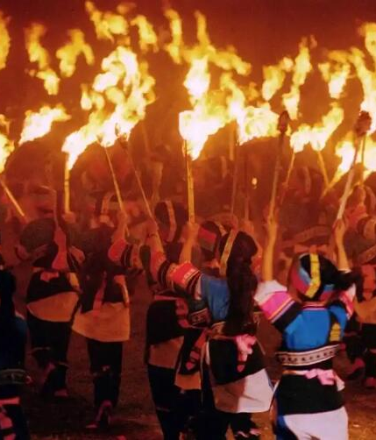
The four major types of activities held during the Torch Festival, namely, rituals, arts and sports, social contacts and product exchanges, are the concentrated manifestation of the strict and complete cultural system of the Yi people.

Slide 15
Thank you!

