Slide 1
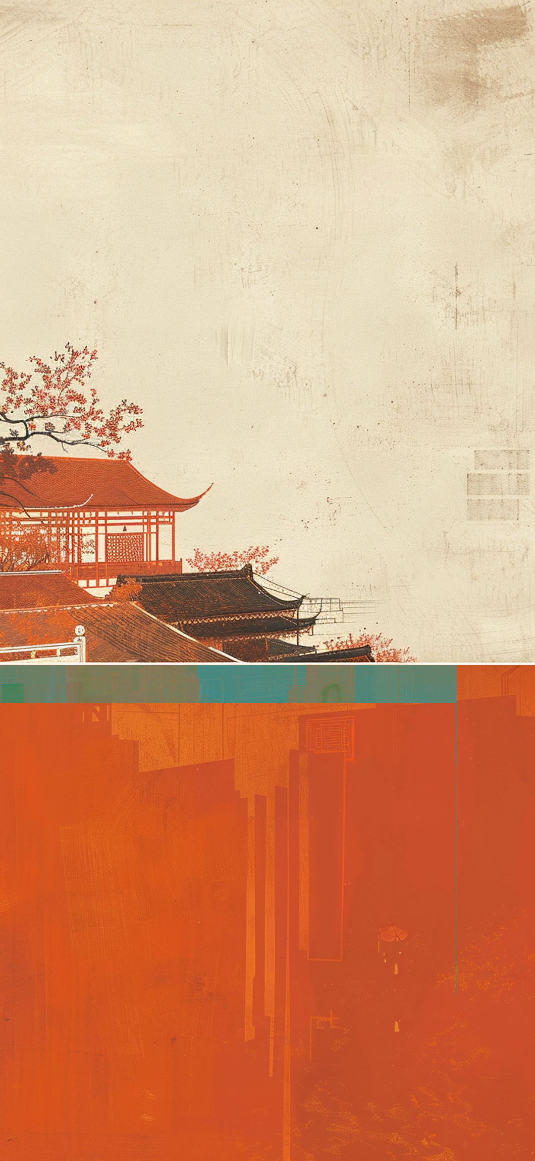
Facial Make-up:
Face Changing in
Sichuan Opera
汇报人：杨婧蔚

Slide 2

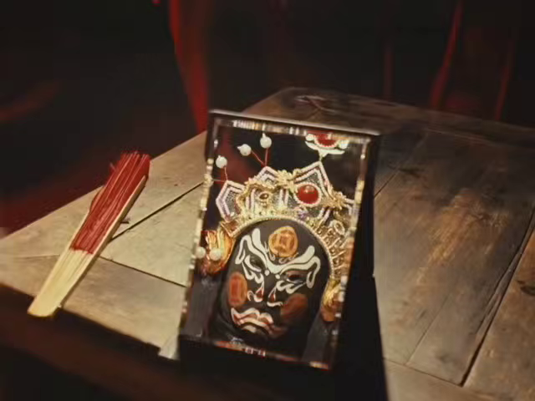


Slide 3
目
录
01
The Symbolic Meaning and Typical Characters
02
The Craft and Materials of Face Changing
02
Three Techniques of Face Changing
CONTETNS

Slide 4

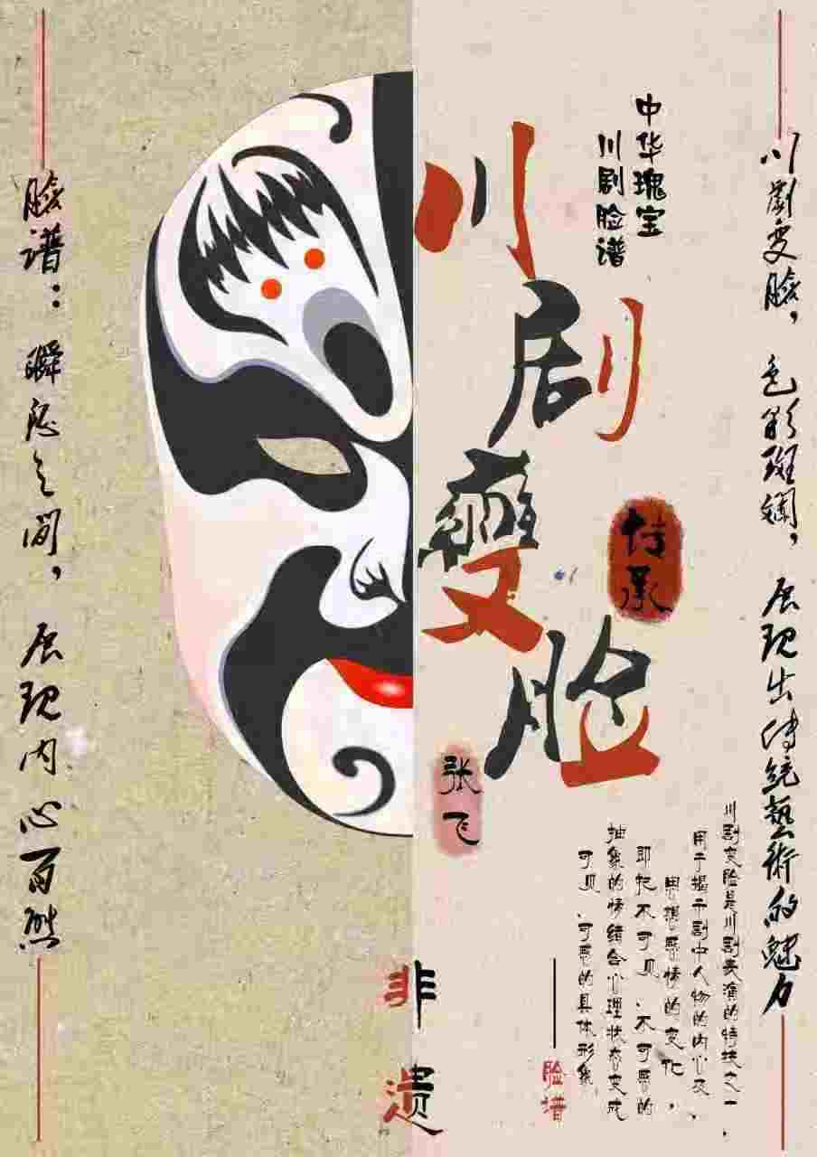

The Symbolic Meaning
and Typical Characters
壹
瑰
瑰宝
宝

Slide 5
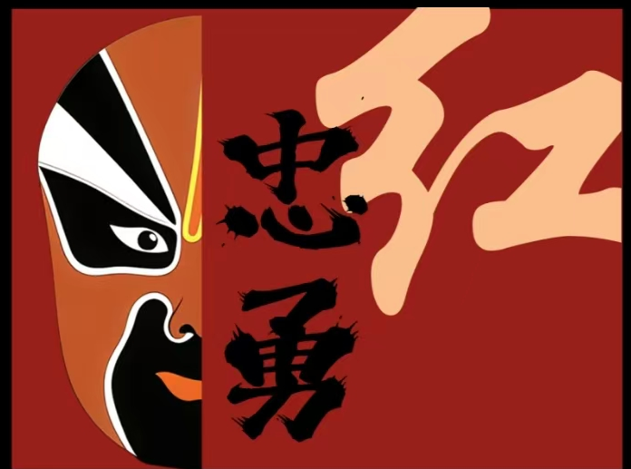
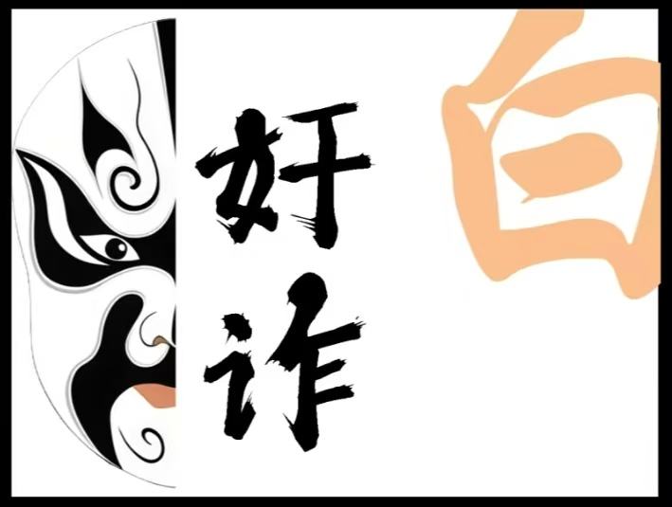
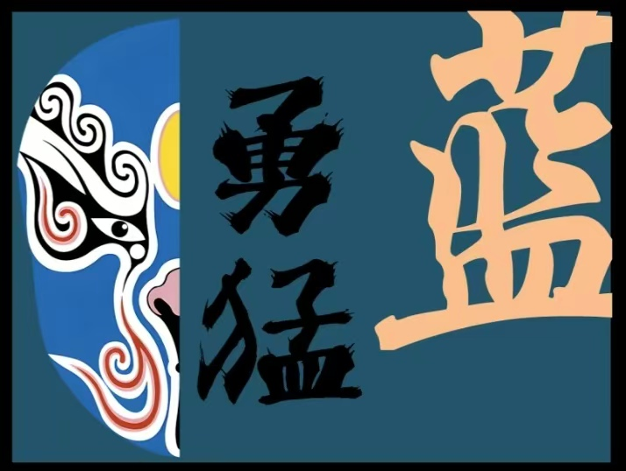
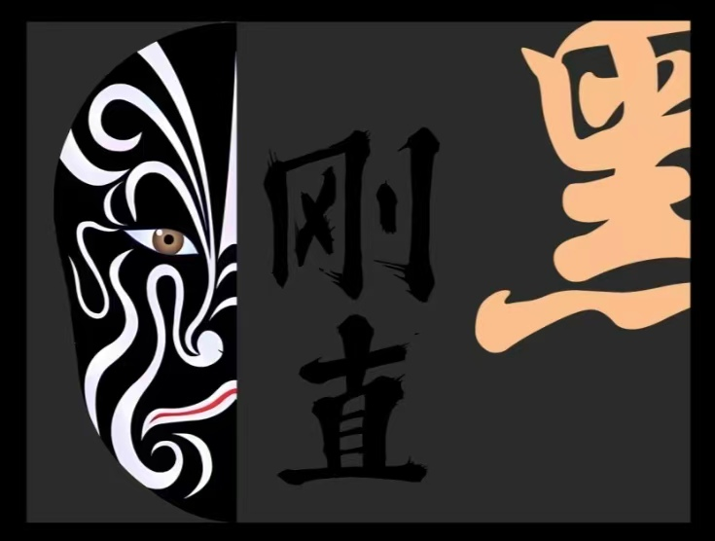
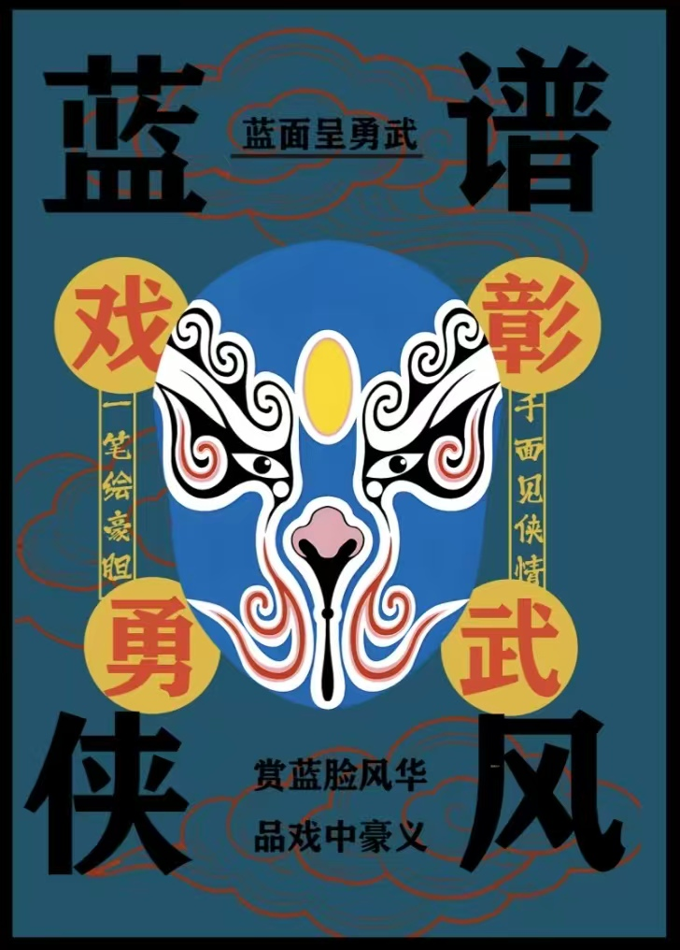
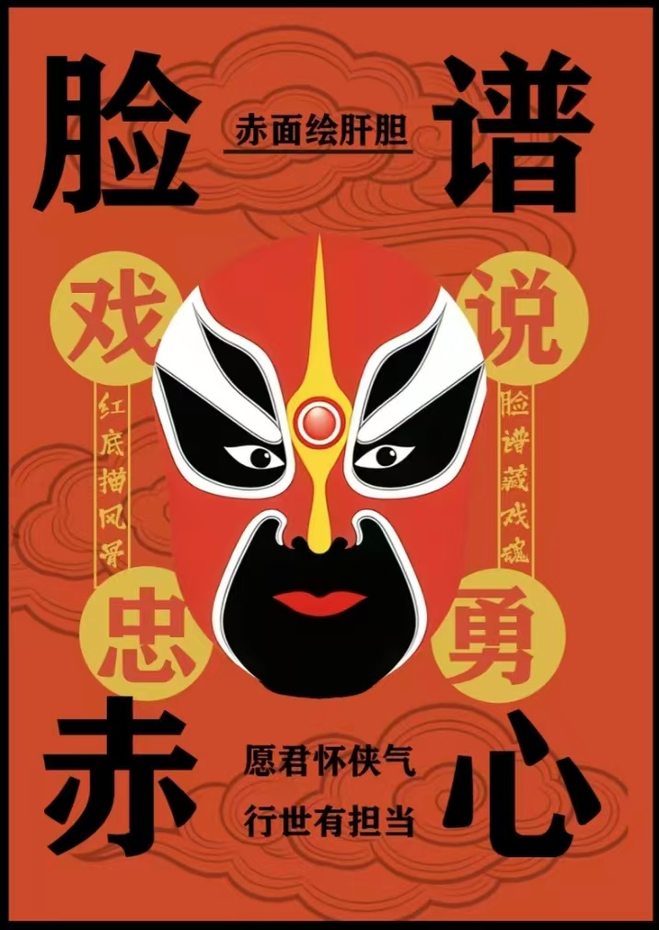
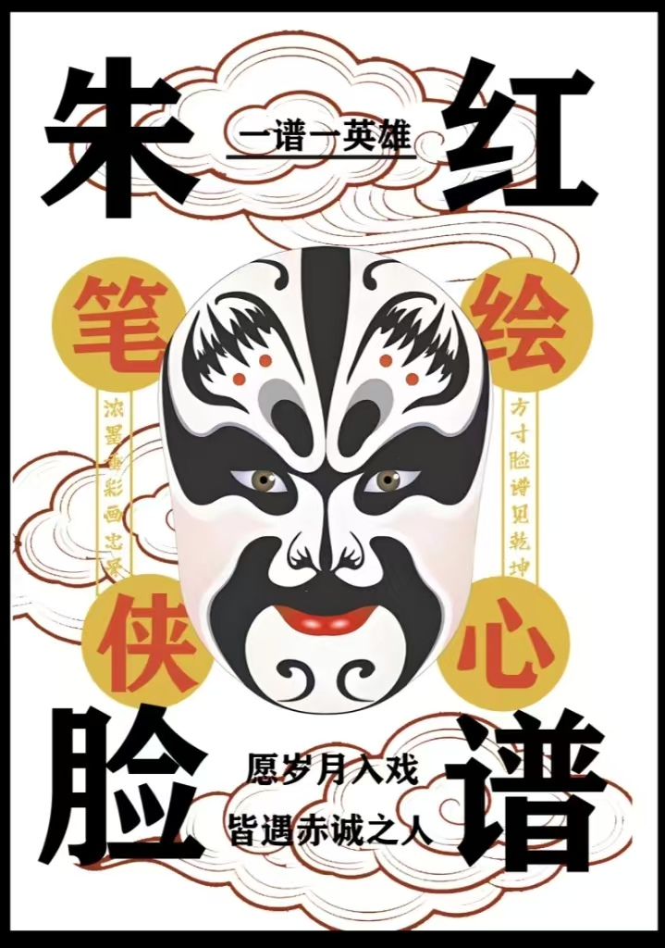
Loyal and brave
strong and formidable
cunning and suspicious
upright and reckless
Zhang Fei
张飞
Dou Erdun
窦尔敦
Guan Yu
关羽
Cao Cao
曹操

Slide 6
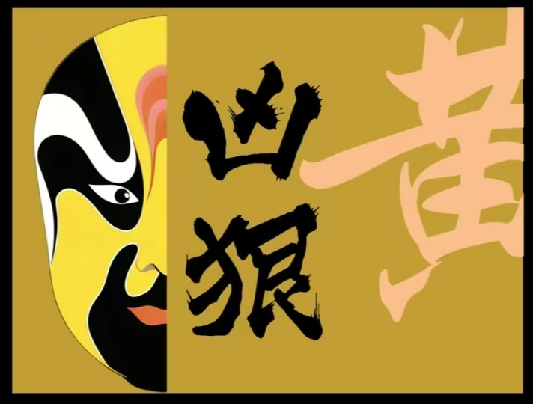
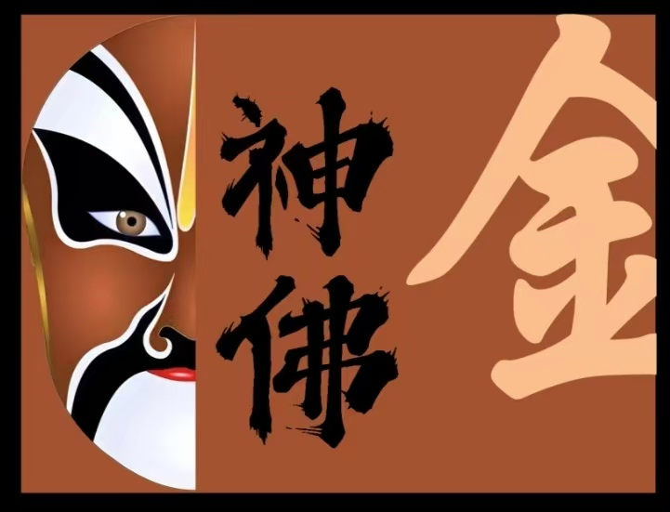
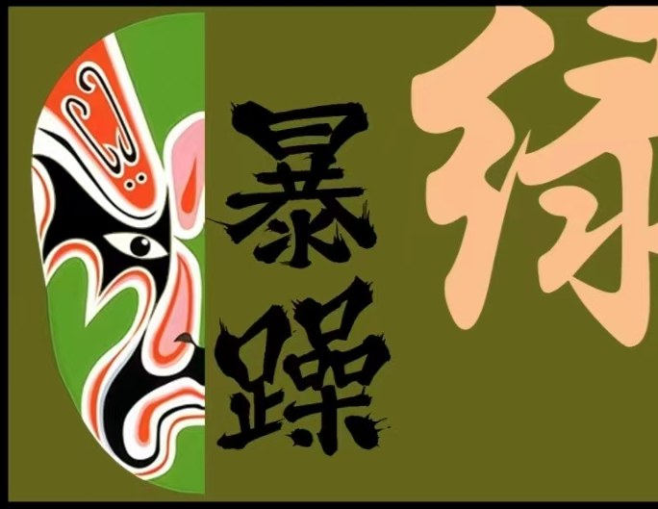
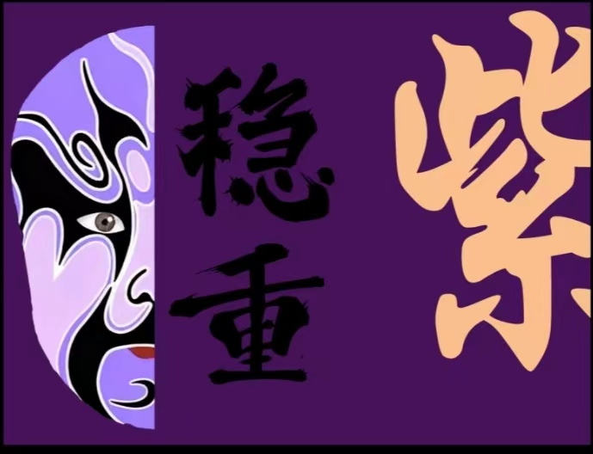
The Symbolic Meaning and Typical Characters
Green symbolizes recklessness and impulsiveness, such as Cheng Yaojin.
Purple symbolizes solemnity and steadfastness.
Gold and silver generally only used by mythological characters, representing Buddhas,gods,spirits, ghosts, etc.
Yellow symbolizes bravery and violence, such as Dian Wei.

Slide 7
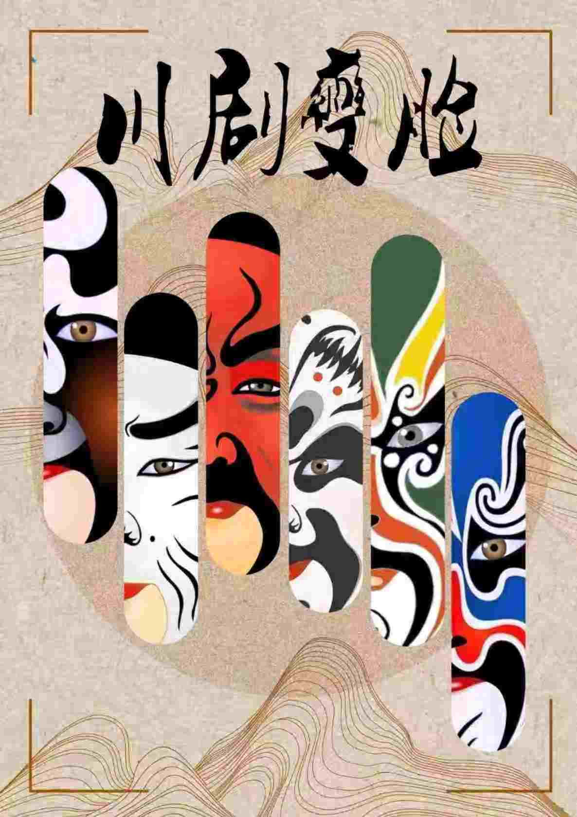
The Craft and Materials
of Face Changing
贰
瑰
瑰宝
宝

Slide 8
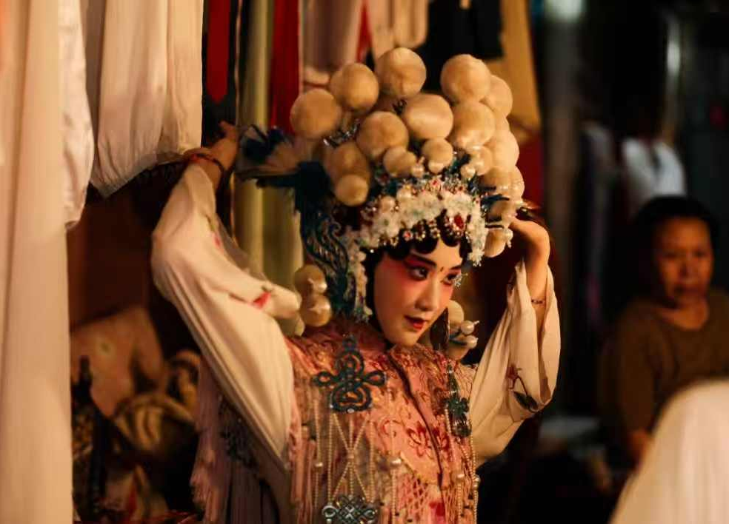
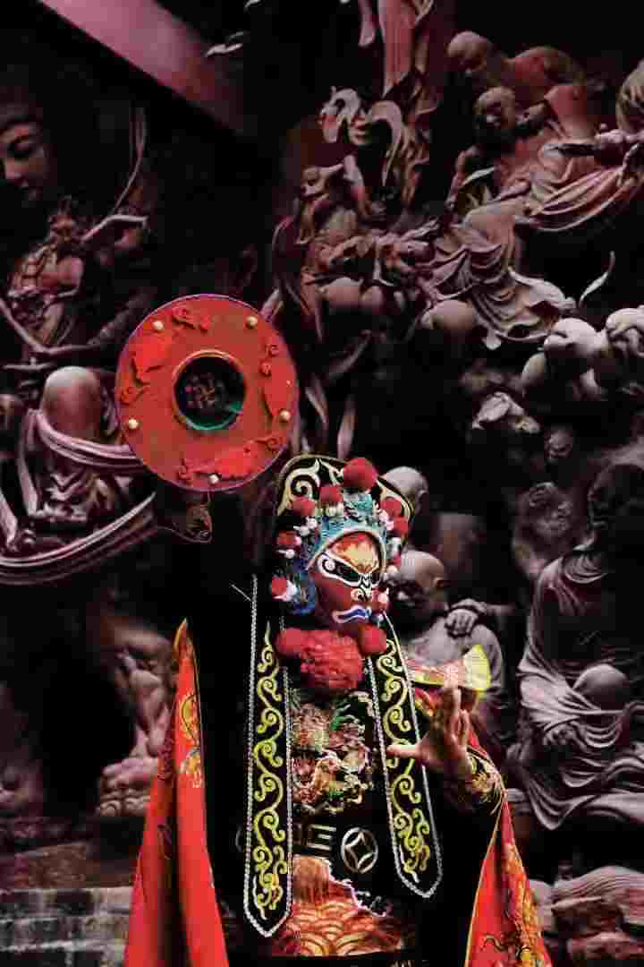
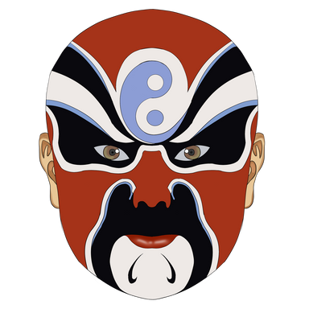

Base of the Masks
highly resilient paper or white cotton cloth
paintings on thin paper
lightweight and durable silk fabrics
Painting the Masks
· Specialized opera makeup are used to ensure vibrant colors and long-lasting wear.
· The designs must be precise, aligning with the character’s traits and the conventions of the role.

Slide 9
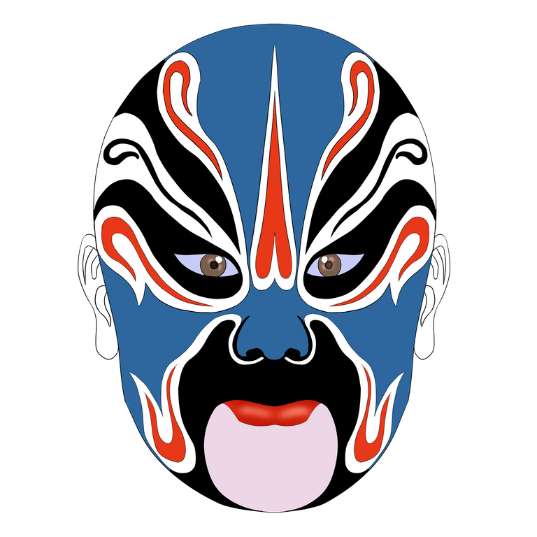
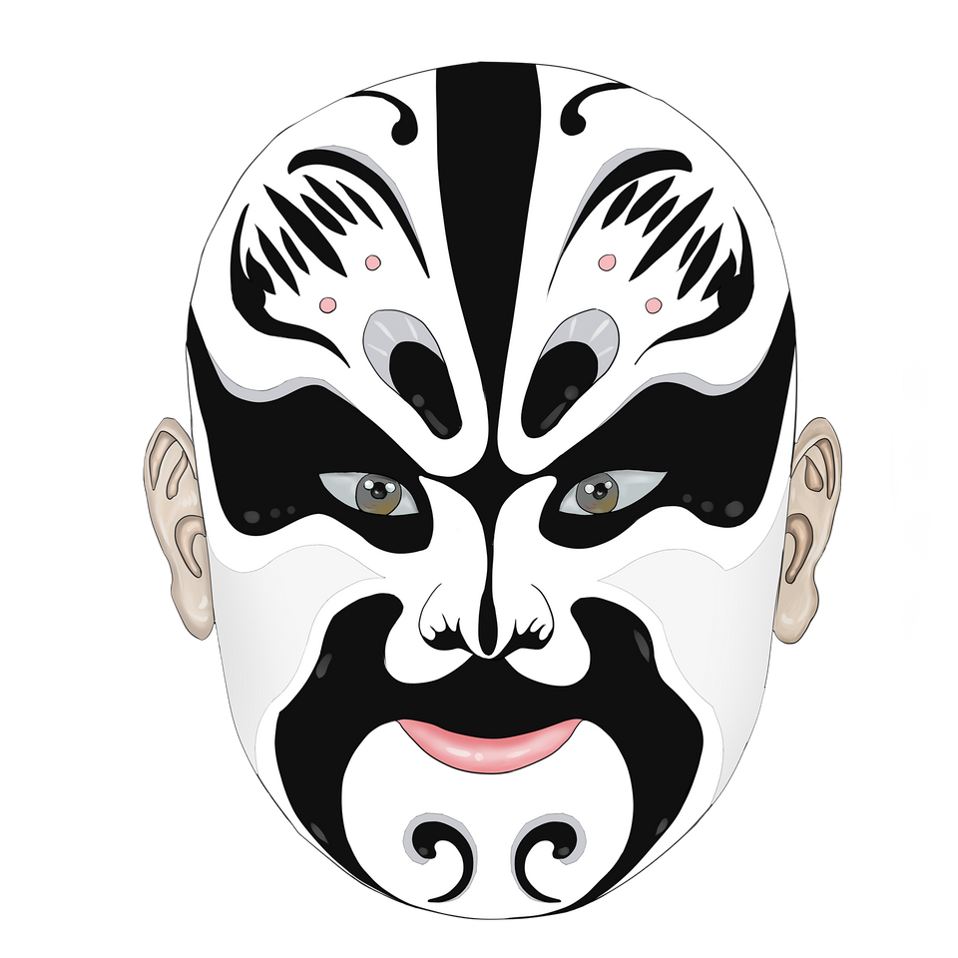
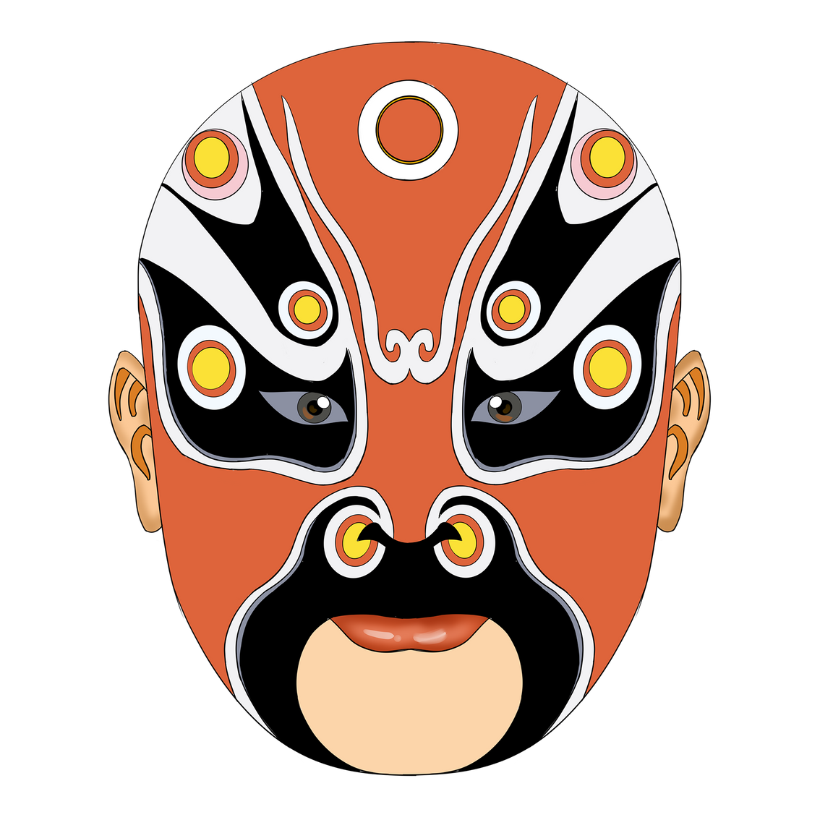
Key Props for Face-Changing
川剧
· Silk Threads: Extremely fine silk threads were sewn onto the masks, with the other end concealed in the actor's costume.
· Special Glue: A unique adhesive that loses its stickiness when exposed to heat or slight pressure is used.
· Powders: Techniques like "the blow" (吹脸）employ gold powder, ink powder, and similar materials.

Slide 10
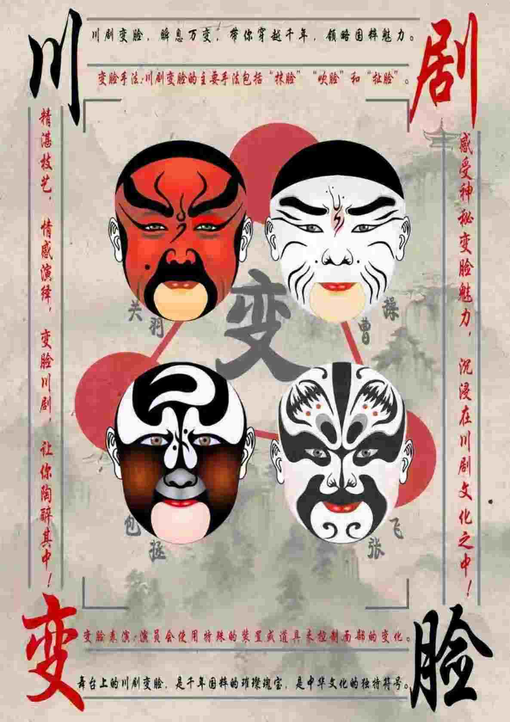
Three Techniques of
Face Changing
叁
瑰
瑰宝
宝

Slide 11


“The Pull”（拉脸）
・Method:
The actor wears multiple pre-painted masks layered on the face, each tied with a silk thread connected to a discreet yet accessible part of the costume. Under the cover of dance movements, the actor swiftly pulls off the layers of masks.
・Characteristics:
Known for its speed and numerous transformations, this technique lies at the core of face-changing performances.

Slide 12
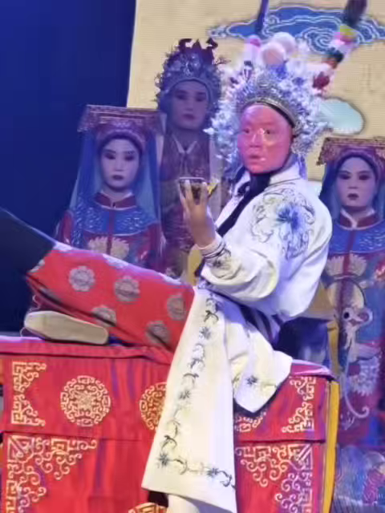
“The Wipe”（抹脸）
Method:
Performers pre-apply greasepaint to specific areas of the face and swift hand motion across the skin instantly transforms the color in these zones.
Characteristics:
It is typically used for localized color changes to convey sudden emotional shifts—like "wiping on red" to express intense anger.

Slide 13
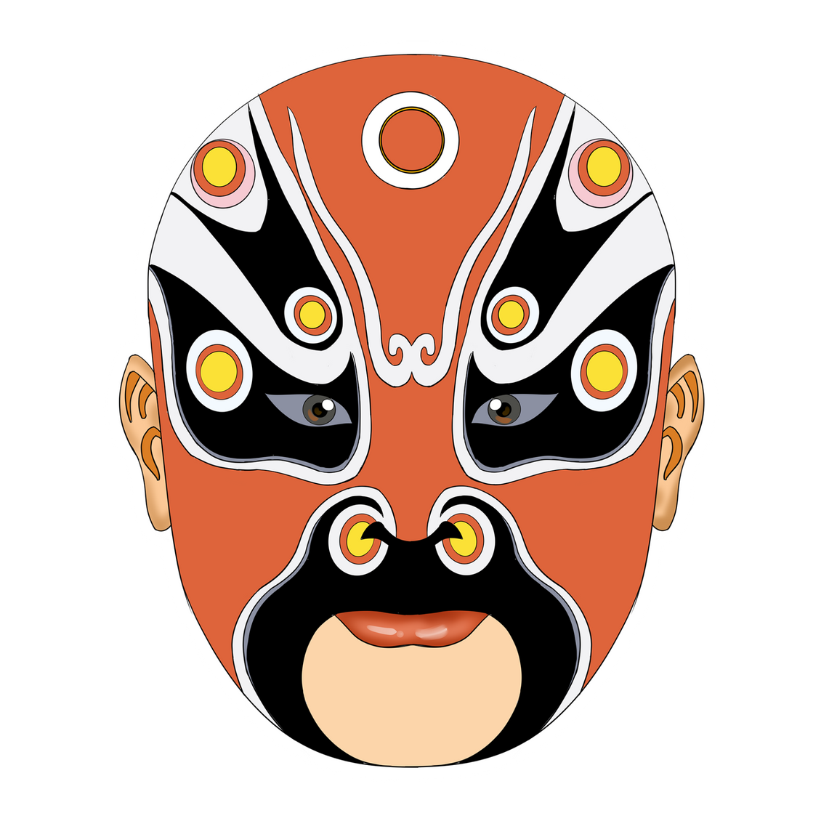
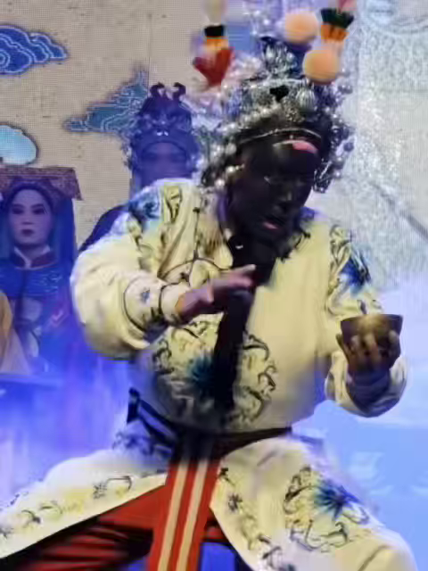
“The Blow”（吹脸）
Method:
A small container holding the colored powder is placed on stage. And then the actor executes a specific movement, seizing the moment to puff a burst of air, which sends the powder upward to adhere to their oiled or prepared face, completing the face change.

Slide 14
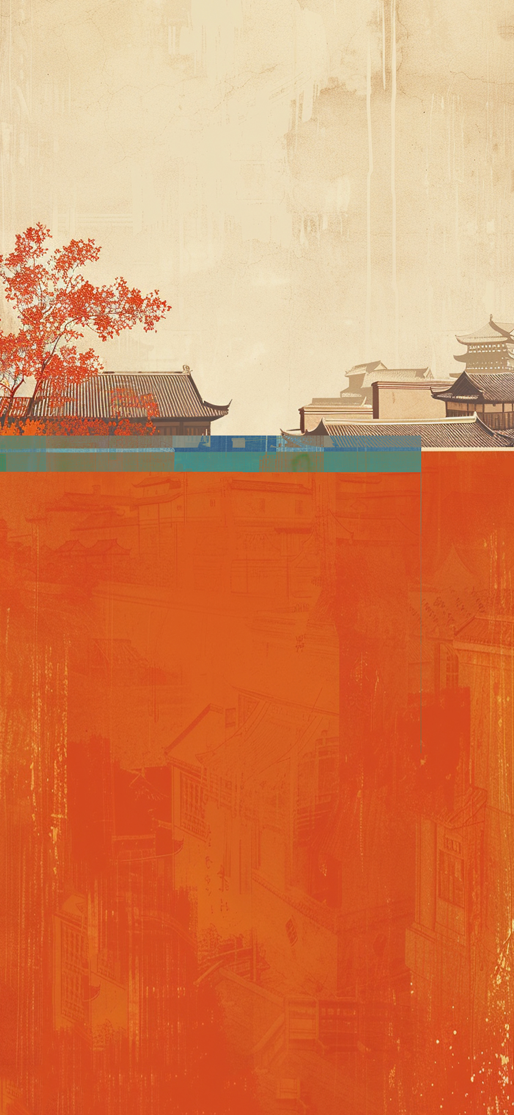
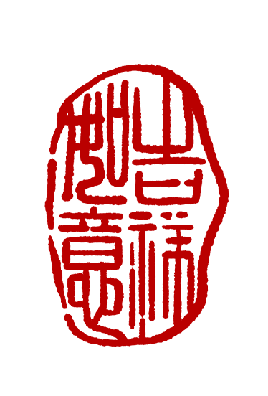
Thank you
传承载智慧之光，因此璀璨
蕴含文化之深，故而厚重
Inheriting the light of wisdom, therefore shining brightly.
It contains profound cultural connotations, hence it is weighty.

