Slide 1
Opera: Flower-drum Opera
202370081592 周静 2024/11/21

Slide 2
Contents
01
02
Origins and Historical Development
Cultural Significance
Modern Adaptations and Influence
03
Artistic Elements
04
05
Challenges and Future Prospects

Slide 3
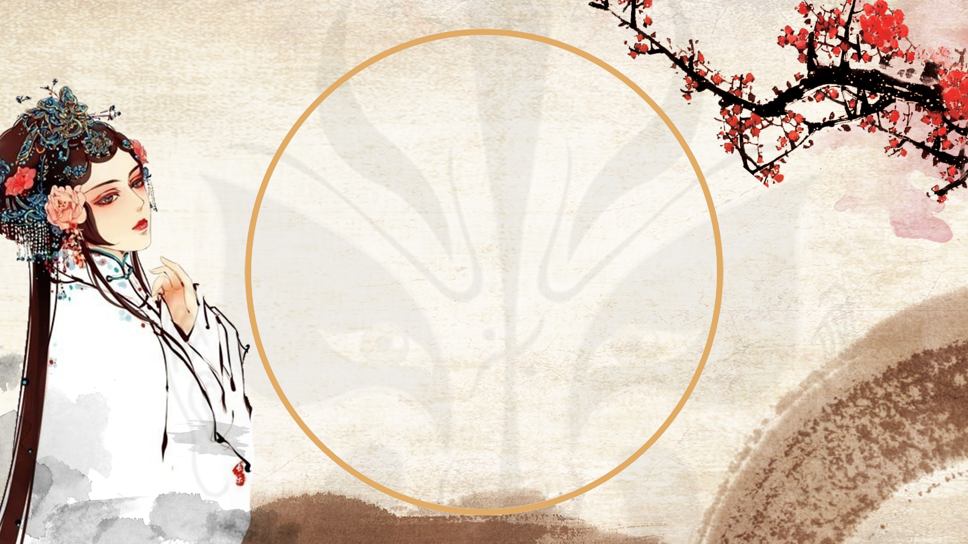
01
Origins and Historical Development

Slide 4
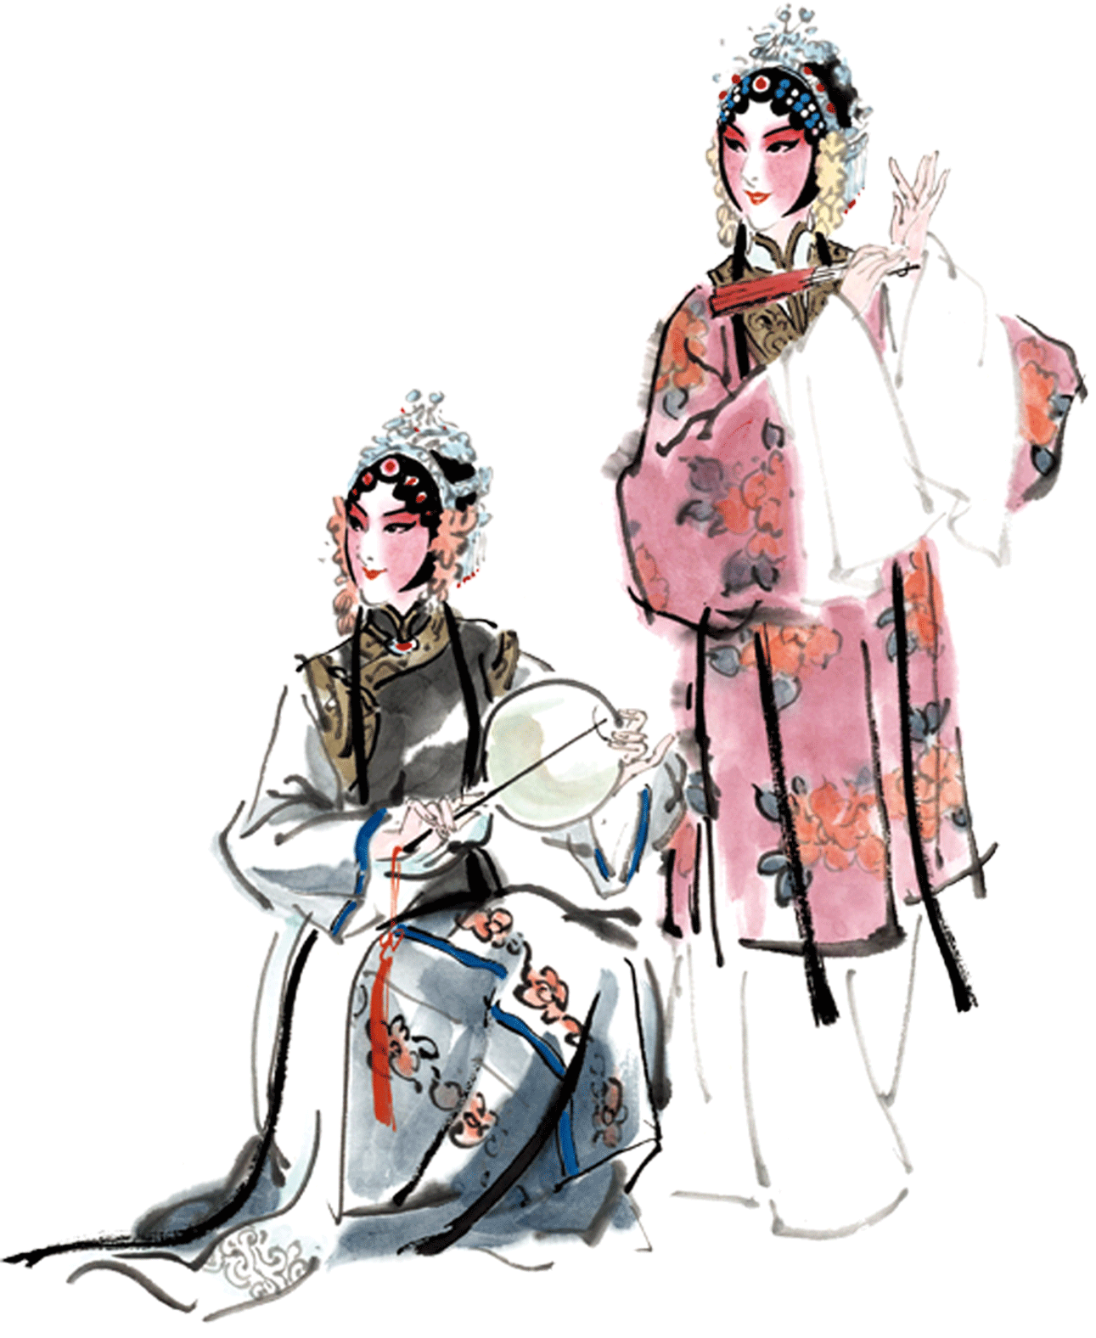
1.Early Beginnings
Flower-Drum Opera can trace its roots back to the Song Dynasty (960- 1279 AD), but it gained significant popularity during the Ming (1368- 1644) and Qing (1644-1912) Dynasties. Initially, it was a form of folk entertainment performed during festivals and agricultural celebrations.

Slide 5
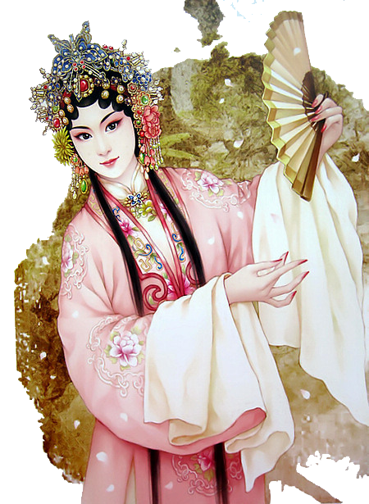

2.Evolution Through Dynasties
Throughout the Ming and Qing Dynasties, Flower-Drum Opera underwent significant changes. It evolved from a purely vocal and dance performance into a more structured form of theater, incorporating elements of drama and storytelling. This period also saw the introduction of more sophisticated musical instruments and elaborate costumes, enhancing the overall performance quality.

Slide 6

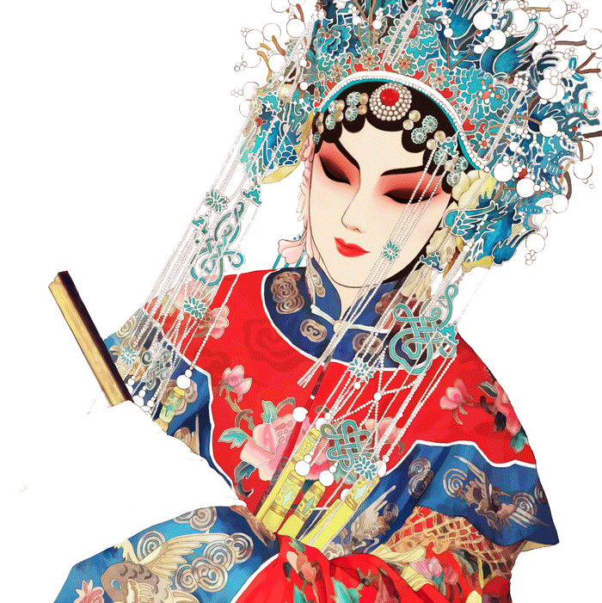
3.Regional Variations
the Anhui Flower-Drum Opera is known for its humorous and lively performances.
the Hunan style is characterized by its emotional depth and intricate musical compositions.

Slide 7
02
Cultural Significance

Slide 8
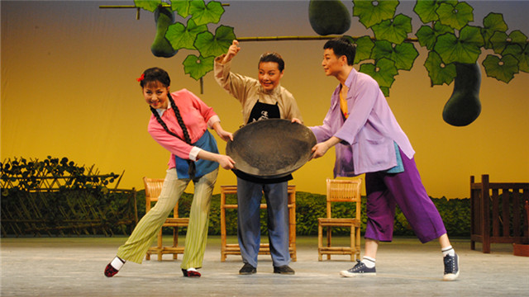
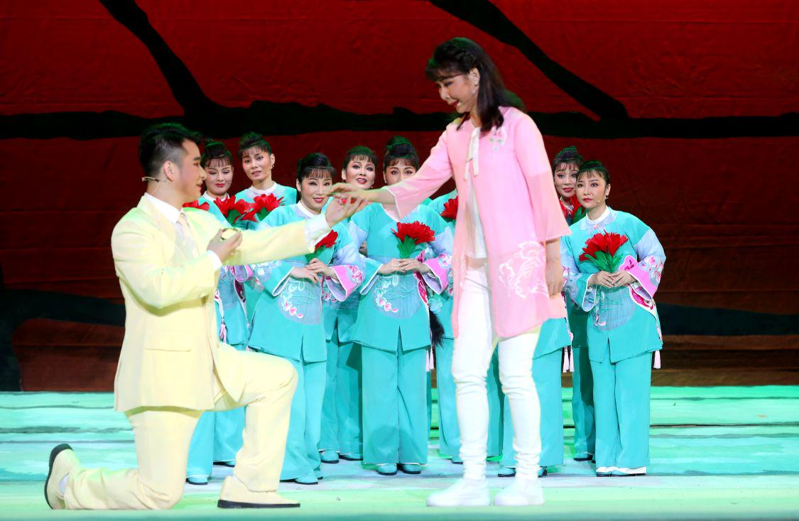
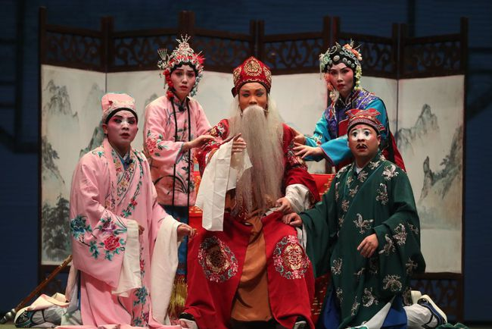

1.Reflection of Rural Life
Flower-Drum Opera has always been closely tied to the lives of rural communities. Its themes often revolve around agricultural activities, rural love stories, and social issues faced by villagers. Through its performances, the opera provides a glimpse into the everyday lives, struggles, and joys of rural China.

Slide 9
2.Medium of Social Commentary
Historically, it has been used to address social injustices, critique corrupt officials, and promote moral values.
By presenting these themes in a relatable and engaging manner, the opera has played a crucial role in educating and influencing public opinion, particularly in rural areas where literacy rates were traditionally low.

Slide 10
3.Preservation of Language and Tradition
The use of local dialects and traditional folk tunes in Flower-Drum Opera helps preserve linguistic diversity and cultural traditions.
local dialects
traditional folk tunes

Slide 11
03
Artistic Elements

Slide 12
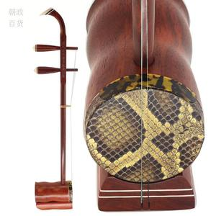
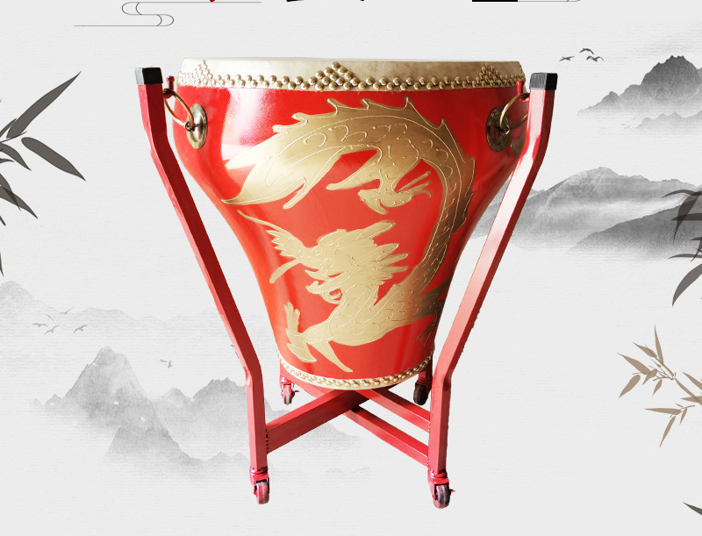
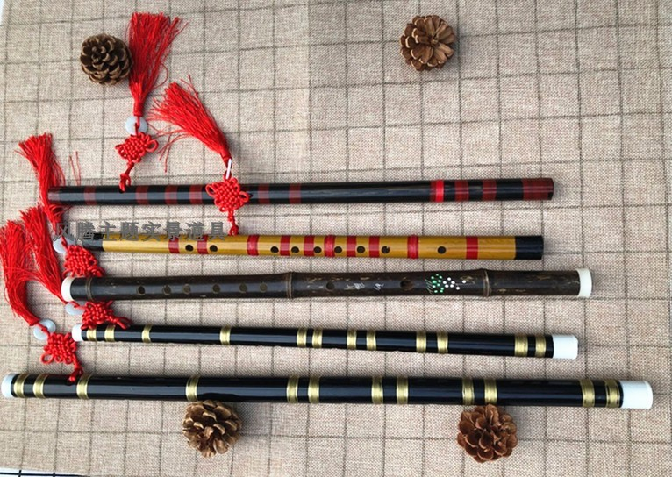
1.Music and Instruments
erhu (a two-stringed fiddle)
flower-drum
dizi (a bamboo flute)

Slide 13
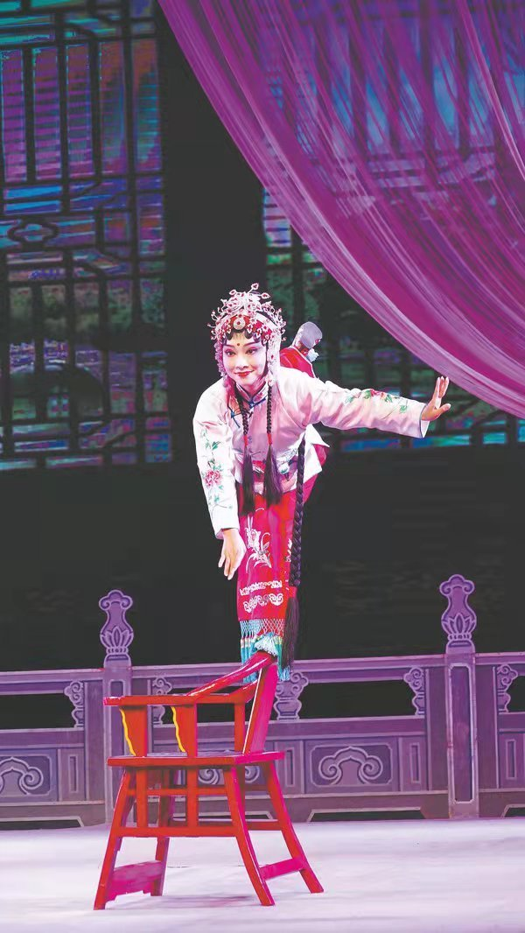
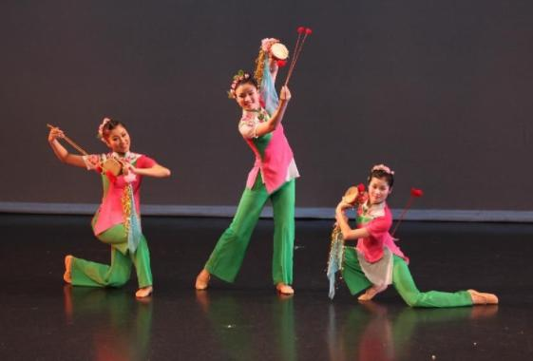
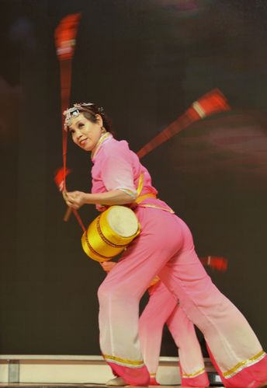
2.Dance and Movement

Slide 14

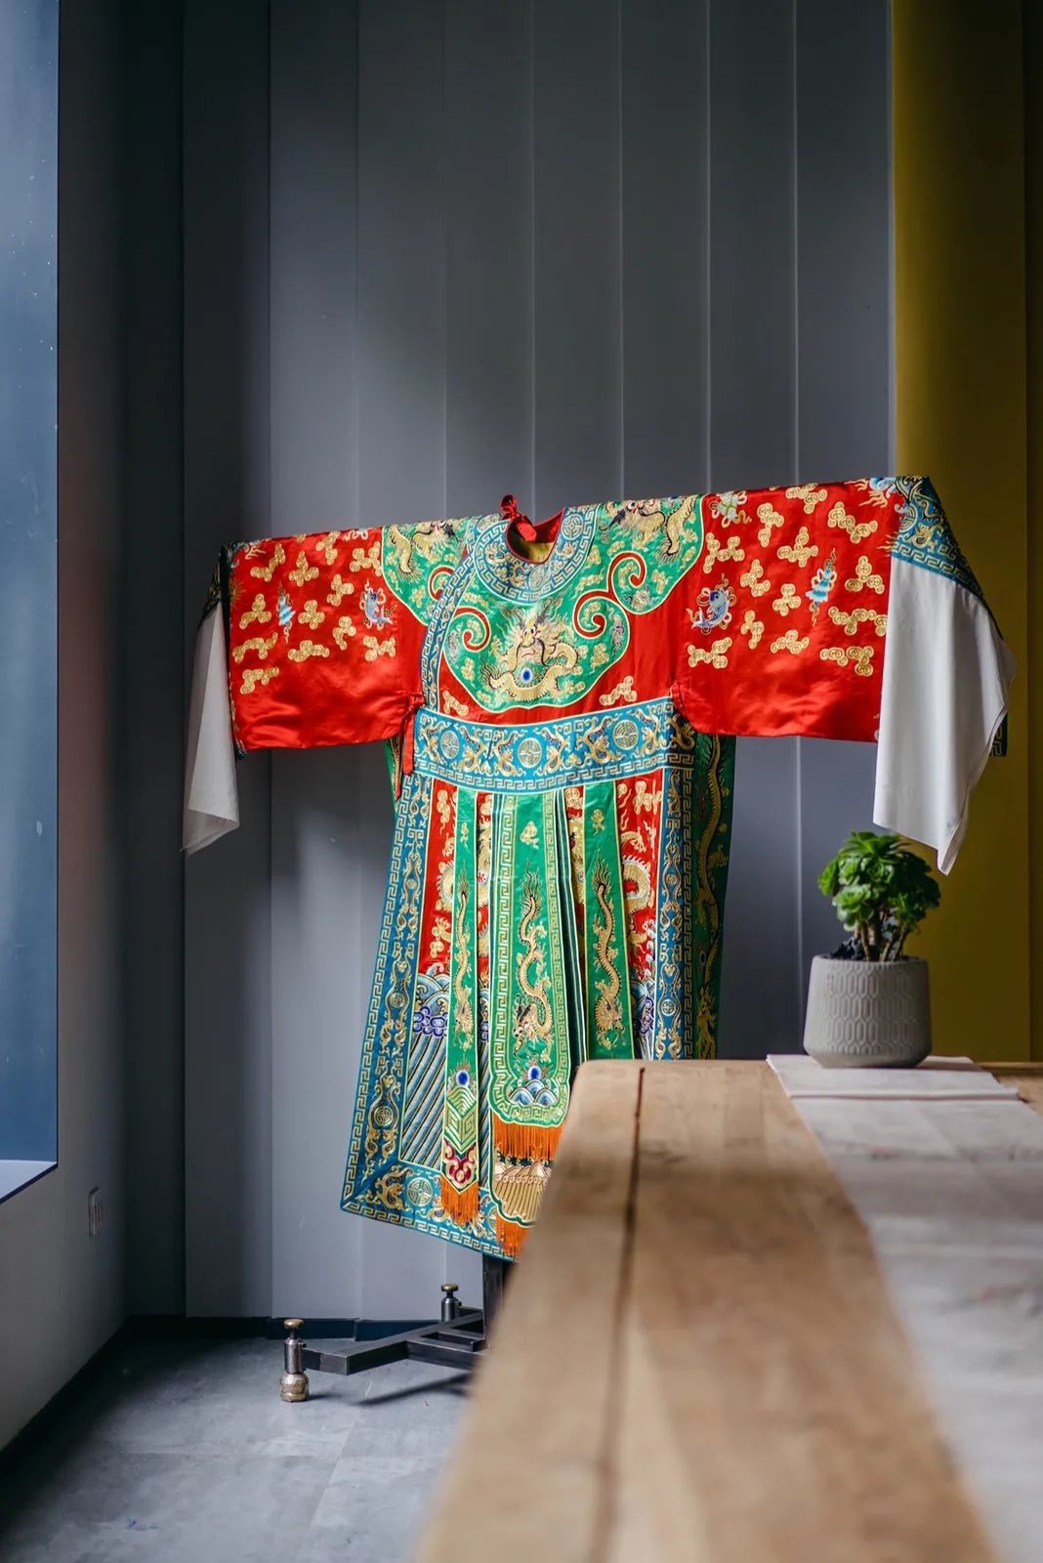
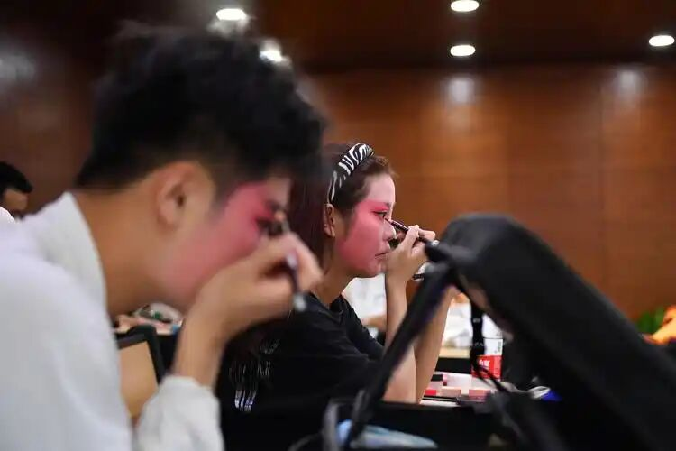
3.Costumes and Makeup
Costumes in Flower-Drum Opera are often colorful and elaborate, reflecting the characters' roles and social status.
Makeup is also an important aspect, with performers using bold colors and patterns to highlight their facial features and convey their characters' personalities

Slide 15
04
Modern Adaptations and Influence

Slide 16

1.Revival Efforts
Cultural organizations and local governments have launched initiatives to document and preserve traditional performances, train new performers, and organize festivals and competitions. These efforts have helped to bring Flower-Drum Opera back into the public eye and ensure its continued relevance.
戏
剧
日
世界

Slide 17
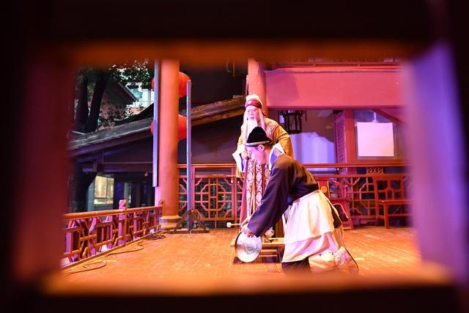
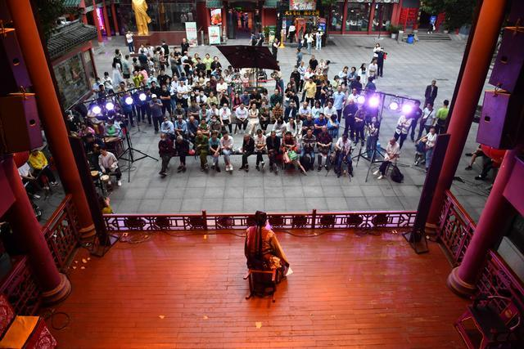
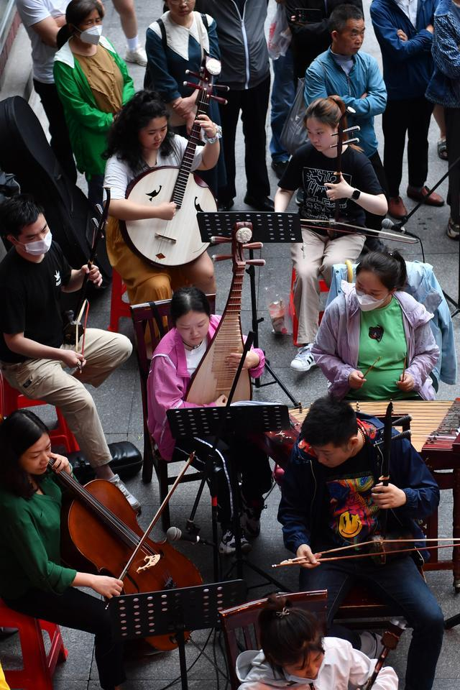
2.Integration with Contemporary Arts Elements of its music, dance, and storytelling techniques have been incorporated into modern theater, film, and television productions.
dance
storytelling
music

Slide 18
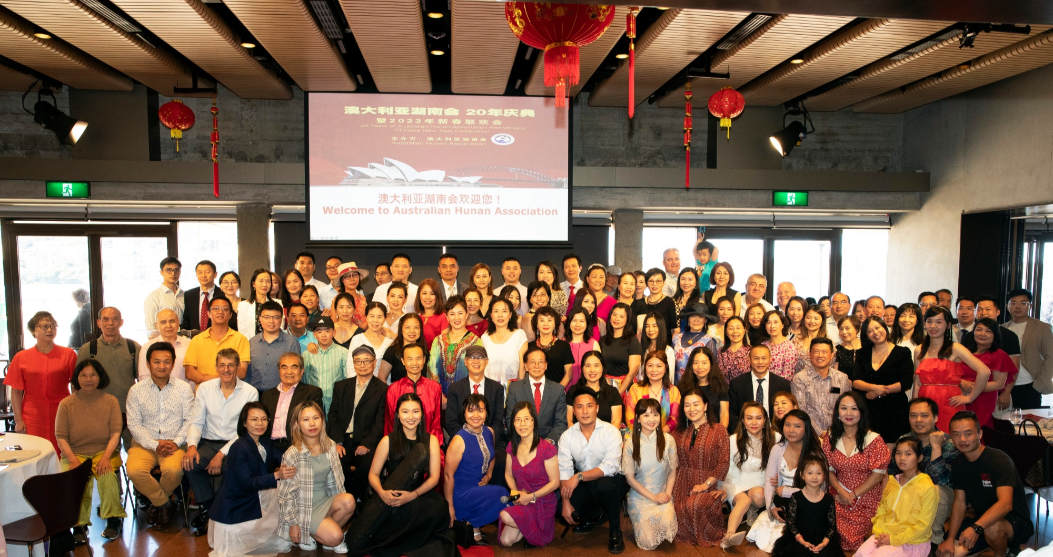
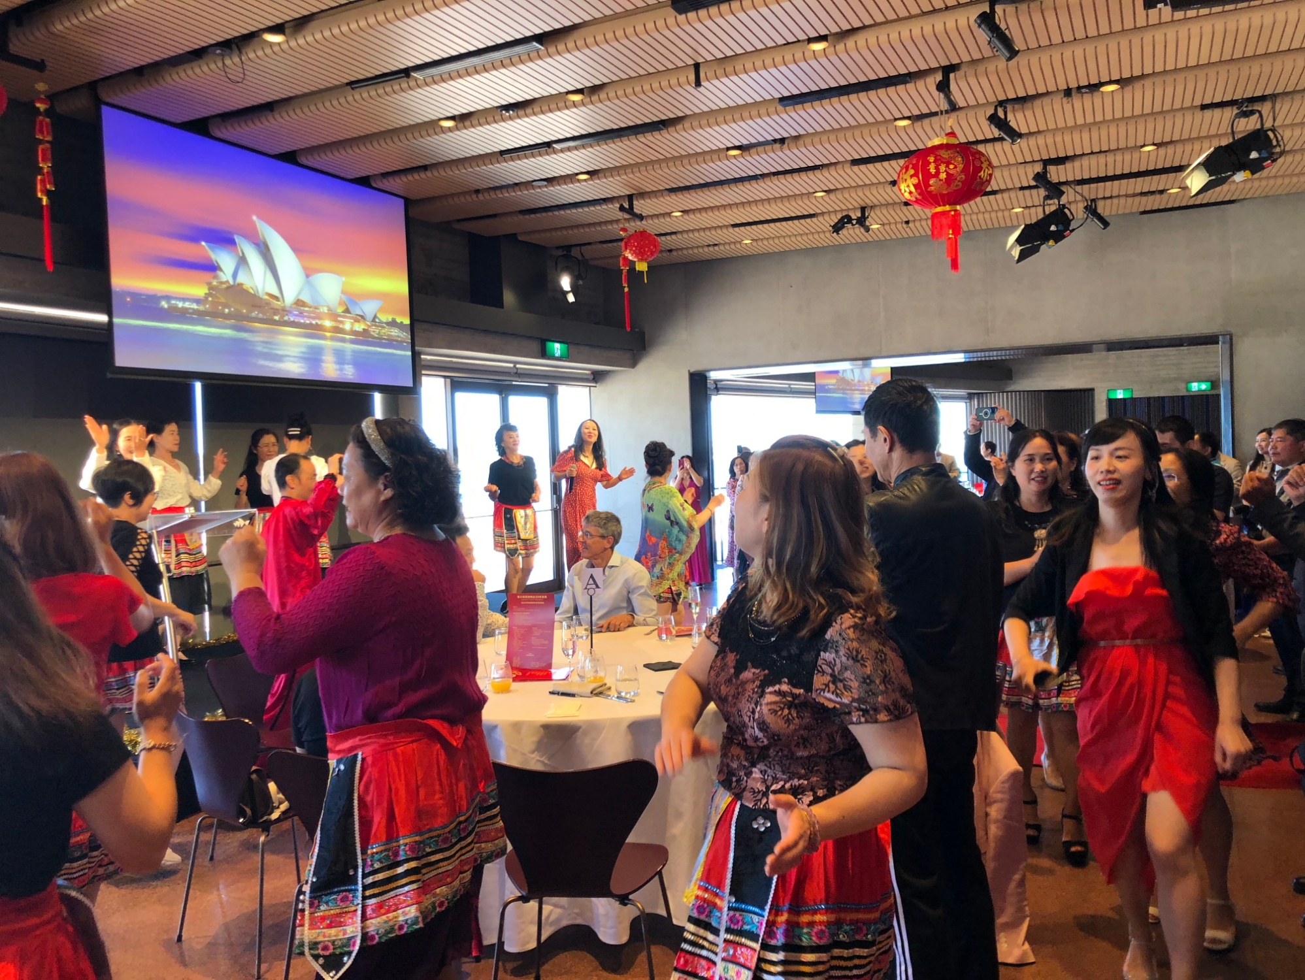
3.Global Recognition

Slide 19
05
Challenges and Future Prospects

Slide 20
1.Decline in Popularity
The fast-paced, technology-driven lifestyle of modern society contrasts sharply with the slow, deliberate pace of traditional opera. As a result, younger generations may find it difficult to relate to or appreciate the art form
戏
剧
日
世界

Slide 21
2.Adaptation to Modern Tastes
Flower-Drum Opera could involve incorporating modern themes, experimenting with new musical styles or using multimedia technology to enhance performances. Balancing tradition with innovation will be key to the future success of Flower Drum Opera.
戏
剧
日
世界

Slide 22
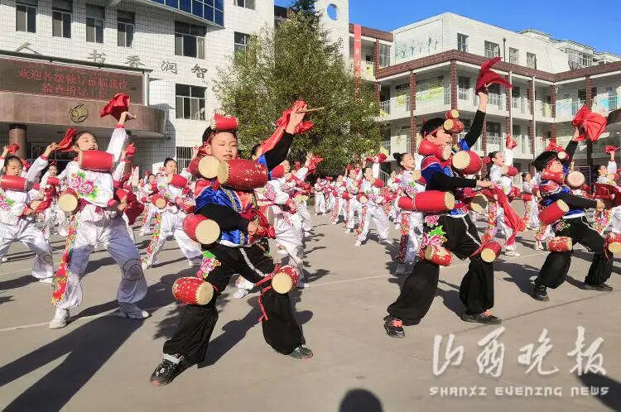
3.Role of Education
By fostering an appreciation for traditional arts from a young age, we can ensure that Flower-Drum Opera continues to thrive.

Slide 23
Conclusion
Flower-Drum Opera is a testament to the rich cultural heritage of China. While it faces challenges in the modern era, efforts to preserve and adapt Flower-Drum Opera offer hope for its continued relevance. By embracing both tradition and innovation, Flower-Drum Opera can continue to enchant audiences and preserve a vital piece of Chinese cultural history for future generations.

Slide 24
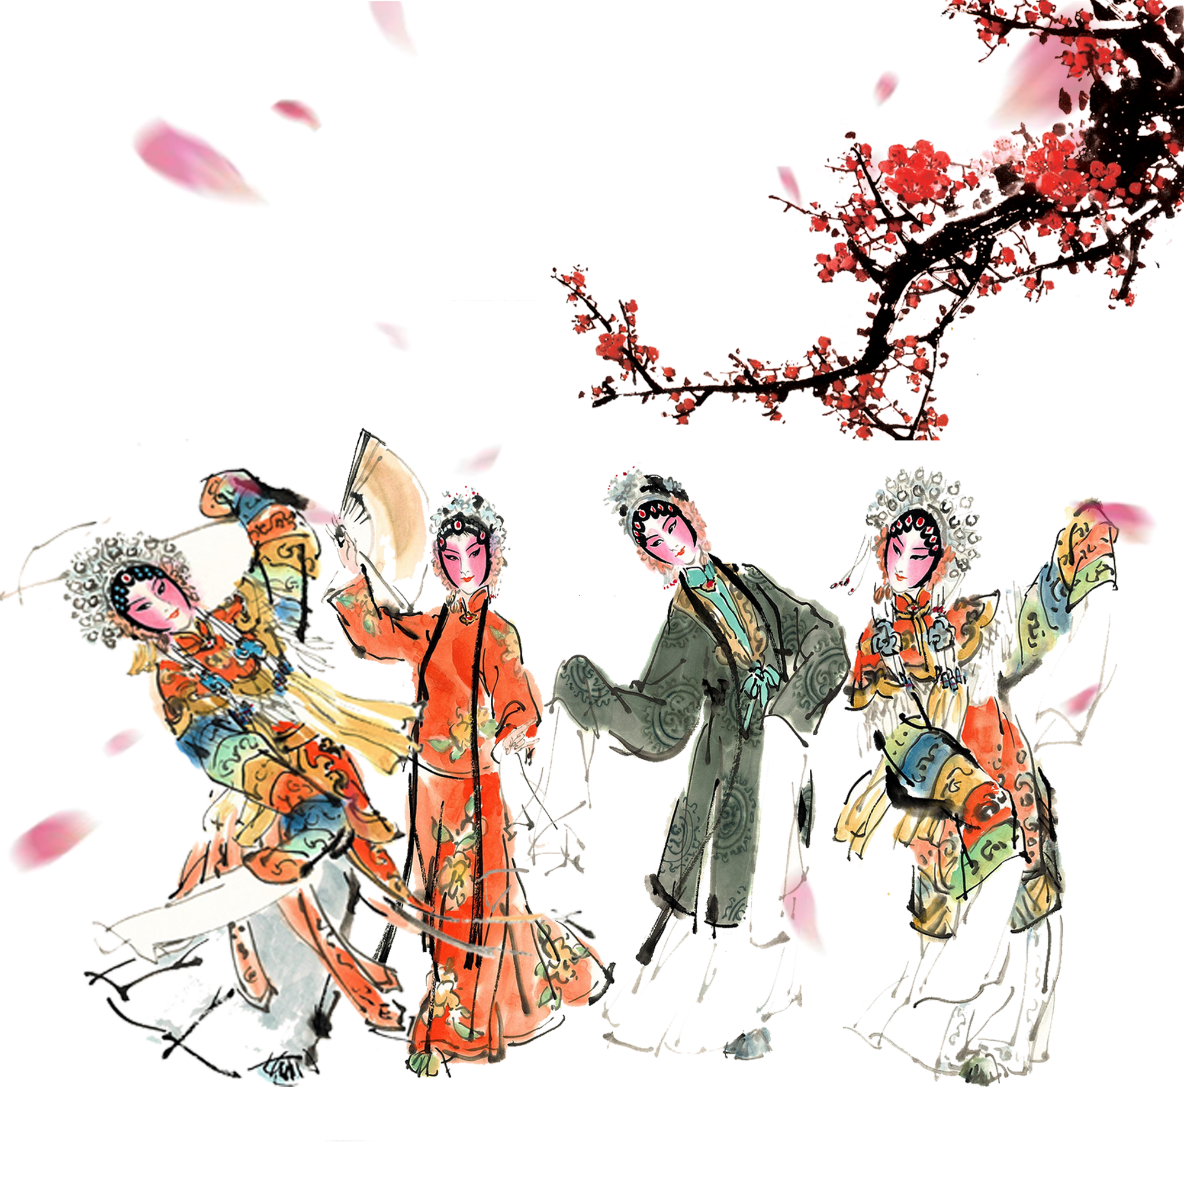
Questions
1.What is the historical origin of Flower-Drum Opera?
2.How does Flower-Drum Opera reflect rural Chinese life?
3.What efforts are being made to revive Flower-Drum Opera today?
4.What are the key artistic elements of Flower-Drum Opera?

