Slide 1

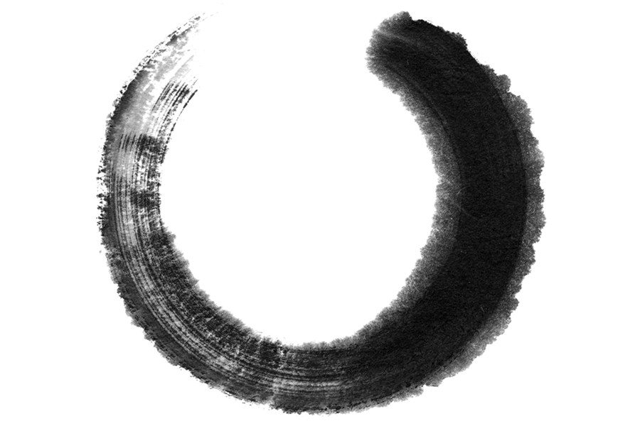




FOUR
Conclusion
江永
女书

Slide 2
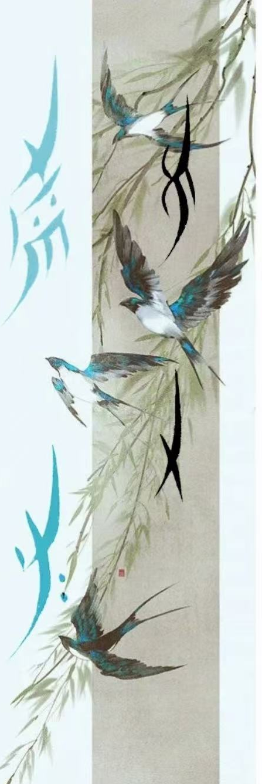
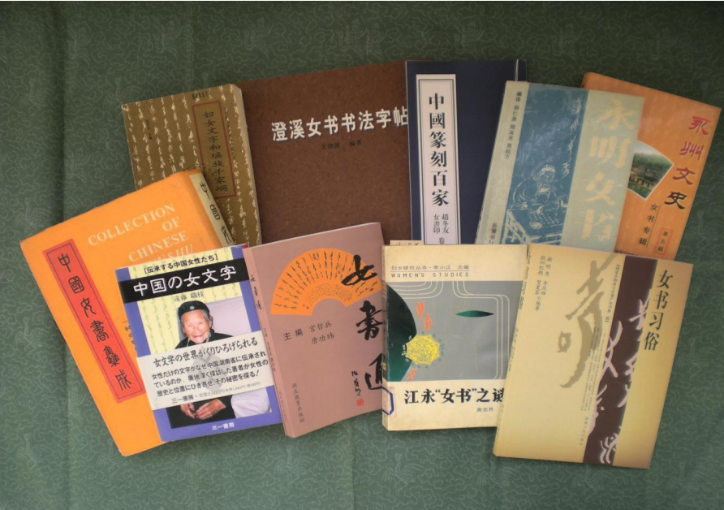
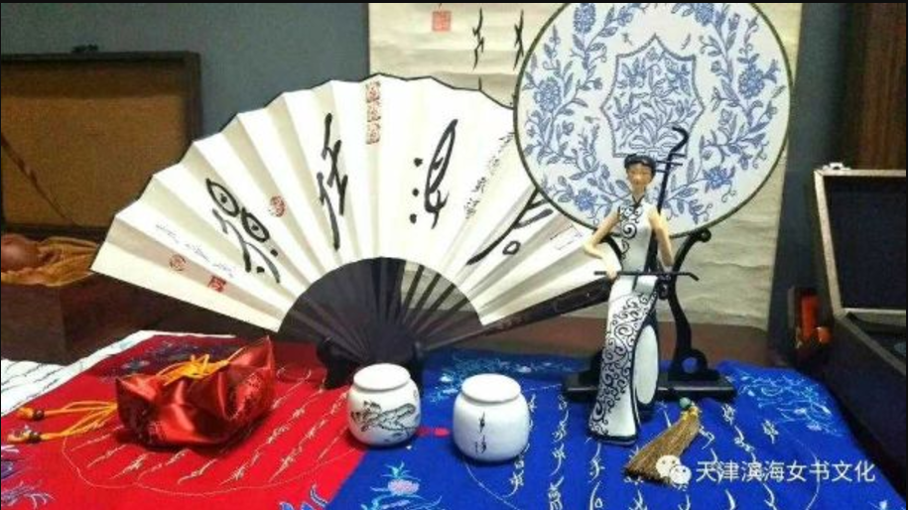
Research significance
The Women’s Script is a unique cultural fossil, which is of great value to the study of the origin of human writing and civilization, the origin of women’s culture and nationality, and the development of civilization in various fields, such as anthropology, ethnology, sociology, linguistics, philology, folklore, archaeology, and so on.

Slide 3
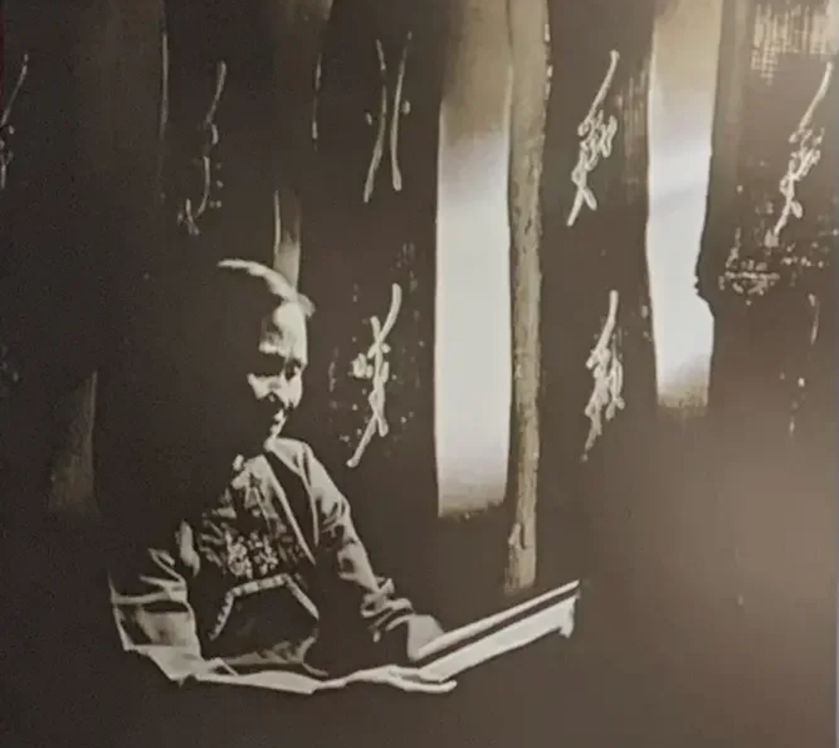
Research significance
“Voice represents identity and authority for women who have been marginalized into silence. Therefore, the act of voicing is not merely a quest for subjectivity but also an assertion of one's identity, political stance, and claim to power.”
Nüshu represents the shift of women from a state of “silence” to one of “soliloquy”, which holds great significance in both the history of Chinese women and the broader history of women worldwide.

Slide 4
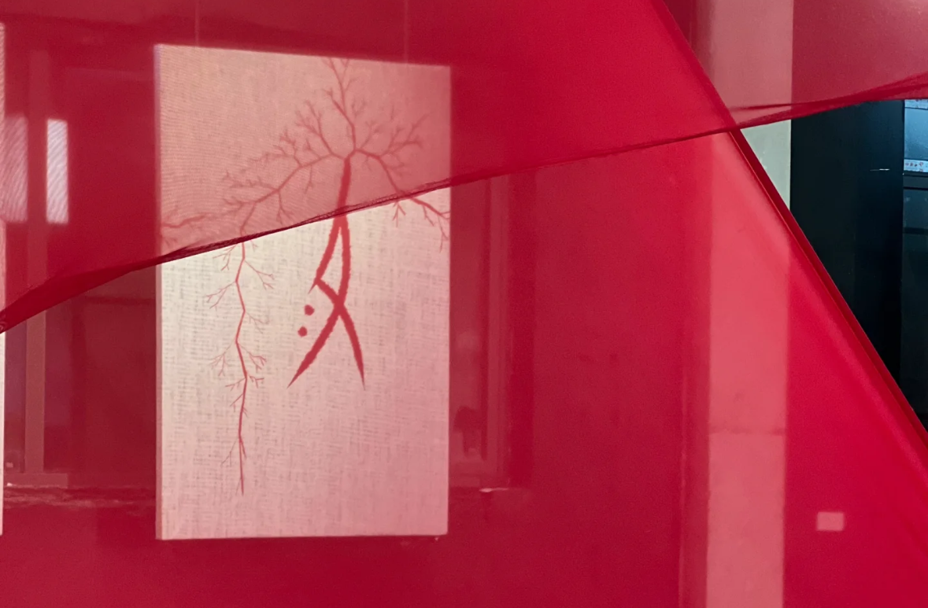

Research significance
In today’s society, women also face numerous challenges, such as gender inequality, workplace discrimination, the struggle to balance family and career, gender-based violence, unequal educational opportunities, and issues related to health and reproductive rights.

Slide 5
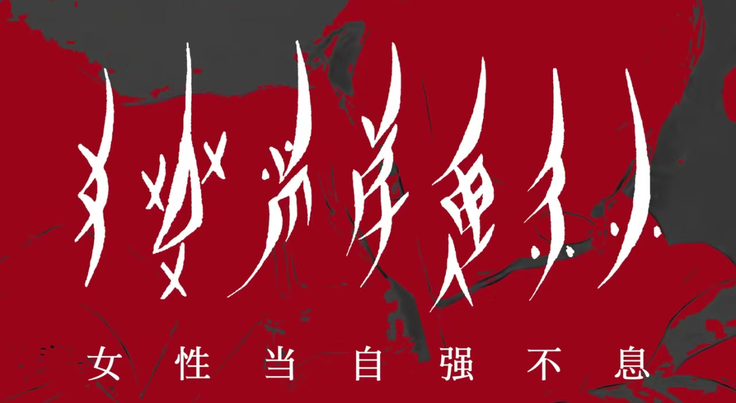
CONLUSION

Slide 6
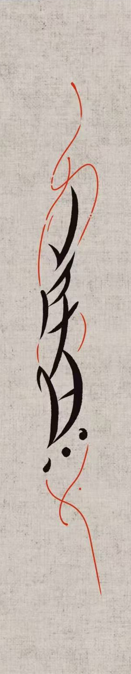
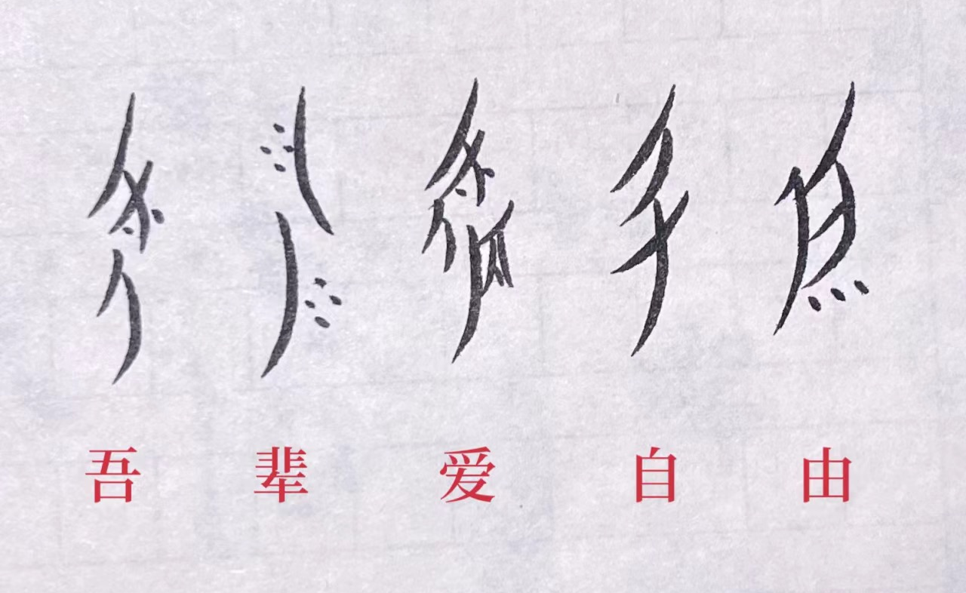
QUESTIONS
1. When was women’s Script included in the first batch of China’s National Intangible Cultural Heritage List?
2. What is your opinion about Women’s Script?

Slide 7
THANKS
江永
女书

