Slide 1
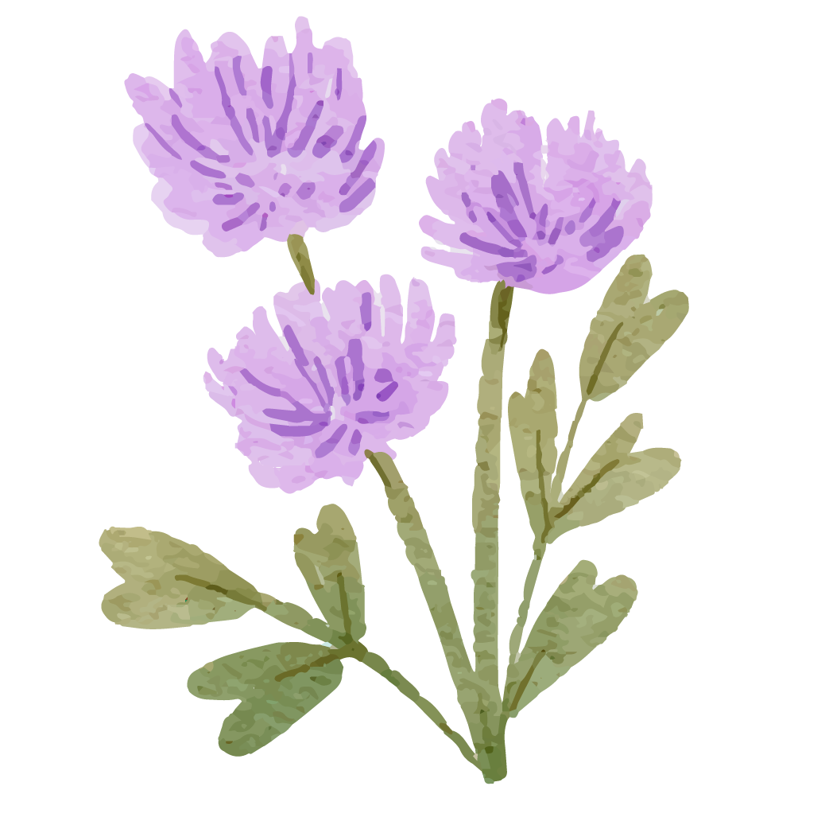
Aesthetic ideals and social customs: The Culture of Flowers
Yang Xiran 2025.11.13

Slide 2
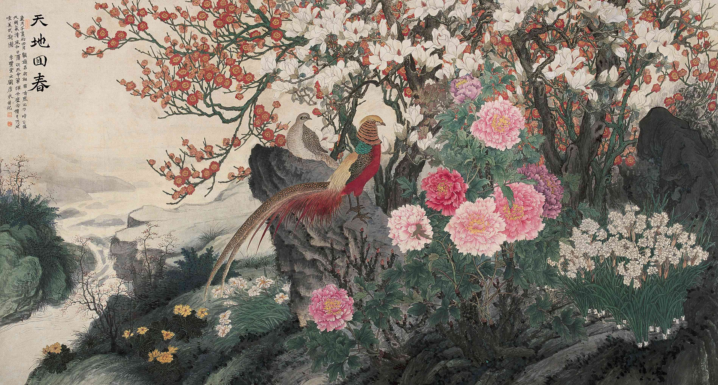
PART 1
The Development of the Culture of Flowers
PART 2
Value of Flower Culture
PART 3
Characteristics of Chinese Flower Culture

Slide 3
01
The Development of the Culture of Flowers

Slide 4
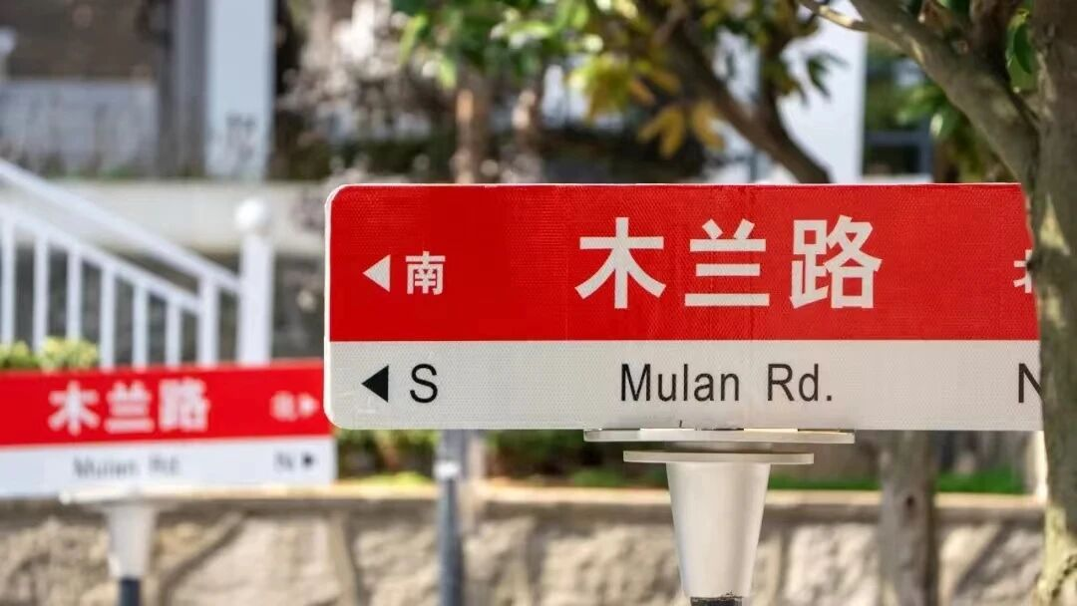
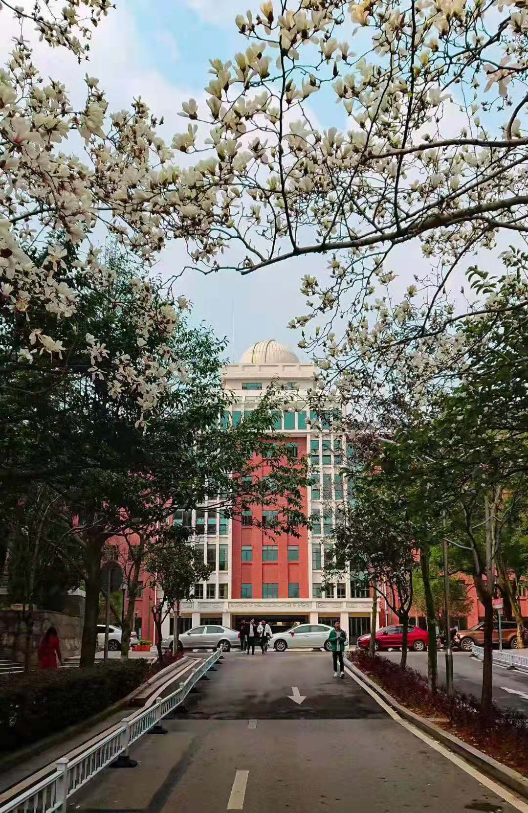
Do you know the name of the road beside our teaching building?

Slide 5
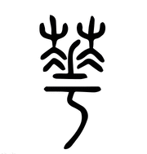
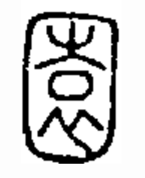
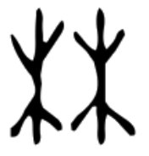
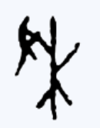
The Development of Flower Culture
Before the advent of writing, flowers were used by people with the development of agriculture.
Notes:
nature worship
practical value
such as for food and medicine
moral symbolism
where the characteristics of flowers were compared with human qualities

Slide 6
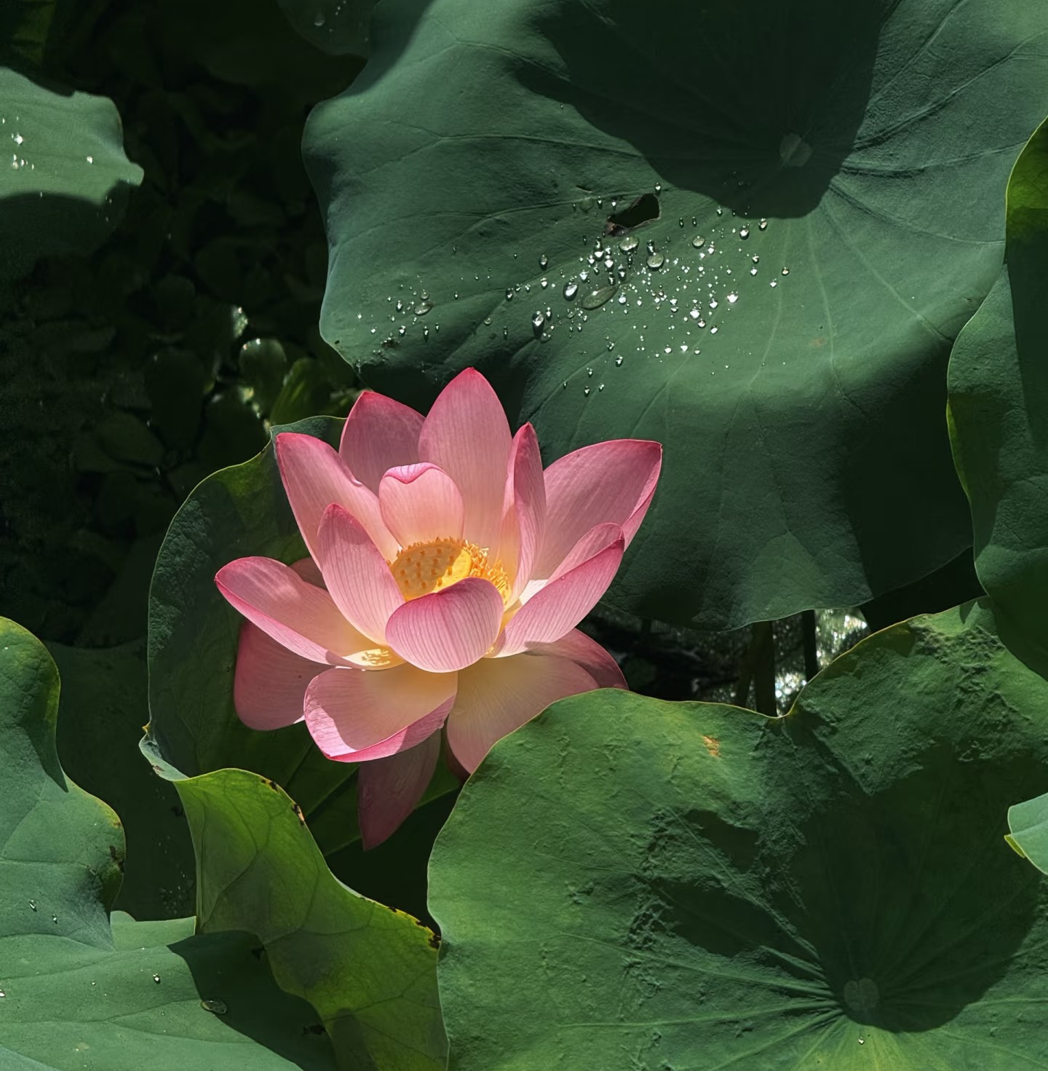
The Development of Flower Culture
At the Hemudu Cultural Site, the carbonized remains of rice, flowers and many other plants are discovered, indicating that 7,000 years ago our ancestors not only cultivated food, but also began to appreciate flowers.
Lotus pollen fossils were discovered in the “Hemudu Culture” site.
Notes:
nature worship
practical value
such as for food and medicine
moral symbolism
where the characteristics of flowers were compared with human qualities

Slide 7
02
Value of Flower Culture

Slide 8
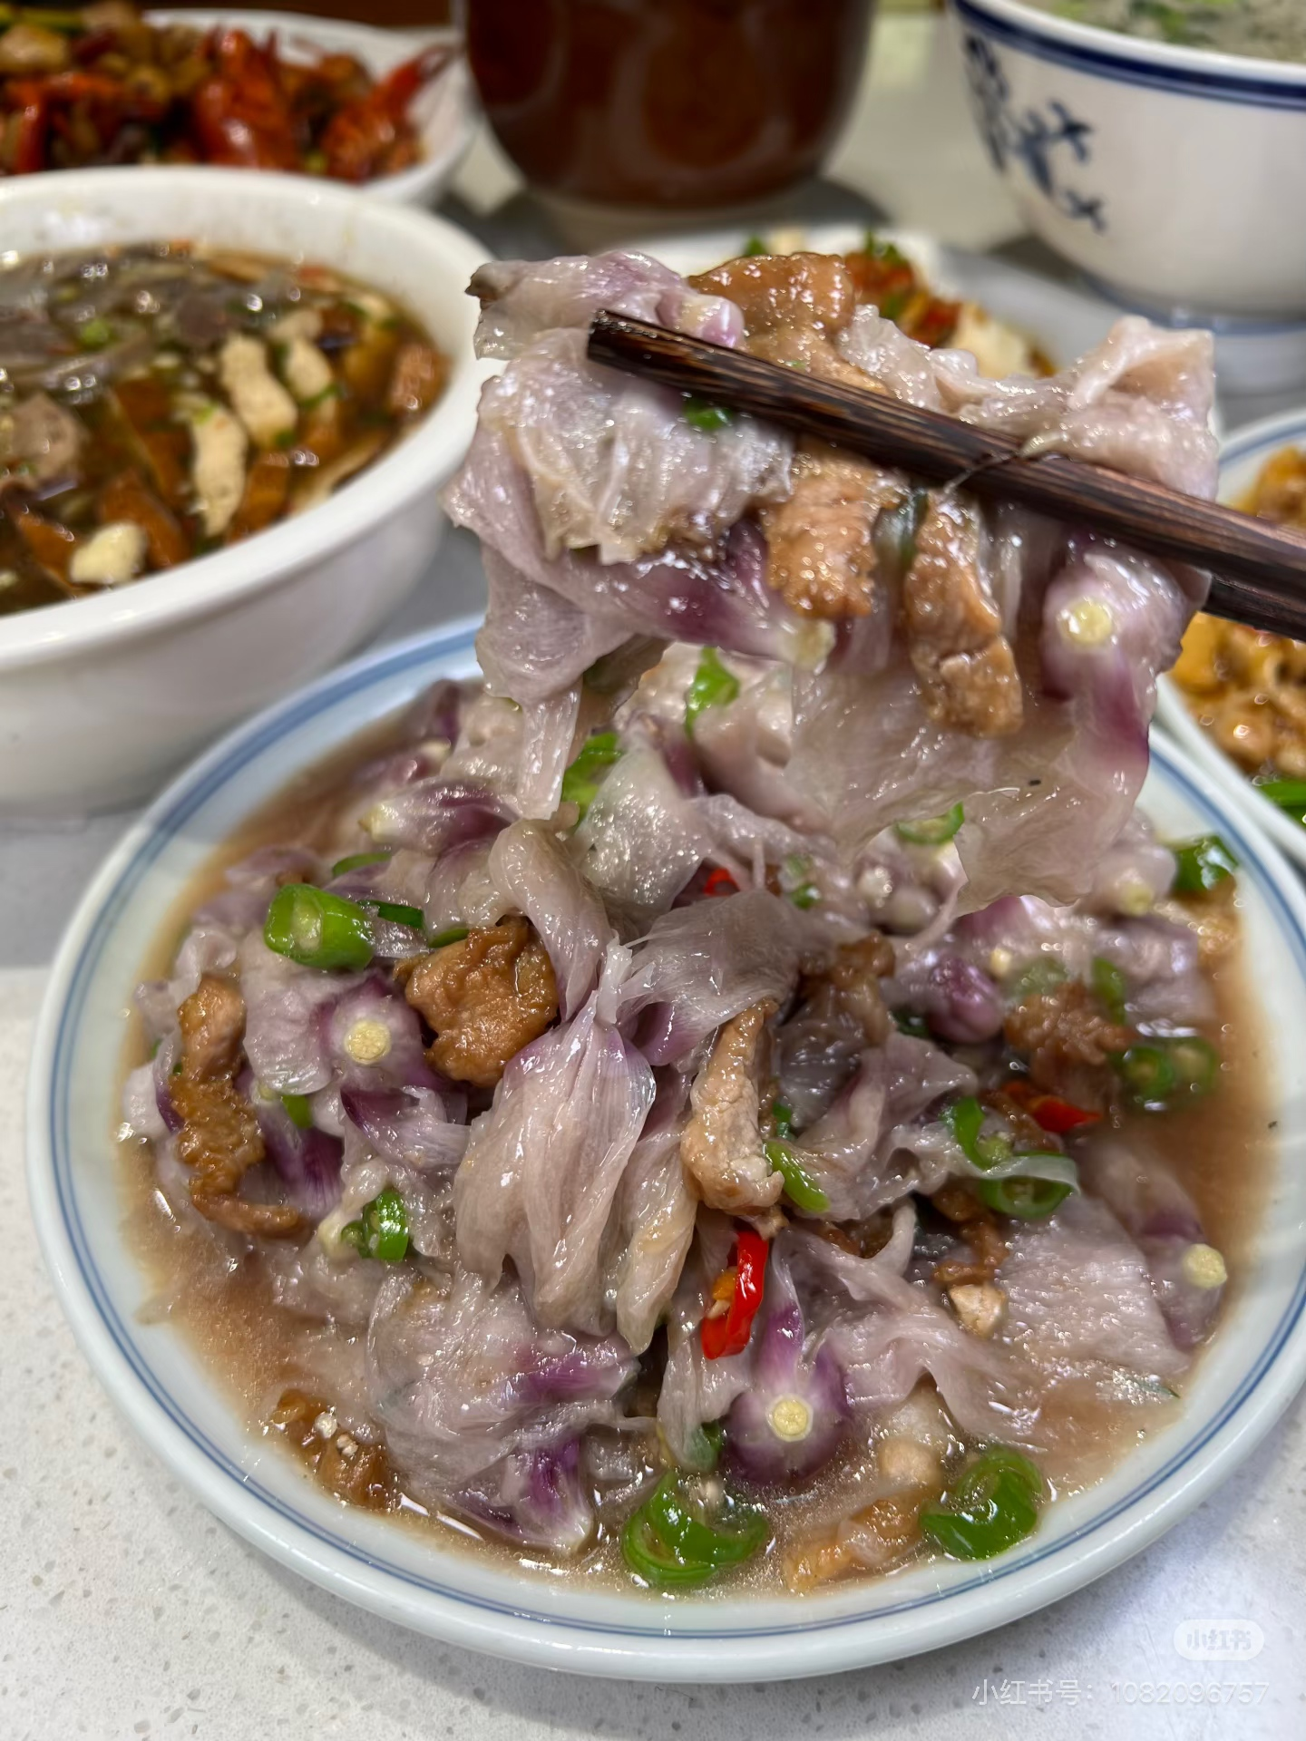
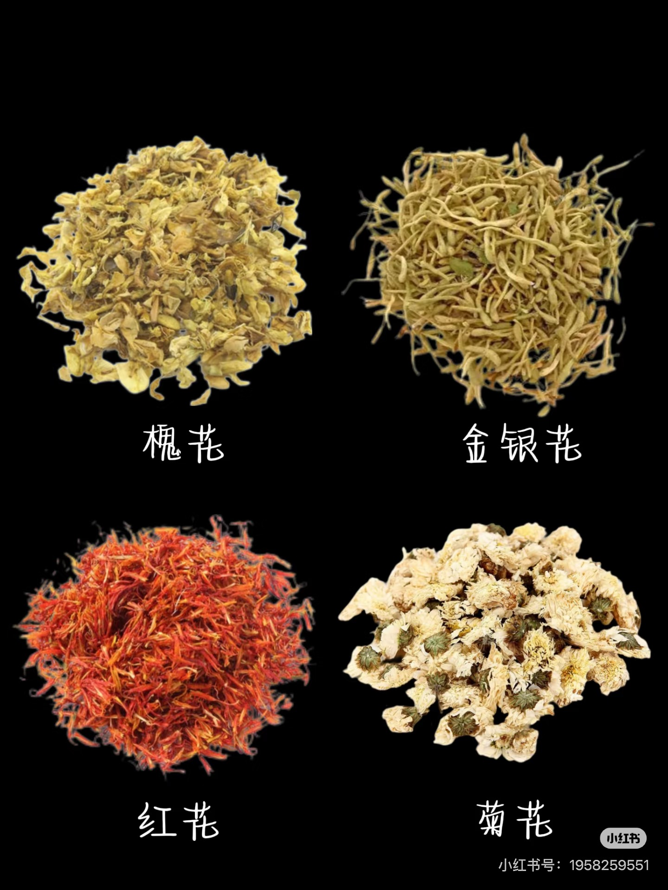
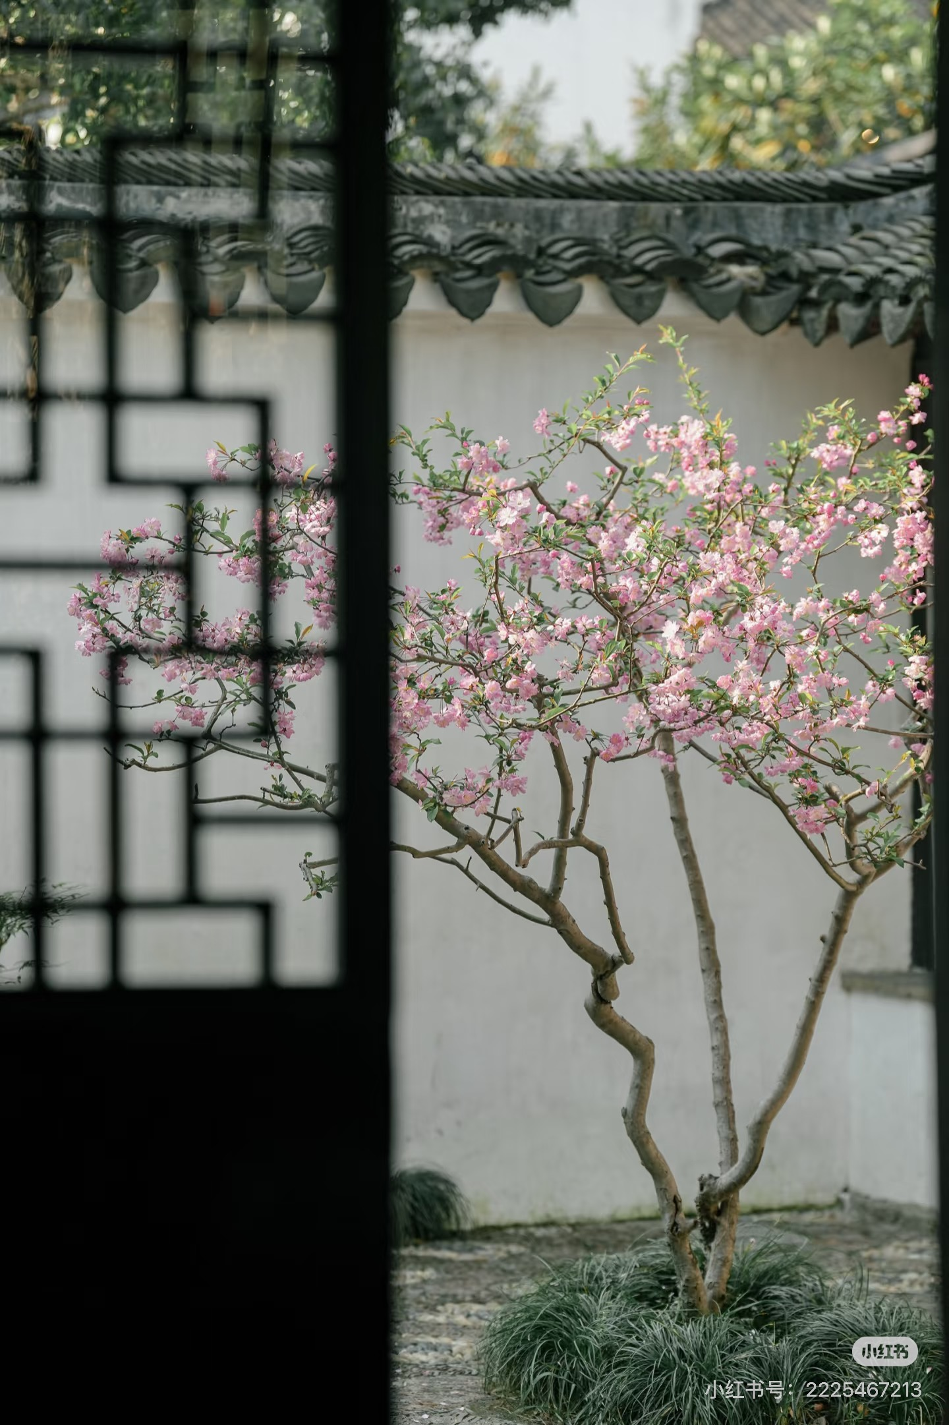
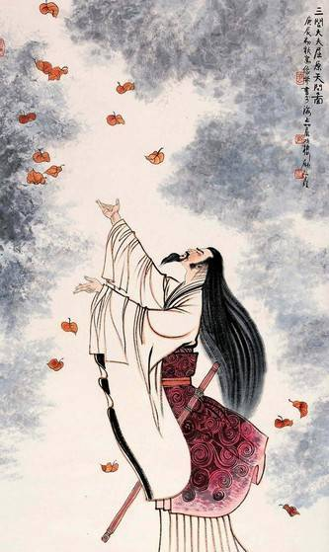
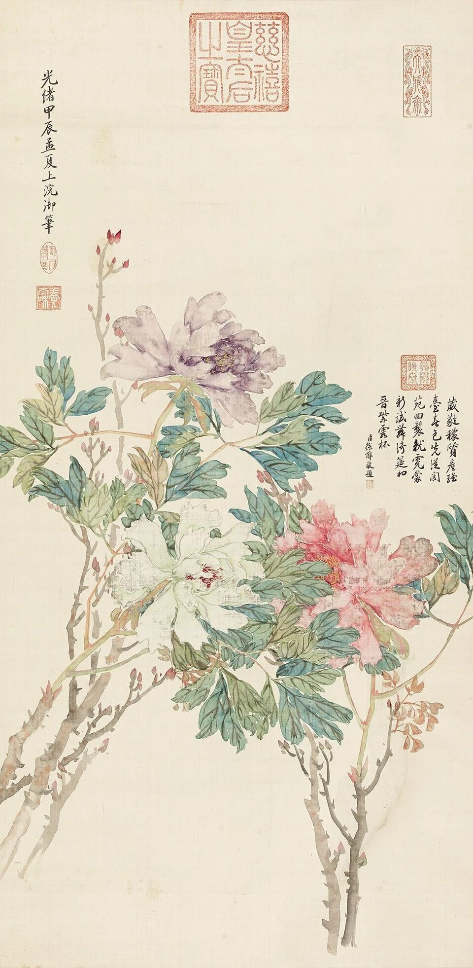
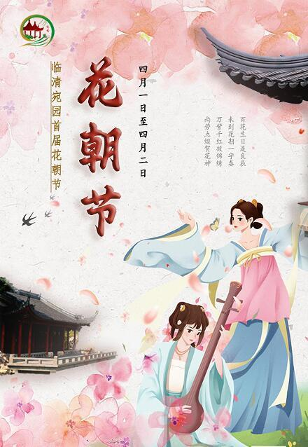
Flower Culture
Literature, painting, handicrafts, flower arrangement, floral-based food, aromatherapy……
Material culture
Spiritual culture

Slide 9
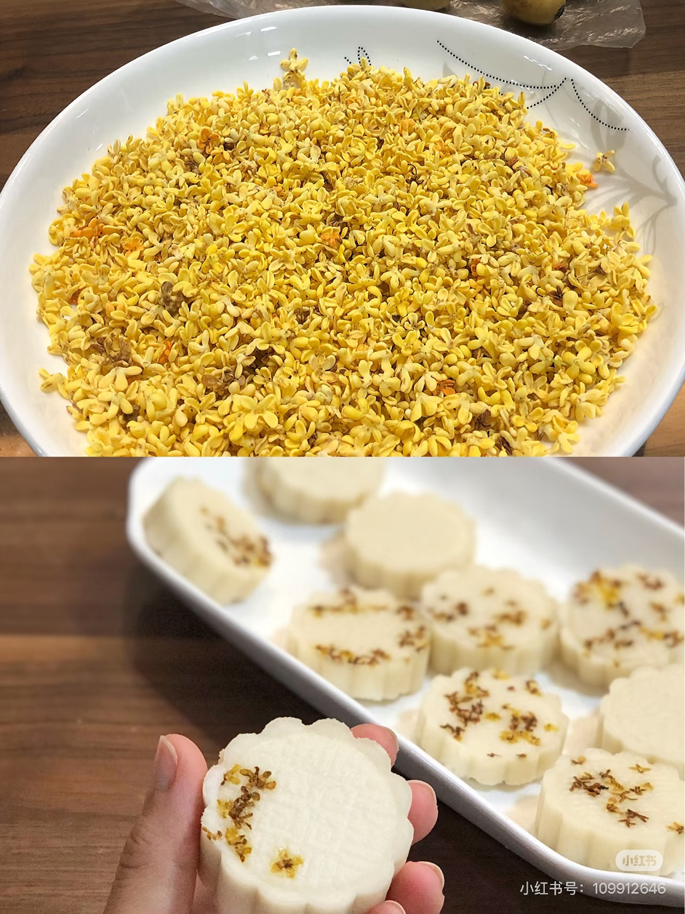
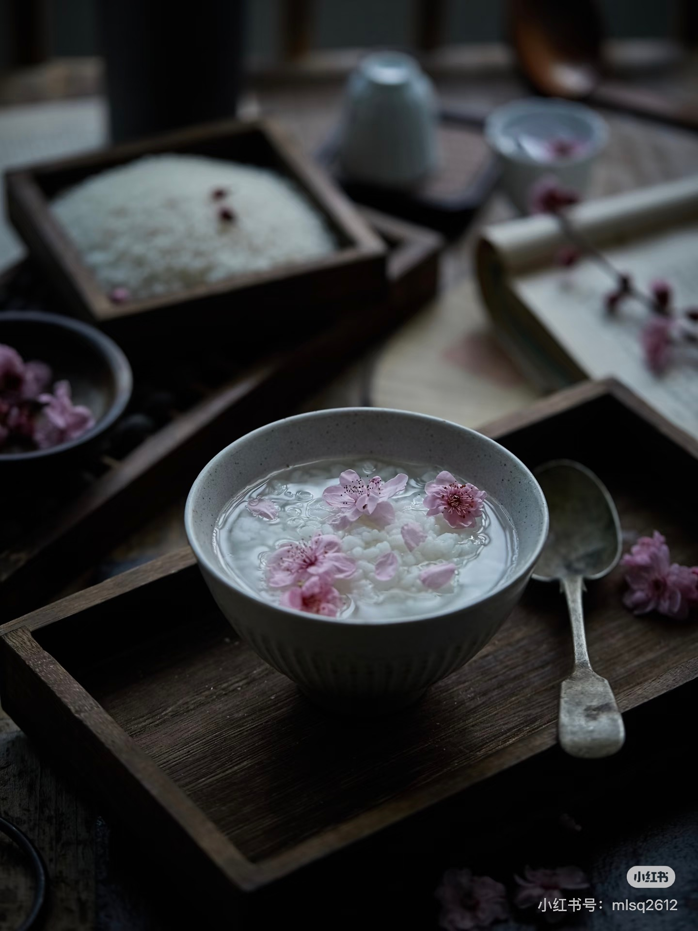
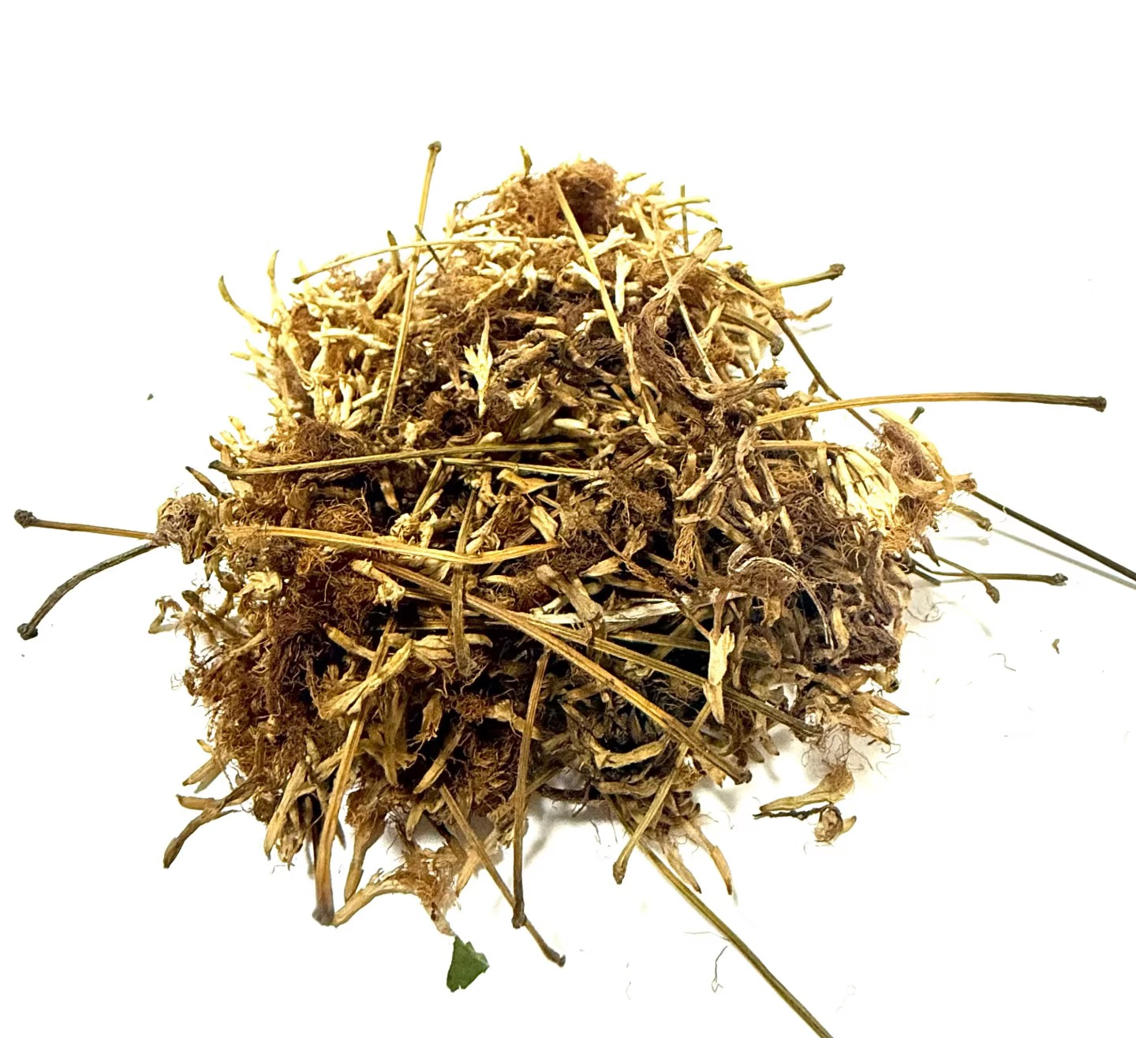
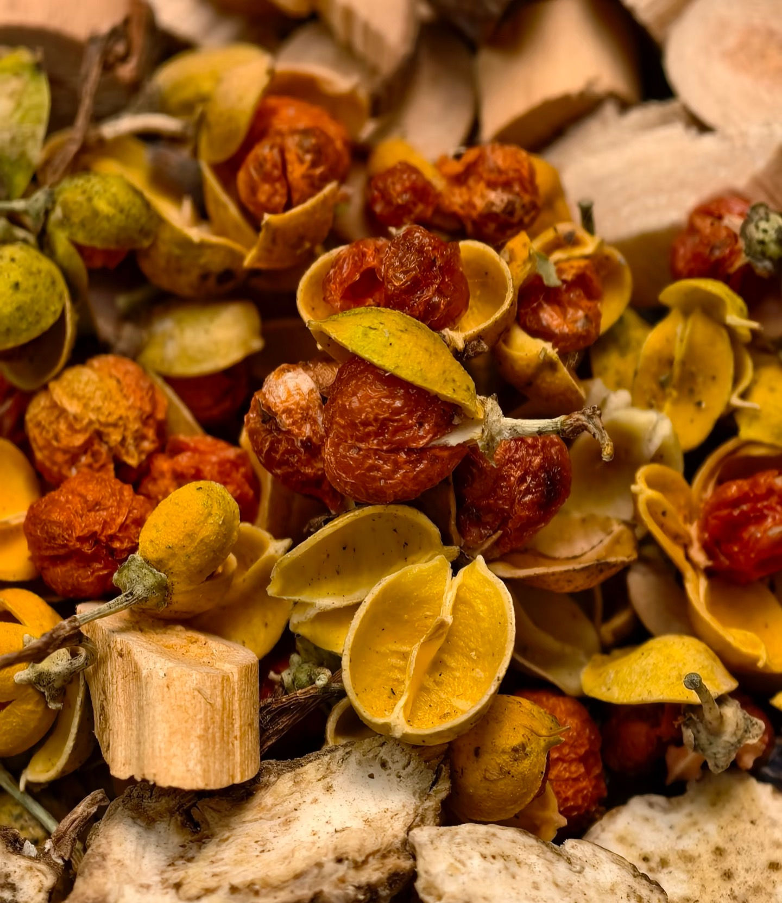
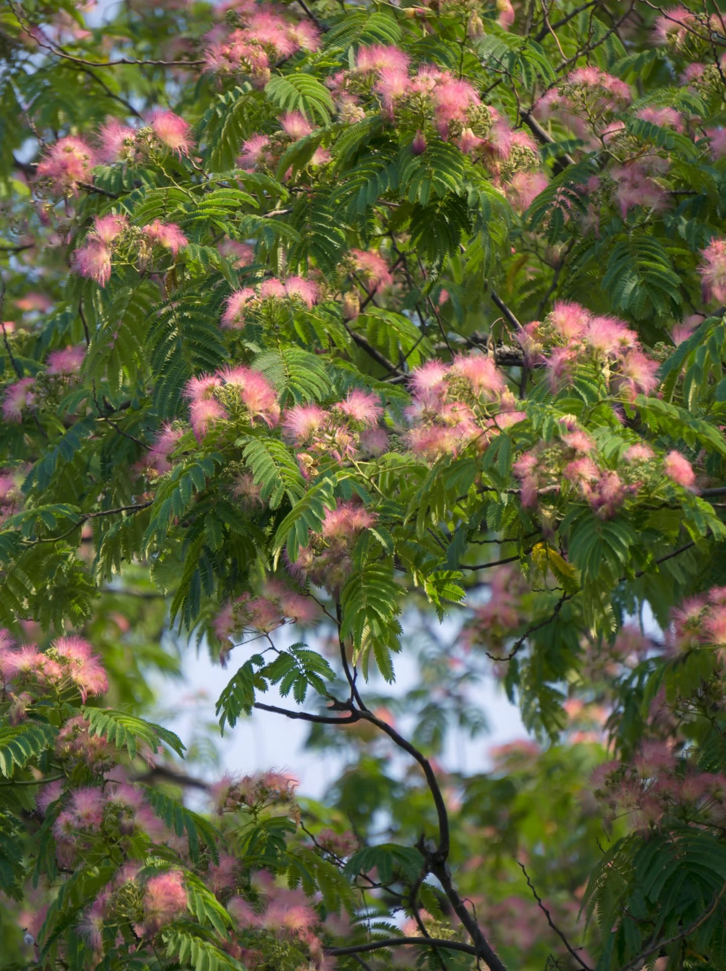
Material culture
Food: The use of flowers in cooking is the most vibrant and creative aspect of floral material culture.
Medicine: Using flowers as medicine to prevent and cure diseases;
香花疗法 (horticulture therapy ).
Notes:
Chinese floarr

Slide 10
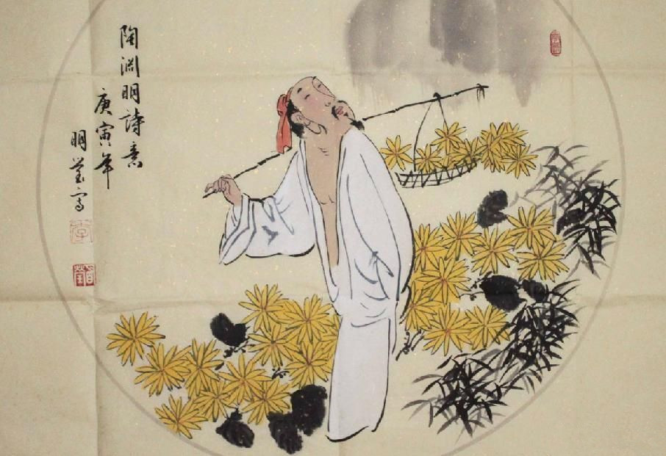
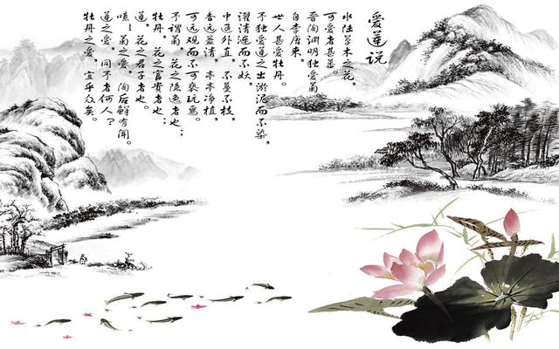
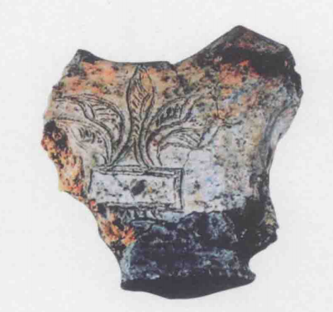
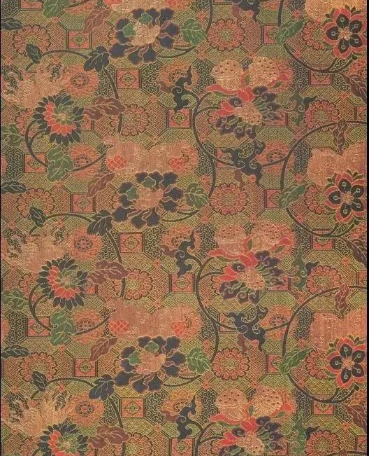
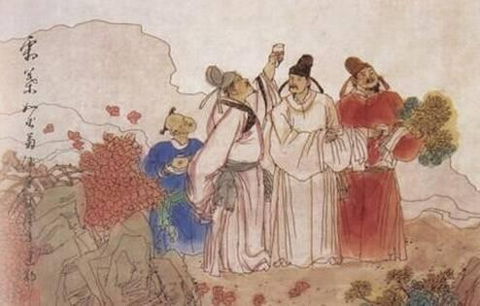
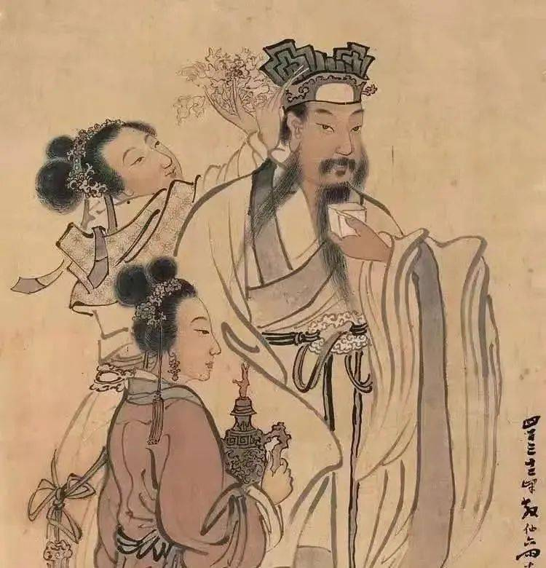
Spiritual culture
Literature: The use of metaphors and expressions of emotion in poetry and prose.
Art: Floral patterns in painting, ceramics, and brocade.
Customs: Seasonal flowers and local customs.
Five-leaf patterned pottery fragments unearthed from the Hemudu Neolithic
Notes:
In ancient times, people would put dogwood on their bodies during the Double Ninth Festival.

Slide 11
03
Characteristics of Chinese Flower Culture

Slide 12
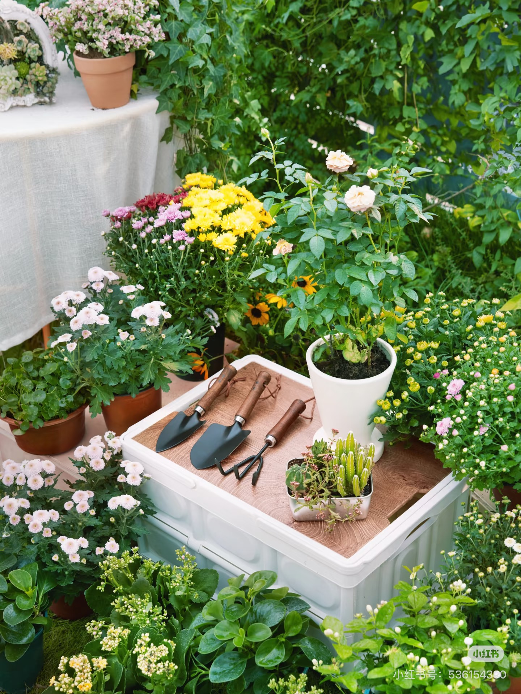
Leisure-oriented culture
The Chinese term for flower cultivation, “playing with flowers” (玩花), reveals that horticulture is fundamentally a recreational activity that enriches people’s life.

Slide 13
Versatility
Emblems of happiness, auspiciousness, and longevity
Folk customs:
daily necessities, marital rituals, seasonal festivals, and recreational activities
the combination of flowers with traditional art categories

Slide 14
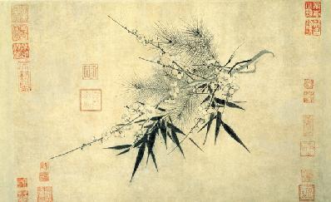
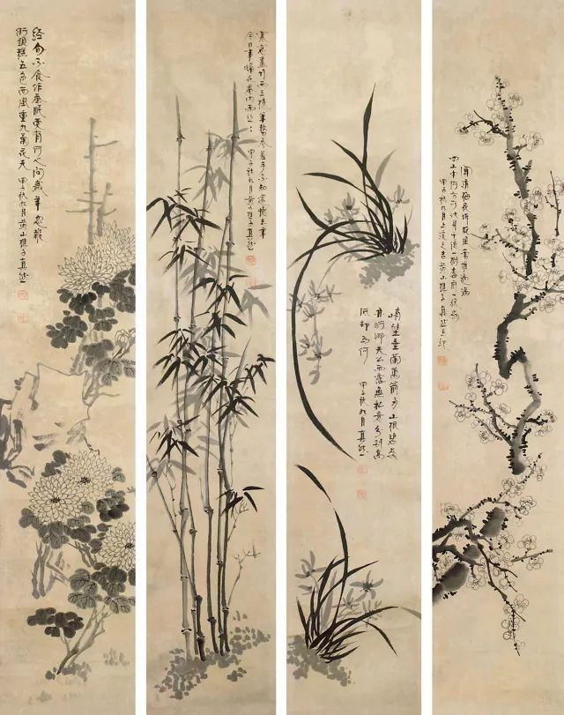
Pan-humanism (泛人文主义)
Influenced by the local Taoist thoughts, the ancient Chinese people, deep in their subconscious mind, seriously treated flowers and trees as human beings and believed that flowers and trees were as intelligent and capable as humans.
Three Friends of Winter (pine, bamboo, plum)
Four Gentlemen of Flowers
(plum, orchid, bamboo, chrysanthemum)

Slide 15
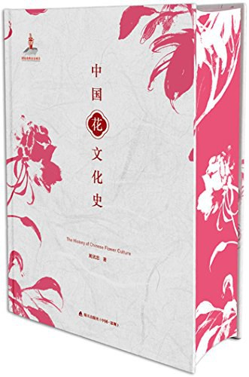
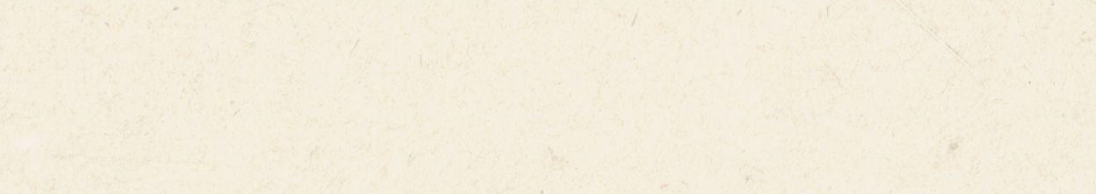
Thanks!
Source: Zhou Wuzhong, A History of Chinese Flower Culture

