Slide 1





Changsha Stinky Tofu
主讲人：
LSC
时间：
2025.5

Slide 2
01
Introduction
02
History & Culture
CONTENTS
03
How It’s Made
04
Why Try It?
05
Translation & Cross-Cultural Perspective

Slide 3






PART
01
Introduction

Slide 4
introduction
Opening Question
Quick Definition
Have you ever tried food that smells off-putting but tastes surprisingly delicious?
Stinky tofu is one such street snack in China—polarizing yet wildly popular.
Stinky tofu is a fermented soybean product, famed for its "pungent aroma but rich flavor." It’s a unique gem in Chinese culinary culture.

Slide 5
PART
02
History & Culture

Slide 6
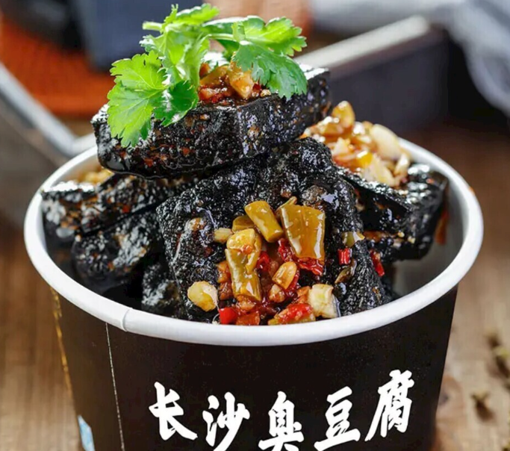
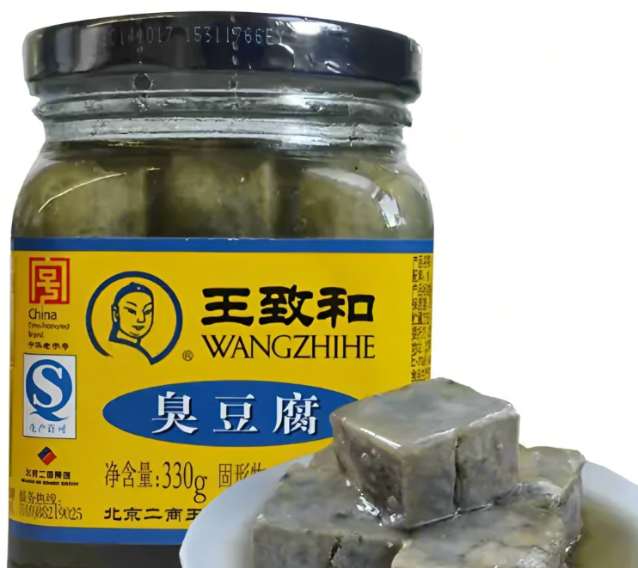
起源传说
Changsha’s Twist
Changsha refined traditional methods, like Fire Palace’s unique recipe, turning it into a signature street snack
01
02
Legend has it that during the Qing Dynasty, scholar Wang Zhihe accidentally invented stinky tofu. This happy accident began its legendary status.
Origin Story

Slide 7
Cultural Significance
Fermentation Heritage
Symbol of Changsha Life
01
02
A flagship of China’s fermented food culture, akin to Western cheese or Korean kimchi.
As the "soul" of local street food, it embodies Changsha’s vibrant grassroots lifestyle.

Slide 8
PART
03
How It’s Made

Slide 9
Key Steps
01
02
03
Fermentation
Frying
Toppings
Tofu soaks in brine (with bamboo shoots, mushrooms) for days—the secret to its funky flavor.
Fermented tofu is deep-fried for a crispy shell and tender interior.
Drizzled with chili sauce, garlic, cilantro for layered flavors.

Slide 10
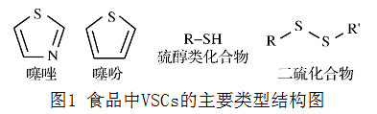
Science Behind It
Volatile sulfur compounds
VSCs in food
http://sf1970.cnif.cn/fileup/0253-990X/HTML/2019-4-229.shtml
Volatile sulfur compounds (VSCs) from fermentation create the "stink" but also unlock savory amino acids.
production process：
https://www.bilibili.com/video/BV1ct411H7uM/?share_source=copy_web&vd_source=d6eed7809713aeeb95aa1b0fc07c9876

Slide 11
PART
04
Why Try It?

Slide 12
Flavor Profile
Texture
Acquired Taste
Crispy outside, creamy inside with spicy umami kick
Like blue cheese or durian—daunting at first, but addictive once tried.

Slide 13
Must-Visit Spots
Iconic Stalls
Celebrity Endorsement
Fire Palace and Pozi Street’s vendors are tourist magnets.
Hunan TV host Wang Han’s rave reviews boosted its fame.

Slide 14
PART
05
Translation &
Cross-Cultural Perspective

Slide 15
Strategy 1
Adapted Terms
Literal Translation
"Stinky Tofu" carries negative connotations in English, often mistaken for spoiled food.
Use "Fermented Tofu" or "Pungent Tofu" to highlight craftsmanship and neutrality.

Slide 16
Strategy 2
Creative Names
Changsha Aroma Tofu
Crispy Fermented Tofu(Spicy Style)
These preserve cultural identity while minimizing stigma.

Slide 17

THANKS
主讲人：
LSC
时间：
2025.5

