Slide 1
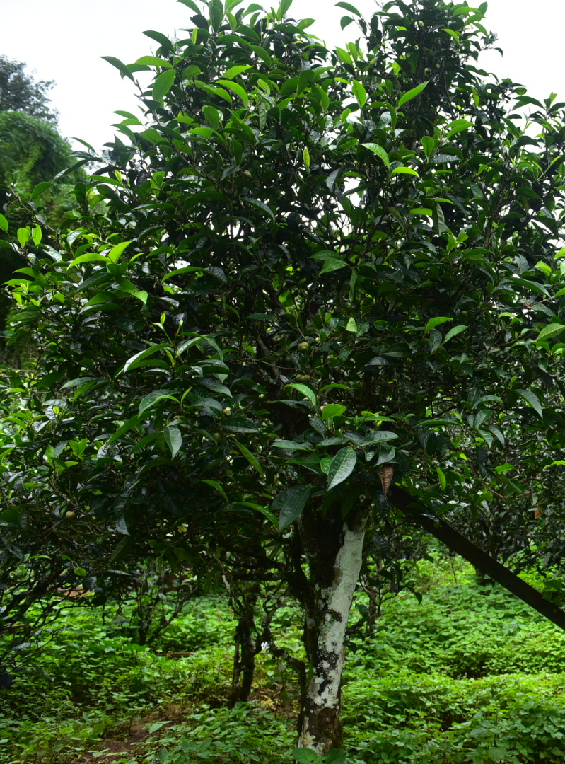

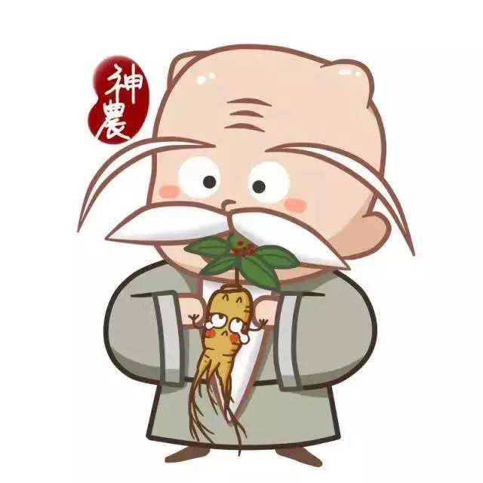
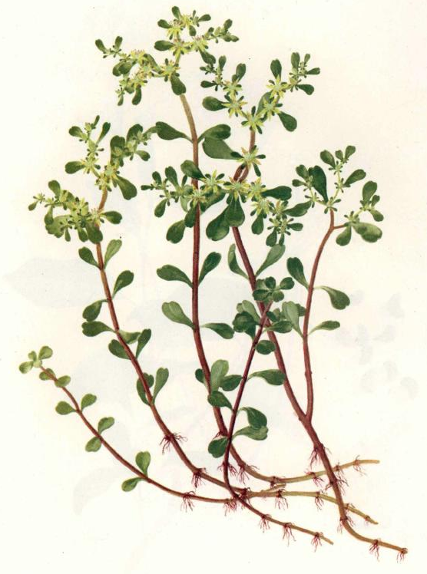

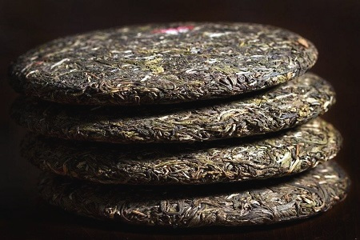
History of Chinese Tea
3000 ago(西、东周)
2000 ago（西汉）
Tea trees began to be cultivated, and tea served as food.
Tea began to be commercial.
5000 ago
2300 ago（秦）
1500 ago（东汉）
Shennong tasted hundreds of grasses. The tea was a medicine.
Tea transitioned from medicine and food to drink.
Tea leaves were pressed into lumps so as to store and transport.

Slide 2

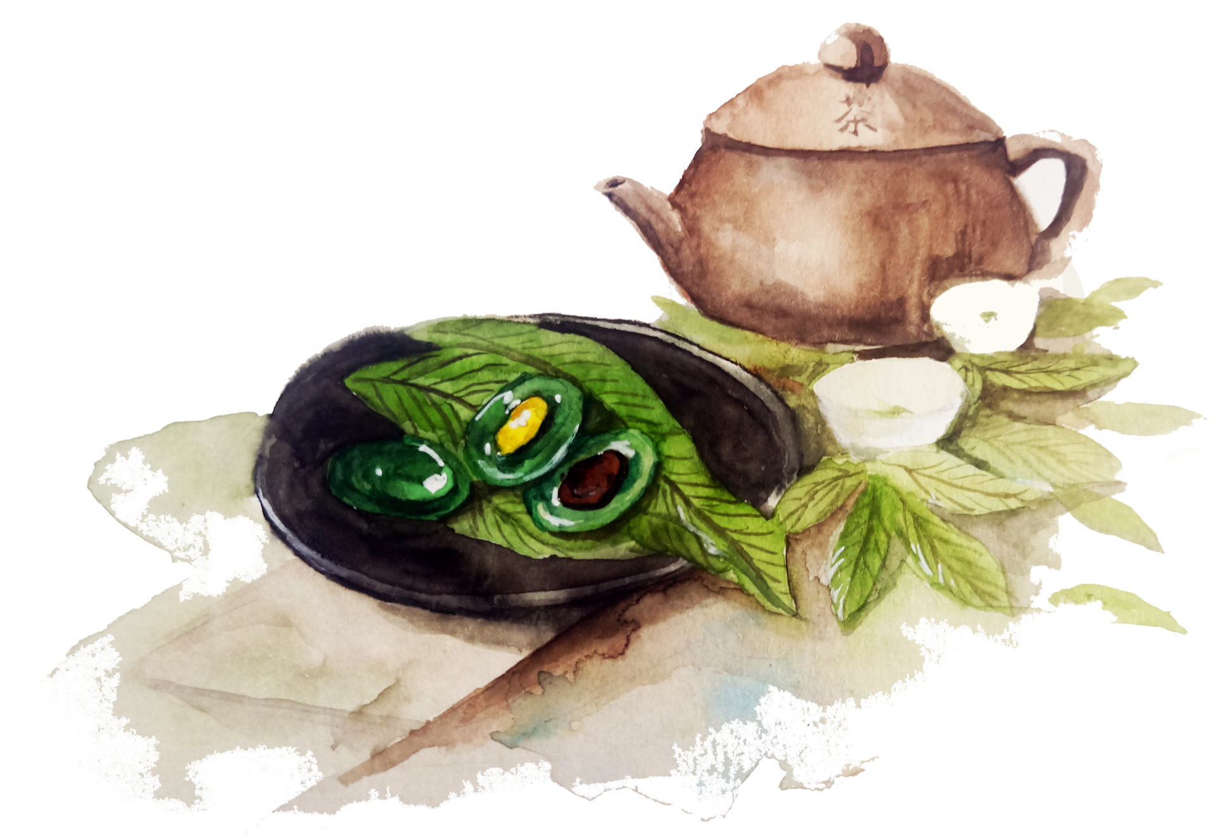
唐
Influenced by the flourishing economy and culture, tea has changed from a material demand to spiritual demand for people.
宋
Tea became more important in social, economic and cultural life with the producing areas of tea expanding.
清
With the continuous improvement of tea, Chinese tea was popular all over the world.

Slide 3

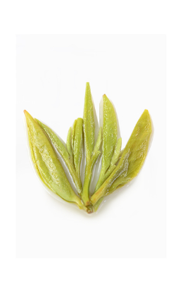
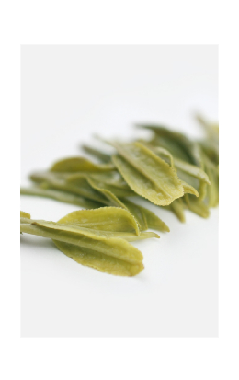
3. Types of Tea

Slide 4
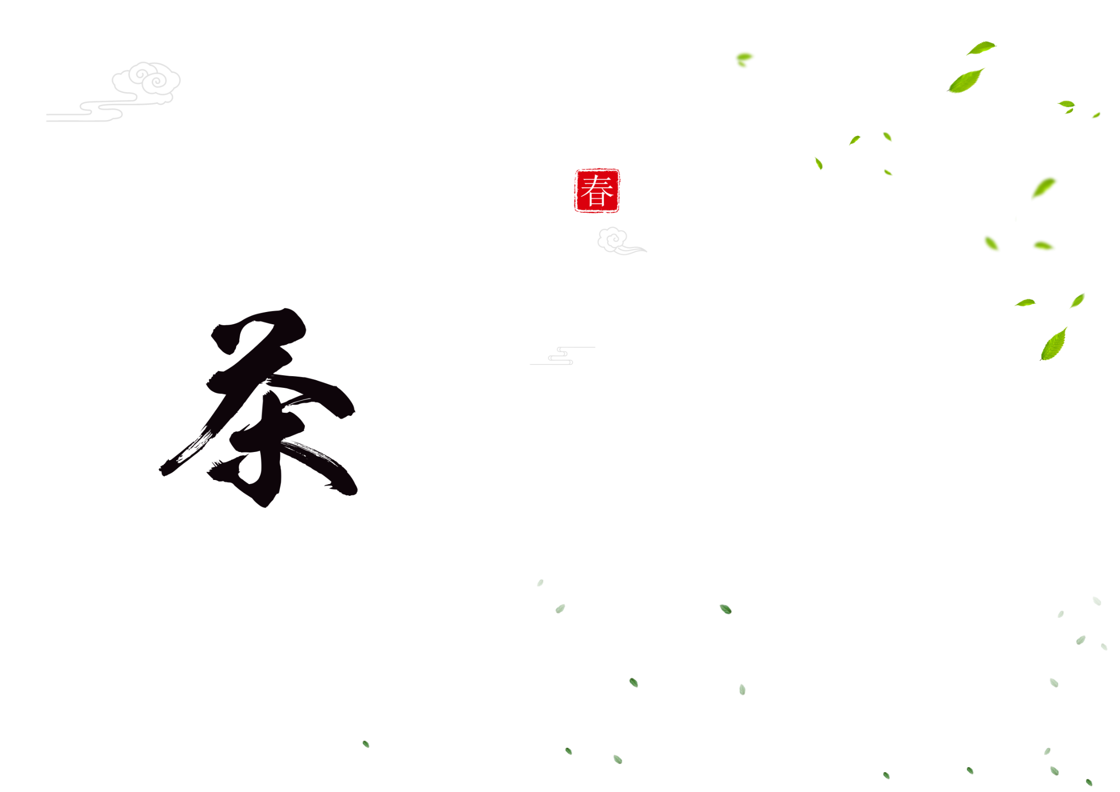
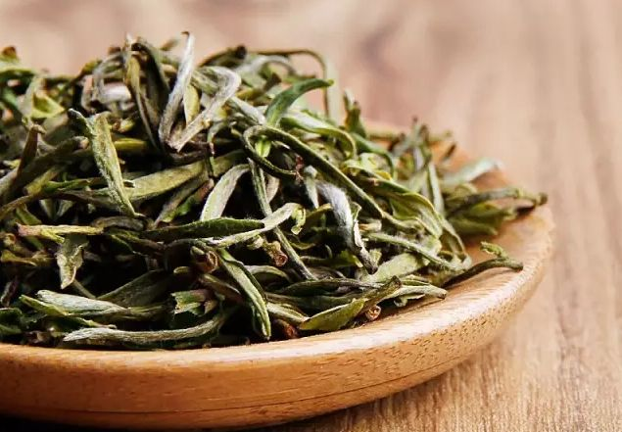
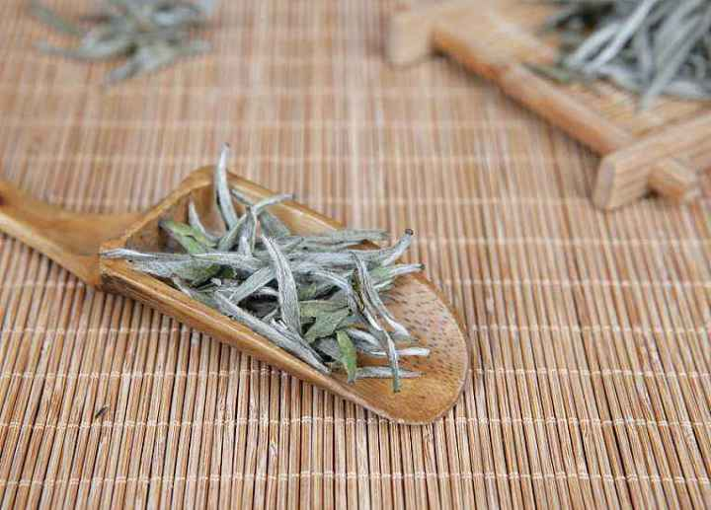
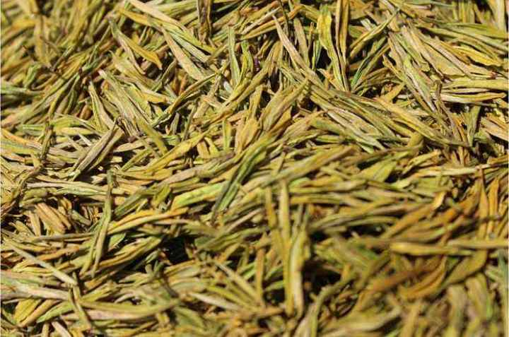

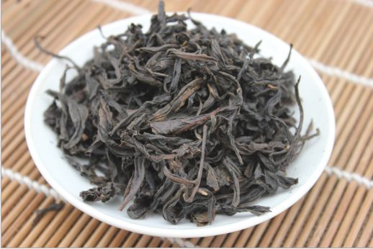
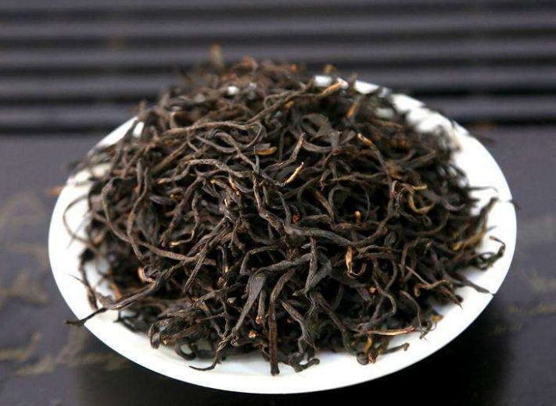
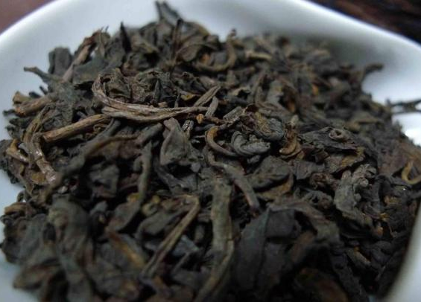
Types of Tea
Green Tea
White Tea
Yellow Tea
狮峰龙井、碧箩春、
黄山毛峰
白牡丹、贡眉
君山银针、蒙顶黄芽、
温州黄汤
Oolong Tea
Black Tea
Dark Tea
滇红、祁红、川红、闽红
安化黑茶、普洱茶、
六堡茶
安溪的铁关音、武夷大红袍、台湾乌龙茶

Slide 5
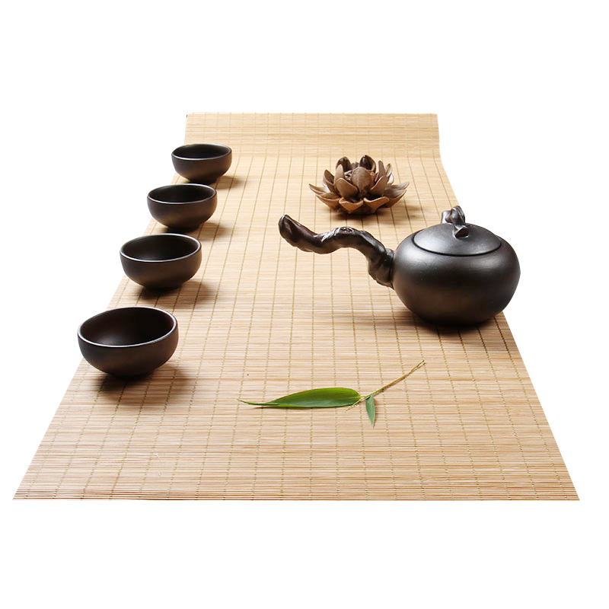
4. Tea Ceremony Spirit of China

Slide 6



Tea Ceremony Spirit of China
和
静
怡
真
中庸之道
茶需静品
愉悦和享受
守真养真藏真

Slide 7
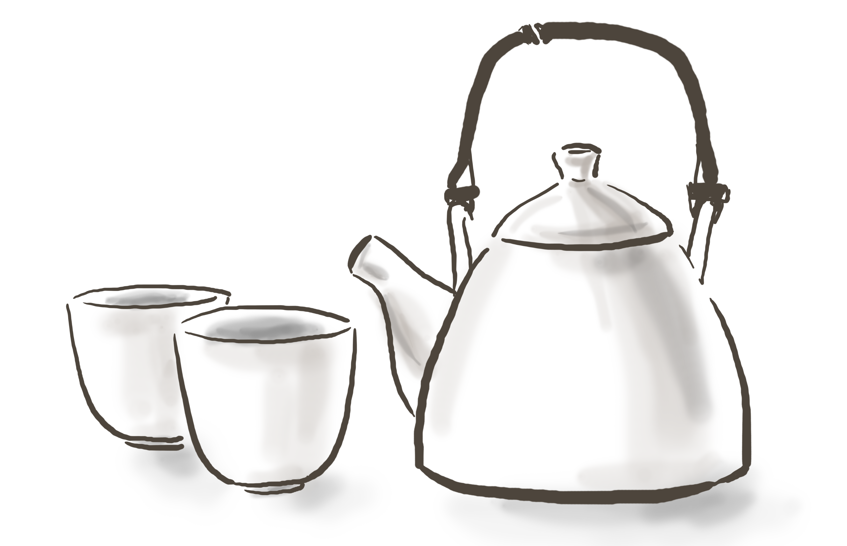

Tea has experienced the transformation from medicinal to edible to drinking, which has been continuously developed and evolved throughout the dynasties.
After thousands of years, tea had entered every aspect of Chinese people’s life. For Chinese people, tea is not only a drink, but also a spiritual sustenance.

Slide 8




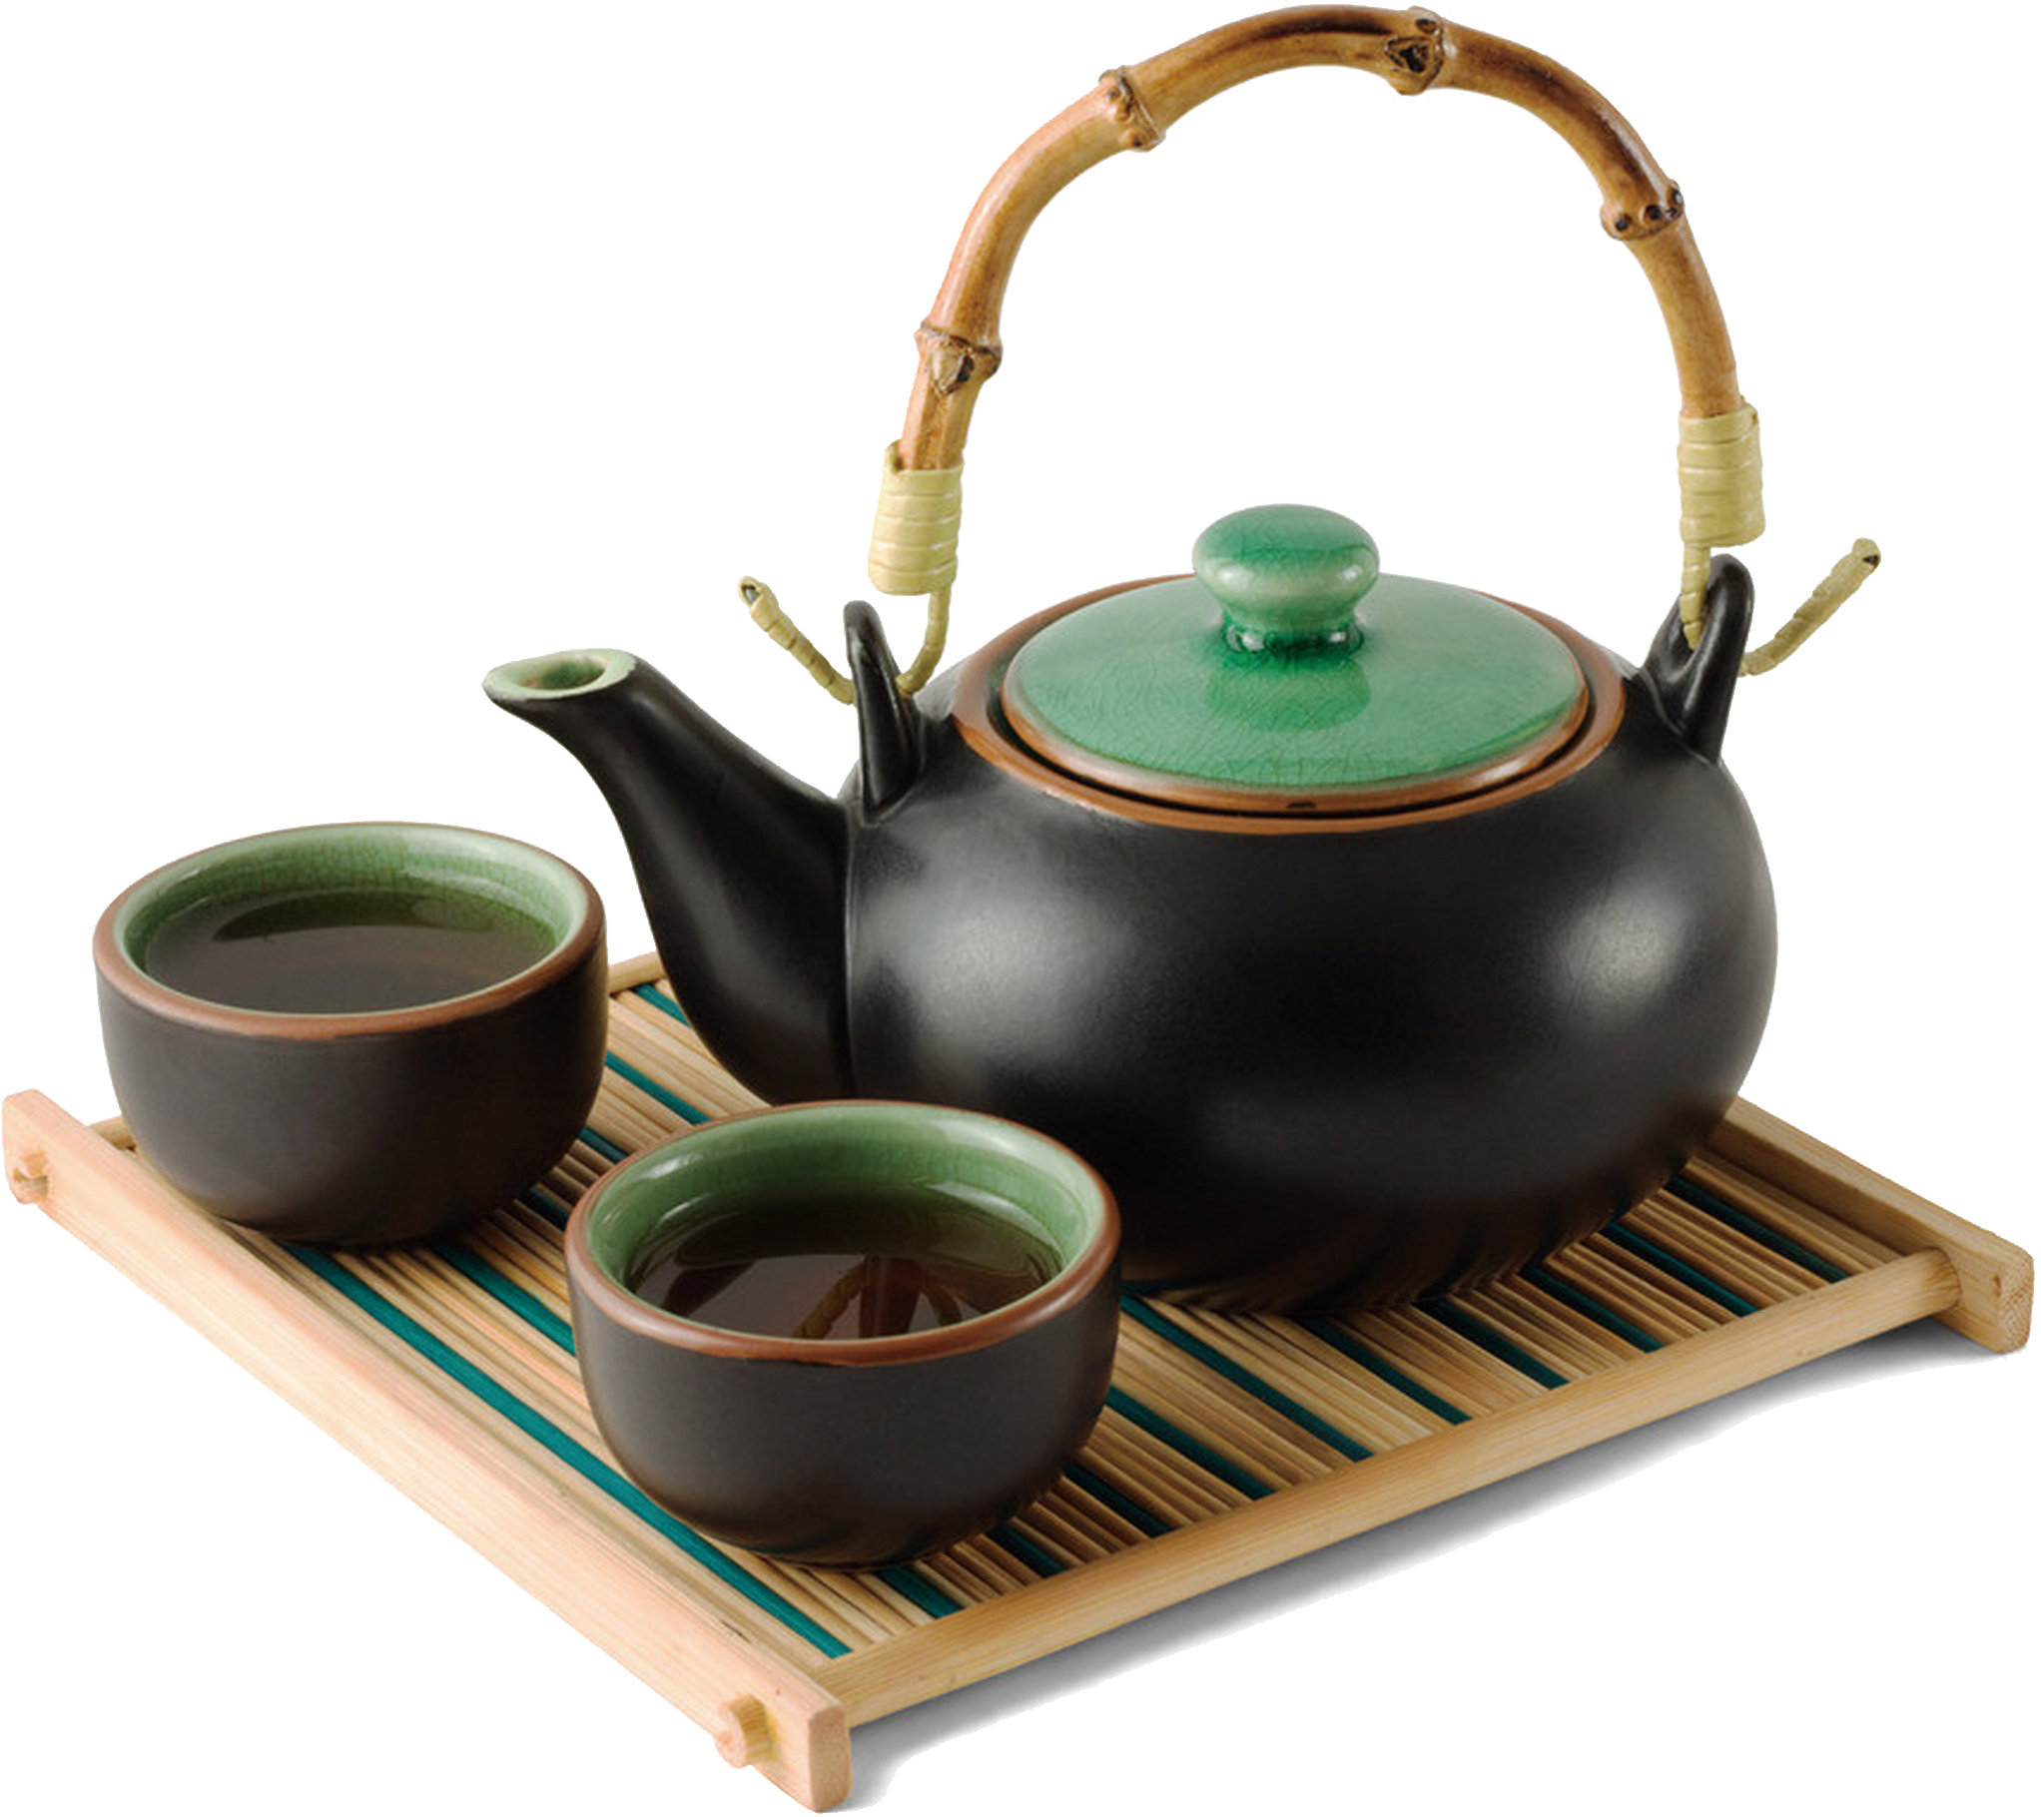


Thanks

