Slide 1
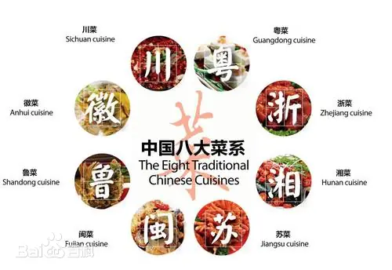

THE EIGHT MAJOR CUISINES OF CHINA
Exploring the Flavors and Stories Behind China's Culinary Heritage
Tang Xinyu

Slide 2
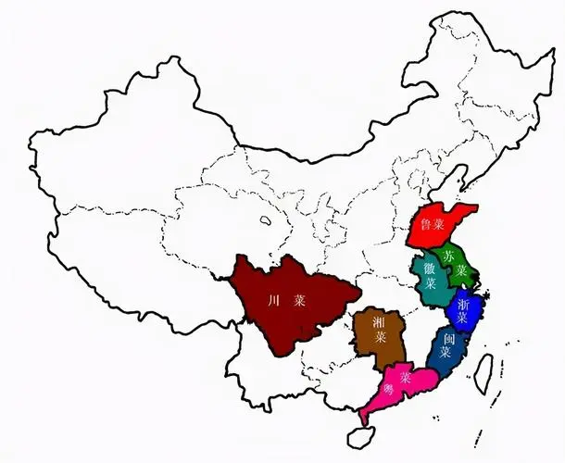
What Makes Chinese Cuisine Unique?
  China’s cuisine is diverse, influenced by geography, climate, and history.
  The Eight Major Cuisines reflect regional traditions, each with distinct flavors and techniques.
  These cuisines have evolved over centuries, shaped by local ingredients and cultural practices.

Slide 3
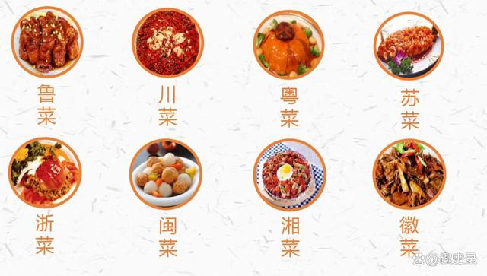

The Eight Major Cuisines of China
  Shandong (Lu): Savory, seafood-based.
  Sichuan (Chuan): Spicy, numbing flavors.
  Guangdong (Yue): Light, fresh, natural flavors.
  Jiangsu (Su): Elegant, balanced, refined presentation.
  Fujian (Min): Delicate broths, sweet flavors.
  Zhejiang (Zhe): Fresh, seasonal ingredients.
  Hunan (Xiang): Bold, spicy, sour, preserved foods.
  Anhui (Hui): Rustic, earthy, slow-cooked.

Slide 4
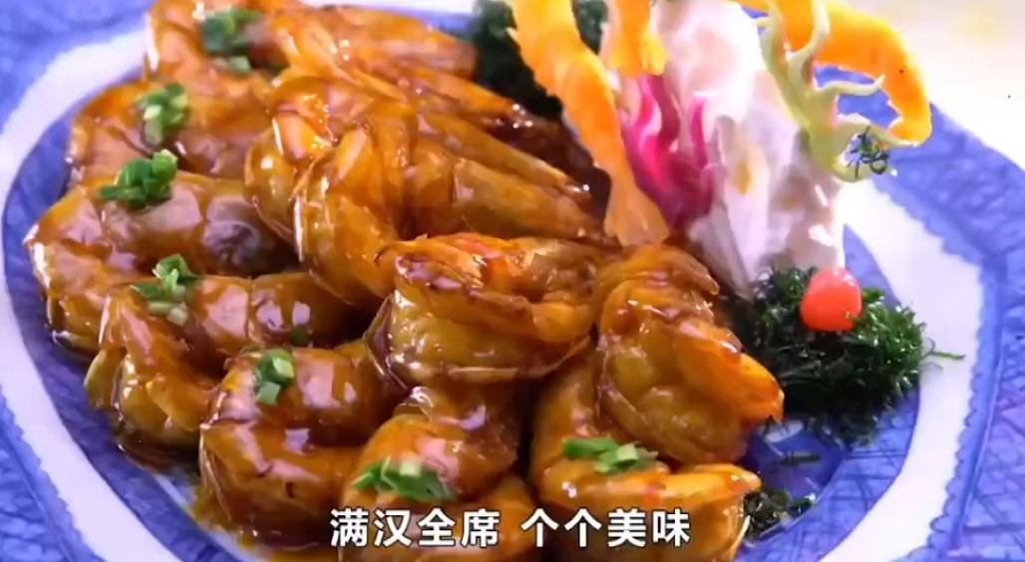
The Eight MAJOR Cuisines of China

Slide 5
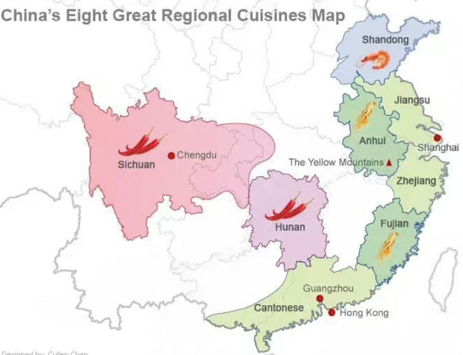
How Geography Shapes Flavors
  Coastal regions: seafood (Shandong, Fujian, Guangdong).
  Inland areas: bold and spicy (Sichuan, Hunan, Anhui).
  Mild climates: light, seasonal ingredients (Zhejiang, Jiangsu).

Slide 6
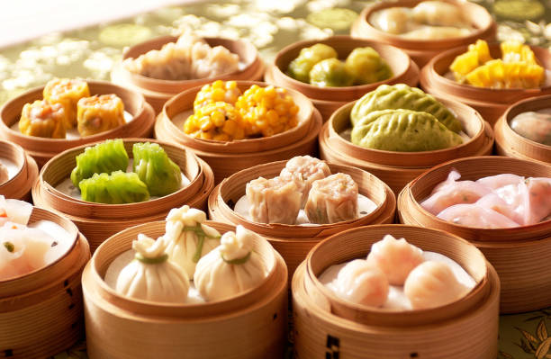
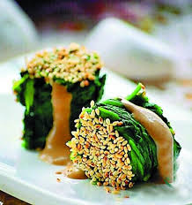
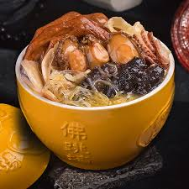
The Influence of History and Culture
  Imperial influence: Refined dishes in Shandong, Jiangsu.
  Immigration: Guangdong cuisine spread internationally (dim sum, roast pork).
  Buddhism: Fujian’s vegetarian traditions.

Slide 7
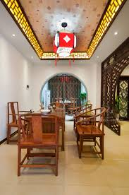
The Role of the Eight Cuisines in Modern China
  a source of cultural pride
  specialty restaurants in cities
  fusion dishes

Slide 8
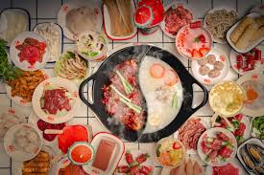
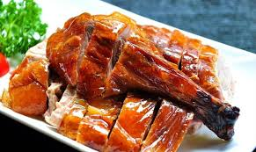
The Global Reach of Chinese Cuisine
  Cantonese cuisine: internationally recognized (dim sum, roast pork).
  Sichuan cuisine: growing in popularity (hotpot, street food).
  Chinese food bloggers are spreading knowledge globally.

Slide 9
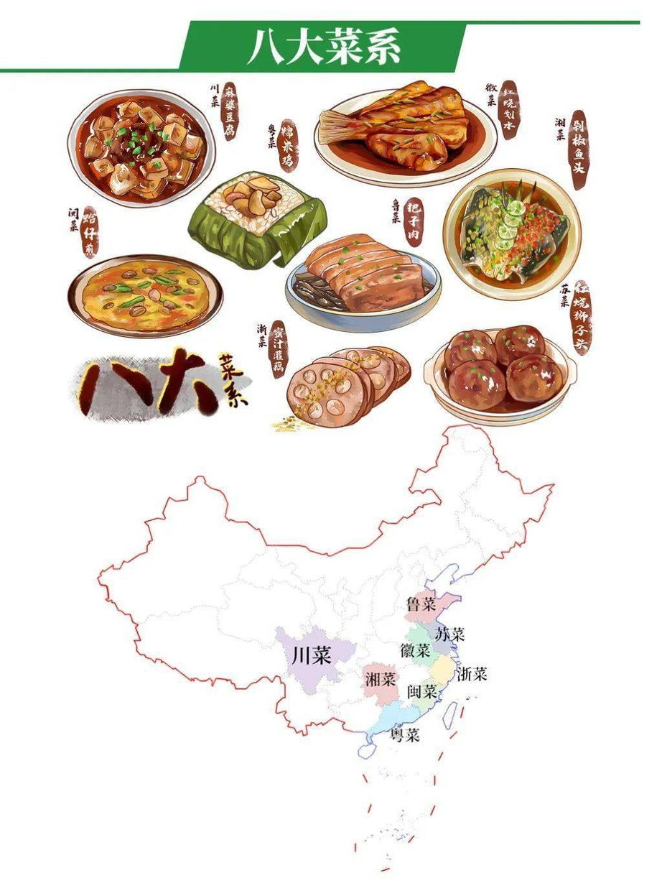
The Diversity of Chinese Cuisine
  The Eight Major Cuisines reflect China’s culinary diversity.
  From bold and spicy to light and fresh, there’s something for everyone.

Slide 10
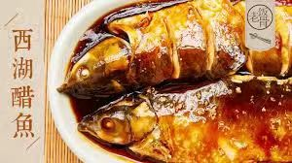
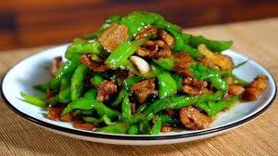
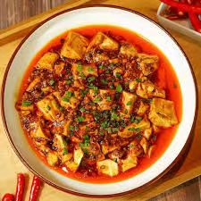
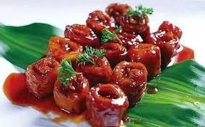
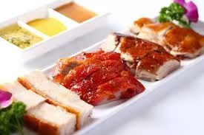
湘
川
浙
鲁
粤

Slide 11
THANK YOU ！
Tang Xinyu

