Slide 1

Adaptation of Chinese Classics in Modern Times
By 肖冬晴 Xiao Dongqing

Slide 2

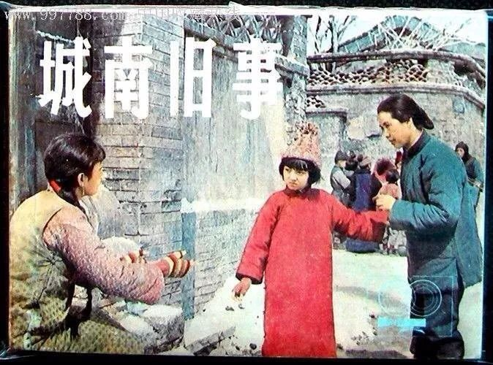


Do you think of the cinematic adaptation of classics a kind of translation? What are the reasons?

Slide 3
Contents
The Dilemma
Major Reasons
Possible Solutions

Slide 4
The Dilemma

Slide 5
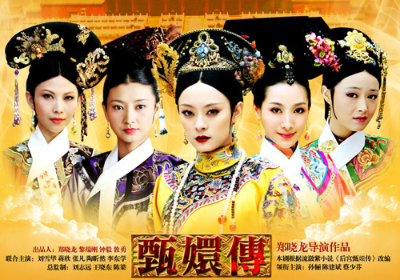

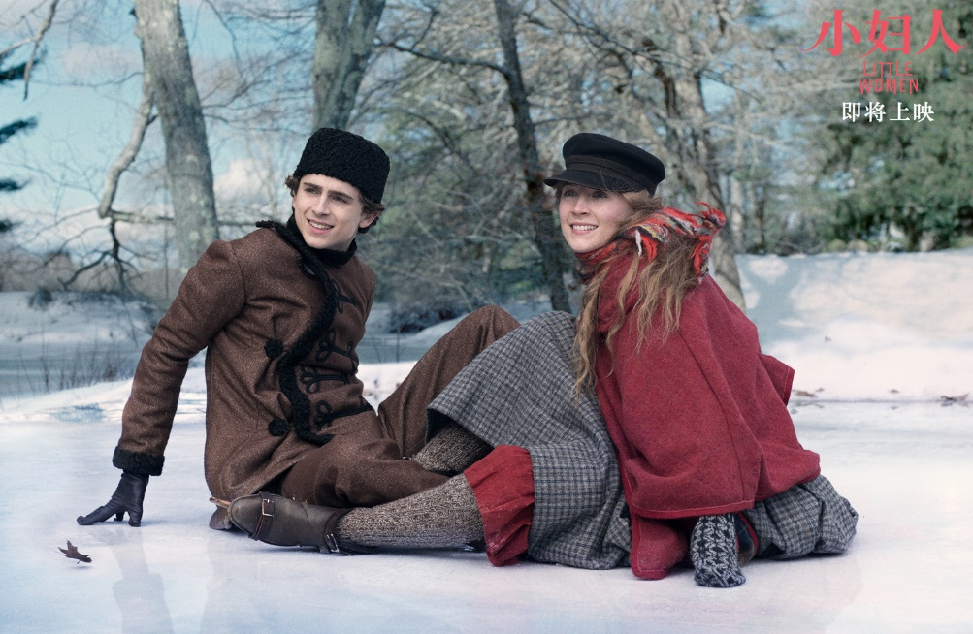

The Dilemma:
The subsided craze for the adaptation of modern classics due to the mediocre audience measurement.
The shock from the adaptation of web fictions which enjoy a larger audience.
The impact of a series of sophisticated adaptations of foreign classics.
The prevailing of new ways of entertainment.

Slide 6
Major Reasons

Slide 7

Major Reasons:
The adaptation of classics is difficult and laborious. The quality of one adaptation is largely dependent on the capabilities of its director, the cast as well as how far it goes. Printed paper could convey the thoughts and feelings of its characters in a way so subtle that any forms of three-dimensional technology would find it impossible to represent.
The prime audience has changed from the middle-aged to the young, who are generally more obsessed with fragmented reading online and less prone to read the long and sometimes difficult classics.
The mentality of artistic creators has changed. Gone are the days when the film crew took the trouble to spend years on selecting performers, looking for shooting locations and training actors simply for better representation. To some extent, the film industry has entered an age of capital-driven “mass production” valuing only speed and profit.

Slide 8


Major Reasons:
4. Modern technology has reshaped the way how people spend their spare time. As the Internet reduces the cost of artistic production and broadens the transmission channels, everyone can be a producer as well as a consumer.
5. The content and idea expressed are limited due to the time limitation of films.

Slide 9
Possible Solutions

Slide 10
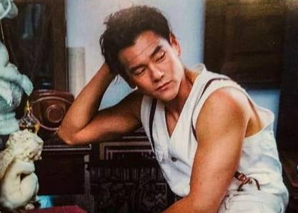
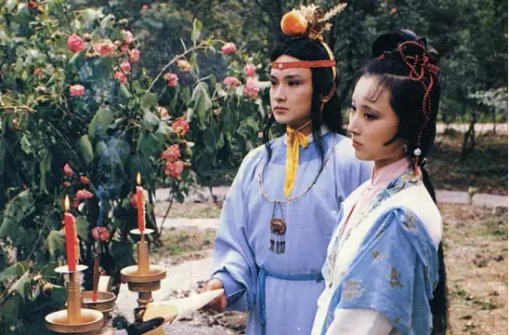
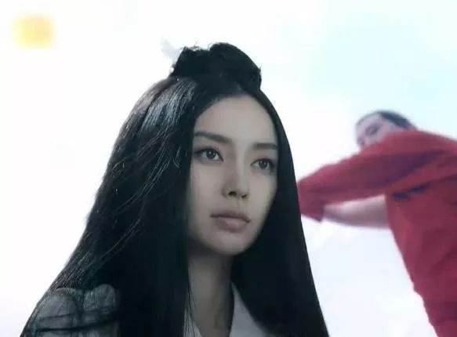
Possible Solutions:
Be faithful to the original. e.g. the selection of cast, the setting, theme, main plot, etc.
Bring artistic innovation and changes in accordance with the time, creating purpose, etc.
Remain true to the spirit of craftsmanship.

Slide 11
Reflections:
Classics naturally endow adaptations with attention and fame and in turn, adaptations could bring classics benefits or even promote the canonization of the original if the they turned out to be a good try.
According to Lefevere, the literary system is controlled by two main factors, of which the patronage outside the system partly determines the ideology. As translators within the system, we need to play our part in partly determining the dominant poetics as we remain faithful to the original work and retain the spirit of craftsmanship in our translation practice and work in the future.

Slide 12
Websites for further reading:
https://zhuanlan.zhihu.com/p/25942689
http://m.cnki.net/mcnki/literature/detail?datatype=CJFD&instanceID=DYLX202019021
http://m.cnki.net/mcnki/literature/detail?datatype=CJFD&instanceID=FYSS202201010

Slide 13
Thank You!

