Slide 1
中国文化 研究生课（研一） Kultura chińska | Chinese Culture for MA1 students 第四周 Session 4
10月6日——THU 11:30-13:00 sal. 401 Chinese Culture Kultura chinska SIN-m I 30+30, fall 2023, Adam Mickiewicz University, Poznan
教室 Classroom sal. 401
助教： Karolina, Wiki Admin: Malwina
吴漠汀助理教授 Adiunkt (Assistant Professor) Dr. Martin Woesler

Slide 2
Schedule
3 Oct 26 11:30-13:00
地理性质是文化发展的基础 Geographic Nature as a Basis for Cultural Development (2)
古代和当代的接触方式 Ancient and Contemporary Ways of Contacting (2)
4 Nov 30 11:30-13:00
中国的婚姻习俗 Chinese Marriage Customs (3) Jin Yue 金乐
湖南的伴嫁歌 Marriage-Accompanying Songs in Hunan (3) Ai Xi 艾希
5 Dec 7 11:30-13:00
土家族的哭嫁 Crying Marriage of Tujia (4) Wei Yuxin 魏雨昕
中国古代的四大才子 The Four Most Handsome men in Ancient China (4) Li Meilin 李美琳
6 Dec 14 11:30-13:00
建筑：紫禁城 The Forbidden City (6) Pei Mengjiao 裴梦姣
建筑:中国四大名桥 Architecture: Four Famous Bridges (6)
7 Dec 21 11:30-13:00
熊猫 The Panda (5) 安浩阳
建筑学 Architecture (5)
8 Jan 11 11:30-13:00
建筑：四大亭子 Four Great Pavilions (7)
中国产出日式文化出品 (China produces Japanese-style products) (7)

Slide 3
Schedule
9 Jan 18 11:30-13:00
中国文化中的象征主义——动物 The Symbolism in Chinese Culture. The Example of Animals (8) Yan Li 晏黎
中国人幸运和不吉利的数字 (Lucky and Unfortunate Numbers in the Eyes of Chinese People) (8) Kang Mingjie 康明杰
10 Jan 18 13:15-14:45
中国摇滚乐的形成 （Development of Chinese Rock Music) (9) Wang Xiaotong 王晓彤
基督教和佛教之间的差别 (The Differences between Christianity and Buddhism) (9) Zhang Yuxuan 张宇璇
11 Jan 25 11:30-13:00
中国饮食文化——中国菜的命名艺术 (Culinary Culture of China: The Art of Naming Chinese Dishes) (10)王美芬
中国佛教 (Chinese Buddhism) (10) 柳雪萍
12 Jan 25 13:15-14:45
缠足 (Foot-binding) (11) Yang Siyi 杨思艺
鬼怪和辟邪 (Monsters and Exorcism) (11) 田小龍
13 Feb 1 11:30-13:00
中医植物 (Herbs in Traditional Chinese Medicine) (12) 安凱榕
广东的文化饮食习惯：广东人为何爱吃野味？ (The tradition of eating of wild animals in Guangdong) (12) 爱答
14 Feb 1 13:15-14:45
Free choice of topics
15 Feb 8 Final Paper (homework)

Slide 4
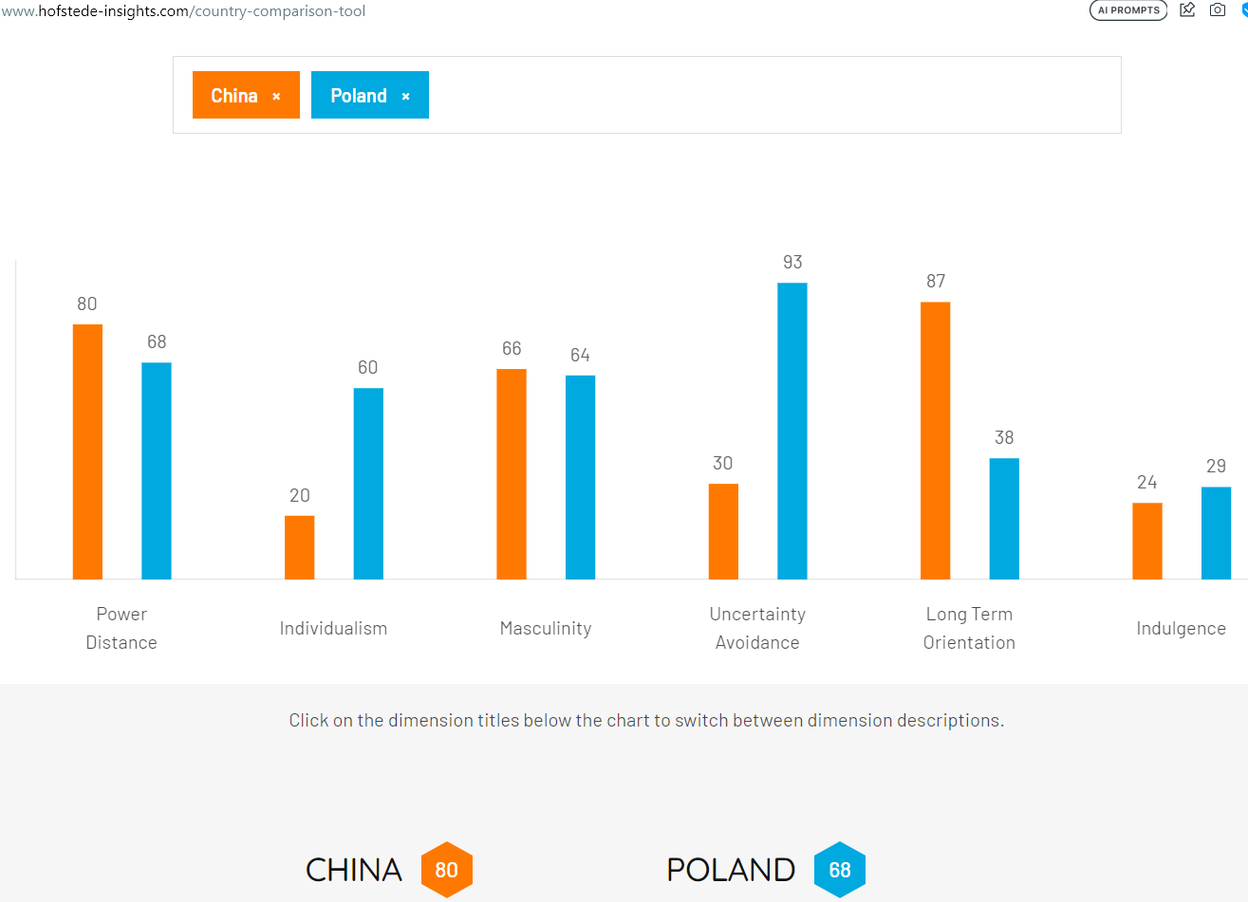

Slide 5
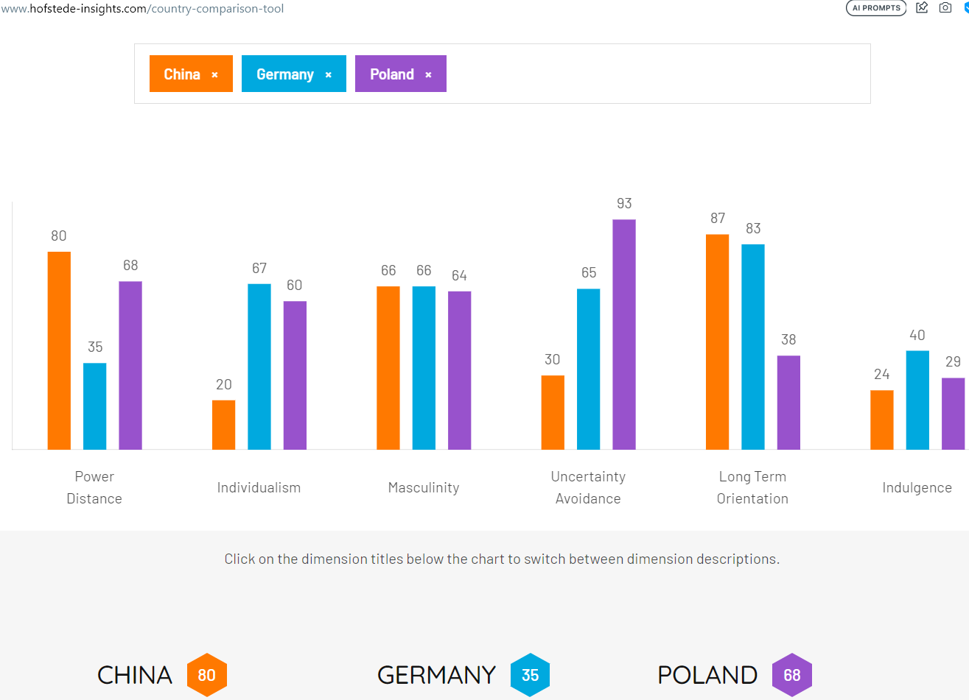

Slide 6
4 Nov 30 11:30-13:00 1. 中国的婚姻习俗 Chinese Marriage Customs Joanna Jin Yue 金乐

Slide 7
第4周 Session 4
准备第三周的作业 Homework to prepare this session
1. 阅读 Read pages 16-21 and 29-35 of our textbook
2. 填多选题线上测试 Complete the quizzes
* 审美理想和社会习俗：中国的婚姻习俗 Aesthetic ideals and social customs: Chinese Marriage Customs: https://ks.wjx.top/vm/YJzn8Fl.aspx#
* 审美理想和社会习俗： 湖南的伴嫁歌 Aesthetic ideals and social customs: Marriage-Accompanying Songs in Hunan: https://ks.wjx.top/vm/mBp0heY.aspx
3. Choose a topic for your final exam paper (homework)
展示 Presentations
审美理想和社会习俗：中国的婚姻习俗 Aesthetic ideals and social customs: [[Media:Chinese_Marriage_Customs_2023.pptx]]
湖南的伴嫁歌 Aesthetic ideals and social customs: [[Media:Marriage-Accompanying_Songs_in_Hunan.pptx]]

Slide 8
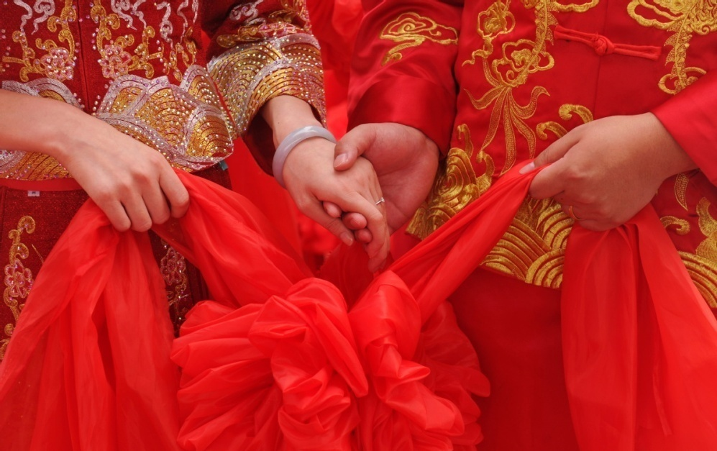
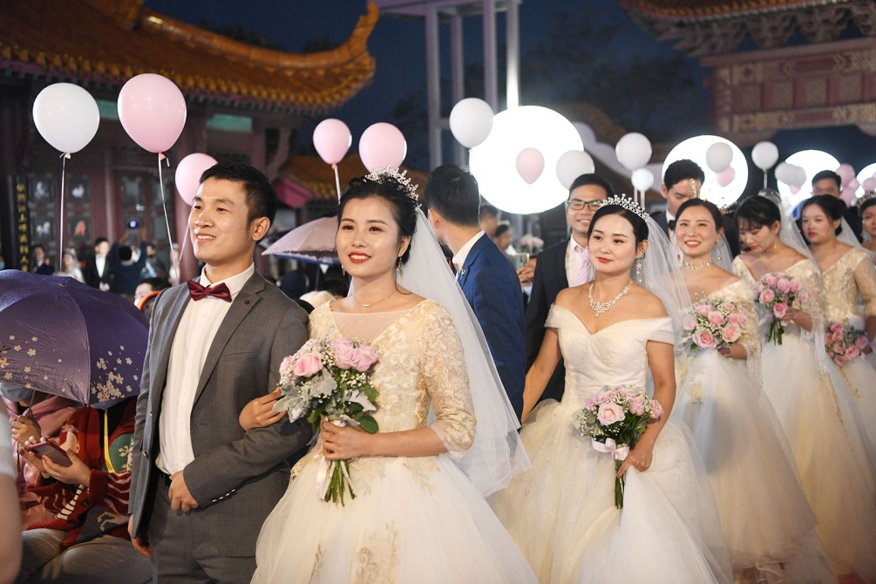
中国的婚姻习俗
金乐

Slide 9
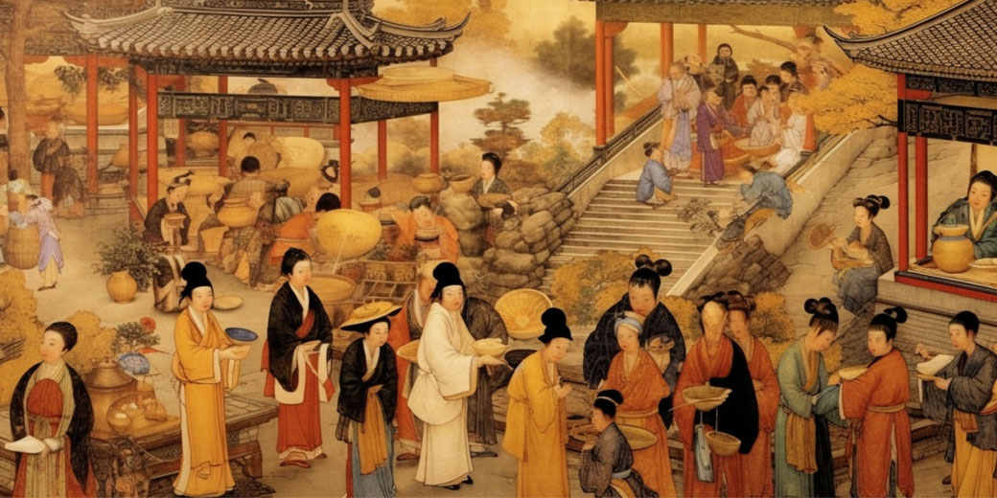
六个步骤
步骤 [bù zhòu] procedure, step
穿越时间 [chuānyuè shíjiān] to travel through time

Slide 10
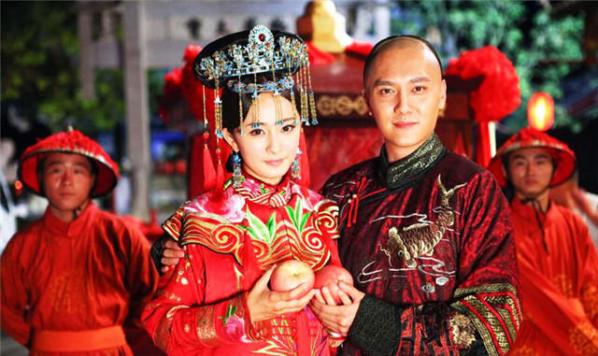
六个步骤
Na Cai (纳采),
Wen Ming (问名),
Na Ji (纳吉),
Na Zheng(纳征),
Qing Qi (请期),
Qin Ying (亲迎)
提亲[tíqīn] to propose marriage

Slide 11
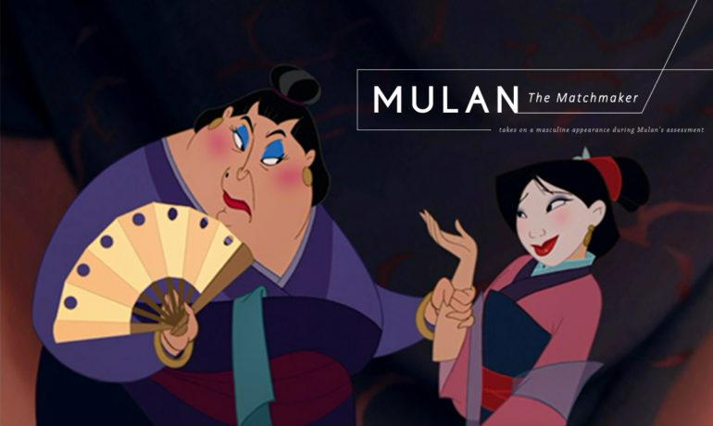
“纳采”是什么？
媒人[ méiren ] go-between, matchmaker
娶 [qǔ] to take wife
新娘 [ xīnniáng ] bride
新郎 [ xīnláng ] bridegroom, groom
https://www.youtube.com/watch?v=jD9ly7H78Sc

Slide 12
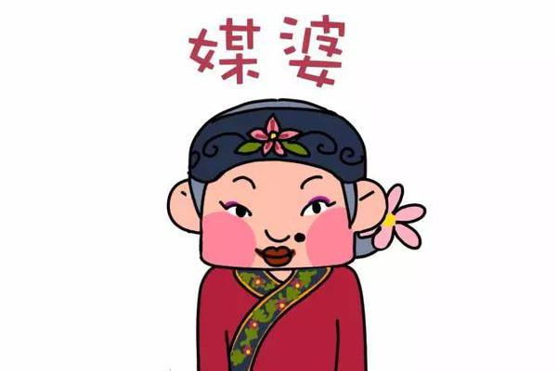
“纳采”是什么？
求婚[ qiúhūn ] propose marriage

Slide 13
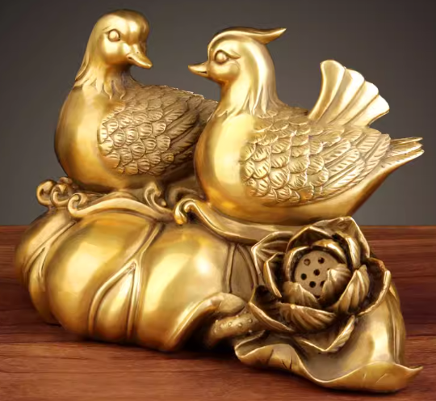
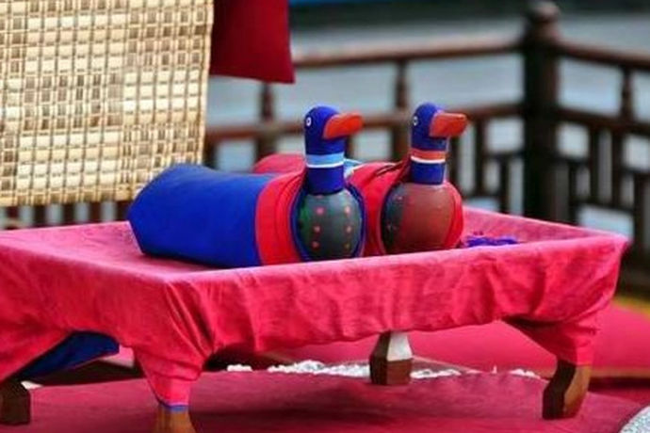
“纳采”是什么？
大雁[ dàyàn ] wild goose
鸳鸯 [yuānyang] mandarin ducks
代表[ dàibiǎo ] represent
忠诚[ zhōngchéng ] devoted, fidelity, loyal, loyalty

Slide 14

为什么这些动物？
终生 [ zhōngshēng ] throughout one's life, lifetime, life long
交配 [ jiāopèi ] mating, copulation (esp. of animals)
离婚率 [ líhūnlǜ ] divorce rate
极低 [ jídī ] very low
成双成对 [ chéngshuāngchéngduì ] to form pairs, to be in couples
忠诚[ zhōngchéng ] devoted, fidelity, loyal, loyalty

Slide 15
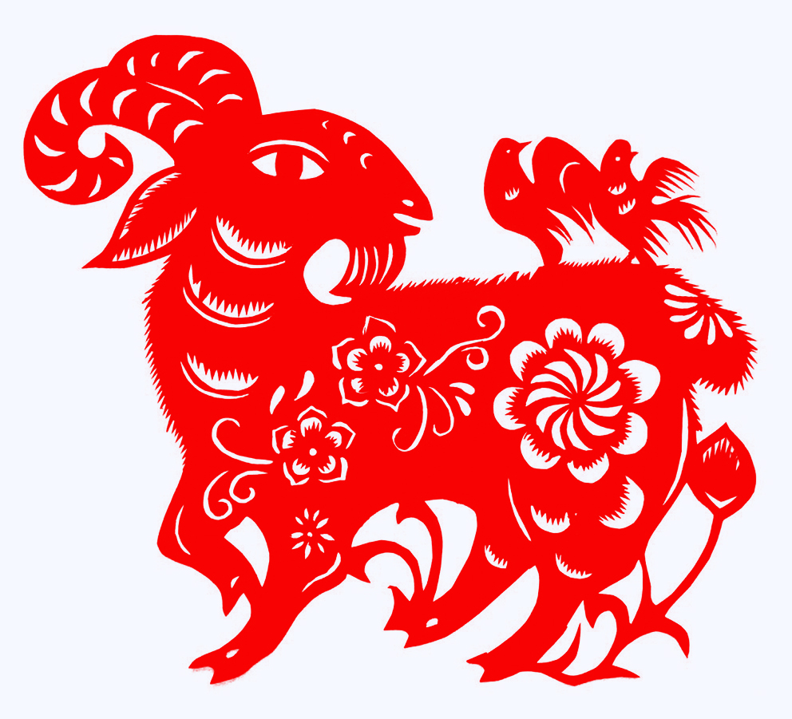
为什么这些动物？
繁荣 [ fánróng ] prosperity
象征 [ xiàngzhēng ] symbolize

Slide 16
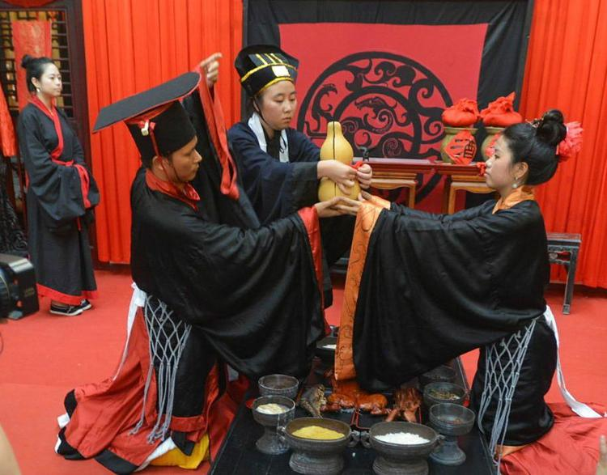
“问名”是什么？
合拍[ hépāi ] in time with (i.e. same rhythm)

Slide 17
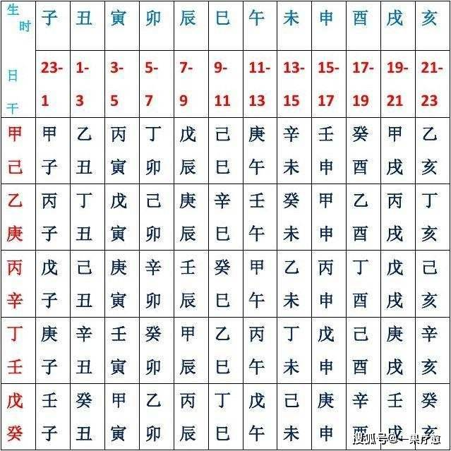
生辰八字 [ shēngchénbāzì ] one's birth data for astrological purposes, combined from year, month, day, hour
干支历 [gānzhīlì] Sexagenary Cycle Calendar，又称星辰历，甲子历等
推算 [tuīsuàn] calculate

Slide 18
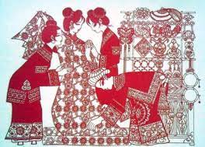
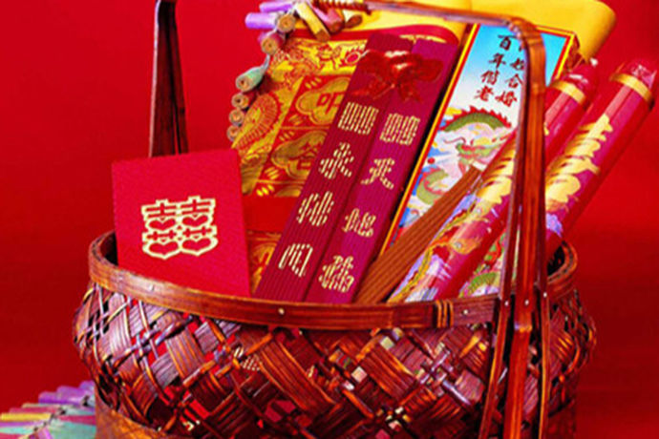
“纳吉”是什么？
取回 [ qǔhuí ] to retrieve

Slide 19
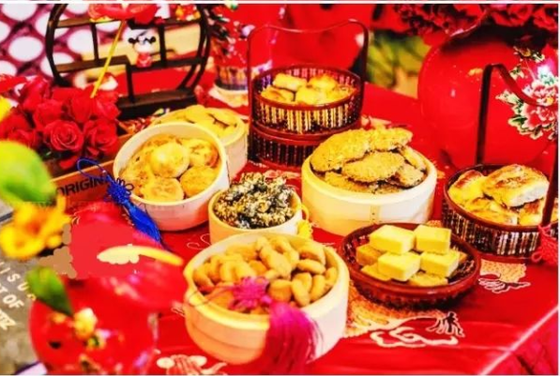
“纳征”是什么？
订婚 [dìnghūn] engage (to get married), be betrothed to

Slide 20
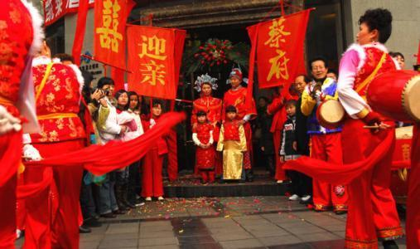
“请期”是什么？
黄道吉日 [huángdàojírì] auspicious date, lucky day

Slide 21
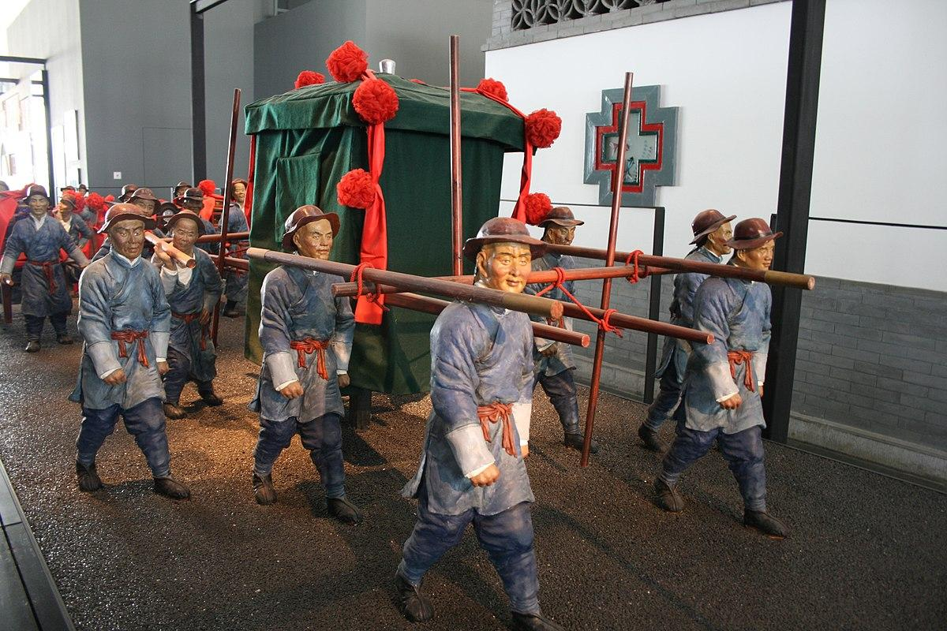
“亲迎”是什么？
新娘 [ xīnniáng ] bride
新郎 [ xīnláng ] bridegroom, groom

Slide 22
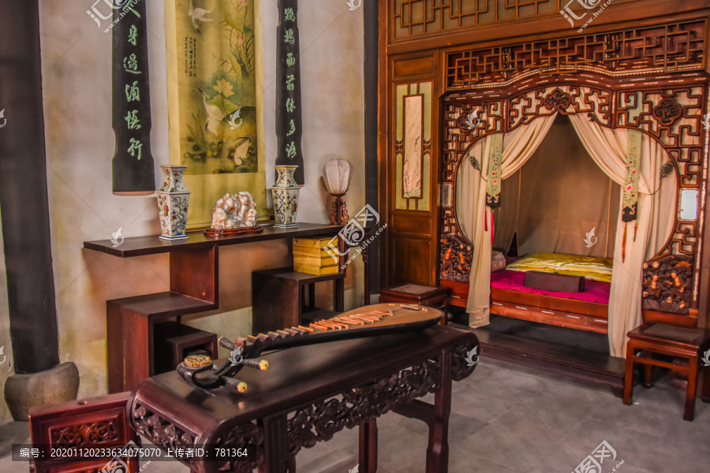
闺房 [guīfáng] lady's chamber

Slide 23
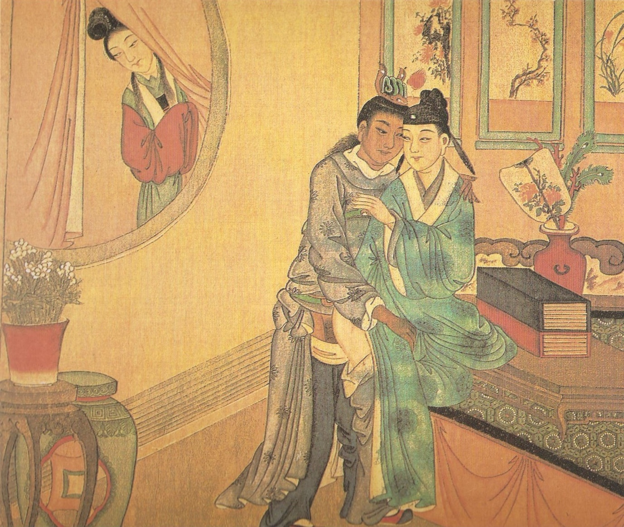
不忠[ bùzhōng ] disloyal, unfaithful spouse,

Slide 24
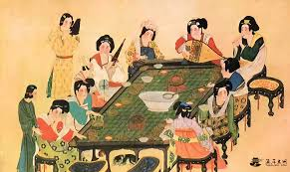
宴会 [ yànhuì ] banquet, feast, dinner party
祭拜祖先 [ jìbài zǔxiān] to offer sacrifice to one's ancestors

Slide 25
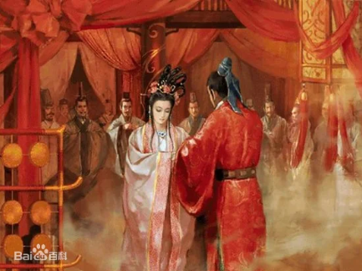
跪拜[ guìbài ] to kowtow, to kneel and worship
叩拜[ kòubài ] to bow in salute,
神灵[ shénlíng ] a God, spirit, demon
大自然[dà zì rán] nature (the natural world)
洞房 [ dòngfáng ] secret inner room, bridal room

Slide 26
https://www.youtube.com/watch?v=3kBm9542m64

Slide 27
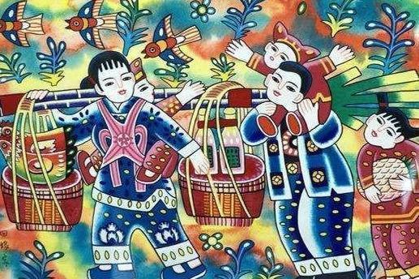

Slide 28
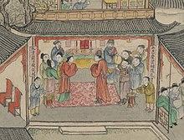
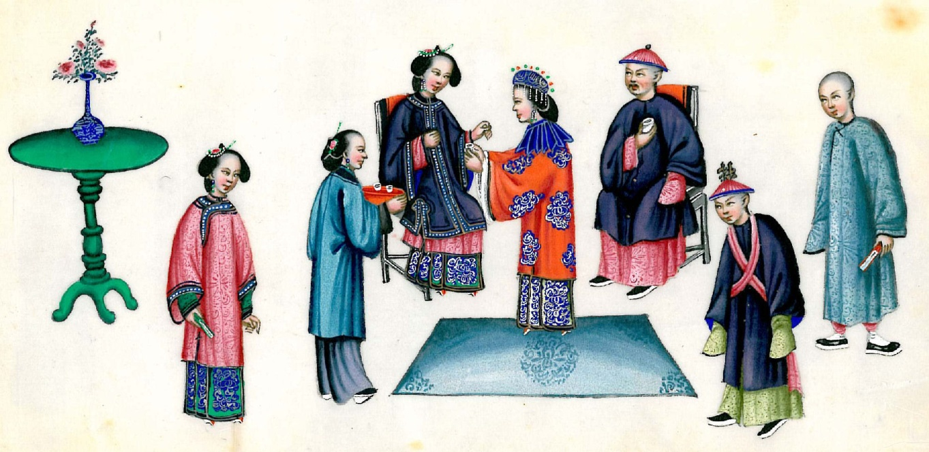
包办婚姻[bāobànhūnyīn ] arranged marriage
服气 [ fúqì ] accept
五四运动 [ wǔsìyùndòng ] May Fourth Movement

Slide 29
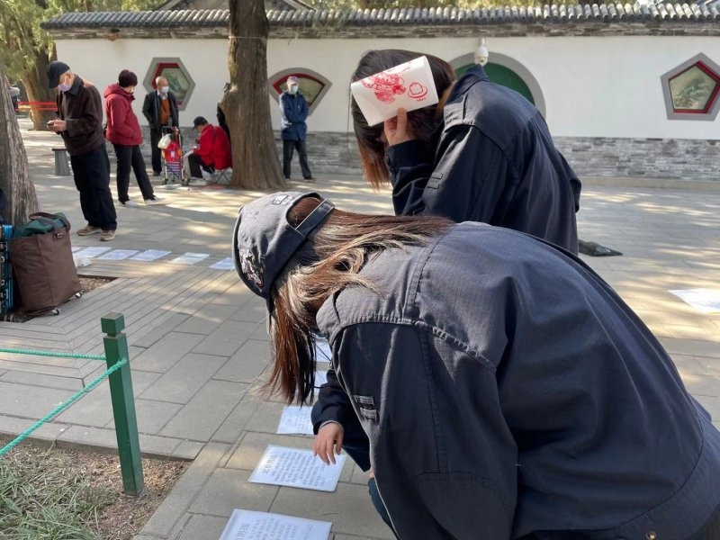
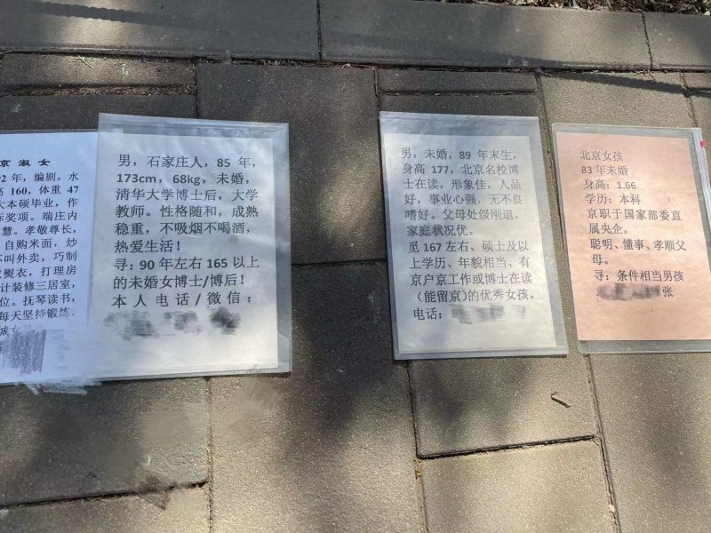
https://www.youtube.com/watch?v=91x5nFVZsWo

Slide 30
https://www.youtube.com/shorts/IdSJvXytDx0
夫妇 [ fūfù ] husband and wife, couple
采用 [ cǎiyòng ] to adopt, to employ, to use
护送 [ hùsòng ] to escort, to accompany

Slide 31
调查
https://www.mentimeter.com/app/presentation/almrofczzmpf2u4pzgzc2ihb8dspuctg/7tco1za918c2/edit

Slide 32
问题
你们觉得中国传统的结婚比现代西方的结婚好吗？为什么？
你们觉得为什么曾经父母安排他们孩子的结婚？
你们觉得现代的改变是好的吗？

Slide 33
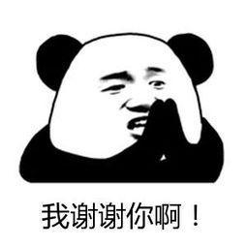

Slide 34
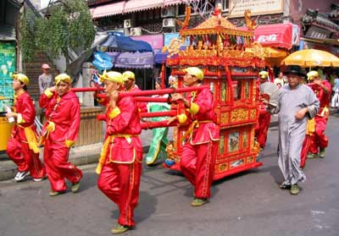
Marriage

Slide 35
Chinese Marriage Customs

Slide 36
Introduction
China is an ancient country of rites. When it comes to the most important thing in one’s life---marriage, Chinese people have developed a set of unique and grand ceremonies. Generally speaking, weddings in ancient China needed to be approved by parents and arranged by parents.

Slide 37
Contents
1
Six Procedures
2
Customs
3
Development

Slide 38
1
Six Procedures
Na Cai
Wen Ming
Na Ji
Na Zheng
Qing Qi
Qin Ying

Slide 39
1
Na Cai

Slide 40

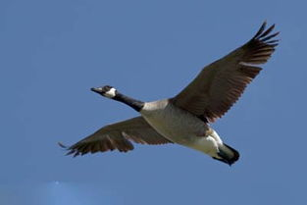
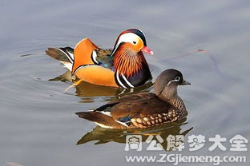
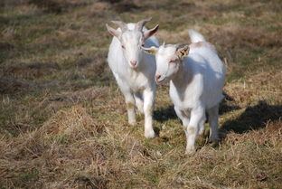
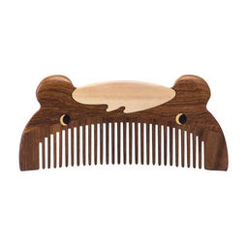
Na Cai is the begining of all the marriage processes. It refers to a practice that if a boy intends to marry a girl, firstly his family must invite a matchmaker to the girl's home to propose marriage
wild goose
mandarin ducks
wooden comb

Slide 41
2
Wen Ming

Slide 42
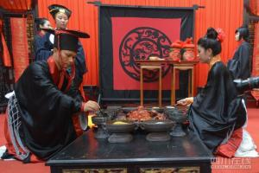
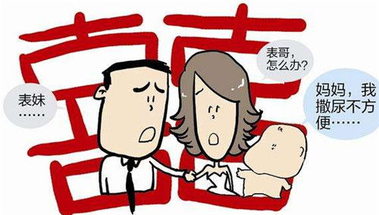
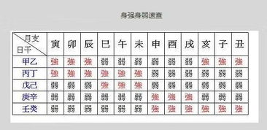
Wen Ming means that the boy's family asks the matchmaker to fetch the girl's name and date of birth.
assure the compatibility of the prospective bride and bridegroom through their “eight characters” of the birth moment.
prevent the marriage of close relatives with the same surname

Slide 43
3
Na Ji

Slide 44
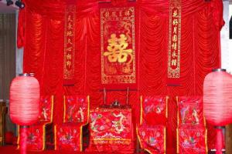
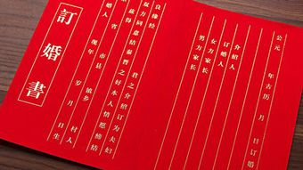
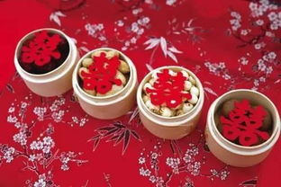
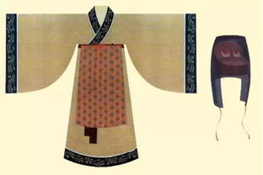
Naji happens after the matchmaker takes back the woman's name and eight characters. If divining an lucky portent, the boy's family will inform the girl’s parents and decide to engage the marriage.
What is more, Na Zheng is an important step when the boy sends engagement presents to the girl and for courtesy the girl will send back part of the presents such as food and some clothes.

Slide 45
4
Na Zheng

Slide 46
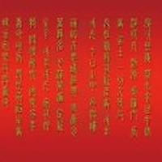
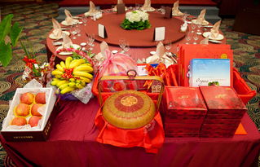
Nazheng is the ancient marriage custom of Han nationality“ The fourth of the six gifts, also known as "Nacheng", means that a man's Naji gives a bride price to a woman's.
The completion of acceptance marks the end of the engagement stage and is one of the main signs of the establishment of marriage.

Slide 47
5
Qing Qi

Slide 48
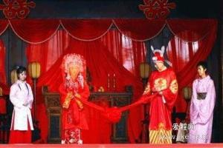
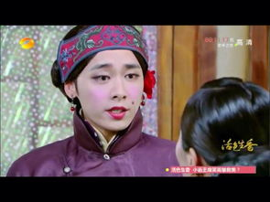
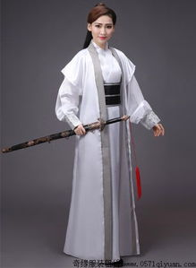
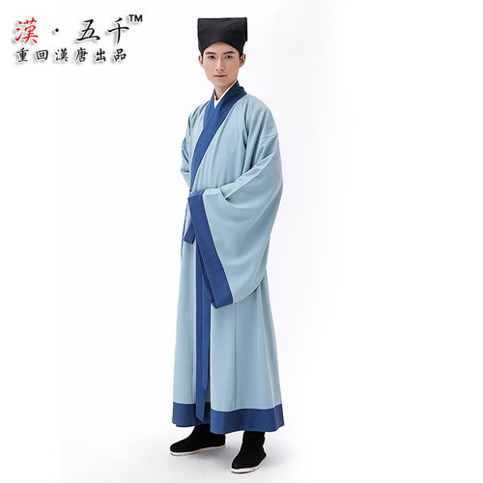
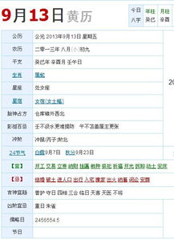
Qing Qi means that the boy's family choose a lucky day to hold the wedding ceremony and then dispatch the matchmaker to tell the girl’s family.
Qing Qi

Slide 49
6
Qin Ying

Slide 50

Qin Ying
Qin Ying is the last process of the six processes, that is, the groom goes to the bride's home to take the bride to his home.

Slide 51
2
Customs
In addition to the six steps mentioned above, there are many other customs in the traditional Chinese wedding ceremony. Generally speaking, ancient marriage was ordered by parents and matchmaker and many young people could not master their own marriage. Before wedding ceremony, men and women were not allowed to meet each other in that ancient people were very conservative and most girls were kept in boudoirs. If they met in private before marriage, it would be regarded as a kind of female infidelity and parents would also think it quite unlucky. Under this condition, newcouples could only see each other until the day of marriage.

Slide 52
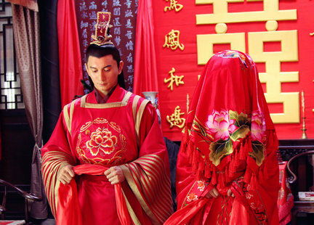
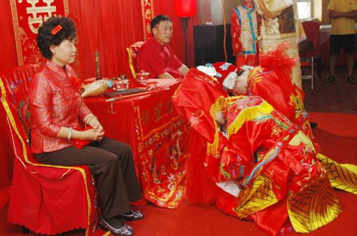
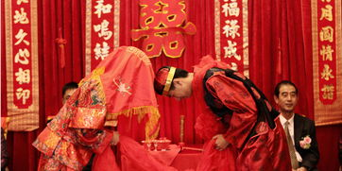

After that, the following step is the most grand one among the whole ceremony --- at the dusk moment, the groom and the bride, his parents as well as all the guests will gather together at the central room to witness the kneeling steps of the couple, which consists of 4 steps
Kneel down to heaven and earth
the new couple kowtow towards each other
drink “ cross-cupped wine ”
Kneel down to parents

Slide 53




After wedding ceremony, the couple must return to the girl’s home together at the third day, which is called “Huimen” or “Guiling”. This step is indispensable. The groom should take some gifts for respect and change the way that he addresses the bride’s parents, and the latter will also prepare a good meal for the couple’s coming.
Hui Meng

Slide 54
4
Development

Slide 55



As time goes by, there are many reforms about marriage nowadays. Adults own the freedom to choose their form and they can meet each other every day if possible. Parents can’t master their “life event” any more. In addition, many couples skip the cumbersome rites in the wedding ceremony. Some of them choose to hold the ceremony in the church with some close relatives and friends and some even finish it through travel.

Slide 56
这是什么情况？
https://www.menti.com/al38zzobwpwa
8325 4726

Slide 57

4. Kulturstandards am Bei-spiel Deutschland-China

Slide 58
为什么青年网络拥护者热烈讨论这个卡尔文·克莱恩广告？

Slide 59
态度？没有偏见？当你自己受到影响时……

Slide 60

态度？没有偏见？当你自己受到影响时……

Slide 61
态度？没有偏见？当你自己受到影响时……
数据:
10 让她走，19不让她走。
„只不
要跟
这种
人结
婚！ “

