Slide 1
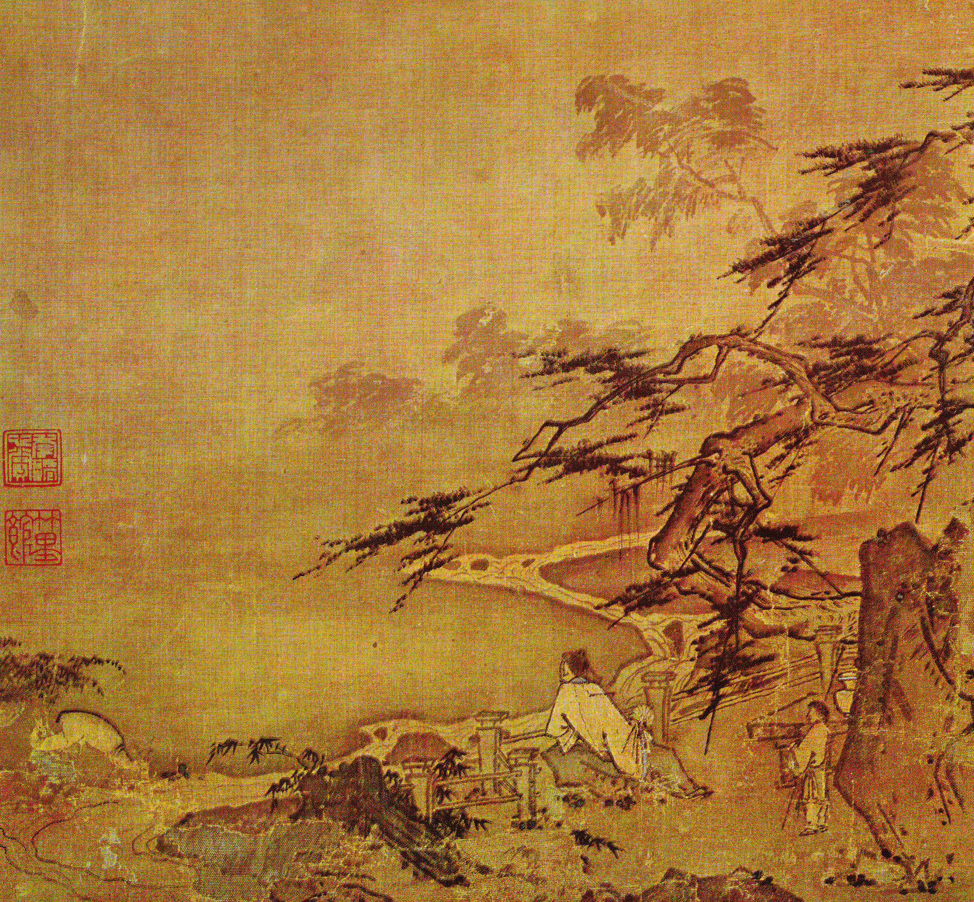
The Chinese Canon
What makes Chinese literature canon in the East and West

Slide 2
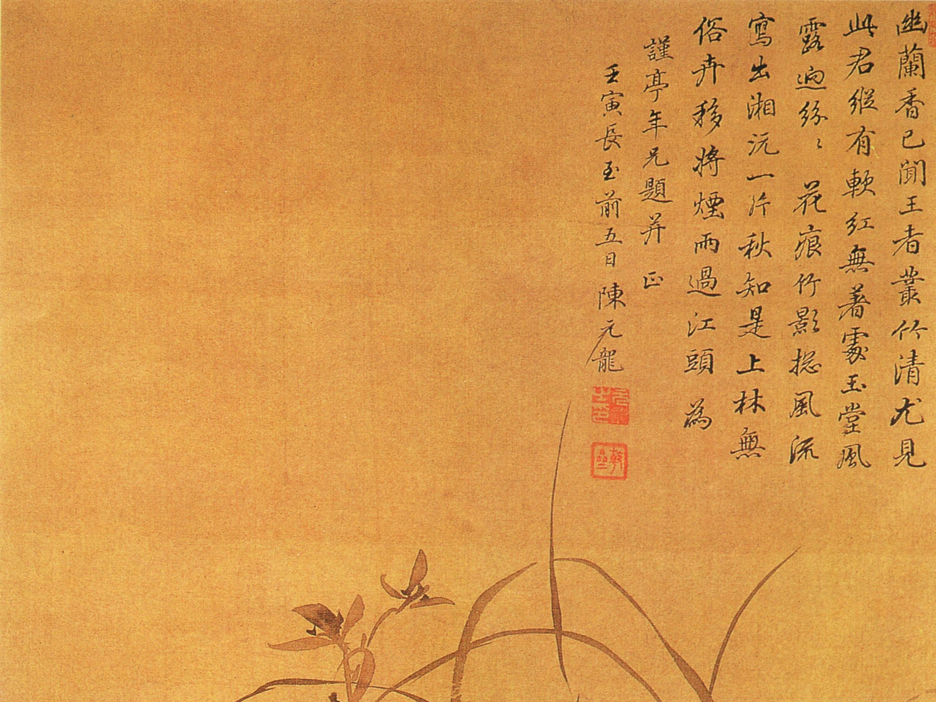
What is the Literary Canon?
A literary canon denotes a canon of books and other forms of literature that are influential in shaping it’s target culture. In the final analysis, literary canons are closely related to the aesthetic value which is supposed to pass the test of time.
today often refer to the pre-Qin Chinese texts, especially the Confucian titles of Four Books and Five Classics (四書五經), a selection of short books and chapters from the voluminous collection called the Thirteen Classics. All of these pre-Qin texts were written in classical Chinese. As canons they are collectively referred to as jing (經).

Slide 3
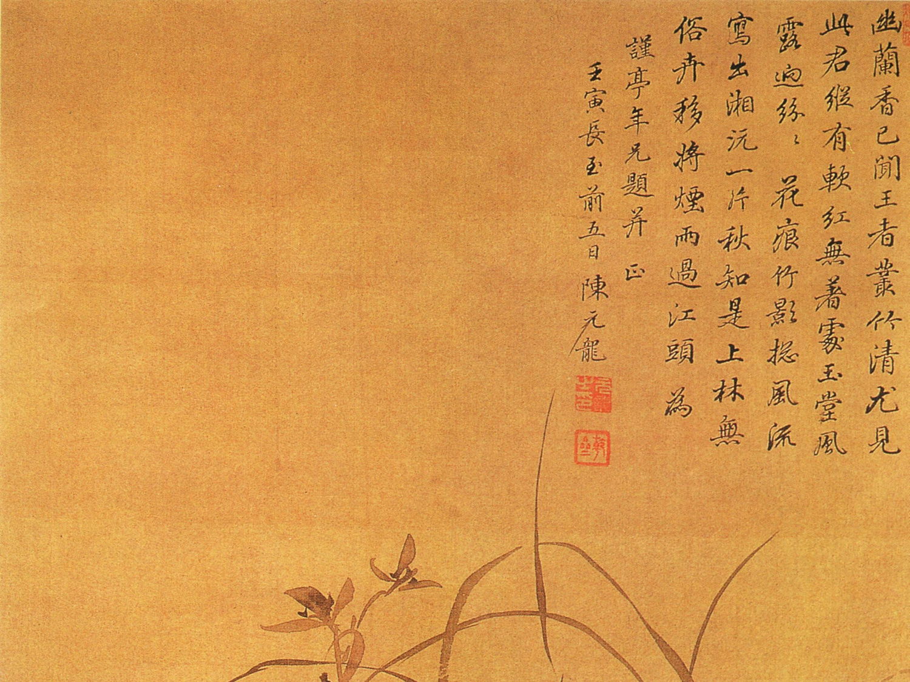
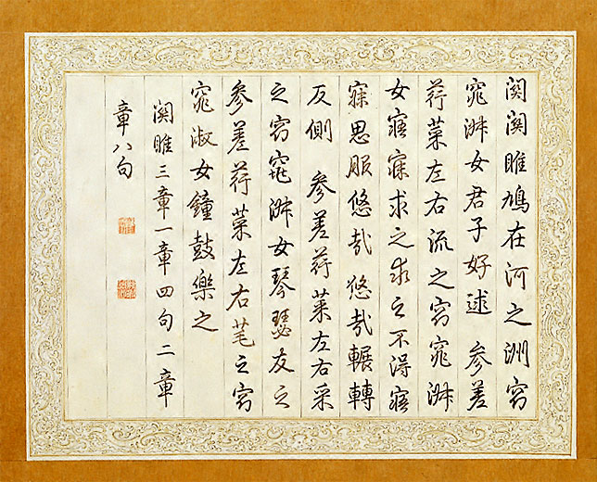
Chinese Canonical Texts
Four Books and Five Classics
The Classics of Legalism
The Classics of Military Science
The Classic of Mohism
The Classics of Taoism
Yet there are many more.

Slide 4
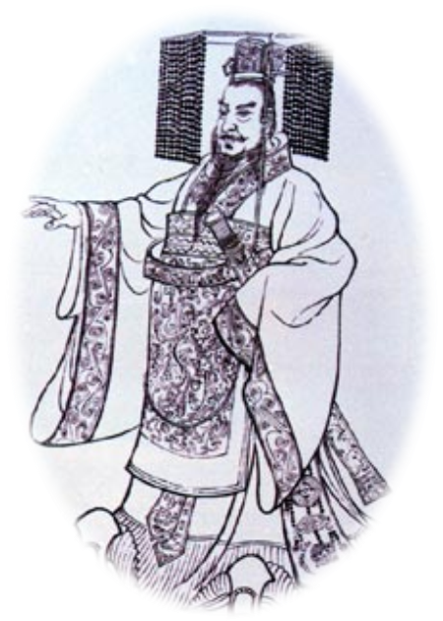
Who is Choosing the Canon
Universities
Professors
Rulers
The Populous
Example Qin Shihuangdi

Slide 5
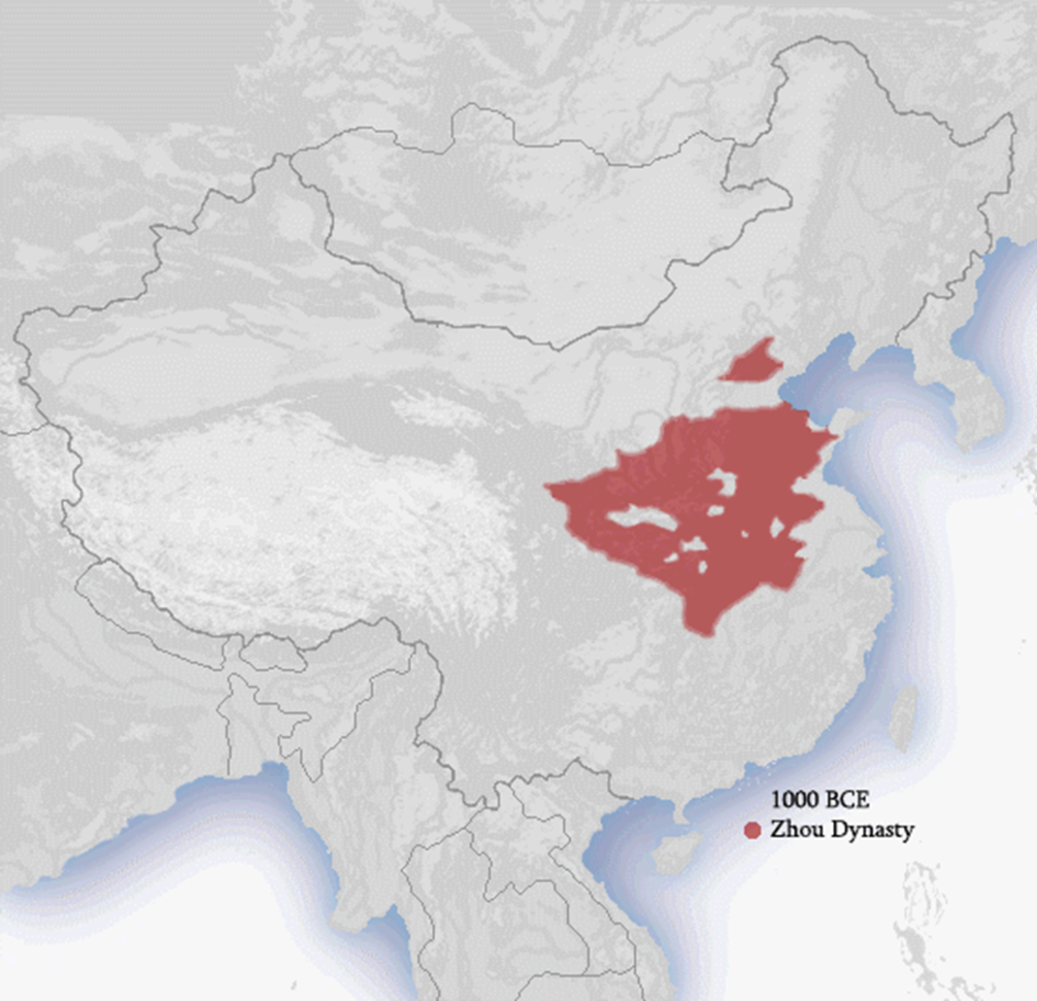
Historic Significance
Qin Book Burning
Unique View

Slide 6
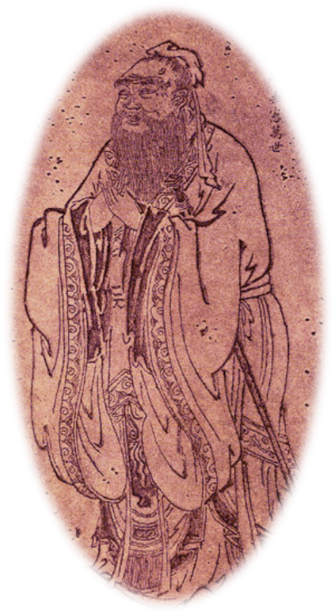
Confucius
Qin’s fire-backfired
Foundation of the Han
Canon remained mostly unchanged

Slide 7
Confucius In the West
廄焚。子退朝，曰：“傷人乎？” 不問馬。 When the stables were burnt down, on returning from court, Confucius said, 'Was anyone hurt?' He did not ask about the horses. Analects X.11 (Arthur Waley translation) or 10-13 (James Legge translation) or Analects X-17 (D.C. Lau translation)
己所不欲，勿施於人。 "What you do not wish for yourself, do not do to others."

Slide 8
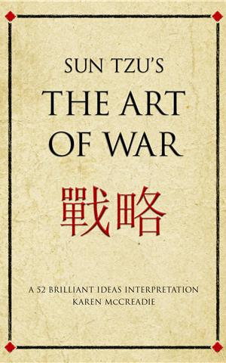
Art of War
Tzu Sun’s art of war when translated was integrated into the western canon due to its use in military tactics.

Slide 9

Re-readability.
Trevor Ross “A work that endures… offers qualities of insight, expression, or beauty that demand repeated readings while resisting complete encapsulation”

Slide 10

Re-visiting
Examples
The Bible
Inception

Slide 11
Translation
All men dream, but not equally. Those who dream by night in the dusty recesses of their minds, wake in the day to find that it was vanity: but the dreamers of the day are dangerous men, for they may act on their dreams with open eyes, to make them possible.
All men dream but not equally. The dreams in their hearts dusty grooves night, in one day and found it vanity, but the days are dreamers dangerous men, because they, according to their dreams with open eyes, to make it possible.

Slide 12

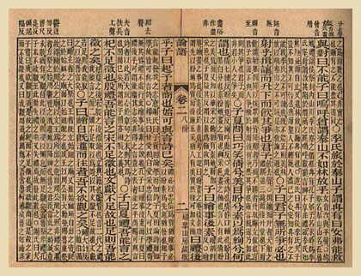
Translation
Quality of translation
Translators Altered text
Those who translated
Re-readablility and re translation
Which Translation?
Beowulf

Slide 13

Translation
Western literary concepts were internalized
Lin Shu and Su Manshu
Caused by the may fourth movement
Ex. Poe
Bei Dao

Slide 14

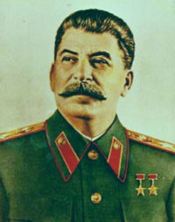
Politics and Ideology
Translation lead to new canon and Culture-Communist manifesto
Instantly canon without aesthetics
Also cause mass exclusion
Eventually Chinese canon was determined by soviet canon.
Example Grapes of Wrath

Slide 15
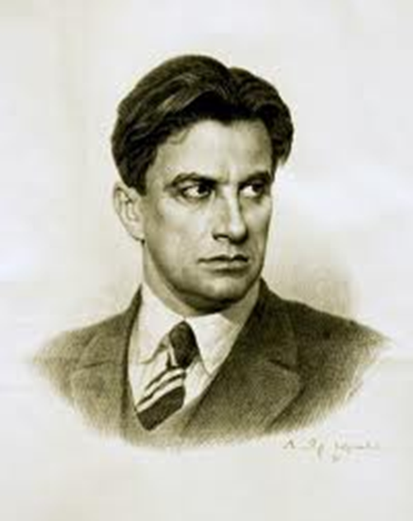
Politics and Ideology
Stalin: Mayakovsky had been, and still remained, the most talented poet of the soviet era. Disrespect for his memory was proclaimed crime.
So Mayakovsy was canonized

Slide 16
Change causes Change
After the cultural revolution writers were reanalyzed and considered overrated

Slide 17
Summary
The People Choosing
History
Use
Re-readiblility
Translation
Political Ideology

Slide 18
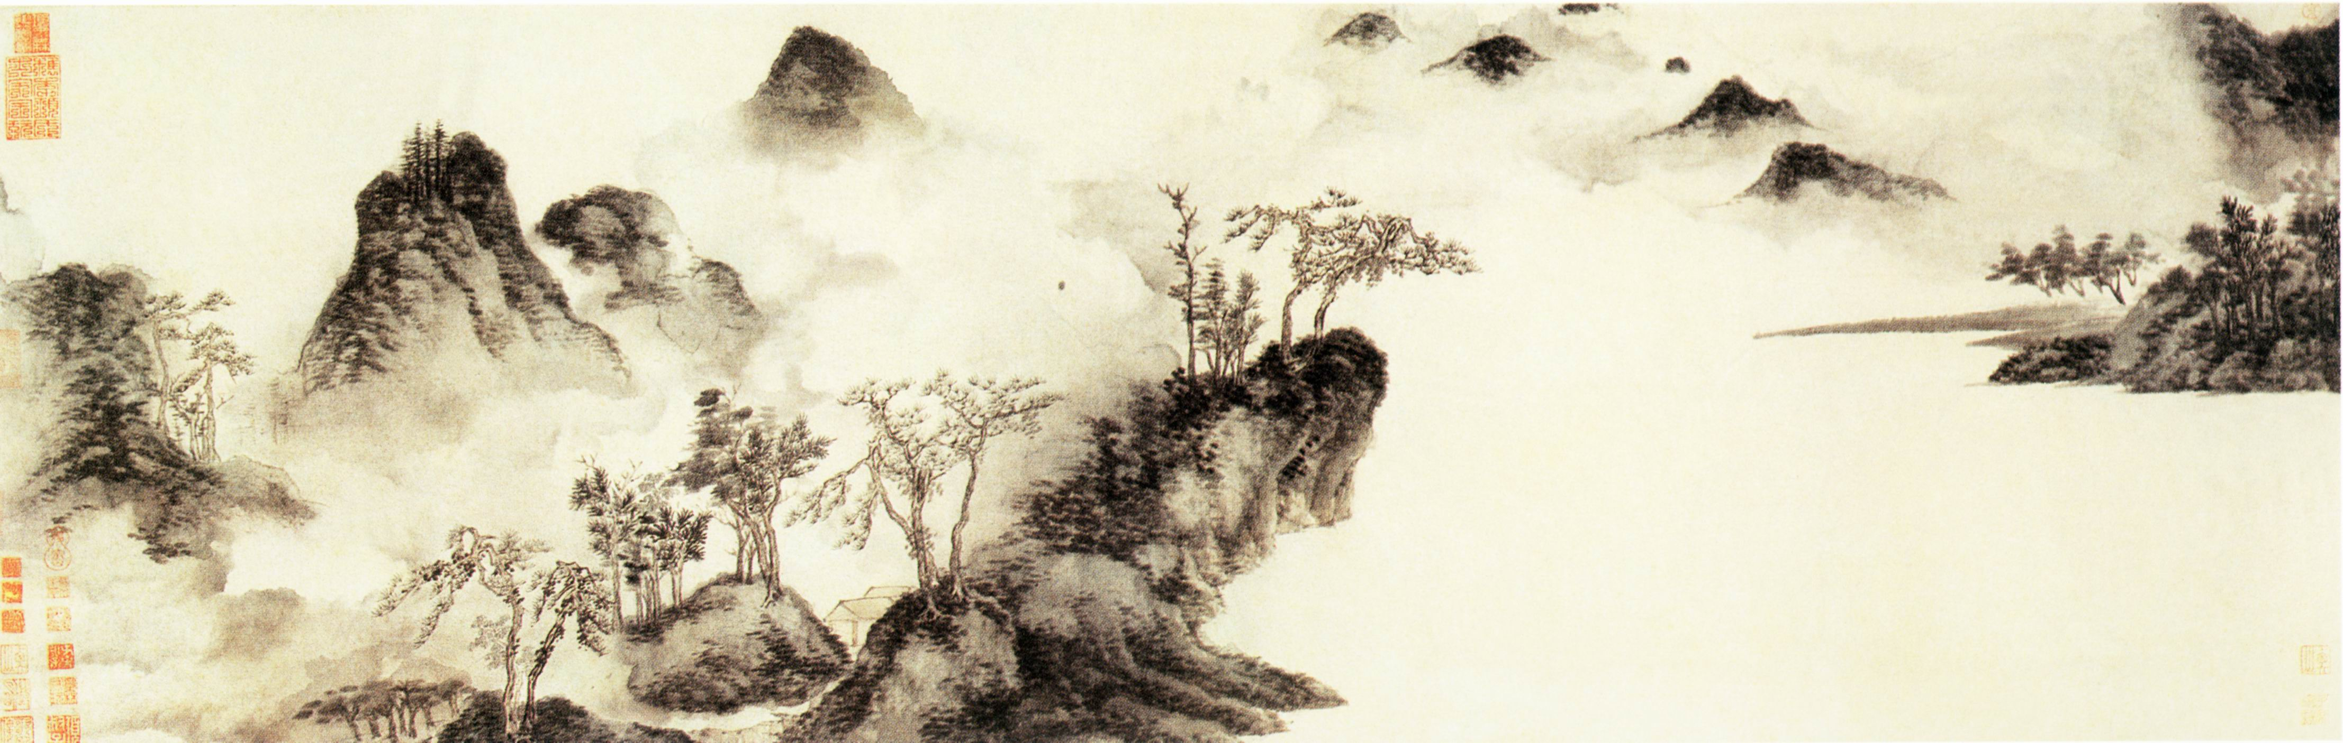
The End

