Slide 1
Crosstalk
Wang Qinyu

Slide 2
The Development of Crosstalk
Four Basic Skills in Crosstalk
目录
Characteristics of Crosstalk
Famous Artists of Crosstalk
Translation

Slide 3
1.The Development of Crosstalk
It is generally believed to be formed during the Emperor Xianfeng (1850—1861) and Emperor Tongzhi (1861—1874) period in Qing dynasty(1636-1912).
After years of development, dual crosstalk has finally become the most popular form of crosstalk among audiences.
In the early years of the Republic of China (1912-1949), crosstalk gradually developed from one-person ventriloquism（口技） to one person stand-up talk, and the name changed to cross talk. Later, it developed into stand-up crosstalk, dual crosstalk, and group crosstalk.
Crosstalk originally refers to imitate others’ voices.(In the ancient time)

Slide 4
2.Four Basic Skills in Crosstalk
Speaking
01
02
Imitating
It means to tell jokes, stories, lantern riddles, drinking games.
It is to imitate all kinds of birds and animals, hawking, singing and the sound of different languages.
“说学逗唱”
Teasing
Singing
It is to gag and tease.
04
03
It means to sing Taiping Lyrics , opera lyrics and songs.

Slide 5
3.Characteristics of Crosstalk
First of all, crosstalk is the art of “speaking”, which belongs to the art of “performing with words”. This kind of performance has a close relationship between the actors and the audience that shortened the distance between the stage and the audience.
Secondly, crosstalk is the art of "laughter", which means that crosstalk has the characteristics of humor and satire.
Crosstalk is different from comedy. In comedy, the laughter of audience mainly comes from plot and comic characters, while in crosstalk it mainly comes from “baofu” (jokes).

Slide 6
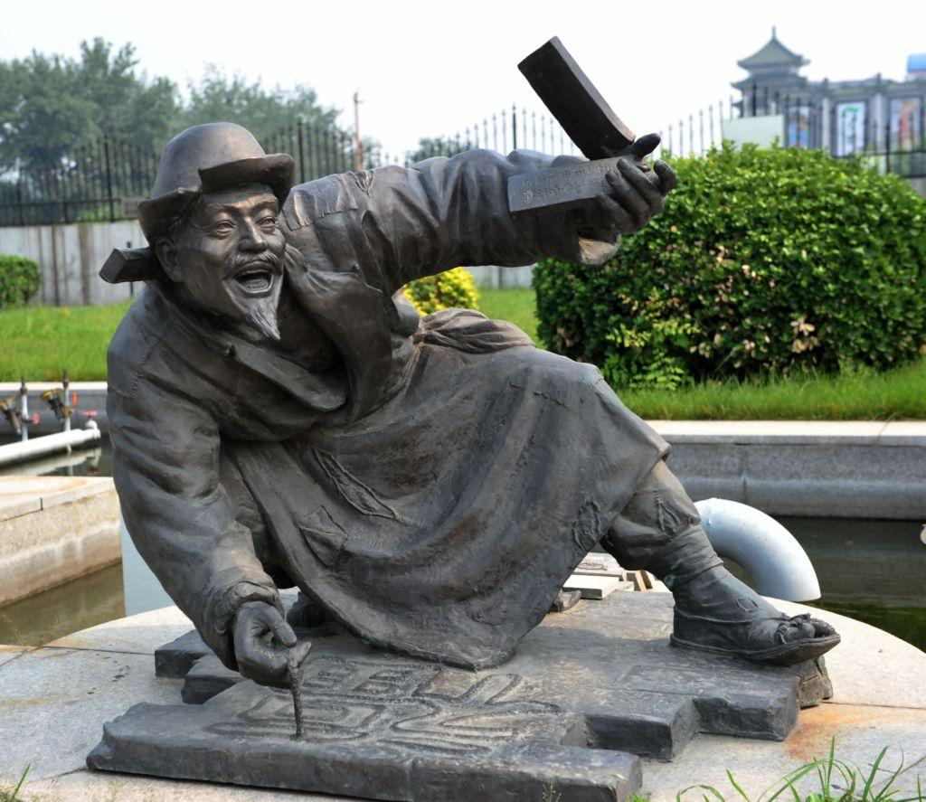
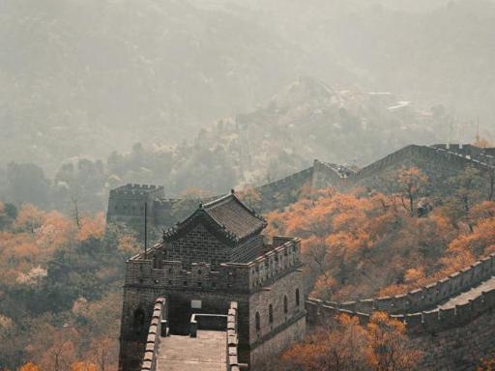
4.Famous Artists of Crosstalk
Zhu Shaowen
He was regarded as the“ancestor”of crosstalk art in Emperor Tongzhi (1861—1874) and Emperor Guangxu (1875—1908) periods.
Stage name(艺名):Qiong Bupa, which means not afraid of poverty.

Slide 7
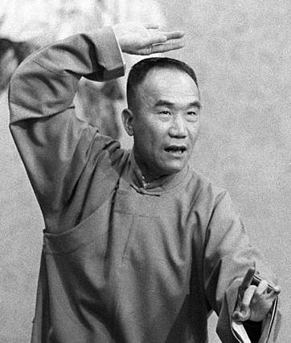
Hou Baolin(1917-1993)
A pioneering master of crosstalk
Under his leadership and promotion, crosstalk art has really entered thousands of households and reached a remarkable artistic peak.

Slide 8
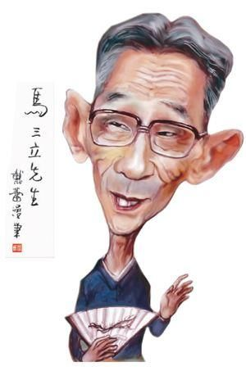

Ma Sanli (1914-2003)
He devoted himself to the exploration of long-term artistic practice, and created the unique “Ma’s Style of Crosstalk”.
His cross talk enjoys wide popularity among the people.

Slide 9
“相声”
crosstalk
comic cross-talk
Talk Show
Chinese Comic Dialogue
stand-up crosstalk 单口相声
dual crosstalk 对口相声（comic dialogue）
group crosstalk 群口相声

Slide 10
Thanks!

