Slide 1
Gideon Toury’s Descriptive Study of Norms in
Translation
Presented by : Rouabah Soumaya : PPT
Muhammad Saqib Mehran : Handouts

Slide 2

The Contents
Abstract
Definition of Descriptive translation study according to Gideon Toury
What is a Norm(s)?
Definition of norms according to Toury
Gideon Toury’s Concepts of Norms in translation study
Toury’s division of Norms into categories
Translational Norms according to Toury
Conclusion
References

Slide 3
Abstract
Gideon Toury pioneered Descriptive Translation Studies as a science based on observation, (re)defining translation as a target-cultural “fact” and, thus, shifting the focus to the translation as a product which can and should be studied without any methodological presumptions. However, this proves illusive, as it falsely supposes neutrality in research. Arguing that there could be no strict separation between description and evaluation, and there fore he introduced in 1978 the study of norms which was revolutionary until today .

Slide 4
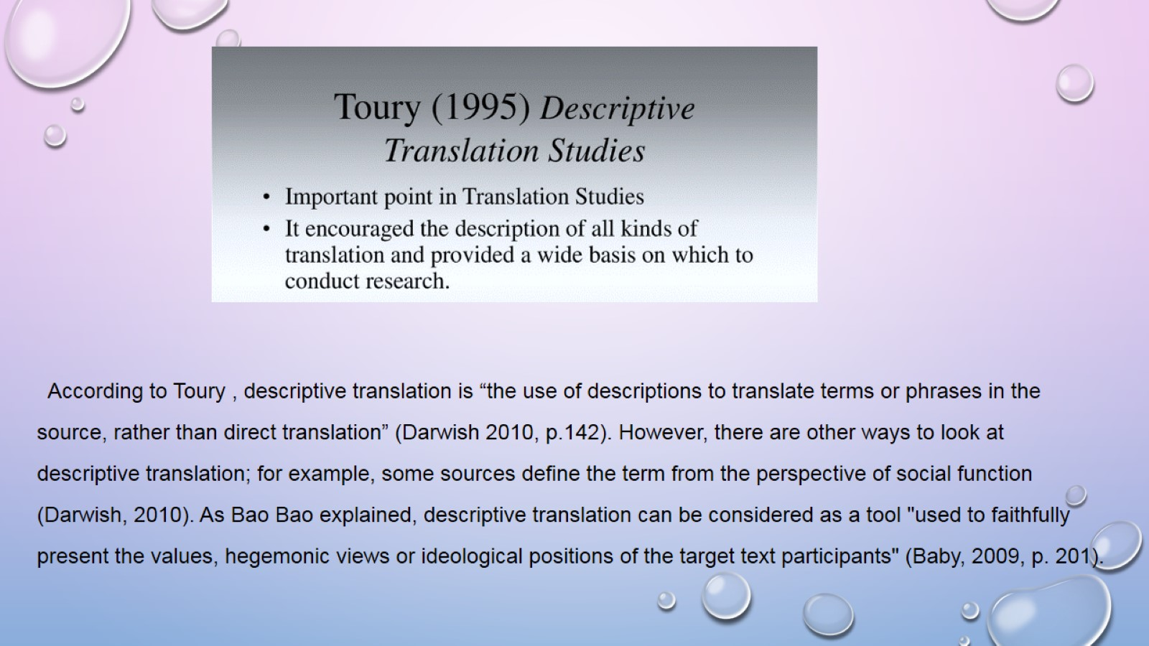
Therefore Some scholars even doubted that the given study can actually be related to the discipline
of translation in general .

Slide 5
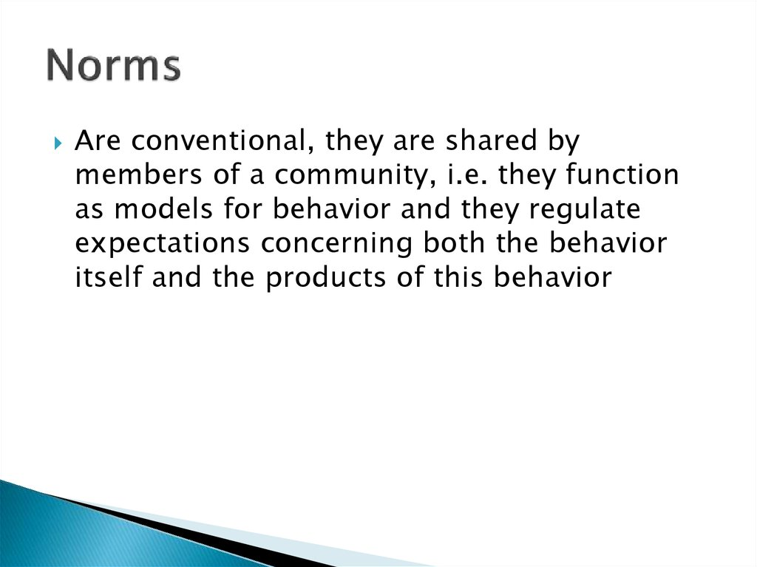
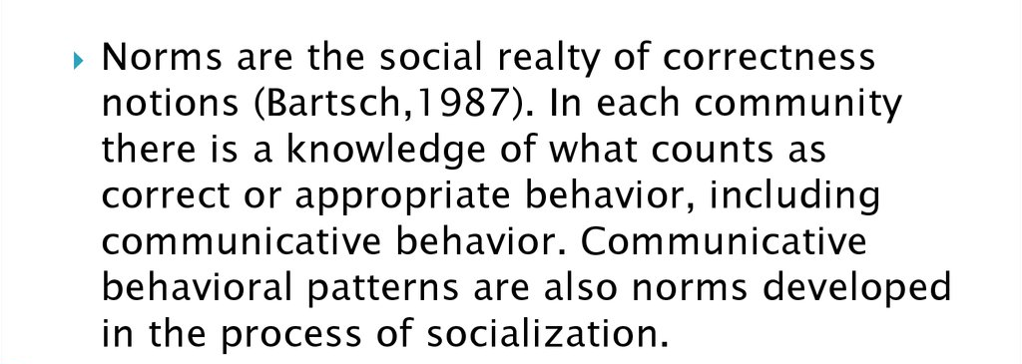
What is a Norm (s) ?
Norms are a fundamental concept in the social sciences. They are most commonly defined as rules or expectations that are socially enforced. Norms may be prescriptive (encouraging positive behavior; for example, “be honest”) or proscriptive (discouraging negative behavior; for example, “do not cheat”).

Slide 6
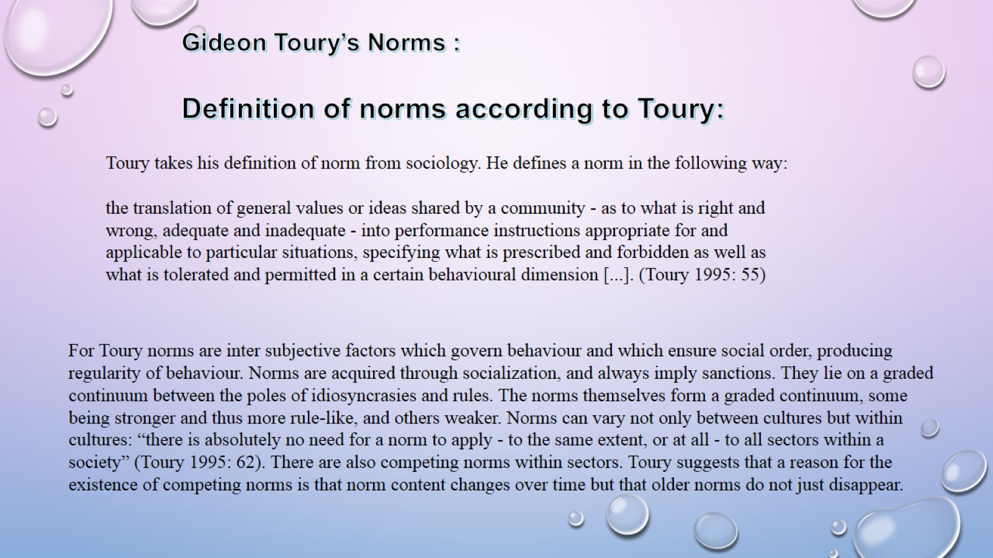

Slide 7
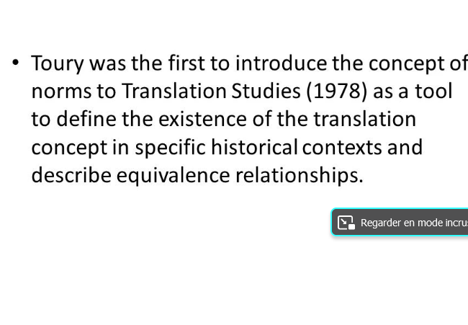
Gideon Toury’s concept of Norms in Translation study :

Slide 8

The concept of norms in translation theory was first mentioned by Jiří Levý (1969) and by Itamar Even-Zohar (1971), but has mainly been propagated by Gideon Toury and his followers since the late seventies. Toury’s development of the concept of “norm” derives from his stance that translating is a learned social activity: “translator ship” amounts first and foremost to being able to play a social role, i.e., to fulfil a function appropriate in its own terms of reference. .
The Concept of Norms In the long history of translation, such notions as accuracy, correctness, or
well-formedness have played an important role in assessing the quality of a translation.
Both Gideon Toury and Theo Hermans have contributed substantially to this debate and to the development of the concept of norms in and for translation studies.

Slide 9
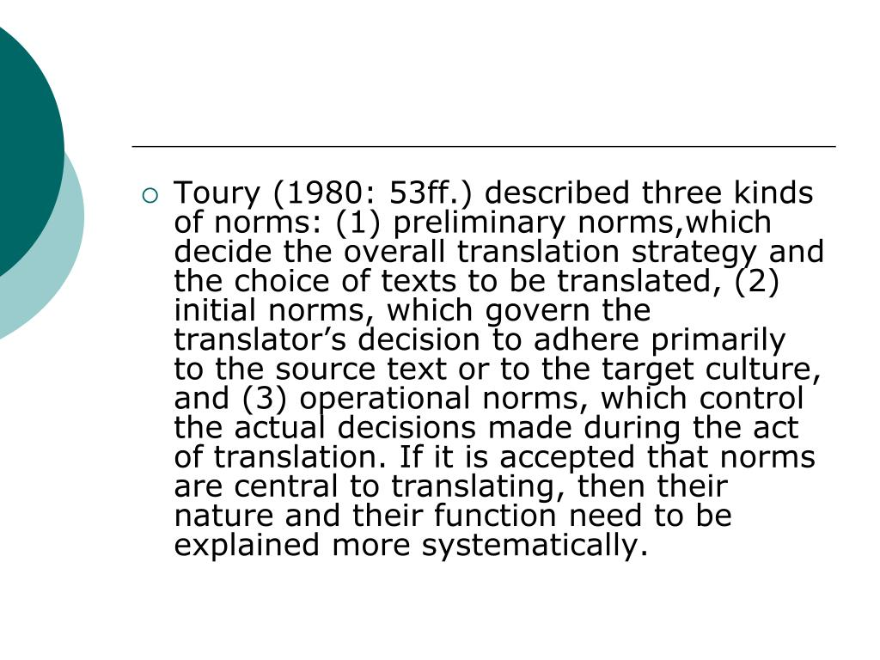
Toury’s division of Norms into Categories :

Slide 10
-Translational Norms according to Toury :
What are Translation norms ?
Translational norms are a function of the environment where the translation is undertaken, which is usually the target culture environment. For Toury norms are inter subjective factors which govern behaviour and which ensure social order, producing regularity of behaviour.
It was defined also by Toury as translating a linguistic unit by its generally accepted equivalent (this position is still held by some scholars today) .
In an attempt to gain a better understanding of the factors governing the communicative behaviour of translators and the interaction between translators and their audiences.

Slide 11
Conclusion
The descriptive approach developed by Gideon Toury has played a major role in the development of Translation Studies and is still motivating a lot of research in the discipline. It is not an exaggeration to say that Toury ’s work revolutionized the scientific field. Thanks to his efforts, Translation Studies has acquired an individual profile as an independent discipline with its own research program. It also no longer has the normative tone it used to have previously. Through emphasizing the value of and the need for systematic descriptive studies based on a solid methodology and a genuine interest in translations as they exist, Toury brought forward a dynamic Norms in 1978 witch proved to change the face of translation forever even though some say it wasresearch paradigm that provides researchers with a valuable tool to investigate translational phenomena in their sociocultural context Without forgetting Toury’s revolunary discover of unsatisfactory .

Slide 12
References
-Gideon Toury’s “DESCRIPTIVE TRANSLATION STUDIES AND BEYOND “
-https://www.semanticscholar.org/paper/ The-Concept-of-Norms-in-Translation-Studies-
-Hermans, Theo. 1991. "Translational Norms and Correct Translations".
Kitty M. van Leuven-Zwart and Ton Naaijkens, eds. Translation .
-Studies: The State of the Art. Proceedings of the First James S
-Holmes Symposium on Translation Studies. Amsterdam-Atlanta, GA: Rodopi, 1991. 155-169.
Toury, Gideon. 1980a. In Search of a Theory of Translation.
Tel Aviv: The Porter Institute for Poetics and Semiotics, Tel Aviv University.
Toury, Gideon 1995 Descriptive Translation Studies and Beyond, Amsterdam / Philadelphia: John Benjamins.
Hermans, Theo. 1991. “Translational Norms and Correct Translations”. Kitty M. Van Leuven-Zwart and Ton Naaijkens, eds. Translation Studies: The State of the Art. Proceedings of the First James S
-Toury, Gideon. 1980a. In Search of a Theory of Translation.
Jackson, Jay 1965 “Structural Characteristics of Norms”,
in Ivan D. Steiner and Martin Fishbein (Eds.), Current
Studies in Social Psychology, New York / Chicago: Holt,
Rinehart and Winston, pp.301-309
Harris, Brian. 1990. “Norms in Interpretation”. Target 2:1. 115-119.

Slide 13
Thank you for
Listening

