Slide 1
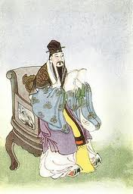
Meng Ke Mencius
Reinventing
Confucian Tradition

Slide 2
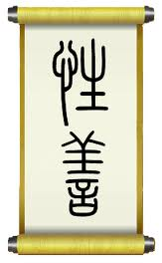
I lived in the 4th century b.c.e. One hundred years after Confucius
Father dies when I was 3. Mother moved so I could attend schooling
I studied with Confucius’s grandson Zizi
Warring States period was getting bad

Slide 3
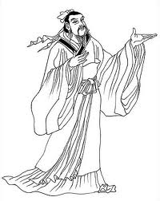
I traveled to states to talk to rulers
The Mencius is a record of my conversations with these rulers
Ren & Yi = Humaneness & rightness the will makes the way

Slide 4
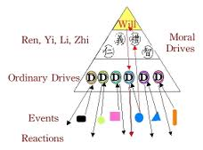

Slide 5
There is within you the great resource of the Qi.
This is the Ren, Yi, Li and Zhi
One can build this by adherence to the foundations of rightness and thinking of others before oneself
The Will of the person makes the acts of the person, good will builds the Qi, selfish will makes the Qi shrink away
One can not do this by thinking of profit for oneself before others needs

Slide 6
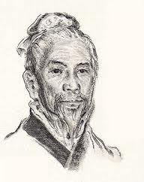
I taught that the Sage kings ruled through the Mandate of Heaven
Signaled by the willingness of the people to follow them
People follow those who are adherents of rightness and selflessness

