Slide 1
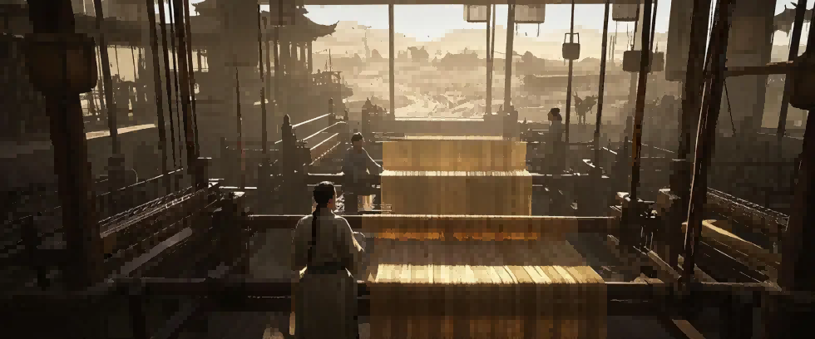
The Story of Silk

Slide 2
Are you ready?
Here we go!

Slide 3

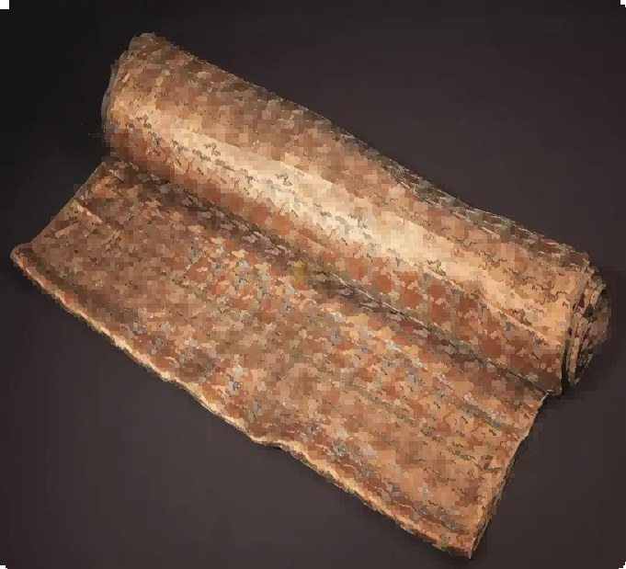
Early Silk Production in China
Notes:
Silk is a fine, smooth material produced t from the cocoons –soft protective shells – that are made by mulberry silkworms桑蚕 (insect larvae).

Slide 4
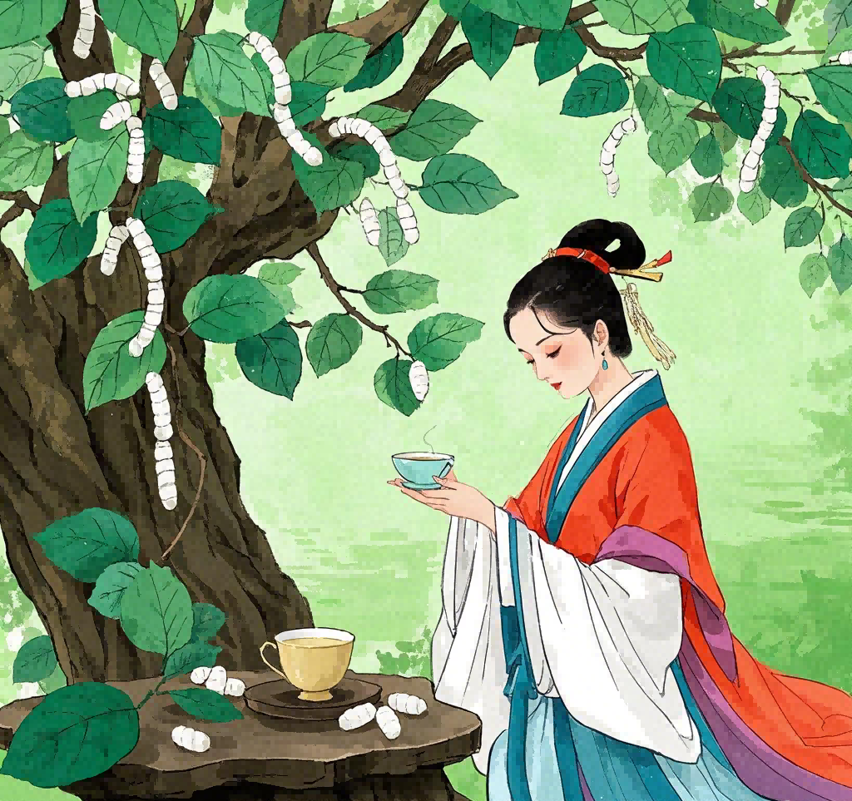
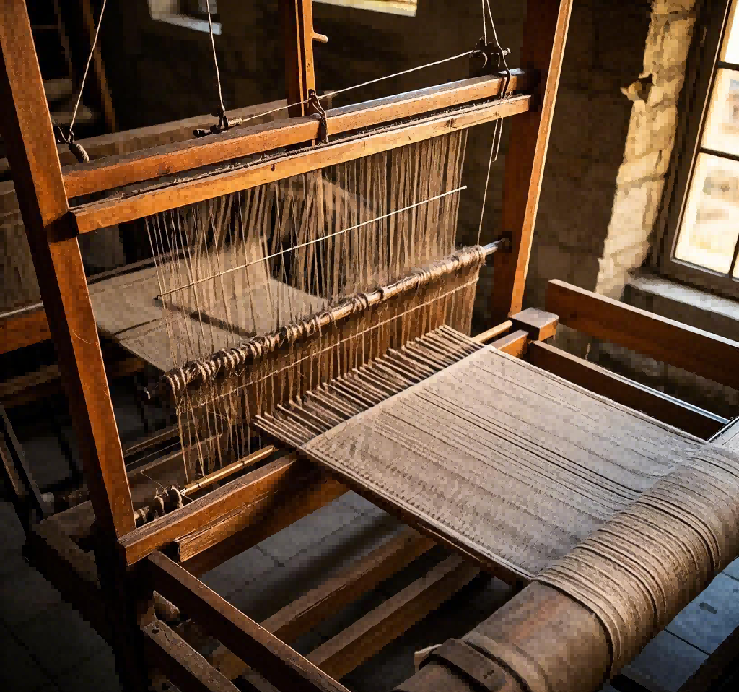
Legend of Lei Tzu (about 3000 BC)
Discovery of silkworms
Invention of silk reeling
Notes:
Legend has it 据说that it was Lei Tzu, wife of the Yellow Emperor, ruler of China in about 3000 BC, who discovered silkworms. One day as she was taking a walk in her husband's gardens, she discovered that silkworms were responsible for the destruction of several mulberry trees. She collected a number of cocoons and sat down to have a rest. While she was sipping some tea, one of the cocoons landed in the hot tea and started to unravel into a fine thread细线. Lei Tzu found that she could wind this thread around her fingers. Subsequently, she persuaded her husband to allow her to rear silkworms on a grove of mulberry trees. She also devised a special reel to draw the fibres from the cocoon into a single thread so that they would be strong enough to be woven into fabric. While it is unknown just how much of this is true, it is certainly known that silk cultivation has existed in China for several millennia.

Slide 5

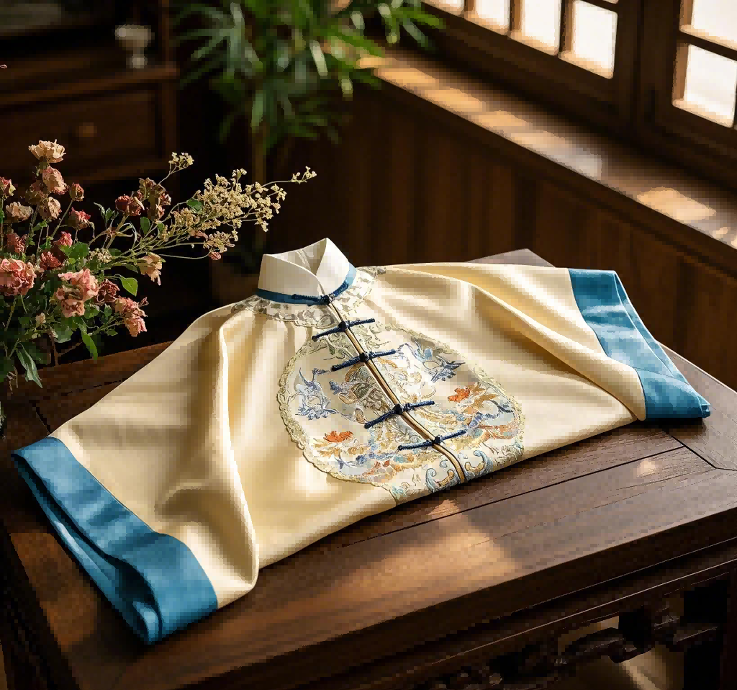
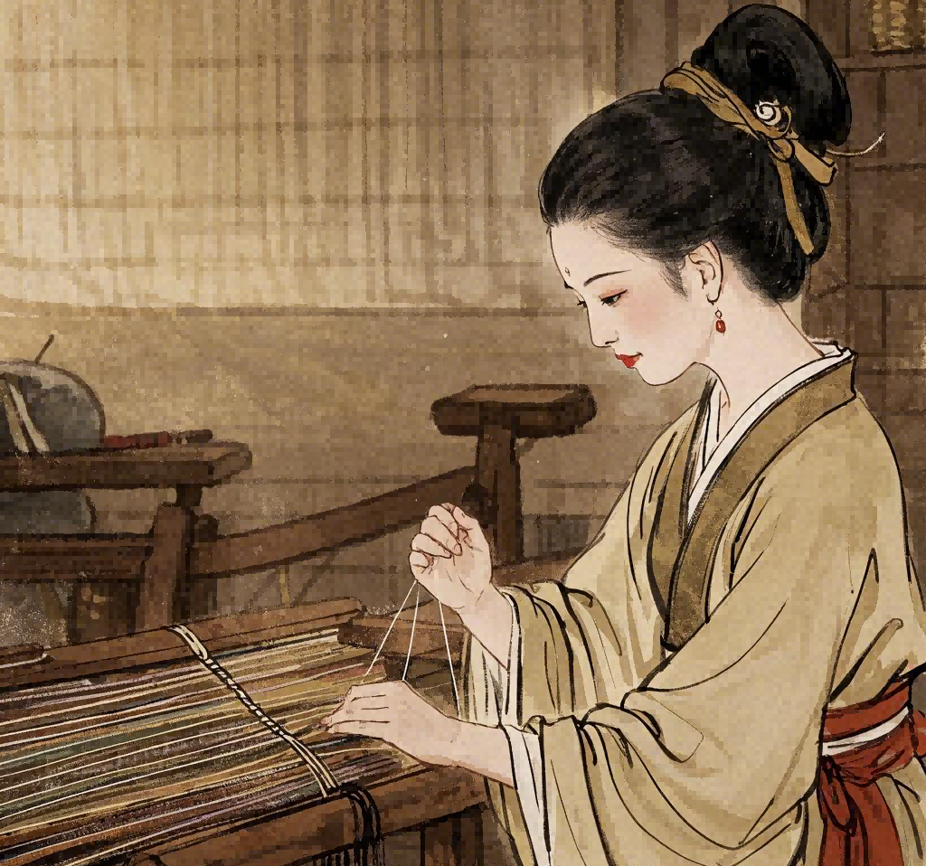
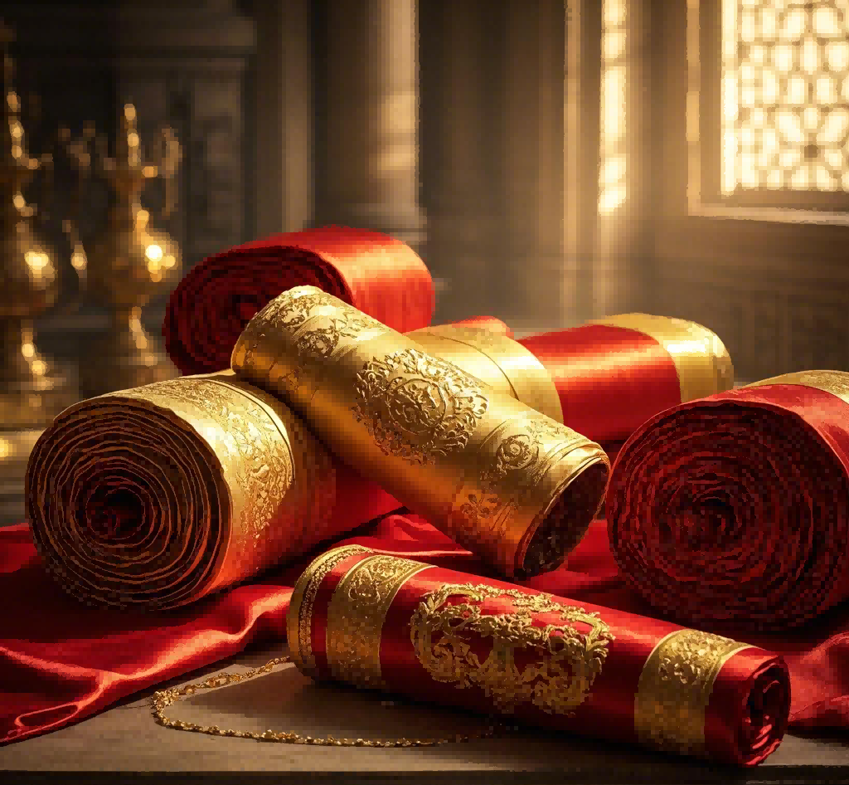
Only Royalty wear
Only women
growing, harvesting and weaving
Until Qing Dynasty
(1644–1911 AD)
Even peasants can wear
Notes:
Originally, silkworm farming was solely restricted to women, and it was they who were responsible for the growing, harvesting and weaving.
Silk quickly grew into a symbol of status, and originally, only royalty were entitled to have clothes made of silk.
The rules were gradually relaxed over the years until finally during the Qing Dynasty (1644–1911 AD), even peasants, the lowest caste, were also entitled to wear silk.

Slide 6
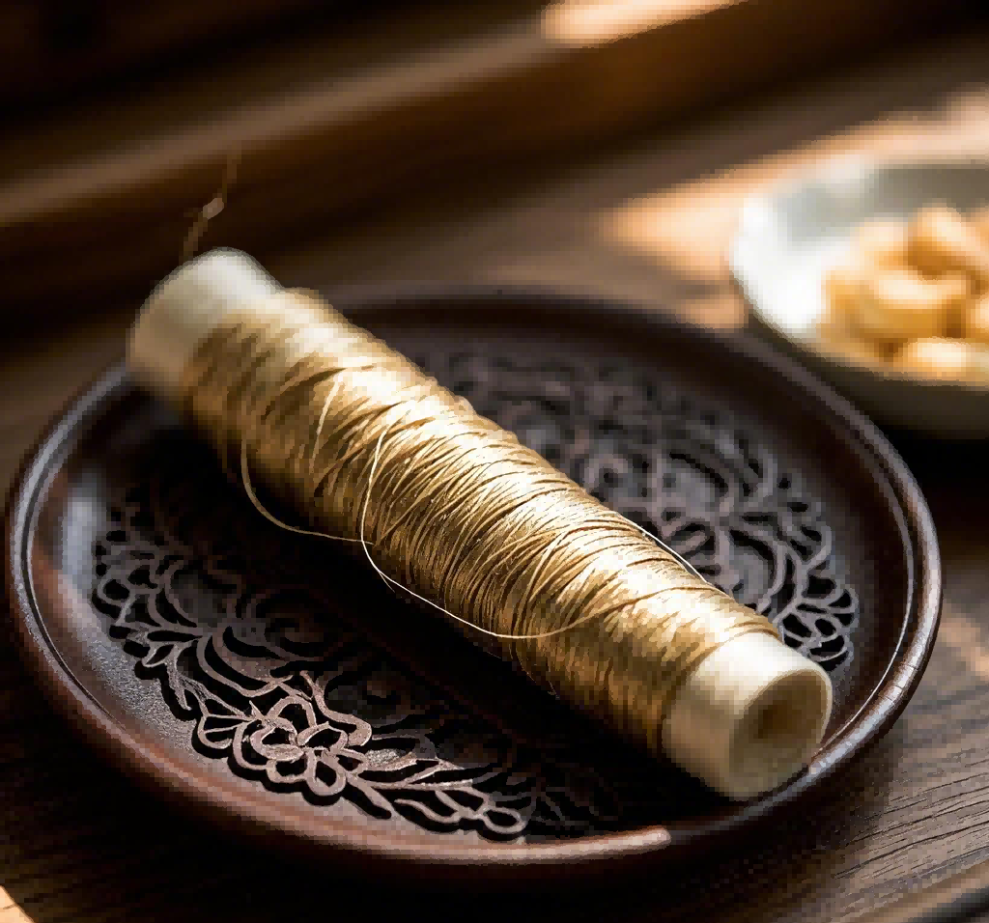
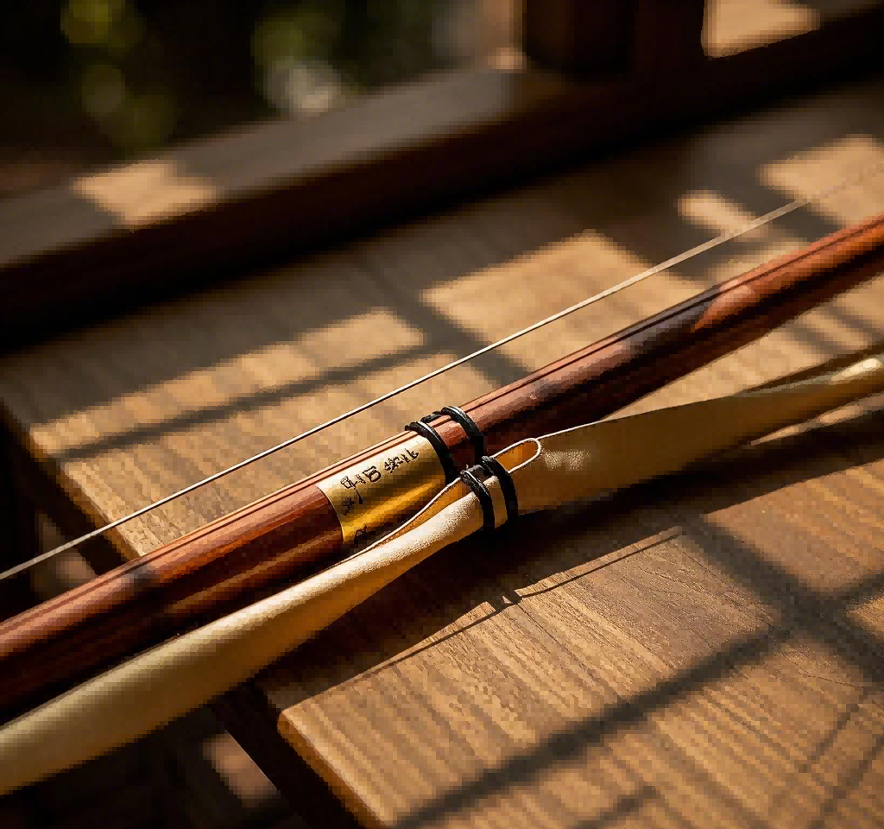
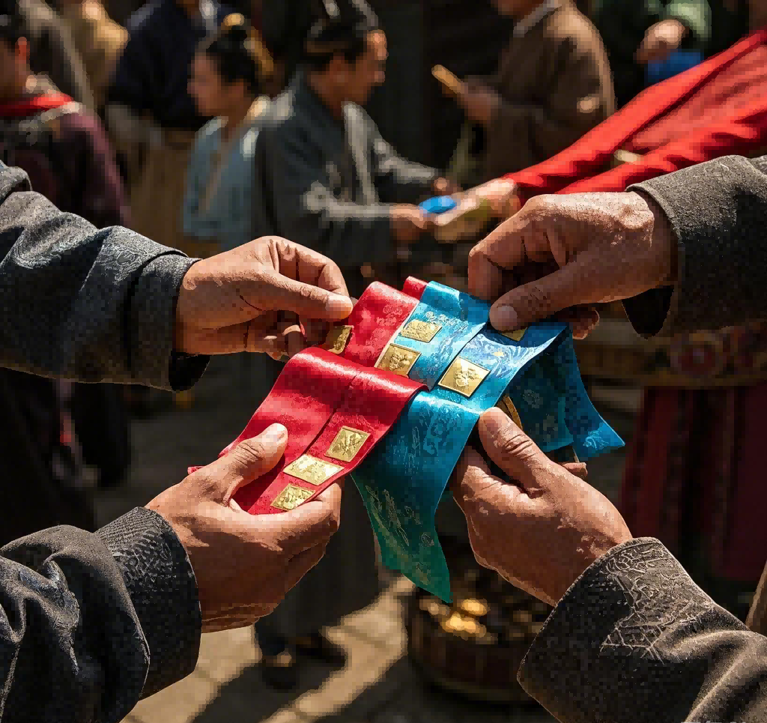
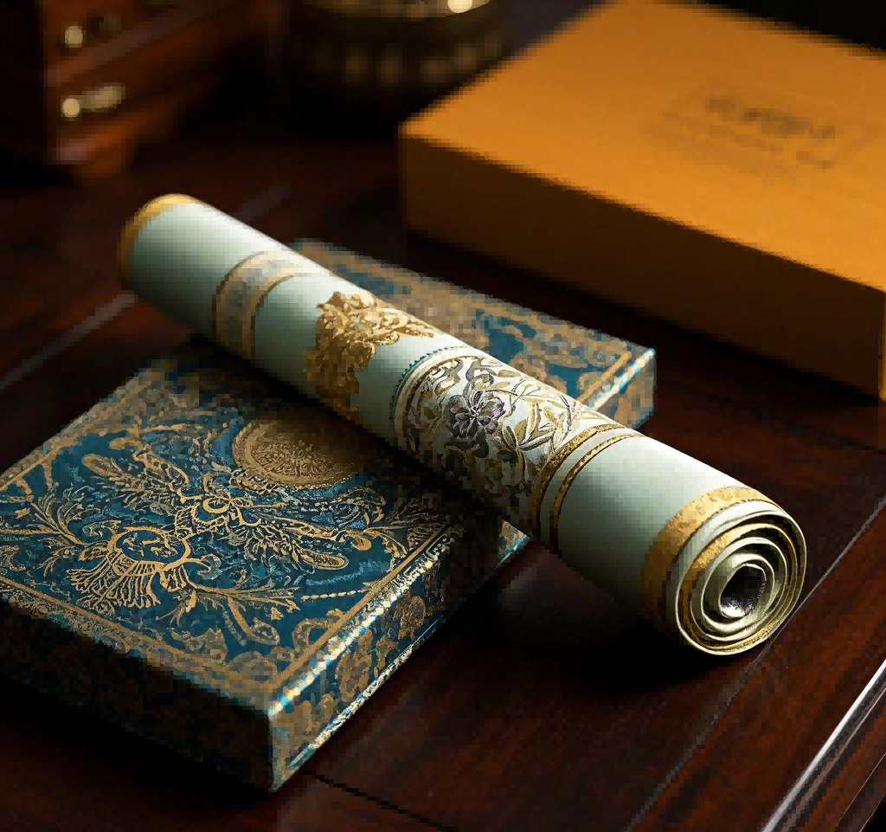
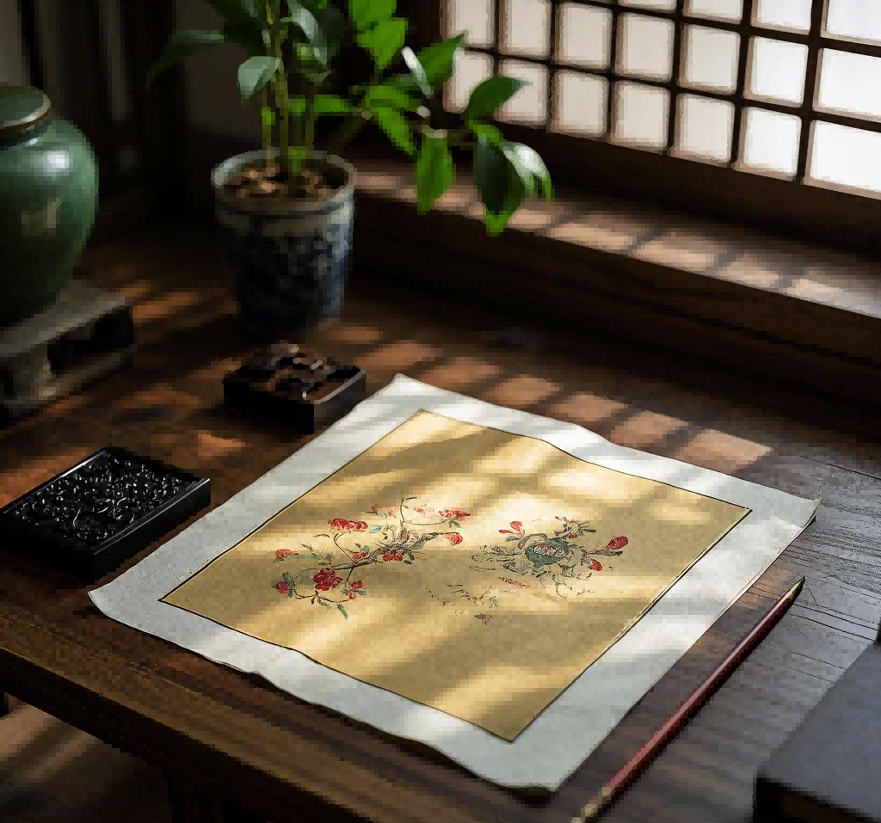
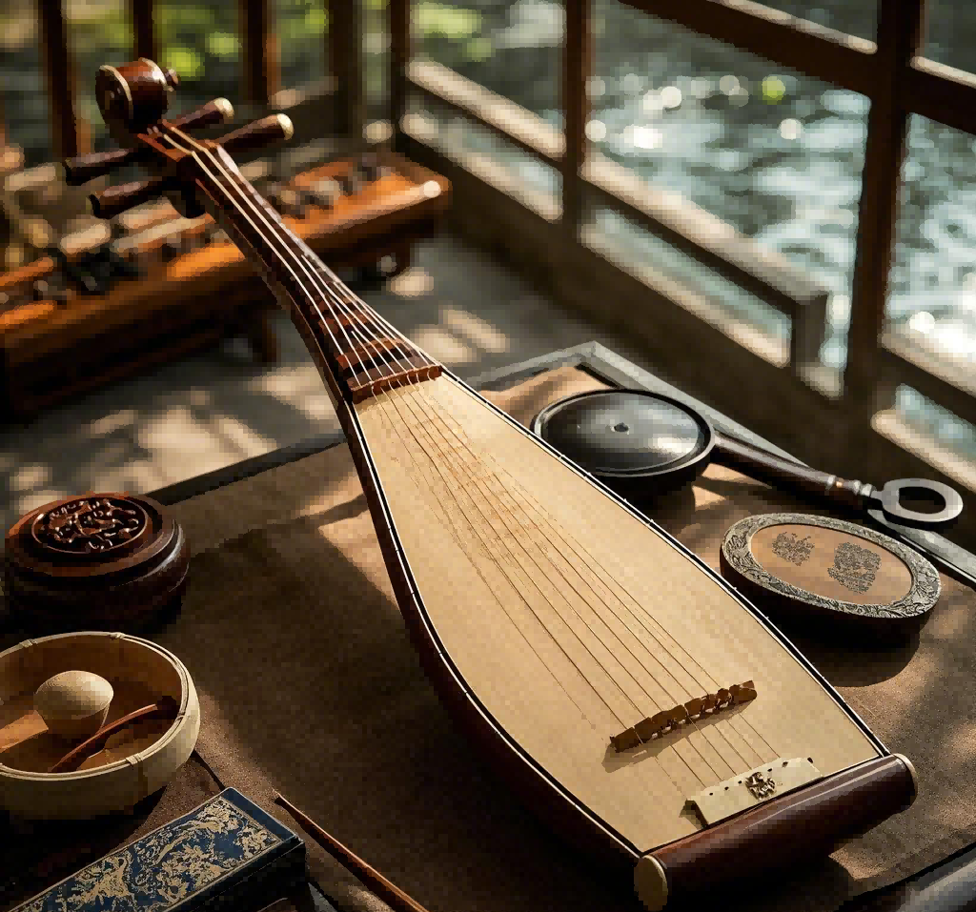
Silk's Uses in Han Dynasty
fishing lines bowstrings
currency/ diplomatic gifts
silk paper musical instrument

Slide 7

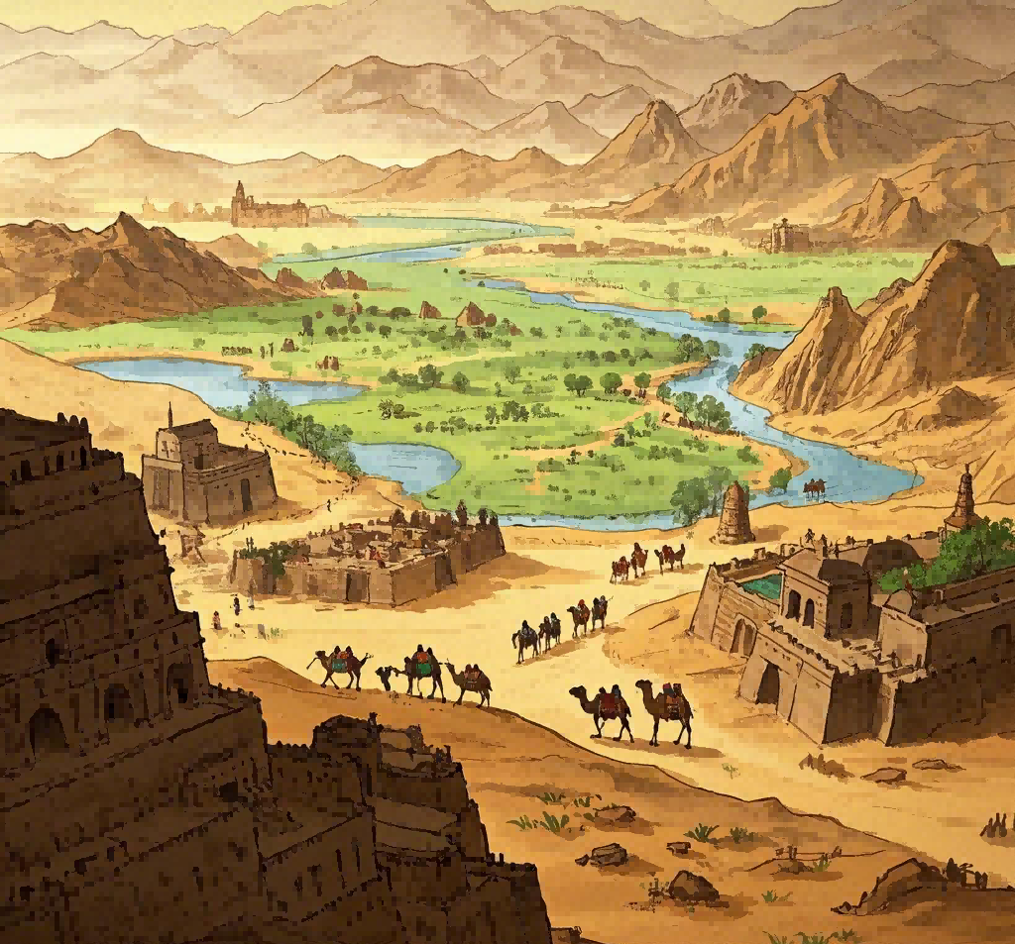
The Expansion of Silk to
the Rest of the World

Slide 8
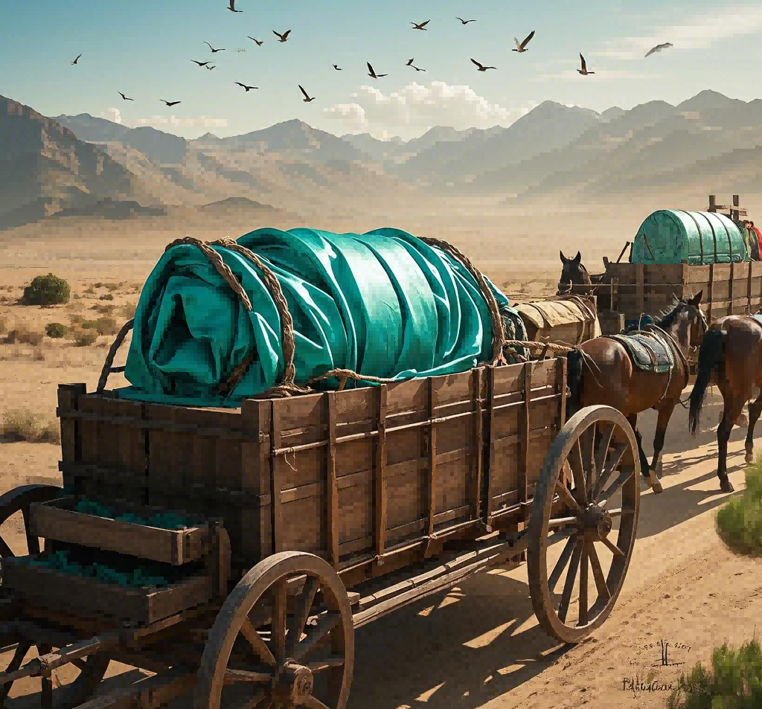
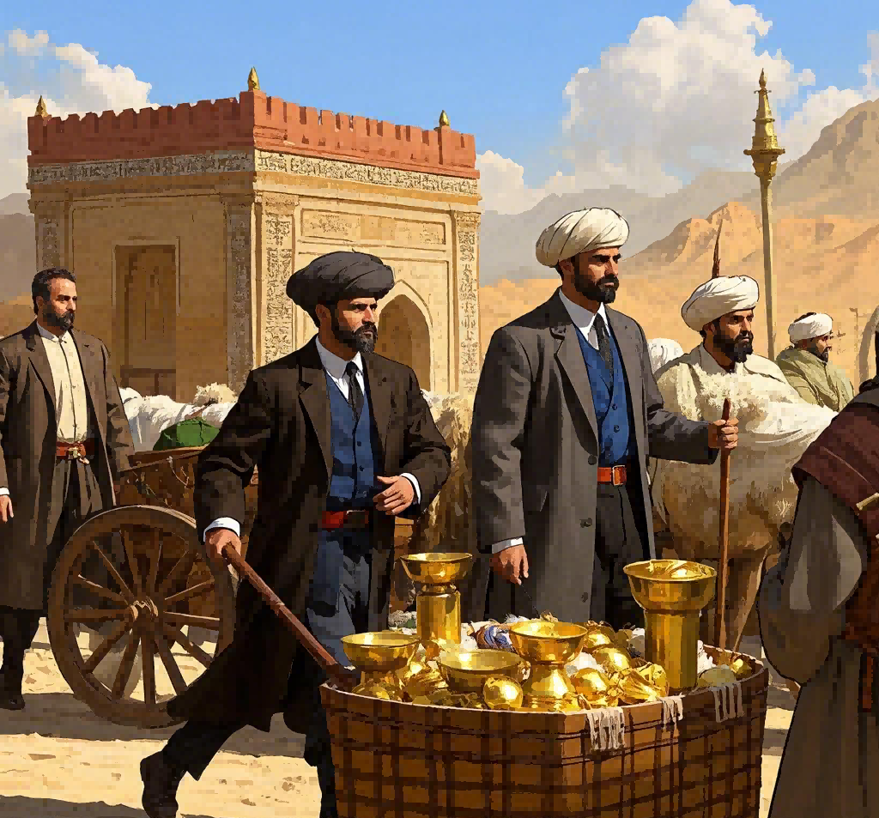
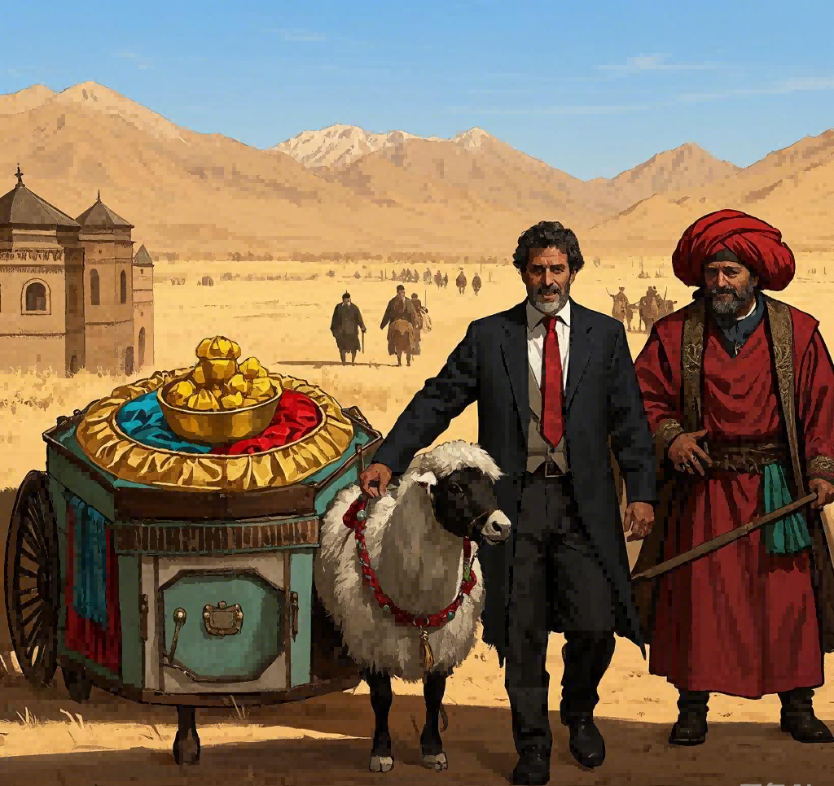
将丝绸运往西方
The Silk Road

Slide 9
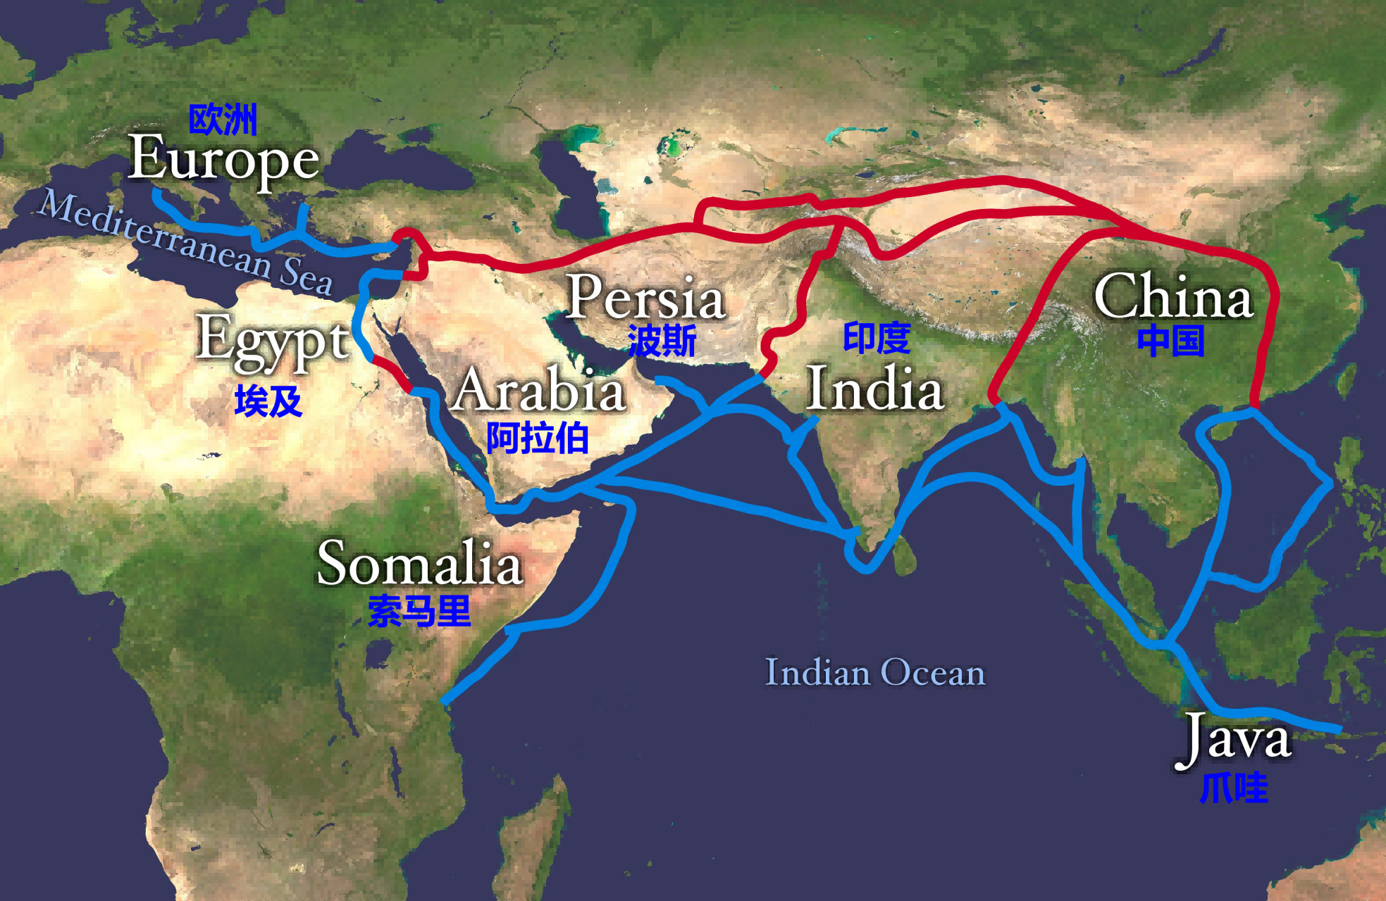
将丝绸运往西方
The Silk Road(over 6,000 km)

Slide 10

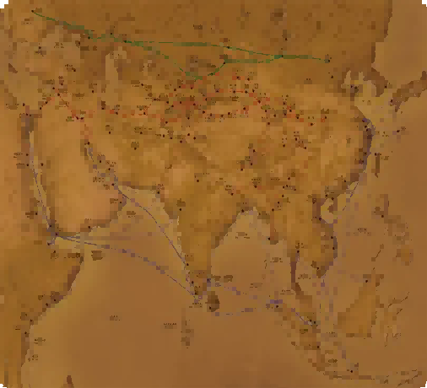
Spread across Continents

Slide 11


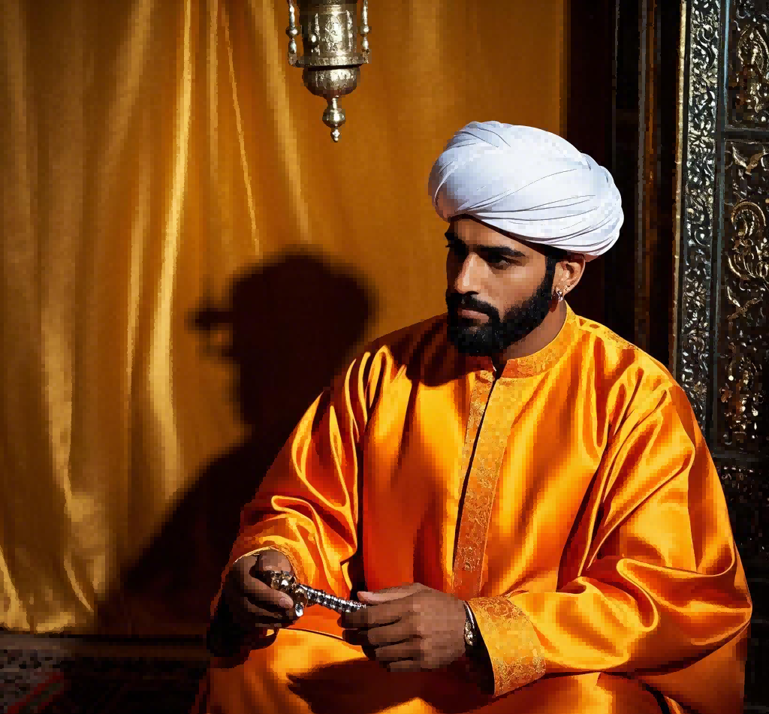
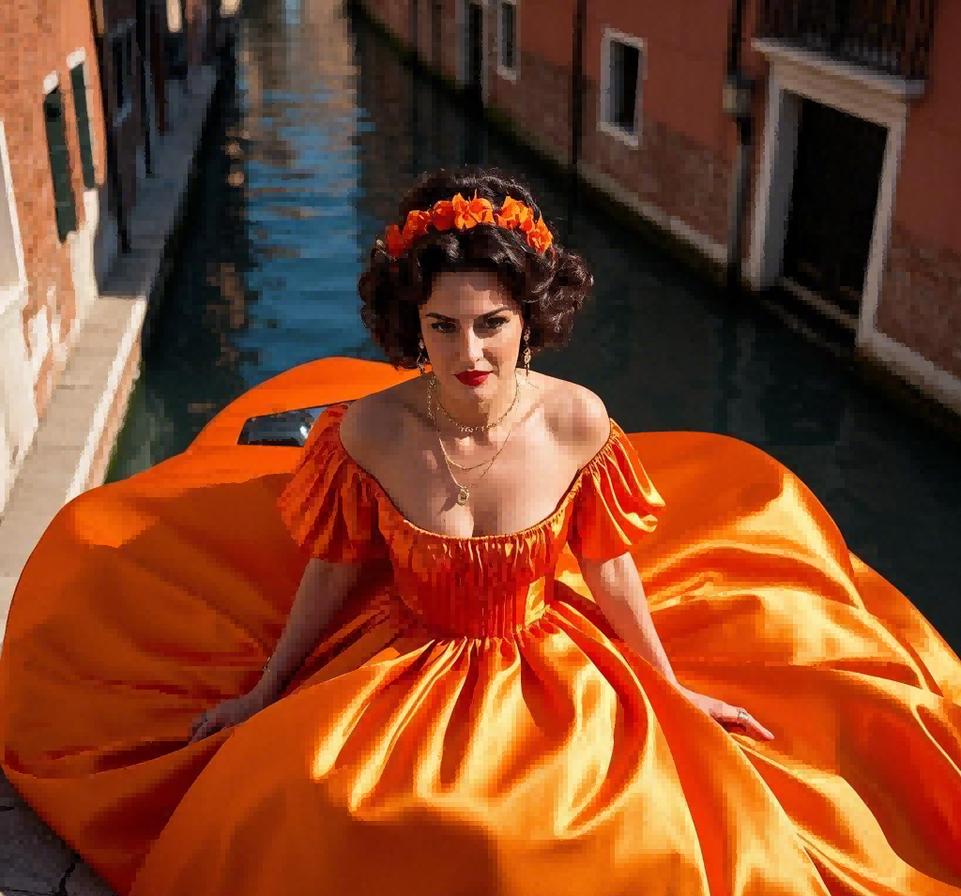

Byzantine emperor Justinian smuggled silkworm eggs
Arabs spread silk production across Africa and Europe
Italy sustains its reputation in Como to date.

Slide 12

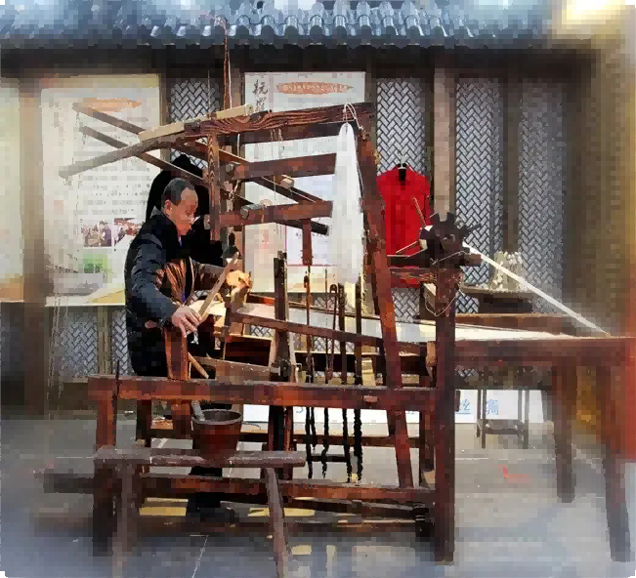
Silk Production Process

Slide 13

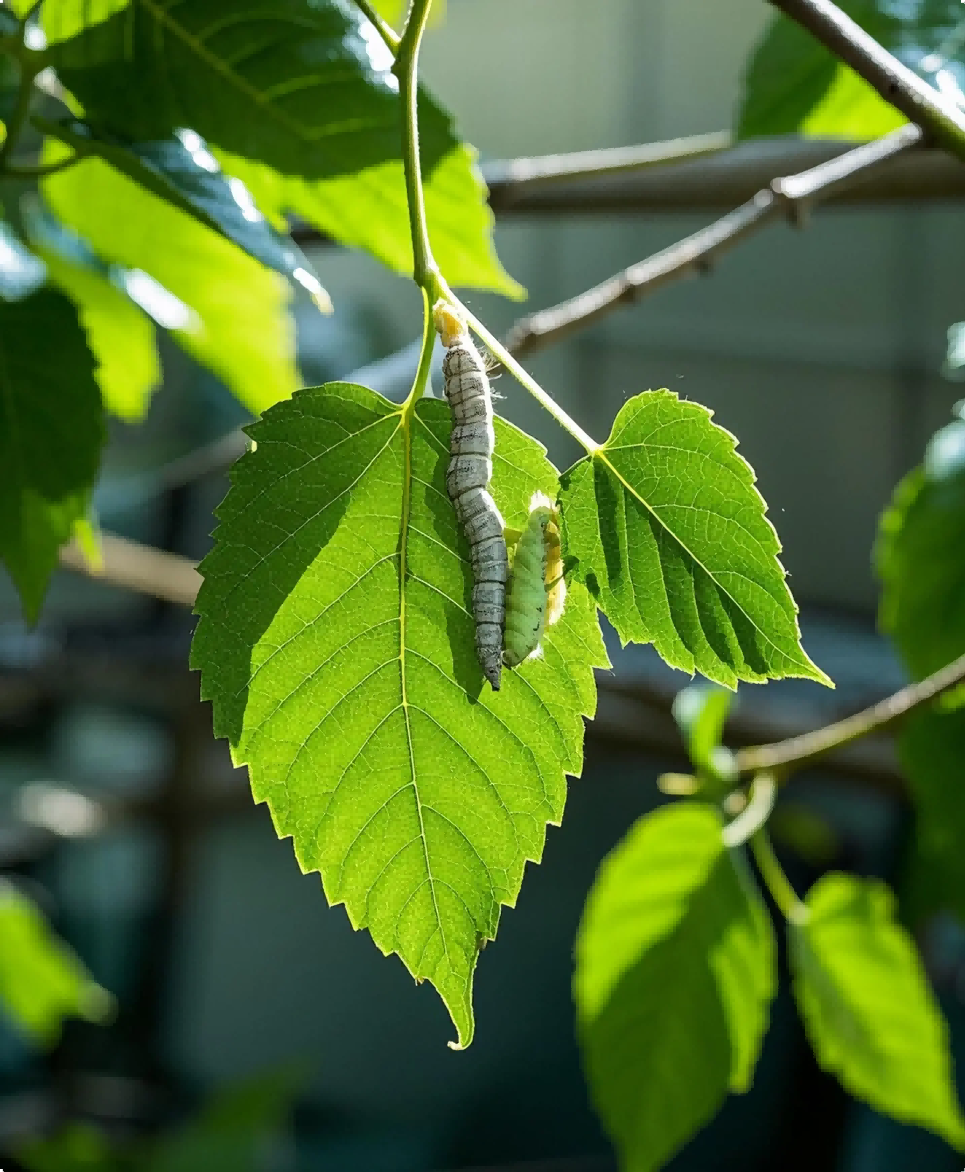
The Lifecycle of the Silkworm

Slide 14

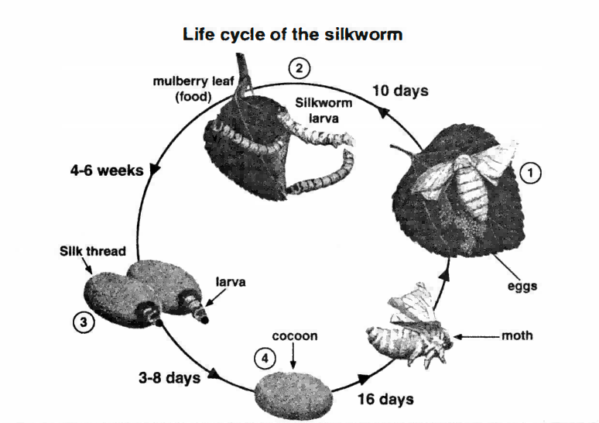

Slide 15
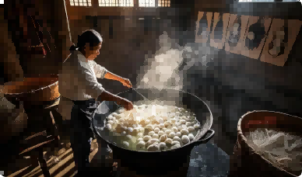
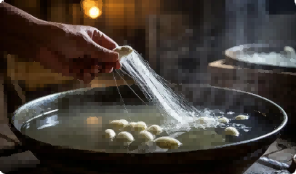
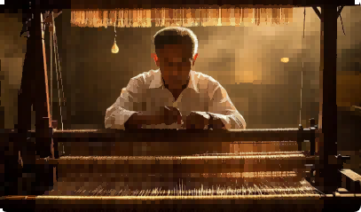
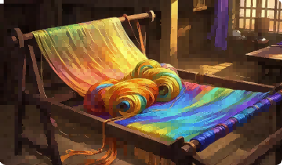
From Cocoon to Cloth

Slide 16
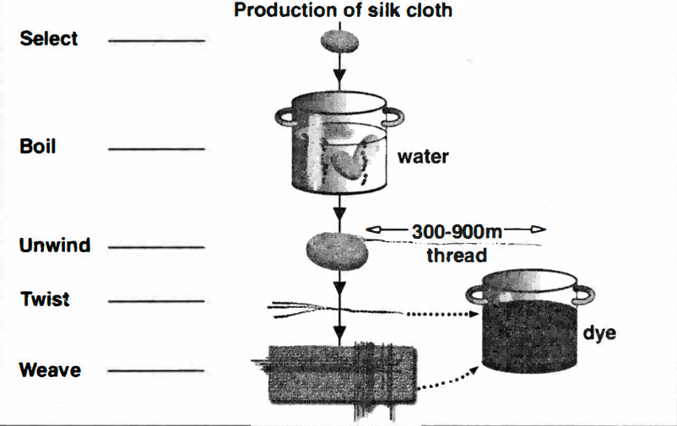

Slide 17

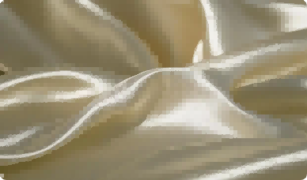
Characteristics and
Translation of Silk

Slide 18
Characteristics
luxury associations
softness, elegance, and prosperity

Slide 19
Translation
1. The silk - stocking district is full of luxurious mansions.
Wealthy Community/ fancy neighborhoods.
富人区到处都是豪华的宅邸。

Slide 20
Translation
1. Silken tongue - 油嘴滑舌
It means having a smooth, persuasive way of speaking.
The salesman had a silken tongue and could convince anyone to buy his products.

Slide 21
The journey is over！

